Slide 1
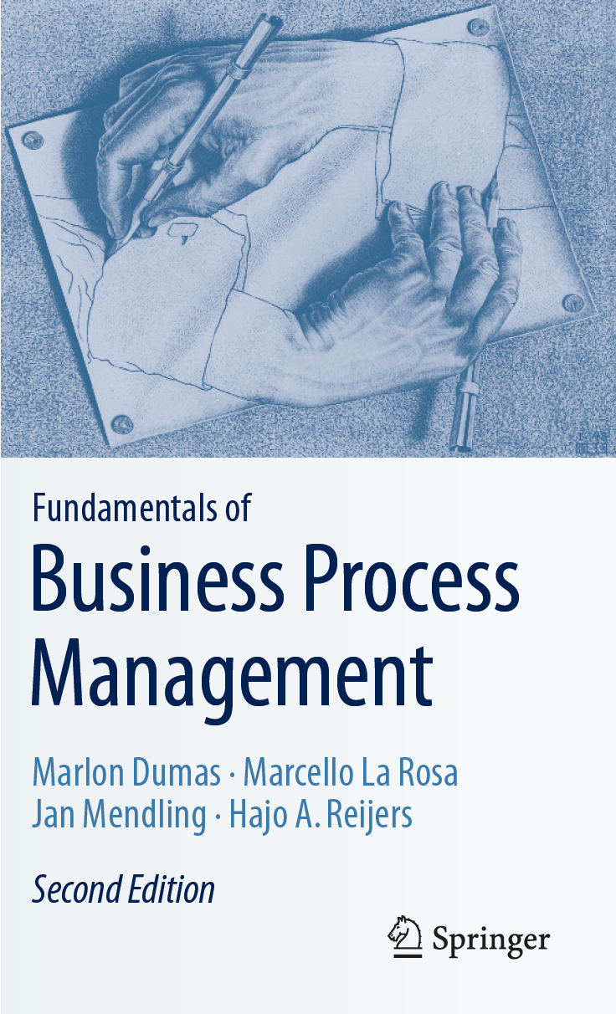
Chapter 1: Introduction to BPM
Contents
Processes Everywhere
Ingredients of a Business Process
Origins and History of BPM
  The Functional Organization
  The Birth of Process Thinking
  The Rise and Fall of BPR
The BPM Lifecycle
Recap

Slide 2
Chapter Overview
Business Process Management (BPM) is the art and science of overseeing how work is performed to ensure consistent outcomes and to take advantage of improvement opportunities.
The term “improvement” may take different meanings depending on the objectives of the organization
  e.g. reducing costs, execution times, and error rates.
Improvement initiatives are one-off or continuous; incremental or radical.
BPM is about managing processes, i.e. entire chains of events, activities, and decisions.

Slide 3
Chapter 1: Introduction to BPM
Contents
Processes Everywhere
Ingredients of a Business Process
Origins and History of BPM
  The Functional Organization
  The Birth of Process Thinking
  The Rise and Fall of BPR
The BPM Lifecycle
Recap

Slide 4
Processes Everywhere
Every organization (governmental body, a non-profit organization, or an enterprise) has to manage a number of processes.
Examples of Processes in Many Organizations
  Order-to-Cash
    Starts by a customer who submits an order to purchase a product or a service and ends when the product or service is delivered and the customer has made the corresponding payment.
    This process encompasses (shipment, delivery, invoicing, and payment receipt)
  Quote-to-Order
    Precedes an order-to-cash process
    Starts when supplier receives a “Request for Quote” (RFQ) from a customer and ends when the customer places a purchase order

Slide 5
Processes Everywhere
Examples of Processes in Many Organizations
  Procure-to-Pay
    Starts when someone in an organization determines that a given product or service needs to be purchased
    It ends when the product or service has been delivered and paid for
  Issue-to-Resolution
    This type of process starts when a customer raises a problem or issue (complaint)
    The process continues until the customer, the supplier, or both of them, agree that the issue has been resolved.
  Etc....

Slide 6
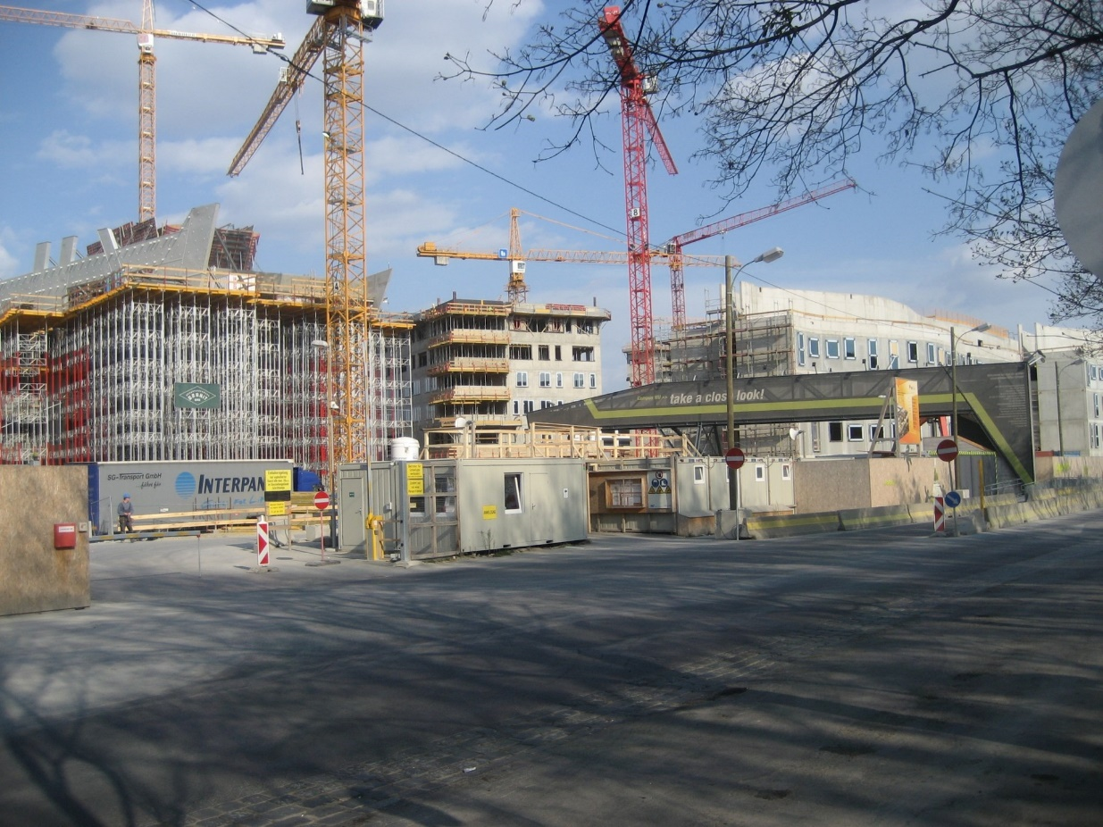
Example: Procure-to-pay process at Construction Company BuildIT
Construction Site of WU Vienna‘s New Campus opened in 2013.
Source: Wikimedia Commons

Slide 7
Example: Procure-to-pay process at Construction Company BuildIT
BuildIT is a construction company specialized in public works, such as roads, bridges, pipelines, tunnels and railroads. Within BuildIT, it often happens that engineers working at a construction site (called site engineers) need a piece of equipment, such as a truck, an excavator, a bulldozer, a water pump, etc. BuildIT owns very little equipment and instead it rents most of its equipment from specialized suppliers.
The existing business process for renting equipment goes as follows. When site engineers need to rent a piece of equipment, they fill in a form called “Equipment Rental Request” and send this request by email to one of the clerks at the company’s depot. The clerk at the depot receives the request and, after consulting the catalogs of the equipment suppliers, selects the most cost-effective equipment that complies with the request. Next, the clerk checks the availability of the selected equipment with the supplier via phone or email. Sometimes the selected option is not available. In these cases, the clerk has to select an alternative piece of equipment and check its availability with the corresponding supplier.
After finding a suitable and available piece of equipment, the clerk adds the details of the selected equipment to the rental request. Each rental request has to be approved by a works engineer, who also works at the depot. In some cases, the works engineer rejects the equipment rental request. Some rejections lead to the cancelation of the request, i.e., no equipment is rented at all. Other rejections are resolved by replacing the selected equipment with another equipment – such as a cheaper piece of equipment or a more appropriate piece of equipment for the job. In this latter case, the clerk needs to lodge another availability request.

Slide 8
Example: Procure-to-pay process at Construction Company BuildIT
When a works engineer approves a rental request, the clerk sends a confirmation to the supplier. This confirmation includes a Purchase Order (PO) for renting the equipment. The PO is produced by BuildIT’s financial information system using information entered by the clerk. The clerk also records the equipment rental in a spreadsheet that is used to monitor rentals.
In the meantime, the site engineer may decide that the equipment is no longer needed. In this case, the engineer asks the clerk to cancel the request for renting the equipment.
In due time, the supplier delivers the rented equipment to the construction site. The site engineer then inspects the equipment. If everything is in order, the site engineer accepts the engagement and the equipment is put into use. In some cases, the equipment is sent back because it does not comply with the requirements of the site engineer. In this case, the site engineer has to start the rental process all over again.
When the rental period expires, the supplier comes to pick up the equipment. Sometimes, the site engineer asks for an extension of the rental period by contacting the supplier via email or phone one to two days before pick-up. The supplier may accept or reject this request.
A few days after the equipment is picked up, the supplier sends an invoice to the clerk by email. At this point, the clerk asks the site engineer to confirm that the equipment was indeed rented for the period indicated in the invoice. The clerk also checks if the rental prices indicated in the invoice are in accordance with those in the PO. After these checks, the clerk forwards the invoice to the financial department. The financial department eventually pays the invoice.

Slide 9
Chapter 1: Introduction to BPM
Contents
Processes Everywhere
Ingredients of a Business Process
Origins and History of BPM
  The Functional Organization
  The Birth of Process Thinking
  The Rise and Fall of BPR
The BPM Lifecycle
Recap

Slide 10
Ingredients of a Business Process and Business Process Definition
A business process as a collection of inter-related events, activities, and decision points that involve a number of actors and objects, which collectively lead to an outcome that is of value to at least one customer.

Slide 11
Ingredients of a Business Process and Business Process Definition
EVENTS
  Events correspond to things that happen atomically
    The arrival of an equipment at a construction site is an event
  Event may trigger the execution of series of activities
    When a piece of equipment arrives, the site engineer inspects it
ACTIVITY
  Something that needs time to be done and may be composed of many steps (equipment inspection)
    The equipment fulfills the requirements, it is in working order, etc..
  If the activity is simple (one single unit of work), it is called a task.
    E.g, Inspection -> just checking the received equipment if it corresponds to what it was ordered
DECISION POINTS
  They are points in time when a decision is made that affects the way the process is executed.
    E,g. As a result of the inspection, the site engineer may decide that the equipment should be returned or that the equipment should be accepted.

Slide 12
Ingredients of a Business Process and Business Process Definition
ACTORS
  Can be a human, organizations, or software
  Clerk, site engineer, works engineer and the equipment suppliers
PHYSICAL OBJECTS
  Equipment, materials, products, paper documents
IMMATERIAL OBJECTS
  Electronic documents and records)
OUTCOME
  The result of a process
    An equipment being used by BuildIT, and a payment to the supplier
  Outcome should deliver value to the actors involved in the process
    If not it is called negative outcome (returned equipment)

Slide 13
Ingredients of a Business Process and Business Process Definition
CUSROMER
  The one who consumes the output of the process
    Site engineer is our customer in our example that can be satisfied or dissatisfied
  Sometimes, there are multiple customers in a process
    For example, in a process for selling a house, there is a buyer, a seller, a real estate agent, one or multiple mortgage providers, and at least one notary.
      The outcome is a sales transaction. This outcome provides value to the buyer who gets the house and to the seller who monetizes the house.

Slide 14
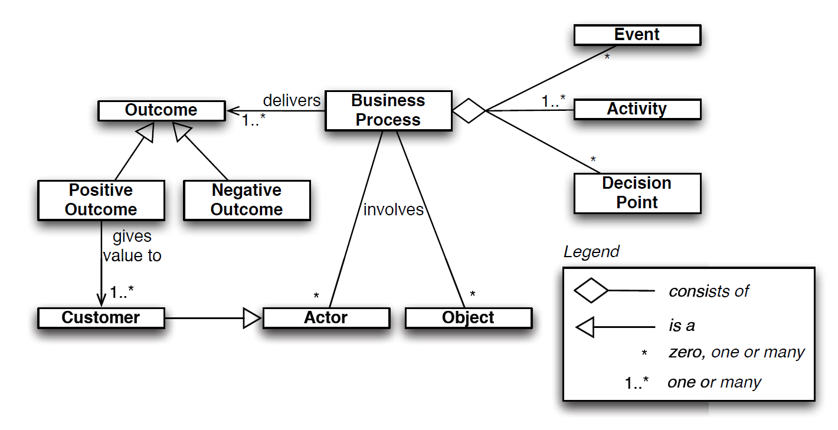
Ingredients of a Business Process and Business Process Definition

Slide 15
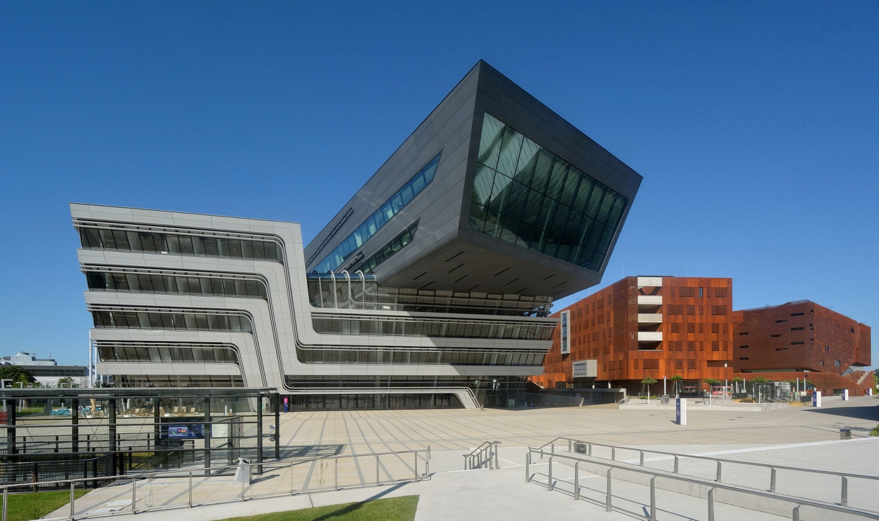
Exercise 1.1: University Admission Process
WU Vienna‘s New Campus opened in 2013. Source: Wikimedia Commons

Slide 16
Exercise 1.1: University Admission Process
Consider the process for the admission of international graduate students at a university.
In order to apply for admission, students first fill in an online form. Online applications are recorded in an information system to which all staff members involved in the admissions process have access. After a student has submitted the online form, a PDF document is generated and the student is requested to download it, sign it, and send it by post together with the required documents, which include:
  certified copies of previous degree and academic transcripts,
  results of English language test,
  curriculum vitae,
  two reference letters.

Slide 17
Exercise 1.1: University Admission Process
When these documents are received by the admissions office, an officer checks the completeness of the documents. If any document is missing, an email is sent to the student. The student has to send the missing documents by post. Assuming the application is complete, the admissions office sends the certified copies of the degrees to an academic recognition agency, which checks the degrees and gives an assessment of their validity and equivalence in terms of local education standards. This agency requires that all documents be sent to it by post, and that all documents be certified copies of the originals. The agency sends back its assessment to the university by post as well. Assuming the degree verification is successful, the English language test results are then checked online by an officer at the admissions office. If the validity of the English language test results cannot be verified, the application is rejected (such notifications of rejection are sent by email).

Slide 18
Exercise 1.1: University Admission Process
Once all documents of a given student have been validated, the admissions office forwards these documents by internal mail to the corresponding academic committee responsible for deciding whether to offer admission or not. The committee makes its decision based on the academic degrees and transcripts, the CV, and the reference letters. The committee meets once every three months to examine all applications that are ready for academic assessment at the time of the meeting.
At the end of the committee meeting, the chair of the committee notifies the admissions office of the selection outcomes. This notification includes a list of admitted and rejected candidates. A few days later, the admissions office notifies the outcome to each candidate via email. Additionally, successful candidates are sent a confirmation letter by post.
With respect to the above process, consider the following questions:
  Who are the actors in this process?
  Which actors can be considered as customers in this process?
  What are the possible outcomes of this process?

Slide 19
Definition of Business Process Management
BPM as a body of methods, techniques, and tools to identify, discover, analyze, redesign, execute, and monitor business processes in order to optimize their performance.

Slide 20
Related Disciplines
Total Quality Management (TQM)
  Focus on continuously improving and sustaining the quality of products and services.
  TQM puts emphasis on products and services themselves, while BPM focuses on improvement of processes.
  Applications of TQM are primarily in manufacturing while BPM more in service organizations.
Operations Management
  Concerned with managing physical and technical functions of organization, particularly those relating to production and manufacturing.
  Using probability theory, queuing theory, decision analysis, mathematical modeling, and simulation for optimizing efficiency of operations.
  Often concerned with controlling an existing process, while BPM making changes to an existing process in order to improve it.

Slide 21
Related Disciplines
Lean
  Originates from manufacturing, in particular Toyota Production System.
  Eliminates waste, i.e., activities that do not add value to the customer.
  BPM puts more emphasis on use of information technology as a tool to improve business processes and to make them more consistent and repeatable.
Six Sigma
  Originates from manufacturing, in particular from production practices at Motorola.
  Focuses on minimization of defects (errors).
  Strong emphasis on measuring output of processes, especially in terms of quality.
  Popular approach to blend Lean with Six Sigma, leading to Lean Six Sigma.
  Many of the techniques of Six Sigma are commonly applied in BPM as well

Slide 22
Chapter 1: Introduction to BPM
Contents
Processes Everywhere
Ingredients of a Business Process
Origins and History of BPM
  The Functional Organization
  The Birth of Process Thinking
  The Rise and Fall of BPR
The BPM Lifecycle
Recap

Slide 23

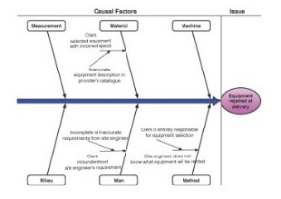
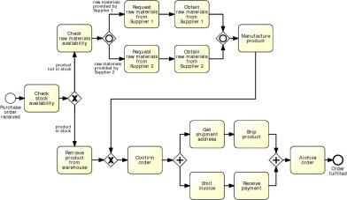

The BPM Lifecycle

Slide 24
The BPM Lifecycle:
1) Process identification
What business processes are we intending to improve?
Business problem is posed
Relevant processes to the problem are identified and related to each other
  E.g. if the problem is in obtaining construction equipment then it is clear that this problem should be addressed by looking at the equipment rental process
The outcome of this stage is a new or updated process architecture that provides an overall view of the processes
  Collection of processes and their relation to each other
In some cases, process identification is done in parallel with performance measure identification
  “You can’t control what you can’t measure”
  Process performance metrics may be used
  Cost-related, time-related and quality (error rates) measures
Notes:
AR to clarify BPMN

Slide 25
The BPM Lifecycle:
2) Process discovery
Understand the business process in detail
Also called as-is process modeling
Current state of each of the relevant processes is documented, typically in the form of as-is process models
Process models are meant to facilitate communication between stakeholders involved in a BPM initiative
Model can be
  Textual descriptions, diagrams or both of them
  Diagrams include flowcharts, cross-organizational flowcharts (swimlanes), UML Activity Diagrams, Event-driven Process Chains (EPCs) and Business Process Model and Notation (BPMN)
Notes:
AR to clarify BPMN

Slide 26
The BPM Lifecycle:
3) Process analysis
Issues associated to the as-is process are identified, documented and whenever possible quantified using performance measures
The output of this phase is a structured collection of issues which are prioritized in terms of their impact, and estimated effort required to resolve them.
This require collecting information about
  The time spent in each task of the process (waiting time)
  The amount of rework that takes place in the process (several tasks are repeated because something went wrong)
Notes:
AR to clarify BPMN

Slide 27
The BPM Lifecycle:
3) Process analysis
E.g.1 When the clerk identifies a suitable piece of equipment in a supplier’s catalog, but later finds out that the piece of equipment is not available on the required dates, the clerk might need to search again for an alternative piece from another supplier. The analyst would need to find out in what percentage of cases the availability check fails and thus how often the clerk needs to do some rework in order to identify alternative pieces of equipment and check for their availability
E.g.2 Sometimes the equipment delivered at the construction site is unsuitable, and the site engineer has to reject it. This is an example of a negative outcome. Analyst would need to find out how often such negative outcomes are occurring. Secondly, the analysts would need to obtain information that would allow them to understand why such negative outcomes are happening. Sometimes, this negative outcome might stem from miscommunication or inaccurate data (e.g. errors in the description of the equipment or from an error on the supplier’s side)
These two issues are tightly related to performance measures (cycle time and waiting time) and error rate
Notes:
AR to clarify BPMN

Slide 28
The BPM Lifecycle:
4) Process redesign
Also called process improvement
The goal of this phase is to identify changes to the process that allow the organization to meet its performance objectives (process redesign)
Multiple change options are analyzed and compared in terms of the chosen performance measures
keep in mind that a change in one process may potentially cause other issues
New changes are analyzed using process analysis techniques
The output of this phase is typically a to-be process model, which serves as a basis for the next phase.
Notes:
AR to clarify BPMN

Slide 29
The BPM Lifecycle:
4) Process redesign
Changing a process is not easy, Why?
  Change resistant
  May require change in the information system(s) , and this change may be costly or may require changes in external organizations
  E.g. To eliminate the rework that the clerk has to do when checking for availability of equipment, would be that the suppliers provide information regarding the availability of plants. This change in the process would require that the suppliers change their information system
Notes:
AR to clarify BPMN

Slide 30
The BPM Lifecycle:
5) Process implementation
Changes required to move from the as-is process to the to-be process are prepared and performed
This include two aspects: organizational change management and process automation
  Change management
    Set of activities required to change the way of working of all participants involved in the process.
  Process automation
    Refers to the development and deployment of IT systems (or enhanced versions of existing IT systems) that support the to-be process
Notes:
AR to clarify BPMN

Slide 31
The BPM Lifecycle:
6) Process monitoring and controlling
  Once the redesigned process is running, relevant data are collected and analyzed to determine how well is the process performing with respect to its performance measures and performance objectives.
  Bottlenecks, recurrent errors or deviations with respect to the intended behavior are identified and corrective actions are undertaken
  New issues may then arise, in the same or in other processes, requiring the cycle to be repeated on a continuous basis.
Notes:
AR to clarify BPMN

Slide 32
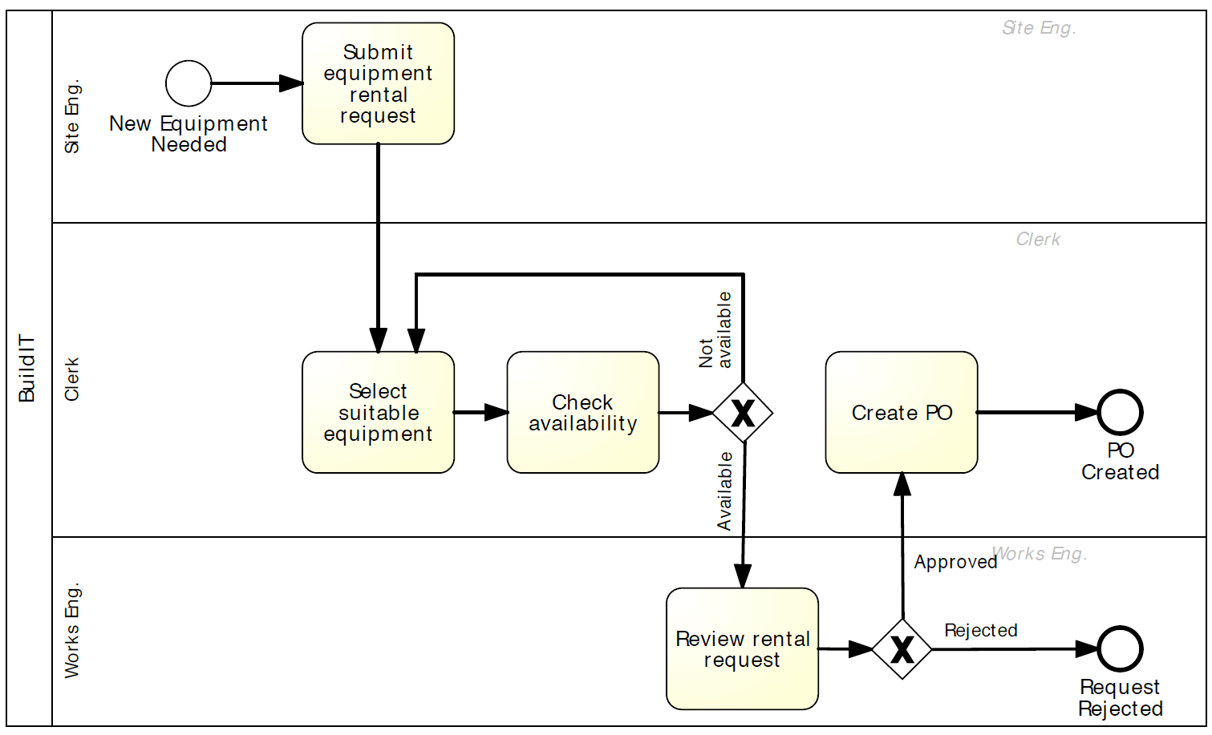
Example: Process model for the initial fragment of the equipment rental process

Slide 33
Exercises 1.3-5: University Admission Process
WU Vienna‘s New Campus opened in 2013. Source: Wikimedia Commons

Slide 34
Exercises 1.3-5: University Admission Process
Consider the student admission process described in Exercise 1.1 (page 5).
Exercise 1.3: Taking the perspective of the customer, identify at least two performance measures that can be attached to this process.
Exercise 1.4: Taking the perspective of the customer, think of at least two issues that this process might have.
Exercise 1.5: What possible changes do you think could be made to this process in order to address these issues?

Slide 35
Stakeholders in the BPM Lifecycle
Management Team:
  Chief Executive Officer (CEO) responsible for overall business success.
  Chief Operations Officer (COO) responsible for defining the way operations are set up, sometimes Chief Process Officer (CPO) or Chief Process and Innovation Officer (CPIO).
  Chief Information Officer (CIO) responsible for operation of information system infrastructure.
  Chief Financial Officer (CFO) responsible for overall financial performance of the company.
  Human Resources (HR) director plays key role in processes that involve many process participants.
Process Owners:
  Process owner is responsible for efficient and effective operation of a given process, including
  Planning and organizing, i.e. defining performance measures and objectives as well as initiating and leading improvement projects.
  Monitoring, i.e. ensuring that performance objectives are met, and taking corrective actions.
  Process owner is involved in process modeling, analysis, redesign, implementation, and monitoring.

Slide 36
Stakeholders in the BPM Lifecycle
Process Participants:
  Perform activities of business process on day-to-day basis.
  Conduct routine work according to the standards and guidelines of the company.
  Coordinated by process owner, who is responsible for non-routine aspects of process.
  Involved as domain experts during process discovery and process analysis.
  Support redesign activities and implementation.
Process Analysts:
  Conduct process identification, discovery, analysis, and redesign.
  Coordinate implementation and monitoring.
  Report to management and process owners
  Have business or IT background.
Process Methodologist:
  Provides advice on methods, techniques and software tools.
  Coordinates technical training.
System Engineers:
  Translate requirements into system design
  Responsible for implementation, testing and deployment.
BPM Group (also BPM Center of Excellence):
  Responsible for preserving project knowledge and documentation.
  Maintain process architecture.
  Prioritize process redesign projects.
  Align the BPM efforts with strategic goals.
  Most common in large organizations with several years of BPM experience.

Slide 37
Chapter 1: Introduction to BPM
Contents
Processes Everywhere
Ingredients of a Business Process
Origins and History of BPM
  The Functional Organization
  The Birth of Process Thinking
  The Rise and Fall of BPR
  The BPM Lifecycle
Recap

Slide 38
Recap
A process is a collection of events, activities, and decisions that collectively lead to an outcome that brings value to an organization’s customers.
Every organization has processes.
Managing processes ensures that they produce value.
BPM is a body of principles, methods, and tools to design, analyze, execute, and monitor business processes.
Process models and performance measures are pillars for managing processes.
Various related disciplines complement BPM, such as Lean, Six Sigma, and Total Quality Management.

