Slide 1
Fatty Acid and Triacylglycerol Metabolism

Slide 2
II. STRUCTURE OF FATTY ACIDS
A fatty acid consists of a hydrophobic hydrocarbon chain with a terminal carboxyl group. More than 90% of the fatty acids found in plasma are in the form of fatty acid esters (primarily triacylglycerol, cholesteryl esters, and phospholipids) contained in circulating lipoprotein particles. Fatty acid chains may contain no double bonds—that is, be saturated—or contain one or more double bonds—that is, be mono- or polyunsaturated. When double bonds are present, they are nearly always in the cis rather than in the trans configuration.
The carbon atoms are numbered, beginning with the carboxyl carbon as carbon 1. The number before the colon indicates the number of carbons in the chain, and those after the colon indicate the numbers and positions (relative to the carboxyl end) of double bonds. For example, as shown in Figure arachidonic acid, 20:4(5,8,11,14), is 20 carbons long and has 4 double bonds (between carbons 5–6, 8–9, 11–12, and 14–15).

Slide 3
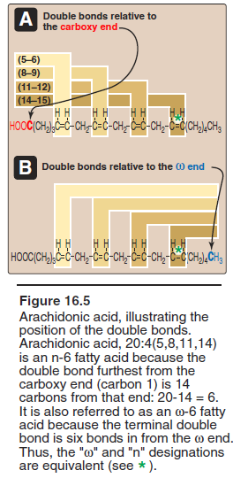
II. STRUCTURE OF FATTY ACIDS
The carbon of the terminal methyl group is called the ω-carbon regardless of the chain length.] The double bonds in a fatty acid can also be denoted relative to the ω (or methyl-terminal) end of the chain. Arachidonic acid is referred to as an ω-6 fatty acid because the terminal double bond is six bonds in from the ω end. Another ω-6 fatty acid is the essential linoleic acid, 18:2(9,12). In contrast, α-linolenic acid, 18:3(9,12,15), is an essential ω-3 fatty acid.
Essential fatty acid deficiency can result in a scaly dermatitis (ichthyosis), as well as visual and neurologic abnormalities. Essential fatty acid deficiency, however, is rare.

Slide 4
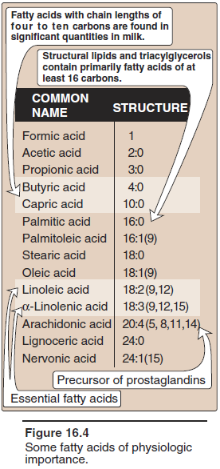
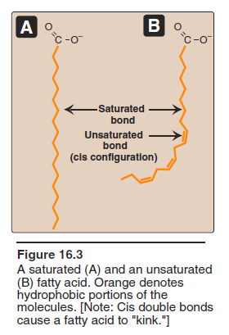
II. STRUCTURE OF FATTY ACIDS

Slide 5
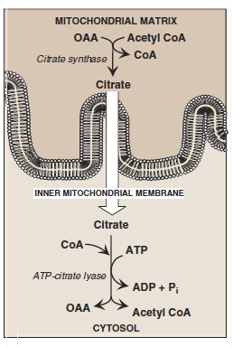
III. DE NOVO SYNTHESIS OF FATTY ACIDS
A. Production of cytosolic acetyl CoA The first step in de novo fatty acid synthesis is the transfer of acetate units from mitochondrial acetyl CoA to the cytosol. The CoA portion of acetyl CoA, however, cannot cross the inner mitochondrial membrane; only the acetyl portion enters the cytosol. It does so as part of citrate produced by the condensation of oxaloacetate (OAA) and acetyl CoA. Because a large amount of ATP is needed for fatty acid synthesis, the increase in both ATP and citrate enhances this pathway. citrate is cleaved by ATP-citrate lyase to produce cytosolic acetyl CoA and OAA, occurs when the mitochondrial citrate concentration is high.

Slide 6
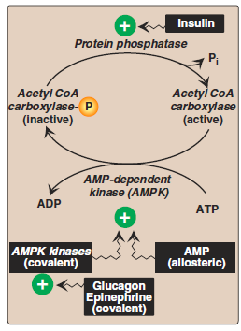
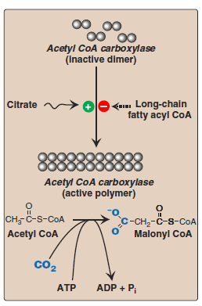
B. Carboxylation of acetyl CoA to form malonyl CoA
The carboxylation of acetyl CoA to form malonyl CoA is catalyzed by acetyl CoA carboxyl ase, and requires CO2 and ATP. The coenzyme is the vitamin, biotin, which is covalently bound to a lysyl residue of the carboxylase. This carboxylation is both the rate-limiting and the regulated step in fatty acid synthesis. The inactive form of ACC is a protomer (dimer). The enzyme undergoes allosteric activation by citrate, which causes dimers to polymerize, and allosteric inactivation by long-chain fatty acyl CoA (the end product of the pathway), which causes its depolymerization.
A second mechanism of short-term regulation is by reversible phosphorylation. AMP-activated protein kinase (AMPK) phosphorylates and inactivates ACC. AMPK itself is allosterically activated by AMP and covalently activated by phosphorylation via several kinases. At least one of these AMPK kinases is activated by cAMP-dependent protein kinase A (PKA).

Slide 7
C. Fatty acid synthase: a multifunctional enzyme in eukaryotes
The remaining series of reactions of fatty acid synthesis in eukaryotes is catalyzed by the multifunctional, dimeric enzyme, fatty acid synthase (FAS). Each FAS monomer is a multicatalytic polypeptide with seven different enzymic activities plus a domain that covalently binds a molecule of 4'-phosphopantetheine. [Note: 4'-Phosphopantetheine, a derivative of the vitamin pantothenic acid, carries acyl units on its terminal thiol (–SH) group during fatty acid synthesis.]
The result of these seven steps is production of a four-carbon compound (butyryl) whose three terminal carbons are fully saturated, and which remains attached to the ACP. All the carbons in palmitic acid have passed through malonyl CoA except the two donated by the original acetyl CoA, which are found at the methyl-group (ω) end of the fatty acid.
Synthesis of fatty acids requires NADPH The hexose monophosphate pathway is the major supplier of NADPH for fatty acid synthesis. The cytosolic conversion of malate to pyruvate, in which malate is oxidized and decarboxylated by cytosolic malic enzyme (NADP+-dependent malate dehy drogenase), also produces cytosolic NADPH and CO2.

Slide 8
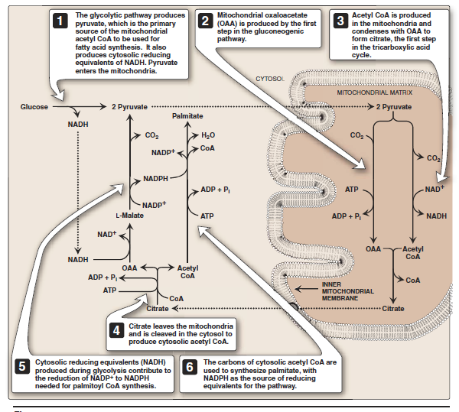

Slide 9
E. Further elongation of fatty acid chains F. Desaturation of fatty acid chains
Although palmitate, a 16-carbon, fully saturated long-chain length fatty acid (16:0), is the primary endproduct of fatty acid synthase activity, it can be further elongated by the addition of two-carbon units in the smooth endoplasmic reticulum (SER). Elongation requires a system of separate enzymes rather than a multifunctional enzyme. Malonyl CoA is the two-carbon donor and NADPH supplies the electrons. The brain has additional elongation capabilities, allowing it to produce the very-long-chain fatty acids (over 22 carbons) that are required for synthesis of brain lipids.
Enzymes (desaturases) also present in the SER are responsible for desaturating long-chain fatty acids (that is, adding cis double bonds). The first double bond is typically inserted between carbons 9 and 10, producing primarily 18:1(9) and small amounts of 16:1(9). A variety of polyunsaturated fatty acids can be made through additional desaturation combined with elongation.

Slide 10
G. Storage of fatty acids as components of triacylglycerols
Because TAGs are only slightly soluble in water and cannot form stable micelles by themselves, they coalesce within adipocytes to form oily droplets that are nearly anhydrous. These cytosolic lipid droplets are the major energy reserve of the body.
There are two pathways for glycerol phosphate production. In both liver (the primary site of TAG synthesis) and adipose tissue, glycerol phosphate can be produced from glucose, using first the reactions of the glycolytic pathway to produce dihydroxyacetone phosphate. Next, DHAP is reduced by glycerol phosphate dehydrogenase to glycerol phosphate. A second pathway found in the liver, but not in adipose tissue, uses glycerol kinase to convert free glycerol to glycerol phosphate.
Conversion of a free fatty acid to its activated form: A fatty acid must be converted to its activated form (attached to CoA) before it can participate in metabolic processes such as TAG synthesis.
Synthesis of a molecule of TAG from glycerol phosphate and fatty acyl CoA: This pathway involves four reactions, shown in These include the sequential addition of two fatty acids from fatty acyl CoA, the removal of phosphate, and the additionof the third fatty acid.

Slide 12
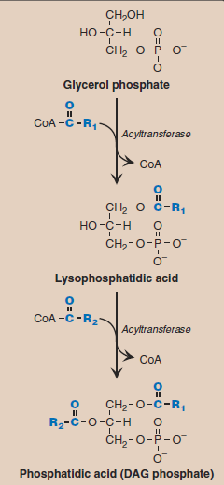
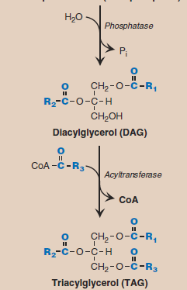

Slide 13
H. Different fates of TAG in the liver and adipose tissue
In white adipose tissue, TAG is stored in a nearly anhydrous form as fat droplets in the cytosol of the cells. It serves as “depot fat,” ready for mobilization when the body requires it for fuel. Little TAG is stored in the liver. Instead, most is exported, packaged with other lipids and apoproteins to form lipoprotein particles called very-lowdensity lipo proteins (VLDL). Nascent VLDL are secreted directly into the blood where they mature and function to deliver the endogenously derived lipids to the peripheral tissues. [Note: Recall that chylomicrons deliver primarily dietary (exogenously derived) lipids.] Plasma lipoproteins are discussed in Chapter 18.

Slide 14
IV. MOBILIZATION OF STORED FATS AND OXIDATION OF FATTY ACIDS
Release of fatty acids from TAG The mobilization of stored fat requires the hydrolytic release of fatty acids and glycerol from their TAG form. This process is initiated by hormone-sensitive lipase, which removes a fatty acid from carbon 1 and/or carbon 3 of the TAG. Additional lipases specific for diacylglycerol or monoacylglycerol remove the remaining fatty acid(s). hormone-sensitive lipase Is activated when phosphorylated by (cAMP)– dependent protein kinase. cAMP is produced in the adipocyte when one of several hormones (such as epinephrine or glucagon) binds to receptors on the cell membrane, and activates adenylyl cyclase. The process is similar to that of the activation of glycogen phosphorylase. In the presence of high plasma levels of insulin and glucose, HSL is dephosphorylated, and becomes inactive.

Slide 15
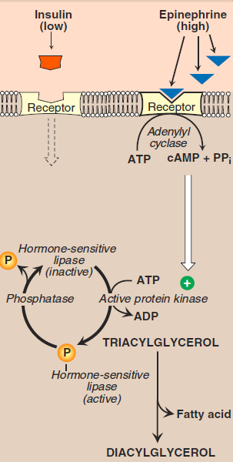

Slide 16
Fate of fatty acids
The free (unesterified) fatty acids are transported to the tissues, enter cells, get activated to their CoA derivatives, and are oxidized for energy. Regardless of their levels, plasma free fatty acids (FFA) cannot be used for fuel by erythrocytes, which have no mitochondria. Brain, too, does not use fatty acids for energy, but the reasons are less clear. [White adipose does not express glycerol kinase, and the phosphorylated glycerol is produced by glyceroneogenesis, an incomplete version of gluconeogenesis: pyruvate to PEP to OAA to DHAP to glycerol 3-phosphate. The process reduces plasma FFA, molecules associated with insulin resistance in type 2 diabetes and obesity.]

Slide 17
B. β-Oxidation of fatty acids
The major pathway for catabolism of fatty acids is a mitochondrial pathway called β-oxidation, in which two-carbon fragments are successively removed from the carboxyl end of the fatty acylCoA, producing acetyl-CoA, NADH, and FADH2.
Transport of long-chain fatty acids (LCFA) into the mitochondria: After a LCFA enters a cell, it is converted in the cytosol to its CoA derivative by long-chain fatty acyl CoA synthetase (thiokinase), an enzyme of the outer mitochondrial membrane. Because β-oxidation occurs in the mitochondrial matrix, the fatty acid must be transported across the inner mitochondrial membrane that is impermeable to CoA. Therefore, a specialized carrier transports the long-chain acyl group from the cytosol into the mitochondrial matrix. This carrier is carnitine, and this rate-limiting transport process is called the carnitine shuttle

Slide 18
a. Steps in LCFA translocation
First, the acyl group is transferred from CoA to carnitine by carnitine palmitoyltransferase I (CPT-I)—an enzyme of the outer mitochondrial membrane. [Note: CPT-I is also known as CAT-I for carnitine acyltransferase I.] This reaction forms acyl carnitine, and regenerates free CoA. Second, the acylcarnitine is transported into the mitochondrial matrix in exchange for free carnitine by carnitine–acylcarnitine translocase.
Carnitine palmitoyltransferase II (CPT-II, or CAT-II)—an enzyme of the inner mitochondrial membrane—catalyzes the transfer of the acyl group from carnitine to CoA in the mitochondrial matrix, thus regenerating free carnitine.

Slide 19
carnitine shuttle
Malonyl CoA inhibits CPT-I, thus preventing the entry of long-chain acyl groups into the mitochondrial matrix. Therefore, when fatty acid synthesis is occurring in the cytosol (as indicated by the presence of malonyl CoA), the newly made palmitate cannot be transferred into the mitochondria and degraded.
Carnitine can be obtained from the diet, where it is found primarily in meat products. Carnitine can also be synthesized from the amino acids lysine and methionine by an enzymatic pathway found in the liver and kidney but not in skeletal or heart muscle. Therefore, these latter tissues are totally dependent on uptake of carnitine provided by endogenous synthesis or the diet, and distributed by the blood. [Note: Skeletal muscle contains about 97% of all carnitine in the body.]

Slide 20
d. Carnitine deficiencies
Such deficiencies result in a decreased ability of tissues to use LCFA as a metabolic fuel. Secondary carnitine deficiency occurs in many situations, including: 1) in patients with liver disease causing decreased synthesis of carnitine; 2) in individuals suffering from malnutrition or those on strictly vegetarian diets; 3) in those with an increased requirement for carnitine as a result of, for example, pregnancy, severe infections, burns, or trauma; or 4) in those undergoing hemodialysis, which removes carnitine from the blood.
Genetic CPT-I deficiency affects the liver, where an inability to use LCFA for fuel greatly impairs that tissue’s ability to synthesize glucose during a fast. This can lead to severe hypoglycemia, coma, and death.
CPT-II deficiency occurs primarily in cardiac and skeletal muscle, where symptoms of carnitine deficiency range from cardiomyopathy to muscle weakness with myoglobinemia following prolonged exercise. Treatment includes avoidance of prolonged fasts, adopting a diet high in carbohydrate and low in LCFA, but supplemented with medium-chain fatty acids and carnitine.

Slide 21
medium-chain fatty acids
Entry of short- and medium-chain fatty acids into the mitochondria: Fatty acids shorter than 12 carbons can cross the inner mitochondrial membrane without the aid of carnitine or the CPT system. Once inside the mitochondria, they are activated to their CoA derivatives by matrix enzymes, and are oxidized. [Note: Medium-chain fatty acids are plentiful in human milk. Because their oxidation is not dependent on CPT-I, it is not subject to inhibition by malonyl CoA.]

Slide 22
Reactions of β-oxidation:
The first cycle of consists of a sequence of four reactions involving the β-carbon (carbon 3) that results in shortening the fatty acid chain by two carbons. The steps include an oxidation that produces FADH2, a hydration step, a second oxidation that produces NADH, and a thiolytic cleavage that releases a molecule of acetyl CoA. Each step is catalyzed by enzymes with chain-length specificity.
These four steps are repeated for saturated fatty acids of even-numbered carbon chains (n/2) – 1 times (where n is the number of carbons), each cycle producing an acetyl group plus one NADH and one FADH2. The final thiolytic cleavage produces two acetyl groups. [Note: Acetyl CoA is a positive allosteric effector of pyruvate carboxylase , thus linking fatty acid oxidation and gluconeogenesis.]

Slide 23
4. Energy yield from fatty acid oxidation
The energy yield from the β-oxidation pathway is high. For example, the oxidation of a molecule of palmitoyl CoA to CO2 and H2O produces 8 acetyl CoA, 7 NADH, and 7 FADH2, from which 131 ATP can be generated; however, activation of the fatty acid requires 2 ATP. Thus, the net yield from palmitate is 129 ATP.

Slide 24
5. Medium-chain fatty acyl CoA dehydrogenase (MCAD) deficiency:
In mitochondria, there are four fatty acyl CoA dehydrogenase species, each with a specificity for either short-, medium-, long-, or very-long-chain fatty acids. MCAD deficiency, an autosomal recessive disorder, is one of the most common inborn errors of metabolism, and the most common inborn error of fatty acid oxidation, being found in 1:14,000 births worldwide, with a higher incidence in Northern Europeans. It results in decreased ability to oxidize fatty acids with six to ten carbons (these accumulate and can be measured in urine), and severe hypoglycemia (because the tissues must increase their reliance on glucose). Treatment includes avoidance of fasting. MCAD deficiency has been identified as the cause of some cases originally reported as sudden infant death syndrome (SIDS).

Slide 25
V. KETONE BODIES: AN ALTERNATE FUEL FOR CELLS
Liver mitochondria have the capacity to convert acetyl CoA derived from fatty acid oxidation into ketone bodies. The compounds categorized as ketone bodies are acetoacetate, 3-hydroxybutyrate, and acetone (a nonmetabolized side product. [Note: The two functional ketone bodies are actually organic acids.] Acetoacetate and 3-hydroxybutyrate are transported in the blood to the peripheral tissues. There they can be reconverted to acetyl CoA, which can be oxidized by the TCA cycle.
Ketone bodies are important sources of energy for the peripheral tissues because 1) they are soluble in aqueous solution and, therefore, do not need to be incorporated into lipoproteins or carried by albumin as do the other lipids; 2) they are produced in the liver during periods when the amount of acetyl CoA present exceeds the oxidative capacity of the liver; and 3) they are used in proportion to their concentration in the blood by extrahepatic tissues, such as the skeletal and cardiac muscle and renal cortex. Even the brain can use ketone bodies to help meet its energy needs if the blood levels rise sufficiently; thus, ketone bodies spare glucose.This is particularly important during prolonged periods of fasting.

Slide 26
Synthesis of 3-hydroxy-3-methylglutaryl (HMG) CoA
The first synthetic step, formation of acetoacetyl CoA, Mitochondrial HMG CoA synthase combines a third molecule of acetyl CoA with acetoacetyl CoA to produce HMG CoA. [Note: HMG CoA is also a precursor of cholesterol. These pathways are separated by location in, and conditions of, the cell.] HMG CoA synthase is the rate-limiting step in the synthesis of ketone bodies, and is present in significant quantities only in the liver.
HMG CoA is cleaved to produce acetoacetate and acetyl CoA. Acetoacetate can be reduced to form 3-hydroxybutyrate with NADH as the hydrogen donor. Acetoacetate can also spontaneously decarboxylate in the blood to form acetone—a volatile, biologically nonmetabolized compound that can be released in the breath.

Slide 27
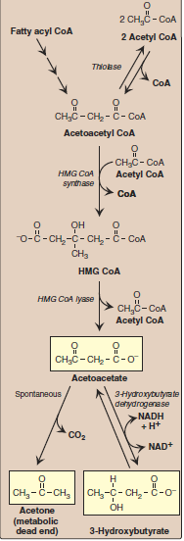

Slide 28
C. Excessive production of ketone bodies in diabetes mellitus
When the rate of formation of ketone bodies is greater than the rate of their use, their levels begin to rise in the blood (ketonemia) and, eventually, in the urine (ketonuria). This is seen most often in cases of uncontrolled, type 1 diabetes mellitus. A frequent symptom of diabetic ketoacidosis is a fruity odor on the breath, which results from increased production of acetone. An elevation of the ketone body concentration in the blood results in acidemia. Ketoacidosis may also be seen in cases of fasting.

