Slide 1
Gluconeogenesis

Slide 2
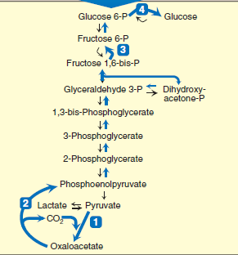

Slide 3
SUBSTRATES FOR GLUCONEOGENESIS
Glycerol: Glycerol is released during the hydrolysis of triacylglycerols in adipose tissue, and is delivered by the blood to the liver. Glycerol is phosphorylated by glycerol kinase to glycerol phosphate, which is oxidized by glycerol phosphate dehydrogenase to dihydroxy acetone phosphate—an intermediate of glycolysis.
Lactate: Lactate is released into the blood by exercising skeletal muscle, and by cells that lack mitochondria, such as red blood cells. In the Cori cycle, bloodborne glucose is converted by exercising muscle to lactate, which diffuses into the blood. This lactate is taken up by the liver and reconverted to glucose, which is released back into the circulation

Slide 4
SUBSTRATES FOR GLUCONEOGENESIS
Amino acids: Amino acids derived from hydrolysis of tissue proteins are the major sources of glucose during a fast. α-Ketoacids, such as α-keto - glutarate, are derived from the metabolism of glucogenic amino acids

Slide 5
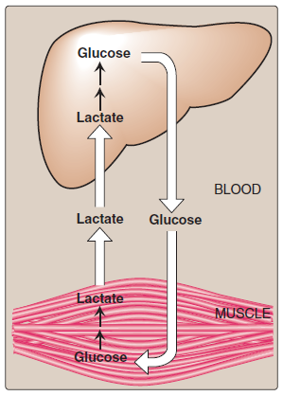
The Cori cycle

Slide 6
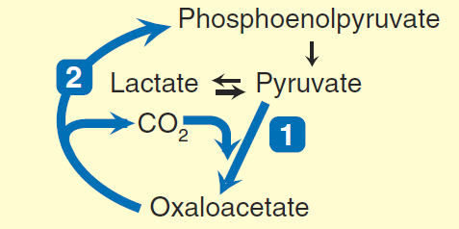
REACTIONS UNIQUE TO GLUCONEOGENESIS
The first “roadblock” to overcome in the synthesis of glucose from pyruvate is the irreversible conversion in glycolysis of PEP to pyruvate by pyruvate kinase. In gluconeogenesis, pyruvate is first carboxylated by pyruvate carboxylase to OAA, which is then converted to PEP by the action of PEP- carboxykinase.

Slide 7
REACTIONS UNIQUE TO GLUCONEOGENESIS
Carboxylation of pyruvate
Pyruvate carboxylase requires biotin covalently bound to the ε-amino group of a lysine residue in the enzyme. Hydrolysis of ATP drives the formation of an enzyme–biotin–CO2 intermediate. This high-energy complex subsequently carboxylates pyruvate to form OAA. [Note: This reaction occurs in the mitochondria of liver and kidney cells, and has two purposes: to provide an important substrate for gluconeogenesis, and to provide OAA that can replenish the TCA cycle intermediates that may become depleted, depending on the synthetic needs of the cell. Muscle cells also contain pyruvate carboxylase, but use the OAA produced only for the latter purpose— they do not synthesize glucose.]

Slide 8
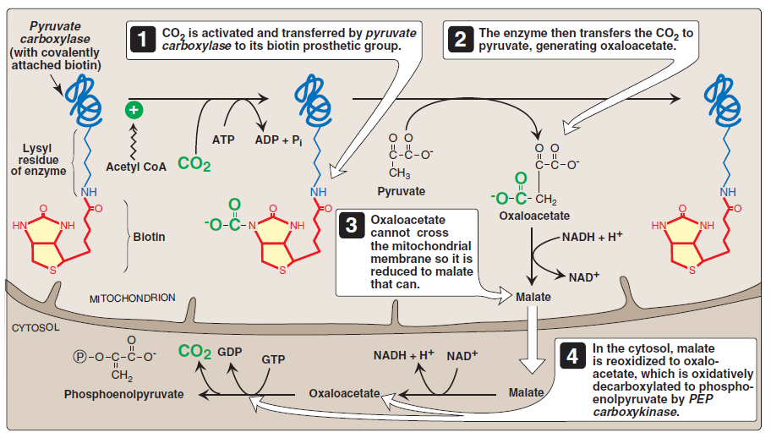

Slide 9
Transport of oxaloacetate to the cytosol
OAA must be converted to PEP for gluconeogenesis to continue. The enzyme that catalyzes this conversion is found in both the mitochondria and the cytosol in humans. The PEP that is generated in the mitochondria is transported to the cytosol by a specific transporter, whereas that generated in the cytosol requires the transport of OAA from the mitochondria to the cytosol. However, OAA is unable to directly cross the inner mitochondrial membrane; it must first be reduced to malate by mitochondrial malate dehydrogenase. Malate can be transported from the mitochondria to the cytosol, where it is reoxidized to oxaloacetate by cytosolic malate dehydrogenase as NAD+ is reduced

Slide 11
Decarboxylation of cytosolic oxaloacetate
Oxaloacetate is decarboxylated and phosphorylated to PEP in the cytosol by PEP-carboxykinase (also referred to as PEPCK). The reaction is driven by hydrolysis of guanosine triphosphate. The combined actions of pyruvate carboxylase and PEPcarboxy kinase provide an energetically favorable pathway from pyruvate to PEP. Then, PEP is acted on by the reactions of glycolysis running in the reverse direction until it becomes fructose 1,6-bisphosphate.

Slide 12
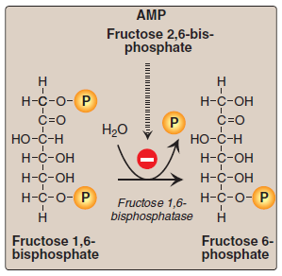
Dephosphorylation of fructose 1,6-bisphosphate
Hydrolysis of fructose 1,6-bisphosphate by fructose 1,6-bisphosphatase bypasses the irreversible phosphofructokinase-1 reaction, and provides an energetically favorable pathway for the formation of fructose 6-phosphate This reaction is an important regulatory site of gluconeogenesis.

Slide 13
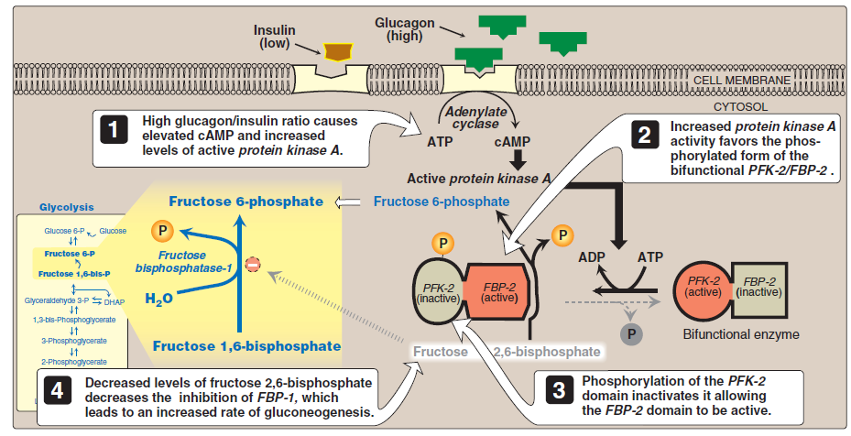
Regulation by energy levels within the cell

Slide 14
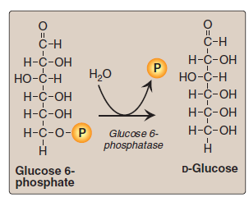
Dephosphorylation of glucose 6-phosphate
Hydrolysis of glucose 6-phosphate by glucose 6-phosphatase bypasses the irreversible hexokinase reaction, and provides an energetically favorable pathway for the formation of free glucose. Liver and kidney are the only organs that release free glucose from glucose 6-phosphate.
an inherited deficiency of glucose 6-phosphatase, is characterized by severe fasting hypoglycemia, because free glucose is unable to be produced from either gluconeogenesis or glycogenolysis.

Slide 15
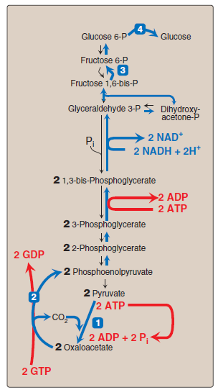
Summary of the reactions of glycolysis and gluconeogenesis

Slide 16
