Slide 1
Ch8. Glycolysis
Dr. Malik Al-Qub Dr. Suliman Alkhalil

Slide 2
Catabolic pathways
Catabolic reactions serve to capture chemical energy in the form of adenosine triphosphate (ATP) from the degradation of energy-rich fuel molecules. Catabolism also allows molecules in the diet (or nutrient molecules stored in cells) to be converted into building blocks needed for the synthesis of complex molecules

Slide 3
Three stages of catabolism
Hydrolysis of complex molecules: In the first stage, complex molecules are broken down into their component building blocks.
Conversion of building blocks to simple intermediates: In the second stage, these diverse building blocks are further degraded to acetyl coenzyme A (CoA) and a few other, simple molecules.
Oxidation of acetyl CoA: The tricarboxylic acid (TCA) cycle is the final common pathway in the oxidation of fuel
molecules that produce acetyl CoA. Oxidation of acetyl CoA generates large amounts of ATP via oxidative phosphorylation as electrons flow from NADH and FADH2 to oxygen

Slide 5
Anabolic pathways
Anabolic reactions combine small molecules, such as amino acids, to form complex molecules, such as proteins. Anabolic reactions require energy (are endergonic), which is generally provided by the breakdown of ATP to adenosine diphosphate (ADP) and inorganic phosphate (Pi). Anabolic reactions often involve chemical reductions in which the reducing power is most frequently provided by the electron donor NADPH

Slide 6
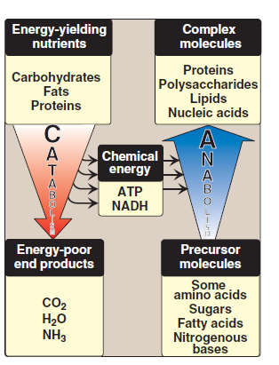

Slide 7
Adenylyl cyclase
The recognition of a chemical signal by some membrane receptors, such as the β- and α2-adrenergic receptors, triggers either an increase or a decrease in the activity of adenylyl cyclase (adenylate cyclase). This is a membrane-bound enzyme that converts ATP to 3',5'-adenosine monophosphate (also called cyclic AMP or cAMP). The chemical signals are most often hormones or neurotransmitters, each of which binds to a unique type of membrane receptor. Therefore, tissues that respond to more than one chemical signal
must have several different receptors, each of which can be linked to adenylyl cyclase. These receptors, known as G protein-coupled receptors (GPCR), are characterized by an extracellular ligand-binding region, seven transmembrane helices, and an intracellular domain that interacts with G proteins

Slide 8
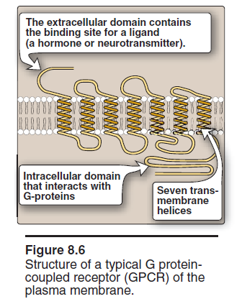

Slide 9
GTP-dependent regulatory proteins
Binding of ligand causes a conformational change in the receptor, triggering replacement of this GDP with GTP.
The GTP-bound form of the α subunit dissociates from the βγ subunits and moves to adenylyl cyclase, which is thereby activated.
One family of G proteins, designated Gs, stimulates adenylyl cyclase; another family, designated Gi, inhibits the enzyme
The actions of the Gα–GTP complex are short-lived because Gα has an inherent GTPase activity, resulting in the rapid hydrolysis of GTP to GDP.

Slide 10
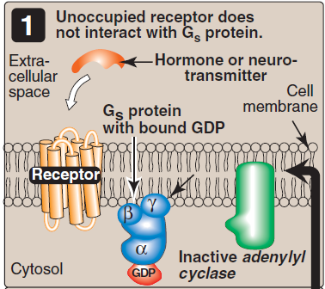
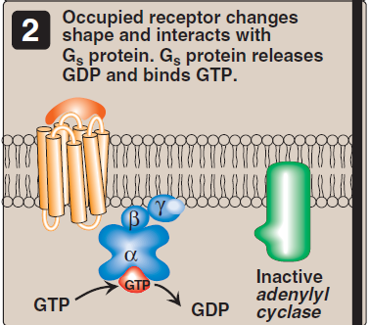
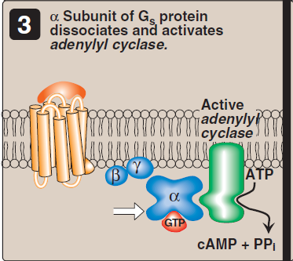
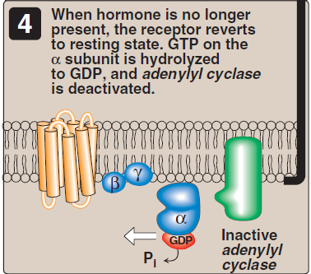

Slide 11
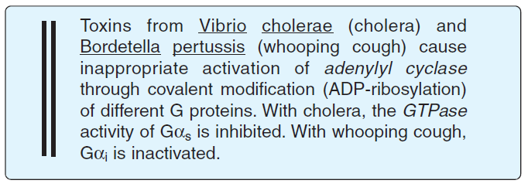

Slide 12
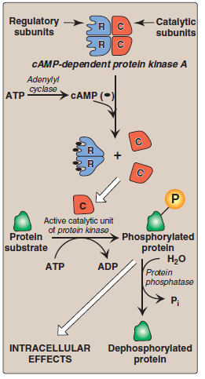

Slide 13
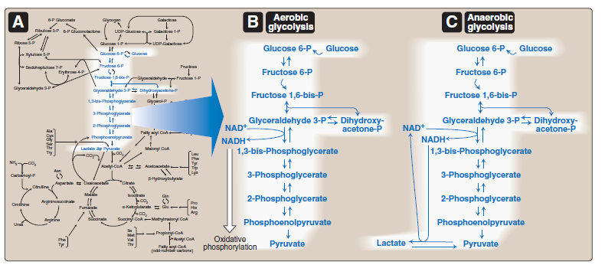
III. OVERVIEW OF GLYCOLYSIS

Slide 14
TRANSPORT OF GLUCOSE INTO CELLS
Na+-independent facilitated diffusion transport
Tissue specificity of GLUT gene expression: The glucose transporters display a tissue-specific pattern of expression. For example, GLUT-3 is the primary glucose transporter in neurons. GLUT-1 is abundant in erythrocytes and blood brain barrier, but is low in adult muscle, whereas GLUT-4 is abundant in adipose tissue and skeletal muscle. [Note: The number of GLUT-4 transporters active in these tissues is increased by insulin. GLUT-5 is unusual in that it is the primary transporter for fructose (instead of glucose) in the small intestine and the testes.
Na+-monosaccharide cotransporter system
The carrier is a sodium-dependent–glucose transporter or SGLT. This type of transport occurs in the epithelial cells of the intestine, renal tubules, and choroid plexus.

Slide 15
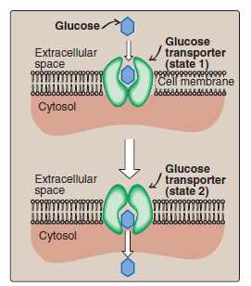

Slide 16
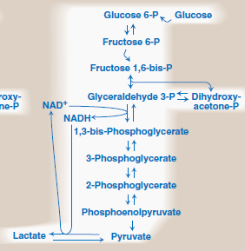
REACTIONS OF GLYCOLYSIS

Slide 17
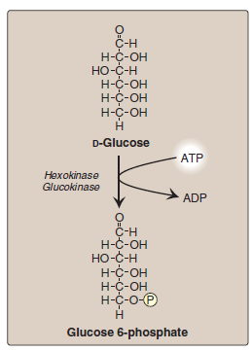
1, Phosphorylation of glucose
Hexokinase: In most tissues, the phosphorylation of glucose is catalyzed by hexokinase, one of three regulatory enzymes of glycolysis (see also phosphofructokinase and pyruvate kinase).
Glucokinase: In liver parenchymal cells and β cells of the pancreas, glucokinase (also called hexokinase D, or type IV) is the predominant enzyme responsible for the phosphorylation of glucose. In β cells, glucokinase functions as the glucose sensor, determining the threshold for insulin secretion

Slide 18
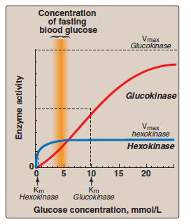
Kinetics

Slide 19
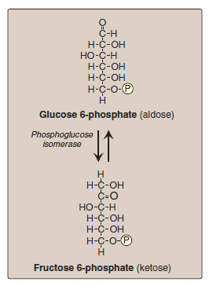
Isomerization of glucose 6-phosphate
The isomerization of glucose 6-phosphate to fructose 6-phosphate is catalyzed by phospho glucose isomerase

Slide 20
Phosphorylation of fructose 6-phosphate
The irreversible phosphorylation reaction catalyzed by phospho - fructokinase-1 (PFK-1) is the most important control point and the rate-limiting and committed step of glycolysis.
PFK-1 is controlled by the available concentrations of the substrates ATP and fructose 6- phosphate, and by regulatory substances described below.

Slide 21
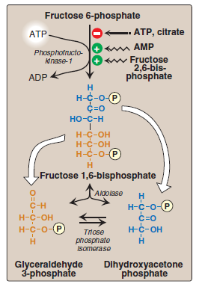
Phosphorylation of fructose 6-phosphate

Slide 22
Regulation
During the well-fed state: Decreased levels of glucagon and elevated levels of insulin, such as occur following a carbohydrate- rich meal, cause an increase in fructose 2,6-bisphosphate and, thus, in the rate of glycolysis in the liver. Fructose 2,6-bisphosphate, therefore, acts as an intracellular signal, indicating that glucose is abundant.
During starvation: Elevated levels of glucagon and low levels of insulin, such as occur during fasting, decreasenthe intracellular concentration of hepatic fructose 2,6-bisphosphate. This results in a decrease in the overall rate of glycolysis and an increase in gluconeogenesis

Slide 23
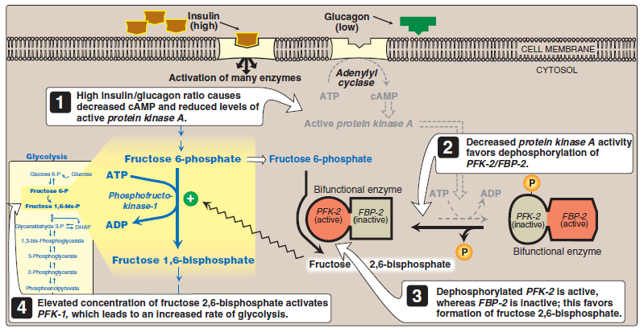

Slide 24
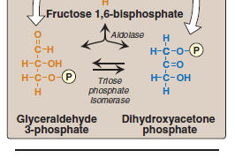
Cleavage of fructose 1,6-bisphosphate
Aldolase cleaves fructose 1,6-bisphosphate to dihydroxy acetone phosphate and glyceraldehyde 3-phosphate. The reaction is reversible and not regulated.

Slide 25
Isomerization of dihydroxyacetone phosphate
Triose phosphate isomerase interconverts dihydroxyacetone phosphate and glyceraldehyde 3-phosphate

Slide 26
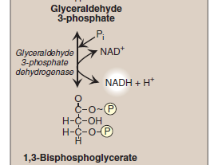
Oxidation of glyceraldehyde 3-phosphate

Slide 27
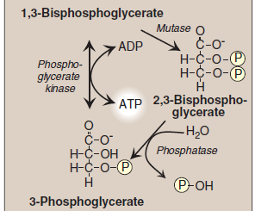
Synthesis of 3-phosphoglycerate producing ATP
When 1,3-BPG is converted to 3-phosphoglycerate, the high-energy phosphate group of 1,3-BPG is used to synthesize ATP from ADP . This reaction is catalyzed by phosphoglycerate kinase, which, unlike most other kinases, is physiologically reversible. Because two molecules of 1,3-BPG are formed from each glucose molecule, this kinase reaction replaces the two ATP molecules consumed by the earlier formation of glucose 6-phosphate and fructose 1,6-bisphosphate.

Slide 28
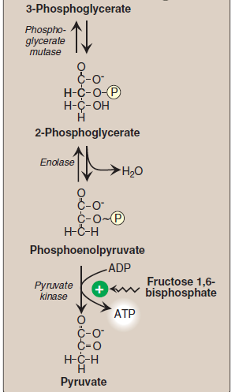
Shift of the phosphate group from carbon 3 to carbon 2
Shift of the phosphate group from carbon 3 to carbon 2
The dehydration of 2 phosphoglycerate by enolase redistributes the energy within the 2-phosphoglycerate molecule, resulting in the formation of phosphoenolpyruvate (PEP), which contains a highenergy enol phosphate
Formation of pyruvate producing ATP

Slide 29
Feed-forward regulation
Feed-forward regulation: In liver, pyruvate kinase is activated by fructose 1,6-bisphosphate, the product of the phosphofructo kinase reaction. This feed-forward (instead of the more usual feedback) regulation has the effect of linking the two kinase activities: increased phosphofructokinase activity results in elevated levels of fructose 1,6-bisphosphate, which activates pyruvate kinase.

Slide 30
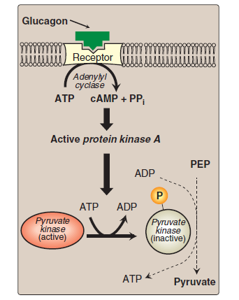
Covalent modulation of pyruvate kinase
Phosphorylation by a cAMP-dependent protein kinase leads to inactivation of pyruvate kinase in the liver (Figure 8.19). When blood glucose levels are low, elevated glucagon increases the intracellular level of cAMP, which causes the phosphorylation and inactivation of pyruvate kinase. Therefore, PEP is unable to continue in glycolysis, but instead enters the gluconeogenesis pathway. This, in part, explains the observed inhibition of hepatic glycolysis and stimulation of gluconeogenesis by glucagon. Dephos phorylation of pyruvate kinase by a phosphoprotein phosphatase results in re activation of the enzyme.

Slide 31
Pyruvate kinase deficiency
The normal, mature erythrocyte lacks mitochondria and is, therefore, completely dependent on glycolysis for production of ATP. This high-energy compound is required to meet the metabolic needs of the red blood cell, and also to fuel the pumps necessary for the maintenance of the biconcave, flexi-ble shape of the cell, which allows it to squeeze through narrow capillaries. The anemia observed in glycolytic enzyme deficiencies is a consequence of the reduced rate of glycolysis, leading to decreased ATP production. The resulting alterations in the red blood cell membrane lead to changes in the shape of the cell and, ultimately, to phagocytosis by the cells of the reticuloendothelial system, particularly macrophages of the spleen. The premature death and lysis of red blood cells results in hemolytic anemia. Among patients exhibiting the rare genetic defects of glycolytic enzymes, about 95% show a deficiency in pyruvate kinase, and 4% exhibit phosphoglucose isomerase deficiency. PK deficiency is restricted to the erythrocytes, and produces mild to severe chronic hemolytic anemia (erythrocyte destruction), with the severe form requiring regular cell transfusions.

Slide 32
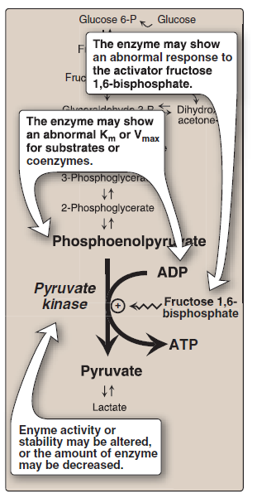

Slide 33
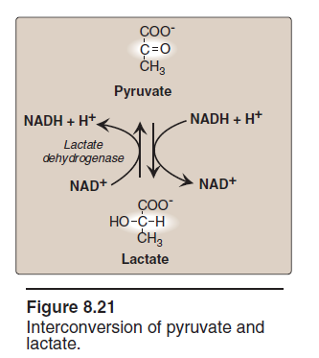
Reduction of pyruvate to lactate

Slide 34
Lactic acidosis
Elevated concentrations of lactate in the plasma, termed lactic acidosis, occur when there is a collapse of the circulatory system, such as in myocardial infarction, pulmonary embolism, and uncontrolled hemorrhage, or when an individual is in shock. The failure to bring adequate amounts of oxygen to the tissues results in impaired oxidative phosphorylation and decreased ATP synthesis. To survive, the cells use anaerobic glycolysis as a backup system for generating ATP, producing lactic acid as the endproduct.

Slide 35
Energy yield from glycolysis
1. Anaerobic glycolysis: Two molecules of ATP are generated for each molecule of glucose converted to two molecules of lactate. There is no net production or consumption of NADH.
2. Aerobic glycolysis: The direct consumption and formation of ATP is the same as in anaerobic glycolysis—that is, a net gain of two ATP per molecule of glucose. Two molecules of NADH are also produced per molecule of glucose. Ongoing aerobic glycolysis requires the oxidation of most of this NADH by the electron transport chain, producing approximately three ATP for each NADH molecule entering the chain. [Note: NADH cannot cross the inner mitochondrial membrane, and substrate shuttles are required (see p. 79).]

Slide 36
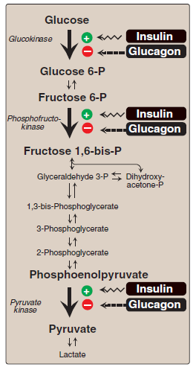
HORMONAL REGULATION OF GLYCOLYSIS

Slide 37
ALTERNATE FATES OF PYRUVATE
Oxidative decarboxylation of pyruvate
Reduction of pyruvate to ethanol (microorganisms
Carboxylation of pyruvate to oxaloacetate

Slide 39
