Slide 1
Disaster management
Prepared by :
Aya Eid
Wafa’ qatesh

Slide 2
objective
  By the end of this seminar, collages will be able to:
  1- define disaster
  2-identify the types of disaster
  3- discuss the common injuries caused by different types of disasters
  4-explain disaster preparedness
  5- discuss the PRE-DISASTER paradigm
  6- explain the disaster management
  7- describe personal protective equipment

Slide 3
What is disaster ?
■ An event in which the needs exceed immediately available resources
■ Local incidents or events in that their impact is immediate and direct, while time course, population, and geography are generally limited
Disaster = Needs > Resources

Slide 4
Types of disasters
■ Natural disasters:
Are caused by acts of nature or emerging diseases.
May be predictable or unexpected
■ Man-made disasters:
Either accidental or intentional
War; chemical, biologic, radiologic, and nuclear terrorism
Transportation accidents
Food or water contamination

Slide 5
Disaster Preparedness
■ The PRE-DISASTER paradigm:
– Planning and practice
– Resilience
– Education and training

Slide 6
Cont…
■ Planning and practice:
– Design
– Implementation
– Ongoing evaluation of efforts to help communities, institutions and individuals prepare for, respond to, and recover from disasters

Slide 7
Cont….
Resilience:
– Is the ability of individuals and communities to rebound to a reasonable state of normalcy after exposure to disasters
– Being prepared through planning, education, and training can reduce fear, anxiety, and losses associated with a disaster and build resilience
– It can be build by educating the population about local disaster planning and response efforts.

Slide 8
■ Education and training:
– INCMCE published educational competencies for registered nurses responding to MCIs
■ core competencies, core knowledge areas, and professional role development.

Slide 9
Disaster management
The DISASTER paradigm is a practical learning tool to enhance communication consistency among disaster response personnel and agencies

Slide 10
■ Detection
– Is the first step of effective disaster response
– Determine:
■ Whether there is a disaster or mass causality situation present
■ Do current needs exceed available capabilities and resources?
■ Is there a suspected threat or hazardous material present?

Slide 11
■ Incident management
– Effective incident management requires:
■ Command
■ Coordination
■ communication

Slide 12
■ Safety and security
– Protecting self first priority in order to save lives in safe manner
– Triage, treatment, and evacuation of causalities is secondary consideration.
– Personal Protective Equipment (PPE)
■ Reparatory protection: purifiers, supplied air devices (SCBA), or air-line respirator
■ Protective garments: vapor-tight suits, partially resistance suits, or hooded coverall

Slide 13
■ Assess hazards
– A challenging feature
– Risk of structural collapse, fire, ruptures gas lines, downed power lines
– Potential release of toxic chemicals and radiation
– Respiratory hazards (smoke, carbon monoxide, cyanide, dust)

Slide 14
■ Support
– Support is getting what is needed to get the job done
– It needs planning by agencies, institutions, and communities
– It includes acquisition and deployment of essential personnel, supplies, facilities, vehicles, and other resources

Slide 15
■ Triage and treatment
– Goal: to do the greatest good for the greatest number of possible survivors
– Focusing on a severely injured casualty, before promoting the safety of the larger casualty population, would not achieve the goal.
– Objective(s):
– The initial objective is to prevent expansion of the causality population by facilitating the movement of ambulatory casualties and uninjured bystanders away from the scene
.

Slide 16
– The next objective is to sort casualties and identify those with life threatening injuries to initiate emergency treatment immediately
– Once this is accomplished, casualties with less-serious injuries can be assessed further and triaged for removal from the scene on the basis of their level of injury and available resources

Slide 17
– Effective triage regulates surge demands for staff, supplies, and space by finding the most critically injured or ill people and prioritizing them for transport from the scene.
– Treatment continues until all casualties have been transported or all available resources have been exhausted

Slide 18
Evacuation:
– Must be built into community and facility disaster response plans and practice

Slide 19
■ Recovery:
– Is the longest phase
– Begins when the event occurs
– The goal of recovery is to :
■ Ensure economic sustainability of the community
■ Ensure Long-term physical and mental well-being
■ Rebuild and repair the physical infrastructure ■ Restore normalcy as soon as possible

Slide 20
Mass casualty triage- Definition
It is a systematic method for organizing casualties at the scene of a mass casualty event.
It involves rapid categorization of casualties with potentially severe injuries or illnesses who require immediate medical attention at the scene

Slide 21
Mass casualty triage-General principles
■ The goal is to create a formal, reproducible process for sorting causalities, so that:
Treat first : the most seriously ill or injured who have reasonable possibility of survival
Treat last : the least severe illness or injuries or a very unlikely to survive
Separate :who require minimal or no treatment can be initially separated from the other

Slide 22
Mass casualty triage- Systems
Examples of mass casualty triage systems:
– Care Fight
– CESIRA
– Homebush
– JumpSTART
– Military triage
– SALT
– Triage SIEVE

Slide 23
Mass casualty triage- SALT
■ SALT triage designed based on the best scientific evidence:
Sort
Assess
Lifesaving interventions
Treatment and transport

Slide 24
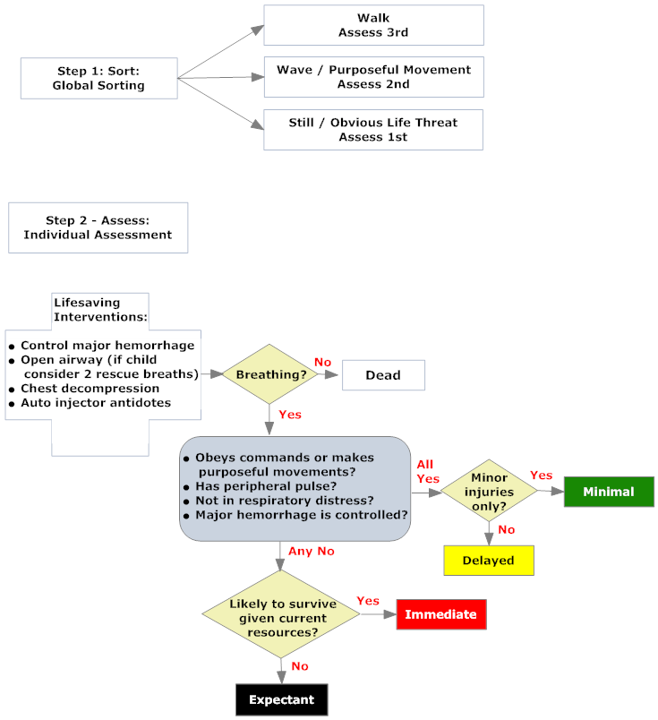
Mass casualty triage- SALT

Slide 25
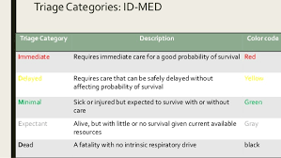
Triage Categories: ID-MED

Slide 26
Recording victim data
■ Centers for Disease Control and Prevention (CDC) created a Mass Trauma Data Instrument to record data about victims of disasters
■ The categories on the data sheet includes demographics, circumstances of the injury, injury conditions, and disposition and details of the conditions.
■ The completion of this form will be initiated by the triage nurse and completed by the nurse who implements the treatment or transfers.

Slide 27
The role of the nurse in disaster relief
1. Prepare selves, families, friends, and communities for disasters in conjunction with the local disaster preparedness plan.
2. Continue educating self on various types of disasters and appropriate response
3. Provide emergency services with consideration of victims’ abilities, deficits, culture, language, or special needs
4. Assist in the mobilization of healthcare personnel, food, water, shelter, medication, clothing, and other assistive devices

Slide 28
Cont..
5. Collaborate with the agencies in authority to deploy resources based on the greatest good for the greatest number
6. Consider needs of victims including shelter both temporary and permanent, as well as psychologic, economic, legal, and spiritual factors
7. Become involved with the national disaster planning agencies to schedule regular meetings to continually review and modify disaster plans

Slide 29
Summary
Disaster = Needs > Resources
There are two types of disasters; natural and man-made
Disaster preparedness consists of planning and practice, resilience, and education and training
Disaster management consists of detection, incident management, safety and security, assess hazards, support, triage and treatment, evacuation, and recovery.
Salt triage: Sort, Assess, Lifesaving interventions, and Treatment and transport
5 triage categories; ID-MED
Recording victims data starts by the triage nurse and completed by the nurse who implements the treatment or transfers.

Slide 30
Thank you

