Slide 1
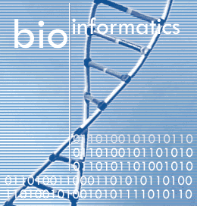

Topic Number Twelve
A Brief Introduction to Bioinformatics

Slide 2
What is Bioinformatics?
Bioinformatics or computational biology involves the use of computer science to solve biological problems using DNA and amino acid sequences

Slide 3
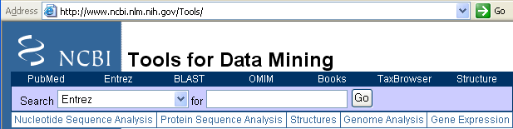

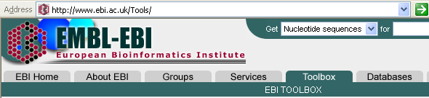
Bioinformatics Resources
Core
http://www.ncbi.nlm.nih.gov/Tools/
National Center for Biotechnology Information
http://www.ebi.ac.uk/Tools/

Slide 4
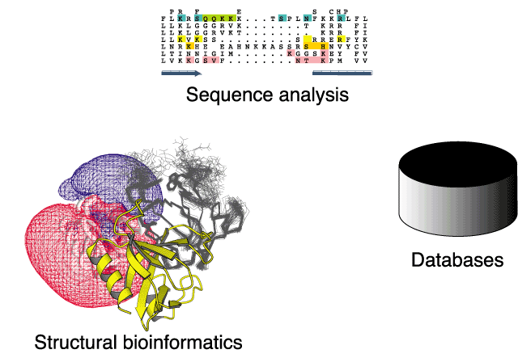
Bioinformatics key areas

Slide 5
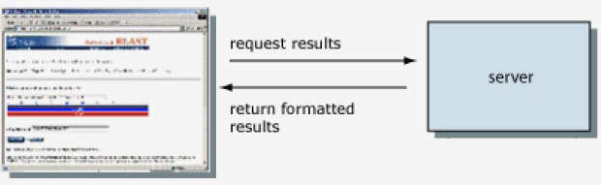

Slide 6
FASTA format
FASTA means FAST Alignment
Digital sequences accepted by software
Starts with greater than “>”
Should be no longer than 120 characters
Notepad or Fench TV
> Sequence name
AGAATCCAAGCATACTCAGTCCAAGATTCTAAAAGATTGGCCAAATGGCAGCAGCAGCAGCAGCTTCTACTTCCATGGCGGCTACTGCCGT

Slide 7
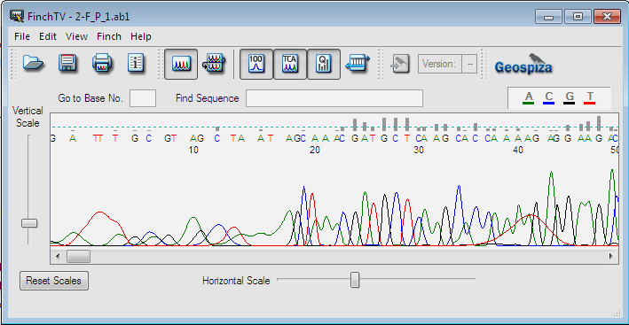
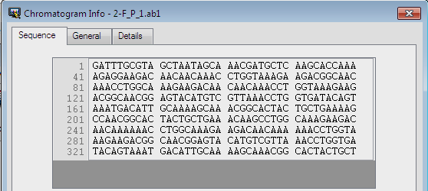
Drag the chromatogram file here

Slide 8
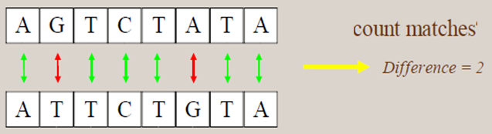
Sequence alignment
تسلسل المحاذاة
Basic Local Alignment Search Tool (BLAST) is the tool most frequently used for calculating sequence similarity

Slide 9
Two components are involved in a nucleotide sequence alignment:
Query sequences: the sequence which we are searching
The reference sequence: available in the Gene Bank.

Slide 10
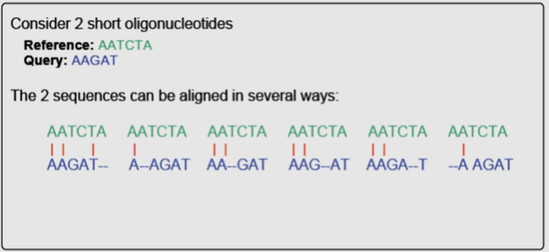
It appears that the first alignment achieved the highest final score of 3 matches, 2 mismatches, 1 gap, and 2 transversion mutations

Slide 11
How does BLAST work?
What Is An Alignment?
One way for calculating final score of the alignment is the dot matrix, where one sequence is written horizontally on the top and the other one vertically on the left
 | A | T | C | G
A | 20 | -10 | -5 | -5
T | -10 | 20 | -5 | -5
C | -5 | -5 | 20 | -10
G | -5 | -5 | -10 | 20
Transitions – purine to purine or pyrmidine to pyrmidine
Transversions – purine to pyrmidine or pyrmidine to purine
Transition
Transversion
Match

Slide 12
Scoring
How does BLAST work?
What Is An Alignment?
The final score of the alignment is the sum of the positive scores and penalty scores:
+ Number of Identities
+ Number of Similarities
- Number of Gap insertions
- Number of Gap extensions
Alignment score
Scoring Matrix
Gap penalties

Slide 13
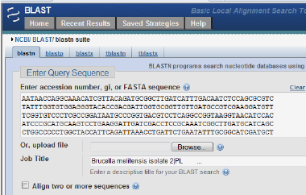
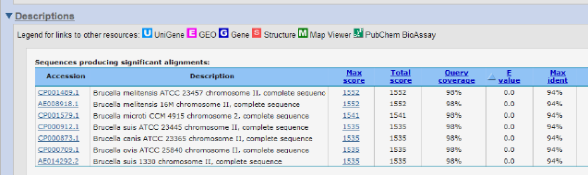
Performing Blast search at NCBI Home page

Slide 14
Classes of Alignments
1. Pair wise Alignment: Only two sequences are compared.
2. Multiple Alignment : More than two sequences are compared
Used to study phylogenetic relationship i.e., to find evolutionarily related organisms
(علاقة النشوء والتطور)

Slide 15

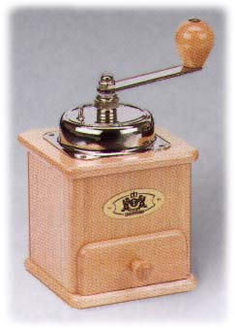
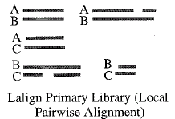
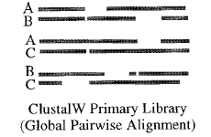
Mixing Local and Global Alignments
Local Alignment
Global Alignment
Extension
Multiple Sequence Alignment

Slide 16
Applications of Bioinformatics
Detecting all manner of mutations associated with genetic disease – from insertions, to deletions, to point mutations.
Diagnosis of infectious diseases.
Forensic science and can also be used to determine a child's paternity (paternity test).

Slide 17

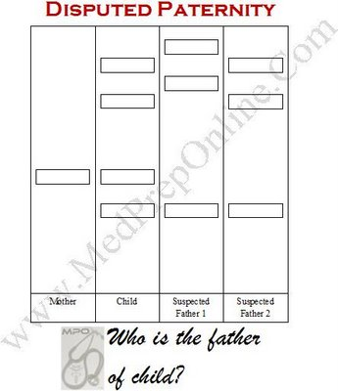
اختبار الأبوة
1. Buccal swab technique
2. DNA extraction
3. PCR technique
4. Restriction fragment length polymorphism
5. Suspected Father 2 is the biological father of child

