Slide 1
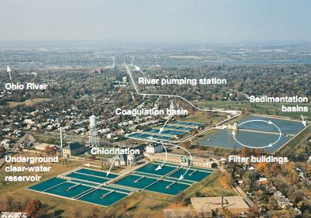

Topic Number Ten
Wastewater treatment and water purification

Slide 2
Coliforms and Water Quality
Coliforms are useful indicators of water contamination because many of them inhabit the intestinal tract of humans and other animals in large numbers.
Thus, the presence of coliforms in water may indicate fecal contamination.
Coliforms are deﬁned as facultatively aerobic, gram-negative, non-spore-forming, rod-shaped bacteria that ferment lactose with gas formation within 48 hours at 358C.
Many coliforms are members of the enteric bacteria group. The coliform group includes a subgroup of thermotolerant bacteria known as fecal coliforms and includes the usually harmless Enterobacter; Escherichia coli, a common intestinal organism and occasional pathogen; and Klebsiella pneumoniae

Slide 3
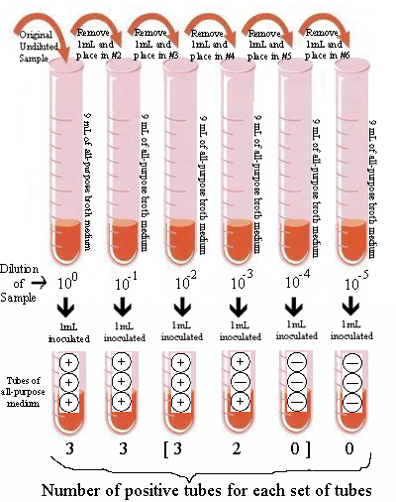
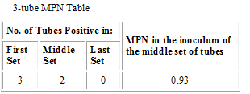
Testing for Fecal Coliforms
The most-probable-number (MPN) procedure
More than one broth tube can be inoculated from each dilution. Standard MPN procedures use a minimum of 3 dilutions
Locate the three sets of tubes which show dilution of the organisms "to extinction" [10⁻², 10⁻³ and 10⁻⁴ ]
A 3-digit number is produced based on the number of positive tubes per set
Using the 3-tube MPN table Look until you see the combination (3, 2, 0) and you will see that it suggest an average of 0.93 organisms from the middle set of test tubes.
The most probable number of organisms per one mL of the original, undiluted sample would be 0.93 × 103 or 9.3 × 102.

Slide 4
You inoculated 10 ml of waste water into 90 ml of sterile normal saline; this is the "first dilution" as shown in the table below. After thorough mixing, 1 ml of this dilution was added to 99 ml of sterile diluent, and a third dilution was made the same way. From each of these dilutions, tubes of Glucose Fermentation Broth were inoculated with amounts as shown in the table below. The tubes were incubated and checked for acid production, and the data are summarized below.
Dilution of waste water | 1st dilution (= 10^{–1}) |  | 2nd dilution (= 10^{–3}) |  | 3rd dilution (= 10^{–5})
Volume inoculated into each of three tubes of Glucose Fermentation Broth | 1 ml | 0.1 ml | 1 ml | 0.1 ml | 1 ml | 0.1 ml
set of tubes | A | B | C | D | E | F
No. of tubes showing acid production | 3 | 3 | 3 | 1 | 0 | 0
What was the most probable number of glucose-fermenters per ml of the original sample of water? Here is one way of finding the solution:
Dilution to extinction is the sets C, D and E. 3-1-0 represents the number of positive tubes.
From the MPN table, 3-1-0 indicates that an average of 0.43 organism in the middle set D
Therefore the most-probable number of glucose-fermenting organisms per ml of the original, undiluted sample was 4.3 X 103

Slide 5
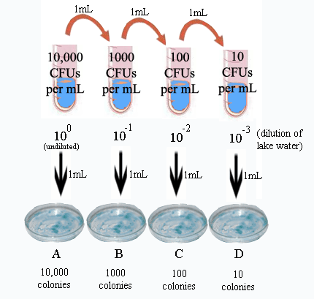
Dilution Plating
Determins the concentration of colony-forming units (CFUs) in our sample
Countable are those plates containing between 30 and 300 colonies.
If fewer than 30, we run into greater statistical inaccuracy. If greater than 300, the colonies would be tedious to count and also would tend to run together.

Slide 6
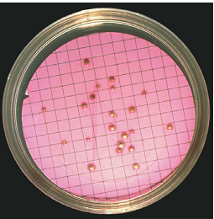
Membrane ﬁlter (MF) procedure
For the MF procedure, at least 100 ml of the water sample is passed through a sterile membrane ﬁlter, trapping any bacteria on the ﬁlter surface.
The ﬁlter is placed on a plate of eosin–methylene blue (EMB) culture medium, which is selective for gram-negative, lactose fermenting microorganisms, including the coliforms.
Following incubation, coliform colonies are counted, and from this value the number of coliforms in the original water sample can be calculated

Slide 7
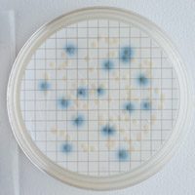
Total coliforms and Escherichia coli
MI Agar is a chromogenic/fluorogenic medium used to detect and enumerate Escherichia coli and total coliforms in drinking water by the membrane filtration technique.
Under UV light, E. coli colony appears dark blue. The other coliforms produce ﬂuorescent colonies
MI agar is named for the two enzyme substrates that are included in its formulation:
MUG (4-Methylumbelliferyl-β-D-galactopyranoside)
All coliforms, including E. coli, metabolize 4-methylumbelliferyl-β-D-galactopyranoside (MUG) using the enzyme β-galactosidase. If coliforms are present in a sample, MUG is metabolized to produce a ﬂuorescent product visible under ultraviolet (UV) light.
indoxyl β-D-glucuronide (IBDG)
E. coli, but not other coliforms, produces the enzyme β-glucuronidase, which metabolizes (IBDG) to a blue compound.

Slide 8
Wastewater and Sewage Treatment
Wastewater treatment can use physical, chemical, and biological (microbiological) processes to remove or neutralize contaminants.
Domestic wastewater is made up of sewage (the water resulting from washing, bathing, and cooking), and wastewater from small-scale food processing in homes and restaurants.
Industrial wastewater includes liquid discharged from the petrochemical, food and dairy and pesticide
Pretreatment may involve mechanical processes in which large debris is removed. Some wastewaters are pretreated biologically or chemically to remove highly toxic substances such as cyanide; heavy metals such as arsenic, lead, and mercury; or organic materials such as acrylamide, atrazine (a herbicide), and benzene. These

Slide 9
Wastewater Treatment and
Biochemical Oxygen Demand
The goal of a wastewater treatment facility is to reduce organic and inorganic materials in wastewater to a level that no longer supports microbial growth and to eliminate other potentially toxic materials.
The efficiency of treatment is expressed in terms of a reduction in the biochemical oxygen demand (BOD), the relative amount of dissolved oxygen consumed by microorganisms
The BOD of wastewater ranges from approximately 200 to 1500 BOD units.
An efficient wastewater treatment facility reduces BOD levels to less than 5 BOD units

Slide 10
Wastewater treatment processes
Treatment is a multistep operation employing a number of independent physical and biological processes. These are: Primary, secondary, and sometimes tertiary treatments

Slide 11
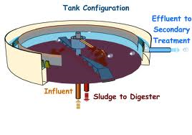
Primary treatment
Primary treatment uses physical separation methods to separate solid and particulate organic and inorganic materials from wastewater.
In the primary sedimentation stage, sewage flows through large tanks, commonly called "primary clarifiers" or "primary sedimentation tanks". The tanks are large enough that sludge can settle and floating material such as grease and oils can rise to the surface and be skimmed off.

Slide 12
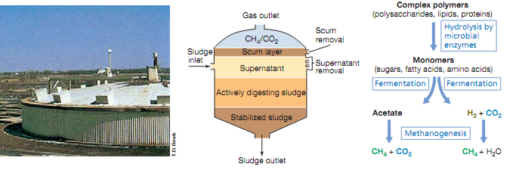
Secondary anaerobic treatment
Treat wastewater containing large quantities of
insoluble organic matter (high BOD) such as ﬁber and cellulose waste from food and dairy plants.
The anaerobic degradation process is carried out in large, enclosed tanks called sludge digesters or bioreactors
Anaerobic sludge digester
Microbial processes in anaerobic sludge digestion
Inner workings of a sludge digester

Slide 13
Secondary aerobic treatment
Secondary treatment is designed to degrade the biological content of the sewage which are derived from human waste, food waste, soaps and detergent
Activated sludge methods are the most, it includes the activated sludge and an aeration tank.
During aeration and mixing, the bacteria form small clusters, or flocs. When the aeration stops, the mixture is transferred to a secondary clarifier where the flocs are allowed to settle out and the effluent is pumped to the anaerobic sludge
The sludge is then recycled back to the aeration tank, where the process is repeated
The trickling ﬁlter method is also commonly used for secondary aerobic treatment
A trickling ﬁlter is a bed of crushed rocks, about 2 m thick.
Wastewater is sprayed on top of the rocks and the organic material in the wastewater adsorbs to the rocks
Microorganisms grow on exposed rock surfaces to complete mineralization of organic matter to CO2, ammonia, nitrate, sulfate, and phosphate

Slide 14

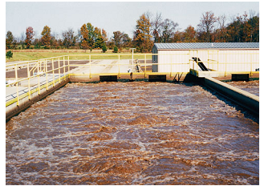
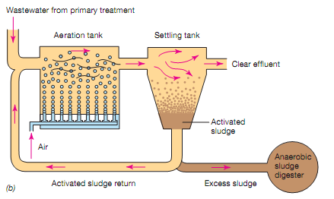
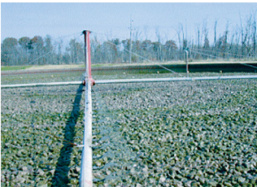
Aeration tank
Trickling ﬁlter method

Slide 15
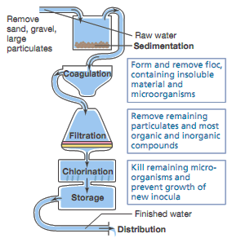
Tertiary Treatment
Tertiary treatment includes precipitation, ﬁltration, or chlorination procedures similar to those employed for drinking water puriﬁcation

Slide 16
Coagulation and Disinfection
Anionic polymers and alum (aluminum sulfate) are added to coagulation basin to form large, aggregated masses, a process called flocculation.
Chlorination is the most common method of primary disinfection.
In sufficient doses, chlorine kills most microorganisms within 30 minutes. A few pathogenic protists such as Cryptosporidium, however, are not easily killed by chlorine
Chlorine oxidizes and effectively neutralizes many taste- and odor-producing chemicals, chlorination improves water taste and smell.
Chlorine is added to water either from a concentrated solution of sodium hypochlorite or calcium hypochlorite, or as chlorine gas
When dissolved in water, chlorine gas is extremely volatile and disperses within hours from treated water (especially in pipes of the distribution system). To maintain adequate levels of chlorine (0.2–0.6 mg/liter) for primary disinfection, many municipal water treatment plants introduce ammonia gas with the chlorine to form the stable, nonvolatile chlorine-containing compound chloramine: HOCL + NH₃ → NH₂CL + H₂O

Slide 17
UV radiation is also used as an effective means of disinfection.
For disinfection, UV light is generated from mercury vapor lamps. Their major energy output is at 253.7 nm, a wavelength that is bacteriocidal and may also kill cysts and oocysts of protists such as Giardia and Cryptosporidium. Viruses, however, are more resistant.
UV radiation has several advantages over chemical disinfection procedures like chlorination.
First, UV irradiation is a physical process that introduces no chemicals into the water.
Second, UV radiation–generating equipment can be used in existing flow systems (pipe of the distribution system).
Third, no disinfection by-products are formed with UV disinfection. Especially in smaller systems where finished water is not pumped long distances or held for long periods (reducing the need for residual chlorine).

