Slide 1
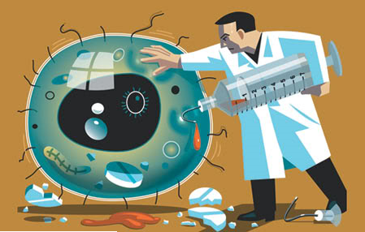
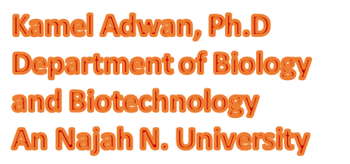
Toipc Number Nine
Antibiotics mode of action and mechanisms of resistance

Slide 2
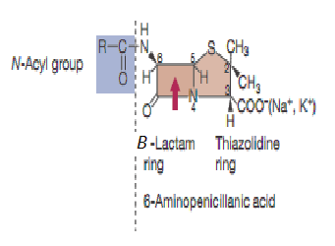
β-lactams
The β-lactam antibiotics include the penicillins, cephalosporins, carbapenems and monobactams.
All penicillins are composed of the 6-aminopenicillanic acid nucleus, plus a side chain side chain
The 6-aminopenicillanic consists of a beta-lactam ring and a thiazolidine ring
Natural penicillin is benzylpenicillin (penicillin G), which is composed of the 6-aminopenicillanic acid nucleus, plus a benzyl side chain
Penicillin G has some disadvantages including its narrow spectrum of activity and susceptibility to penicillinases

Slide 3
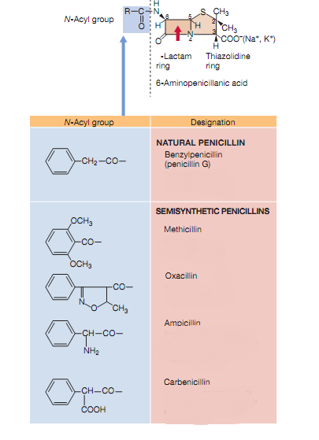
Semisynthetic penicillins
Semisynthetic penicillins such as methicillin, oxacillin, ampicillin and carbenicillin have been chemically altered with side chains
This increases their spectrum and makes them useful in treating many types of gram-negative infections.

Slide 4
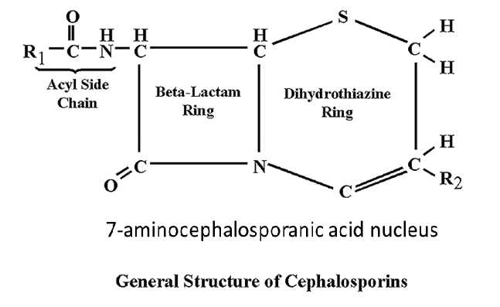
Cephalosporins
Cephalosporins are β-lactam drugs that act in the same manner as penicillins; i.e., they inhibit the cross-linking of peptidoglycan.
The structures, however, are different: The cephalosporins have a six-membered dihydrothiazine ring adjacent to the β-lactam ring (7-aminocephalosporanic acid nucleus), whereas penicillins have a five-membered ring adjacent to the β-lactam ring (6-aminopenicillanic acid nucleus

Slide 5
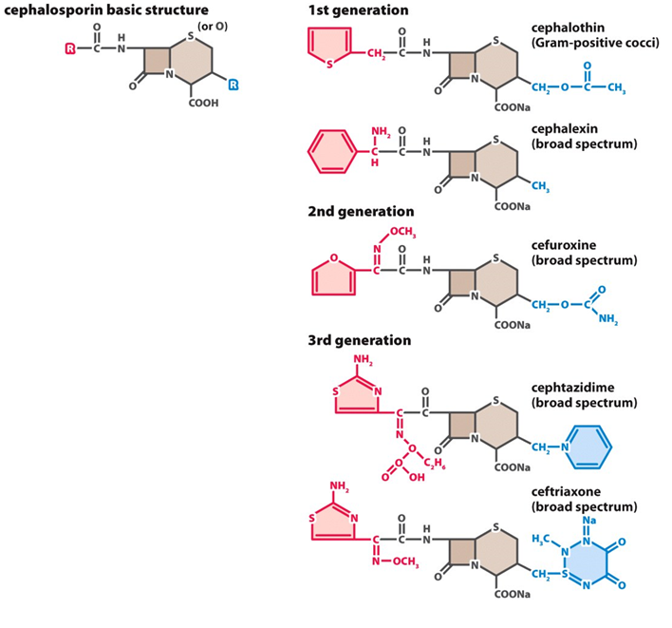
Cephalosporins (generations)
1st gen: cephalothin
2nd gen (cephamycins): cefoxitin, cefotetan
3rd gen: ceftazidime, cefotaxime, ceftriaxone
4th gen: cefepime

Slide 6
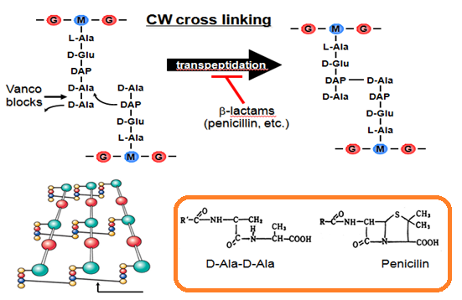
How do ß-lactam antibiotics work?
ß-lactam antibiotics efficiently block the normal transpeptidation process by inhibiting the bacterial transpeptidases, therefore these enzymes are often termed penicillin binding proteins or PBPs.
They are able to do this due to the stereochemical similarity of the ß-lactam moiety with the D-alanine–Dalanine substrate.
This results in weakly cross-linked peptidoglycan, which makes the growing bacteria highly susceptible to cell lysis and death.

Slide 7
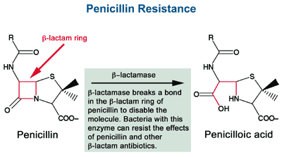
β-lactamase resistance
Many bacteria produce enzymes that are capable of destroying the beta-lactam ring of penicillin. these enzymes are referred to as penicillinases or beta-lactamases, and they make the bacteria that possess them resistant to many penicillins.
Clavulanic acid is a chemical that inhibits beta-lactamase enzymes, thereby increasing the longevity of beta-lactam antibiotics in the presence of penicillinase-producing bacteria.
Clavamox is a combination of amoxicillin and clavulanate and is marketed under the trade name Augmentin.
Zosyn, a similar combination of the beta-lactamase inhibitor tazobactam and piperacillin,

Slide 8
Evolution of β-lactamase
The first plasmid-mediated β-lactamase in gram-negative bacteria was discovered in Greece in the 1960s. It was named TEM after the patient from whom it was isolated (Temoniera)
Subsequently, a closely related enzyme was discovered and named TEM-2. It was identical in biochemical properties to TEM-1 but differed by a single amino acid with a resulting change in the isoelectric point of the enzyme.
TEM-1 and TEM-2 hydrolyze penicillins and narrow spectrum cephalosporins, such as cephalothin. However, they are not effective against higher generation cephalosporins with an oxyimino side chain, such as cefotaxime, ceftazidime, ceftriaxone, or cefepime.
A related but less common enzyme was termed SHV, because sulfhydryl reagents had a variable effect on substrate specificity.

Slide 9
Classification of betalactamases
>470 β-lactamases known to date
There have been a number of schemes for the classification of beta lactamases. The most often used scheme
Ambler classification [Molecular classification]
Groups β-lactamases into four major classes (A to D) based on genotypic relationships. Class A, C, and D enzymes which utilize serine for β-lactam hydrolysis and class B metalloenzymes which require divalent zinc ions for substrate hydrolysis.
Bush-Jacoby-Medeiros (BJM) classification [Functional classification scheme]
Classifies β-lactamases according to their substrate and inhibitor
Major groupings generally correlate with the more broadly based molecular classification. The updated system includes:
Group 1 (class C) cephalosporinases
Group 2 (classes A and D) broad-spectrum, inhibitor-resistant, and extended-spectrum β-lactamases and serine carbapenemases
Group 3 metallo-β-lactamases. Several new subgroups of each of the major groups are described, based on substrate and inhibitor profiles, and molecular sequence

Slide 10
Extended-spectrum β-lactamases
Extended-spectrum ß-Lactamases (ESBLs) are extremely broad spectrum ß-Lactamase enzymes found in a variety of Enterobacteriaceae.
The ESBLs are mutant forms of TEM-1, TEM-2 and SHV-1 enzymes. The ESBLs often differ from the original enzymes by only one to a few changes in their amino acid sequences.
ESBLs are enzymes that mediate resistance to extended-spectrum (third generation) cephalosporins (e.g., ceftazidime, cefotaxime, and ceftriaxone) and monobactams (e.g., aztreonam) but do not affect cephamycins (e.g., cefoxitin and cefotetan) or carbapenems (e.g., meropenem or imipenem).
ESBLs are generally encoded by plasmid-borne genes, characteristically hydrolyse oximino-cephalosporins (e.g. ceftriaxone), are inhibited by clavulanic acid and sulbactam, and lack activity against cephamycins (cefoxitin) and carbapenems
The majority of ESBLs (SHV and TEM derivatives) contain a serine at the active site, and belong to Ambler's molecular class A (Bush’s group 2be).
The OXA type ESBLs (Amber class D, Bush’s group 2d) have more commonly been identified in P. aeruginosa and are another growing family of ESBLs. There are several recent

Slide 11
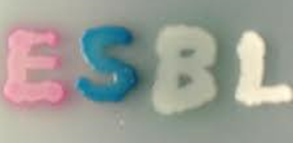
laboratory methods for the detection of ESBL
1. Broth microdilution and disk diffusion screening tests using selected antimicrobial agents
2. CHROMagar™ ESBL
E.coli ESBL produces dark pink to reddish colonies
Sensitive Gram negative strains are inhibited
Klebsiella, Enterobacter, Citrobacter produce metallic blue
Proteus produces brown halo colonies
Disk diffusion | MICs
cefpodoxime < 22 mm | cefpodoxime > 2 µg/ml
ceftazidime < 22 mm | ceftazidime > 2 µg/ml
aztreonam < 27 mm | aztreonam > 2 µg/ml
cefotaxime < 27 mm | cefotaxime > 2 µg/ml
ceftriaxone < 25 mm | ceftriaxone > 2 µg/ml

Slide 12
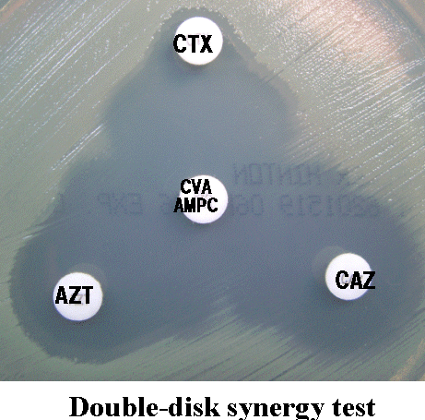
3. Double-disk synergy test(DDST)
This method uses multiple target disc with clavulanic acid disc; or a single cefpodoxime disc with clavulanic acid discs.
Disc containing the standard ceftazidime (30ug), ceftriaxone (30mg), aztreonam (30mg) or cefpodoxime (10mg) are placed 15mm to 20mm (edge to edge) from an amoxicillin-clavulanic acid disc.
Plates are then incubated overnight at 35oC. Enhancement of zone of inhibition (keyhole shape-zone) is indicative of presence of an ESBL
4. Amplification of ESBL genes

Slide 13
Important clinical and therapeutic implications of of ESBL-producing isolates
Resistance determinants for ESBL production are carried on plasmids that can be easily spread from organism to organism.
The spread of resistance toward extended-spectrum cephalosporins may lead to increased prescription of more broad-spectrum and expensive drugs.
These resistant isolates may escape detection with routine susceptibility testing performed by a clinical microbiology laboratory, which can result in adverse therapeutic outcomes

Slide 14
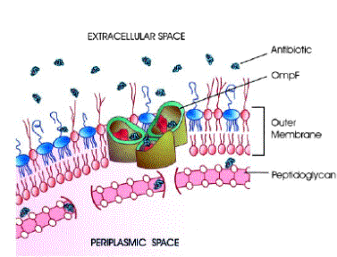
Permeability-based resistance
The outer membrane functions as an impenetrable barrier for some antibiotics. Some small hydrophilic antibiotics, however, diffuse through aqueous channels in the outer membrane that are formed by proteins called porins.
Deficiency in the expression of the general diffusion porin OmpF (Outer membrane protein F) leads to resistance.
Further, production of porins exhibiting narrow channels (decreased pore radius) have been shown to inhibit antibiotic uptake.

Slide 15
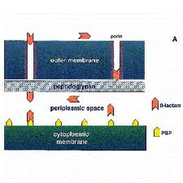
PBPs modifications
Point mutations altering an amino acid in PBPs 1A, 2B, and 2X play an important role in the development of resistance to ß-lactam antibiotics by S. pneumoniae
The acquisition of foreign PBP resistant to β-lactam antibiotics; for example, the acquisition of PBP2a by methicillin-resistant Staphylococcus aureus confers resistance to β-lactam antibiotics
Overexpression of a PBP. When PBP5 is overexpressed, it is responsible for both natural insensitivity and acquired intrinsic resistance to penicillin in enterococci

Slide 16
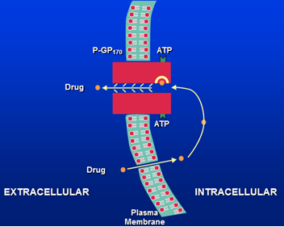
Multidrug Efflux Pumps
Efflux pumps (transport proteins) are found in both gram positive and gram negative bacteria and play a major role in antibiotic resistance
This resistance is further increased when the expression levels of these efflux pumps are elevated due to either genetic alteration or physiological regulation.
Multidrug transporters in bacteria are generally classified into five families on the basis of sequence similarity
The Major Facilitator Superfamily (MFS)
The Resistance-Nodulation-Cell Division (RND) family
The Small Multidrug Resistance (SMR) family
The Multidrug and Toxic compound Extrusion (MATE) family
The ATP-Binding Cassette (ABC) family

Slide 17
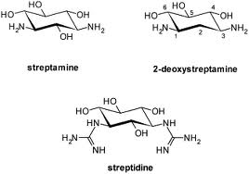
Aminoglycoside structure
Aminoglycosides have a hexose ring (either streptidine, in streptomycin or 2-deoxystreptamine) to which various amino sugars are attached via glycoside linkages
Most of the clinically useful aminoglycosides are 4,6-disubstituted 2-deoxystreptamines (gentamicin, tobramycin, amikacin and netilmicin) whilst paramomycin, ribostamycin and neomycin are 4,5-disubstituted.
Spectinomycin, although often considered an aminoglycoside, does not contain an amino sugar

Slide 18
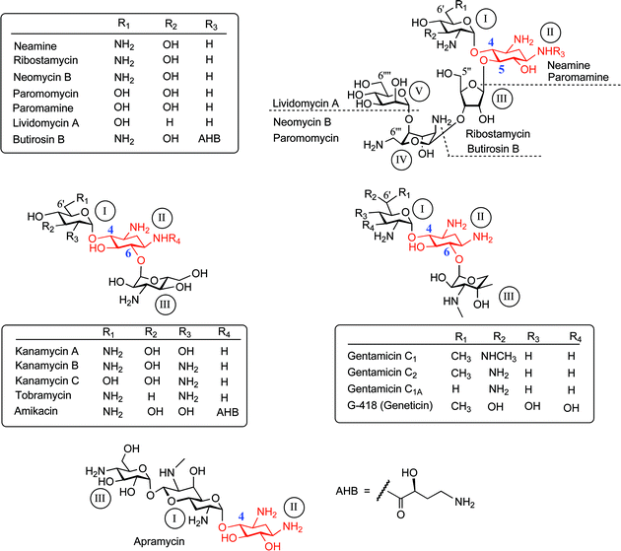

Slide 19
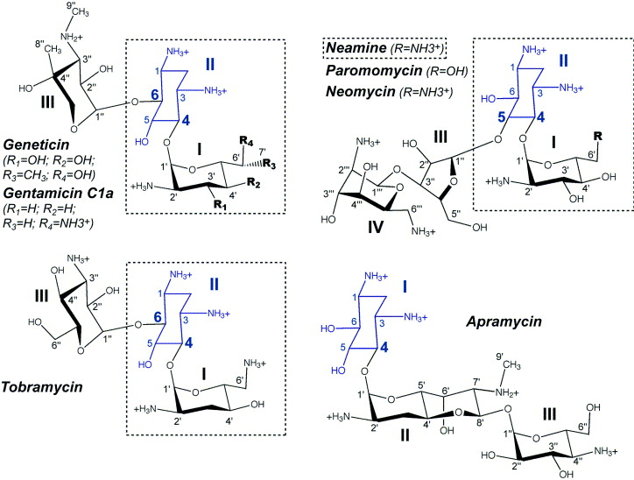
Representative structural formulae of the 4,6 and 4,5-disubstituted 2-
deoxystreptamine-containing aminoglycosides

Slide 20
Mechanism of activity
Cell entry
Aminoglycosides are basic, strongly polar, positively-charged cationic compounds, able to bind to negatively charged residues (such as lipopolysaccharides and phospholipids) in the outer membrane of Gram-negative bacilli. In Gram-positive bacteria, phospholipids and teichoic acids are used as the initial binding sites.
In a passive, non-energy dependent process, aminoglycosides diffuse through the outer membrane by a process called “self-promoted uptake” and enter the periplasmic space.
The next phase of transport across the cytoplasmic membrane (so called “energy dependent phase I”; EDP-I), varies in duration and rate, depending on the external concentration of aminoglycosides.
It is thought to depend on the electron transport machinery of the cell and is inhibited by divalent cations, high osmotic pressure, low pH, and by anaerobiosis.

Slide 21
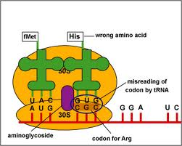
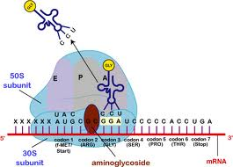
Mechanism of Action of Aminoglycosides
Aminoglycosides inhibit bacterial growth via 2 pathways:
The irreversible binding of the aminoglycosides to the 30S subunit of the ribosome causes the misreading of the codons along the mRNA. This misreading of the codons causes an error in the proofreading process of translation leading to improper protein translation and bacterial cell death
The irreversible binding of the aminoglycosides to the 30S subunit of the ribosome inhibits the translocation of the tRNA from the A-site of the ribosome to the P-site of the ribosome. As a result of which the protein can’t be synthesized.

Slide 22
Mechanisms of resistance
1. Intrinsic resistance
Some bacteria possess natural (intrinsic) resistances. An example of natural resistance is the inability of aminoglycosides to penetrate the cell wall of streptococci and enterococci in sufficient concentration to be toxic, due to poor transport across the cytoplasmic membrane.
2. Ribosome alteration
Methylation of the bases involved in the binding of the aminoglycosides to 16S rRNA by acquisition of a plasmid carrying the genetic determinants has been described in Enterobacteriaceae and Pseudomonas.These enzymes confer high level resistance to almost all clinically important 4,6-disubstituted 2-deoxystreptamine aminoglycosides (e.g. amikacin, tobramycin, and gentamicin)
High level resistance to streptomycin and spectinomycin can result from single step mutations in chromosomal genes encoding ribosomal proteins: rpsL (or strA), rpsD (or ramA or sud2), rpsE (eps or spc or spcA). Mutations in strC (or strB) generate a low-level streptomycin resistance.

Slide 23
Conti
3. Decreased permeability
Absence of or alteration in the aminoglycoside transport system, inadequate membrane potential, modification in the LPS (lipopolysacchaccarides) phenotype can result in a cross resistance to all aminoglycosides.
4. Inactivation of aminoglycosides
AME`s are the most important mechanism of resistance to aminoglycoside antibiotics. The
enzymes inactivate aminoglycosides by transferring a functional group to the minoglycoside structure. This makes the aminoglycoside unable to interact with the ribosome effectively. There are 3 types of enzymes:
Aminoglycoside nucleotidyltransferases (ANT`s) transfer a nucleotide triphosphate moiety to a hydroxyl group
Aminoglycoside acetyltransferases (AAC`s) transfer the acetylgroup from acetyl-CoA to an amino group
Aminoglycoside phosphotransferases (APH`s) transfer the phosphoryl group from ATP to a hydroxyl group

Slide 24
Aminoglycoside modifying enzymes (AME)

Slide 25
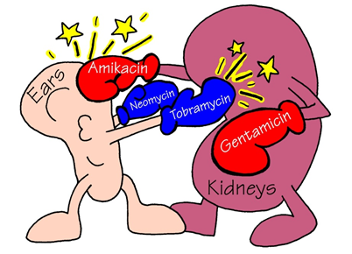
Toxicity of aminoglycoside antibiotics
1. Nephrotoxicity
More polycationic like gentamicin and neomycin, enter proximal tubular cells by pinocytosis. Inhibit lysosomal enzymes and the vesicles accumulate as cytosegresomes.
Excessive numbers of these apparently kill the cells, producing severe toxicity
2. Ototoxicity
Progressively damage the sensory cells of the cochlea and vestibular apparatus
Killed sensory cells do not regenerate
Loss of hearing, vertigo, ataxia, and loss of balance
3. Neuromuscular paralysis
Inhibit Ca++ into nerve on depolarization
required for exocytotic ACh release
Weakness and respiratory paralysis

