Slide 1
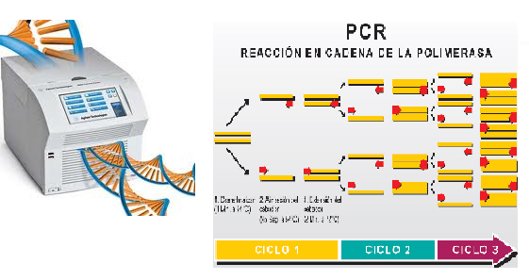

Topic Number Five
Molecular techniques in clinical microbiology

Slide 2
The application of molecular technology in microbiology
Classification of organism based on genetic relatedness (genotyping)
Detection of pathogens in clinical specimen
Rapid detection of antibiotic resistance
Detection of mutations
Differentiation of toxigenic from non-toxigenic strains
Detection of microorganisms that grow slowly or present in extremely small numbers in clinical specimen
Apart from their role in microbiology, these techniques can also be used in identifying abnormalities in human and forensic medicine.

Slide 3
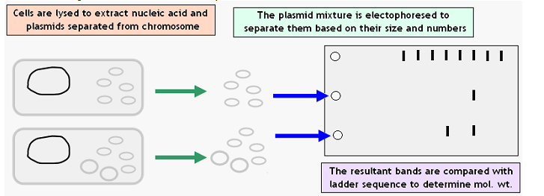
1. Plasmid profiling
Plasmid profile analysis involves study of size and number of plasmids.
Plasmid profiling may not provide useful information Why?
1. Some species may contain variable number of plasmids or even unrelated bacteria may
harbour similar number of plasmids.
2. Plasmids are not stable

Slide 4
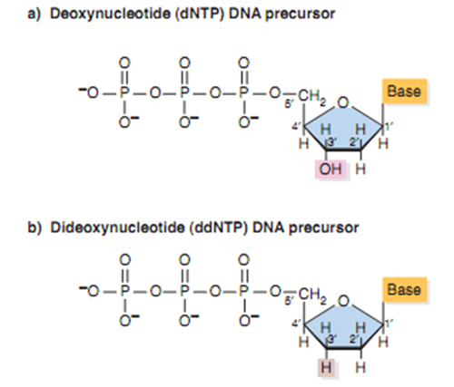
2. Nucleotide sequencing
DNA sequencing is a method used for determining the order of the nucleotide bases in a molecule of DNA
Two methods for sequencing DNA; The chain termination method or dideoxy sequencing [Fred Sanger in 1970s] and the chemical degradation method [Maxam and Gilbert in 1977s]
Chain termination method
Incorporation of a dideoxynucleotide stops further DNA synthesis because no 3 hydroxyl group is available for addition of the next nucleotide

Slide 5
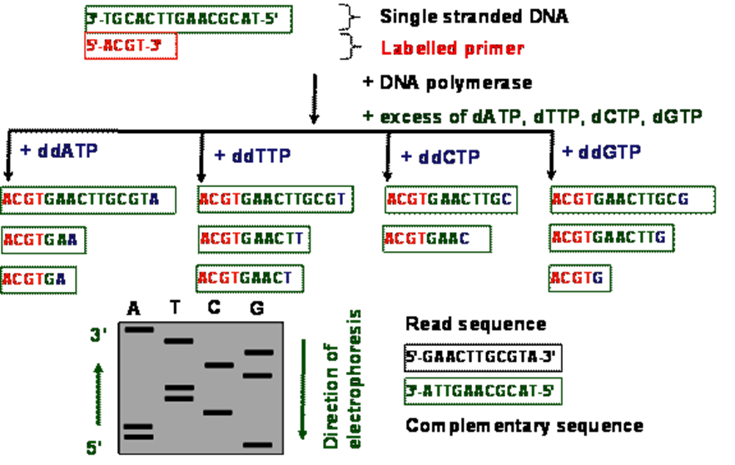
Cont

Slide 6
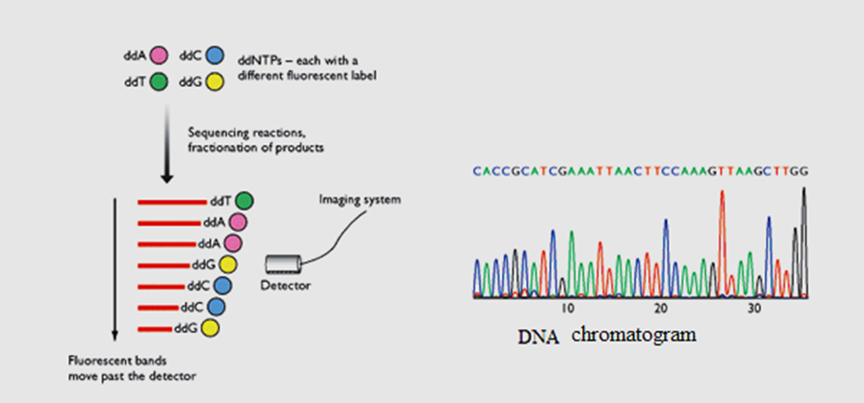
Conti
The chain termination reactions are carried out in a single tube, with each dideoxynucleotide labeled with a different fluorescent label.
The sequence is represented by a series of peaks called DNA chromatogram

Slide 7
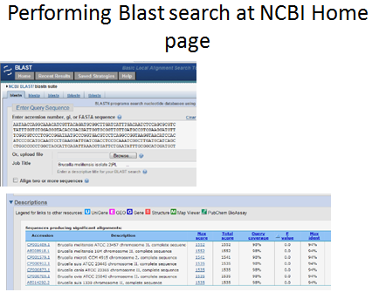
Databases of sequence information
GenBank (www.ncbi.nlm.nih.gov/Genbank),
2. EMBL (www.ebi.ac.uk/embl),
3. DDBJ (www.ddbj.nig.ac.jp).
Basic Local Alignment Search Tool (BLAST) analysis of the unknown sequence to known sequences contained within a large database (such as the National Center for Biological Information (NCBI), GenBank databases) can be done to determine similarity and species identification.

Slide 8
3. Restriction fragment length polymorphism (RFLP)
Polymorphism refers to the DNA sequence variation between individuals of a species. If the sequence variation occurs at the restriction sites, it could result in different DNA fragments in size (RFLP).
This technique is very useful in epidemiological studies and forensic medicine.
PCR-ribotyping, a typing method based on polymorphism in the 16s-23s intergenic spacer region
16s-23s rRNA are said to be most conserved sequence.

Slide 9
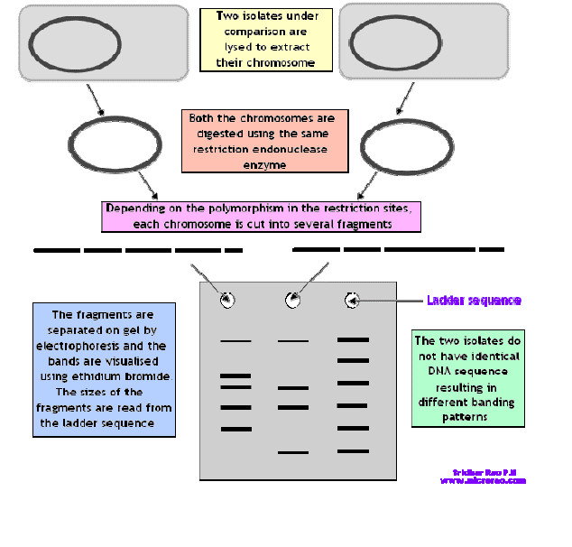
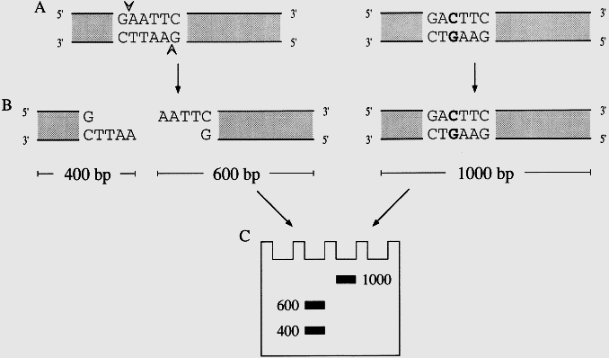

Slide 10
4. Nucleic Acid Hybridization
Denaturation of a DNA molecule can be done by exposing the DNA to high temperature, low salt or alteration in pH.
The process of denaturation or melting can be reversed by lowering the temperature, raising the salt concentration or removing the denaturation agent. This process is known as renaturation or annealing.
DNA hybridization can be used to study the genetic relatedness between the two organisms.
In DNA hybridization, labeled probes enable detection of microorganisms.
Oligonucleotide probes are preferred in in-situ hybridization because their compact size allows them to penetrate the tissue better than larger probes.
However, shorter probes have some limitations too; shorter result in background cross hybridization and false positive hybridization results
The common radioactive isotopes used for labeling include P32, S35,I125.
The labeled probes can be detected by scintillation counter or on X-ray autoradiography.

Slide 11
Cont
The non-radioactive labels include biotin, digoxygenin and acridinium ester.
Biotin is a small molecule that is a part of vitamin B and binds specifically to avidin (a protein found in egg white). Biotinylated probes are used to hybridize with the target and such probes are detected using avidin tagged enzymes.
Addition of substrate results in production of coloured product.
Other methods include use of fluorescein conjugated avidin or fluorescein conjugated antibody to biotin molecule.
Hybridization is observed for fluorescence using UV light. Digoxygenin labeled probes are detected by enzyme labeled anti-digoxygenin antibody and then using substrate to detect it.

Slide 13
Hybridization Stringency
Stringency - a term used in hybridization experiments to denote the degree of homology between the probe and the filter bound nucleic acid; the higher the stringency, the higher percent homology between the probe and filter bound nucleic acid
The temperature, salt concentration and sequence homology forms the conditions of stringency for hybridization.
Stringency increases as the salt concentration decreases and temperature increases.

Slide 14
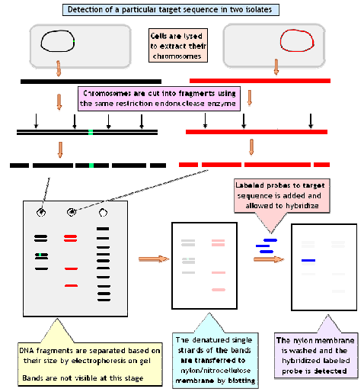
Solid phase hybridization-
Southern blot hybridization
This technique is named after its inventor Edwin Southern, a British biologist.
Northern blot hybridization
This is similar to the southern blot in all aspects except that the target nucleic acid is single
stranded RNA.

Slide 15
In situ hybridization
In DNA hybridization methods and due nucleic acid extraction, the histopathological architecture is lost.
In situ hybridization, it is possible to perform molecular hybridization without damaging the histopathological structure of the specimen
In in-situ hybridization the microscopy glass slide acts as the solid phase.
The stages of in situ hybridization are
Deparaffinization of tissue section, protease digestion to expose nucleic acid targets, denatuaration of DNA at high temperature, application of probe, hybridization at physiological temperature, washing and detection of signals.
Radio-labeled probes and biotinylated probes are commonly used.
This technique is useful in detecting intracellular parasites such as viruses.
Since the probe has to reach the target inside the cells, only probes that are small (~300 bases) can be used for tissue penetration.

Slide 16
5. Amplification techniques
Signal Amplification
This technique is used to increase the sensitivity of the probe based assays.
The simplest signal amplification technique utilizes multiple reporter molecules attached to a single probe.

Slide 17
Polymerase chain reaction (PCR)
Developed by Kary Mullis in 1983, which can enzymatically amplify minute quantities of DNA or RNA to large number of copies.
PCR reaction mixture consists of target DNA, primer pairs, thermostable DNA polymerase, deoxynucleotides (dATP, dTTP, dGTP & dCTP), PCR buffer
Primers are short, single stranded oligonucleotide DNA that are 20-30 nucleotides that are chemically synthesized
In order to overcome the problem of adding the polymerase enzyme after each cycle as they are destroyed at high temperatures, thermostable polymerase enzymes such as Taq is used. Taq DNA polymerase enzyme is obtained from Thermus aquaticus,
PCR is an exponential amplification system. The general formula for the number of DNA strands created by PCR is 2^{n} where n = the # of PCR cycles
After certain number of PCR cycles, PCR attains plateau phase. The plateau phase of PCR indicates that almost same amount of amplified products will be obtained, regardless of the initial amount of the templates and the no of PCR cycles.

Slide 18
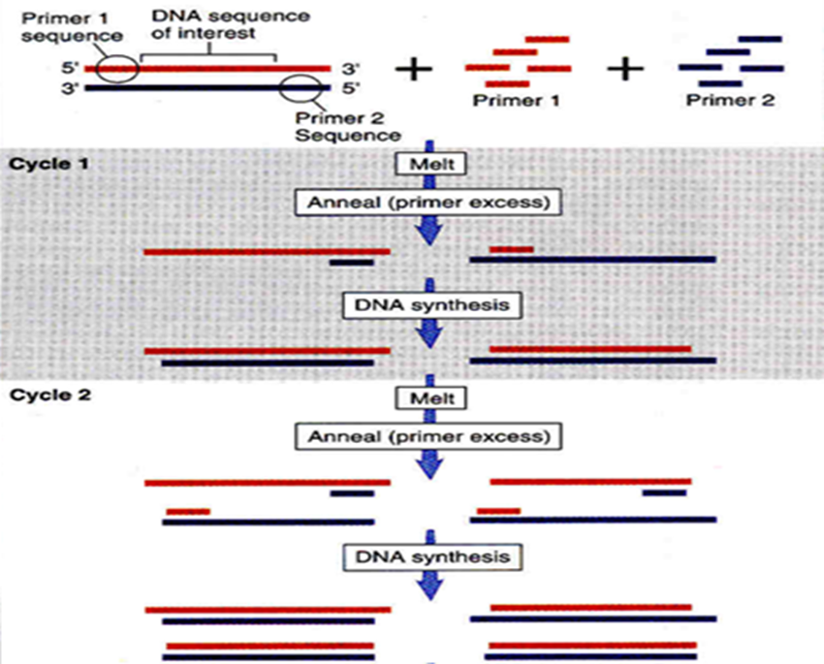
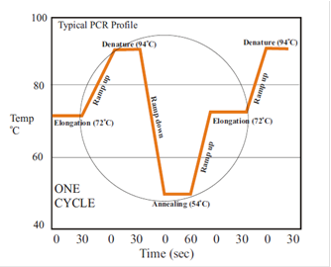
The PCR cycling reaction: three major steps

Slide 19
Factors affecting PCR
Concentration of Mg⁺²; since Tag polymerase is Mg⁺² dependent.
Concentration and source of Tag polymerase
Concentration and purity of both target DNA and primer, denaturing temperature, annealing temperature and time
Methods to improve sensitivity of PCR
Number of cycle
Dimethyl sulphoxide allows allows larger target DNA to be amplified more efficiently.
20% glycerol allows amplification of up to 2500 bases.
PCR specificity can be improved by “Hot start” method. If all the reaction mixtures are added at the same time and slowly heated at the start of PCR, the thermostable polymerase may extend any non-specific primer –template complex before denaturation can begin. This problem can be overcome by adding the polymerase after all the components have reached 70°C.

Slide 20
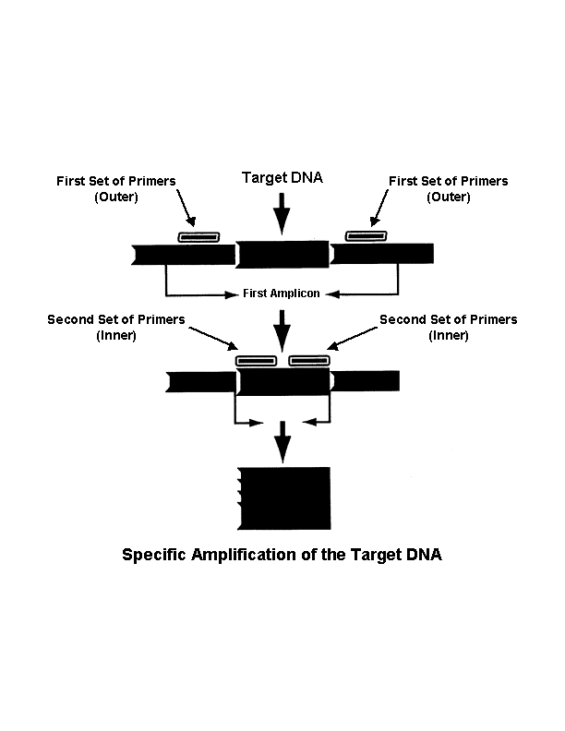
Types of PCR
1. Nested PCR uses two sets of amplification primers. The target DNA sequence of one set of primers (termed "inner" primers) is located within the target sequence of the second set of primers (termed "outer" primers).
2. Multiplex PCR is a technique in which several PCR-products are amplified in one PCR-reaction
3. Reverse transcription polymerase chain reaction (RT-PCR) an RNA strand is first reverse transcribed into its DNA complement (complementary DNA, or cDNA) using the enzyme reverse transcriptase, and the resulting cDNA is amplified using traditional or real-time PCR.

Slide 21
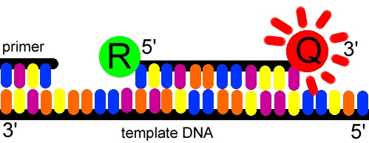
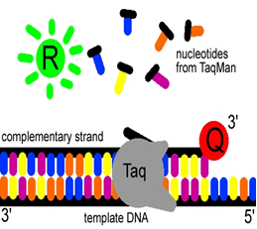
Cont
4. Real-time PCR
TaqMan® real-time PCR
In TaqMan® real-time PCR, the probe consists of two types of fluorophores, the quencher (Q) (usually a long-wavelength colored dye, such as red) at the 3’ end of the probe and reporter (R) (usually a short-wavelength colored dye, such as green) at the 5’ end of the probe .
Once the TaqMan® probe has bound to its specific piece of the template. Taq polymerase then adds nucleotides and removes the Taqman® probe from the template DNA.
This separates the quencher from the reporter, and allows the reporter to emits its energy. This is then quantified using a computer.

Slide 22
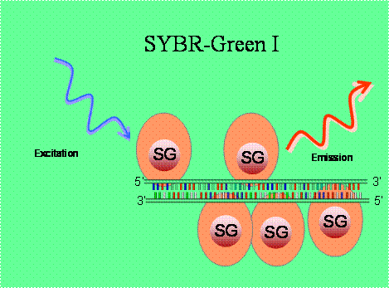
Cont
SYBR Green dye PCR
SYBR Green is a dye that binds the double stranded DNA.
When SYBR Green dye binds to double stranded DNA, the intensity of the fluorescent emissions increases.
As more double stranded amplicons are produced, SYBR Green dye signal will
increase.

Slide 23
PCR PCR calculation formula
How to change the conc. of a primer from nanomole to µM
Multiply the number of nanomoles listed on the label by 10. This product is the number of µL of water or buffer that needs to be added to the oligo to obtain a 100µM solution.
How to change the optical density reading of a primer to molarity
1 OD ssDNA = 37 µg/ml
OD X 37 µg/ml / MW of the primer
Preparation of Master Mix
Use the following formula : Initial concentration X Volume needed = Final concentration X Volume of sample

Slide 24
Solved Problems
Q1. How would you prepare 10 uM stock solution X primer from 10 nm of this primer.
Answer: Dissolve in 100 µL water and dilute 1:10
Q2. A 10-mer primer -10 OD units/ml . Calculate the concentration in uM. Suppose that 1 OD ssDNA = 33 µg/ml
Answer =10X33 = 330 µg/ml = 330mg/L = 0.333 g/L
= 0.33/10X330= 0.0001M = 100 uM
Q3. If you have 0.5 mM primers and Taq DNA polymerase at 5 Units/µl. You are making a 100 µl PCR mixture that will be 1.0 µM and 0.5 Units/100µl of the primers and Taq DNA polymerase, respectively. Calculate the volumes needed from both reagents.
Primer = 0.2 µl, Tag= 0.1 µl
Q4. How many DNA molecules will have been produced from a molecule of DNA after 4 complete PCR cycles?
Answer =16

Slide 25
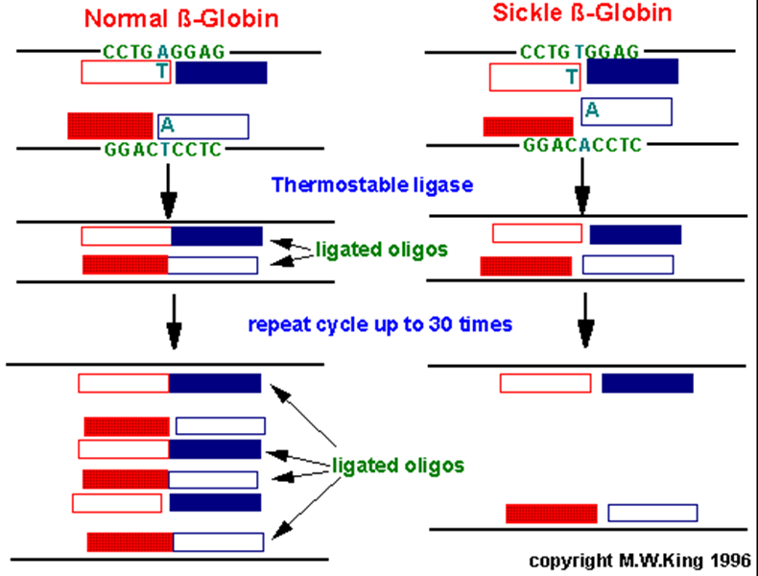
Ligase Chain Reaction (LCR)
Detection of single point mutations in disease genes
Two oligos are used per each DNA strand and are ligated together to form a single oligo by DNA ligase.
In the example shown below for the sickle-cell mutation, the 3' nucleotide of one oligo in each pair is mismatched. This mismatch prevent the annealing of the oligos directly adjacent to each other.
With the wild-type sequence the oligo pairs that are ligated together become targets for annealing the oligos and, therefore, result in an exponential amplification of the wild-type target.

Slide 26
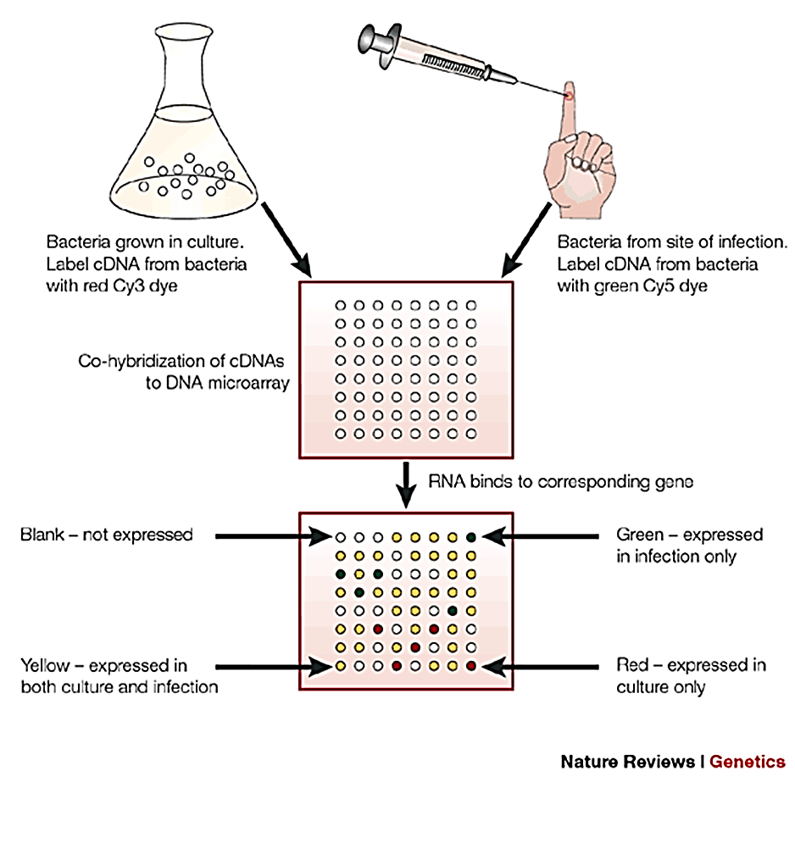
DNA Microarrays
Consist of molecules of immobilized single-stranded DNA on DNA microarrays
Fluorescently labeled DNA washed over array will adhere only at locations where there are complementary DNA sequences
DNA microarrays applications
Monitoring of gene expression
Diagnosis of infection
Identification of organisms in an environmental sample

