Slide 1
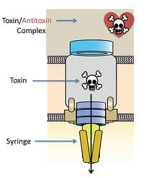

Topic number four: Molecular mechanisms of Escherichia coli pathogenicity

Slide 2
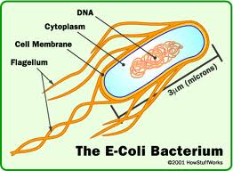
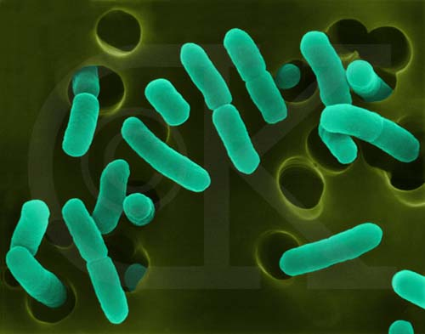
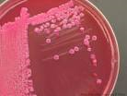
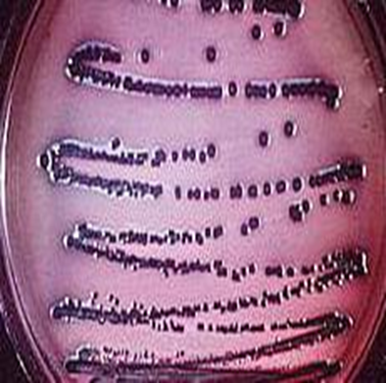
Escherichia coli
part of the normal intestinal microflora in humans and warm-blooded animals
Gram negative, rods, motile, produce peritrichous flagella
Violet colonies on EMB agar
Red colonies on MacConkey agar
Facultative anaerobes
Typically oxidase-negative
On TSI most strains ferment lactose and glucose with the production of acid and gas A/A + G
IMViC reaction : + + - -

Slide 3
Cont
Over 700 antigenic types (serotypes) are recognized based on O, H, and K antigens.
1. Lipopolysaccharide LPS
(heat-stable somatic antigens ) [O] antigens
2. Flagellar antigens [H]antigens
3. Capsular antigens [K] antigens

Slide 4
Pathogenic E. coli
Pathogenic forms of E. coli can cause a variety of diarrhoeal diseases in hosts due to the presence of specific colonisation factors, virulence factors and pathogenicity associated genes which are generally not present in other E. coli.
In the first part of this lecture, I will discuss the toxin secretion systems in both Gram-Negative and Gram-Positive bacteria. Then I will go through some E. coli pathotypes causing diarrhoeal disease

Slide 5
Toxin secretion in Gram-Positive Bacteria
secretion systems used by pathogenic bacteria are essential for their virulence
There are three main systems involved in the transport of proteins in Gram positive bacteria:
1. ATP-binding cassette (ABC)
2. The Sec (general secretory pathway, or GSP),
3. Tat (twin-arginine translocation) pathways

Slide 6
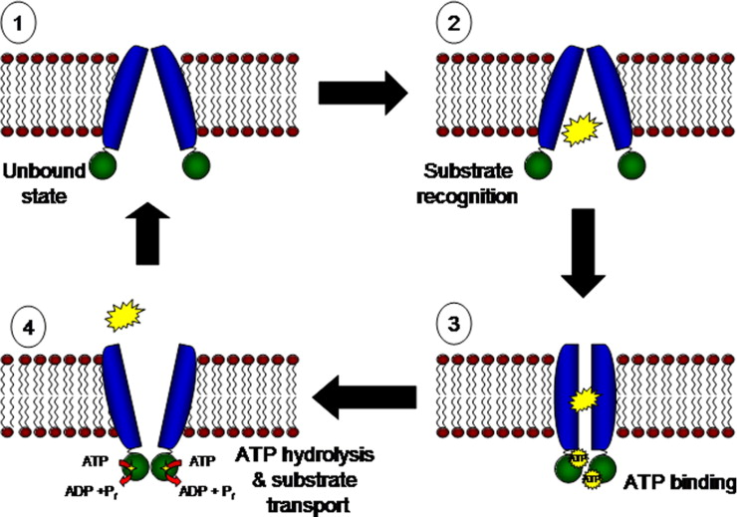
ATP-binding cassette (ABC)
ATP-binding cassette (ABC) transporters couple ATP hydrolysis to the uptake and efflux of solutes across the cell membrane in bacteria
In ABC, the unbound (1) ABC protein recognizes the substrate (2) and then binds ATP (3). Binding of ATP promotes conformational changes that leads to substrate entry. This process is followed by subsequent transport of the substrate into the transmembrane channel (4)
Schematic shows the proposed
ABC mechanism

Slide 7
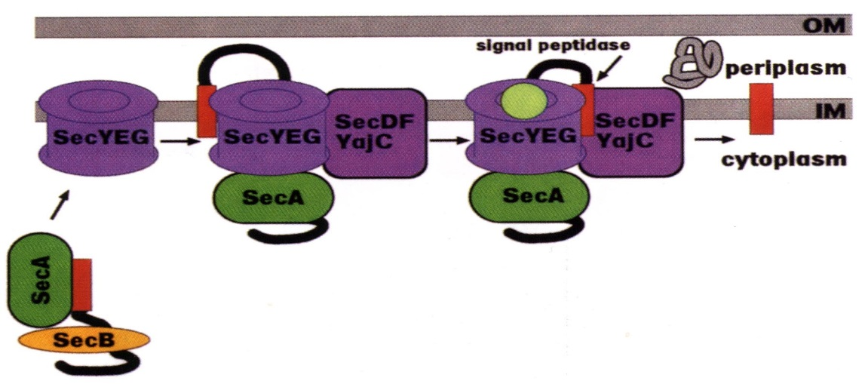
Sec (general secretory pathway or GSP)
The preprotein is targeted to the cytoplasmic membrane surface with the assistance of the export chaperone SecB.
SecA, an ATPase, drives the preprotein chain across the membrane through the SecYEG channel, using the energy of ATP hydrolysis.
Once the preprotein is translocated across the membrane, the signal peptide is cleaved off by the Type I signal peptidase

Slide 8
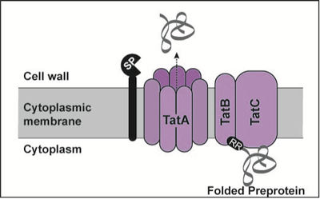
Twin-arginine translocation (Tat) pathway
The Tat pathway is responsible for the export of folded proteins across the cytoplasmic membrane of bacteria
Prior to export, Tat exported proteins are folded and they contain an N-terminal signal sequence (black oval) with a twin arginine (RR) motif.
This folded preproprotein is recognized by the TatB and TatC complex and then delivered to TatA.
An oligomeric complex of TatA is believed to form the channel through which the protein translocates across the membrane.
Following export, the signal sequence is removed by signal peptidase (SP).

Slide 9
Toxin secretion in Gram-Negative Bacteria
For Gram –, the secreted protein must be transported across the IM; escape protein-degrading enzymes in the periplasmic space; and finally across the OM
5 quite different mechanisms identified to date
Sec-independent: Secreted proteins get directly from cytoplasm to outside without entering the periplasm. It includes Type I and Type III
Sec-dependent: Proteins secreted first to periplasm by GSP (Sec) and then through the OM. It includes Type II, Type IV and Type V

Slide 10
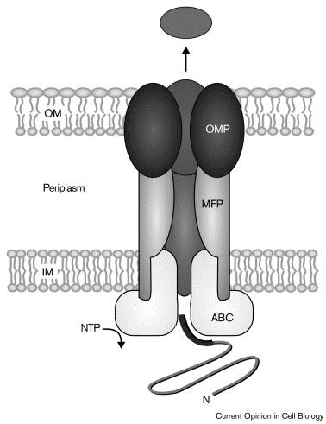
Gram-negative - Type I secretion (ABC secretion)
Type I is a continuous channel that spans both bacterial membranes, which consists of only three protein subunits: the ABC protein, membrane fusion protein (MFP), and outer membrane protein (OMP)
Type I do not posses an amino terminal signal sequence recognized by the Sec system, instead they possess a carboxy-terminal signal sequence that is not cleaved.
This allows secretion to the toxin without a periplasmic intermediate.
Type I secreted proteins: E. coli hemolysin, bacteriocins, metalloproteases

Slide 11
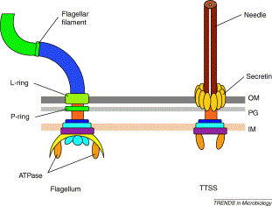
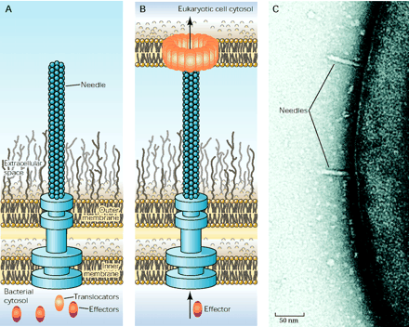
Type III secretion system(T3SS)- Nanoinjector
Host-cell contact induced secretion process
Type III secretion system (T3SS) serves as a syringe with a needle and is used to inject virulence proteins into a target cell
Bacterial proteins are encoded by effector genes on a pathogenicity island (chromosomal or plasmid)
No Sec-dependent signal sequence
Evolutionary relationship with flagella

Slide 12
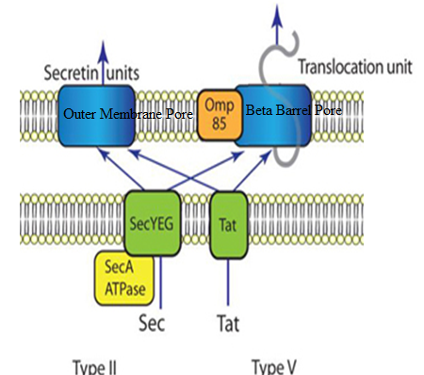
Type II secretion system (T2SS)
Type II depends on the Sec or Tat system for initial transport of toxins into the periplasm
Once there, they pass through the outer membrane via outer membrane pores
Secrete cholera toxin

Slide 13
Type IV secretion system (T4SS)
It is homologous to conjugation machinery of bacteria.
It is capable of transporting both DNA and proteins.
It was discovered in Agrobacterium tumefaciens, which uses this system to introduce the T-DNA portion of the Ti plasmid into the plant host, which in turn causes the affected area to develop into a crown gall (tumor). Helicobacter pylori uses a type IV secretion system to deliver CagA into gastric epithelial cells, which is associated with gastric carcinogenesis.
Bordetella pertussis, the causative agent of whooping cough, secretes the pertussis toxin partly through the type IV system.
Legionella pneumophila, the causing agent of legionellosis (Legionnaires' disease)

Slide 14
Type V secretion system (T5SS)
Type 5- Also known as ‘autotransporter’ because once secreted from the inner membrane into the periplasm, the protein being transported forms its own beta-barrel in the outer membrane.
This structure allows it to pass through the outer membrane.

Slide 15
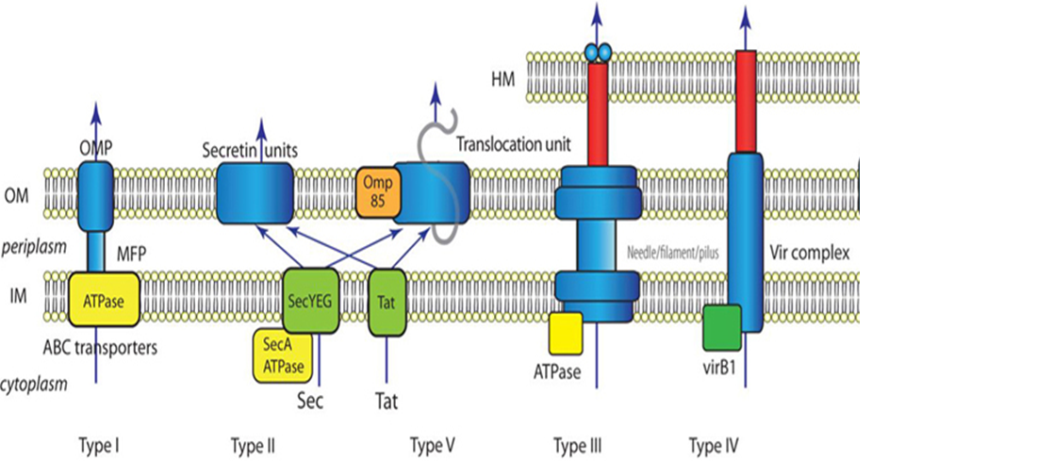
Summary of known bacterial secretion systems

Slide 17
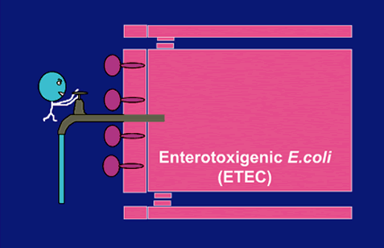
1. Enterotoxigenic E. coli (ETEC)
Produce secretory (watery) diarrhoea (“traveler’s diarrhea”) similar to that of Vibrio cholerae, but less severe
Like V. cholerae, ETEC
Do not invade, they adhere to epithelium of small intestine
produce enterotoxins that cause secretory diarrhea
Both adhesins and toxins encoded by plasmids, so they are easily transferred among different E. coli strains

Slide 18
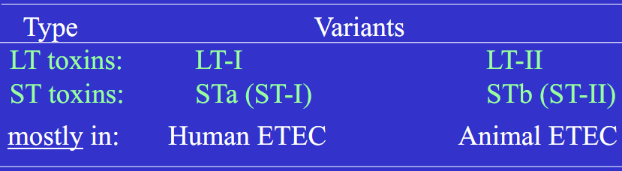
Enterotoxins produced by ETEC strains
Two different general types discovered by early ‘70s
Heat-labile enterotoxins (LT)
Heat-stable enterotoxins (ST)
Two variants of each type
ETEC strains may produce LT only (30%), ST only (35%), or both (35%)

Slide 19
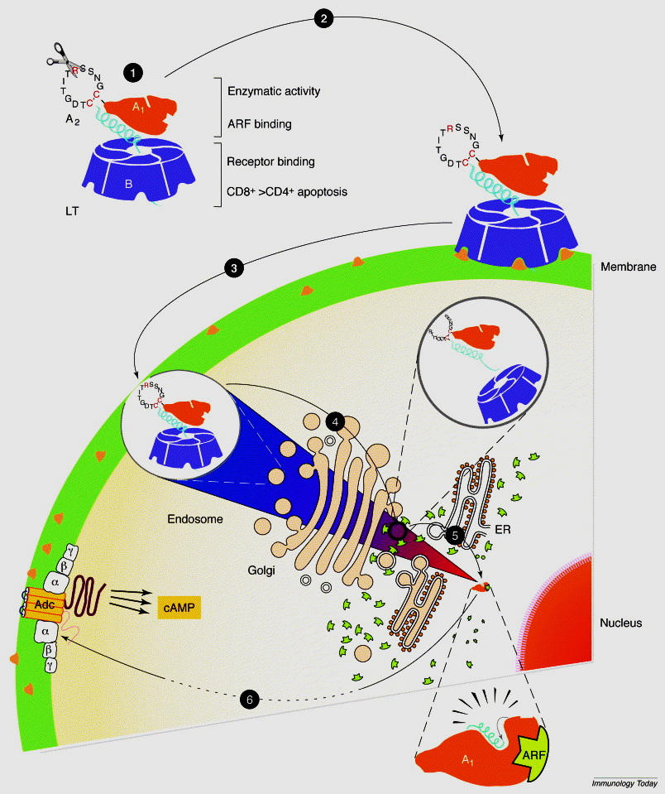
Modes of intracellular entrance of LT
1. Structural and functional features and the site of LT.
2. LT binds the receptor located on the plasma membrane of eukaryotic cells. 3. LT is internalized into vesicles. 4. The vesicles are transported to the Golgi apparatus where the holotoxin is disassembled.
5. The A subunit is transported from the Golgi to the endoplasmic reticulum (ER), the A or the A1 subunit is translocated from the ER to the cytosol, where it can interact with the soluble ADP-ribosylation factor (ARF).
6. The activated A1 migrates to the plasma membrane where the substrate Gs is located. The ADP-ribosylation of the α subunit of Gs induces permanent activation of adenylate cyclase and intracellular accumulation of cAMP.

Slide 20
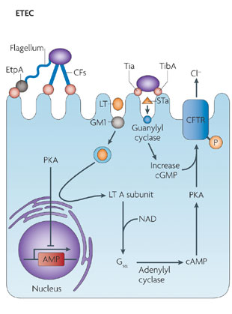
Heat-labile enterotoxin (LT) and heat-stable enterotoxin (ST)
- mechanism of action
Enterotoxigenic Escherichia coli (ETEC) becomes anchored to enterocytes of the small intestine through colonization factors (CFs) and an adhesin that is found at the tip of the flagella (EtpA).
Tighter adherence is mediated through Tia and TibA.
Two toxins, heat-labile enterotoxin (LT) and heat-stable enterotoxin (ST), are secreted and cause diarrhoea through cyclic AMP (cAMP)- and cyclic GMP (cGMP)-mediated activation of cystic fibrosis transmembrane conductance regulator (CFTR).

Slide 21
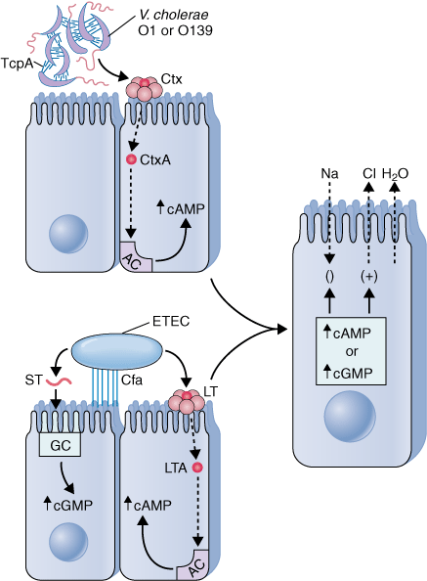
ETEC versus V. cholerae CT
ETEC becomes anchored to enterocytes of the small bowel through colonization factors (CFs) and an adhesin that is found at the tip of the flagella (EtpA).
A toxin coregulated pilus (Tcp) causes V. cholerae to adhere to one another and form microcolonies on the epithelial surface.
Once colonization has occurred, an active subunit of each (CtxA or LTA) is transported to the adenylate cyclase (AC) complex.
Two toxins, CT and LT cause diarrhoea through cyclic AMP (cAMP)- and cyclic GMP (cGMP)-mediated activation of cystic fibrosis transmembrane conductance regulator (CFTR).
Both cAMP and cGMP reduce sodium absorption in villus cells and increase chlorine secretion in crypt cells, leading to watery diarrhea.

Slide 22
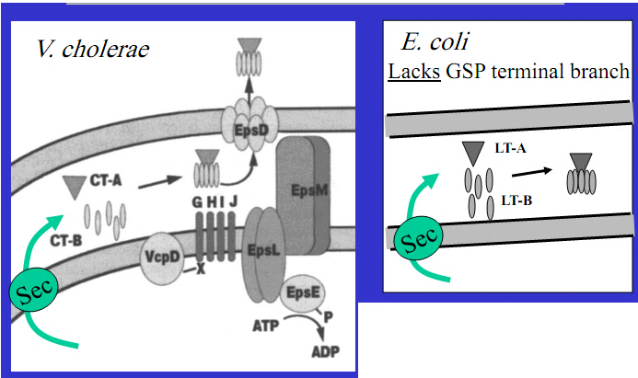
ETEC versus V. cholerae CT
LT & CTx very similar toxins - identical mechanisms, but Cholera usually more severe -Why ?
This is due to difference in the way the toxins are released
CTx actively secreted by the extracellular protein secretion apparatus
T remains in periplasm and small quantities ‘leak’ through the OM

Slide 23
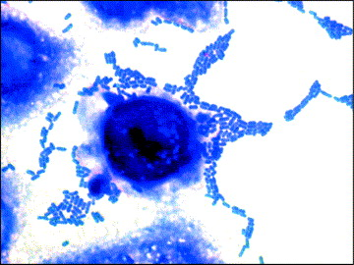
2. Enteroaggregrative E. coli (EAEC)
EAEC are characterized by their ability to adhere to particular laboratory-cultured cells in an aggregative or 'stacked brick ' pattern
They resemble ETEC strains in that the bacteria adhere to the intestinal mucosa and cause non-bloody diarrhea without invading or causing inflammation.

Slide 24
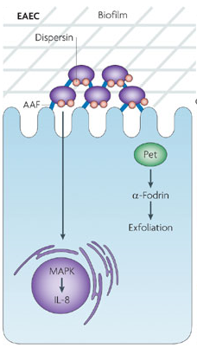
Putative virulence genes
Enteroagreggative E. coli (EAEC) attaches to enterocytes in both the small and large bowels through aggregative adherence fimbriae (AAF) that stimulate a strong mitogen-activated protein kinases and interleukin-8 (IL-8) response, allowing biofilms to form on the surface of cells.
Plasmid-encoded toxin (Pet) is a serine protease autotransporter of the Enterobacteriaceae (SPATE) that targets α-fodrin (also known as SPTAN1), which disrupts the actin cytoskeleton and induces exfoliation.

Slide 25
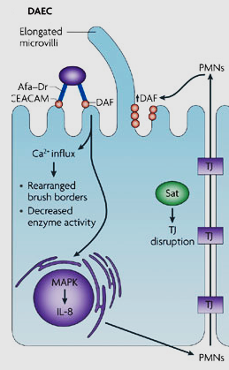
3. Diffusely adhering E. coli (DAEC)
DAEC forms a diffuse attaching pattern on enterocytes of the small bowel, which is mediated through afimbrial (Afa) and fimbrial adhesins, which are collectively known as Afa–Dr fimbriae
These bacteria adhere to human intestinal epithelial cells by recognizing the brush-border associated decay-accelerating factor (DAF)
The brush border attachment of Afa/Dr DAEC is followed by
1. Signaling involving MAPKs leads to IL-8 production and PMNL transmigration
2. Cytoskeleton rearrangements as a result of calcium influx
3. Production of autotransported toxin Sat that damages tight junctions (TJs), as well as enhances Polymorphonuclear leukocyte (PMN) infiltration that increases surface localization of DAF.

Slide 26
4. Enteropathogenic E. coli (EPEC)
EPEC strains are a leading cause of infantile diarrhea.
EPEC strains are said to be "moderately-invasive", meaning they are not as invasive as Shigella, and unlike ETEC or EAEC, they cause an inflammatory response.
EPEC and EHEC are attaching and effacing (A/E) pathogens that makes membranous protrusions, termed (A/E) pedestals beneath the attachment site.
Virulence factors are
A plasmid-encoded protein referred to as EPEC adherence factor (EAF) that enables localized adherence of bacteria to intestinal cells, and
A non fimbrial adhesin designated intimin, which is an outer membrane protein that mediates the final stages of adherence.

Slide 27
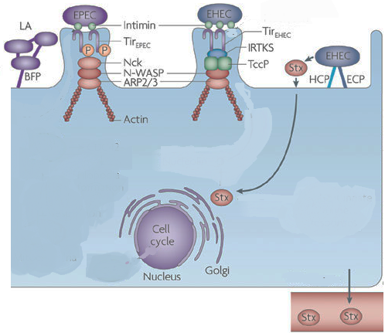
Pathogenesis of EPEC
EPEC attaches to the small bowel through the bundle-forming pilus (BFP), forming localized adhesions (LA).
Intimate attachment is mediated by the interaction between intimin and the translocated intimin receptor (Tir).
Tir is phosphorylated and phosphorylated Tir binds to adaptor protein Nck, which activates neural Wiskott–Aldrich syndrome protein (N-WASP) and the actin-related protein (ARP2/3) complex to mediate actin rearrangements and pedestal formation.

Slide 28
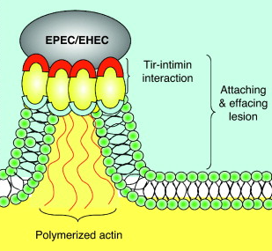
5. Enterohemorrhagic E. coli (EHEC)
EHEC are recognized as the primary cause of hemorrhagic colitis (HC) or bloody diarrhea and hemolytic uremic syndrome (HUS).
EHEC produce toxins very like S. dysenteriae Shiga-toxin –called ‘shiga-like’ toxin (SLT), Shiga toxin (Stx), or verocytotoxin (VT) and strains called Shiga toxin-producing E. coli (STEC) or verocytotoxin-producing E. coli (VTEC).
The Vero lineage was isolated from kidney epithelial cells extracted from an African green monkey
The original cell line was named "Vero" after an abbreviation of "Verda Reno", which means "green kidney" in esperanto

Slide 29
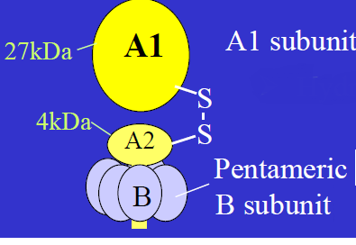
Virulent Factors of STEC
Shiga toxins (Stx)
STx-1 (=VT1)
Almost identical to S. dysenteriae ST (differ in only 1 a.a.)
STx-2 (=VT2)
55% sequence homology with Stx-1, but essentially same
basic structure & mechanism of action
STEC strains may contain either one, or both toxins
Shiga-toxin structure
A single catalytic 32-kDa which is proteolytically nicked to yield 28-kDa peptide (A1) and a 4-kDa peptide (A2).
The A1 peptide contains the enzymatic activity, and the A2 peptide serves to bind the A-subunit to a pentamer of five identical 7.7 kDa B-subunits.

Slide 30
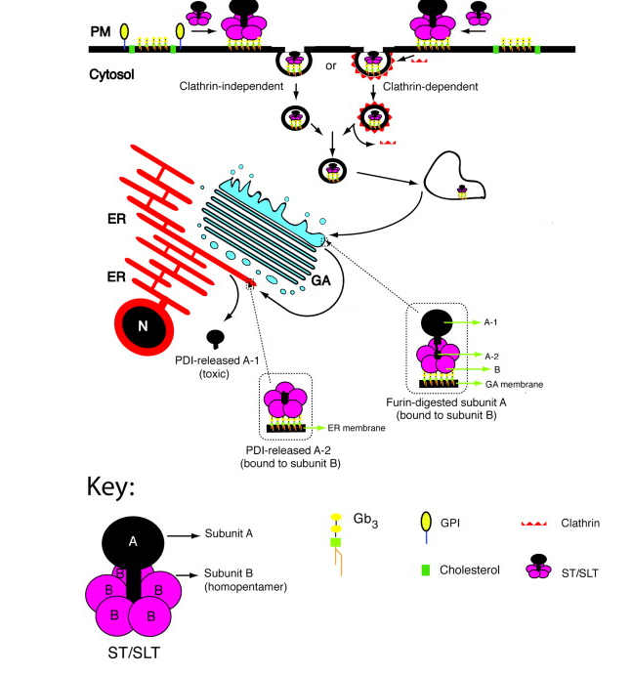
Modes of intracellular entrance of Shiga toxin
ST/SLT upon binding globotriaosylceramide (Gb3) can enter the cell by clathrin-dependent endocytosis or clathrin-independent mechanism.
ST/SLT initially accumulates in endosomes and from there it moves to the Golgi apparatus (GA).
In GA, ST/SLT subunit A is digested by the protease furin resulting in the cleavage of subunit A from B.

Slide 31
ST/SLT continues its journey to the ER, where the enzyme PDI releases fragment A-1 from the rest of the molecule. The A1 peptide has RNA N-glycosidase activity that removes a single adenine residue from the 28S rRNA (elongation factor 1) of eukaryotic ribosomes.
Thus, Inhibiting protein synthesis and leading to the death of intestinal epithelial cells
2. Intimin (Intestinal adherence factors).
Play a role in intestinal colonization.
Studies with eaeA-negative O157:H7 STEC mutants have shown that intimin is essential for the tight binding of bacteria to host cells and actin reorganization in vitro
Encoded by the eae gene.

Slide 32
Cont..
Enterohemolysin.
Distinct from that associated with the E. coli alpha-hemolysin (Hly)
Strains producing this enterohemolysin (subsequently designated EHEC-Hly) produce small, turbid hemolytic zones on washed sheep RBC agar (supplemented with Calcium)
Unlike alpha-hemolysin which is chromosomally encoded, EHEC-Hly was found to be encoded by plasmid" (pO157)
Enterohemolysin is found in nearly all O157:H7 strains
The role of enterohemolysin is still subject to speculation. Lysis of erythrocytes in vivo would release heme and hemoglobin, which enhance the growth of E. coli O157:H7 and could serve as a source of iron.

Slide 33
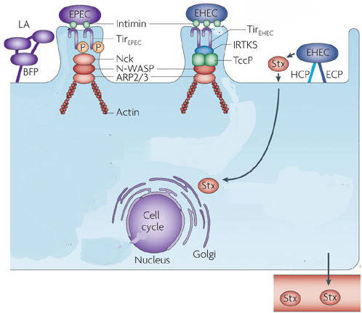
Pathogenesis of EPEC
The mechanism of pedestal formation by EHEC is slightly different from that used by EPEC.
Tir is not phosphorylated, and pedestal formation is Nck-independent.
Pedestal formation are mediated by Tir cytoskeleton-coupling protein (TccP) which is linked to Tir through insulin receptor tyrosine kinase substrate (IRTKS) and interacts with N-WASP to activate the actin-related protein ARP2/3.
In addition to this intimate attachment, EHEC attaches to the large bowel through the E. coli common pilus (ECP) and the haemorrhagic coli pilus (HCP).
In addition, Shiga toxin (Stx; also known as verocytotoxin) is released following phage-mediated lysis in response to stress, further contributing to disease.

Slide 34
6. Enteroinvasive E. coli (EIEC)
EIEC penetrate and multiply within epithelial cells of the colon causing widespread cell destruction.
The clinical syndrome is identical to Shigella dysentery and includes a dysentery-like diarrhea with fever.
They do not produce LT or ST toxin.
Unlike typical E. coli, EIEC are non-motile, do not decarboxylate lysine and do not ferment lactose, thus, resembling Shigella spp. by biochemical properties.
The invasion phenotype, encoded by a high molecular weight plasmid, can be detected by PCR and probes for specific for invasion genes.

Slide 35
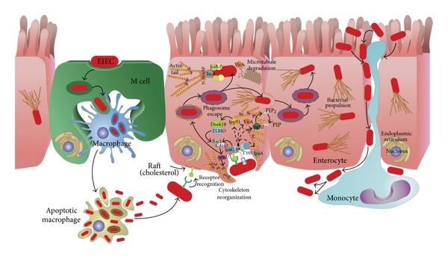
Model of pathogenesis induced by EIEC
EIEC invade the epithelium from the intestinal lumen through M-cells.
After reaching the epithelium they invade epithelial cells and are phagocytosed by resident macrophages.
EIEC escape the phagosome of both cells but while EIEC replicate within epithelial cells, they induce apoptosis in macrophages.
Bacteria are released and can invade the epithelial cells from the basolateral side, move into the cytoplasm by triggering actin polymerization, and spread to adjacent cells

Slide 36
The initial contact between EIEC and host cells takes place at lipid raft membrane domains
Genes necessary for invasiveness the colonic epithelium in humans are carried 140-MDa plasmid in EIEC
The invasion-related plasmid has been designated pInv
Prominent among these genes are the mxi and spa loci, which encode a so-called type III secretion apparatus
Type III secretion systems (T3SSs) are central virulence factors, used to inject protein effectors of virulence into eukaryotic host cells.
The Ipa proteins (IpaA to IpaD) are secreted proteins, of which Ipa acts onto host cells causing actin rearrangement and membrane ruffling resulting in bacterial internalization

Slide 37
Once inside a vacule in the cell, the IpaB protein degrades the vacule, releasing the bacteria into the cytosol
An outer-membrane protein called VirG (IcsA), are critical for trigerring actin polymerization by binding cytosol components such as N-WASP which propels the organism through the cell into neighboring cells
Expression of virulence genes is transcriptionally regulated by a chromosomal encoded VirR gene which is affected by temperature
Bacteria which are invasive at 37 C become non-invasive at 30 C

Slide 38
Preliminary identification of samples containing pathogenic E. coli

Slide 39
