Slide 2
Table of Contents
(10.1) Intermolecular forces
(10.2) The liquid state
(10.3) An introduction to structures and types of solids
(10.4) Structure and bonding in metals
(10.5) Carbon and silicon: Network atomic solids

Slide 3
Table of Contents Continued
(10.6) Molecular solids
(10.7) Ionic solids
(10.8) Vapor pressure and changes of state
(10.9) Phase diagrams

Slide 4
Figure 10.1 - Schematic Representations of the Three States of Matter

Slide 5
Intramolecular and Intermolecular Bonding
Intramolecular bonding - Occurs within molecules
Condensed states of matter - Liquids and solids
Forces involved
Covalent bonding
Ionic bonding
Intermolecular bonding: Occurs between molecules

Slide 6
Changes in States
When a substance changes from solid to liquid to gas, the molecules remain intact
Caused by the changes in the forces among the molecules and not within the molecules
When energy is added to ice, the motion of the molecules increases
Results in greater movement and disorder characteristic of liquid water

Slide 7
Changes in States (Continued)
When more energy is added to water, gaseous state is eventually reached
Intermolecular distance increases and intermolecular interaction decreases
More energy is required to overcome the covalent bonds and decompose the water molecules into their component atoms

Slide 8
Dipole–Dipole Forces
Forces that act between polar molecules
Dipole–dipole attraction: Electrostatic attraction between molecules with dipole moments
Molecules orient themselves in a way that the positive and negative ends are close to each other
In a condensed state, dipoles find the best compromise between attraction and repulsion

Slide 9
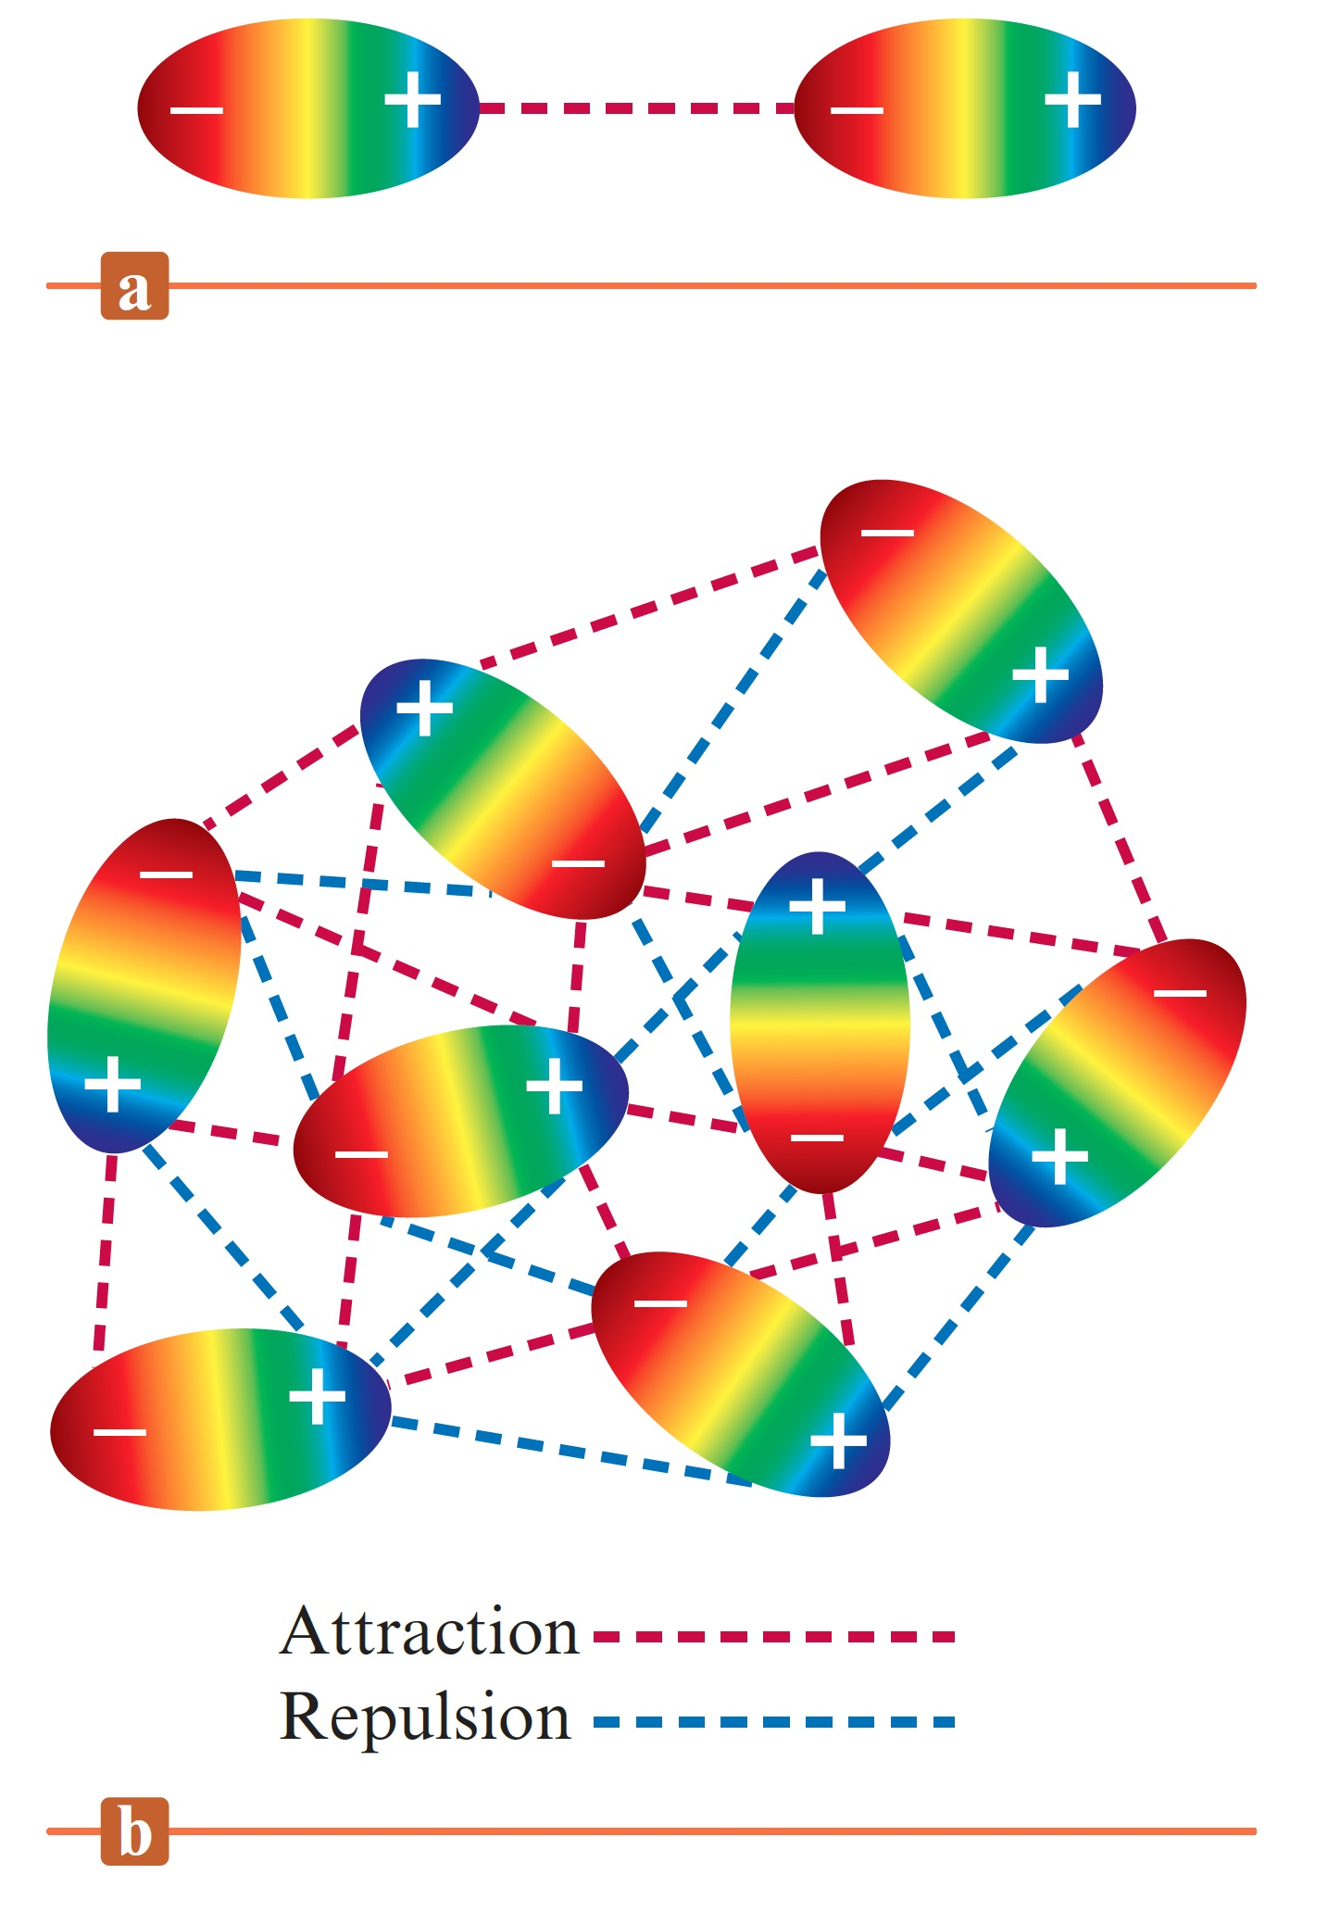
Characteristics of Dipole–Dipole Forces
Approximately 1% as strong as covalent or ionic bonds
Strength of the forces decreases as the distance between the dipoles increases

Slide 10
Hydrogen Bonding
Significantly strong dipole–dipole forces
Prevalent in molecules that have a hydrogen atom bound to a highly electronegative atom
Causative factors
Polarity of the bond
Proximity of the dipoles
Influenced by the size of the hydrogen atom
Influences physical properties of molecules

Slide 11
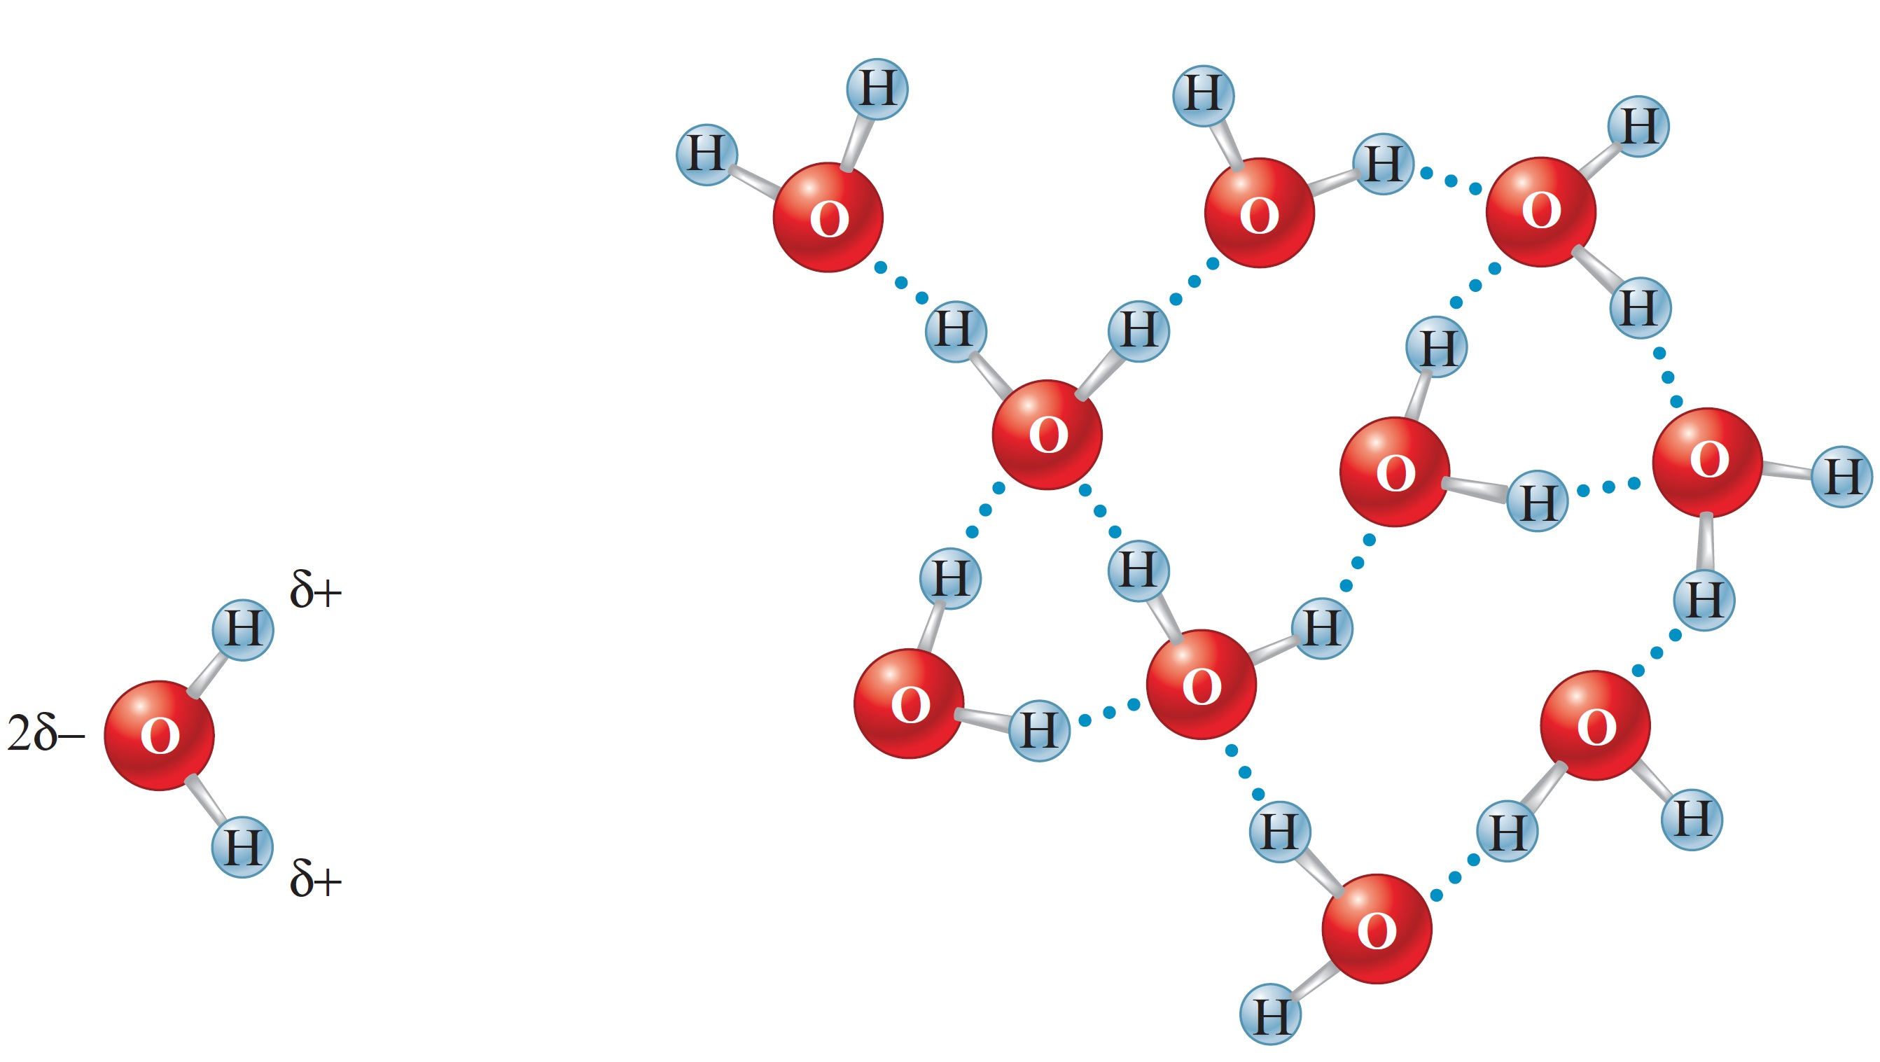
Figure 10.3 - Hydrogen Bonding in Water

Slide 12
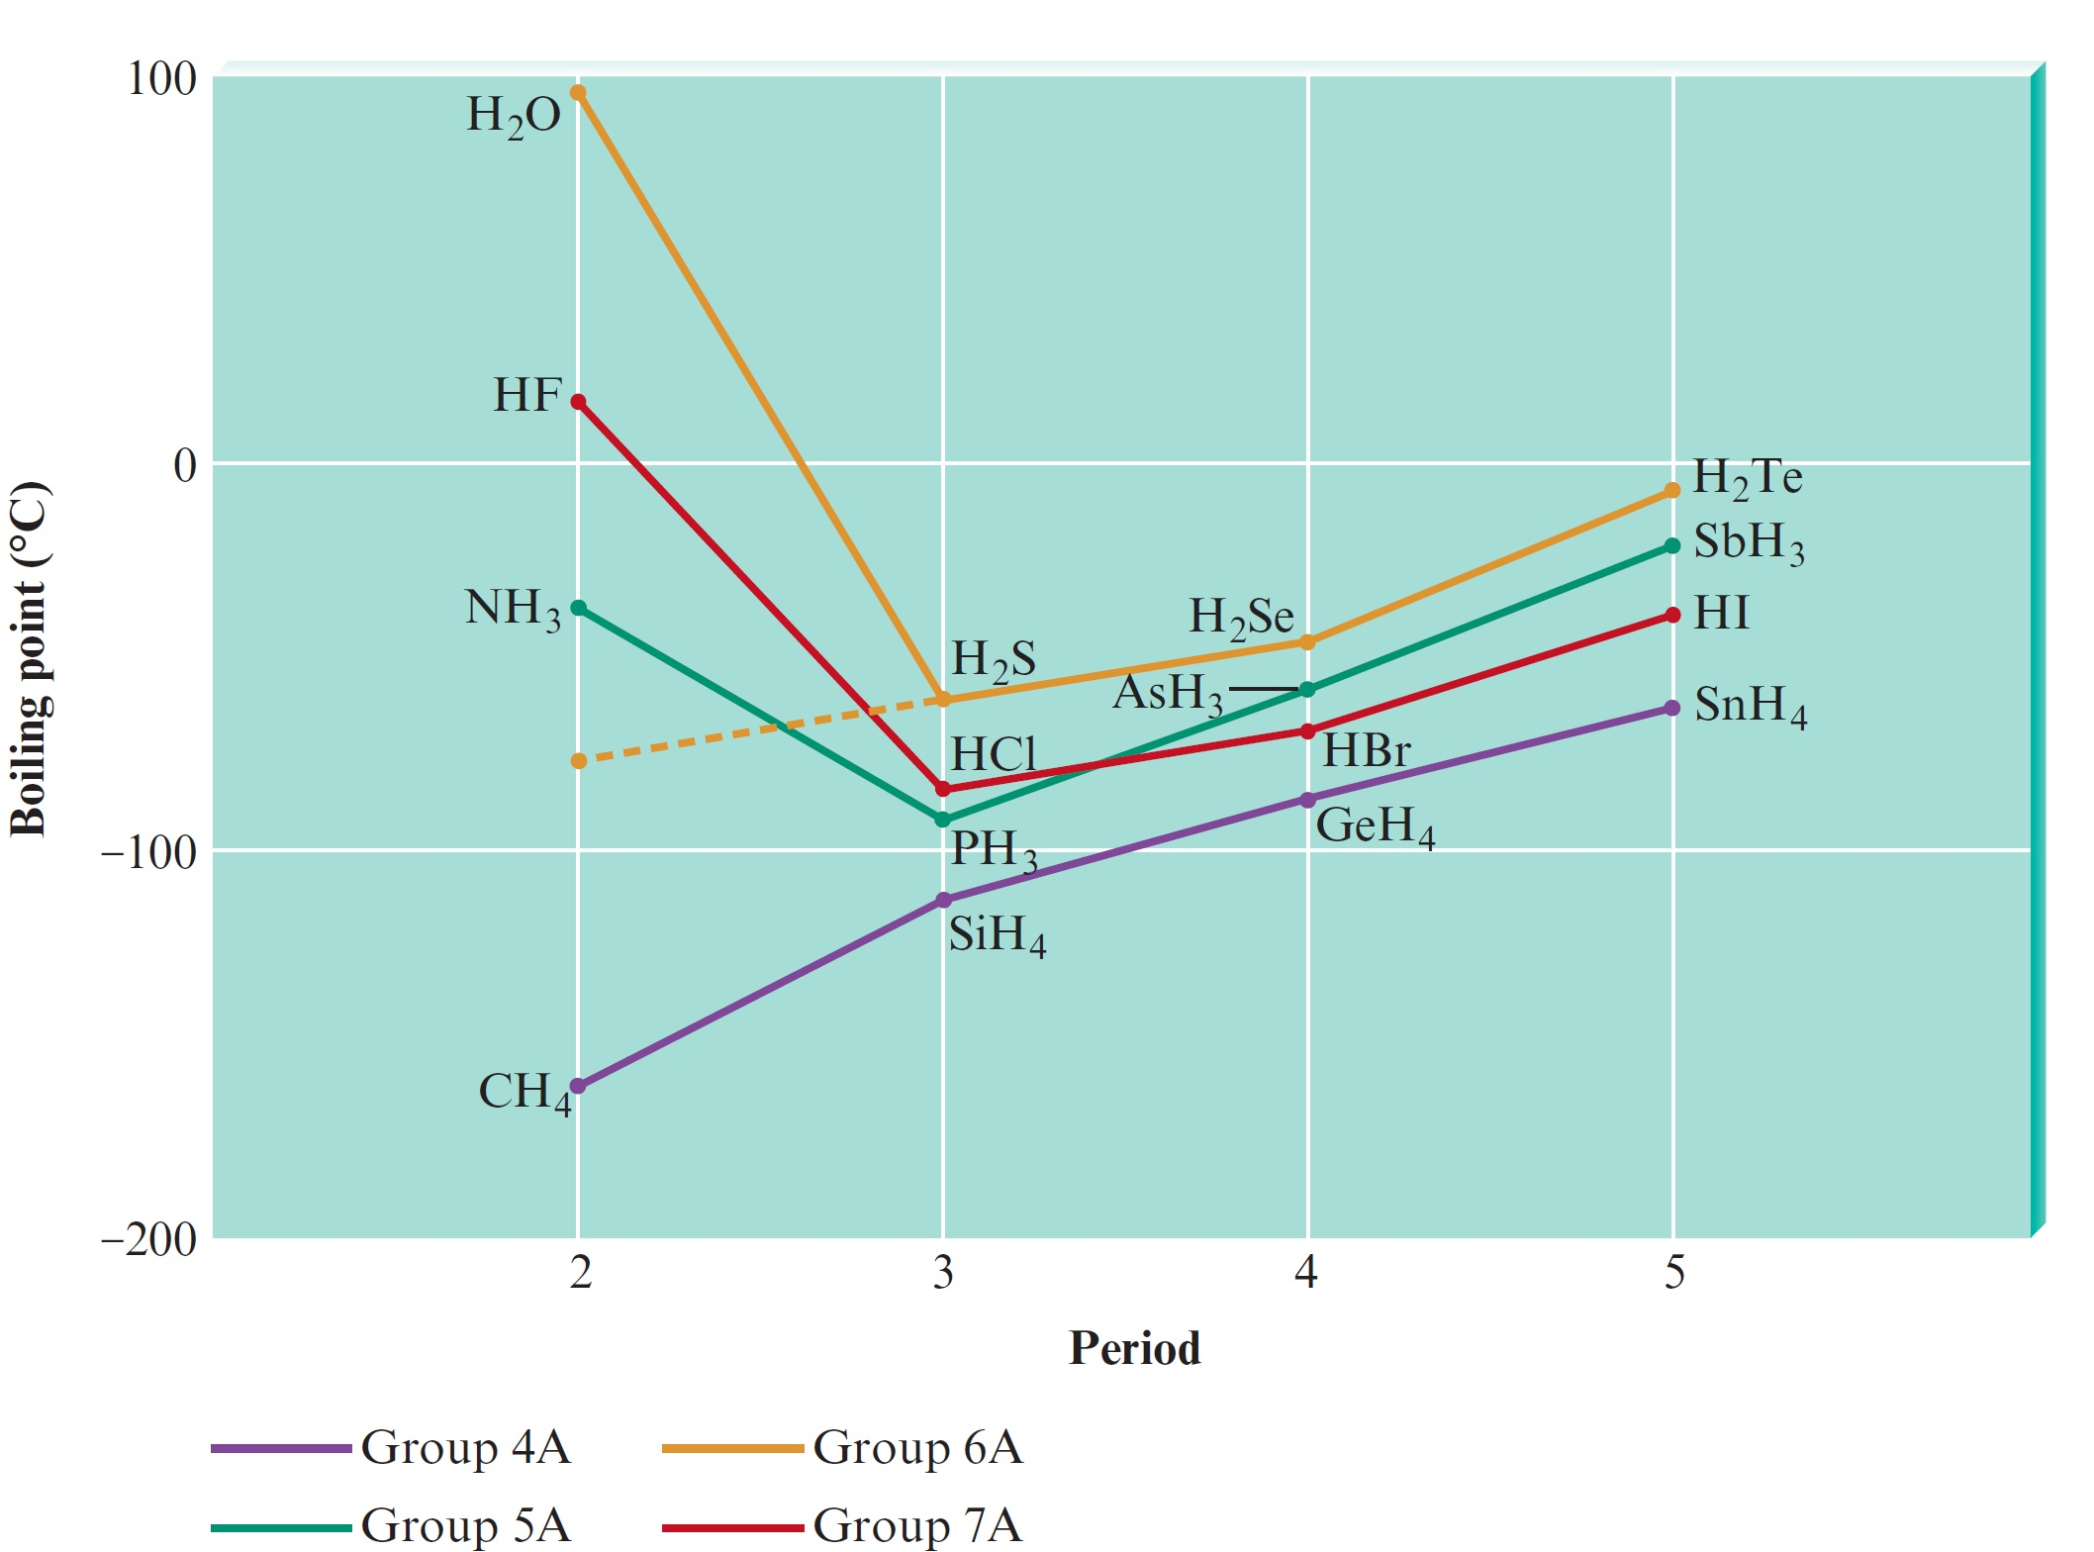
Figure 10.4 - Boiling Points of the Covalent Hydrides of the Elements in Groups 4A, 5A, 6A, and 7A

Slide 13
London Dispersion Forces
Forces that exist among noble gas atoms and nonpolar molecules
An accidental instantaneous dipole that occurs in an atom can induce a similar dipole in a neighboring atom
Leads to an interatomic attraction that is weak and short-lived
Can be significant for large atoms

Slide 14
London Dispersion Forces (Continued)
Polarizability - Indicates the ease with which the electron cloud of an atom can be distorted to give a dipolar charge distribution
As the atomic number increases, the number of electrons increases
Increases the probability of the occurrence of momentary dipole interactions
Used by nonpolar molecules to attract each other

Slide 15
Critical Thinking
You have learned the difference between intermolecular forces and intramolecular bonds
What if intermolecular forces were stronger than intramolecular bonds?
What differences could you observe in the world?

Slide 16
Liquids
Possess low compressibility, lack rigidity, and have high density compared with gases
Surface tension: Resistance of a liquid to an increase in its surface area
Liquids with large intermolecular forces tend to have high surface tensions

Slide 17
Liquids (Continued)
Polar liquids exhibit capillary action
Capillary action: Spontaneous rising of a liquid in a narrow tube
Cohesive forces - Intermolecular forces among the molecules of the liquid
Adhesive forces - Forces between the liquid molecules and the walls of the container

Slide 18
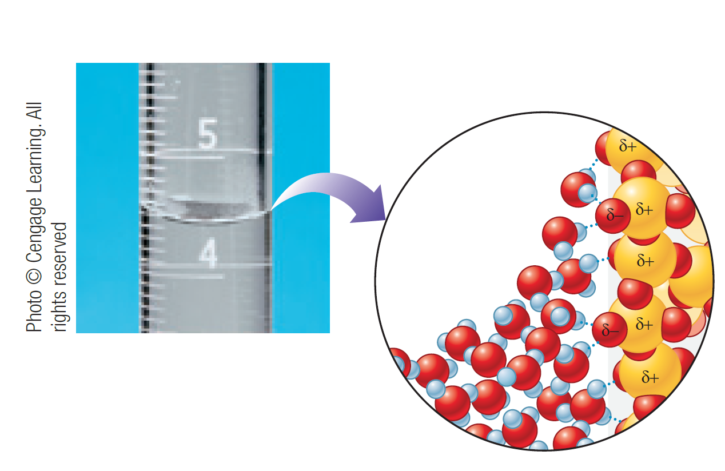
Concave Meniscus Formed by Polar Water
Adhesive forces toward glass are stronger than cohesive forces in the liquid

Slide 19
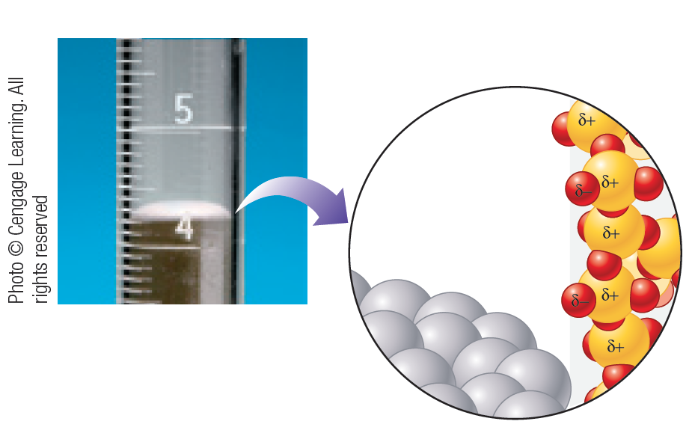
Convex Meniscus Formed by Nonpolar Liquid Mercury
Cohesive forces in the liquid are stronger than adhesive forces toward glass

Slide 20
Viscosity
Measure of a liquid’s resistance to flow
Liquids with large intermolecular forces and complex molecules tend to be highly viscous
Example - Glycerol and grease

Slide 21
Structural Model for Liquids
Have strong intermolecular forces and significant molecular motions
Contain a large number of regions
Arrangement of the components are similar to those that are present in solids, but with more disorder
Holes are present in a few regions
Regions are subject to rapid fluctuations

Slide 22
Classification of Solids
Amorphous solids: Have considerable disorder in their structures
Crystalline solids: Characterized by highly regular arrangement of components
Positions of components are represented by lattices
Lattice: Three-dimensional system of points designating positions of components that make up the substance
Unit cell: Smallest repeating unit of a lattice

Slide 23
Figure 10.9 - Three Cubic Unit Cells and the Corresponding Lattices

Slide 24
Figure 10.9 - Three Cubic Unit Cells and the Corresponding Lattices (Continued)

Slide 25
X-Ray Analysis of Solids
X-ray diffraction: Helps determine the structures of crystalline solids
Diffraction occurs due to:
Constructive interference when parallel beam waves are in phase
Destructive interference when waves are out of phase

Slide 26
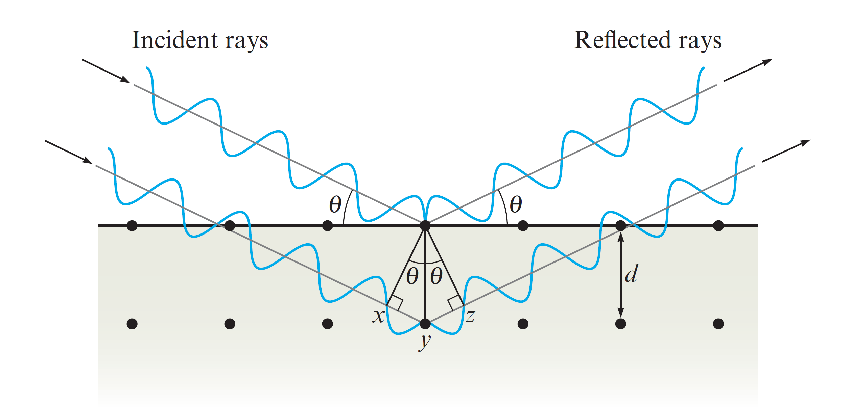
Bragg Equation
Used to determine interatomic spacings
Consider two in-phase waves being reflected by atoms in two different layers in a crystal

Slide 27
Bragg Equation (Continued 1)
If the sum of xy and yz gives the extra distance traveled by the lower wave, the waves will be in phase after reflection if
n is an integer
λ is the wavelength of the X rays

Slide 28
Bragg Equation (Continued 2)
Using trigonometry, it can be shown that
d is the distance between the atoms
θ is the angle of incidence and reflection
Combining equations 10.1 and 10.2 gives Bragg’s equation

Slide 29
Diffractometer
Used to conduct X-ray analysis of crystals
Rotates the crystal based on the X-ray beam
Collects data produced by the scattering of X rays from the various planes of atoms in the crystal
Helps gather data on bond lengths and angles

Slide 30
Interactive Example 10.1 - Using the Bragg Equation
X rays of wavelength 1.54 Å were used to analyze an aluminum crystal
A reflection was produced at θ = 19.3 degrees
Assuming n = 1, calculate the distance d between the planes of atoms producing this reflection

Slide 31
Interactive Example 10.1 - Solution
To determine the distance between the planes, use the Bragg equation
n = 1
λ = 1.54 Å
θ = 19.3 degrees

Slide 32
Types of Crystalline Solids
Ionic solids: Possess ions at the lattice points that describe the structure of the solid
Molecular solids: Possess discrete covalently bonded molecules at the lattice points
Atomic solids: Possess atoms at the lattice points that describe the structure of the solid

Slide 33
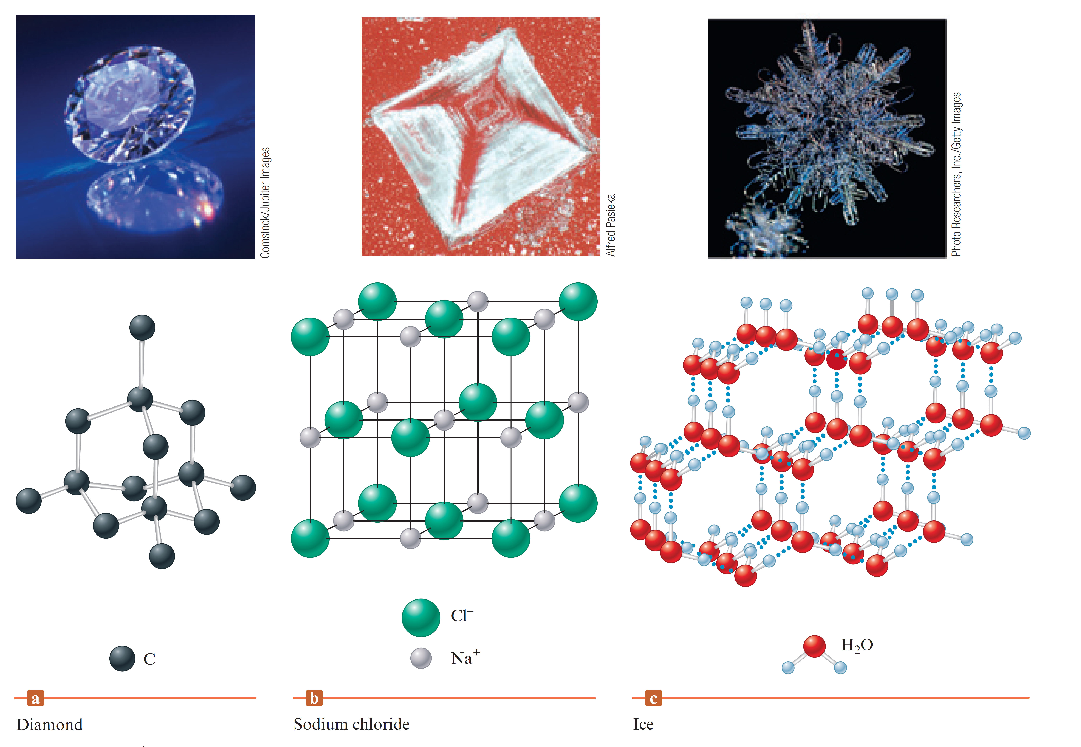
Figure 10.22 - Examples of Three Types of Crystalline Solids

Slide 34
Classification of Atomic Solids
Metallic solids - Possess a special type of delocalized nondirectional covalent bonds
Network solids - Possess atoms bonded by strong directional covalent bonds
Bonds lead to giant molecules of atoms
Group 8A solids - Possess noble gas elements that are attracted to each other by London dispersion forces

Slide 35
Closest Packing Model
Closest packing arrangement
Characterized by layers of uniform hard spheres that efficiently use available space
Each sphere is surrounded by six others
Types of arrangement
The aba arrangement
The abc arrangement

Slide 36
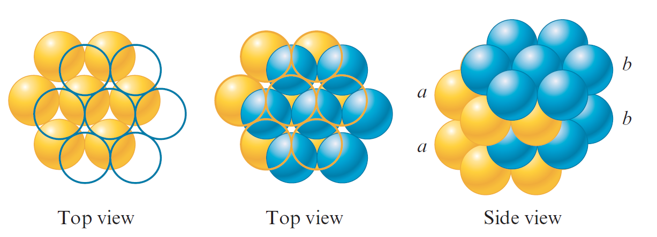
The aba Arrangement
Spheres in every third layer lie directly over spheres in the first layer
Resulting structure is called the hexagonal closest packed (hcp) structure

Slide 37
Figure 10.14 - Hexagonal Closest Packing

Slide 38
The abc Arrangement
No spheres in the third layer lie over ones in the first layer
Resulting structure is called the cubic closest packed (ccp) structure

Slide 39
Figure 10.15 - Cubic Closest Packing

Slide 40
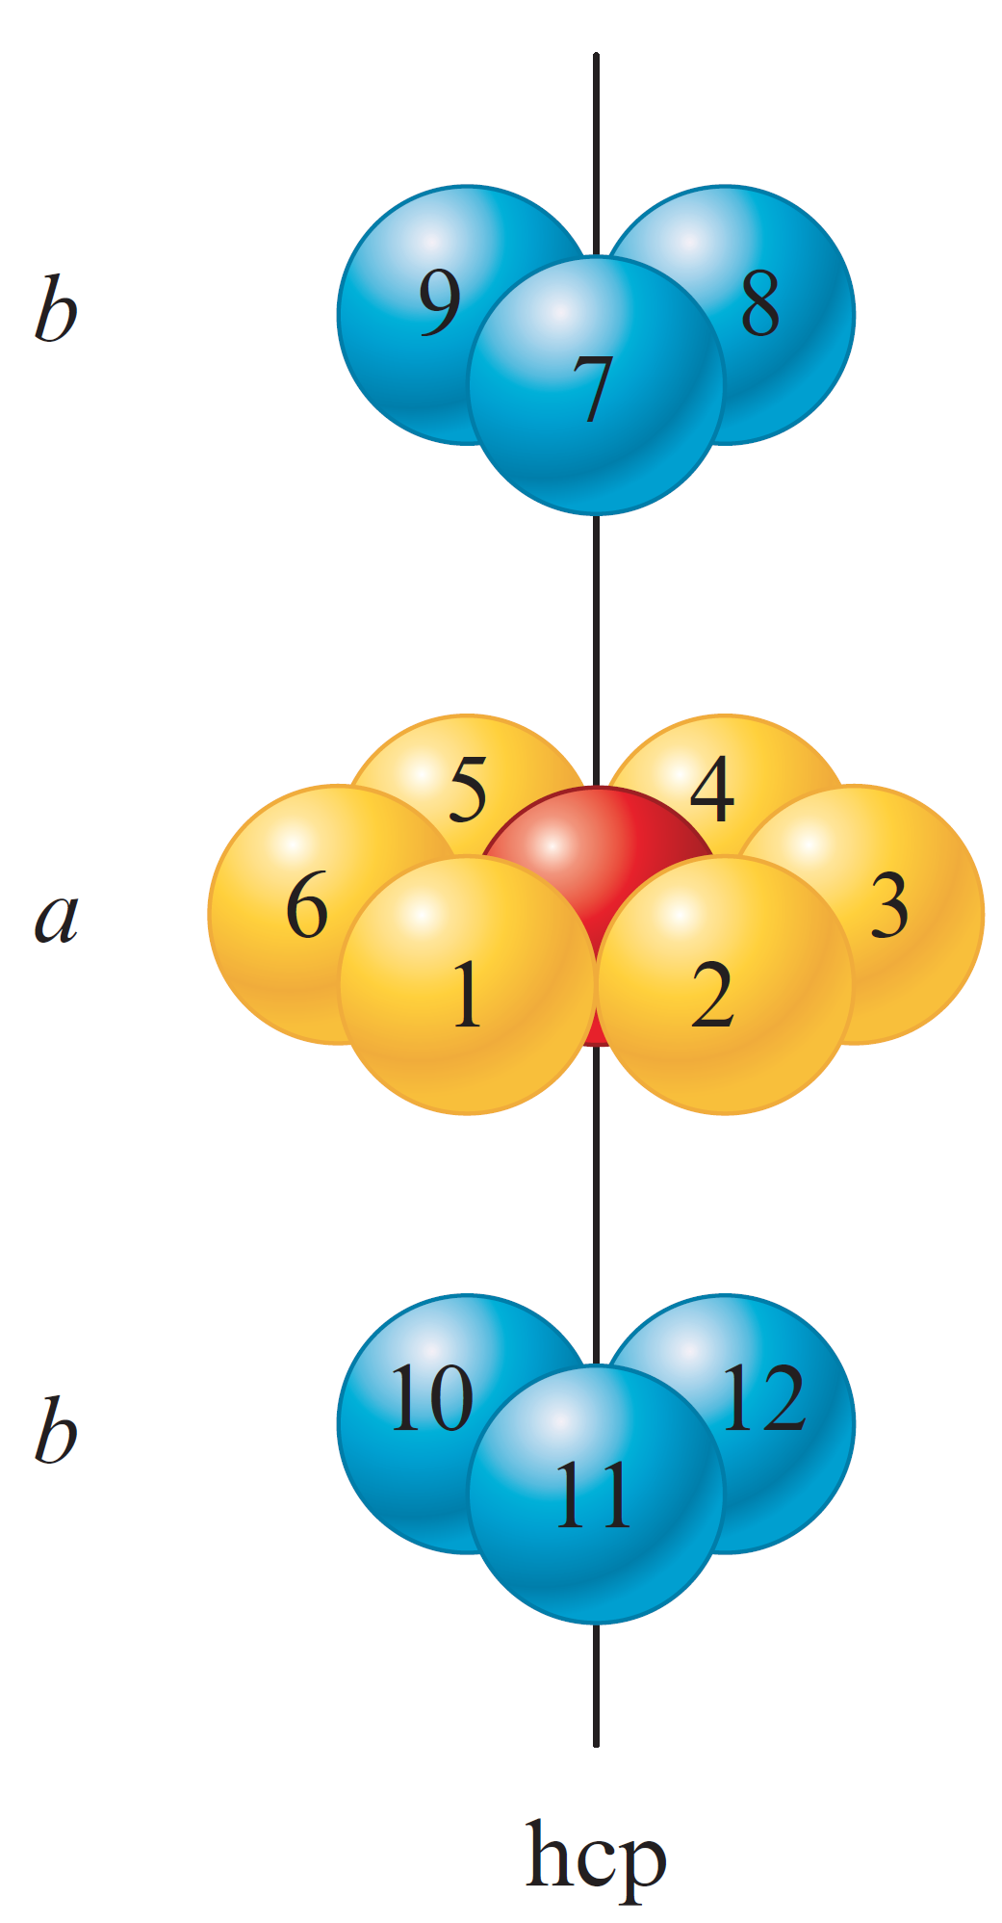
Nearest Neighbors of a Sphere
Each sphere has 12 equivalent nearest neighbors

Slide 41
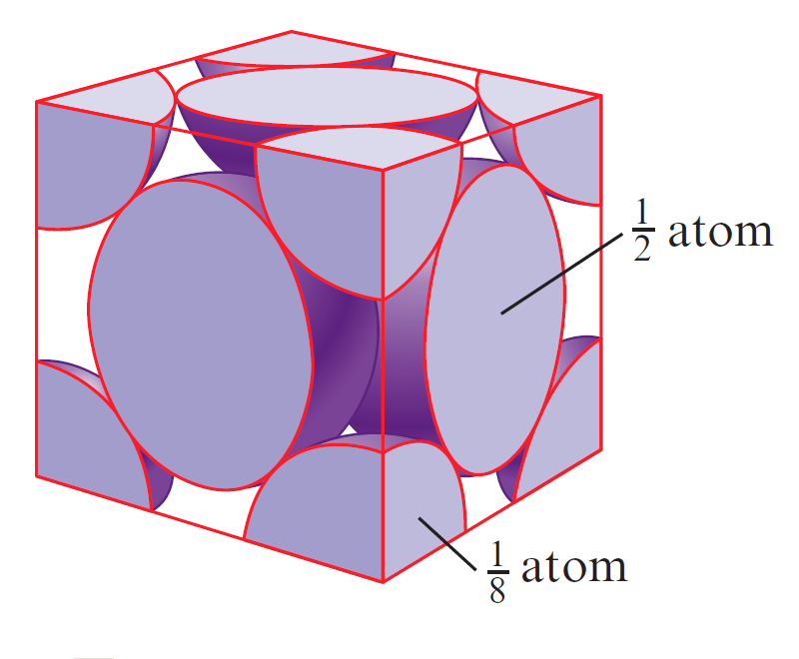
Net Number of Spheres in a Face-Centered Cubic Unit Cell
A unit cell is defined by the centers of the spheres on the corners of the cube
Net number of spheres in a face-centered cubic unit would be
Number of corners in a cube
Number of spheres that lie inside a unit cell
Number of faces in a cube
Number of central spheres that lie inside a unit cell

Slide 42
Interactive Example 10.2 - Calculating the Density of a Closest Packed Solid
Silver crystallizes in a cubic closest packed structure
The radius of a silver atom is 144 pm
Calculate the density of solid silver

Slide 43
Interactive Example 10.2 - Solution
Density is mass per unit volume
We need to know how many silver atoms occupy a given volume in the crystal
The structure is cubic closest packed, which means the unit cell is face-centered cubic
We must find the volume of this unit cell for silver and the net number of atoms it contains

Slide 44
Interactive Example 10.2 - Solution (Continued 1)
Note that in this structure the atoms touch along the diagonals for each face and not along the edges of the cube
Length of the diagonal is r + 2r + r, or 4r
We use this fact to find the length along the edge of the cube by the Pythagorean theorem

Slide 45
Interactive Example 10.2 - Solution (Continued 2)
Since r = 144 pm for a silver atom,

Slide 46
Interactive Example 10.2 - Solution (Continued 3)
The volume of the unit cell is d³, which is (407 pm)³, or 6.74×10⁷ pm³
Converting this to cubic centimeters,

Slide 47
Interactive Example 10.2 - Solution (Continued 4)
Since we know that the net number of atoms in the face-centered cubic unit cell is 4, we have 4 silver atoms contained in a volume of 6.74×10 ^{–23} cm³
Therefore, the density is

Slide 48
Bonding Models for Metals
A successful bonding model for metals must consider:
Malleability
Ductility
Efficient and uniform conduction of heat and electricity

Slide 49
Electron Sea Model
Envisions a regular array of metal cations in a sea of valence electrons
Mobile electrons conduct heat and electricity
Metal ions freely move around as the metal is hammered into a sheet or drawn into a wire

Slide 50
Figure 10.8 (a) and (b) - Depiction of Electron Sea Model
Representation of an alkali metal (Group 1A) with one valence electron
Representation of an alkaline earth metal (Group 2A) with two valence electrons

Slide 51
Band Model or Molecular Orbital (MO) Model
Electrons are assumed to travel around the metal crystal in molecular orbitals formed from the valence atomic orbitals of the metal atoms

Slide 52
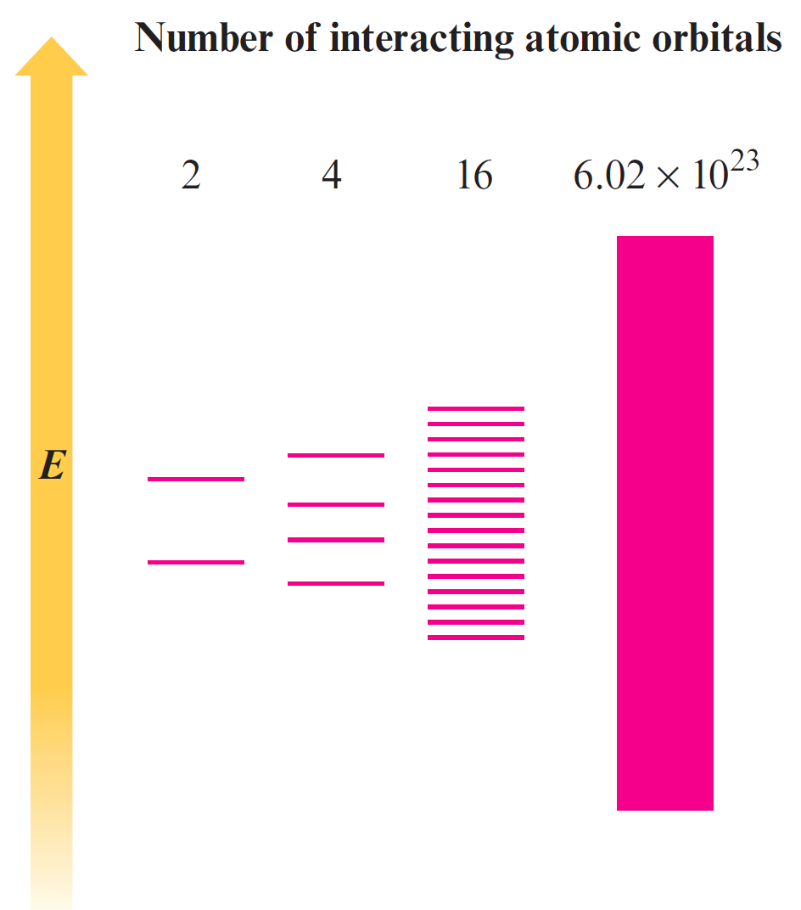
Figure 10.19 - Molecular Orbital Energy Levels Produced When Various Numbers of Atomic Orbitals Interact

Slide 53
Figure 10.20 - Representation of Energy Levels in a Magnesium Crystal

Slide 54
Metal Alloys
Alloy: Substance that contains a mixture of elements and possesses metallic properties
Substitutional alloy: Some host metal atoms are replaced by other metal atoms of similar size
Interstitial alloy: Some of the interstices in the closest packed metal structure are occupied by small atoms

Slide 55
Figure 9.21 - Two Types of Alloys

Slide 56
Influence of Carbon on the Properties of Steel
Mild steel - Contains less than 0.2% carbon
Malleable and ductile
Used for nails, cables, and chains
Medium steel - Contains 0.2 to 0.6% carbon
Used in rails and structural steel beams
High-carbon steel - Contains 0.6 to 1.5% carbon
Tough and hard
Used for springs, tools, and cutlery

Slide 57
Network Solids
Atomic solids that contain directional covalent bonds
Form solids that are viewed as giant molecules
Properties
Brittle in nature
Ineffective conductors of heat and electricity

Slide 58
Diamond
Each carbon atom is surrounded by a tetrahedral arrangement of other carbon atoms to form a huge molecule
Structure fits the characteristics of the localized electron model
Covalent bonds result in a stable structure
Formed by the overlap of sp³ hybridized carbon atomic orbitals

Slide 59
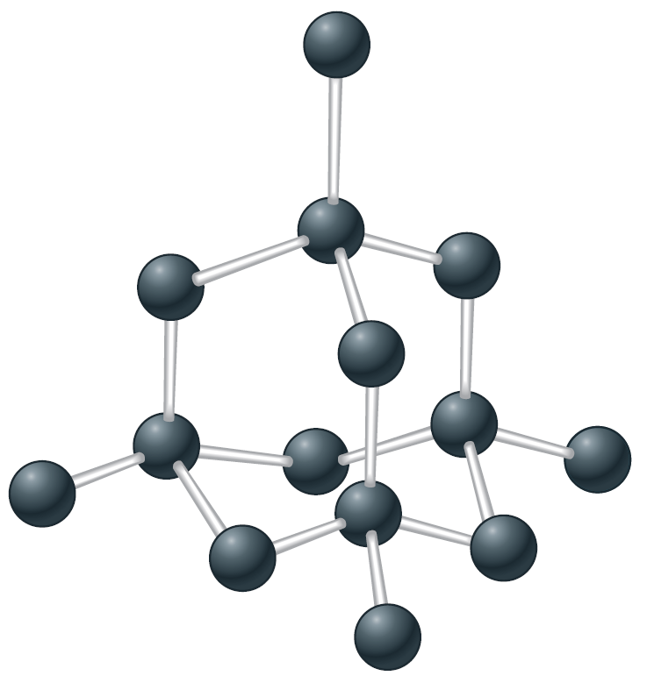
Figure 10.22 (a) - The Structure of Diamond

Slide 60
Diamond (Continued)
Structure according to the MO model
A large gap between the filled and empty levels exists
Electron transfer is difficult
Diamond is not expected to be a good electrical conductor
Used in industrial cutting implements
Graphite can be converted to diamond by applying 150,000 atm of pressure at 2800^{ₒ}C

Slide 61
Figure 10.23 (a) - Partial Representation of the Molecular Orbital Energies in Diamond

Slide 62
Graphite
Slippery, black, and a conductor of heat and electricity
Structure is based on layers of carbon atoms arranged in fused six-membered rings
Each carbon atom in a layer is surrounded by three other carbon atoms in a trigonal planar arrangement with 120-degree bond angles

Slide 63
Graphite (Continued)
sp² hybridization is predicted by the localized electron model
Three sp² orbitals on each carbon atom form σ bonds with three other carbon atoms
One 2p orbital on each carbon remains unhybridized and is perpendicular to the plane
Used as a lubricant in locks
Slipperiness is due to the strong bonding within the layers of carbon atoms rather than between the layers

Slide 64
Figure 10.22 (b) - The Structure of Graphite

Slide 65
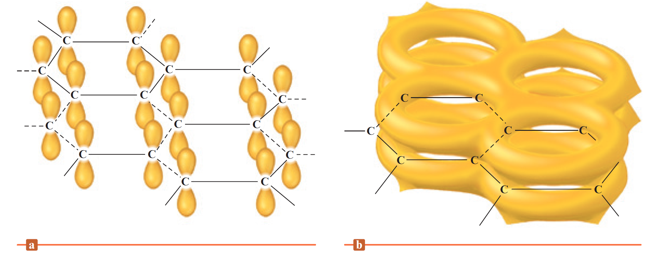
Figure 10.24 (a) and (b) - The p Orbitals and the π-Bonding Network in Graphite

Slide 66
Silicon
An important constituent of the compounds that form the earth’s crust
Stable silicon compounds involve chains with silicon–oxygen bonds
Silica (SiO₂): Fundamental silicon–oxygen compound
Structure
Silicon atom satisfies the octet rule by forming single bonds with four oxygen atoms

Slide 67
Figure 10.26 - Structure of Quartz

Slide 68
Silicates
Compounds related to silica
Based on interconnected SiO₄ tetrahedra
Found in rocks, soils, and clays
Possess O/Si ratios greater than 2:1 and contain silicon–oxygen anions
Cations are required to balance the excess negative charge to form neutral silicates

Slide 69
Silicates (Continued)
Glass: Amorphous solid that is formed when silica is heated above 1600°C and cooled rapidly
Homogeneous, noncrystalline frozen solution
Common glass results when substances like Na₂CO₃ are added to the silica melt and then cooled
Properties vary based on the additives

Slide 70
Figure 10.28 (a) and (b) - Two-Dimensional Representations of Quartz Crystal and Quartz Glass
Quartz Crystal
Quartz Glass

Slide 71
Figure 10.5 - Compositions of Some Common Types of Glass

Slide 72
Ceramics
Made from clays and hardened by firing at high temperatures
Nonmetallic materials that are strong, brittle, and resistant to heat and attack by chemicals
Heterogeneous in nature

Slide 73
Structure of Clay
Formed by the weathering action of water and carbon dioxide on the mineral feldspar
Feldspar - An aluminosilicate that weathers to form kaolinite
Kaolinite - Consists of tiny thin platelets with the empirical formula Al₂Si₂O₅(OH)₄
Platelets interlock as the clay dries
During firing, silicates and cations form a glass that binds the crystals of kaolinite

Slide 74
Uses of Ceramics
Construction of jet and automobile engines
Flexible ceramics can be obtained by adding small amounts of organic polymers
Organic polymers are used to produce durable engine parts, flexible superconducting wires and microelectronic devices, and prosthetic devices

Slide 75
Semiconductors
Conduct only a slight electric current at room temperature
Show increased conductivity at higher temperatures
Types
n-type semiconductor
Substance whose conductivity is increased by doping the element with atoms that have more valence electrons than the atoms in the host crystal

Slide 76
Semiconductors (Continued)
p-type semiconductor: Semiconductors are doped with atoms that have fewer valence electrons than the atoms in the host crystal
Substance becomes a better conductor
A p-type and an n-type semiconductor can be connected to form a p–n junction
Makes an excellent rectifier
Rectifier - Device that produces a pulsating direct current from alternating current

Slide 77
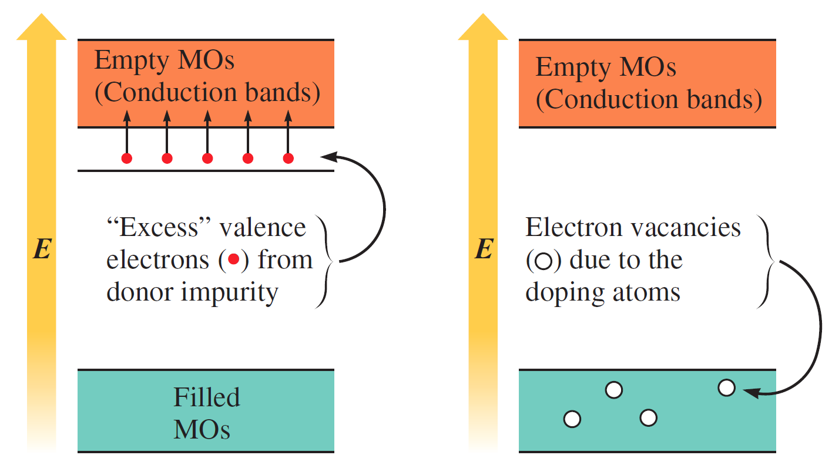
Figure 10.30 - Energy-Level Diagrams for an N-Type and a P-Type Semiconductor

Slide 78
P–N Junction
A small number of electrons migrate from the n-type region into the p-type region
The migrations place a negative charge on the p-type region and a positive charge on the n-type region
Contact potential prevents further migration
Contact potential - Charge buildup

Slide 79
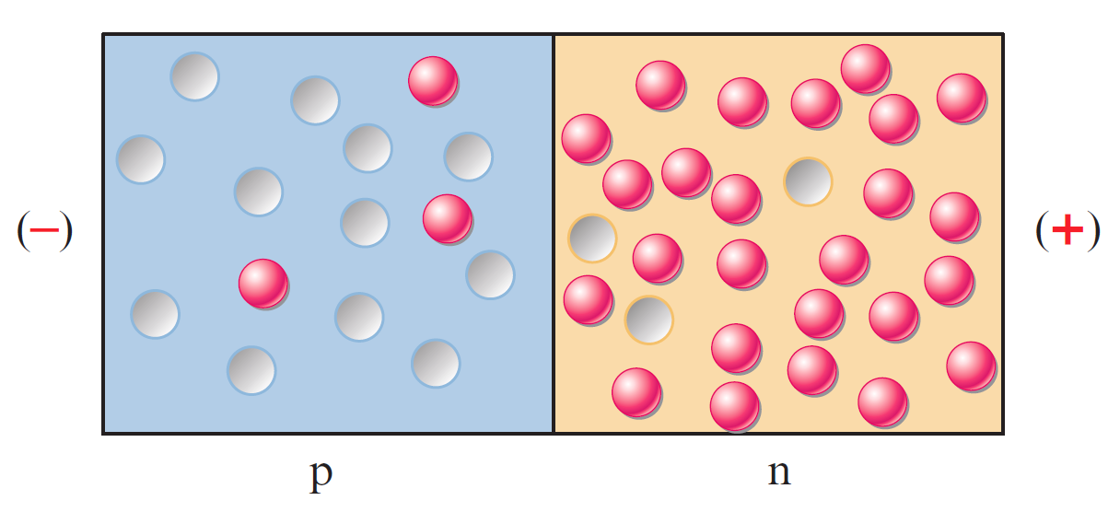
Figure 10.31 (a) - Charge Carriers in the P-Type and N-Type Regions

Slide 80
Figure 10.31 (b) and (c) - Reverse and Forward Bias
Reverse bias
Forward bias

Slide 81
Molecular Solids
Characterized by strong covalent bonding within molecules and weak bonding between molecules
Intermolecular forces depend on the nature of the molecules
Molecules that do not have a dipole moment possess London dispersion forces
Molecules with dipole moments have greater intermolecular forces when hydrogen bonding is possible

Slide 82
Ionic Solids
Stable, high-melting substances held together by the strong electrostatic forces that exist between oppositely charged ions
Structure of binary ionic solids can be explained by closest packing of spheres
Spheres are packed to:
Maximize electrostatic attractions among oppositely charged ions
Minimize repulsions among ions with like charges

Slide 83
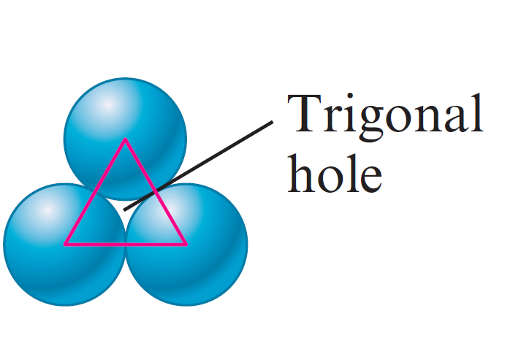
Types of Holes in Closest Packed Structures
Trigonal holes - Formed by three spheres in the same layer
Never occupied in binary ionic compounds
Tetrahedral holes
Formed when a sphere is located in the dimple of three spheres in an adjacent layer

Slide 84
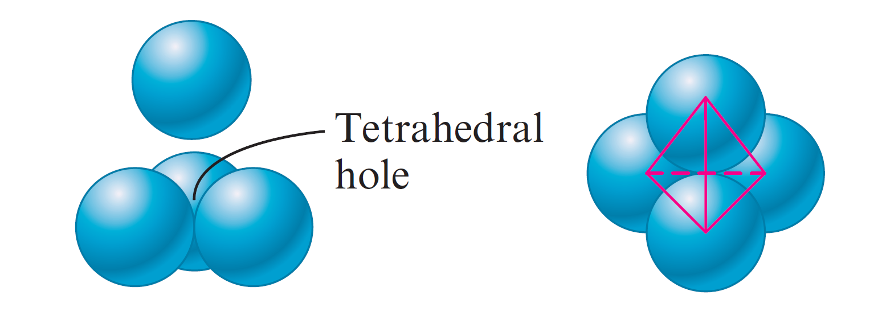
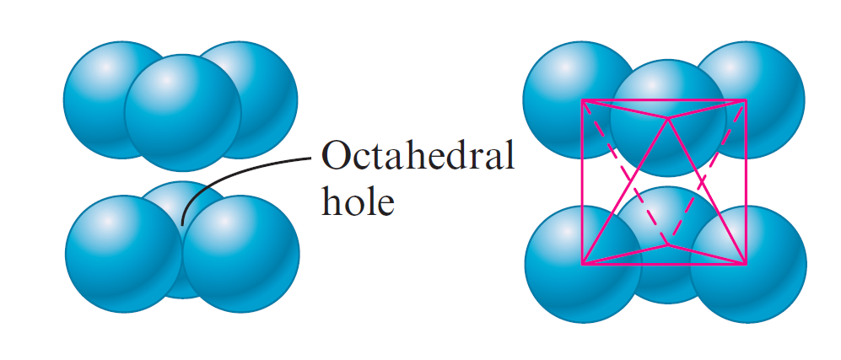
Types of Holes in Closest Packed Structures (Continued)
There are twice as many tetrahedral holes as packed anions in a closest packed structure
Octahedral holes
Formed between two sets of three spheres in adjoining layers of the closest packed structures
Closest packed structures contain the same number of octahedral holes as packed spheres

Slide 85
Figure 10.34 (a), (b), and (c) - Tetrahedral Holes
The location (red X) of a tetrahedral hole
One of the tetrahedral holes

Slide 86
Figure 10.35 - Octahedral Holes
The locations (gray X) of the octahedral holes
Representation of the unit cell for solid NaCl

Slide 87
Interactive Example 10.3 - Determining the Number of Ions in a Unit Cell
Determine the net number of Na⁺ and Cl– ions in the sodium chloride unit cell

Slide 88
Interactive Example 10.3 - Solution
The Cl– ions are cubic closest packed and thus form a face-centered cubic unit cell
There is a Cl– ion on each corner and one at the center of each face of the cube
The net number of Cl– ions present in a unit cell is

Slide 89
Interactive Example 10.3 - Solution (Continued 1)
The Na⁺ ions occupy the octahedral holes located in the center of the cube and midway along each edge
The Na⁺ ion in the center of the cube is contained entirely in the unit cell, whereas those on the edges are shared by four unit cells

Slide 90
Interactive Example 10.3 - Solution (Continued 2)
Since the number of edges in a cube is 12, the net number of Na⁺ ions present is:
We have shown that the net number of ions in a unit cell is 4 Na⁺ ions and 4 Cl– ions
Agrees with the 1:1 stoichiometry of sodium chloride

Slide 91
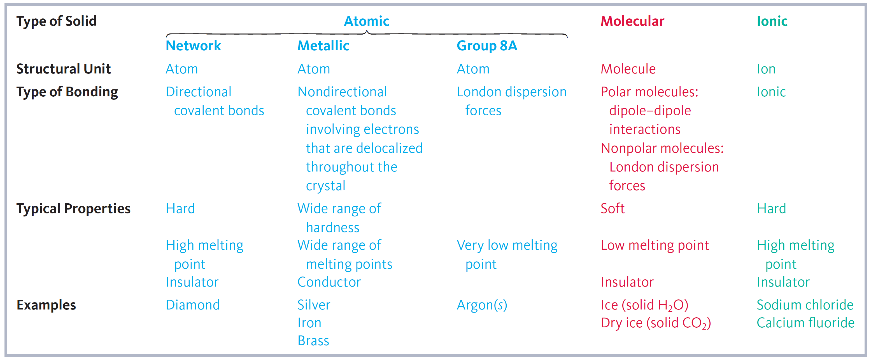
Table 10.7 - Types and Properties of Solids

Slide 92
Interactive Example 10.4 - Types of Solids
Using the Table 10.7, classify each of the following substances according to the type of solid it forms
Gold
Carbon dioxide
Lithium fluoride
Krypton

Slide 93
Interactive Example 10.4 - Solution
Solid gold is an atomic solid with metallic properties
Solid carbon dioxide contains nonpolar carbon dioxide molecules and is a molecular solid
Solid lithium fluoride contains Li⁺ and F– ions and is a binary ionic solid

Slide 94
Interactive Example 10.4 - Solution (Continued)
Solid krypton contains krypton atoms that can interact only through London dispersion forces
It is an atomic solid but has properties characteristic of a molecular solid with nonpolar molecules

Slide 95
Vaporization (Evaporation)
Molecules of a liquid escape the liquid’s surface to form a gas
Heat of vaporization (ΔH_{vap} ): Energy required to vaporize 1 mole of a liquid at a pressure of 1 atm
Endothermic in nature

Slide 96
Figure 10.36 (a) and (b) - Behavior of a Liquid in a Closed Container

Slide 97
Vapor Pressure
Equilibrium: The point at which no further net change occurs in the amount of liquid or vapor
Rate of condensation equals rate of evaporation
Condensation: Process by which gases become liquids
Equilibrium vapor pressure: Pressure of vapor at equilibrium

Slide 98
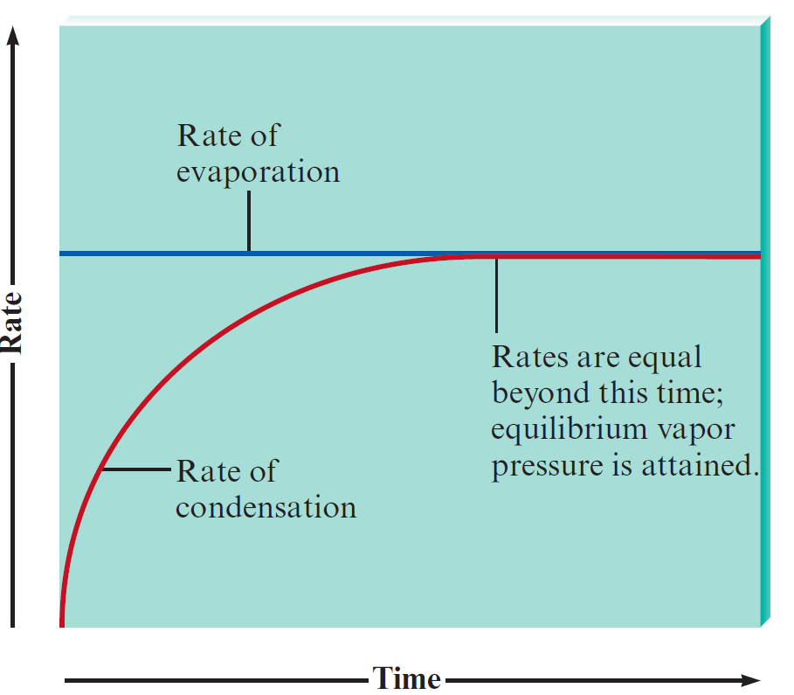
Figure 10.37 - Rates of Condensation and Evaporation

Slide 99
Measurement of Vapor Pressure
Vapor pressure can be measured using a simple barometer
When the system reaches equilibrium, the vapor pressure can be determined from the change in the height of the mercury column
P_{vapor} = P_{atmosphere} – P_{Hg column}

Slide 100
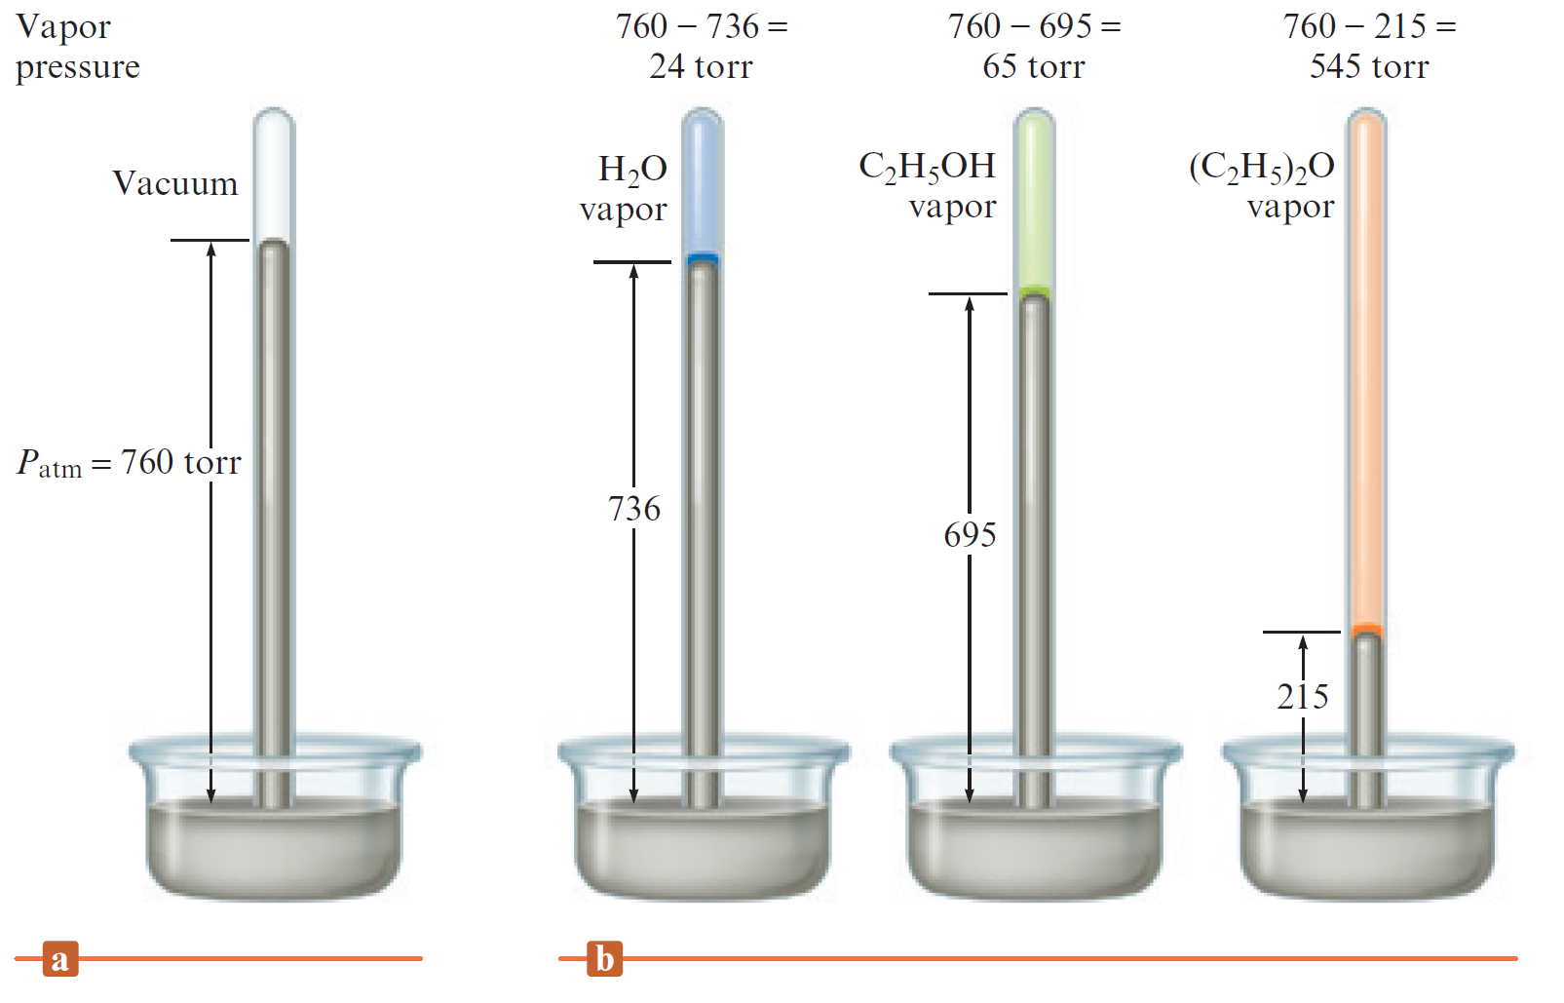
Figure 10.38 - Measuring Vapor Pressure

Slide 101
Critical Thinking
You have seen that the water molecule has a bent shape and therefore is a polar molecule
This accounts for many of water’s interesting properties
What if the water molecule was linear?
How would this affect the properties of water, such as its surface tension, heat of vaporization, and vapor pressure?
How would life be different?

Slide 102
Vapor Pressure and Liquids
Liquids with high vapor pressures are volatile
Evaporation occurs rapidly in an open environment
The size of the intermolecular forces in a liquid determines its vapor pressure
Substances with large molar masses have relatively low vapor pressures

Slide 103
Vapor Pressure and Liquids (Continued)
Vapor pressure increases significantly with temperature
A molecule must have sufficient kinetic energy to overcome intermolecular forces

Slide 104
Vapor Pressure versus Temperature
Produces a straight line when plotted on a graph
T - Temperature in Kelvin
ΔH_{vap} - Enthalpy of vaporization
R - Universal gas constant
C - Constant characteristic of a given liquid
ln - Natural logarithm of the vapor pressure

Slide 105
Vapor Pressure versus Temperature (Continued)
Equation 10.4 is the equation for a straight line of the form y = mx + b

Slide 106
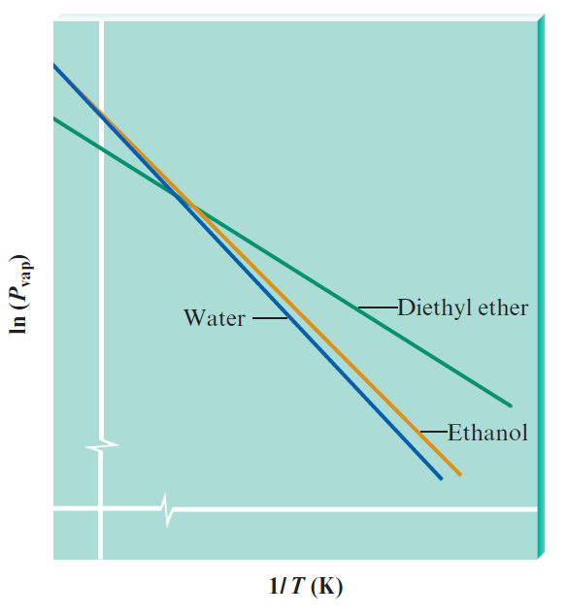
Example 10.5 - Determining Enthalpies of Vaporization
Using the plots in the figure determine whether water or diethyl ether has the larger enthalpy of vaporization

Slide 107
Example 10.5 - Solution
When ln(P_{vap}) is plotted versus 1/T, the slope of the resulting straight line is
The slopes of the lines for water and diethyl ether are both negative, as expected, and that the line for ether has the smaller slope
Ether has the smaller value of ΔH_{vap}
This makes sense because the hydrogen bonding in water causes it to have a relatively large enthalpy of vaporization

Slide 108
The Clausius–Clapeyron Equation
When the values of ΔH_{vap} and P_{vap} at one temperature are known, it is possible to calculate the value of P_{vap} at another temperature
Assume that C does not depend on temperature
At temperatures T₁ and T₂

Slide 109
The Clausius–Clapeyron Equation (Continued)
Rearranging the equation gives
P_{vap} = vapor pressure
ΔH_{vap} = enthalpy of vaporization
R = Universal gas constant
T = temperature (in Kelvin)

Slide 110
Interactive Example 10.6 - Calculating Vapor Pressure
The vapor pressure of water at 25°C is 23.8 torr, and the heat of vaporization of water at 25°C is 43.9 kJ/mol
Calculate the vapor pressure of water at 50°C

Slide 111
Interactive Example 10.6 - Solution
We will use the following equation:
For water we have
P_{vap,T1} = 23.8 torr
T₁ = 25 + 273 = 298 K T₂ = 50 + 273 = 323 K
ΔH_{vap} = 43.9 kJ/mol = 43,900 J/mol
R = 8.3145 J/K · mol

Slide 112
Interactive Example 10.6 - Solution (Continued)
Taking the antilog of both sides gives

Slide 113
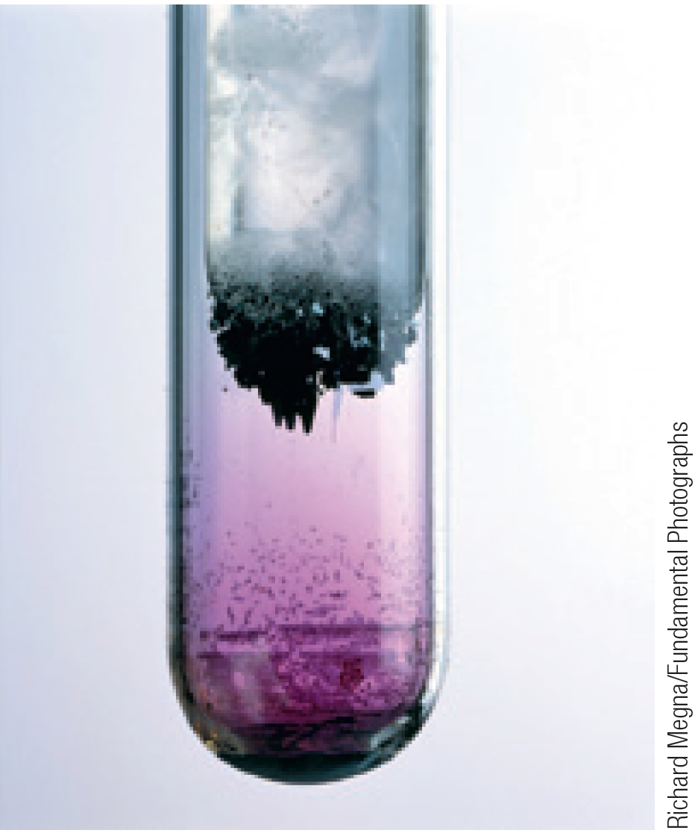
Sublimation
Process in which solids change to gases without passing through the liquid state
Occurs with dry ice and iodine

Slide 114
Changes of State
Heating curve: Plot of temperature versus time for a process where energy is added at a constant rate
When a solid is heated, it melts to form a liquid
If the heating continues, it will eventually form the vapor phase
Heat of fusion (enthalpy of fusion): Change in enthalpy at the melting point of a solid

Slide 115
Figure 10.42 - Heating Curve for a Specific Quantity of Water

Slide 116
Table 10.9 - Melting Points and Enthalpies of Fusion for Several Representative Solids

Slide 117
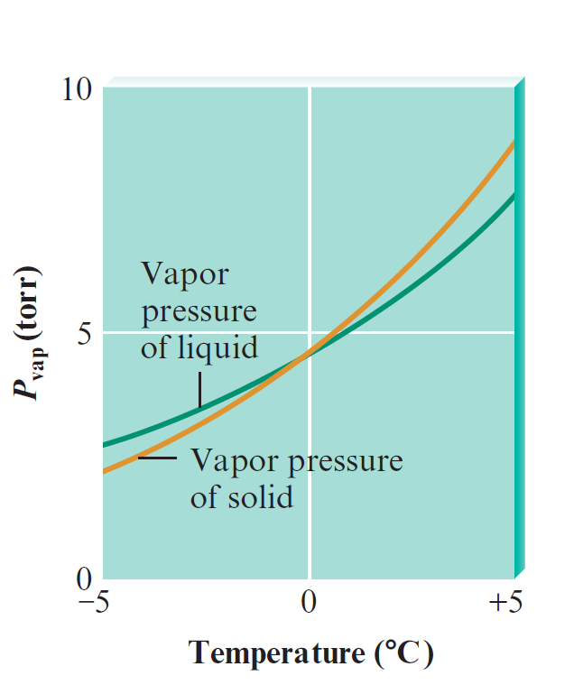
Melting Point
The temperature at which the solid and liquid have identical vapor pressures

Slide 118
Figure 10.44 - Interaction of Solid and Liquid Water in the Vapor State

Slide 119
Temperature and Vapor Pressure - Case 1
Temperature at which the vapor pressure of the solid is greater than that of the liquid
The solid releases vapor, attempting to achieve equilibrium
The liquid attempts to achieve equilibrium by absorbing vapor
Net effect - Conversion from solid to liquid through the vapor phase
Temperature would be above the melting point of ice

Slide 120
Temperature and Vapor Pressure - Case 2
Temperature at which vapor pressure of the solid is less than that of the liquid
Liquid will disappear, and the amount of ice will increase
Solid will achieve equilibrium with the vapor
Temperature should be below the melting point of ice

Slide 121
Temperature and Vapor Pressure - Case 3
Temperature at which the vapor pressures of the solid and liquid are identical
Coexist in the apparatus at equilibrium with the vapor
Normal melting point: Temperature at which the vapor pressures of the solid and liquid states are identical at 1 atmosphere of pressure
Represents the freezing point that enables existence of solid and liquid states

Slide 122
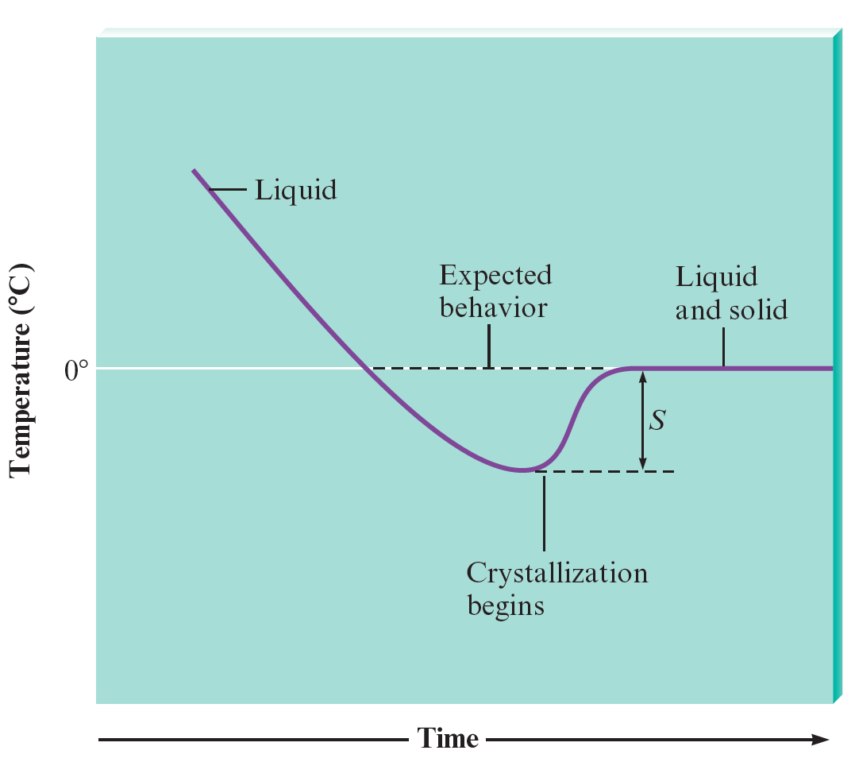
Temperature and Vapor Pressure - Case 3 (Continued 1)
Normal boiling point
Temperature at which the vapor pressure of the liquid is 1 atmosphere
Changes of state do not always occur at the boiling or melting point

Slide 123
Temperature and Vapor Pressure - Case 3 (Continued 2)
Supercooled water remains in the liquid state below 0°C and 1 atm of pressure
Water can be superheated if it is heated rapidly
Vapor pressure in the liquid is greater than atmospheric pressure
Bubbles formed burst before reaching the surface, resulting in bumping

Slide 124
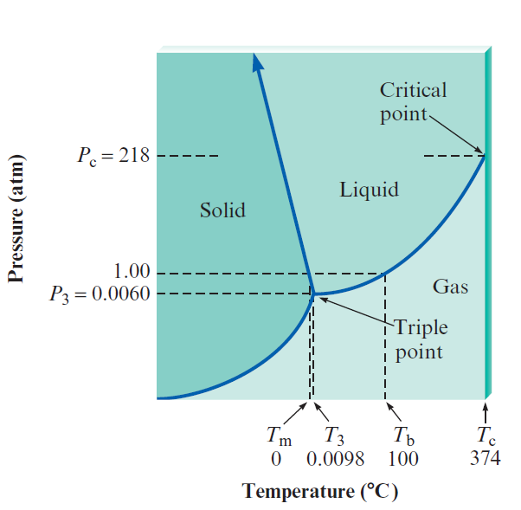
Phase Diagram
Convenient method of representing the phases of a substance as a function of temperature and pressure
Phase diagram of water
T_{m} - Normal melting point
T₃ and P₃ - Triple point
T_{b} - Normal boiling point
T_{c} - Critical temperature
P_{c} - Critical pressure

Slide 125
Phase Diagram (Continued)
Triple point: Temperature at which all three phases exist simultaneously
Critical point: Defined by critical pressure and temperature
Critical pressure: Pressure required to produce liquefaction at the critical temperature
Critical temperature: The temperature above which vapor cannot be liquefied, irrespective of the pressure applied

Slide 126
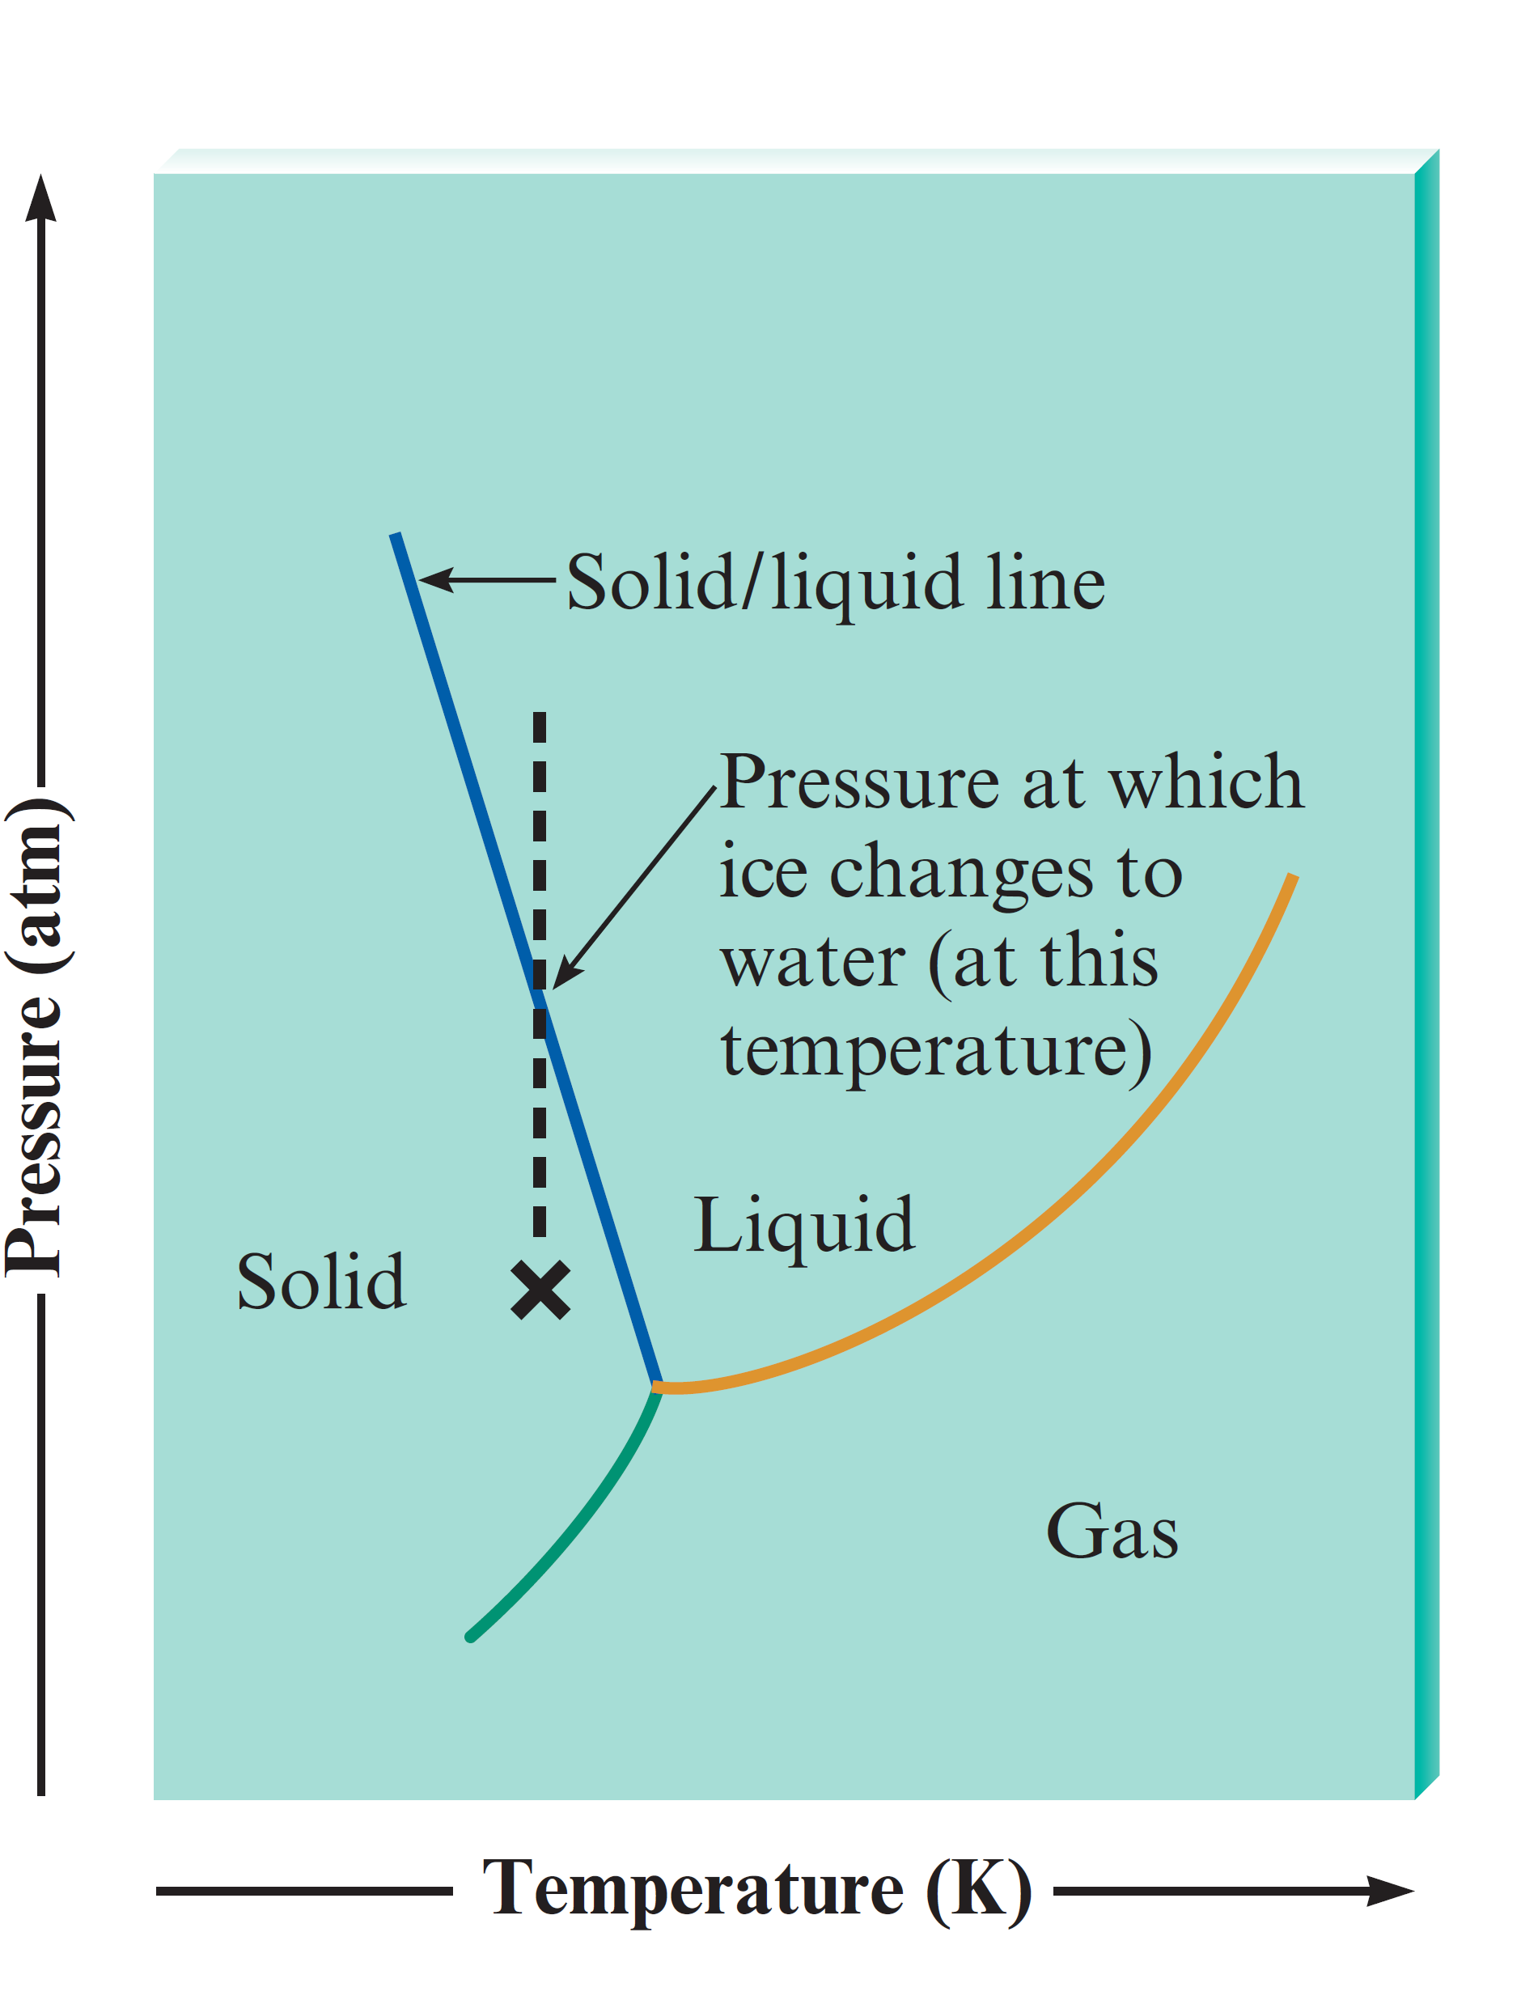
Phase Diagram for Water
Describes a closed system
At point X, ice is subjected to increased pressure at constant temperature
Solid/liquid line is crossed as the pressure is increased

Slide 127
Phase Diagram for Water - Observations
The solid/liquid boundary line has a negative slope
At the melting point, liquid and solid are in dynamic equilibrium
When pressure is applied, the volume is reduced
A given mass of ice has more volume at 0°C than the same mass of water in liquid state
Freezing point of water is less than 0°C when external pressure is greater than 1 atm

Slide 128
Phase Diagram for Water - Applications
Ice skating
Narrow blades of skates exert a large amount of pressure
Frictional heat caused when skates moves over ice contributes to further melting of ice
As the blades pass by, the liquid refreezes
Low density of ice
Causes ice formed on rivers and lakes to float, and this helps prevent water bodies from freezing in the winter

Slide 129
Table 10.10 - Boiling Point of Water at Various Locations

Slide 130
Critical Thinking
Ice is less dense than liquid water, as evidenced by the fact that ice floats in a glass of water
What if ice was more dense than liquid water?
How would this affect the phase diagram for water?

Slide 131
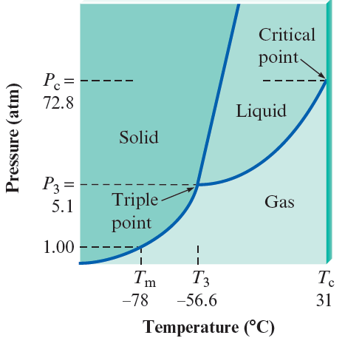
Figure 9.49 - Phase Diagram for Carbon Dioxide
The liquid state does not exist at a pressure of 1 atm
Solid/liquid line has a positive slope
Density of solid carbon dioxide is greater than that of liquid carbon dioxide

Slide 132
Phase Diagram for Carbon Dioxide - Applications
Carbon dioxide is used in fire extinguishers
Liquid released from the extinguisher into the environment at 1 atm immediately changes to a vapor
Dry ice
A convenient refrigerant as it does not undergo the liquid phase under normal atmospheric conditions

