Slide 1

bp.com/statisticalreview #BPstats
© BP p.I.c.2017

Slide 2

Coal

Slide 3
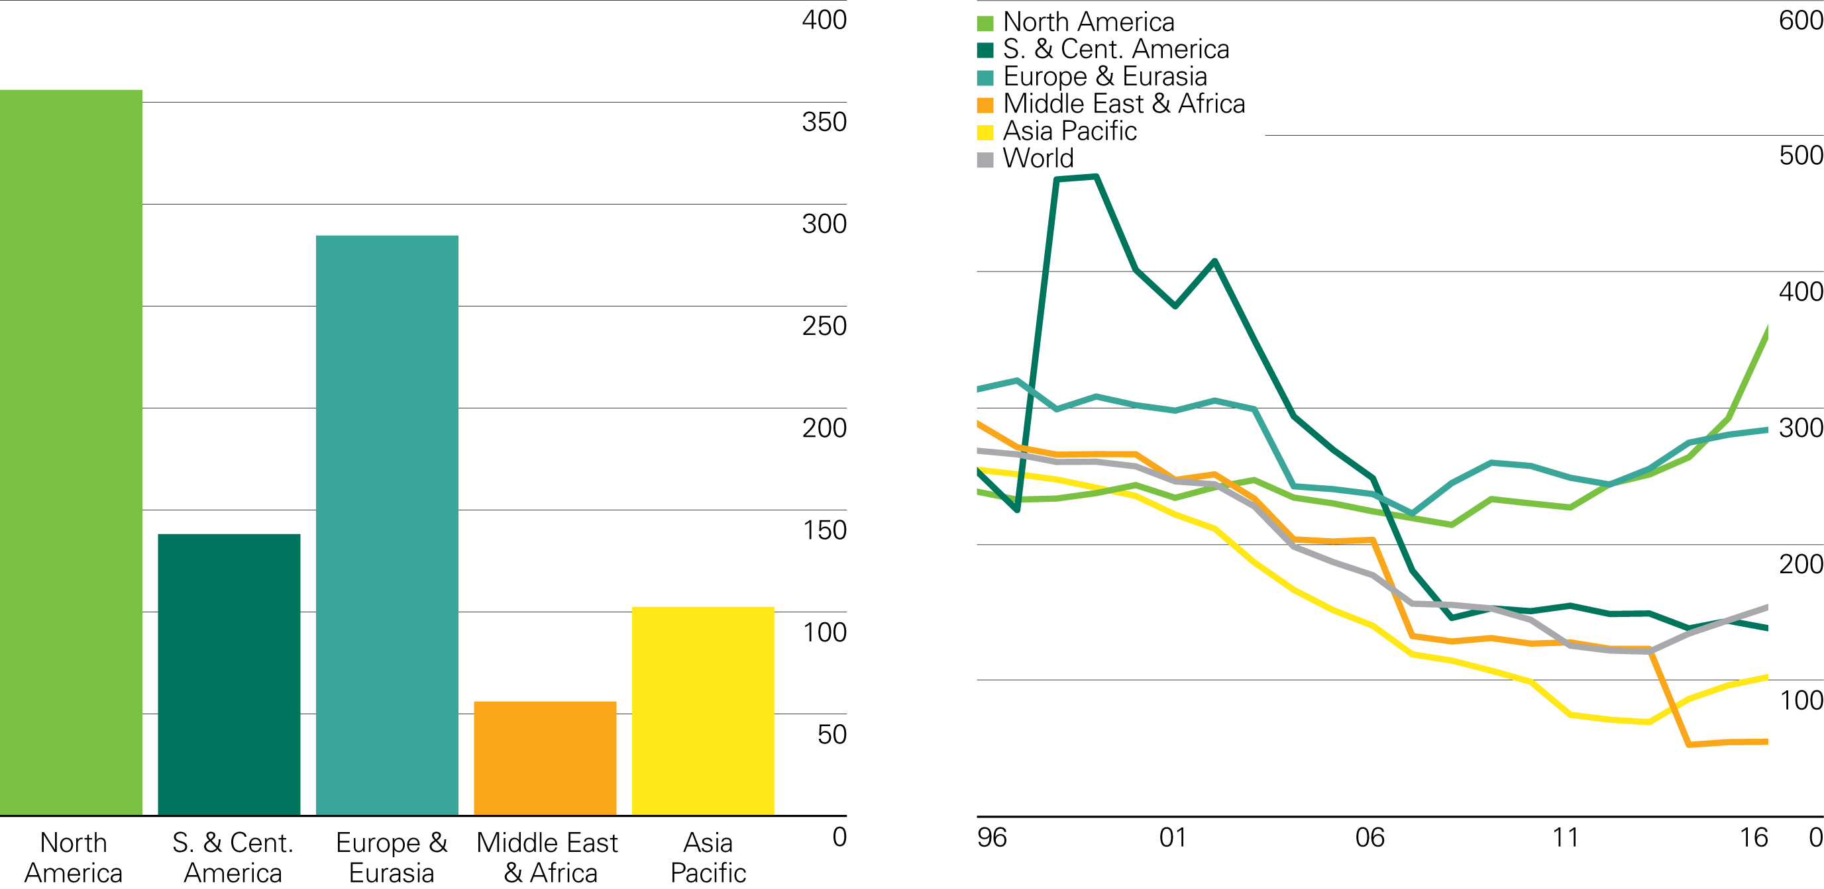
Coal reserves-to-production (R/P) ratios
Years
2016 by region
History

Slide 4
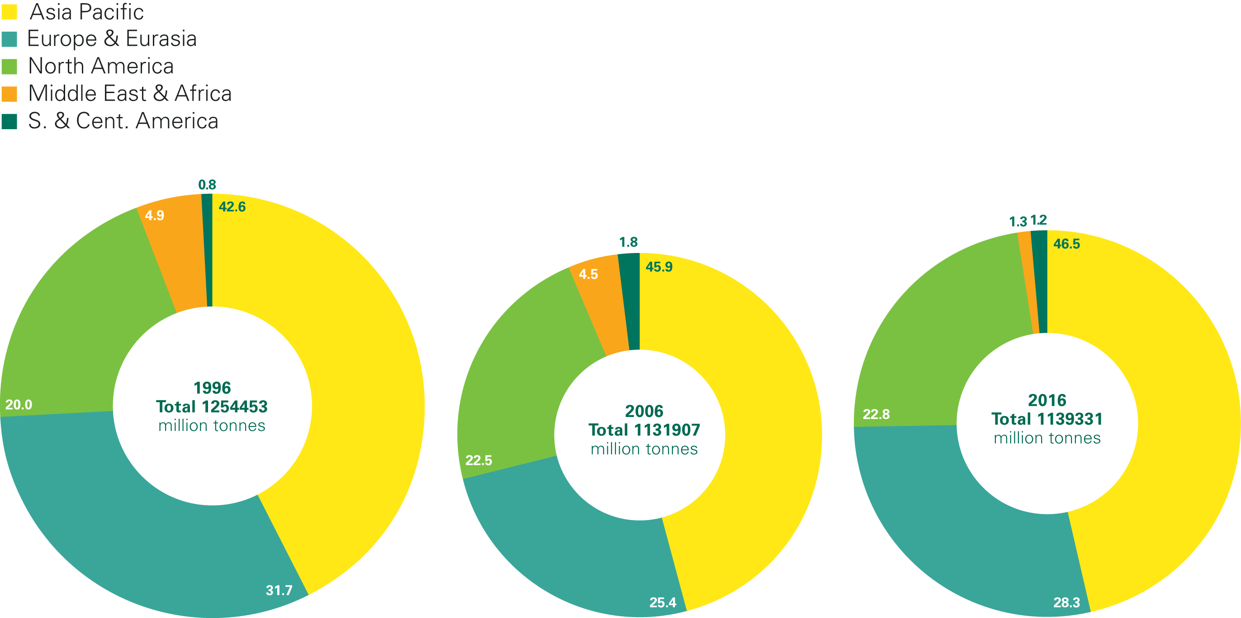
Distribution of proved coal reserves: 1996, 2006 and 2016
Percentage
Source: World Energy Resources 2013 Survey, World Energy Council.

Slide 5
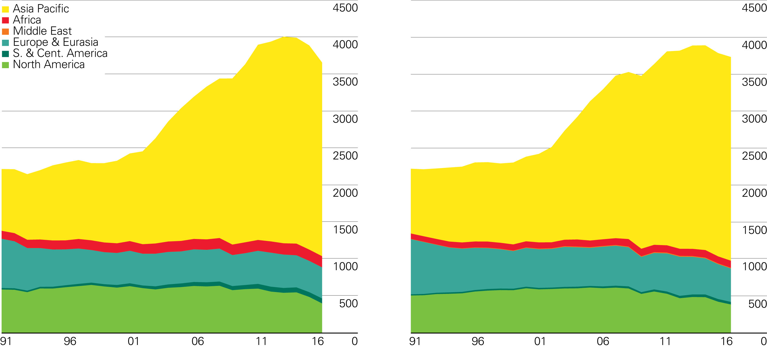
Coal production/consumption by region
Million tonnes oil equivalent
Production by region
Consumption by region

Slide 6
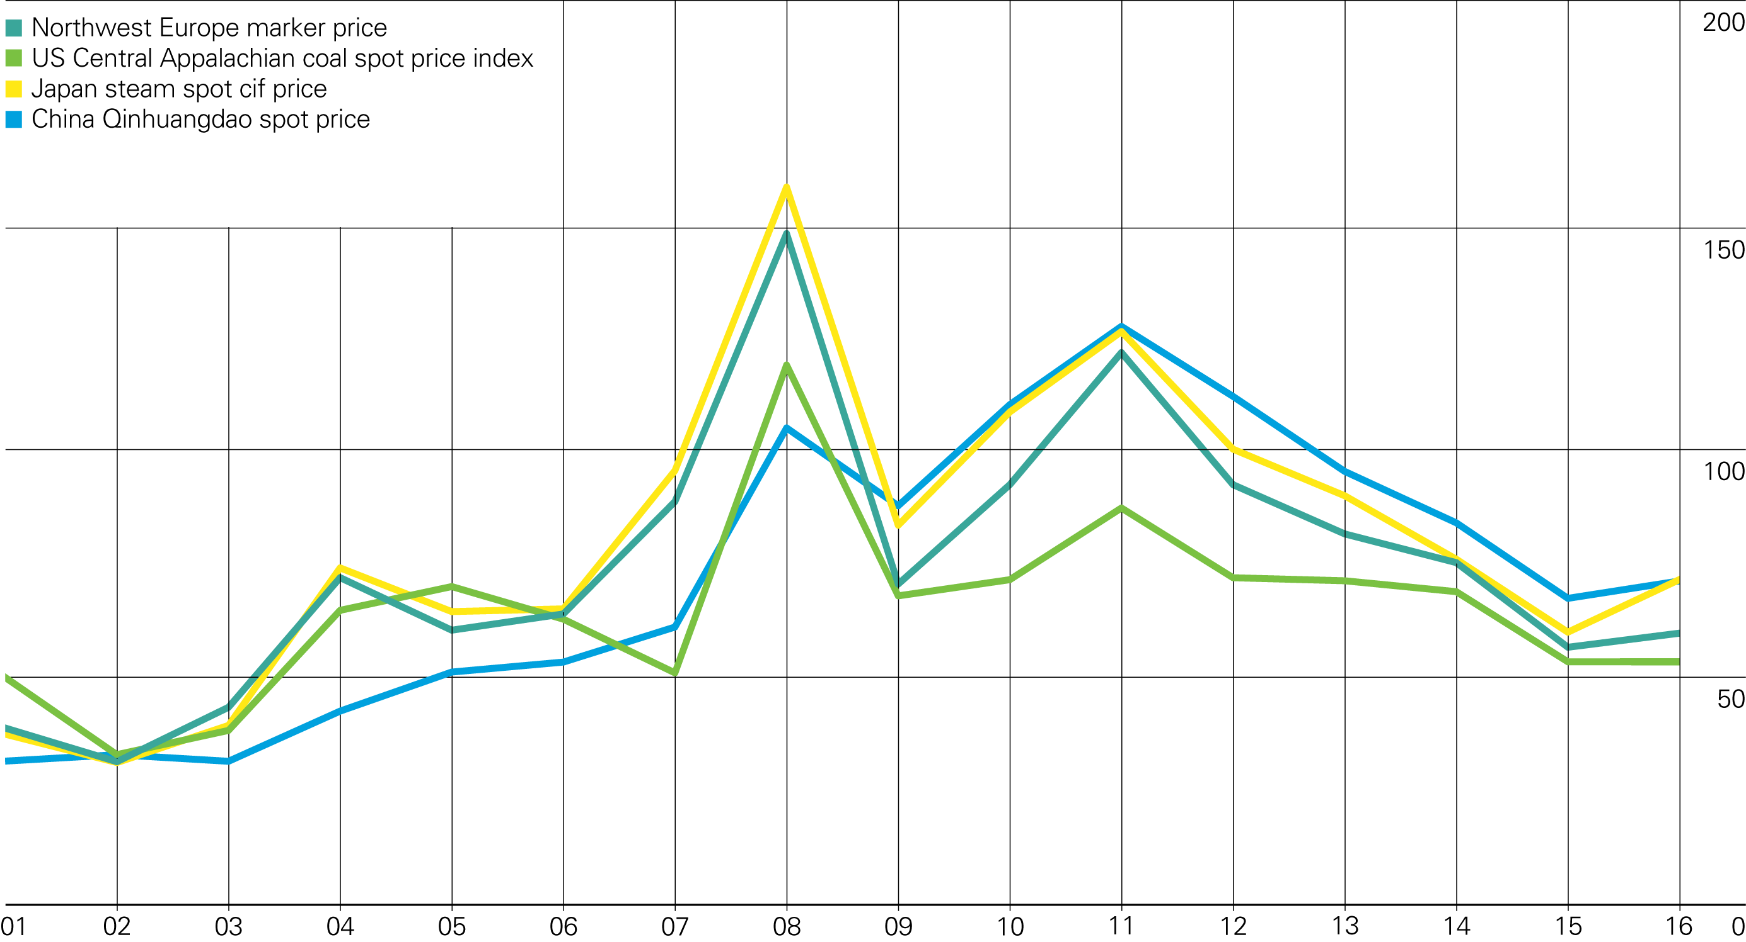
Coal prices
US dollars per tonne

