Slide 1

On the use of Neural Network for sensors node localization in IoT.
An-najah National university
Department of Mathematics
Master in computational Mathematices
/9/2019
Name: Batoul Sulaiman
Supervisors: Dr. Mohammad Sharaf
Prof. Dr. Naji Qatanani

Slide 2
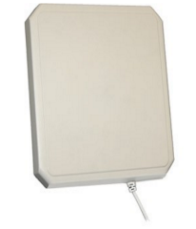
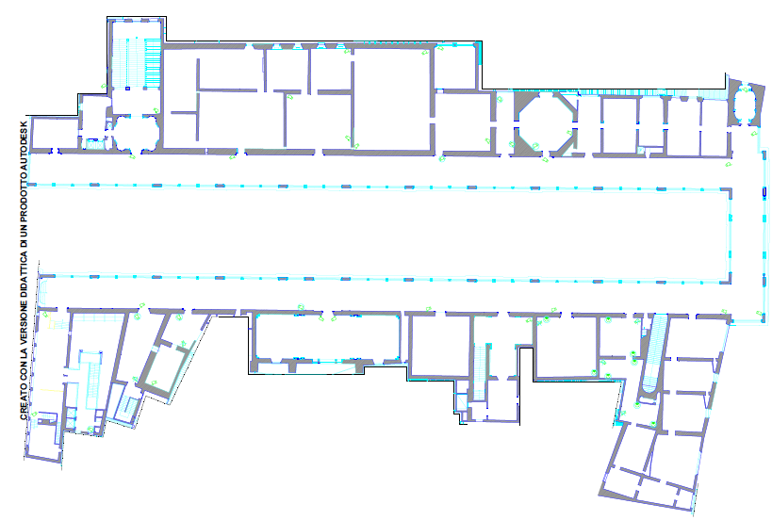

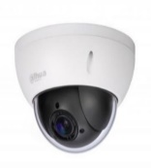
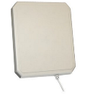
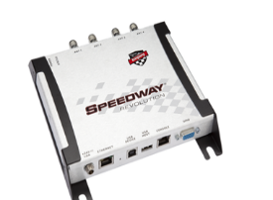
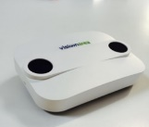
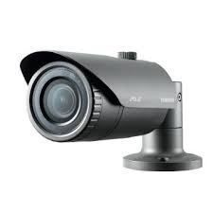
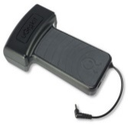

1
The Internet of Things

Slide 3
2
The Internet of Things
Huge network of connected "things"
Everything connect to the internet
      simple sensors
      smartphones
      wearable devices

Slide 4
3
The Internet of Things
allows devices on closed private internet connections to communicate with others
it is possible to "gather information and data , analyse it and create an action"

Slide 5

4
Machine Learning
Machine
Learning
    enable computers to learn from examples and experience.
    provides systems the ability to learn and improve from experience without being explicitly programmed.
Notes:
Every time the IoT sensors gather data, so there has to be someone at the backend to classify the data, process them and ensure information is sent out back to the device for decision making.
If the data set is massive, how could an analyst handle the influx?

Slide 6
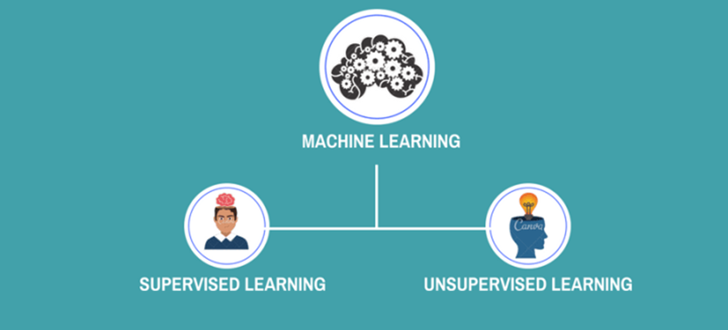
5

Slide 7
6
Both input and desired output data are provided.
Input and output data are labelled for classification to provide a learning basis for future data processing.
Mathematically, input x & output y
we can use an algorithm to derive the …..mapping function from the input to the …..output.
Notes:
Speaking mathematically, supervised learning is where you have both input variables (x) and output variables(Y) and can use an algorithm to derive the mapping function from the input to the output.

Slide 8
7
information is neither classified nor labeled.
The machine has no idea what our results should look like.

Slide 9
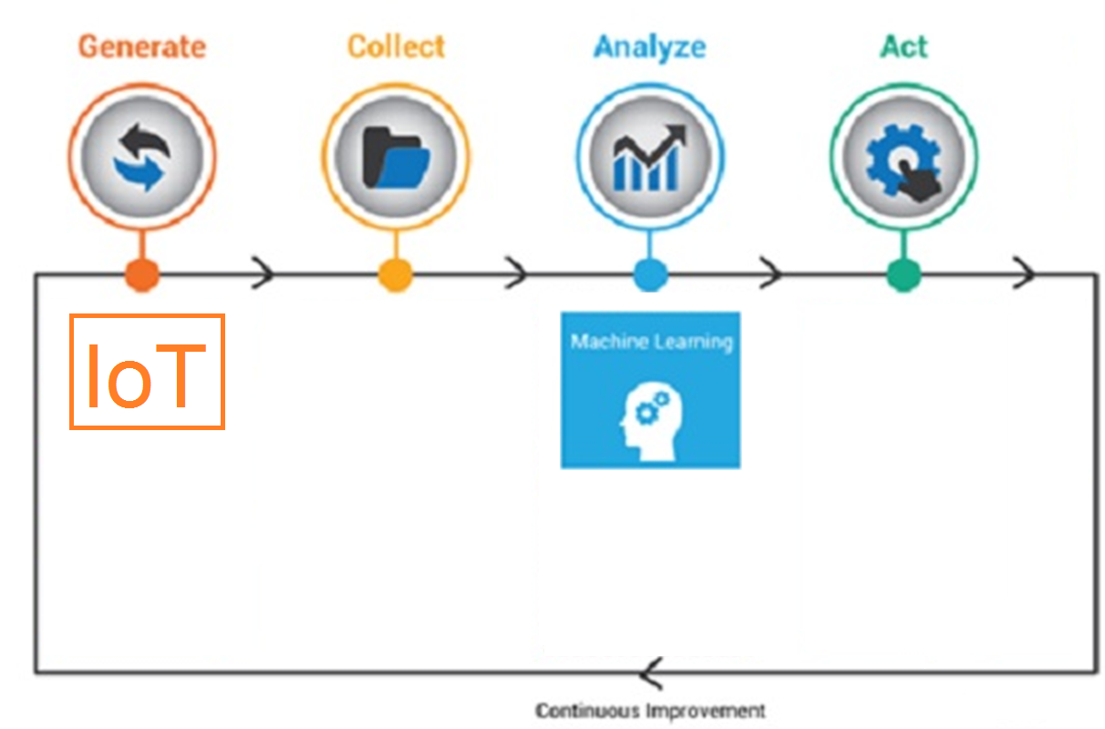
8
Notes:
Every time the IoT sensors generate and gather data, so there has to be someone at the backend to analyze and classify the data, process them and ensure information is sent out back to the device for decision making to make an action.
If the data set is massive, how could an analyst handle the influx?

Slide 10


9
Two Phases
Investigation
Comparison
Levenberg –Marquardt training algorithm
RQ1: How is mathematical principles of machine learning algorithms applied in IoT environment.
RQ2: What is the appropriate machine learning algorithm we should use for each application.
RQ3: What type of evidence is provided by existing approach of machine learning in IoT environment.
RQ4: what are the strength and limitations of the proposed approach.
Gradient descent training algorithm
Notes:
The study goal has been achieved by investigating four questions.

Slide 11
10
Part I
Investigation

Slide 12
Investigation
11
Investigates how Machine Learning algorithms are used and support the IoT data analyses.
Systematic Study
Challenges and solutions in IoT data analysis.
Notes:
1.Systematic reviews are transparent about how their conclusions are generated, also each piece of research is evaluated.
2.A 'protocol' show how the systematic review is to be conducted before the work starts.
3.Exhaustive searches are undertaken to find as much as possible of the relevant research.
4.The systematic review methods are made explicit so users of the review know if they can trust the review's findings or not.

Slide 13

Investigation
12
Investigates how Machine Learning algorithms are used and support the IoT data analyses.
Systematic Study
Notes:
There is a three-stage process to run the systematic study that we will follow:
Plaining: study goal has been achieved by invest questions that I mentioned it before.
Conducting: we will put the protocol in practice.
Reporting: the data extracted from the primary studies will collected in spreadsheet.

Slide 14
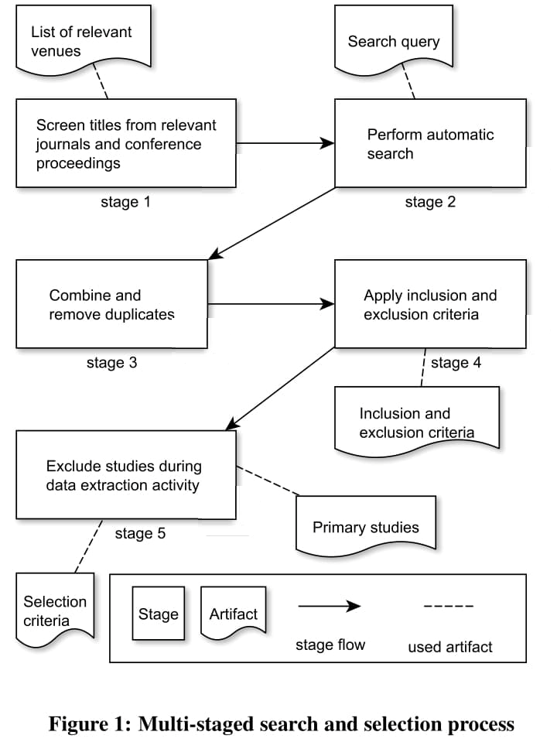
Investigation
13
Investigates how Machine Learning algorithms are used and support the IoT data analyses.
Systematic Study
Notes:
Our search strategy combine manual search an automatic search.
This chart shows each stage of our method.

Slide 15
14
Part II
Comparison

Slide 16
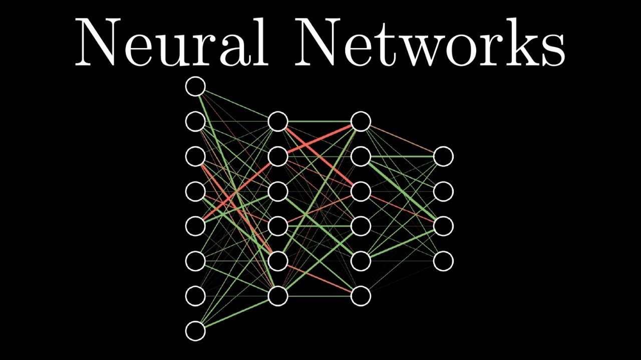
15
Notes:
from the preliminary studies that I read it until now, I have noticed that one of the most important machine learning algorithms that are used in the IoT environment is the neural network.

Slide 17
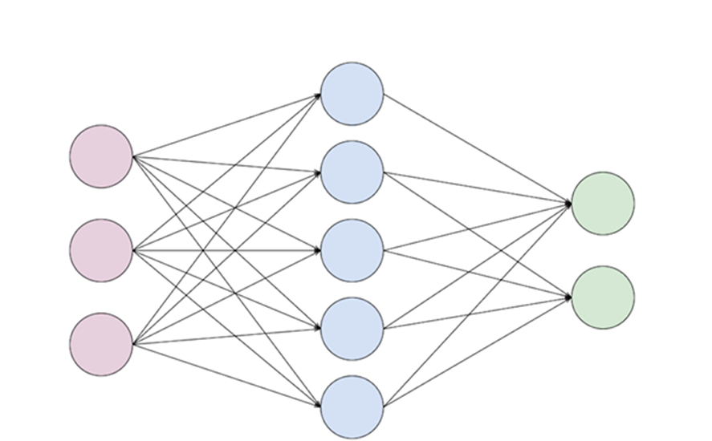
16
Model of reasoning based on the human brain.
It is composed of a large number of highly interconnected processing elements (neurons) working in unison to solve specific problems

Slide 18

17
Different techniques have been used in finding an optimal network performance
Evolutionary Algorithms (EA)
Genetic Algorithms (GA)
Back Propagation (BP) algorithm.

Slide 19
18
The learning problem in neural networks is formulated in terms of the minimization of a loss function.
Gradient descent
Levenberg-Marquardt algorithms
Notes:
For that purpose a different training algorithms have been developed.

Slide 20
19
Gradient descent
the simplest training algorithm.
first order method.
iterative technique.

Slide 21
20
Gradient descent
wi+1 = wi - ∇f·ηi, i=0,1,...
The parameter η is the training rate.
Notes:
The method begins at a point w0 and stopped until a stopping criterion is satisfied
It moves from wi to wi+1 and iterates in the following way:

Slide 22
21
Levenberg-Marquardt algorithm
iterative technique.
locates the minimum of a the loss function .
standard technique for nonlinear least-squares problems.
Notes:
standard technique for solving nonlinear least squares problems.
Least squares problems arise in the context of fitting a parameterized function to a set of measured data points by minimizing the sum of the squares of the errors between the data points and the function.
If the fit function is not linear in the parameters the least squares problem is nonlinear.
Nonlinear least squares methods iteratively reduce the sum of the squares of the errors between the function and the measured data points through a sequence of updates to parameter values.
The Levenberg-Marquardt curve-fitting method is a combination of two minimization methods: the gradient descent method and the Gauss-Newton method

Slide 23
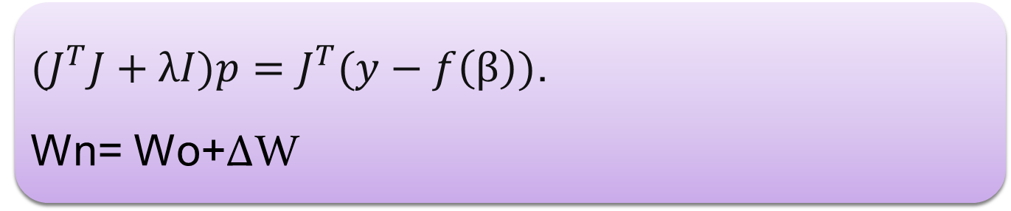
22
Levenberg-Marquardt algorithm
${(J}^{T}J+λI)p=J^{T}(y−f\left(β\right))$.
Wn= Wo+ΔW

Slide 24
23
Notes:
Applying the neural network algorithm that trained by each of the levenberg-Marquard and gradient descent algorithms on a smart campus energy consumption and then we will carry out a comparison between them using Matlab software.

Slide 25
Thanks

