Slide 1
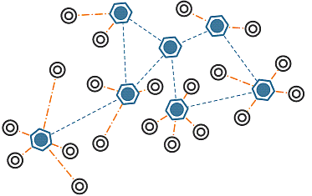
Optimizing the Power Consumption in Wireless Sensor Network using Simulation Tools based on Cluster Head Selection Algorithms: Case Study Agricultural WSN
Done by: Yasmeen Ghanem
Supervised by: Dr. Saed Tarapiah

Slide 2
Outline: Summary Introduction Literature Review Research Problem Research Significance Research Objectives Research Scope Research Questions Research Hypothesis Research Methodology Research Expected Outcomes

Slide 3
Summary
WSN management topics and optimizing the power consumption
Agricultural WSN for monitoring farming area in order to increase the probability of taking the best decision for their farming management was taken as a case study.
Data will be collected through available Agricultural WSN, data from other researchers, articles, books, interviews with farmers and journals.
Also feasibility study will implement for agricultural networks

Slide 4
Introduction
Smart
Internet of Things
(IOT)
Wireless Sensor Network
(WSN)

Slide 5
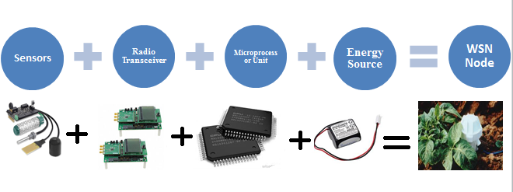
Wireless Sensor Network

Slide 6
WSN Challenges
Bandwidth
Cost
Power Optimization

Slide 7
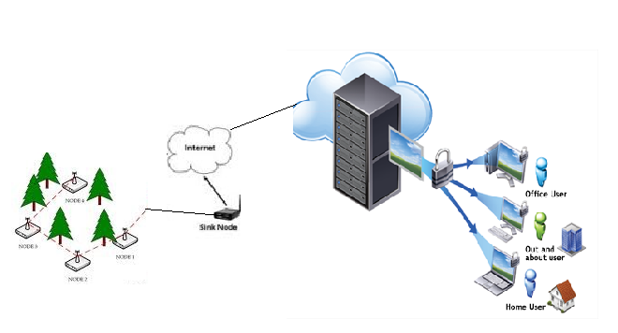
Agricultural WSN designed for monitoring agricultural system in order to increase the probability of taking the best decision for their farming management.

Slide 8
Why Agricultural WSN?
Restrictions to access
Preventing farmers from reaching their lands
Occupation
Settlers
Burning the trees
Lack of rainfall
Increased drought in the soil
Decline of the Agricultural Sector

Slide 9
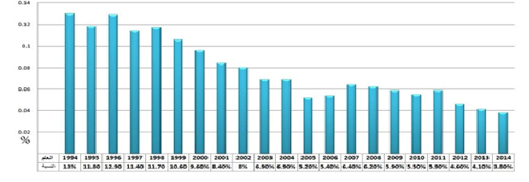
The contribution of the agricultural sector to the GDP in the last 20 year decreased by 23%

Slide 10
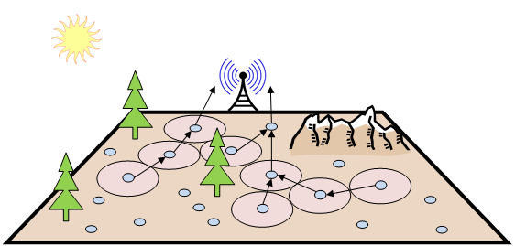
Since the main target to the system is automated monitoring, that means you don’t have to be really in your land every day. Wherever you are now or whatever challenges you face you are assured that everything in your farm will work correctly.

Slide 11
Power Consumption Rate at Different mode
In this research we will work on a network layer to optimize the power consumption according to data transition.

Slide 12
Power Optimization Technique
Authentication Scheme based power optimization technique
Ant Colony Optimization (ACO) technique
Clustering
This technique is use for draining the injected invalid data from wireless sensor network
Applied to find the near-optimal multihop routing path in mobile ad hoc networks
Divided the whole network into number of small clusters with its cluster head which is responsible for processing, aggregation and transmission data through related nodes at same region.

Slide 13
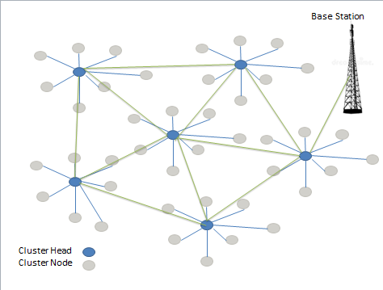
Clustering choose to be the optimizing technique for the energy consumption in the proposed agriculture WSN.

Slide 14
Selecting best CH is one of the challenges that will be focused on this proposal. Many algorithms was proposed such as:
WOA
Whale Optimization Algorithm
NRA
Node Rank Algorithm

Slide 15
LITERATURE REVIEW According to a study done in 2018, Internet of Things and smart agriculture was applied in many countries in Sub-Sahara Africa (SSA). They found that useful for the farmer in: grow more crops in any season of the year, improves farmer’s living standard and raises the economy of these countries. Node Rank Algorithm (NRA) for selecting cluster head proposed also in 2017.Theydeveloped NRA based on Low-energy adaptive clustering hierarchy(LEACH) protocol. This algorithm showed that selecting the cluster head for the cluster depend on path cost and number of links between nodes. Node Rank Algorithm provide accurate cluster head selection method and overcome the randomly selection

Slide 16
RESEARCH PROBLEM Effective performance for the network determined from connectivity, coverage, latency and the most critical one is power consumption; since the sensor node in WSN depends on batteries. The most power consumption rate is determined by transmit and receive time for data. To reach effective performance of power consumption , research will analyze selection CH algorithms such as: WOA, NRA and consider more factors like: energy balancing.

Slide 17
Research Significance Considering factors such as energy balance which is not considering before for power optimizing.

Slide 18
Research Objectives
Increase the efficiency of the network and reach lowest energy consumption rate.
Define best number of cluster that should maintain to reach lowest energy rate.
Define best shortest path between cluster head and sink and cluster member and cluster head.
Develop selecting CH algorithm considering energy balance using fitness function to choose best solution.
Test the proposed development algorithm using mainly the MATLAB simulation.

Slide 19
Research Scope To any WSN application with defined numbers of nodes and determined area. For agriculture WSN the scope will be any farming area, field, greenhouse, and mountain

Slide 20
Research Questions
What is the homogeneous optimizing technique in WSN to maintain lowest energy consumption?
What is the number of cluster that will maintain lowest energy consumption?
What is the appropriate cluster head selection technique for research case study?
How to develop useful algorithm for CH selection using fitness function considering factors such as energy balancing?
What is the suitable technique to select the path between cluster head and sink and cluster member and cluster head?
Q1
Q2
Q3
Q4
Q5

Slide 21
Research Hypothesis
Selecting cluster head plays main role in the optimal scenario for WSN performance optimization with clusters

Slide 22
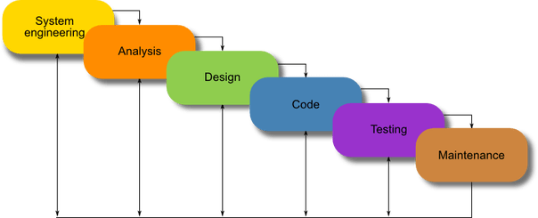
Research Methodology The approach that will follow is Waterfall Development approach. It is a sequential development approach, in which development is seen as flowing steadily through several phases: Data collection, Design, Implementation, Controlling, and Development

Slide 23
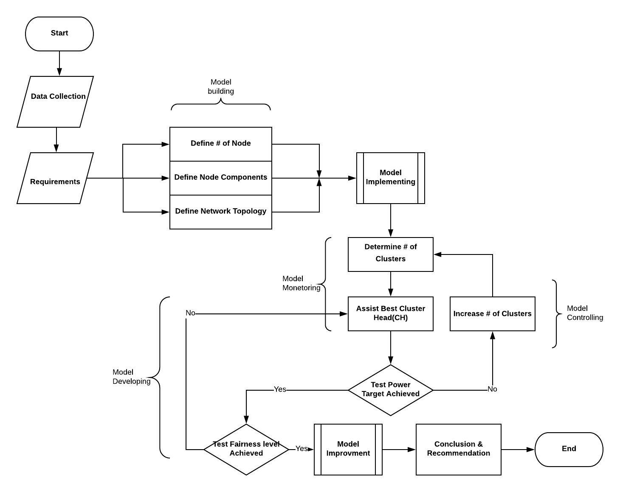
The process flow is shown below:

Slide 24
Methodology
Data Collection Phase
Primary data
Secondary data
Analysis phase
Mainly using MATLAB
Cooja simulation
Development phase
Suggestions and actions will be implemented using information gained from simulation.

Slide 25
Research Expected Outcomes
Propose cluster head selection algorithm considering energy balancing.
Feasibility Study for the proposed Agricultural WSN.
Determined the best technique from the available of cluster head selection that Appropriate to research study case.
Reach optimal power consumption after simulate the best appropriate technique.

Slide 26
That’s it. Thank you for your attention. Any questions?

Slide 27
Research Gantt chart

Slide 28
Research Budget
Item No. | Item Description | Sub-Total
1 | Data collection and processing | $ 200
2 | Scientific journal articles and reference books | $ 150
3 | Communications | $ 200
4 | Data analysis | $ 150
5 | Thesis writing and printing | $ 300
Total |  | $ 1,000

