Slide 1
An-Najah National University Faculty of Graduate Studies Engineering Management Program
Presentation of thesis entitled:
Applying Virtualized Evolved Packet Core in Palestinian Mobile Operators
Prepared By: Eng. Khawla Daraghmeh Supervisors: Dr. Saed Ttarapiah Dr. Shadi Atallla

Slide 2
Outline
Introduction
Methodology
Analysis
Results
Conclusion
Recommendation

Slide 3
Introduction-(1/4)
Research Problem
THE GLOBAL TELECOM SECTOR IS UNDER PRESSURE oF BEING A LOW PROFIT BUSINESS
The Mobile Operators at Palestine Are Facing Illegal Competition Came From Other Operators Such As Cellcom Il, and Orange Il
The Supply Chain Complexity Due to Israeli Control on Importing Telecom HW From Outside

Slide 4
Introduction-(2/4)
Objective1
Studying Different EPC NFV Models to Deploy Evolved Packet Core at Emerging Market.
Objective2
Find Out The Best Business Model to Deploy Virtualized Evolved Packet Core in Mobile Operators at Emerging Markets.
Objective3
Define the Briars and Limitations of Deploying NFV.
Objective 4
To Assess NFV Operational and Commercial Impact.

Slide 5
Introduction-(3/4)
What Are The EPC NFV Business Models And Its Use Cases in The Emerging Market
What Are The Suitable Management Models to Transform The Legacy Evolved Packet Core Network to NFV at Emerging Markets?
How NFV Will Contribute in Resources Optimization and Its Impact on The Company Overall Performance Operationally and Commercially?
What The Considerations That Shall Be Taken in Account in Deploying Virtualized EPC Commercially?

Slide 6
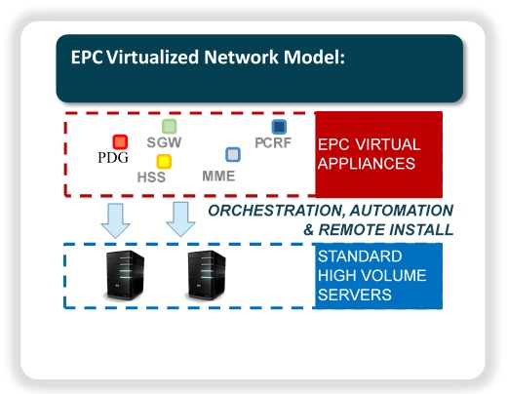
Introduction-(4/4)
The Network Functions Virtualization (NFV) Raised As A New Technology Provides An Efficient Solution That Can Enhance The Flexibility

Slide 7
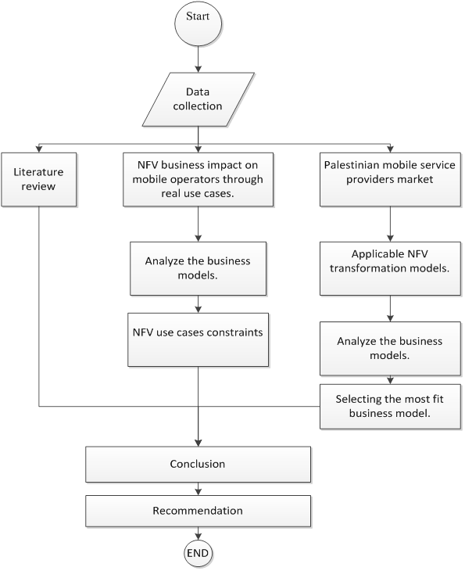
Methodology

Slide 8
SWOT Analysis
S
W
T
O

Slide 9
SWOT Analysis
STRENGTHS (+)
WEAKNESSES (–)
•Modernized core network
•Improved network team skills
•Core network has the capacity due to suitable network planning to handle customers demand with high quality.
•Ooredoo Palestine is a part of international group (Oreedo group)
•Low EBITDA
•Number of customer is less than local competitor due to their monopoly in the market for so long time.
•High OpEx
OPPORTUNITIES (+)
THREATS (–)
•Be the first choice for customers.
•Provide new services with optimum leading time and highest quality.
•Implement new technologies with optimized time.
•Israeli restrictions on applying new technologies
•Israeli restrictions on equipment' entering to Palestine.
•Increment in OpEx and decrements in Revenue in Telecom industry.
•Illegal Competition from Israeli Operators.
•High investments are required for every new technologies.
•Limitation in Vendor due to existing restrictions.

Slide 10
SOWT Analysis Result
Strength
Improved network team skills.
Threats
Israeli restrictions on equipment' entering to Palestine.
ST
Threats
Limitation in Vendor due to existing restrictions.
Opportunity
Provide new services with optimum leading time and highest quality.
Virtualization Strategy
OW
Weaknesses
Number of customer is less than local competitor due to their monopoly in the market for so long time.
Opportunity
Implement new technologies with optimized time.

Slide 11
Models Analysis
Owned Legacy
Owned NFV
IaaS
PaaS
SaaS
Applications
Applications
Applications
Applications
Applications
Application
Application
Application
Application
Application
Data
Data
Data
Data
Data
Data
Data
Data
Data
Data
Runtime
Runtime
Runtime
Runtime
Runtime
Run time
Run time
Run time
Run time
Run time
Middleware
Middleware
Middleware
Middleware
Middleware
Middleware
Middleware
Middleware
Middleware
Middleware
Managed by you
Op.Sys.
Op.Sys.
Op.Sys.
Op.Sys.
Op.Sys.
Managed by vendor
Op.Sys
Op.Sys
Op.Sys
Op.Sys
Op.Sys
Virtualization
Virtualization
Virtualization
Virtualization
Virtualization
HW
Virtualization
Virtualization
Virtualization
Virtualization
servers
servers
servers
servers
servers
Servers
Servers
Servers
Servers
Storage
Storage
Storage
Storage
Storage
Storage
Storage
Storage
Storage
Storage
Networking
Networking
Networking
Networking
Networking
Networking
Networking
Networking
Networking
Networking
Managed by Operator
Owned Legacy
Owned NFV
NFVIaaS
VNPaaS
VNSaaS
Managed by Vendor

Slide 12
KPIs Analysis
Security Threats
CAPEX
OPEX
QoS (Availability, SLA, Service Redundancy)
Time to Market
Services Value Proposition
Management Complexity
Operation Complexity
Overcome the Regulation Issues
Follow Regulation Policies and Recommendation

Slide 13
Study Case Analysis
GGSN
SGSN
BSC
IP Network
HLR
2G
MSC
PSTN/ISDN
RNC
MGW
3G
RAN
Core Network
Other Networks

Slide 14
Study Case Analysis
Operator Readiness
KPIs Weight
KPIs Rate
Select the Model

Slide 15
Study Case Analysis/ Readiness Survey
2.6
EPC_NFV Ambition
3
Product and services
challenges in preparing your business for EPC –NFV
3.2
Impacted by move to EPC NFV
company view of EPC-NFV advantage
2.67
EPC-NFV technologies enablement
3
EPC-NFV KPIs effects
2
2.71
In the Readiness Survey, Ooredoo Showed its Interest in Virtualization Technology

Slide 16
Study Case Analysis/ KPIs Wight
6.80%
14.27%
13.18%
Security Threats
CAPEX
OPEX
QoS (Availability, SLA, Service Redundancy)
10.33%
Time to Market
9.65%
Services Value Proposition
9.65%
Management Complexity
6.80%
Operation Complexity
11.42%
Overcome the Regulation Issues
11.81%
Follow Regulation Policies and Recommendation
6.10%

Slide 17
Study Case Analysis/ KPIs Rate
KPI /Model | Legacy | NFV - Owned | NFVIaaS | NFVSaaS | NFVPaaS
Reduce CAPEX | 1.00 | 2.00 | 3.00 | 5.00 | 5.00
Reduce OPEX | 4.00 | 5.00 | 4.00 | 1.00 | 2.00
Improve QoS (Availability, SLA, Service Redundancy ..etc.) | 3.56 | 4.44 | 3.78 | 2.56 | 2.89
Minimize the Security Threats | 4.00 | 3.00 | 1.00 | 1.00 | 1.00
Optimize the time to Market | 1.80 | 4.00 | 4.40 | 4.20 | 3.40
Products and Services Value Proposition | 1.00 | 4.00 | 3.80 | 3.40 | 3.60
Reduce Management Complexity | 1.20 | 2.80 | 3.40 | 4.40 | 3.60
Reduce Operation Complexity | 1.00 | 2.50 | 3.00 | 5.00 | 4.00
Overcome the Regulation issues | 1.00 | 4.00 | 5.00 | 5.00 | 5.00
Follow Regulation policies and Recommendation | 5.00 | 5.00 | 2.00 | 2.00 | 2.00

Slide 18
Study Case Result/Selected Model
NFV Owned Model (vEPC) is the Recommended Solution for Ooredoo Palestine Case According to the Analysis Engines and Company Inputs.
Legacy | NFV - Owned | NFVIaaS | NFVSaaS | NFVPaaS
2.4 | 3.8 | 3.5 | 3.2 | 3.2

Slide 19
Study Case Result/Risk Identification
Risk Identification |  |  |  | Inherent Risk Assessment
Rank | Risk Description | Perceived Cause | Risk Category | Impact | Probability | Inherent Risk Severity
1 | Service Drop | Due to Disconnection Through Implementation and Integration stage | Internal | 5 | 4 | 20
3 | Availability of Virtualization Experts and Consultants | Difficulty to Find Virtualization Experts Willing to Work in Palestine Based on a Short Term Contract | External | 3 | 5 | 15
4 | Delay and Additional Cost in the Project | The Concept May Be Changed in Later Stages According to Vendors Systems | External/Internal | 3 | 3 | 9
1 | Security Threats | Virtual Mobile Networks Become vulnerable to a Number of Security Threats. | External | 5 | 4 | 20

Slide 20
Study Case Conclusion/Risk Assessment
 |  | Residual Risk Assessment
Rank | Risk Description | Residual Risk Assessment | Impact | Probability | Residual Risk Severity
1 | Service drop | To Do Virtualization in Multi Stages Starting with Less Important Nodes That Has less Impact on Customers Services | 5 | 3 | 15
3 | Availability of virtualization Experts and Consultants | Accelerate the Training Plan for WM Team. Utilize the Oreedo Group Mobility to Bring Experts. | 3 | 3 | 9
4 | Delay and Additional Cost in the Project | N/A | 3 | 3 | 9
1 | Security Threats | Some of Existing Threats Can be leveraged Using Some Available Mitigation Techniques, Security Expert Should be Available to Minimize Effect of These Threats | 3 | 4 | 12

Slide 21
Study Case Recommendation
Based On Analysis Result, Owned NFV (Vepc) Model Is Recommended To Ooredoo Palestine As It’s The Most Fit To Their Objectives .
In General, The Mobile Operator Has To Address The Risks Of Owned NFV Before Implementation And Do Required Assessments To Mitigate
For Ooredoo Palestine Case Its Recommend To Apply The Following Mitigation Plans:
To Implement The Virtualization In Multi Stages Starting With Less Important Nodes That Has Less Impact On Customers Services, With Service Backup Plan.
Accelerate The Training Plan For Ooredoo Team. Utilize Ooredoo Group Mobility Program.
To Leverage The Existing Security Threats Using Different Mitigation Techniques, Such As Hire Security Expert To Minimize The Security Threats Impacts.

