Slide 1
An-Najah National University
Faculty of Graduate Studies
Engineering Management Program
Presentation of thesis Proposal entitled:
AL - Najah National University
Analyzing the service management functions in Virtualized Evolved Packet Core (vEPC)
Prepared By: Eng. Khawla Daraghmeh
Supervisors:
Dr. Saed Ttarapiah Dr. Shadi Atallla

Slide 2
Outline
Introduction
Research Problem
Research Questions
Literature Review
Objectives
Deliverables
Methodology

Slide 3

Introduction – (1/5)
65%
Smartphone adoption is accelerating in developed countries .
40%
Smartphone adoption is Accelerating in developing countries.
90%.
Its potential to reach by 2020

Slide 4

Introduction – (2/5)
Rapid Growth In Data Services Demand ➔ Revenue Growth Struggles ➔ EBITDA decreases
Total global revenue

Slide 5
Introduction – (3/5)
The huge demand of data traffic ➔ handled in the mobile operators using the Evolved Packet core network (EPC)
Evolved Packet Core (EPC)

Slide 6
Introduction – (4/5)
Increasing Gap Between Capacity And Demand Is A Significant Sign For Deploying New Approaches And New Network Architects To Enable Mobile Operators To Handle More Traffic With Less Cost
The Network Functions Virtualization (NFV) Raised As A New Technology Provides An Efficient Solution That Can Enhance The Flexibility

Slide 7
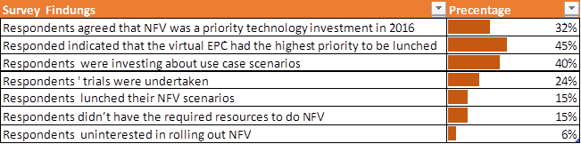
Introduction – (5/5)

Slide 8
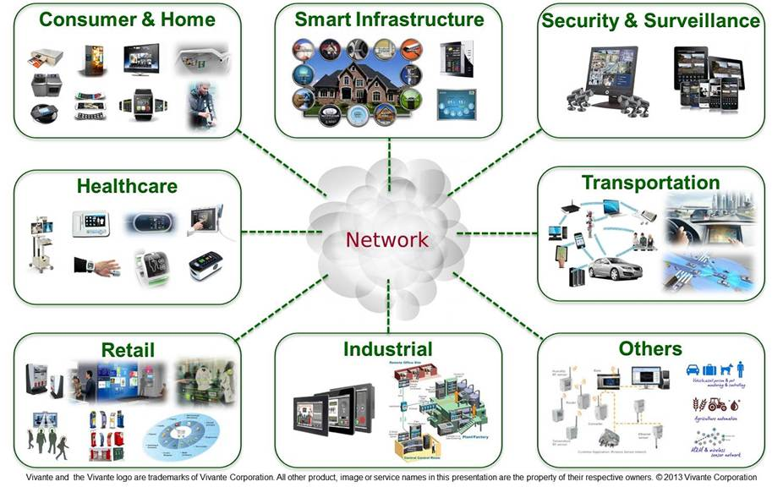

Literature Review – (1/2)

Slide 9
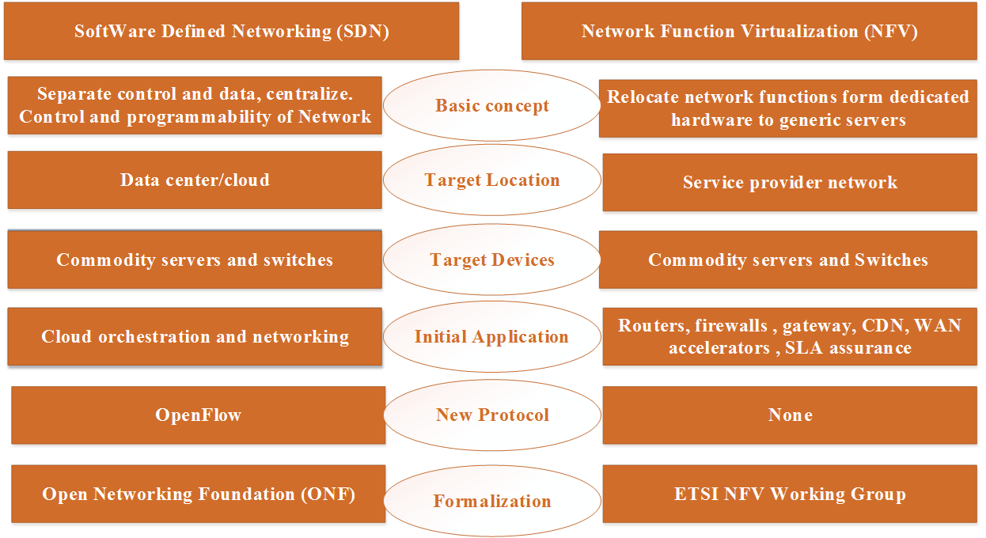
Literature Review – (2/2)

Slide 10
Research Problem
The Traffic demand is increasing rapidly → OPEX/CAPEX is increasing to handle demand → while telecom profit is declining
Supply Chain Challenge and Time to Market → Due to Special HW manufacturing and delivery
Palestinian Market has special case due to political/customs constrains in HW delivery
Mobile operators in Palestine face illegal competition

Slide 11
Research Questions
What the current EPC architecture and its related issues?
How to plan for NFV from business prospective considering the technical and financial aspects?
What are the suitable management models to transform the legacy evolved packet core network to NFV?
How NFV will contribute in resources optimization in terms of cost and capacity?
What are the effects of NFV on overall KPIs that related to customer and mobile operators?
How security aspects will be addressed considering NFV?
How NFV will help in time to market in introducing new technologies?
What the considerations that shall be taken in account in deploying Virtualized EPC commercially?

Slide 12
Objectives
Objective1
Studying different models to deploy evolved packet core at emerging market.
Objective2
Find out the best business model to deploy virtualized evolved packet core in mobile operators at emerging markets.
Objective3
Define the briars and limitations of deploying NFV.
Objective 4
To assess NFV operational and commercial impact.

Slide 13
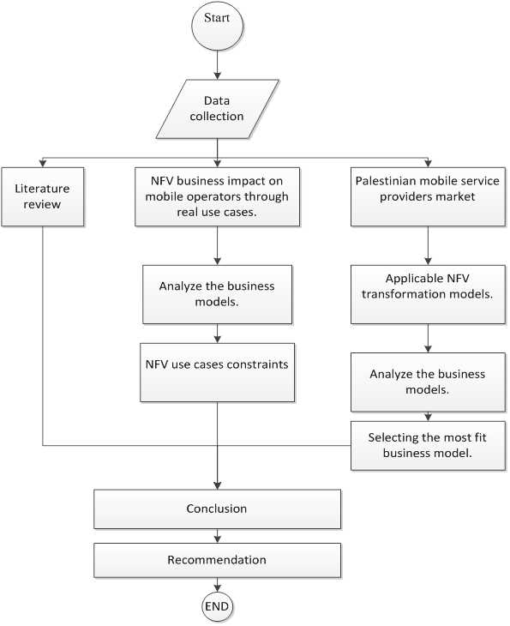
Methodology

Slide 14
Deliverables
Scenario analysis for selected applicable management models of rollout NFV within mobile packet core network
Defining the most fit applicable model for the mobile operator in Palestinian market
Illustrate the best practices and points that shall be taken in consideration in deploying the NFV model at mobile packet network.
NFV Selected Model evaluation and benchmark for overall KPIs

Slide 15


