Slide 1
Classical Mechanics
Gravitation and Central Forces

Slide 2
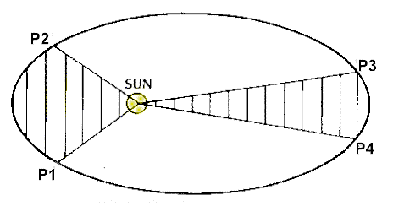
Copernicus : Planets travel in circles around the sun.
Explained retrograde motion of planets.
Tycho Brahe : Precise measurements of orbits.
kepler :
Kepler’s laws:
1. Planets orbit the sun in ellipses with the
sun at one of the foci.
2. Equal areas in equal time.
3. T² α a³

Slide 3
Galileo : acceleration by gravity independent of mass.
Newton :
Compare with electrostatics:
Is it really the same m on both sides of the
equation?
Einstein : Yes it is.
Gravitational mass
Inertial mass

Slide 4
Newton’s law of universal gravitation:
: The force on particle i of mass m_{i} exerted by particle j of mass

Slide 5
Kepler’s laws of planetary motion:
Law of Ellipses(1609):
“The orbit of each planet is an ellipse, with the Sun located at one of its foci”.
Law of Equal Areas(1609):
“A line drawn between the Sun and the planet sweeps out equal areas in equal times as the planet orbits the Sun”.
Harmonic law(1618):
“The square of the sidereal period of a planet "the time it takes a planet to complete one revolution about the Sun relative to the stars" is directly proportional to the cube of the semimajor axis of the planet’s orbit. T² α a³
Semimajor
Semiminor

Slide 6
Kepler’s second law: Equal Areas
Conservation of Angular Momentum:
0
Is the momentum of force or torque on the particle about the origin of the coordinate system.

Slide 7
is angular momentum.
is torque.
If and are parallel, then and .
Force of gravity is:
So angular momentum is conserved.
Angular momentum and areal velocity of a particle moving in a central field.

Slide 8
Consider a planet orbiting the sun:

Slide 9
Area swept out by the radius vector:
L and m are constants
→Equal area dA in equal time dt.

Slide 10
Kepler’s First law: Law of Ellipses
Consider a general central force:

Slide 11
Angular momentum per unit mass.

Slide 12
We don’t necessarily want to know what is.
We just want to know the shape of the orbit.
Derive an equation for the orbit:

Slide 13
This is the differential equation for the orbit .

Slide 14
Example 6.5.1 :
A particle in a central field moves in the spiral orbit r=cθ² . Determine the force function.
Solution:

Slide 15
Thus, the force is a combination of an inverse cube and inverse-fourth power law.

Slide 16
Example : Inverse-square law

Slide 17
We can pick θ₀=0 by choosing a suitable orientation of the coordinate axes.
Major axis is 2a , a : semimajor axis.
Minor axis is 2b, b : semiminor axis.
This is the equation
for an ellipse.

Slide 19
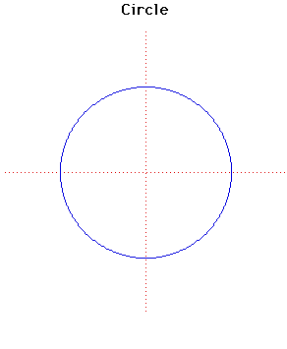
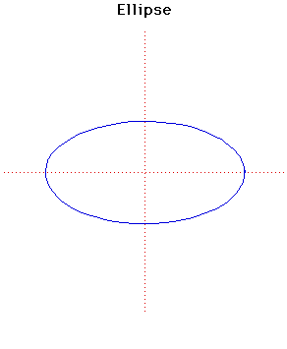
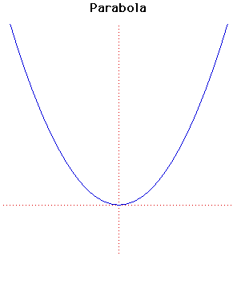
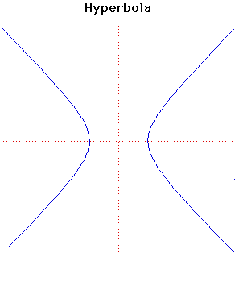
If ε = 0 it is a circle
If ε < 1 it is an ellipse
If ε = 1 it is a parabola
If ε > 1 it is a hyperbola

Slide 20
ε : Eccentricity : each focus displaced from center by εa .
α : Latus rectum : distance of focus from point on the
ellipse perpendicular to major axis: α =(1 − ε²)a .
r₀ : distance from the focus to the pericenter : r₀ =(1−ε)a
r₁ : distance from the focus to the apocenter : r₁ =(1+ε)a

Slide 21
Apogee
Earth
Perigee

Slide 22
Kepler’s third law: Harmonic Law
We want to show that T² α a³

Slide 23
Relationship between ε and a :

Slide 24
The square of a planet’s orbital period is proportional to the cube of its “distance” from the Sun. The relevant “distance” is the semimajor axis a of the elliptical orbit. In the case of a circular orbit, this distance reduces to the radius.
The constant is the same for all objects in orbit about the Sun, regardless of their mass.
If distances are measured in astronomical units
and periods are expressed in Earth years, then .
Kepler’s third law then takes the very simple form .
(Note: Most of the planets have nearly circular orbits, with the exception of Pluto, Mercury, and Mars).

Slide 25
Potential Energy in a General Central Field:
Central forces are conservative:
If we write:
The gravitational potential energy per unit mass is defined by:

Slide 26
Ф(r) is additive: If M₁ , M ₂ ,... are masses at
then
It is convenient here to employ spherical coordinates:

Slide 27
For our central force F_{r} = f(r) , F_{θ} = 0 , F_{ϕ} = 0

Slide 28
Energy Equation of an orbit in a Central Field:
Energy is conserved:
Energy Equation
of the orbit

Slide 29
Example 6.9.1 :
As in Ex. 6.5.1

Slide 30
Orbital Energies in an inverse-square field:

Slide 33
Compare with

Slide 34
E < 0 , ε < 1 closed orbits (circle or ellipse)
E= 0 , ε = 1 parabolic orbit
E > 0 , ε > 1 hyperbolic orbit

Slide 35
Because E = T + V and is constant, the closed orbits are those for which T < |V|, and the open orbits are those for which T ≥ |V|.
Total Energy:

Slide 36
Limits of the Radial Motion: Effective Potential
From Equation(6.9.2):

Slide 37
The function U(r) defined here is called the effective potential.
The term mℓ²/2r² is called the centrifugal potential.
The limits of the radial motion (turning points) are given by setting ṙ̇=0 in eqn.(3).
These limits are, therefore, the roots of the eqn.
The allowed values of r are those for which U(r) ≤ E, because ṙ̇² is necessarily positive or zero.

Slide 38
Example : Inverse-square law
which is a quadratic eqn. in r.
The two roots are:

Slide 39
giving the maximum (upper sign)and minimum (lower sign) values of the radial distance r under the inverse-square law of force.
When E < 0, the orbits are bound, the two roots are both positive, and the resulting orbit is an ellipse in which r₀ and r₁ are the pericenter and apocenter, respectively.
When the energy is equal to its minimum possible value

Slide 40
When E ≥ 0 ⟹ eqn.(a) has only a single positive real root corresponding to a parabola (E = 0 ) or a hyperbola (E > 0 ).
Fig. : The effective potential for the inverse-square law of force and limits of the radial motion.

Slide 41
Nearly circular orbits in central fields: stability

Slide 42
For a circular orbit , r is constant, and r̈ = 0
Thus calling a the radius of the circular orbit,
D.E. for radial motion then becomes:
Expanding the two terms involving (x + a) as power series in x ,

Slide 43
Eqn.(5), by virtue of the relation shown in Eqn.(2)
reduces to
if we ignore terms involving x² and higher powers of x.
If the coefficient of x in eqn.(6) is positive, then the eqn. is the same as that of the Simple Harmonic Oscillator.
In this case the particle, if perturbed, oscillates harmonically about the circle r = a, so the circular orbit is a stable one.

Slide 44
On the other hand, if the coefficient of x is negative, the motion is nonoscillatory, and the result is that x eventually increases exponentially with time, the orbit is unstable.
(If the coefficient of x is zero, then higher terms in the expansion must be included to determine the stability).
Hence, we can state that a circular orbit of radius a is stable if the force function f(r) satisfies the inequality.

Slide 45
Example :
If the radial force function is a power law:
then the condition for stability reads
which reduces to n > −3

Slide 46
Thus, the inverse-square law (n = −2 ) gives stable circular orbits, as does the law of direct distance (n = 1 ).
For the inverse-fourth power (n = −4 ) circular orbits are unstable.
It can be shown that circular orbits are also unstable for the inverse-cube law of force (n = −3 ) .
To show this it is necessary to include terms of higher power than 1 in the radial eqn.(See problem 6.26 ).

Slide 47
Review:
Gravitation and planetary motion:
Planets move in ellipses with the sun at one foci.
Kepler’s third law:
Apogee
Perigee
Earth

Slide 48
Potential Energy:
Gravitational potential energy per unit mass:
defined so that V(r)= m𝛷 (r)
Stable orbits have E < 0.
Parabolic orbits have E = 0.
Hyperbolic orbits have E > 0.

Slide 49
Orbital Maneuvers:
Problem:
How do you move a satellite from one orbit to another?
Example:
A satellite is lunched into a low altitude elliptical orbit.
How do you get it into a circular orbit?
How do you get it into a high altitude circular orbit?
Solution:
Increase v at points of perigee or apogee:

Slide 50
earth
Initial elliptical orbit has apogee r₀ and eccentricity ℇ .

Slide 51
So the initial velocity is determined by:
The new orbit will have ℇ₁=0 and radius r₁=r₀ .

Slide 52
Example :
1 Nautical mile
=1.852 km

