Slide 1
Classical Mechanics
Newtonian Mechanics

Slide 2
All of mechanics boils down to Newton’s three laws.
The second law is
What exactly is ?
We can measure m using a scale:

Slide 3
But this just tells us when and are the same
without explaining what mass actually is.
You could use a spring scale:
But this is just says:
that the earth appears to produce
a force that is proportional to m.

Slide 4
Here’s another way:
Push on two objects with the same force.
The ratio of their masses is defined as the ratio of their velocities.
One way to make sure they get the same force is Newton’s 3rd law.

Slide 6
Newton’s second law is :
We define the constant of proportionality to be 1 so that F=ma.
Given units of time, length and mass, this defines the units of force.

Slide 7
Now, consider two very different ways that we use mass:
First is F=ma.
Next, consider a force caused by an electrostatic charge:
F is proportional to q₁ and q₂.
Gravity is similar
So m is like a gravitational charge.

Slide 8
Is m really the same on both sides?
This is known as the equivalence principle:
gravitational mass = inertial mass
Experiments tested this and found it to be true to a high degree of accuracy.
General Relativity resolves this mystery… There really is only one mass.

Slide 9
Rectilinear Motion: uniform acceleration under a constant force.
Motion in a straight line (e.g. call it the x-axis)
This is a simple differential equation, but F could be arbitrarily complicated.

Slide 10
We will examine how to solve this for a few special
forces.
Constant Force: F = const.
In this case, x(t) can be obtained by integration.

Slide 12
Another important case: F is not exactly constant, but is “piecewise” constant.
In this case: the problem can be solved in pieces.
E.g. Friction Forces:
In this case

Slide 13
Example:
Case 1: Assume (moving down)
calculate :

Slide 14
Differential equation for x(t) :
Consistency check:
If then would be negative
(Not what we assumed). So for this to be the solution
we must have

Slide 15
If this is the case then we can write:
Then
In particular, any initial velocity must be positive.

Slide 16
What about if (moving up the ramp)?
Then
Then
The only way we can have
is if , that is if

Slide 17
A block is pushed up a ramp with initial velocity .
How long will it take to return to the starting point?
First part, moving up until it comes to rest.

Slide 18
At this time,
Second part, sliding back down.

Slide 19
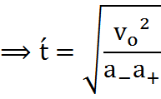
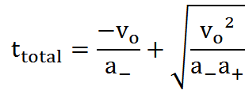
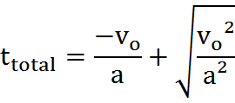
Total time is
Suppose that then
and then

Slide 20
Second case: Force depends on velocity.
viscous drag resists the motion of an object through a fluid.
In this case
or
This is the case for objects falling in liquids or ting objects in a gas, but quadratic drag is more typical in gases.
For a sphere of diameter D (in meters).

Slide 21
Example:
Forces are:
Two ways to solve this:

Slide 22
We can write it as a first order differential equation in v:
or
For convenience, let
A solution can be obtained by integrating:

Slide 25
Another method:
Linear second order D.E. with constant coefficients:
In this case there is no term proportional to x.
The Homogeneous equation is with the term on the right equal to zero.
If solves the Homogeneous equation and if is ANY function that solves the non homogeneous equation, then a general solution is:

Slide 26
Constructing solutions to the Homogeneous equation.
Let
We have
=
&
Then the solution of the Homogeneous equation is given by
Notes:
Let

Slide 27
So
A particular solution can be obtained by inspection:
Since

Slide 28
The general solution is:
Where A and B depend on the initial conditions.
Suppose x(0)= 0
Then
A + B=0 → A= –B

Slide 29
Suppose v(0)=0.
Then
So

Slide 30
Compare with previous solution:

Slide 31
Rectilinear Motion:
We are considering solutions to the differential equation with initial conditions for different types of forces, F.
Case 1: F = constant → constant acceleration
Then
Case 2: Suppose F is some function of velocity, then we can write F=f(v)
and

Slide 32
In principle this can be solved by integration:
This gives an equation of the form:
If this can be solved for v(t), then x(t) can be obtained by integration.
Works for simple cases like when:

Slide 33
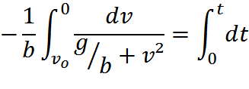
Example:
A bullet is fired straight up with initial velocity .
How long will it take to land?
.

Slide 34
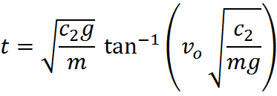
Turns out to be

Slide 37
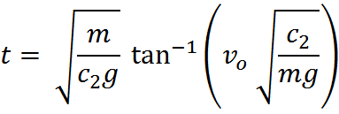
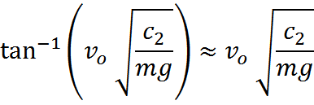
Does this give the same answer?
If is very small, then

Slide 38
How high does it go?
We could integrate v(t) to obtain x(t) and substitute in the value of t we just obtained.
Or, we can solve for v as a function of x directly:
In this case:

Slide 39
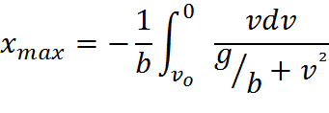

Slide 40
Forces that are functions of position.
Examples:
1. Constant forces.
2. Spring F= –k x.
3. Gravity (or electrostatics).
Others?
We rearrange as follows:

Slide 41
If we could find a function V(x) such that:
then we would have:
Which is easy to integrate
We call:
the kinetic energy.
the potential energy.
the total (mechanical) energy.

Slide 42
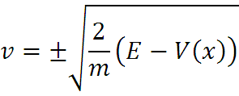
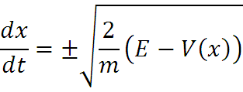
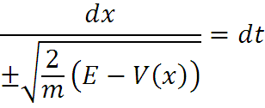
In principle, we could solve for v :
Only makes sense when E > V(x) which defines the allowed ranges of x.

Slide 43
Some important examples…
Very useful since any potential energy function that has a minimum at can be written as

