Slide 1
Petri net Introduction
Prepared by Dr. Ahmad Shraideh

Slide 2
What are Petri nets
Were presented by Carl Adam Petri in his dissertation in 1962
Petri nets are a graphical and mathematical modeling tool applicable to many systems
A promising tool for describing and studying information processing systems that are
Concurrent,
Asynchronous,
Distributed,
Parallel,
Nondeterministic, and/or stochastic
As a graphical tool, They can be used as a visual-communication

Slide 3
application areas are
Performance evaluation
Communication protocols
Modeling and analysis of distributed-software systems and database systems
Control systems
Dataflow computing systems
Etc...

Slide 4
Petri-nets definition
Petri net is a directed, weighted, bipartite graph N
They consist of two kinds of nodes
Places (circles)
places represent conditions
Transitions bars or boxes
Transitions represent events
Arcs connect places to transitions
Arcs are either from
Place to a transition
Transition to a place
Are labeled with their weights (positive integers)
k-weighted arc can be interpreted as the set of k parallel arcs
We place k black dots (tokens) in place p

Slide 5
Some Typical Interpretations of Transitions and Places

Slide 6
Petri-nets marking
A marking is denoted by M
An m-vector, where m is the total number of places
The p^{th} component of M is denoted by M(p) and it is equal the number of tokens in place p
Marking (state)
Assigns to each place anon negative integer
If a marking assigns to place p a nonnegative integer k, we say that p is marked with k tokens
Initial state called the initial marking (M_{O} )

Slide 7
Petri-nets marking
The marking of a Petri net represents its state
The state of the following Petri net is represented by
M = [1, 1, 1, 0, 0, 1, 0]
M(p1) = M(p2) = M(p3) = M(p6) = 1
M(p4) = M(p5) = M(p7) = 0

Slide 8
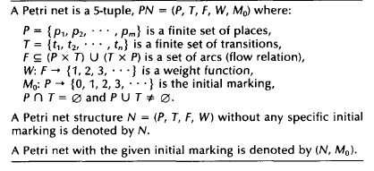
Formal Definition of a Petri Net

Slide 9
Transition (firing) rule
The structure of Petri nets is fixed
But tokens may change their position according to firing rules
Tokens current distribution among the places determines the state of the Petri net and, thus, of the system it models
A transition may fire if it is enabled
A transition t is said to be enabled if each input place p of is marked with at least w(p,t) tokens, where
w(p,t) is the weight of the arc from p to t.

Slide 10
Transition (firing) rule
An enabled transition may or may not fire (depending on whether or not the event actually takes place)
A firing of an enabled transition t removes w(p, t) tokens from each input place p of t, and adds w(t, p) tokens to each output place p of t
w(t, p) is the weight of the arc from t to p
Transitions fire instantly without consuming time

Slide 11
Transition (firing) rule
A transition without any input place is called a source transition
A transition without any output place is called a sink transition
A source transition is unconditionally enabled
The firing of a sink transition consumes tokens, but does not produce any

Slide 12
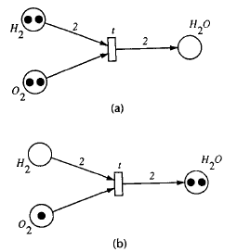
Examples

Slide 13
Examples

Slide 14
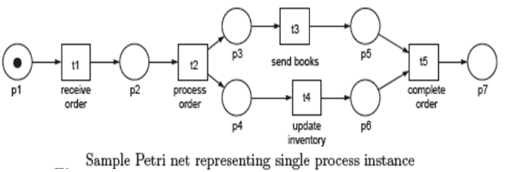
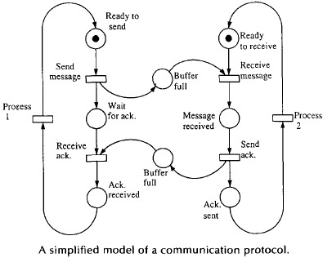
Examples

Slide 15
Petri-net state change
The firing of a transition is represented by a state change of the Petri net

Slide 16
Incidence Matrix and State Equation
It is used to study the dynamic behavior of a systems by differential or algebraic equations
For a Petri net N with n transitions and m places, the incidence matrix A = [a_{ii}] is an n x m matrix of integers and its typical entry is given by
where a_{ij}⁺ (Post)= w(i, j ) is the weight of the arc from transition i to its output place j and a_{ij}⁻ (Pre)= w(j, i ) is the weight of the arc to transition i from its input place j
M=M₀+ A. α
where α is the vector of enabled transitions for M₀

Slide 17
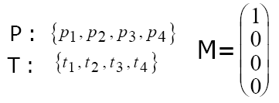
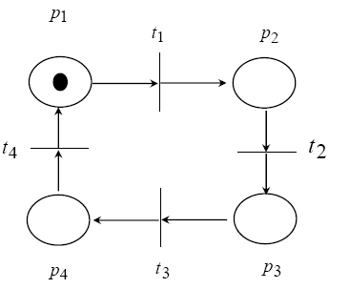
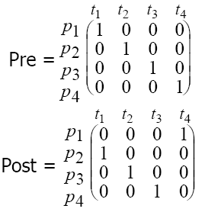
Incidence Matrix and State Equation

Slide 18
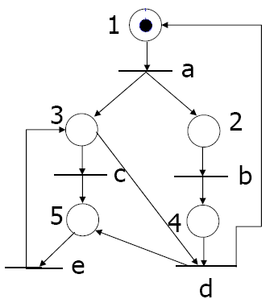
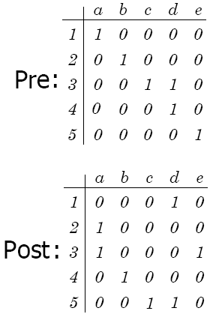
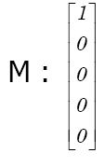
Incidence Matrix and State Equation
What would be the Petri-net?

Slide 19
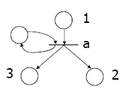
Petri-nets properties
A Petri net is said to be pure if it has no self-loops (p is both an input and output place of t)
A Petri net is said to be ordinary if all of its arc weights are 1’s
An example on non pure Petri-nets

Slide 20
Petri-nets properties
Reachability
Fundamental basis for studying the dynamic properties of any system
A sequence of firings will result in a sequence of markings
A marking M_{n}, is said to be reachable from a marking M_{o} if there exists a sequence of firings that transforms M_{o} to M_{n}
The set of all possible markings reachable from M_{o} in a net (N, M_{o}) is denoted by R(N, M_{o}) or simply R(M_{o})
Thus, reachability problem for Petri nets is the problem of finding if M_{n} is in R(M_{o}) for a given marking M_{n} in a net (N, M_{o})

Slide 21
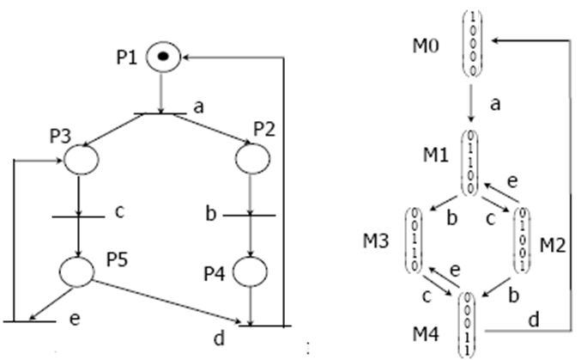
Petri-nets properties
Reachability

Slide 22
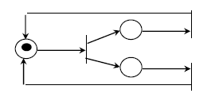
Petri-nets properties
Boundedness
A Petri net (N, M_{o}) is said to be k-bounded or simply bounded if the number of tokens in each place does not exceed a finite number k for any marking reachable from M _{o}
i.e., M(p)< k for every place p and every marking M in R(M _{o})
A Petri net (N,M_{o}) is said to be safe if it is 1-bounded
The following is unbounded Petri-nets Why?

Slide 23
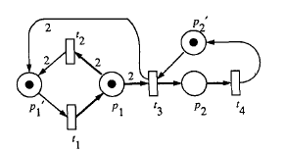
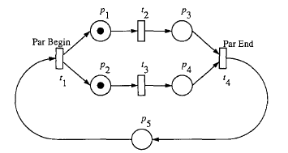
Petri-nets properties
Boundedness
2-Bounded Petri-net
Safe Petri-nets

Slide 24
Petri-nets properties
Liveness
The concept of liveness is closely related to the complete absence of deadlocks in operating systems
A Petri net (N,M_{o}) is said to be live (or equivalently M_{o} is said to be a live marking for N) if, no matter what marking has been reached from M_{o}, it is possible to ultimately fire any transition of the net by progressing through some further firing sequence
This means that a live Petri net guarantees deadlock-free operation, no matter what firing sequence is chosen

Slide 25
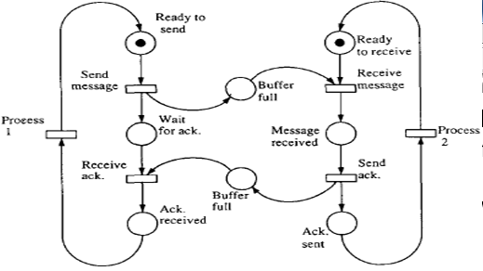
Petri-nets properties
Liveness
Live Petri-nets

Slide 26
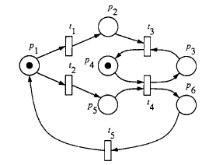
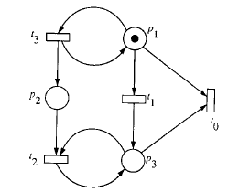
Petri-nets properties
Liveness
Non-Life Petri-nets

Slide 27
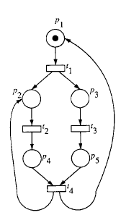
Petri-nets properties
Persistence
A Petri net (N, M_{o})is said to be persistent if, for any two enabled transitions, the firing of one transition will not disable the other
A transition in a persistent Ptri-net, once it is enabled, will stay enabled until it fires

Slide 28
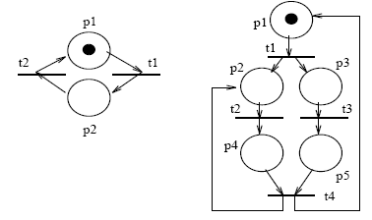
Petri-nets properties
Fairness (bounded-fairness)
A Petri net (N, M_{o})is said to be a B-fair net if every pair of transitions in the net are in a B-fair relation
Two transitions t1 and t2 are said to be in a bounded-fair (or B-fair) relation
If the maximum number of times that either one can fire while the other is not firing is bounded
B-Fair
None B-fair

Slide 29
Petri-nets properties
Reversibility
In reversible net one can always get back to the initial marking or state
A Petri net (N,M _{o}) is said to be reversible, if for each marking M∈R(M_{o}), M_{o} is reachable from M
Home state
A marking M’ is said to be a home state if, for each marking M∈R(M_{o}), M’' is reachable from M

Slide 30
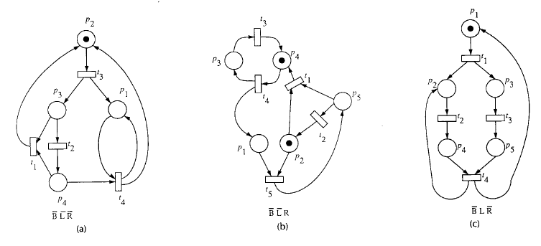
Example on Petri-net properties
B , L and R denote the negations of boundedness ( B ), liveness ( L ) and reversibility ( R )

Slide 31
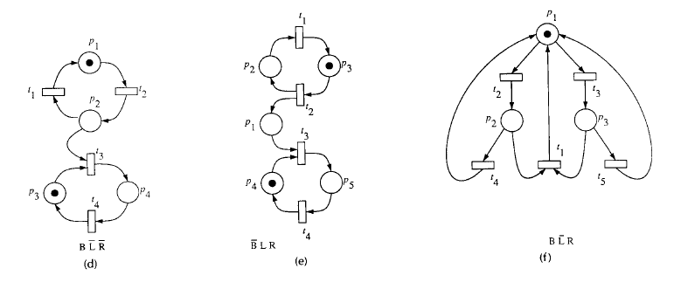
Example on Petri-net properties
B , L and R denote the negations of boundedness ( B ), liveness ( L ) and reversibility ( R )

Slide 32
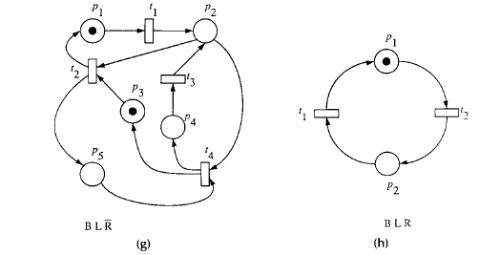
Example on Petri-net properties
B , L and R denote the negations of boundedness ( B ), liveness ( L ) and reversibility ( R )

Slide 33
Transform BPMN to Petri-net
What would be the corresponding Petr inets

Slide 34
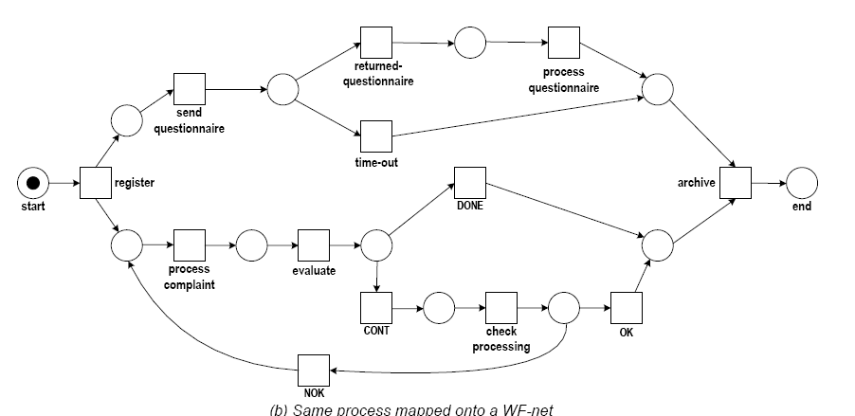
Transform BPMN to Petri-net

Slide 35
Workflow Nets
Petri nets are useful for representing simple processes
Complex processes such as business processes require advanced modelling mechanisms
Tokens need to carry information at least about the process instance they belong to
Workflow nets are an approach to enhance traditional Petri nets with concepts and notations that ease the representation of business processes
It introduces structural restrictions that are useful for business processes
It focus on the control flow behaviour of a process

Slide 36
Workflow Nets
Places represent conditions and tokens represent process instances
Activities of a business process are represented by transitions in the workflow net
Tokens hold application data including process instance identifiers
Tokens are coloured

Slide 37
Workflow Nets
Definition
Petri net PN = (P, T, F) is called workflow net if and only if the following conditions hold

Slide 38
Workflow Nets
Each place and each transition in a workflow net can participate in a process instance
each place and each transition needs to be located on a path from i to o
A token in the initial place i represents a process instance that has not yet started; a token in place o represents a finished process instance.

Slide 39
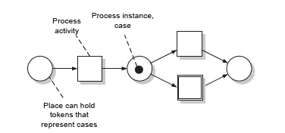
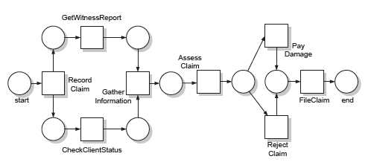
Workflow Nets

Slide 40
Workflow soundness
In the context of WF-nets a correctness criterion called soundness
A WF-net is sound if and only if the following three requirements are satisfied
(1) Option to complete:
For each case it is always still possible to reach the state which just marks o place (the end place)
(2) Proper completion
If o place (the end place) is marked all other places are empty for a given case, and
(3) no dead transitions:
it should be possible to execute an arbitrary activity by following the appropriate route through the WF-net
a WF-net is sound if and only if the corresponding short-circuited net (i.e., the net where place end is connected to place start) is live and bounded

Slide 41
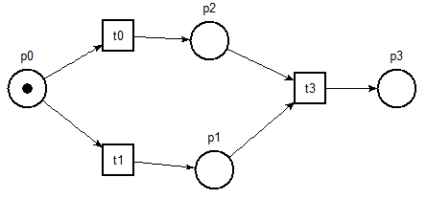
Workflow soundness
Motivation of Soundness
What is the problem in this WF-petri net?
cases based on the workflow net shown will suffer from deadlock—no case will ever terminate

Slide 42
Workflow soundness
Motivation of Soundness
What is the problem in this WF-petri net?

Slide 43
Workflow soundness
Motivation of Soundness
What is the problem in this WF-petri net?
The loop is entered by an and split transition
The loop is repeatedly iterated, realizing a livelock
In a livelock situation a set of activities are trapped in an infinite loop
This workflow net also suffers from the fact that each time the loop is iterated, one token is put in the output place
A token in the output place no longer indicates the completion of the process

Slide 44
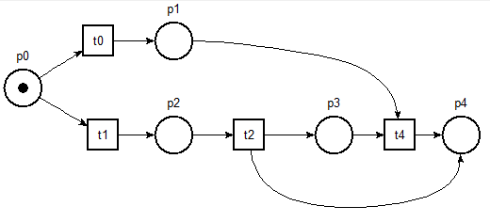
Workflow soundness
Motivation of Soundness

Slide 45
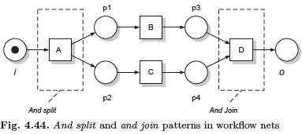
Control Flow in Workflow Nets

Slide 46
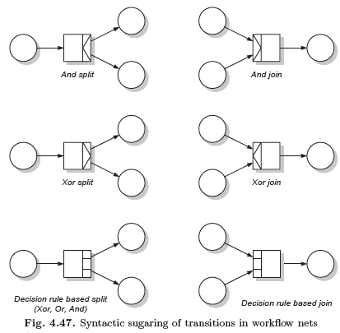
Control Flow in Workflow Nets
Syntactic sugaring of transitions in workflow nets

Slide 47
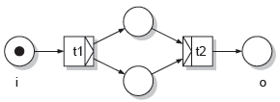

Slide 49
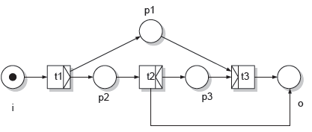

Slide 50
Time Petri nets
Each transition t is associated with two interval of time a and b where
0 ≤ a ≤ b
Times a and b for a transition t are relative to the moment at which the transition was last enabled
If transition t has been enabled at time Ø, then t may not fire before time Ø+a and must fire before or at time Ø+b
Unless t was disabled before then by the firing of another transition

Slide 51
