Slide 1

Chapter 6: Qualitative Process Analysis
Contents
Value-Added Analysis
Waste Analysis
Stakeholder Analysis & Issue Documentation
Root-Cause Analysis
Recap

Slide 2

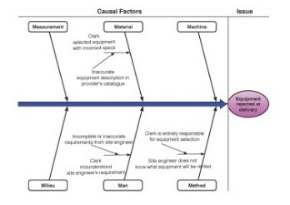
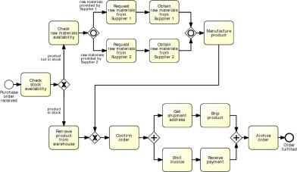

Process Analysis in the BPM Lifecycle

Slide 3
Introduction
Analyzing business processes is both an art and a science.
  Qualitative analysis is the artistic side of process analysis
  There is no single way of producing a good process analysis
    Rather a range of principles and techniques that tell us what practices typically lead to a “good” process analysis.

Slide 4
Qualitative Process Analysis: Overview
Issue Register & Pareto Chart
Value-Added & Waste Analysis
Root-Cause Analysis
Stakeholder analysis

Slide 5
Chapter 6: Qualitative Process Analysis
Contents
Value-Added Analysis
Waste Analysis
Stakeholder Analysis & Issue Documentation
Root-Cause Analysis
Recap

Slide 6
Value-added analysis
Value-added analysis is a technique aimed at identifying unnecessary steps in a process in view of eliminating them.
  Steps within a task are sometime documented in the form of checklists
  They tell process participants what things needed to be done
  Not always available, they are performed implicitly

Slide 7
Value-added analysis
Composed of four steps
  Divide the process into steps
    Steps performed before a task
    The task itself, possibly decomposed into smaller steps
    Steps performed after a task, in preparation for the next task
  Identify who is the customer of the process and what are the positive outcomes that the customer seeks for
    These outcomes are said to add value to the customer
  Classify each step
    Value-adding (VA)
    Business value-adding (BVA)
    Non-value-adding (NVA)
  Eliminate waste

Slide 8
1) Value-adding activities
Produces value or satisfaction to the customer.
Criteria:
  Is the customer willing to pay for this step?
  Would the customer agree that this step is necessary to achieve their goals?
  If the step is removed, would the customer perceive that the end product or service is less valuable?
Examples:
  Order-to-cash process: Confirm delivery date, Deliver products
  University admission process: Assess application, Notify admission outcome
  Repairing a washing machine: Diagnoses the problem, Repairing the machine are clearly value-adding steps

Slide 9
2) Business value-adding activities
Necessary or useful for the business to operate.
Customer is not willing to pay for the performance of these steps nor do they gain satisfaction from these steps
Criteria
  Is this step required in order to collect revenue, to improve or grow the business?
  Would the business (potentially) suffer in the long-term if this step was removed? Does it reduce risk of business losses?
  Is this step required in order to comply with regulatory requirements?
  Control steps are generally business value-adding activity
Example
  Order-to-cash process: Check purchase order, Check customer’s credit worthiness, Issue invoice, Collect payment, Collect customer feedback
  University admission process: Verify completeness of application, Check validity of degrees, Check validity of language test results
  Repairing a washing machine: Record defect step is of no value for the customer

Slide 10
3) Non-value-adding activities
Everything else besides VA and BVA
Incudes:
  Handovers(توصيل تسليم), context switches
  Waiting times, delays
  Rework or defect correction
Examples
  Order-to-cash: Forward PO to warehouse, Re-send confirmation, Receive rejected products
  University admission: Forward applications to committee, Receive admission results from committee

Slide 11
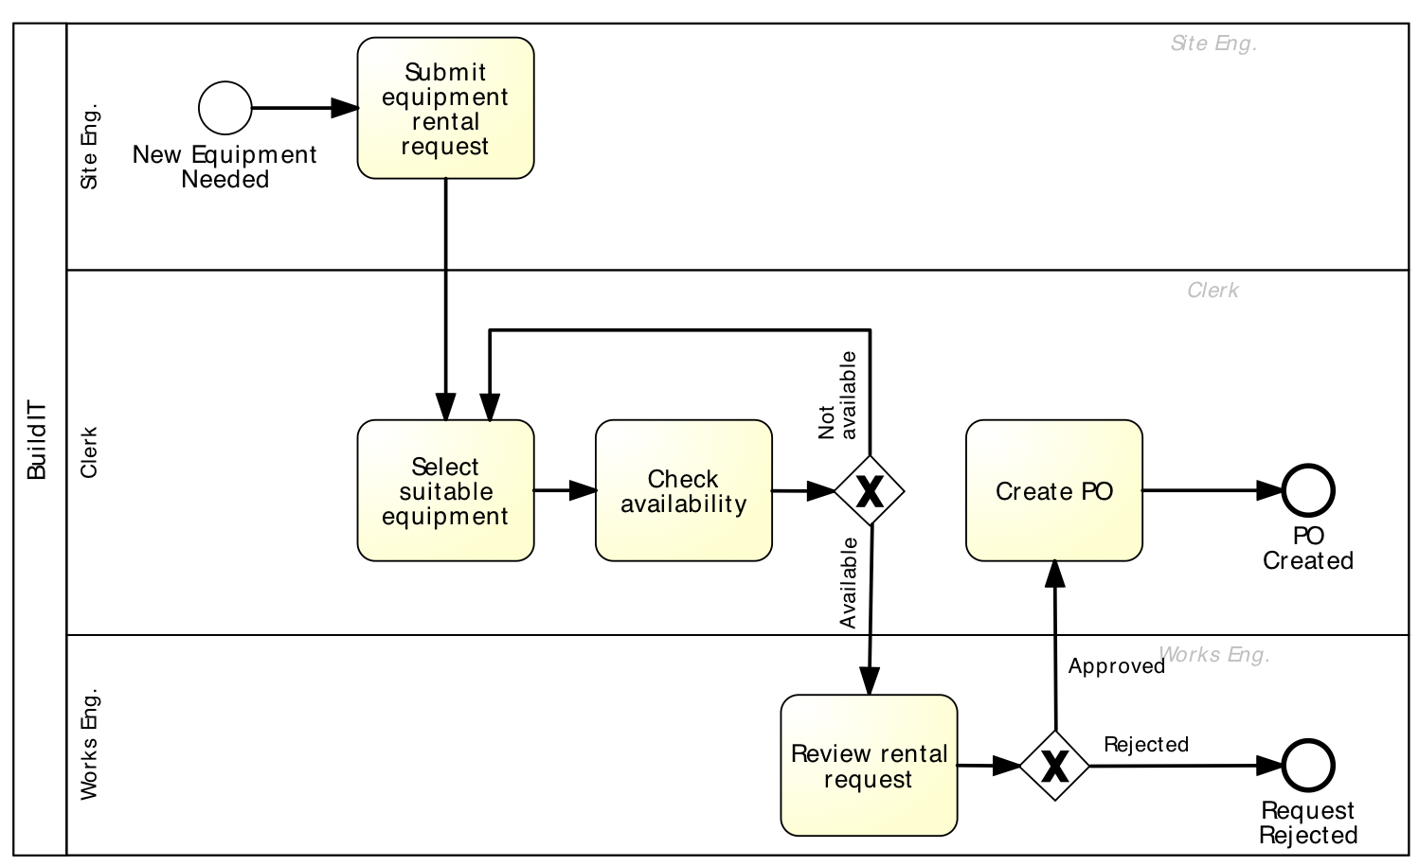
Extract of Equipment Rental Process
Fill request (VA)
Send request to clerk (NVA)
Check equipment availability (VA) – 1st time
Record recommended equipment (BVA)
Forward request to works engineer (NVA)
Open and read request (NVA)
Select suitable equipment (VA) – 1st time
Produce PO (BVA)
Submit PO to supplier (VA)
Open and examine request (BVA)
Communicate issues (BVA)
Forward request back to clerk (NVA)

Slide 12
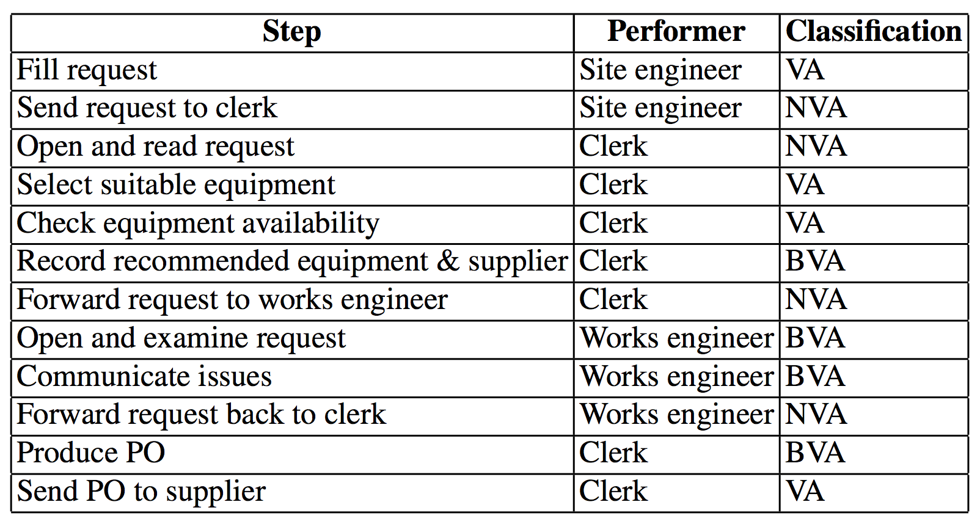
Equipment Rental Process – VA Analysis

Slide 13
4) Eliminate waste
A general rule is that one should strive to minimize or eliminate NVA steps
  Use information system to automat handovers steps
    This make NVA steps transparent to the performers of the steps
  One may eliminate one actor from the process and give its work to other actors
    Give them authority and make them accountable for their acts
Elimination of BVA steps should be considered as a trade-off
  Map BVA steps to business goals and business requirements, such as regulations that the company must comply to and risks that the company seeks to minimize.

Slide 14
Exercise
Pharmacy prescription process (Exercise 1.6)
  Identify at least three VA steps, at least three BVA steps and at least three NVA steps

Slide 15
Root-cause analysis
تحليل السبب الرئيسي(الجذري) للمشكله
“even a good process can be made better”
Any non-trivial business process, no matter how much improvement it has undergone, suffers from a number of issues
There are always errors, misunderstandings, incidents, unnecessary steps and other forms of waste
Part of the job of a process analyst is to identify and to document the issues that disrupt process.
Root cause analysis is a family of techniques to help analysts identify and understand the root cause(s) of problems or undesirable events.
Cause-and-effect diagrams
Why–why diagrams.

Slide 16
Root-cause analysis
تحليل السبب الرئيسي(الجذري) للمشكله
Why-why diagram
Factors
Issue
Cause-effect diagram

Slide 17
Cause-effect (Fishbone) diagram
Cause–effect diagrams depict the relationship between a given negative effect and its causes
  Negative effect is usually either a recurrent issue or an undesirable level of process performance
  Causes can be divided into causal and contributing factors

Slide 18
Cause-effect (Fishbone) diagram
Causal factors
  Factors if corrected, eliminated or avoided would prevent the issue from occurring in future
  E.g. insurance claims handling process have errors in “estimation of damages” process will lead to incorrect claim assessments
Contributing factors
  Factors that increase the chances of a given issue occurring
  E.g. “ Registering insurance claims” requires the claimant to enter a few dates (e.g. the date when the claim incident occurred), but the interface does not provide a calendar widget so that the user can easily select the date
    This may increase the chances that the user enters wrong date

Slide 19
Cause-effect (Fishbone) diagram
A cause–effect diagram consists of horizontal line (the trunk) and a number of branches (stems), with and an end box containing the negative effect to be analyzed
A well-known categorization for cause–effect analysis are 6M’s
  Machine
  Method
  Material
  Man
  Measurement
  Milieu

Slide 20
Cause-effect (Fishbone) diagram

Slide 21
Categories of causes: Six Ms
Machine: factors stemming from used technology
  Lack of suitable functionality in the supporting software applications
  Poor User Interface (UI) design (process participants not realizing that some data are missing )
  Lack of integration between systems
Method: factors stemming from the way the process is designed, understood or performed
  Unclear assignments of responsibilities
  Unclear instructions
  Lack of timely communication
  E.g. Participant A thinks that another participant B will send an e-mail to a customer, but participant B does not send it because they are not aware they have to send it

Slide 22
Categories of causes: Six Ms
Material: factors stemming from input materials or data
  Missing, incorrect or outdated data
  E.g. Incorrect data leading to a wrong decision
Man: factors stemming from wrong assessments or incorrect performance of steps attributable to:
  Lack of training and clear instructions
  Lack of motivation
  Too high demands towards process workers
  E.g. A claims handler accepting a claim even though the data in the claim and the rules used for assessing the claim require that the claim be rejected.

Slide 23
Categories of causes: Six Ms
Measurement: factors stemming from reliance on:
  Inaccurate estimations
  Miscalculations
  E.g. The amount to be paid to the customer is miscalculated due to an inaccurate estimation of the damages being claimed
Milieu: factors outside the scope of the process
  Delays caused because of unresponsive external actors
  Sudden increases of workload due to special circumstances
  E.g. Handling insurance claims for car accidents. This process depends partly on data extracted from police reports that contains missing details

Slide 24
Cause-effect diagram example

Slide 25
Exercise
Pharmacy prescription process (Exercise 1.6)
  Select one of the previously identified issues and analyze it using a why-why diagram

Slide 26
Why-why diagram
The basic idea is to recursively ask the question: Why has something happened?
First define an issue
  The issue is become the root of a tree.
  Then at each level the following questions are asked: “Why does this happen?” and “What are the main sub-issues that may lead to this issue?”
  Possible factors are then identified
    Each of these factors is then analyzed using the same questions
  When getting down in the tree (e.g. to levels 3 or 4) it is recommended to start focusing on factors that can be resolved
    Something that can be done to change them
    The leaves of the tree should correspond to factors that are fundamental
      Cannot be explained in terms of other factors
      These factors are called root causes and thus should be eliminated or mitigated

Slide 27
Why-why diagram
Five levels of nesting
“Five Why’s”

Slide 28
Why-why diagram example (Equipment rental process BuildIT)
Issue 1 Site engineers sometimes reject delivered equipment, why?
  Wrong equipment is delivered, why?
    Miscommunication between site engineer and clerk, why?
      site engineer provides only brief/inaccurate description of what they want
      site engineer does not (always) see the supplier catalogs when making a request and does not communicate with the supplier, why?
        site engineer generally does not have Internet connectivity
      site engineer does not check the choice of equipment made by the clerk
    equipment descriptions in supplier’s catalog not accurate

Slide 29
Why-why diagram example (Equipment rental process BuildIT)
Issue 2 Site engineers keep equipment longer than needed via deadline extensions, why?
  Site engineer fears that equipment will not be available later when needed, why?
    Time between request and delivery too long, why?
      Excessive time spent in finding a suitable equipment and approving the request, why?
        time spent by clerk contacting possibly multiple suppliers sequentially
        time spent waiting for works engineer to check the requests

Slide 30
Why-why diagram example (Equipment rental process BuildIT)
Issue 3 BuildIT often has to pay late payment fees to suppliers, why?
  Time between invoice received by clerk and confirmation is too long, why?
    clerk needs confirmation from site engineer, why?
      clerk cannot assert when was the equipment delivered and picked-up, why?
        delivery and pick-up of equipments are not recorded in a shared information system
        site engineer can extend the equipment rental period without informing the clerk
      site engineer takes too long to confirm the invoice, why?

Slide 31
Issue register
A listing that provides a detailed analysis of each issue and its impact in the form of a table with a pre-defined set of fields
Complements the output of root cause analysis by providing a more detailed analysis of individual issues and their impact
The purpose of the issue register is to
  Determine how and to what extent each issue is impacting on the performance of the process
  The impact of an issue can be described
    Quantitatively, e.g. for example in terms of time or money lost
    Qualitatively, e.g. in terms of perceived annoyance to the customer
Purpose: to maintain, organize and prioritize perceived weaknesses of the process (issues)

Slide 32
Issue register structure
Can take the form of a table with:
  Issue identifier
  Short name
  Description
  Assumptions
  Impact: Qualitative and Quantitative
  Possible improvement actions

Slide 33
Example of an issue documentation
Issue name
Equipment kept longer than needed
Description
Site engineers keep rented equipment longer than needed by asking for deadline extensions
Assumptions
3000 pieces of equipment rented p.a.
Quantitative impact
0.1 × 3000 × 2 × 100 = 60,000 p.a
In 10% of cases, equipment is kept two days more than needed
Average rental cost is 100 per day

Slide 34
Issue Register Example
Name | Explanation | Assumptions | Qualitative Impact | Quantitative Impact
Equipment kept longer than needed | Site engineers keep equipment longer than needed via deadline extensions | 3000 pieces of equipment rented p.a. In 10% of cases, equipment kept two days longer than needed. Rental cost is 100 per day |  | 0.1 × 3000 × 2 × 100 = 60,000 p.a.
Rejected equipment | Site engineers reject delivered equipment due to non-conformance to their specifications | 3000 pieces of equipment rented p.a. 5% of them are rejected due to an internal mistake For each equipment rejected due to an internal mistake, BuildIT is billed 100. | Disrupted schedules. Employee stress and frustration | 3000 × 0.05 × 100 = 15,000 p.a.
Late payment fees | Late payment fees incurred because invoices are not paid by their due date | 3000 pieces of equipment rented p.a. Average rental time is 4 days Rental cost is 100 per day. Each rental leads to one invoice. About 10% of invoices are paid late. Penalty for late payment is 2%. | Poor reputation with suppliers | 0.1 × 3000 × 4 × 100 × 0.02 = 2400 p.a.

Slide 35
Pareto chart
Useful to prioritize a collection of issues
Bar chart where the height of the bar denotes the impact of each issue
Bars sorted by impact
Superposed curve of cumulative percentage impact

Slide 36
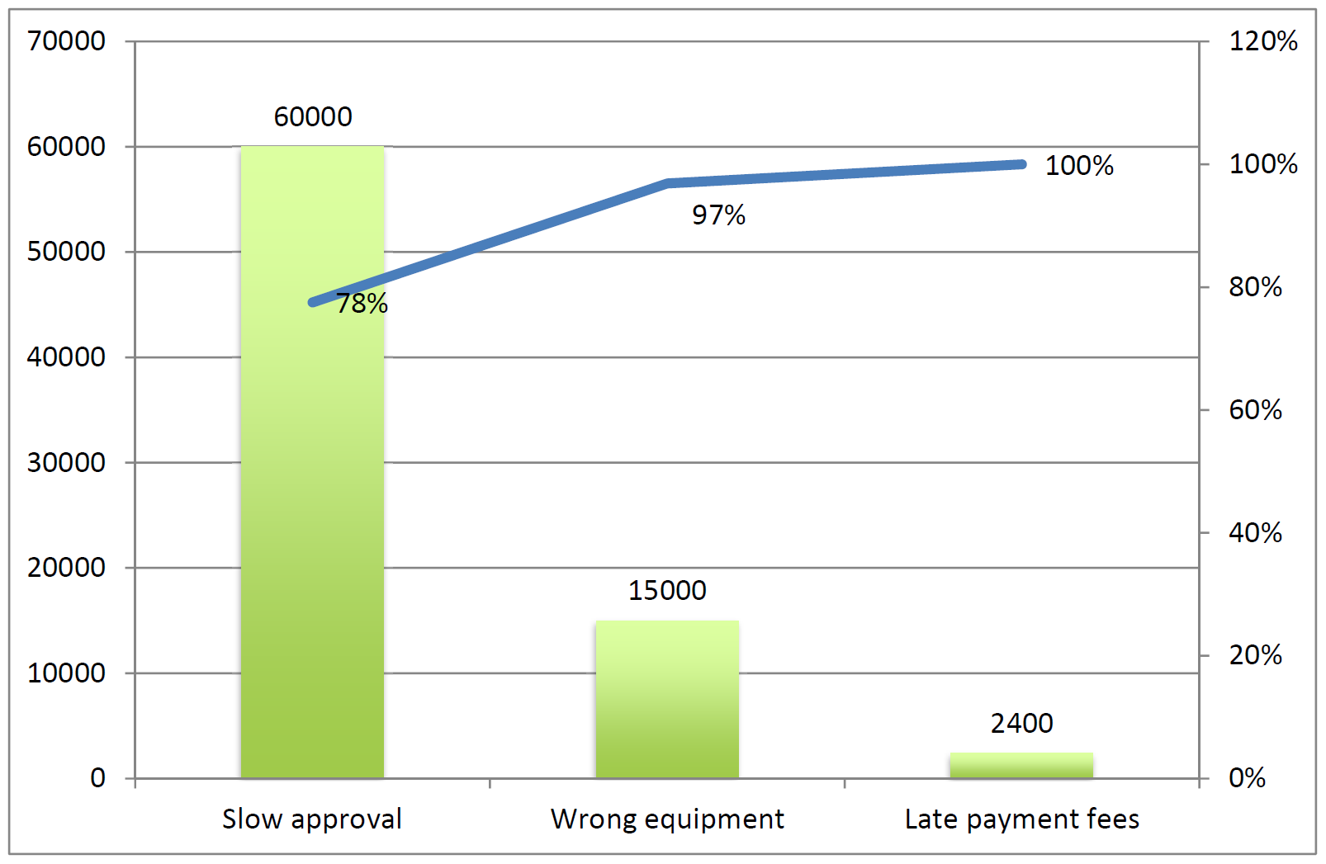
Pareto chart example

Slide 37
Exercise 6.5
Let us consider again the equipment rental process. This time we take the perspective of the site engineer, whose goal is to have the required equipment available on site when needed. From this perspective, the main issue is that in about 10 % of cases, the requested equipment is not available on site the day when it is required. When this happens, the site engineer contacts the suppliers directly to resolve the issue, but still, resolving the issue may take several days. It is estimated that each such delay costs € 400 per day to BuildIT. By inspecting a random sample of delayed equipment deliveries during a one-year period and investigating the cause of each occurrence, an analyst found that:

Slide 38
Exercise 6.5
five occurrences were due to the site engineer not having ordered the equipment with sufficient advance notice: The site engineers ordered the equipment the day before it was needed, when at least two days are needed. These cases cause delays of one day on average.
nine occurrences were due to the fact that none of BuiltIT’s suppliers had the required type of equipment available on the requested day. These cases cause delays of one to four days (three days on average).
13 occurrences were due to the approval process taking too long (more than a day) due to mistakes or misunderstandings. For these cases, the delay was one day on average

Slide 39
Exercise 6.5
27 occurrences were due to the equipment having been delivered on time, but the equipment was not suitable and the site engineer rejected it. These cases cause delays of two days on average.
four occurrences were due to mistakes or delays attributable entirely to the supplier. These cases lead to delays of one day. However, in these cases, the supplier compensated BuildIT by providing the equipment two days for free (the remaining days are still charged). Recall that the average cost of an equipment rental per day is € 100.
For two occurrences, the analyst did not manage to determine the cause of the delay (the process participants could not recall the details). The delays in these cases where two days per occurrence.
The sample of analyzed occurrences represents around 20 % of all occurrences of the issue during a one-year period. Draw a Pareto chart corresponding to the above data.

Slide 40
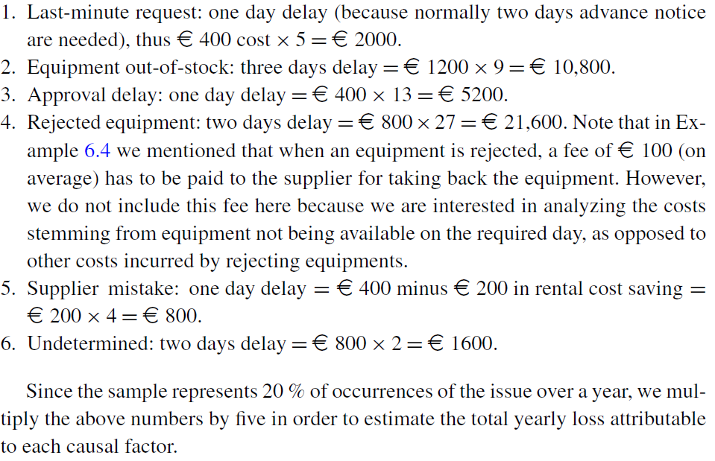
Exercise 6.5 solution

Slide 41
Exercise 6.5 solution

Slide 42
Two-Dimensional Prioritization: PICK Chart
A four-quadrant chart where each issue appears as a point
The horizontal axis captures the difficulty of addressing the issue
The vertical axis captures the payoff
These splits lead to four quadrants that allow analysts to classify issues according to the trade-off between payoff and difficulty:

Slide 43
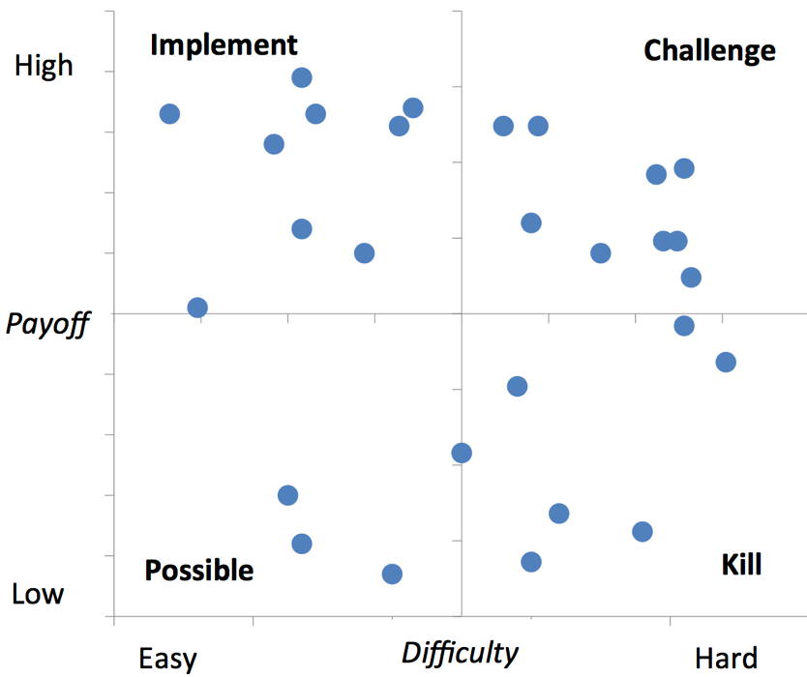
Two-Dimensional Prioritization: PICK Chart

Slide 44
Two-Dimensional Prioritization: PICK Chart
PICK Chart has four quarters to classify issues
  Possible (low payoff, easy to do): issues that can be addressed if there are sufficient resources for doing so.
  Implement (high payoff, easy to do): issues that should definitely be implemented as a matter of priority.
  Challenge (high payoff, hard to do): issues that should be addressed but require significant amount of effort. In general one would pick one of these challenges and focus on it rather than addressing all or multiple challenges at once.
  Kill (low payoff, hard to do): issues that are probably not worth addressing or at least not to their full extent.

Slide 45
Exercise
Pharmacy prescription process (Exercise 1.6)
  Identify and document at least two issues in an issue register

Slide 46
Recap
Segregate value-adding, business value-adding and non-value-adding steps
Identify waste: move, hold, overdo
Collect and systematically organize issues, assess their impact, priotirize
Analyze root causes of issues

