Slide 1
An-Najah National University
Faculty of Medicine
Department of Physiology
Anatomy and Physiology 1
7102101
Instructor: Heba Salah
Chapter 3:
The Skeletal System
Part 4: Axial Skeleton: Facial Bones, and Fetal Skull

Slide 2
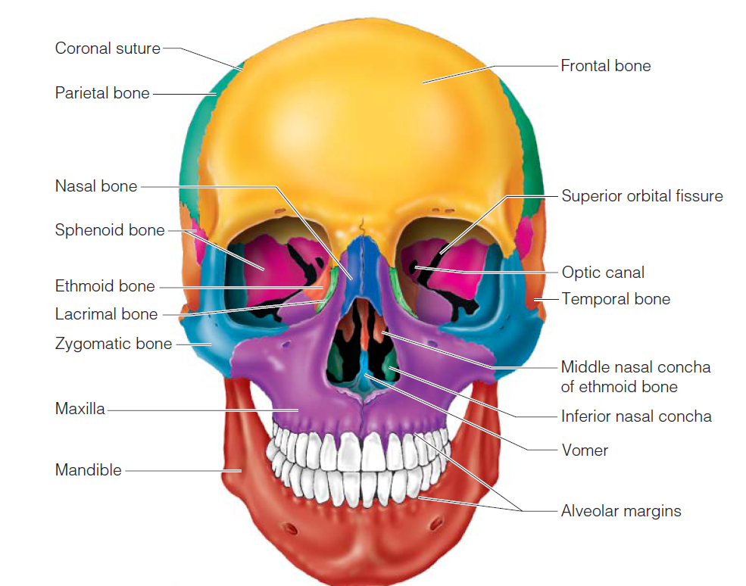
The Skull: Anterior View

Slide 3
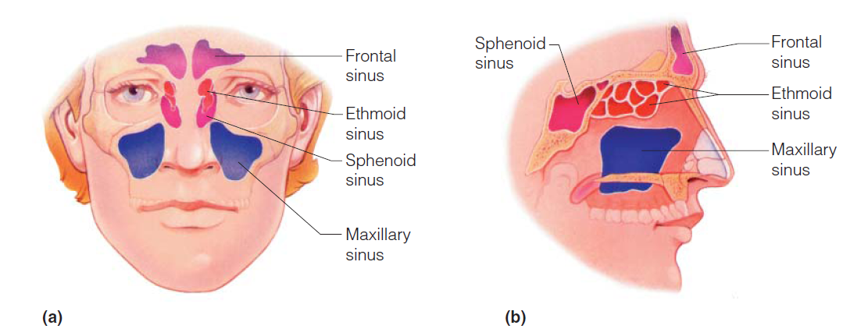
Paranasal Sinuses
Hollow portions of bones surrounding the nasal cavity

Slide 4
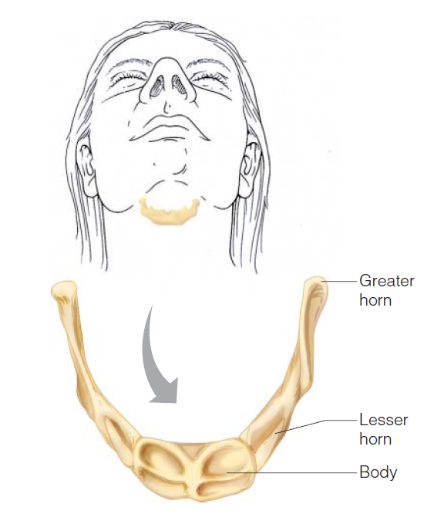
The Hyoid Bone
The only bone that does not articulate with another bone
Serves as a moveable base for the tongue

Slide 5
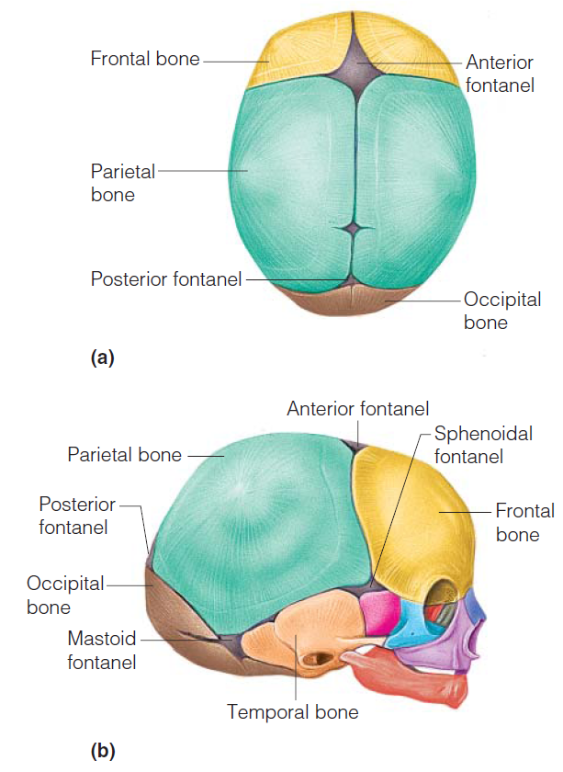
The Fetal Skull

