Slide 1
POLYTENE CHROMOSOMES & CHROMOSOME PUFFING

Slide 2
Objective:
To stain and identify the polytene chromosomes of the salivary glands of Drosophila melanogaster.
To identify puffing, which is a visual indicator of RNA transcription.

Slide 3
Introduction:
Many larval and some adult tissues of insects in the family Diptera are characterized by nuclei with giant chromosomes.
These chromosomes develop by multiple replications of the chromosomes within each cell during development.
Each nucleus will contain hundreds of copies of each chromosome.
Cells are considered polyploid if they have more than two copies of each chromosome.
If the chromosomes align perfectly forming large cables of chromosomes they are polytene.

Slide 4
In Drosophila melanogaster, chromosomes of the larval salivary gland contain about 1024 copies of the DNA, or ten doublings from the normal 2n condition, of each of the three chromosomes.
Each gene is exactly aligned with its homologs on the other 1023 copies.

Slide 5
The pattern of condensed regions (heterochromatin), and transcribed regions (euchromatin) gives a series of about 5000 light and dark bands when the chromosomes are stained with orcein.
Genetic maps relate these bands to their functions.
In general, the DNA in each band codes for a single function, although there are exceptions to this observation.
Drosophila has given us substantial insight into DNA function and gene organization.
In March 2000, the full genome map of D. melanogaster was published in the journal Science.

Slide 6
At certain times during development, some bands undergo a reversible modification to form structures known as "puffs."
Puffs are localized expansions of the polytene chromosome structures.
Puffs are sites of synthesis of RNA and result from the activation of the gene (or genes) contained within a particular band.

Slide 7
The size of the puff reflects the number of copies of that gene that are being transcribed - larger puffs have a larger percentage of the 1024 chromatids being simultaneously copied into mRNA.
The specific RNAs are translated into a set of polypeptides

Slide 8
Increased or decreased transcription can also result from a wide variety of environmental factors including a brief heat shock.
In 1962, heat shock was found to induce a unique set of puffs and the translation of the heat shock polypeptides or "hsp's".
When Drosophila larvae, or their excised tissues, are subjected to a brief heat shock (for example, 40 min. at 37º C, the normal culture temperature being 25º C), puffs are induced at a few specific sites.

Slide 9
The induction of the puffs by the heat shock is very rapid; it occurs within one minute of the temperature increase though the puffs continue to increase in size for some 30 to 40 min (at 37º C) before regressing.
The maximum sizes of the induced puffs are a function of the severity of the temperature shock, at least until lethal temperatures are met.

Slide 10
Materials:
In this experiment, you will dissect out the salivary glands of
Drosophila melanogaster larvae 0.7% 1N HCl Dissecting pins Dissecting microscopes Orcein stain Glass slides and cover slips Petri dishes

Slide 11
Procedures:
Use mature third instar larvae
1. Adjust your dissecting microscope so it has a dark background or dark field where the light is coming from an angle so you can see the tissues clearly.
2. Dissect out the salivary glands in 2-3 drops on NaCl . Do not allow the glands to dry. Place pins near head (region where dark mouth parts are located) and about half way down the body, then pull pins apart.

Slide 12
Once you see the salivary glands, dissect away the abdomen.

Slide 13
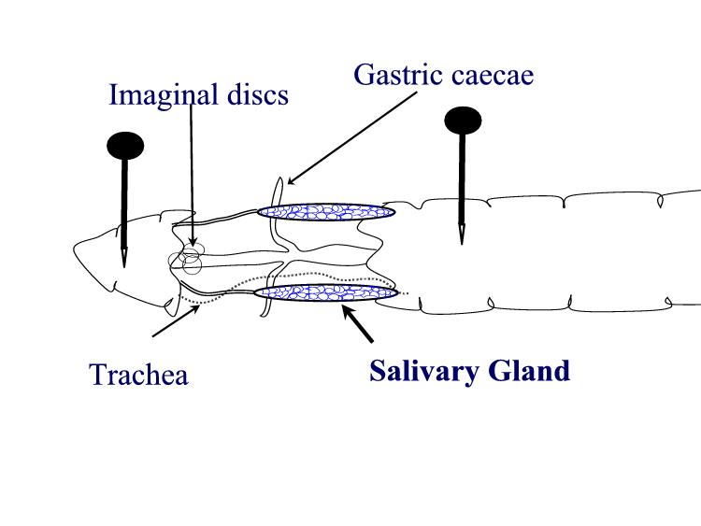
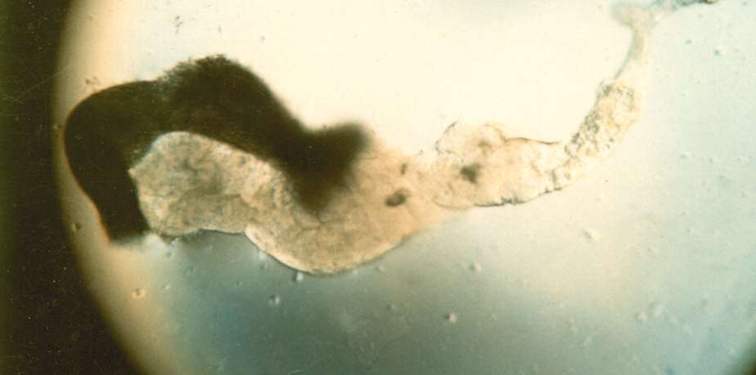

Slide 14
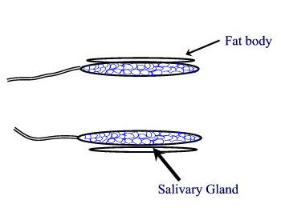
Be sure to remove the head. Don't try to remove the fat bodies that are located along the salivary glands.
You will see the fatty material under the slide, but it will not interfere with viewing the glands or staining their chromosomes.
The mouth parts are very hard and if they are under the coverslip, you will not be able to put enough pressure on it to crush them.
They are much thicker than the cells of the salivary gland, the cells and their nuclei will not be splited.

Slide 15
3.Stain with 2-3 drop of aceto-orcein.
4. Replace the slide if its not clean (messed up)
5. Allow the gland to stand in the stain for 10-15 mint
6. Put the slide on one paper towels cover with coverslip fold the second paper towel and place in the top of coverslip
7. Examine the chromosomes. If you look carefully along the length of each chromosome, you may see puffs, genes that are being transcribed.

Slide 16
9. If you have a copy of the Drosophila chromosome map handy, you can attempt to identify chromosomes 1, 2, 3, and 4.

Slide 17
