Slide 1
Body Composition Analysis
Instructor: Alma Irshaid. MSc. ANutr

Slide 2
Body Composition
Body composition particularly the relative proportions of body fat and lean body mass (fat-free mass) and the distribution of body fat is much more relevant to health than the simple determination of the appropriateness of weight for height in adults.

Slide 3
Body Composition
Body composition is divided into two major types:
Fat-free mass measurement (lean; muscle, bone and water) | Body fat measurement (adipose)
Mid upper arm circumference (MUAC) Mid arm muscle circumference (MAMC) Mid arm muscle area. | Triceps skin fold (TSF) Mid upper arm fat area (MURFA) Calculation of body fat from skinfold measurements. Waist to hip ratio.

Slide 4
Fat mass
Essential vs. Storage!
Contains 14% water
Expressed either as total weight of mass or %

Slide 5
Fat-free mass
Not homogenous
74% water
Higher density

Slide 6
4-compartment model
Body
Protein
Water
Mineral
Fat

Slide 7
Let’s try it out!
Calculate for a male who weighs 93 kgs and has body fat of 27% aims to reach 21%
Weight of fat = 93 kgs x 0.25 → 25.11 kgs
Fat-free weight = 93 – 25.11 → 67.89 kgs
Target weight = 67.89 $÷$ (100% - 21%) -->
85.9 kgs

Slide 8
Estimation by anthropometry

Slide 9
Fat free mass
1. Mid upper arm:
It reflects decrease in subcutaneous fat and/or a reduction in muscle mass.
It is useful in the diagnosis of protein-energy malnutrition or starvation in less developed countries.
“ Changes in MUAC is parallel to changes in muscle mass”

Slide 11
Fat-free mass
It also can be used to monitor progress during nutritional therapy.
It is positively correlated with changes in weight.

Slide 12
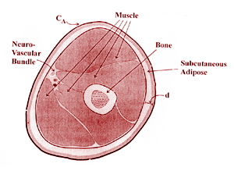
Mid-upper arm muscle circumference
2. Mid-upper arm muscle circumference (MUAM)
It reflects the circ. of the inner circle of muscle mass surrounding a small central core of bone.
It can be used to assess total muscle mass and frequently used in field surveys.
It can also be used in clinical setting to assess PEM.
It can be estimated either by using the equation or a nomogram.

Slide 13
Equation of MUAC
Equation:
Mid-upper arm muscle (cm) = MAC (cm) - π X TSF(mm)
It is insensitive to small changes of muscle mass that occur during illness.
It is assumed that the limb is circular, with fat evenly distributed around its circumference and makes no allowance for variable skinfold compressibility “Age, gender, site of measurement among individuals, inter-subject variation in diameter of the body frame relative to MAC”

Slide 14
% of reference value | Men (cm) | Women (cm) | Muscle mass status
100 | 25.5 | 23 | Adequate
90 | 23 | 21
80 | 20 | 18.5 | Borderline
70 | 18 | 16
60 | 15 | 14 | Severely depleted
50 | 12.5 | 11.5
40 | 10 | 9

Slide 15
Fat free mass
3. Mid arm muscle area “MAMA”:
It is preferable to circumference because it reflects more adequately the true magnitude of tissue changes. Therefore, it is considered an index of total muscle mass.
Arm muscle area (cm²) = (C “cm” – (π x TSF ”cm”))²
4π
C = Mid upper Arm circ.
TSF = triceps skinfold thickness
π = 3.14

Slide 16
Guideline to the Interpretation of Arm muscle area
Category | Percentile
Wasted | <5th percentile
Below average | 5th – 15th percentile
Average | 15th – 85th percentile
Above average | 85th – 95th percentile
High muscle | > 95th percentile

Slide 17
Example
Find the arm muscle area knowing the following: Mid-upper arm circumference = 35 cm. Triceps skinfold thickness = 21 mm.
Arm muscle area (cm) = (C “cm” – (π * TSF ”cm”))²
4π
Notes:
64.2 cm2

Slide 18
example
Age : 51
Gender : female
C = 31.75 cm
TSF = 30 mm
What is the interpretation?
Notes:
On the 75th percentile , average

Slide 19
Upper arm fat area

Slide 21
What is a desirable level of fatness?

Slide 22
Body Fat
Types of fat:
1. Essential fat It makes up to 9% of body weight in women and 3% of body weight in men.
2. Fat storage:
- Inter and intra muscular fat.
- Fat surrounding organs and G.I (visceral fat)
- Subcutaneous fat (1\3 of total body fat) contributes to 12% in males and 15% in females.

Slide 23
Essential fat
Important for childbearing and hormone-related functions.
Required for normal physiological functioning: reducing essential fat below some minimal amount can impair overall health. Extremes in dieting (and exercise) can reduce essential fat stores).

Slide 24
Body fat can be measured as:
% of total body fat
Weigh of total body fat (kg)
To calculate a target weight necessary to achieve a certain body fat, these formulas can be used:
Weight of fat = Total body weight X Percent body fat
Fat-free weight = Total body weight – Fat weight
Target weight = Present fat-free weight / (100- desired person body fat)%

Slide 25
Example:
Take a subject who weighs 91 kgs, has 25% body fat, and desired to have a 15% body fat:
Weight of fat = 91X 25% = 22.75 kgs
Fat-free weight = 91– 22.75 = 68.25 kgs
Target weight = 68.25/ (100- 15)%= 80.3 kgs

Slide 26
Your turn!
Calculate for a female who weighs 76 kgs and has body fat of 38% aims to reach 25%
Notes:
62.8 kgs!

Slide 27
Assessment of severity of malnutrition is done by estimating the initial body fat along with the rate of change in body fat content.
Anthropometric measurements are not sensitive for small changes in body fat.

Slide 28
Skin fold thickness: Provides and estimate of the size of subcutaneous fat that in turn can give an estimate of total body fat.
Notes:
1. Thickness of subcutaneous fat reflects a constant proportion of total body fat.
2. Skinfold thickness is usually measured from 5 different sites of the body then an average is used. “Triceps, biceps, subscapula, Suprailiac, mid thigh”
3. Varies with age, weight, gender, ethnic group.
4. Generally the Triceps is the most frequently selected measure for a single indirect measure of body fat.

Slide 29
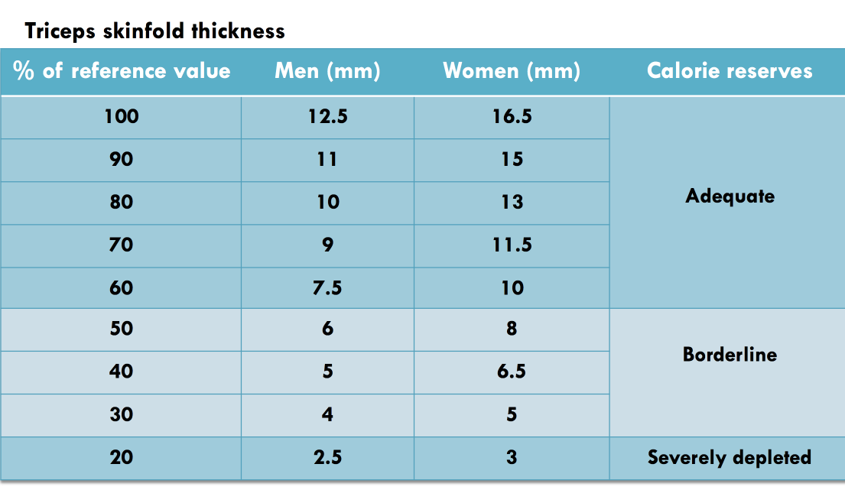

Slide 30
Body fat measurement
Waist to hip ratio: It describes the distribution of subcutaneous and intra abdominal fat.
- Indicator of chronic disease and metabolic syndromes NOT % body fat.
- Health risks if W-H ratio for men is > 0.9 and for women > 0.8

Slide 31
Body fat
Upper-arm fat area and fat index: (% fat) Calculations of arm, muscle, and fat area are based on measurements.
of the upper arm circumference and triceps skinfolds.
This technique assumes that the upper arm and its constituent are cylindrical; hence, the corresponding areas of cross section can be computed from the formula that yields the areas of a circle from its circumference.

Slide 32
Densinometry
Assessing body composition by measuring the density of the entire body.
Density is expressed as mass per unit volume and obtained through hydrostatic, or underwater, weighing, or other methods.

Slide 33
Underwater weighing/hydrostatic
The most widely used technique of determining whole-body density
The technique is based on Archimedes’ principle, which states that the volume of an object submerged in water equals the volume of water the object displaces. Thus, if the mass and the volume of a body are known, the density of that body can be calculated. Using another formula, percent body fat can be calculated from body density.
The approach also assumes a constant fat mass density of 0.90 g/cm3 and a density of the fat-free mass of 1.10 g/cm3.
The densities of bone and muscle tissue are greater than the density of water (density of distilled water = 1.00 g/cm3), whereas fat is less dense than water.
Thus, muscular subjects having a low percentage of body fat tend to weigh more submerged in water than do subjects having a higher percentage of body fat.

Slide 34
Body density can be calculated from the following formula:

Slide 35
Male RV = 0.017 A + 0.06858 S - 3.477
Female RV = 0.009 A + 0.08128 S - 3.900
Because measuring gastrointestinal tract gas is impossible using conventional methods, it is nearly always estimated to be 100 mL in adults.

Slide 36
Other methods “Tissue Conductivity Techniques”
Bio-impedance analysis (BIA): Requires passage of small electrical current that is undetectable to the individuals between two electrodes placed on the body.

Slide 37
BIA
The principle of use is marking the difference in electrolyte content between fat and fat-free tissue.
Electrolytes such as Na ,Cl, K and HCO₃ are found primarily in the fat-free mass.
Electrolytes are better conductors of electrical current.

Slide 38
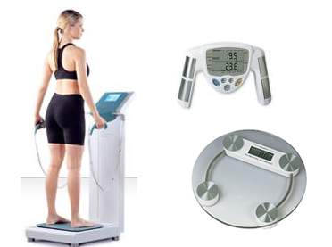

Slide 39
BIA
Advantages
Disadvantages
Reliable results
Safe
Convenient
Portable
Rapid
Noninvasive
Error in estimation if dehydrated (Excessive perspiration, excessive exercise, alcohol intake)
Cost.

Slide 40
Tissue conductivity technique
Total Body electrical conductivity (TOBEC):
The subject is surrounded by a low electromagnetic field in a detection chamber; the conductivity of hydrated tissues allows estimation of fat vs. fat- free mass (FFM)
Accurate but very expensive and bulky.

Slide 41
Air displacement plethysmography
Works on the principle of changed air volume in chamber.
Connected to a computer which analyze the output and provide body composition %.
Usually referred to as BOD POD.

Slide 42
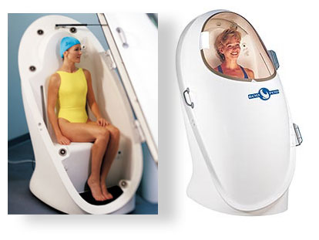

Slide 43
Imaging techniques
Dual energy x-ray absorptiometry (DEXA)
Computerized tomography (CT)
Magnetic resonance imaging (MRI)
Ultrasonography.

Slide 44
Which method to use?
Depends on compartment of interest.
Availability of techniques.
Technical training of staff.
Condition of patient.
Location where assessment will be done:
Laboratory / clinic
Field / remote site

Slide 45
Clinical Case
A 69 year-old female, who has recently recovered from viral pneumonia. She has lost two kilos in the last 2 months, but complains of loss of appetite and extreme fatigue. She is worried about that and is too tired to exercise. Her current BMI is 23 kg/m? (weight: 65 kg, and height:1,68 m).
Q1: Is the patient at nutritional risk?
Q2: How would you further assess body composition?
Q3: Do you need to assess muscle strength?
Q4: Are nutritional supplements indicated here?
Q5: How would you monitor nutritional therapy?
Q6: Does the patient need to increase physical activity?

