Slide 1
An-Najah National University
Faculty of Medicine
Department of Physiology
Anatomy and Physiology 1
7102101
Instructor: Heba Salah
Chapter 4:
The Muscular System
Part 7: Gross anatomy of Upper and lower limbs Muscles

Slide 2
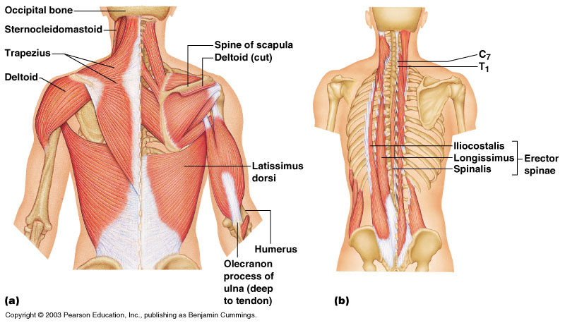
Deep Trunk and Arm Muscles

Slide 3
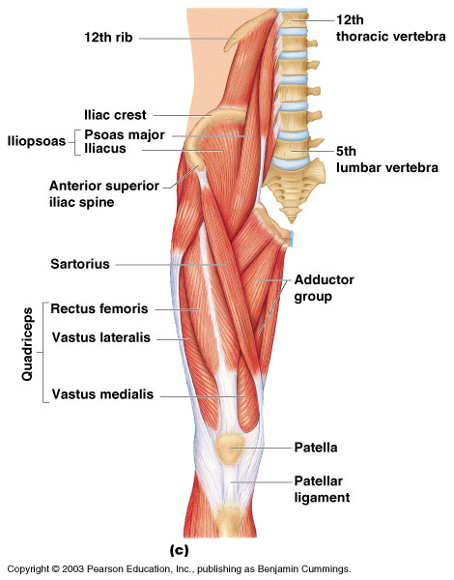
Muscles of the Pelvis, Hip, and Thigh

Slide 4
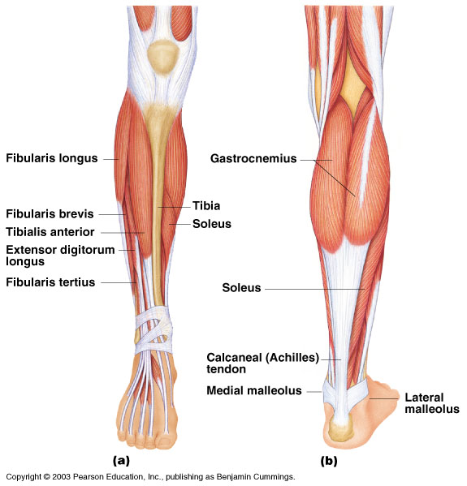
Muscles of the Lower Leg

Slide 5
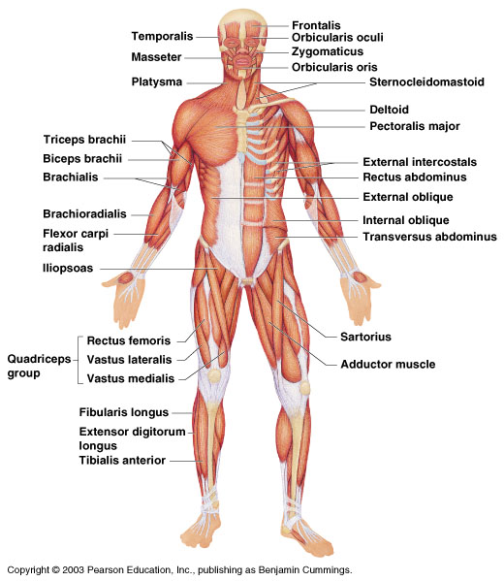
Superficial Muscles: Anterior

Slide 6
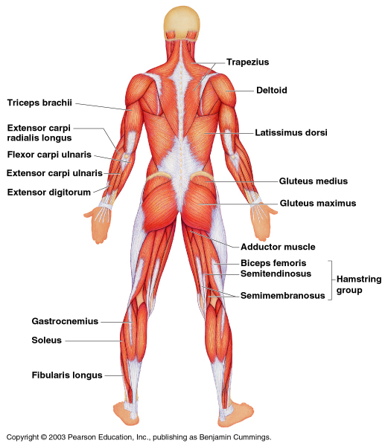
Superficial Muscles: Posterior

