Slide 1
Clinical Assessment
Instructor: Alma Irshaid. MPH. ANutr
Chapter 4

Slide 2
You are what you eat, so, do you know who you are?

Slide 3
Clinical Assessment
A. A detailed history
B. Thorough physical examination
C. Interpretation of the signs and symptoms associated with malnutrition.
Signs are defined as observations, made by a qualified examiner, of which the patient is usually unaware. Symptoms are clinical manifestations reported by the patient.

Slide 4
Medical History (Hx)
First step in the clinical assessment of nutritional status.
A good way to begin is by reviewing the patient’s medical record, giving careful attention to the patient’s medical history.
A variety of diseases can affect nutritional status. Among these are diabetes, kidney disease, various cancers, CHD, stroke, liver disease (e.g., hepatitis and cirrhosis), gallbladder disease, AIDS, ulcers, and colitis, as well as recent or past surgical procedures.

Slide 5
Historical Information
Medical history
Age/Gender
Weight changes
Prescription drugs and OTC medications, supplements
Type of illness
Past Surgeries
Treatments (Radiation,chemo..)
Social history
Cultural heritage
Financial concerns
Who prepares and shops for food
Living situation
Diet history
Food intake
Meal patterns
Physical problems
Ability to swallow
Alcohol/Smoking

Slide 7
Diet Historical Information
Historical information is obtaining information about a person’s history in respect to:
1. Health Status
Health history reflects a person’s medical record and may reveal a disease that interferes with the person’s ability to eat or use of some nutrients.
It is also worth noting the family history of diseases which reflects tendency of genetic diseases like heart conditions and diabetes.

Slide 8
Historical Information
2. Socioeconomic status
Economical circumstances shows financial inability to buy food or kitchen facilities to prepare food.
Also, Social factors like martial status, ethnic background, religion, family size and educational level may also influence food choices and thus nutritional status.

Slide 9
Historical Information
3. Drug Use:
Drug history including all prescribed and over-the- counter medications as well as any illegal substances.
Certain medications may highlight possible nutrient deficiencies (Nutrient-drug interaction)

Slide 10
Historical Information
4. Diet History/Diet measurement:
A diet history examines a person’s food, drink and supplements intake and this may reveal either overconsumption or inadequate intake of macro or micro nutrients.
This method can be performed by:
1. 24-hour food recall.
2. Food records.
3. Food frequency questionnaires.
4. Diet History.

Slide 11
Nutritional History Screens—a Systematic Approach to the Detection of Deficiency Syndromes
Refer to table 10.1 page 355 in the book.

Slide 12
Components of a system-based examination of each region of the body are as follows:
General Inspection → how does the over-all person look
Vitals ; BP , HR , RR , Temperature
Skin ; Pale , coarse , elasticity and turgor
Nails ; concave nails , brittle , not-smooth , discolored
Head/Hair ; brittle, thin , major fall outs , texture , poor color
Eyes/Nose ; bitot’s spot , pale inner eyelids, hallow loose skin
Mouth ; dry, cracked, and swollen lips or tongue inflammation
Neck/Chest ;
Abdomen ; swollen , soft , hard
Musco-skeletal ; loss of muscles in certain areas

Slide 13
Body area | Sign associated with malnutrition
Hair | Lack of natural shine; dry; fine and sparse; straight; color changes (flag sign); can be easily plucked
Nails | Nails are spoon-shape (koilonychia); brittle, ridged nails
Face | Skin color loss (depogmentation), skin dark over cheeks and under eyes; lumpiness or flakiness of skin of nose and mouth; swollen face; enlarged parotid glands
Eyes | Eye membranes are pale; Bitot’s spots; dryness of eye membranes; cornea has dull appearance ; comea is soft (keratomalacia); scar on cornea; ring of fine blood vessels around corner
Lips | Redness and swelling of mouth or lips (cheilosis); especially at corners of mouth

Slide 14
Body area | Sign associated with malnutrition
Tongue | Swelling; purplish color of tongue; smooth tongue; swollen sores; hyperemic and hyper-trophic papillae; and atrophic papillae
Teeth | Missing, abnormal, grey or black spots , cavities
Gums | "Spongy” and bleed easily; recession of gums
Thyroid | Thyroid enlargement (front of neck); parotid enlargement (cheeks become swollen)
Skin | Dryness of skin(xerosis);sand paper feel of skin(folicular hyperkeratosis); flakiness of skin; skin swollen and dark; red swollen pigmentation of exposed areas excessive lightness or darkness of skin(dyspigmentation);black and blue marks due to skin bleeding; lack of fat under skin

Slide 15
Body area | Sign associated with malnutrition
Tmuscolar and skeletal system | Muscles have "wasted" appearance; baby's skull bones are thin and soft ; round swelling of front and side of head (frontal and parietal bossing); swelling of ends of bones; small bumps on both sides of chest wall (on ribs)-beading of ribs; baby's soft spot on head does not harden at proper time knock-knees or bow-legs; bleeding into muscle (Musculo-skeletal hemorrhages); person cannot get up or walk properly
Cardiovascular system | Rapid heart rate (above 100 tachycardia); enlarged heart; abnormal rhythm; elevated blood pressure
G.I system | Liver enlargement; enlargement of spleen (usually indicates other associated diseases)
Nervous System | Mental irritability and confusion; burning and tingling of hands and feet; loss of position and vibratory sense; weakness and tenderness of muscles (may result In inability to walk); decrease and loss of ankle and knee reflexes

Slide 17
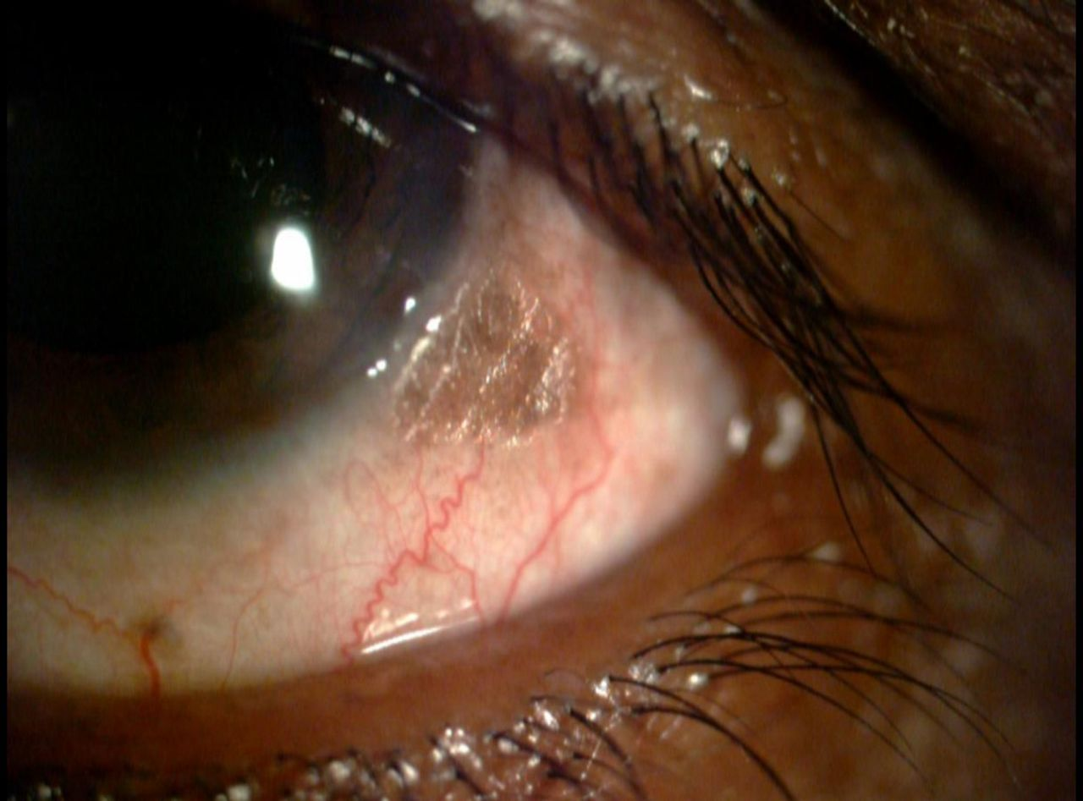
Eyes

Slide 18
Skin
follicular hyperkeratosis

Slide 19
Lips and tongue

