Slide 1
An-Najah National University
Faculty of Medicine
Department of Physiology
Anatomy and Physiology 1
7102101
Instructor: Heba Salah
Chapter 1:
The human Body: An Orientation
Part 6: Body Planes & Body Cavities

Slide 2
Body Planes and Sections
MRI Scan
Organs seen in the MRI

Slide 3
Body Planes and Sections
MRI Scan
Organs seen in the MRI

Slide 4
Body Planes and Sections
MRI Scan
Organs seen in the MRI

Slide 5
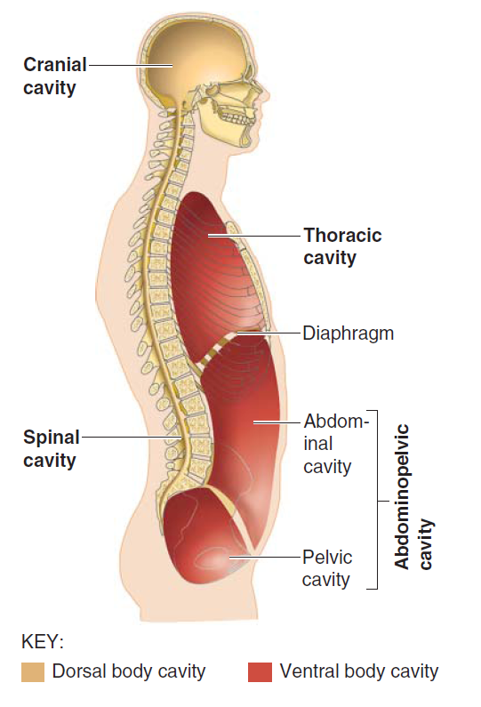
Body Cavities
Body cavities are hollow spaces within the human body that contain internal organs
The dorsal cavity: located toward the back of the body, and divided into the cranial cavity and vertebral or spinal Cavity
The ventral cavity: located toward the front of the body, and divided into abdominopelvic cavity and thoracic cavity by the diaphragm

Slide 6
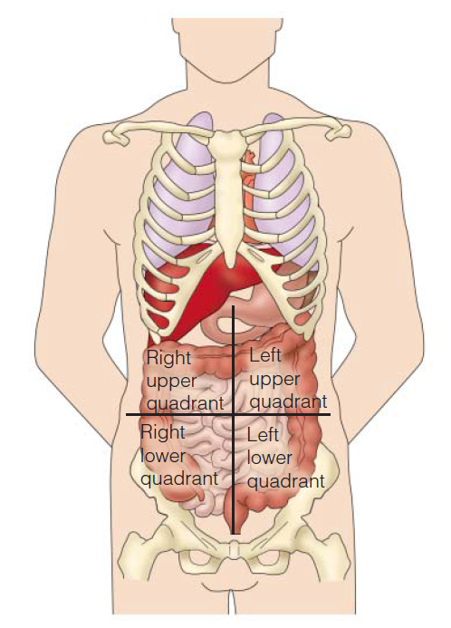
Abdominopelvic Cavity
The four Quadrants

Slide 7
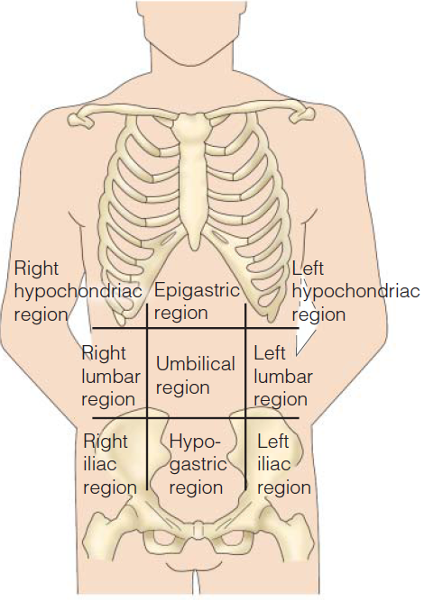
Abdominopelvic Cavity
The nine abdominopelvic Regions

Slide 8
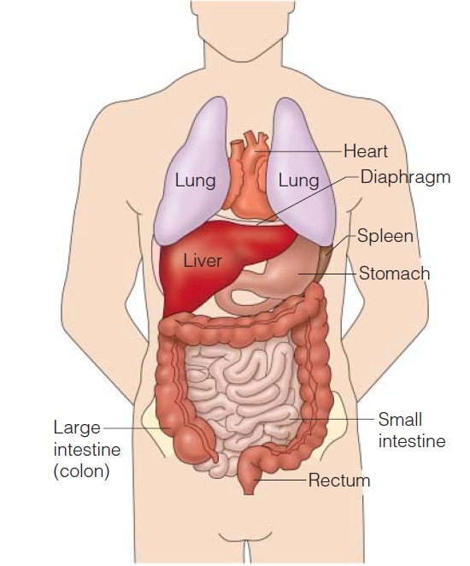
Abdominopelvic Cavity
Superficial organs of the ventral body cavity

