Slide 1
BOILERS AND FIRED SYSTEMS
Dr. Mohammed Alsayed

Slide 2
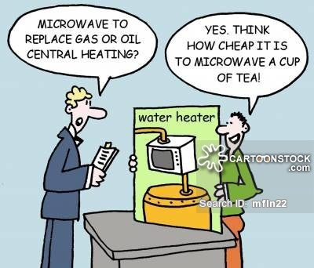
Introduction
Over 68% of the electricity generated in the USA is produced through the combustion of coal, fuel oil, and natural gas.
The remainder is produced through nuclear, 22%; hydroelectric, 10%; and geothermal and others, <1%.

Slide 3
Boilers Types
A boiler is either a fire tube boiler with tubes containing flame and surrounded by water or a water tube boiler—with tubes containing water surrounded by flame.

Slide 4
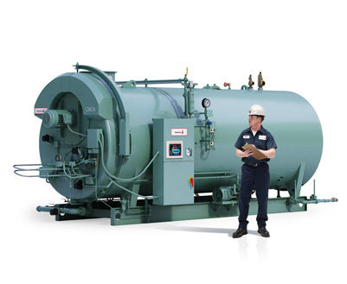
Boilers Types
Fire tube boiler

Slide 5
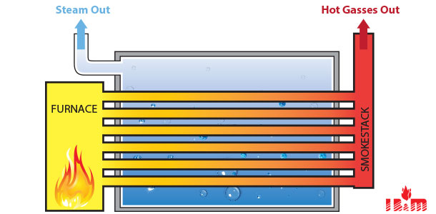
Boilers Types
Fire tube boiler

Slide 6
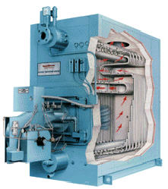
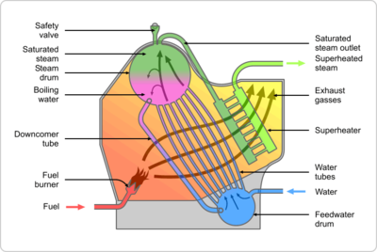
Boilers Types
Water tube boiler

Slide 7
Boilers Types
A third kind of boiler is the fluidized bed boiler.
The fuel is burned on a bed of limestone fragments that are kept suspended by air forced into the bed from below.
There are many advantages to such a system. First, many different fuels can be burned-waste plastic, municipal solid waste.
High sulfur coal can be burned without the need of flue gas scrubbers.
The temperature is low enough that lower amounts of NOx are produced than with other combustion methods.
Finally, less slag is produced on the water-cooled furnace walls.

Slide 8
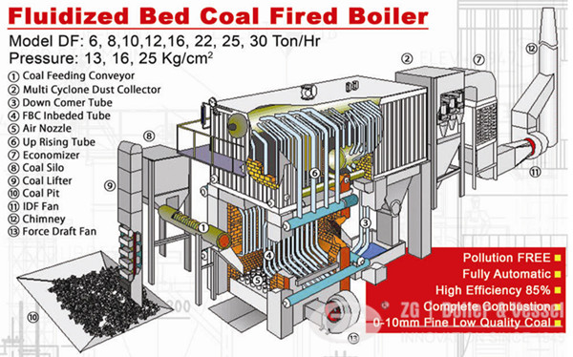
Boilers Types

Slide 10
System Analysis
The purpose of the system may be to raise the temperature of an industrial product as part of a manufacturing process, it may be to generate high-temperature high-pressure steam in order to power a turbine, or it may simply be to heat a space so the occupants will be comfortable.
The energy consumption of boilers, furnaces, and other fi re systems can be determined simply as a function of load and efficiency as expressed in the equation:
However, solving the equation for the energy consumption or energy cost may not always be simplistic.

Slide 11
System Analysis
In order to reduce boiler energy consumption, one can either:
Reduce the load,
Increase the operating efficiency,
Reduce the unit fuel energy cost,
Or combinations thereof.

Slide 12
System Analysis
Balance Equations
Balance equations are used in an analysis of a process which determines inputs and outputs to a system.
Heat Balance
A heat balance is used to determine where all the heat energy enters and leaves a system.

Slide 13
System Analysis
Heat Balance – cont.
In a simple furnace system, energy enters through the combustion air, fuel, and mixed-air duct. Energy leaves the furnace system through the supply-air duct and the exhaust gases.
In a boiler system, the analysis can become more complex. Energy input comes from the following: condensate return, make-up water, combustion air, fuel, and maybe a few others depending on the complexity of the system. Energy output departs as the following: steam, blowdown, exhaust gases, shell/surface losses, possibly ash, and other discharges depending on the complexity of the system.

Slide 14
System Analysis
Mass Balance
A mass balance is used to determine where all mass enters and leaves a system.

Slide 15
System Analysis
Mass Balance – cont.
In the case of a steam boiler, a mass balance can be used in the form of a water balance (steam, condensate return, makeup water, blowdown, and feedwater.)
A mass balance can also be used for water quality or chemical balance (total dissolved solids, or other impurity.)
The mass balance can also be used in the form of a combustion analysis (fireside mass balance consisting of air and fuel in and combustion gasses and excess air out.)

Slide 16
System Analysis
For analyzing complex systems, the mass and energy balance equations may be used simultaneously such as in solving multiple equations with multiple unknowns.

Slide 17
Efficiency
There are several different measures of efficiency.
The American Society of Mechanical Engineers (ASME) Power Test Code 4.1 (PTC-4.1-1964.)
This procedure defines and established two primary methods of determining efficiency: the input- output method and the heat-loss method.
Both of these methods result in what is commonly referred to as the gross thermal efficiency.
The efficiencies determined by these methods are “gross” efficiencies as apposed to “net” efficiencies which would include the additional energy input of auxiliary equipment such as combustion air fans, fuel pumps, stoker drives, etc.

Slide 18
Efficiency
Another efficiency term commonly used for boilers and other fired systems is combustion efficiency.
Combustion efficiency is similar to the heat loss method, but only the heat losses due to the exhaust gases are considered.

Slide 19
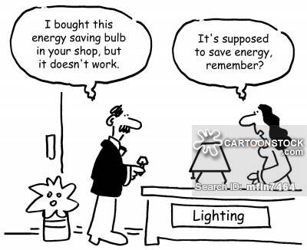
Energy Conservation Measures

Slide 20
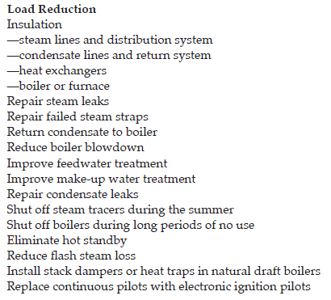
Energy Conservation Measures

Slide 21
Energy Conservation Measures

Slide 22
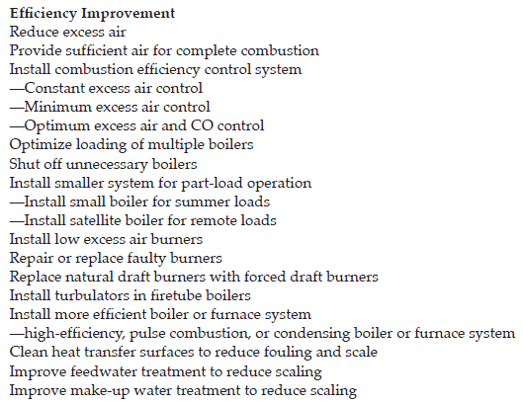
Energy Conservation Measures

Slide 23
Energy Conservation Measures

Slide 24
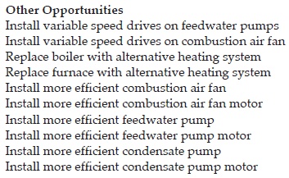
Energy Conservation Measures

Slide 25
Key Elements for μ_{maximum}
Excess Air (EA)
It is defined as air in excess of the amount required for stoichiometric conditions.
In combustion processes, EA is generally defined as air introduced above the stoichiometric or theoretical requirements to effect complete and efficient combustion of the fuel.

Slide 26
Key Elements for μ_{maximum}
As illustrated in Figure 5.1, the amount of carbon dioxide, percent by volume, in the exhaust gas reaches a maximum with no excess air stoichiometric conditions.
While carbon dioxide can be used as a measure of complete combustion, it can not be used to optimally control the air-to-fuel ratio in a fired system. A drop in the level of carbon dioxide would not be sufficient to inform the control system if it were operating in a condition of excess air or insufficient air.
However, measuring oxygen in the exhaust gases is a direct measure of the amount of excess air. So, it is more common and preferred method of controlling the air-to-fuel ratio in a fired system.

Slide 27
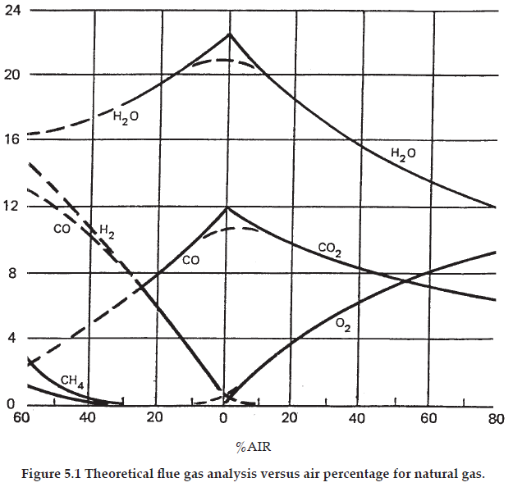

Slide 28
Key Elements for μ_{maximum}
To identify the point of minimum excess-air operation for a particular fi red system, curves of combustibles as a function of excess O₂ should be constructed similar to that illustrated in Figure 5.2.
The curves should be developed for various firing rates as the minimal excess-air operating point will also vary as a function of the fi ring rate (percent load).

Slide 29
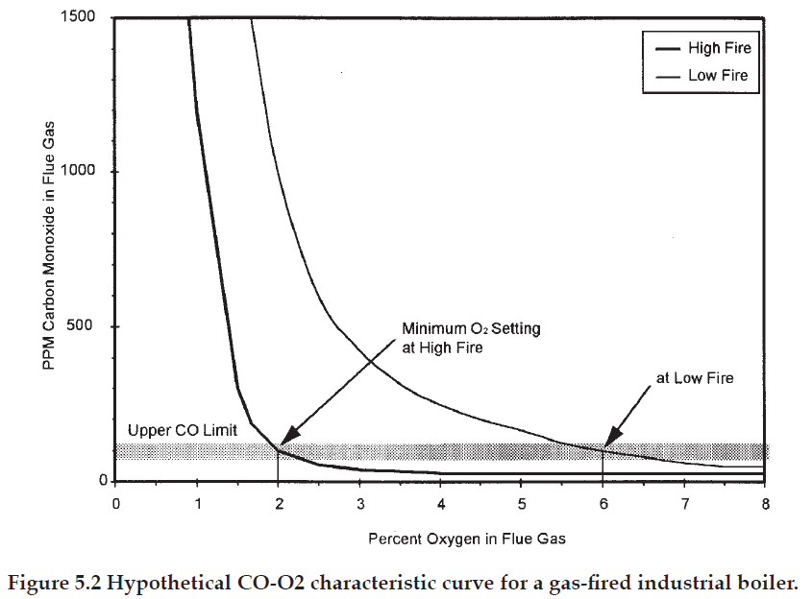

Slide 30
Key Elements for μ_{maximum}
The optimal excess-air-control set point should be set at some margin (generally 0.5 to 1%) above the minimum O₂ point to allow for response and control variances.
It is important to note that some burners may exhibit a gradual or steep CO-O₂ behavior and this behavior may even change with various firing rates.
It is also important to note that some burners may experience potentially unstable operation with small changes in O₂ (steep CO-O₂ curve behavior).

Slide 31
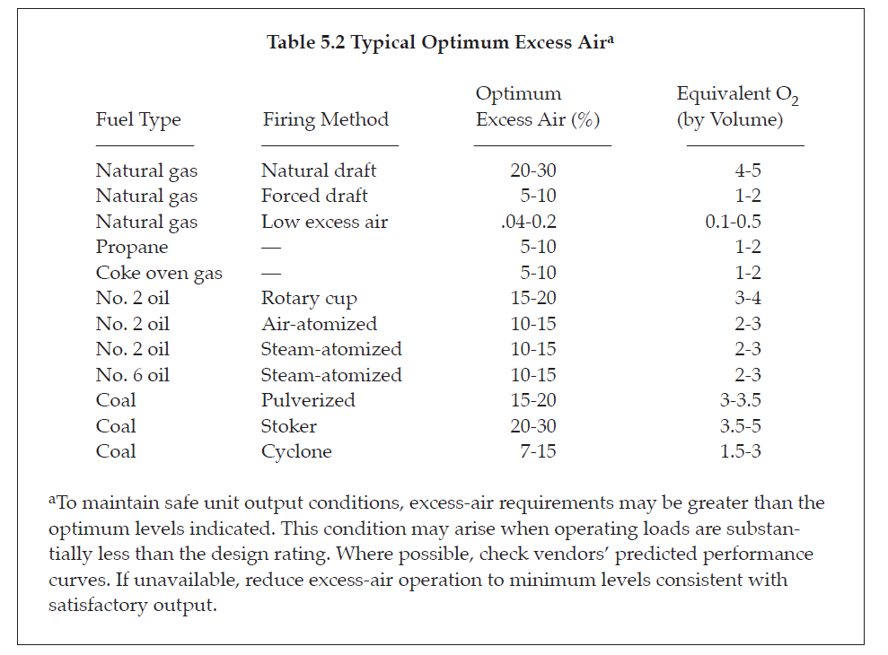

Slide 32
Key Elements for μ_{maximum}
Excess oxygen (O₂) measured in the exhaust stack is the most typical method of controlling the air-to-fuel ratio. However, for more precise control, carbon monoxide (CO) measurements
may also be used to control air flow rates in combination with O₂ monitoring. Careful attention to furnace operation is required to ensure an optimum level of performance.

Slide 33
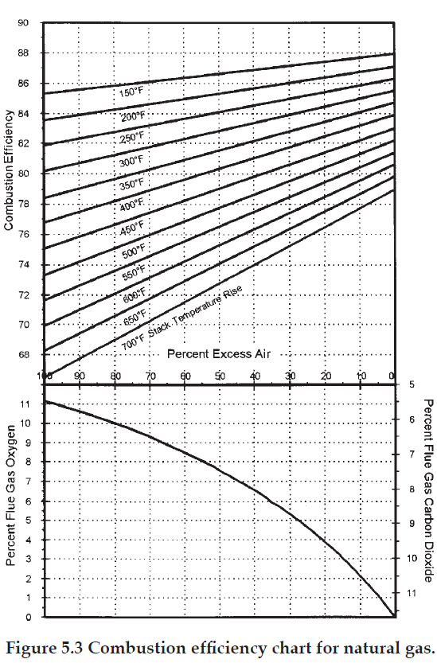
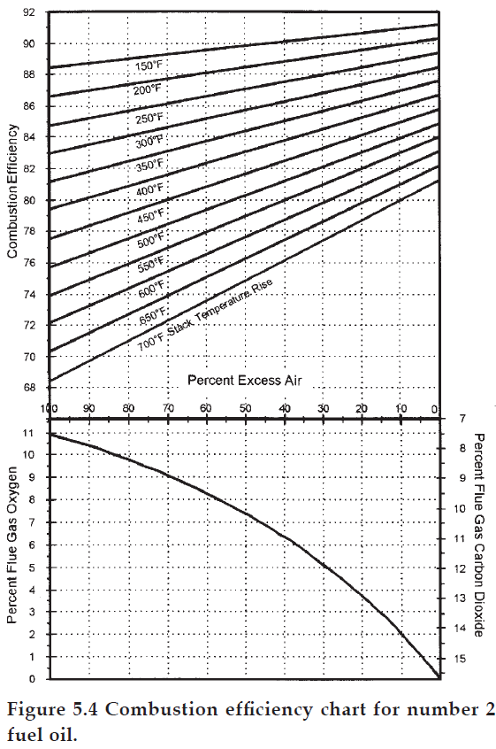

Slide 34
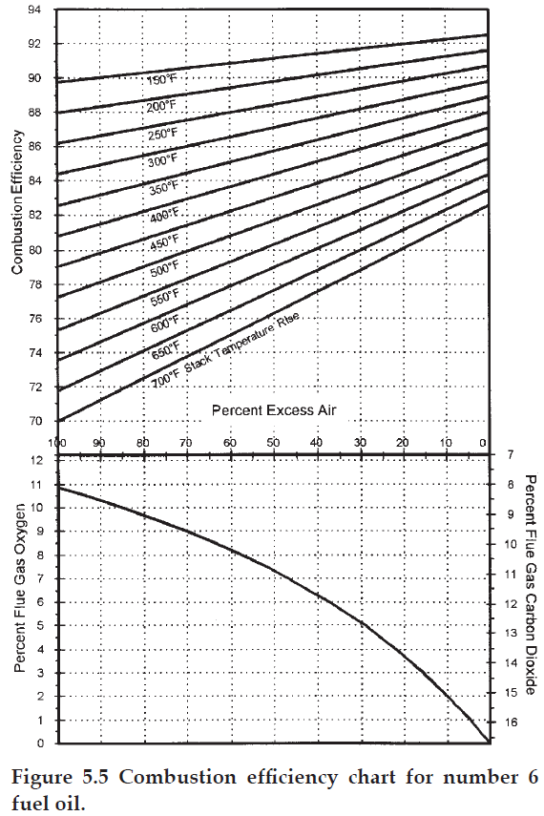

Slide 35
How to Test for Relative Efficiency
To establish energy conservation benefits for an EA control program, you must determine:
O₂% (by volume) in the flue gas (typically dry),
stack temperature rise (the difference between the flue gas temperature and the combustion air inlet temperature), and
fuel type.

Slide 36
How to Test for Relative Efficiency
To accomplish optimal control, continuous measurement of the excess air is a necessity.
There are two types of equipment available to measure EA level:
Portable equipment such as an Orsat flue-gas analyzer, heat prover, electronic gas analyzer, or equivalent analyzing device;
Permanent-type installations probe-type continuous oxygen analyzers .
The major advantage of permanently mounted equipment is that the on-line indication or recording allows remedial action to be taken frequently.

Slide 37
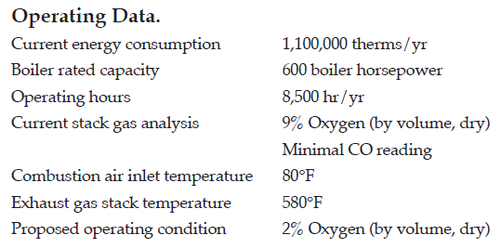
How to Test for Relative Efficiency
Example: Determine the potential energy savings associated with reducing the amount of excess air to an optimum level for a natural gas-fired steam boiler.

Slide 38
Key Elements for μ_{maximum}
Exhaust Stack Temperature
Another primary factor affecting unit efficiency and ultimately fuel consumption is the temperature of combustion gases rejected to the stack. Increased operating efficiency with a corresponding reduction in fuel input can be achieved by rejecting stack gases at the lowest practical temperature consistent with basic design principles.
In general, the application of additional heat recovery equipment can realize this energy conservation objective when the measured flue-gas temperature exceeds approximately 250°F.

Slide 39
Key Elements for μ_{maximum}
Economizers are used to extract heat energy from the flue gas to heat the incoming liquid process feed stream to the furnace.
Flue gas/air preheaters lower the flue-gas temperature by exchanging heat to the incoming combustion air stream.

Slide 40
Key Elements for μ_{maximum}
In assessing overall efficiency and potential for heat recovery, the parameters of significant importance are temperature and fuel type/sulfur content.
To obtain a meaningful operating flue-gas temperature measurement and a basis for heat-recovery selection, the unit under consideration should be operating at, or very close to, design and optimum excess-air values

Slide 41
Key Elements for μ_{maximum}
To obtain a proper and accurate temperature measurement, the following guidelines should be followed:
Locate the probe in an unobstructed flow path and sufficient distance, approximately five diameters downstream or upstream, of any major change of direction in the flow path.
Ensure that the probe entrance connection is relatively leak free.
Take multiple readings by traversing the cross-sectional area of the flue to obtain an average and representative flue-gas temperature.

Slide 42
Key Elements for μ_{maximum}
There are no “firm” exit-temperature guidelines that cover all fuel types and process designs. However, certain guiding principles will provide direction to the lowest practical temperature level of heat rejection.
The elements that must be considered to make this judgment include
fuel type,
flue-gas dew-point considerations,
heat-transfer criteria,
type of heat-recovery,
surface,
relative economics of heat-recovery equipment.

Slide 43
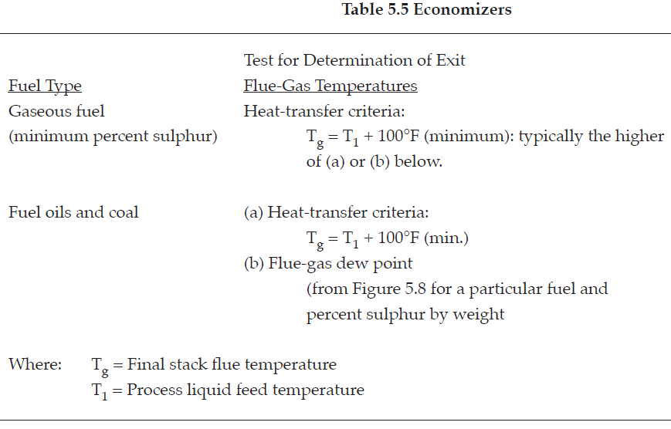
Key Elements for μ_{maximum}

Slide 44
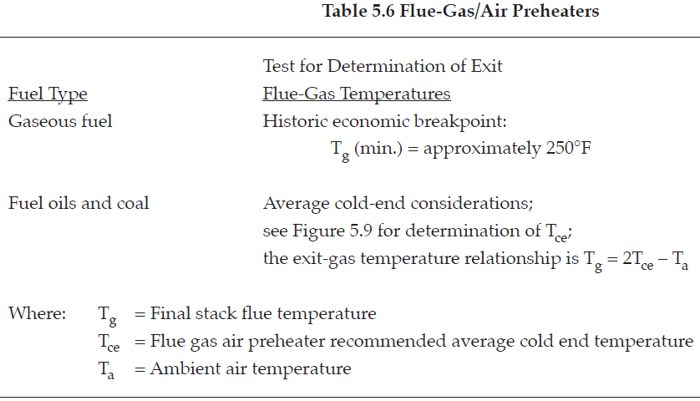
Key Elements for μ_{maximum}

Slide 45
Key Elements for μ_{maximum}
Example: Determine the energy savings associated with installing an economizer or flue-gas air preheater on the boiler from the previous example. Assume that the excess-air control system from the previous example has already been implemented.

Slide 46
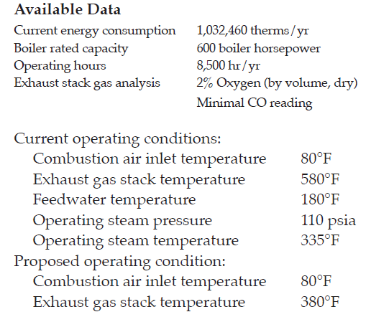
Key Elements for μ_{maximum}

Slide 47
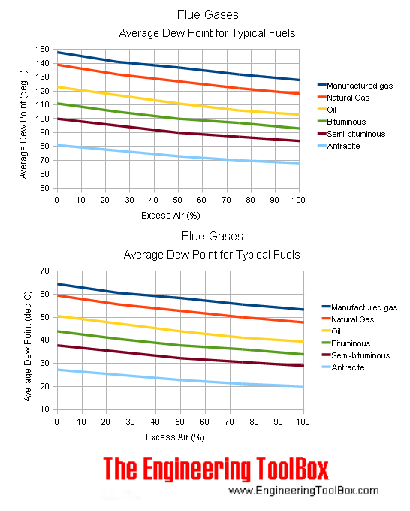

Slide 48
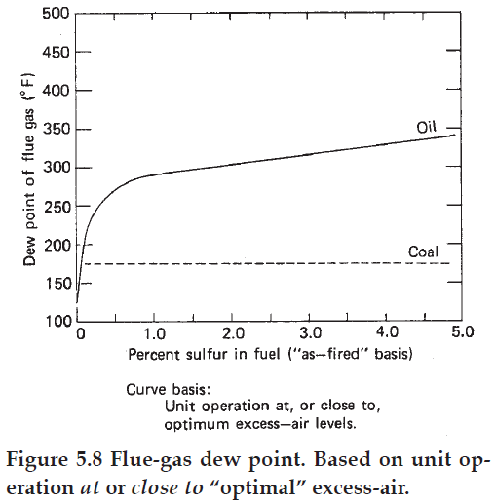
Key Elements for μ_{maximum}

Slide 49
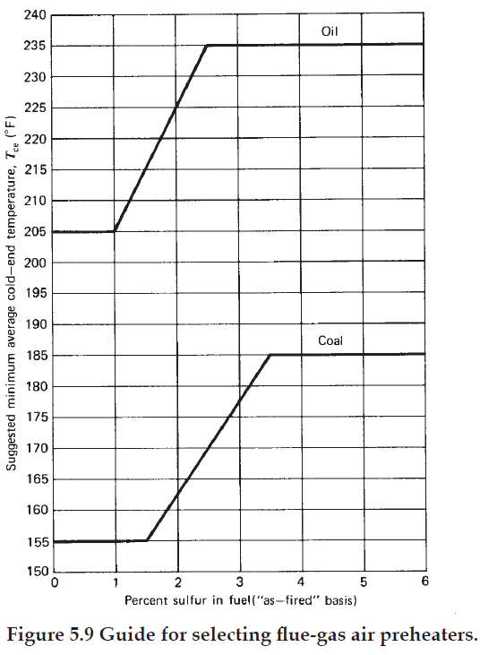

Slide 50
Key Elements for μ_{maximum}
Waste-Heat-Steam Generation
Plants that have fired heaters and/or furnaces of the type designed during the era of cheap energy may have significant energy saving opportunities.
The major problem on older units is to determine a practical and economical approach to utilize the sensible heat in the exhaust flue gas.

Slide 51
Key Elements for μ_{maximum}
Typically, many vintage units have exhaust-flue-gas temperatures in the range 1050 to 1600°F.
Conventional flue-gas air preheater normally is not a practical approach because of materials of construction requirements and significant burner front modifications. Additionally, equipping these units with an air preheater could materially alter the inherent radiant characteristics of the furnace, thus adversely affecting process heat transfer.

Slide 52
Key Elements for μ_{maximum}
An alternative approach to utilizing the available flue-gas sensible heat and maximizing overall plant energy efficiency is to consider:
waste-heat-steam generation.
installing an unfired or supplementary fired recirculating hot-oil loop to effectively utilize transferred heat to a remote location.
installing a process feed economizer.

Slide 53
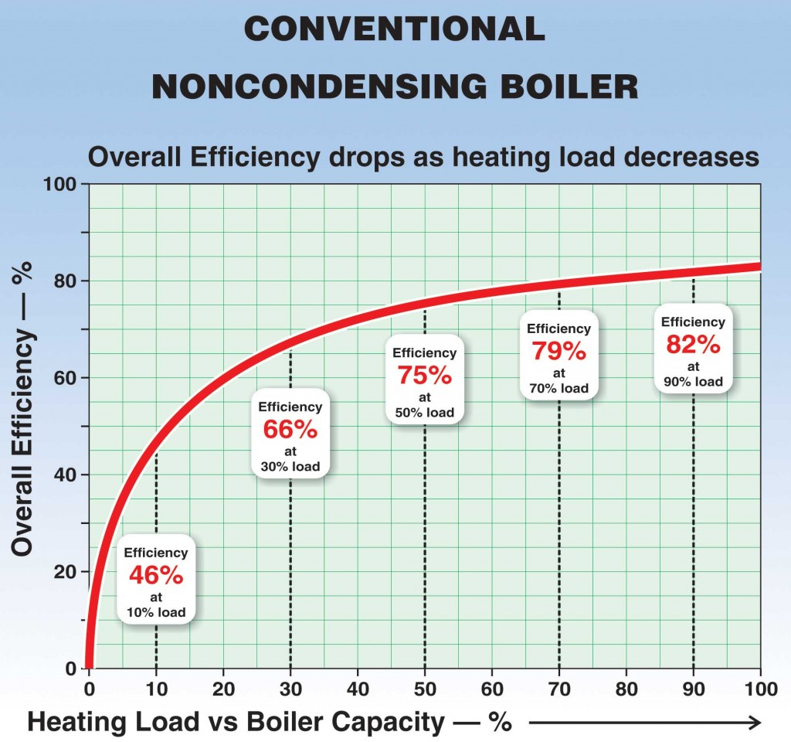
Key Elements for μ_{maximum}
Load Balancing

Slide 54
Key Elements for μ_{maximum}
Example: A plant has a total installed steam-generating capacity of 500,000 lb/hr, and is served by three boilers having a maximum continuous rating of 200,000, 200,000, and 100,000 lb/hr, respectively. Each unit can deliver superheated steam at 620 psig and 700°F with feedwater supplied at 250°F. The fuel fired is natural gas priced into the operation at $3.50/106 Btu. Total plant steam averages 345,000 lb/hr and is relatively constant. The boilers are normally operated according to the following loading. Determine the savings obtainable with optimum steam plant load-balancing conditions.

Slide 55
Key Elements for μ_{maximum}

Slide 56
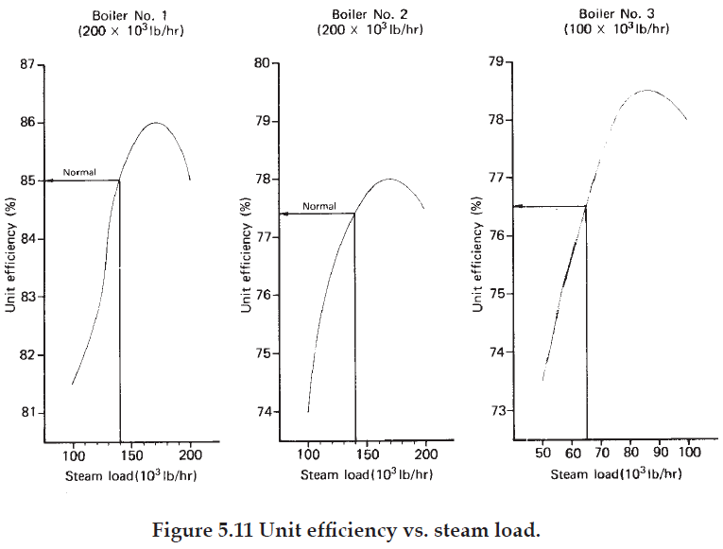
Key Elements for μ_{maximum}

Slide 57
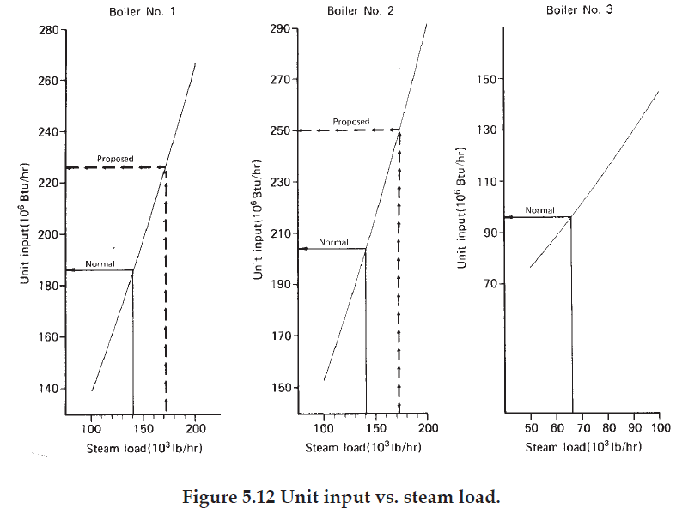
Key Elements for μ_{maximum}

Slide 58
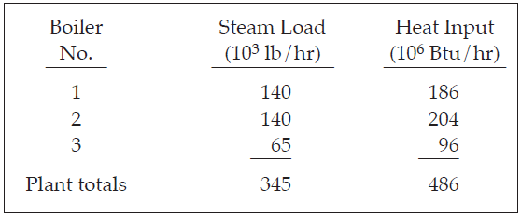

Slide 59
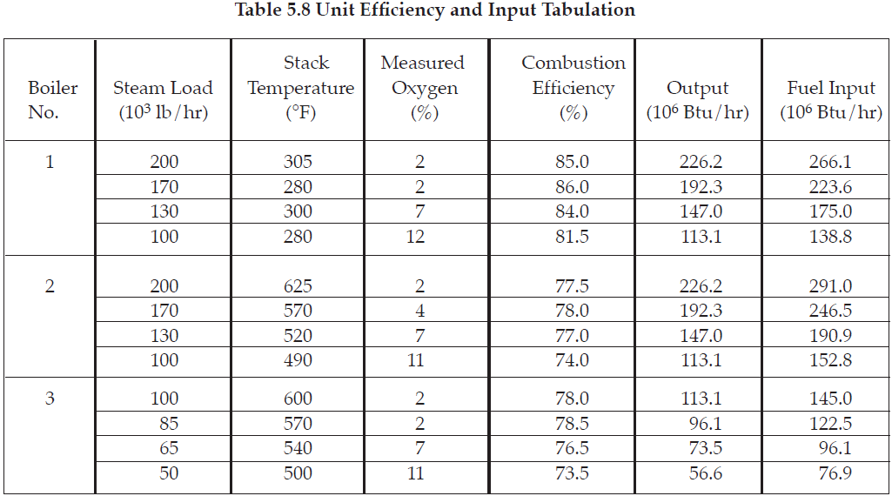

Slide 60
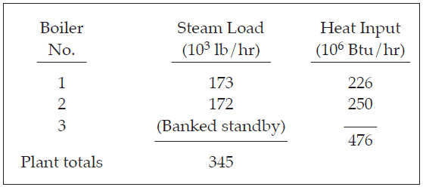
Key Elements for μ_{maximum}

Slide 61
Key Elements for μ_{maximum}
Boiler Blowdown
In the generation of steam, most water impurities are not evaporated, thus, concentrate in the boiler water.
It is usually regulated by the adjustment of the continuous blowdown valve, which controls the amount of water (and concentrated impurities) purged from the steam drum.

Slide 62
Key Elements for μ_{maximum}
When the amount of blowdown is not properly established and/or maintained, either of the following may happen:
If too little blowdown, sludge deposits and carryover will result.
If too much blowdown, excessive hot water is removed, resulting in increased boiler fuel requirements, boiler feedwater requirements, and boiler chemical requirements.

Slide 63
Key Elements for μ_{maximum}
Significant energy savings may be realized by:
Reduce blowdown (BD) by adjustment of the blowdown valve such that the controlling water impurity is held at the maximum allowable level.
Maintain blowdown continuously at the minimum acceptable level.
Minimize the amount of blowdown required by: Recovering more clean condensate, Establishing a higher allowable drum solids level than is currently, Selecting the raw-water treatment system which has the largest effect on reducing makeup water impurities.
Recover heat from the hot blowdown water.

Slide 64
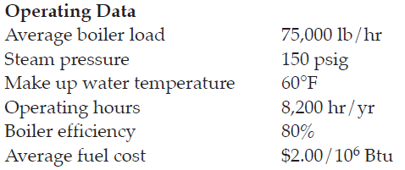
Key Elements for μ_{maximum}
Example: Determine the potential energy savings associated with reducing boiler blowdown from 12% to 10% using Figure 5.13.

Slide 65
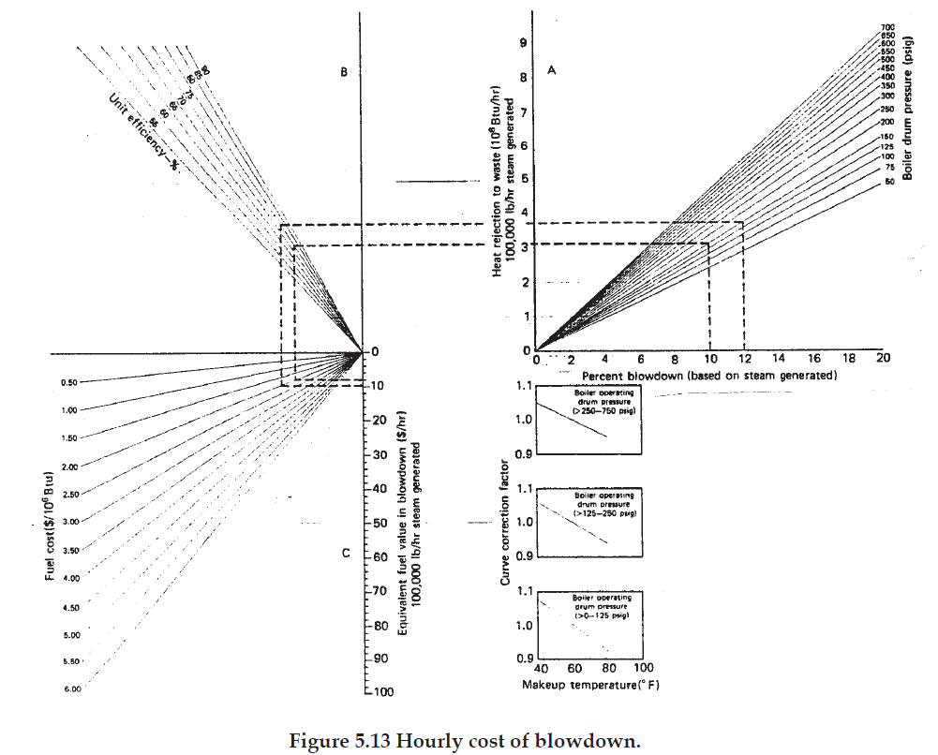
Key Elements for μ_{maximum}

Slide 66
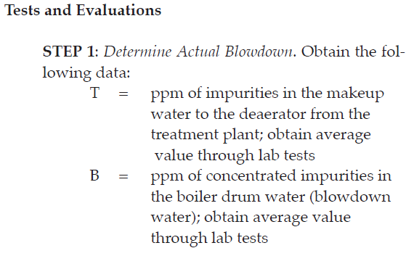
Key Elements for μ_{maximum}

Slide 67
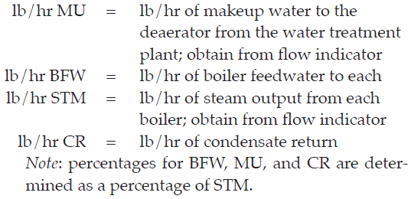
Key Elements for μ_{maximum}

Slide 68
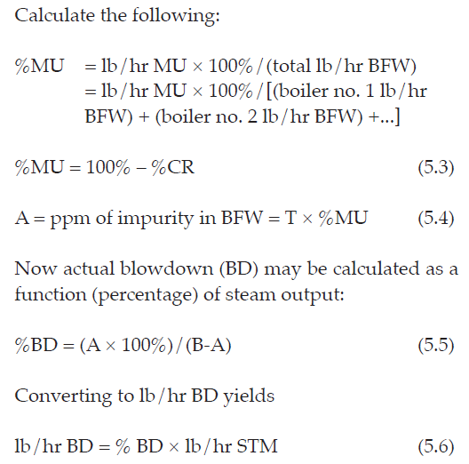
Key Elements for μ_{maximum}

Slide 69
Key Elements for μ_{maximum}

Slide 70
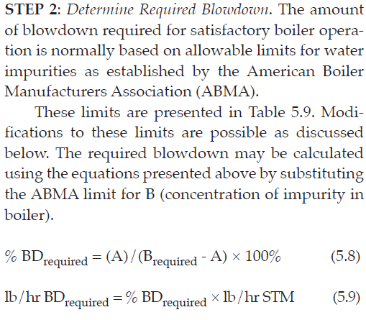
Key Elements for μ_{maximum}

Slide 71
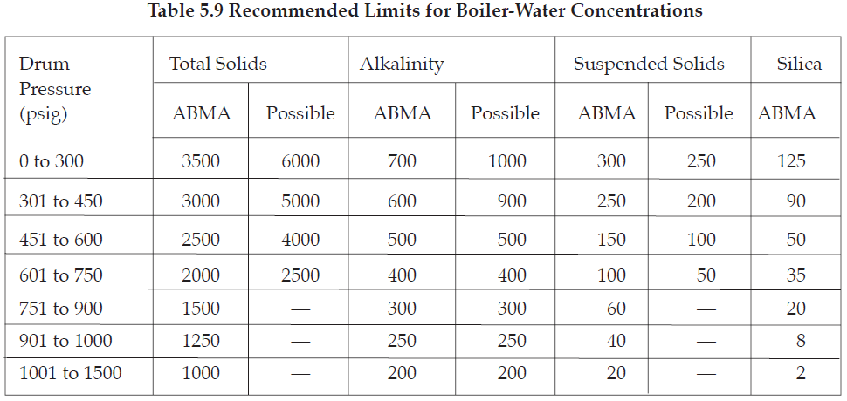
Key Elements for μ_{maximum}

Slide 72
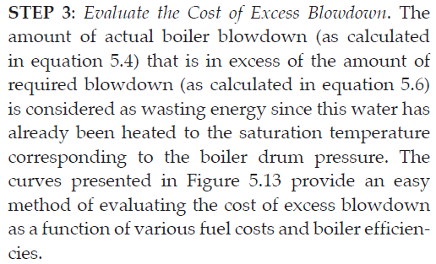
Key Elements for μ_{maximum}

Slide 73
Key Elements for μ_{maximum}

