Slide 1
An-Najah National University
Faculty of Medicine
Department of Physiology
Anatomy and Physiology 1
7102101
Instructor: Heba Salah
Chapter 4:
The Muscular System
Part 2: Anatomy, and Activity of Skeletal Muscle Tissue

Slide 2
Microscopic Anatomy of Skeletal Muscle

Slide 3
Skeletal Muscle Activity
Properties of Skeletal Muscle Activity (single cells or fibers)
Irritability – ability to receive and respond to a stimulus
Contractility – ability to shorten when an adequate stimulus is received

Slide 4
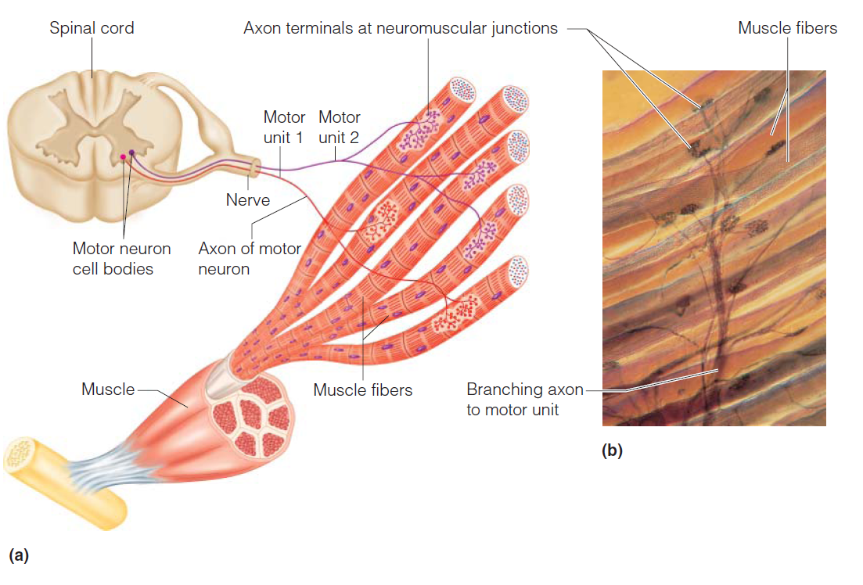
Motor Unit

Slide 5
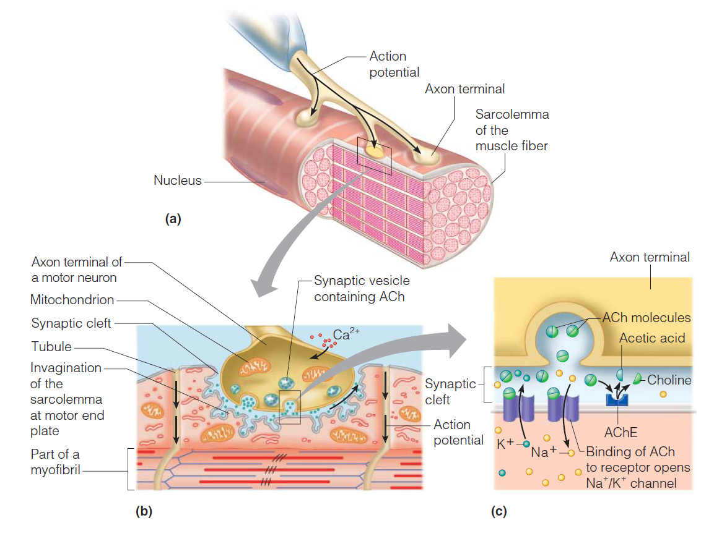
The Neuromuscular Junction

Slide 6
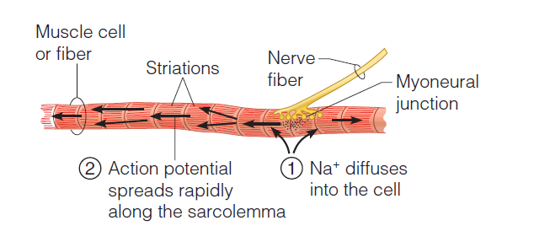
Transmission of Nerve Impulse to Muscle

Slide 7
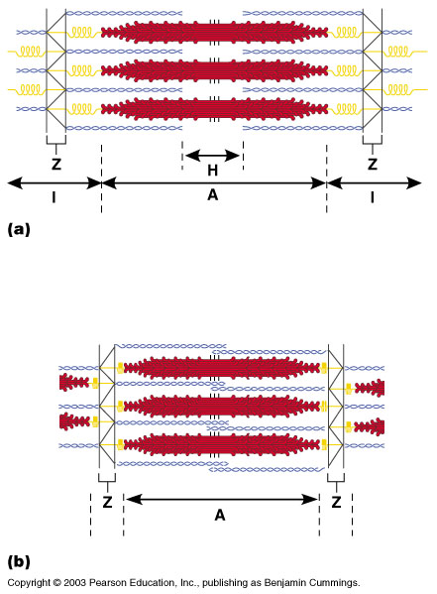
The Sliding Filament Theory of Muscle Contraction
Activation by nerve causes myosin heads (crossbridges) to attach to binding sites on the thin filament
Myosin heads then bind to the next site of the thin filament
This continued action causes a sliding of the myosin along the actin
The result is that the muscle is shortened (contracted)

Slide 8
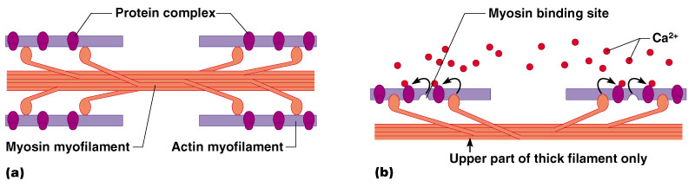
The Sliding Filament Theory

