Slide 1
ADME - distribution
Dr Basma Damiri
Toxicology
105447

Slide 2
Distribution
Initial rate of toxicants distribution to organs is determined primarily by
Blood flow
Rate of diffusion out of the capillaries into the cell
Final distribution depends on the affinity of a toxicants for various tissue.

Slide 3
Organs with high blood/mass
High blood flow organs→ heart, kidneys, lungs, liver, intestine, spleen
Low blood flow organs→ muscles, fats, bones

Slide 4
Volume of distribution
Total body water is divided into three distinct parts
Plasma water 4% of body weight (BW)
Interstitial water 4% of BW
Intracellular water 16% of BW

Slide 5
If inject a toxicant in blood stream and take a sample later
High level→ low level of volume distribution (only in plasma water)
Low level→ high level of volume distribution
But cannot just equate it to the amount of toxicant in body water.
Concentration of a toxicant in blood depends on its volume and distribution.
Other factors include binding to various storage sites such as liver, bones, and fat.
Typically, a site of accumulation is not the same as the site of target action.
Storage in blood cells by using plasma protein.

Slide 6
1- Plasma proteins as targets
Albumin→
Transferrin
Ceruloplasmin→ normally carrier for copper or metals in generally Cd, Mg, Zn.
Alpha and beta lipoproteins→ carry most likely lipid soluble compounds such as cholesterol, vitamins, and steroids hormones.
LDL, HDL,

Slide 7
Think of it???
Warfarin and dieldrin are rodenticides.
[ ] in plasma vs tissues !!!!!!
Variation in chemical and physical features can affect binding to plasma constituents.

Slide 8
Albumin
is most important (constitutes 50% of the plasma protein); it has approximately 100 positive and 100 negative potential binding sites
Think about
Displacement of new toxicants on plasma proteins→ free old and new toxicants in plasma → sever toxicity

Slide 9
Toxicants that form stable bonds with blood proteins will accumulate in the body and can be potentially dangerous. The plasma-bound compounds can be released suddenly by exposure to new compounds which can compete for the same binding sites.

Slide 10
example:
in some newborns the liver may lack the enzyme, glucuronyl transferase which conjugates bilirubin, a water-insoluble hemoglobin breakdown product; as a result, large amounts of bilirubin accumulate on the plasma albumin (hyperbilirubinemia);
if such infants are given sulfonamides or vitamin K which displace the bilirubin from albumin, enough bilirubin can be freed in a short period of time and enter the brain to cause kernicterus (widespread destruction of nerve cells in the brain).

Slide 11
The affinity for albumin and lipoproteins is inversely related to water solubility, although the relation may be imperfect.
Chlorinated hydrocarbons bind strongly to albumin but even more strongly to lipoproteins.
Strongly lipophilic organophosphates bind to both protein groups, whereas more water soluble compounds bind primarily to albumin.

Slide 12
The most water-soluble compounds appear to be transported primarily in the aqueous phase.
Chlordecone (Kepone) has partitioning characteristics that cause it to bind in the liver, whereas DDE, the metabolite of DDT, partitions into fatty depots. Thus the toxicological implications for these two compounds may be quite different.

Slide 13
Although highly specific (high-affinity, low-capacity) binding is more common with drugs, examples of specific binding for toxicants seem less common. It seems probable that low-affinity, high-capacity binding describes most cases of toxicant binding.

Slide 14
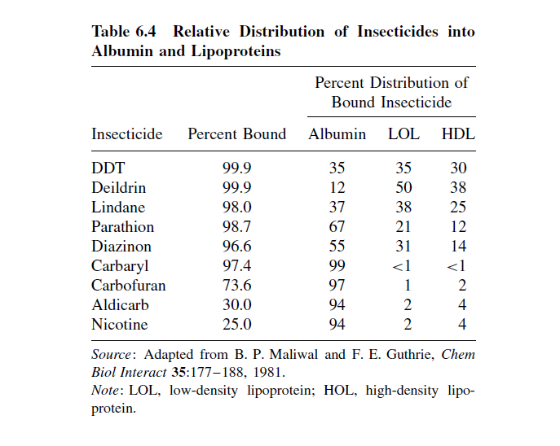

Slide 15
2- liver and kidney as storage depots
High capacity of binding and storing toxicants.
Ligandin
Found in liver
Facilitate the transfer of moderately lipophilic toxicants
Toxicants leaves binding to a protein in the plasma and binds to ligandin in the liver
Bilirubin
Carcinogens
Number of exogenous organic anions

Slide 16
3- fat as depot
Lipophilic chemicals very easily can concentrate in fat
DDT, PCB, Dioxin,
Think of mebolization of fat, migration of fat, hyper nation, and pregnancy and their effect on toxicants storage????

Slide 17
4- Bone as depots
Fluoride and lead,
Cd
Anything resemble Ca will be stored in bones

Slide 18
Body barriers
No absolute barrier but sites that are less permeable than most other areas in the body.
Blood brain barrier :
Not fully developed at birth
Four reasons:
Endothelial cells: typically joined together
Glial cells: 2nd cell layer
Active transporters: P-glycoproteins is a carrier lipids soluble compounds
Protein content: is low in the interstitial fluid

Slide 19
The anatomical and physiological features that makes an axon a particular target for toxicants
Blood Brain Barrier
Tight junctions of capillaries.
Oligodendrites-glial as a 2nd layer.
Astrocytes.
The chemical to go there has to be a lipophilic or resemble a neurotransmitter.
Site of toxicity –Circumventricular organs- spinal and autonomic ganglia. Less restrictive areas.

Slide 20
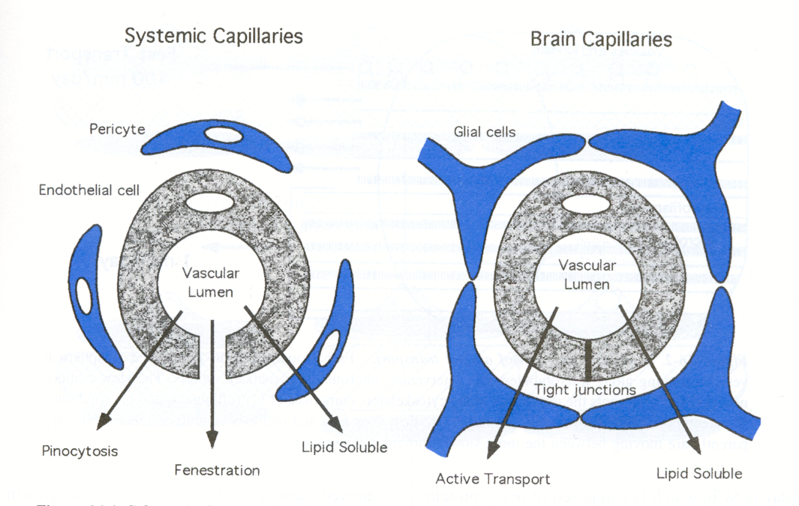
NERVOUS SYSTEM ANATOMY
BLOOD BRAIN BARRIER

Slide 21
Blood Brain barrier
Selective barrier which protects most of brain against water soluble toxins
but permeable to lipid soluble toxins (e.g. organometals, solvents)
Matures 6 months after birth (consequence?)
Most tissues
Blood brain barrier
Notes:
Infant / foetus vulnerable to water soluble toxins

Slide 22
Placenta barrier
Number of cell layers between the fetal and maternal circulation → provides extra cell layer→ helps to slow down permeability
Not true barrier→ does not have tight junction

Slide 23
Testes barrier
To protect spermatozoa from toxicity
Extra layer

Slide 24
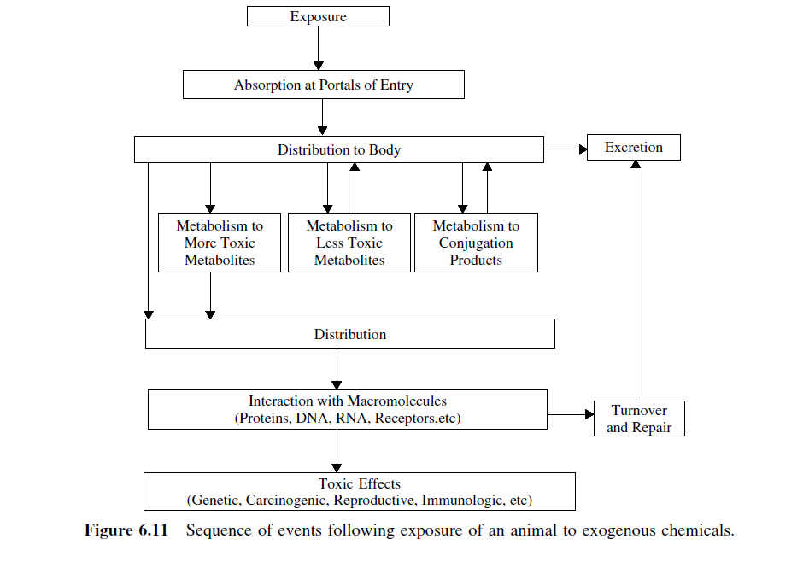

Slide 25
excretion
Water-soluble compounds can be rapidly excreted by the kidney via the urine (compounds with molecular weights usually less than 400)
and by the liver via the bile (compounds with molecular weights usually greater than 300).
Both urine and bile are aqueous (water) systems.

Slide 26
Two characteristics are primarily responsible for determining whether a chemical will be eliminated by the kidneys:
size
and water solubility.

Slide 27
Size
The reverse filtration process requires that chemicals to be removed from the blood are able to pass through 70 to 100 A pores.
As a rule, chemicals having a molecular mass of less than 65,000 are sufficiently small to be subject to reverse filtration.

Slide 28
Water Solubility
Non-water-soluble chemicals will be transported to the kidneys in association with transport proteins.
Thus, in association with these proteins, the chemicals will not be able to pass through the pores during reverse filtration.
Lipophilic chemicals are generally subject to renal elimination after they have undergone hydroxylation or conjugation reactions in the liver or elsewhere.

Slide 29
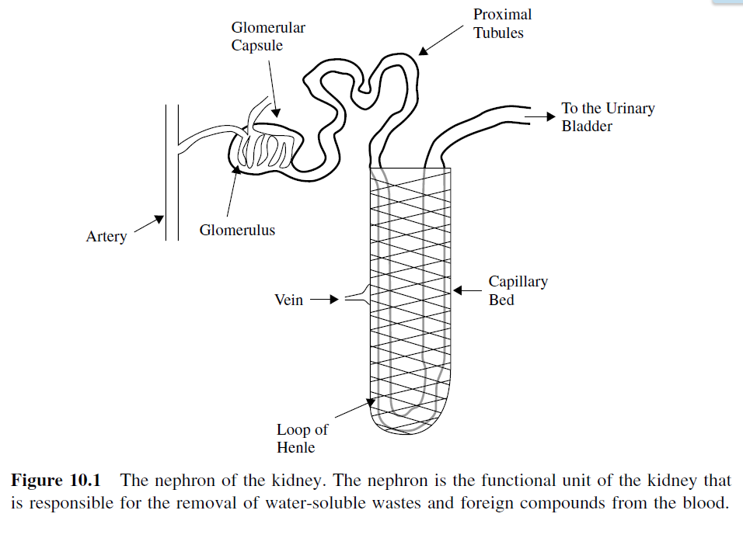

Slide 30
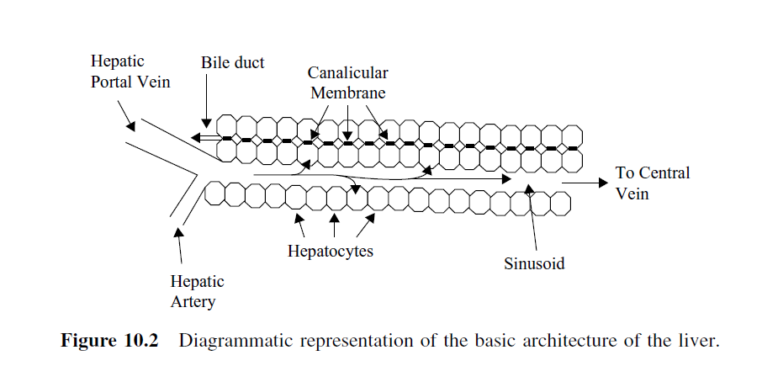

Slide 31
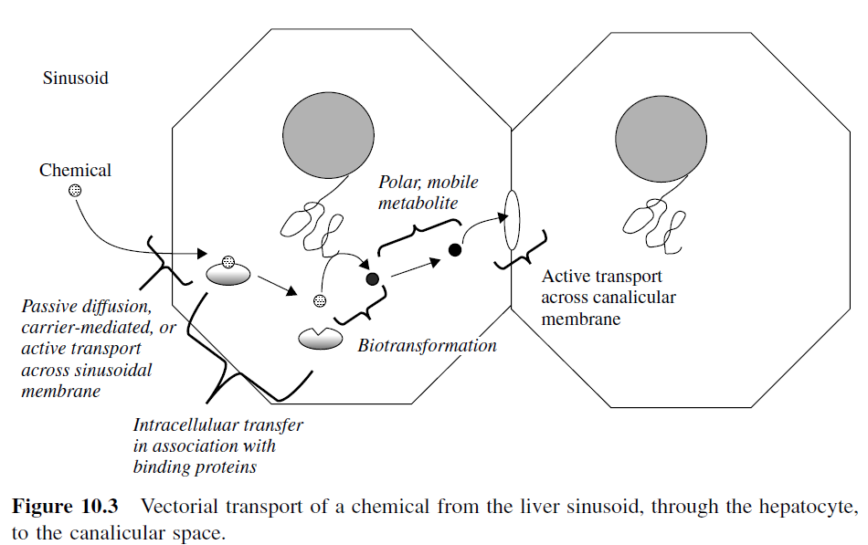

Slide 32
