Slide 1
3. Solar Energy: PV cells

Slide 2
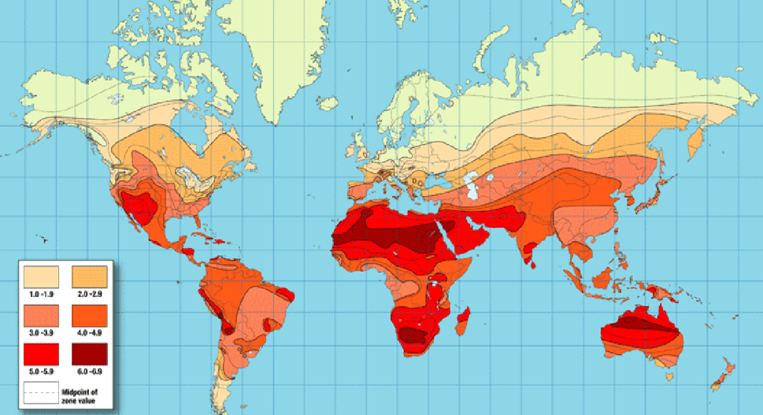
Average daily solar insolation
http://www.matthewb.id.au/media/Solar_Power_Calculator.html
Units: kWh/m²/day

Slide 3
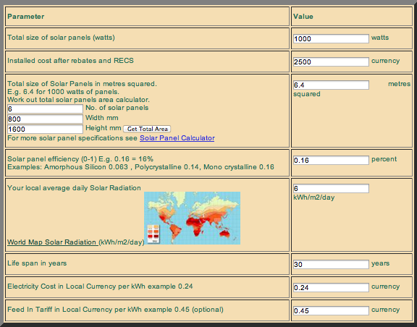
Solar Power Calculator
http://www.matthewb.id.au/media/Solar_Power_Calculator.html

Slide 4
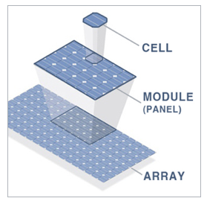
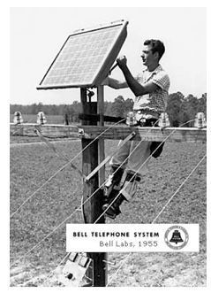
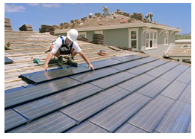
Photovoltaic (PV) array components
PV cells
Modules
Arrays
http://www.northamericansolarstores.com/how-solar-pv-works.php

Slide 5
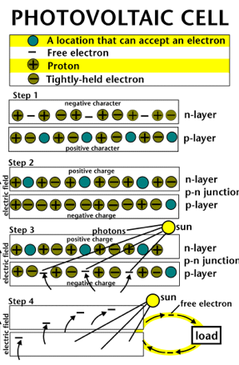
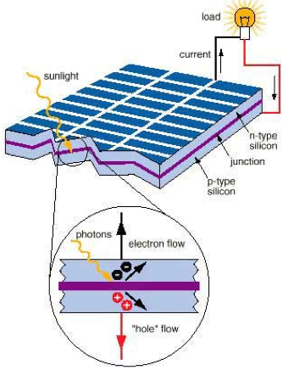
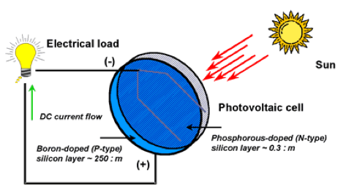
Photovoltaic cell
http://www.station57.org/solar_energy
http://www.fsec.ucf.edu/en/consumer/solar_electricity/basics/how_pv_cells_work.htm

Slide 6
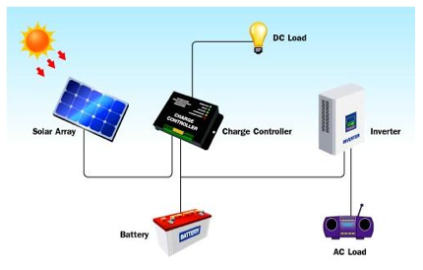
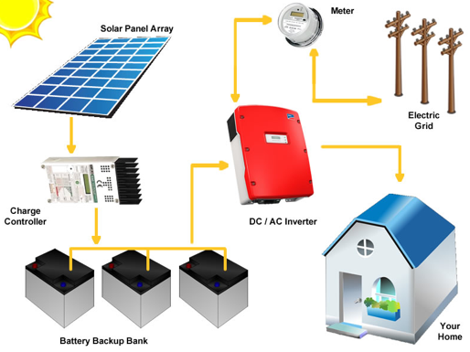
PV system components
http://www.leonics.com/support/article2_13j/articles2_13j_en.php
Net metering

Slide 7
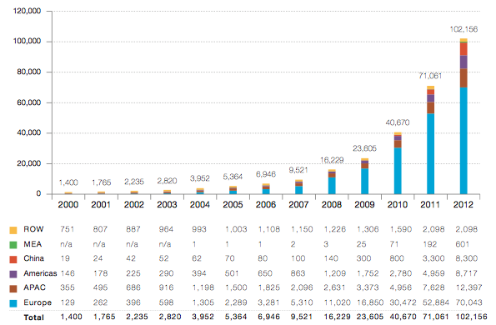
Evolution of global PV cumulative installed capacity 2000-2012 (MW)
ROW: Rest of the World. MEA: Middle East and Africa. APAC: Asia Pacific
http://www.epia.org/fileadmin/user_upload/Publications/GMO_2013_-_Final_PDF.pdf

Slide 8
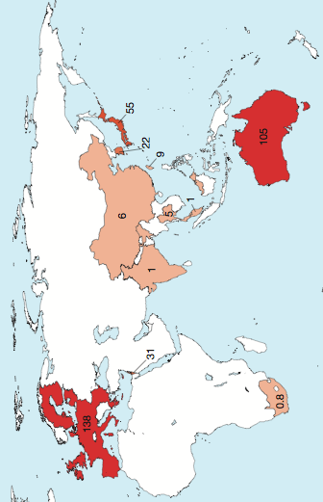
Global market outlook for PVs 2013-2017
http://www.epia.org/fileadmin/user_upload/Publications/GMO_2013_-_Final_PDF.pdf

Slide 9
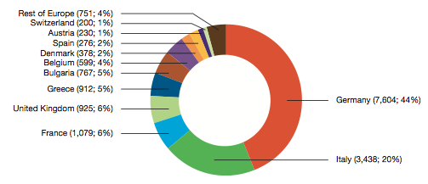
European PV market split in 2012 (MW; %)
http://www.epia.org/fileadmin/user_upload/Publications/GMO_2013_-_Final_PDF.pdf

Slide 10
Solar energy pros and cons
Pros
Clean
Sustainable
Free
Good for remote areas
Cons
Inefficient and costly equipment
Part time source
Reliability depends on location
Environmental impact of PV cell production

Slide 11
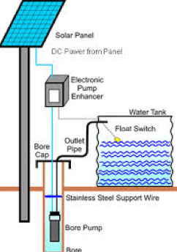
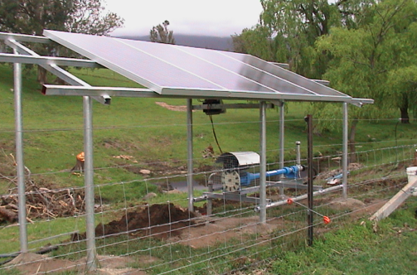
PV applications in Palestine
Promotion of PV technologies for electrification of houses in different sites in Palestine
Using PV systems for public lighting in Wadi Gaza Bridge and Wadi An-Nar street
Electrification of seven isolated clinics through PV system (lighting, refrigeration, small medical equipment)
Providing Emnazeil village with electricity using PV cells (45 houses)
Providing Innab Alkabeera village with lighting by solar energy technology (12 houses)
Implementing a pilot project of rural electrification with micro-grids of solar hybrid cells of Atouf village
Solar water pumping project in Beitello
Solar cells for Bedouins surrounding
Jerusalem and the Jordan Valley

Slide 12
Conclusion
Photovoltaic solar cell technology is a viable source of renewable energy
It has already been implemented in homes and businesses of many countries
The market of PV is growing annually because it is a practical energy alternative
This is a technology that every homeowner can look for
Information is abundant
local market lacks experts of renewable energy

