Slide 1
Polmunary edema

Slide 2
Introduction.
many of Conditions affecting the lower respiratory tract range from acute problems to long-term chronic disorders.
Many of these disorders are serious and often life-threatening

Slide 3
Anatomy of the lung

Slide 4
Definition
Pulmonary edema is defined as abnormal accumulation of fluid in the lung tissue and/or alveolar space. It is a severe, life threatening condition

Slide 5
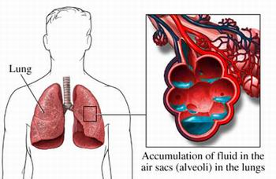

Slide 6
pathophysiology
Pulmonary edema most commonly occurs as a result of increased micro vascular pressure from abnormal cardiac function. The backup of blood into the pulmonary vasculature resulting from inadequate left ventricular function causes an increased micro vascular pressure .

Slide 7
Cont……………
and fluid begins to leak into the interstitial space and the alveoli. Other causes of pulmonary edema are hypervolemia or a sudden increase in the intravascular pressure in the lung. One example of this is in the patient who has undergone pneumonectomy.

Slide 8
Cont…………..
When one lung has been removed, all the cardiac output then goes to the remaining lung. If the patient’s fluid status is not monitored closely, pulmonary edema can quickly develop in the postoperative period

Slide 9
Clinical manifestation
The patient has increasing respiratory distress, characterized by dyspnea, air hunger, and central cyanosis. The patient is usually very anxious and often agitated. As the fluid leaks into the alveoli and mixes with air

Slide 10
Cont………..
The patient coughs up or the nurse suctions out these foamy, frothy, and often blood-tinged secretions. The patient has acute respiratory distress and may become confused

Slide 11
Assessment and Diagnostic Findings
Auscultation reveals crackles in the lung bases (especially in the posterior bases) that rapidly progress toward the apices of the lungs. These crackles are due to the movement of air through the alveolar fluid.

Slide 12
Cont……..
The chest x-ray reveals increased interstitial markings. The patient may be tachycardic, the pulse oximetry values begin to fall, and arterial blood gas analysis demonstrates increasing hypoxemia

Slide 13
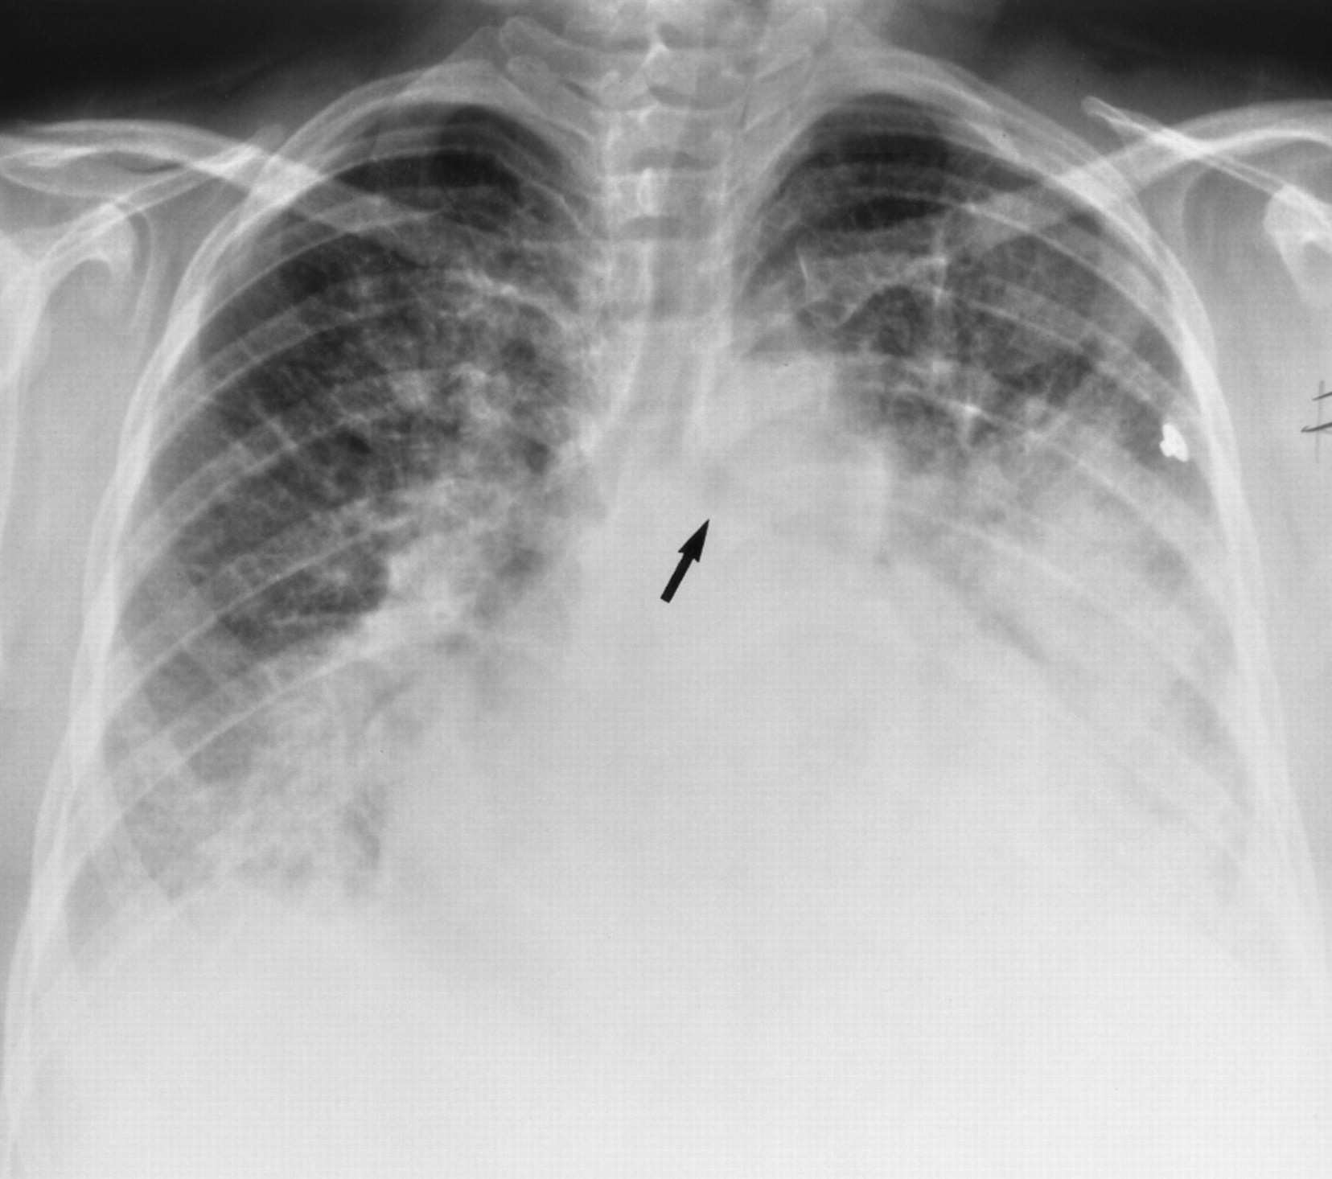

Slide 14
Medical management
Management focuses on correcting the underlying disorder.
If the pulmonary edema is cardiac in origin, then improvement in left ventricular function is the goal.
Vasodilators, inotropic medications, afterload or preload agents, or contractility medications may be given.
Additional cardiac measures (eg, intra-aortic balloon pump) may be indicated if the patient does not respond.

Slide 15
Cont……….
If the problem is fluid overload, diuretics are given and the patient is placed on fluid restrictions.
Oxygen is administered to correct the hypoxemia; in some circumstances, intubation and mechanical ventilation are necessary
The patient is extremely anxious,
and morphine is administered to reduce anxiety and control pain.

Slide 16
Nursing Management
Nursing management of the patient with pulmonary edema includes assisting with administration of oxygen and intubation and mechanical ventilation if respiratory failure occurs.

Slide 17
Cont…………………..
The nurse also administers medications (ie, morphine, vasodilators, inotropic medications, preload and afterload agents) as prescribed
and monitors the patient’s response.

Slide 18
Thanks

