Slide 1
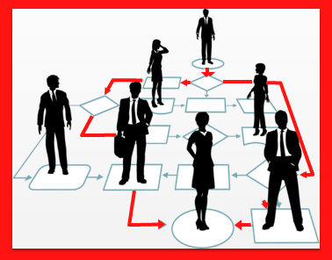
Healthcare Service Management
Organizing
Wafaa Menawi
Ph.D. Health Care Management
Head of Quality Assurance Unit
An-Najah BioSciences Unit (NBU)
Mobile: +972 568279063
E. mail: w.menawi@najah.edu

Slide 2
Learning Objectives
Explain organizations and systems
Relate organizing to planning
Organize work tasks into jobs, positions, and departments
Coordinate work among positions and departments
Contrast the formal and informal organizations
Organization structures
Coordination within an healthcare organization

Slide 3
Organizing is the process by which managers establish the structure of working relationships among employees to allow them to achieve organizational goals efficiently and effectively.
The function of organizing includes the determination of the activities to be performed; creation of departments, sections and positions to perform those activities; and establishing relationships among the various parts of an organization.
The purpose is to create a framework for the performance of the activities of an organization in a systematic manner.
Organizations Social entities that are goal-directed deliberately structured activity systems linked to the external environment.
The process of organizing refers to identifying and grouping of activities to be performed, defining and delegating authority, casting responsibility and establishing relationships to enable people to work together effectively in accomplishing objectives.

Slide 4
A manager engaged in organizing allocates resources (people, equipment, and money) to achieve a company’s plans.
Successful managers make sure that all the activities identified in the planning process are assigned to some person, department, or team and that everyone has the resources needed to perform assigned activities.

Slide 5
Tasks no longer randomly done or left to chance – Certain jobs held accountable for certain tasks
Size – Goals – Worker motivation – Coordination
Supervision
adjustment
work process
work output
worker skills

Slide 6
Establishing Relationship Among Individuals And Groups
Responsibility: Responsibility is the obligation of a subordinate to perform the assigned duties in the manner desired by the superior.
Authority: When a person is given certain duties to perform, he must be given necessary authority also. Authority includes the right to take decision, right to issue orders and the right to take action if orders are not carried out. Authority should always follow responsibility.
Accountability: Accountability means answerability. That is, each person has to report to his superior how the work has been done and how authority has been used. Accountability is always upward. Each subordinate is accountable to his superior who in turn is accountable to his own superior.

Slide 7
Meaning Of Organization Structure
Organization structure is a framework of formal relationships among different departments and positions.
Structure refers to the arrangement of parts and interrelationships among activities and people.
The Organization structure of a business unit consists of the following elements:
The number of departments
The number of sections, units and positions in each department
The function of each department, section and position
The number of levels of management
The responsibility, authority and accountability relationships
The channels of communication, i.e., the paths through which information travels from one position to another and from one level to the other.
The purpose of having a formal structure is to perform the activities in a planned and systematic manner.

Slide 8
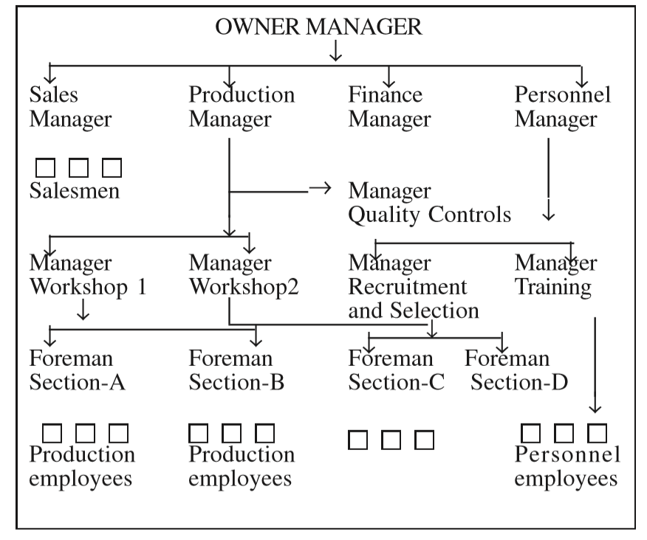
How An Organization Structure Is Created
Line Functions
Staff Function

Slide 9
Principles Of Organization
(i) Purpose
(ii) Authority
(iii) Responsibility
(iv) Scalar Principle: a clear line of formal authority from top to the bottom
(v) Span of control
(vi) Specialization of functions
(vii) Coordination of Effort : smooth, effective coordination
(viii) Definition : Every position in every organization should be clearly described in writing

Slide 10
Line, Staff And Functional Authority Relationships
These are of three types:
1. Line Authority
2. Staff Authority
3. Functional Authority
Scalar Chain
Line authority is the authority to issue orders and to see that these orders are carried out.
Staff officers are appointed to help line managers. Their main job is to give advice.
Functional authority is the authority of a manager over a person who is not his immediate subordinate. The main reason of using functional authority is to take advantage of the special knowledge and skill of functional specialists.

Slide 11
Formalization
• Formalization – written procedure manuals, budgets, job descriptions, and other documents that guide activity and behavior
• Helps achieve consistency and predictability
• Stifles creativity and flexibility
• Best approach and amount of formalization depends on factors such as
– Type of work
– Professionalism of workers
– Span of control
– Stability of the environment

Slide 12
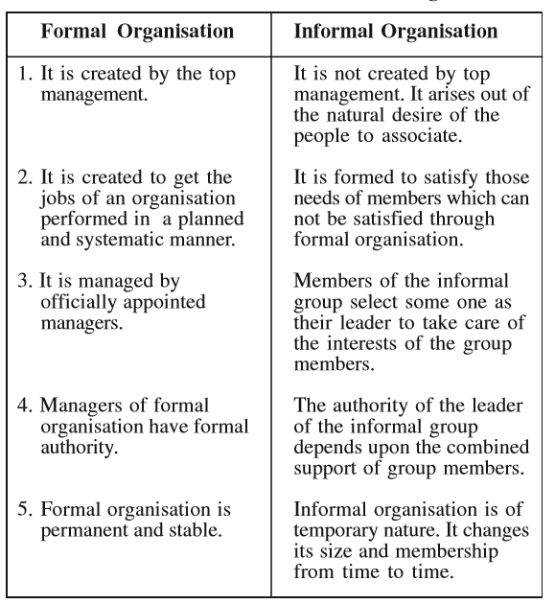
Difference between Formal and Informal Organizations

Slide 13
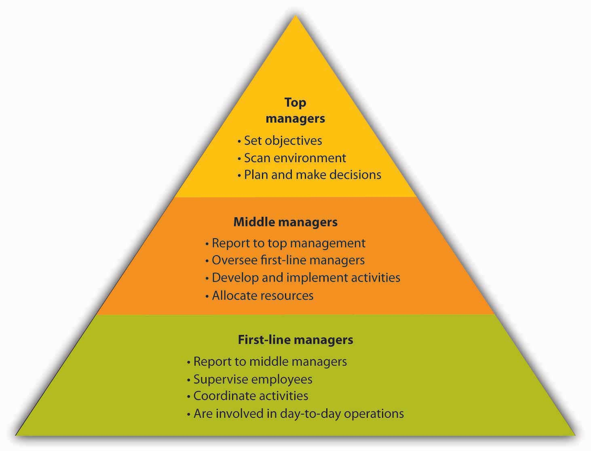
Levels of Management

Slide 14
Organizational Structure: How Companies Get the Job Done
What jobs need to be done?
Who does what?
Who reports to whom?
What are the formal relationships among people in the organization?
organizational structure: an arrangement of positions that’s most appropriate for your company at a specific point in time.
companies restructuring—altering existing organizational structures to become more competitive under conditions that have changed.
In building an organizational structure, you engage in two activities:
job specialization (dividing tasks into jobs)
departmentalization (grouping jobs into units).

Slide 15
Specialization
The first step in designing an organizational structure is twofold:
Identifying the activities that need to be performed in order to achieve organizational goals.
Breaking down these activities into tasks that can be performed by individuals or groups of employees.
This twofold process of organizing activities into clusters of related tasks that can be handled by certain individuals or groups is called specialization. Its purpose is to improve efficiency.
Obviously, specialization has advantages. In addition to increasing efficiency, for example, it results in jobs that are easier to learn.
But it has disadvantages, too. Doing the same thing over and over bores people and will eventually leave employees dissatisfied with their jobs, decreased performance and increased absenteeism and turnover.

Slide 16
Departmentalization
The next step in designing an organizational structure is departmentalization—grouping specialized jobs into meaningful units.
Depending on the organization and the size of the work units, they may be called divisions, departments, or just plain groups.
Traditional groupings of jobs result in different organizational structures types like functional and divisional organizations.
– Serve the same group of customers
– Create the same health service
– Work in the same place
– Work at the same time
– Perform the same kind of work

Slide 17
Functional Organization
A functional organization groups together people who have comparable skills and perform similar tasks.
small to medium-size companies, which group their people by business functions: accountants, finance, marketing and sales, human resources, production.
Each unit is headed by an individual with expertise in the unit’s particular function.
jobs might be grouped into four clusters:
-Operations (overseeing note takers and copiers)
-Marketing (arranging for advertising, sales, and distribution)
-Accounting (handling cash collection and disbursement)
homogeneity also has drawbacks: it can hinder communication and decision making between units and even promote interdepartmental conflict.
-Human resources (hiring, training, and evaluating employees)

Slide 18
Divisional Organization
Large companies are structured as divisional organizations made up of several smaller, self-contained units, or divisions, which are accountable for their own performance.
Each division functions autonomously because it contains all the functional expertise needed to meet its objectives.
The challenge is to find the most appropriate way of structuring operations to achieve overall company goals.
Divisions can be formed according to products, customers, processes, or geography.

Slide 19
Product Division
Product division means that a company is structured according to its product lines.
A downside is that it results in higher costs as corporate support services.
Customer Division
Companies are grouped into customer-based business segments: Johnson
consumer business (personal-care and hygiene products )
pharmaceuticals (prescription drugs sold to pharmacists)
professional business (medical devices and diagnostics products used by physicians….

Slide 20
Process Division
If goods move through several steps during production, a company might opt for a process division structure.
This form works well at Bowater Thunder Bay, a Canadian company that harvests trees and processes wood into newsprint and pulp.
The first step in the production process is harvesting and stripping trees.
Then, large logs are sold to lumber mills and smaller logs chopped up and sent to Bowater’s mills.
At the mill, wood chips are chemically converted into pulp.
About 90 percent is sold to other manufacturers (as raw material for home and office products), and the remaining 10 percent is further processed into newspaper print.
Bowater, then, has three divisions: tree cutting, chemical processing, and finishing

Slide 21
Geographical Division
Geographical division enables companies that operate in several locations to be responsive to customers at a local level.
McDonald’s, for example, is organized according to the regions of the world in which it operates.
In the United States, the national unit is further subdivided into three geographic operating divisions: east, west and central.
There are pluses and minuses associated with divisional organization. On the one hand, divisional structure usually enhances the ability to respond to changes in a firm’s environment.
on the other hand, services must be duplicated across units, costs will be higher. In addition, some companies have found that units tend to focus on their own needs and goals at the expense of the organization as a whole.

Slide 22
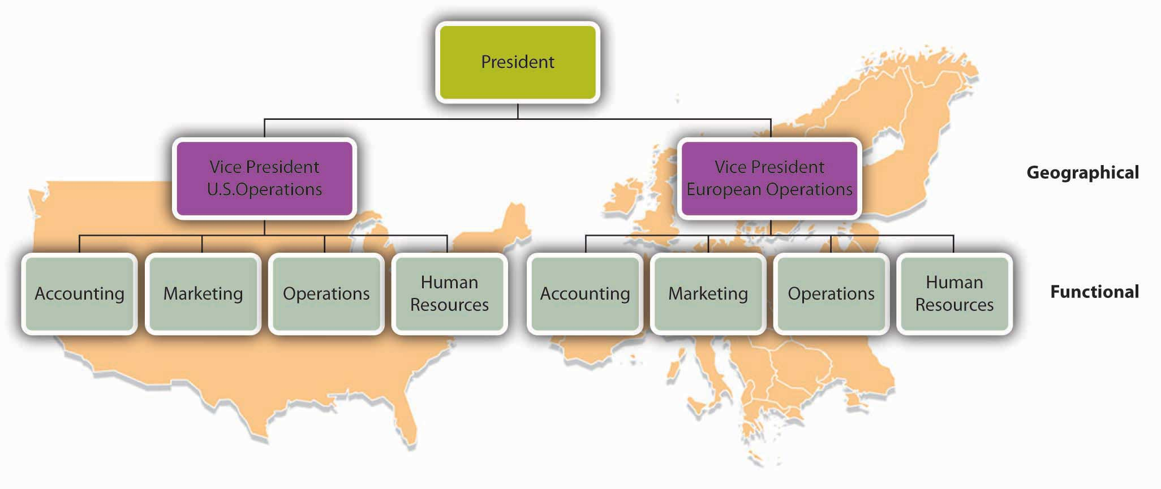
Combination Divisional and Functional Structures

Slide 23
Lines of Authority
To whom does a particular person report?
Does each person report to one or more supervisors?
How many people does a manager supervise?
How many layers are there, for example, between the top managerial position and the lowest managerial level?

Slide 24
Chain of Command
Chain of command: the authority relationships among people working at different levels of the organization. That is to say, they show who reports to whom.
Under a matrix structure, for example, employees from various functional areas (product design, manufacturing, finance, marketing, human resources, etc.) form teams to combine their skills in working on a specific project or product.
Nike sometimes uses this type of arrangement. To design new products, the company may create product teams made up of designers, marketers, and other specialists with expertise in particular sports categories—say, running shoes or basketball shoes. Each team member would be evaluated by both the team manager and the head of his or her functional department.

Slide 25
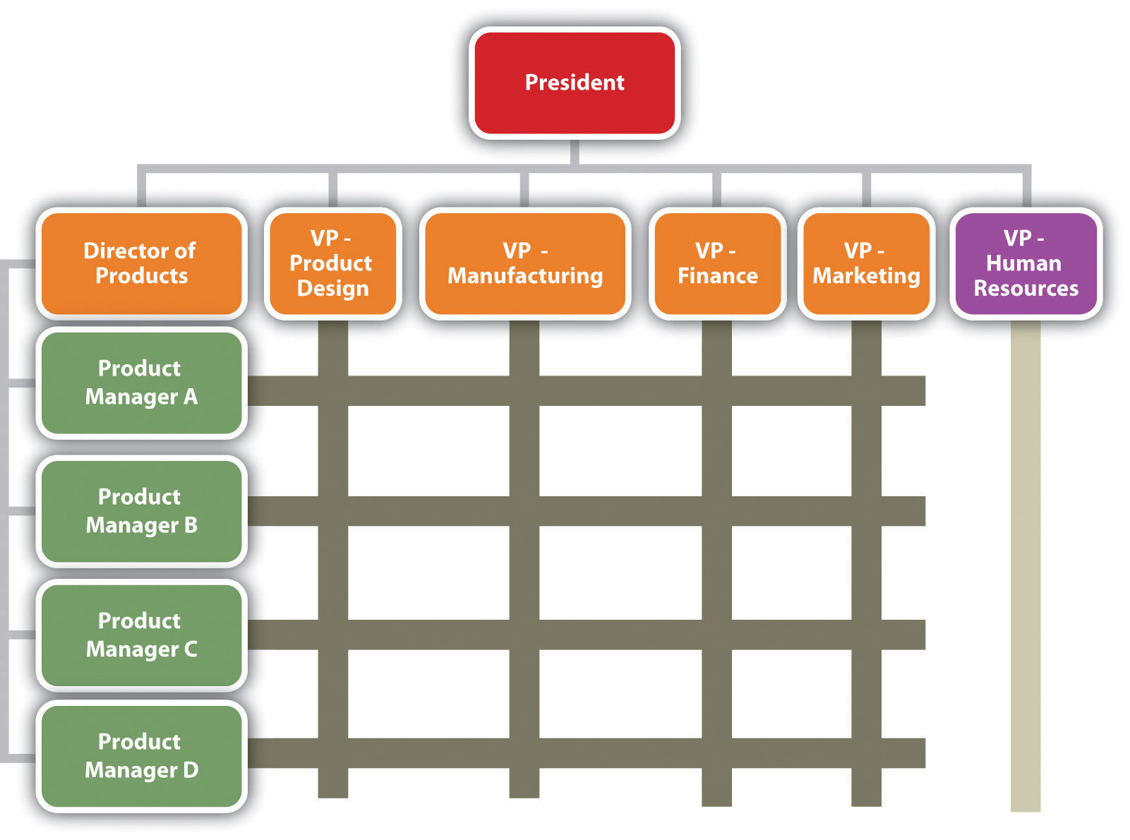
Matrix Structure

Slide 26
Span of Control
Another thing to notice about a firm’s chain of command is the number of layers between the top managerial position and the lowest managerial level.
As a rule, new organizations have only a few layers of management—flat.
As a company grows, it tends to add more layers between the top and the bottom; that is, it gets taller.
Added layers of management can slow down communication and decision making, causing the organization to become less efficient and productive. That’s one reason why many of today’s organizations are restructuring to become flatter.
Span of control, which measures the number of people reporting to a particular manager.
Depends on a number of factors, including ; frequency and type of interaction, proximity of subordinates, competence of both supervisor and subordinates, and the nature of the work being supervised.

Slide 27
Centralization and Decentralization
Most decision making is concentrated at the top- centralization.
Decision making throughout the organization-decentralization.
Decentralizing authority…
– Delegates more authority from upper-level to lower-level position to make decisions
– Relieves higher position of some work and decisions
– Depends on people involved, type of work, and the performance of the system

Slide 28
Organizations As Systems
Katz and Kahn (1978), advocate for thinking about organizations as systems, social systems that are alive, organic, dynamic, and complex.
Ludwig von Bertalanffy (1956, 1968), systems behaviors:
Open/closed exchange: high or low attention and responsiveness to information about the system that is internal or external to the system
Interdependence: members (subsystems) of the system influence each other simultaneously, and each part is affected by the actions of the other parts
Homeostasis: participation in maintaining system stability
Nonsummativity: the whole system equals more (is greater than) the sum of its parts . Meadows and Wright (2008) proposed a slightly different emphasis. They defined system as an organized collection of parts or subsystems that are integrated to accomplish an overall goal.

Slide 29
Organizations Social entities that are goal-directed deliberately structured activity systems linked to the external environment
To maintain the health of organizations of every kind, they must be receptive to fresh perspectives as exposure to negative entropy (the dissenting voice) builds resilience.
Every system is dependent on a periodic infusion of opposing forces (negative entropy) to secure a reservoir of energy for future use
Balancing the opposing forces that compose it are what makes the system possible.

Slide 30
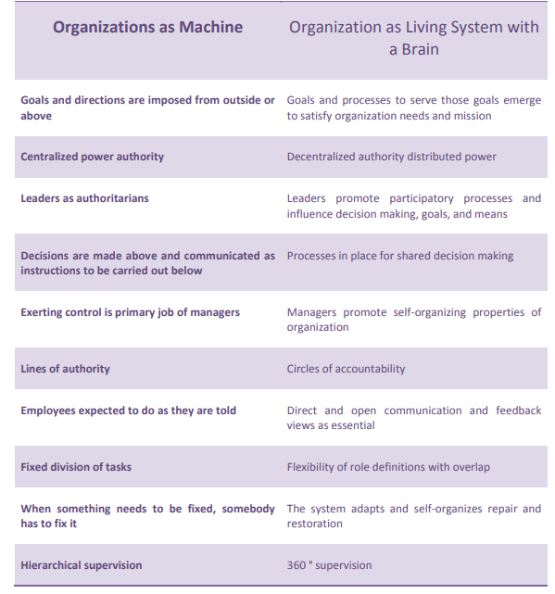

Slide 31
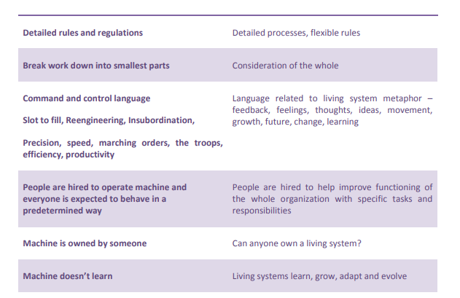

Slide 32
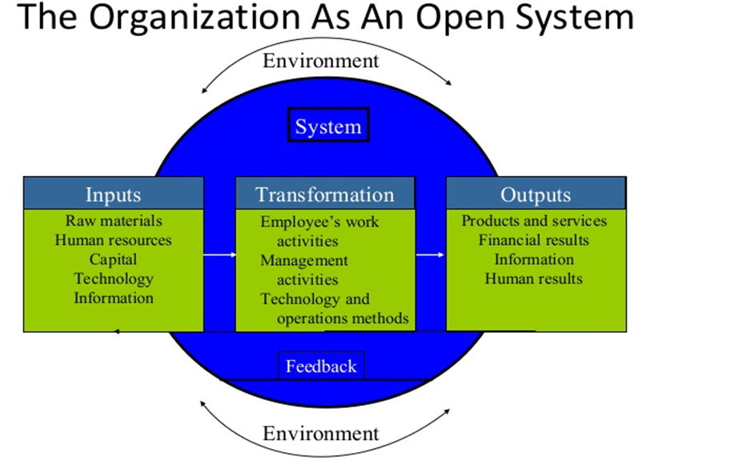

Slide 33
HCOs and the Environment
Acquire resources, staff, supplies, equipment, information, technology, and other inputs from environment
IN PUT
HCOs open to their environments
Transform input to output
Give, sell, provide, and deliver outputs, products, and services to customers, clients, and people in the environment
OUTPUT

Slide 34
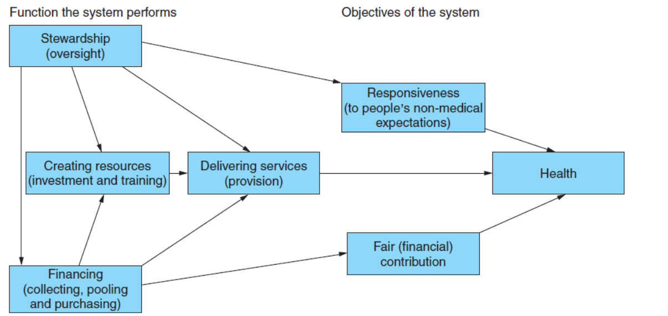
providers and institutions
that support the basic functions of a health system,
public health, consultation and treatment, provision
of drugs, physical support for the infirm, and
management of inter-temporal expenditure
Functions of a Health System

Slide 35
Physicians and the Medical Staff
• Medical positions filled by physicians can make HCOs unlike other types of organizations
• Physicians and medical positions filled by physicians often guided by medical expertise rather than managerial authority
• Boundary between medical care and management may be unclear
• Traditional bureaucratic approaches less effective in organizations where physicians are main type of labor or expertise

