Slide 1
Differential Pulse Code Modulation DPCM
When voice or video signal is sampled at a rate slightly higher than the Nyquist rate, the resulting sampled signal is found to exhibit a high degree of correlation between adjacent samples
When the resulting samples are encoded as in standard PCM, the encoded signal contains redundant information (extra unwanted bits)

Slide 2
Differential Pulse Code Modulation DPCM
This means that, the PCM process generates extra bits to be transmitted in the channel
Those extra bits wastes the channel bandwidth
In DPCM the redundant extra bits can be eliminated by using linear prediction before encoding

Slide 3
Differential Pulse Code Modulation DPCM
DPCM uses the linear prediction in order to predict an estimate samples $\hat{m}\left[n\right]$from the actual signal samples $m[n]$
The difference between the actual samples and the predicted samples is quantized then encoded in order to generate DPCM signal
The block diagram of this DPCM is illustrated in the next slide

Slide 4
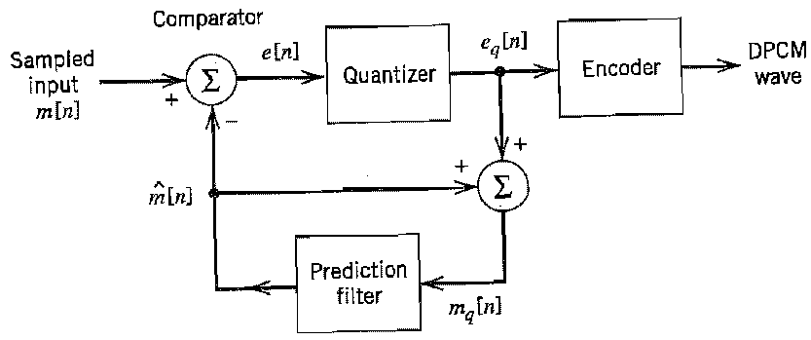
DPCM block diagram

Slide 5
DPCM equations
The equations used to describe the operation of the DPCM block diagram are
The prediction error $e[n]$ which is the error between the actual sample and the prediction of it is given by
$$e\left[n\right]=m\left[n\right]−\hat{m}[n]$$
The quantized version of this prediction error is given by
$$e_{q}\left[n\right]=e\left[n\right]+q[n]$$

Slide 6
DPCM equations
Where $q[n]$ is the quantization error
According to the Figure shown in slide 4 the quantized signal sample $m_{q}[n]$ is given by
$m_{q}\left[n\right]=\hat{m}\left[n\right]+e_{q}[n]$
or alternatively
$$m_{q}\left[n\right]=\hat{m}\left[n\right]+e\left[n\right]+q[n]$$

Slide 7
DPCM equations
However the sum term $\hat{m}\left[n\right]+e[n]$ is equal to the input sample $m[n]$, therefore the quantized sample $m_{q}[n]$ can be written as
$$m_{q}\left[n\right]=m\left[n\right]+q\left[n\right]$$
This equation shows that, the quantized sample $m_{q}[n]$ differs from the original sample $m[n]$ only by the quantization error $q[n]$ only
$m_{q}[n]$does not depend on the properties of the prediction filter

Slide 8
DPCM reciever
The DPCM receiver consists from a decoder followed by an accumulator as shown below

Slide 9
DPCM notes
Delta modulation is a special case from the DPCM
DPCM is subject to slope-overload distortion when the signal changes too rapidly for the prediction filter to track it
Also DPCM suffers from quantization noise as the case of PCM

Slide 10
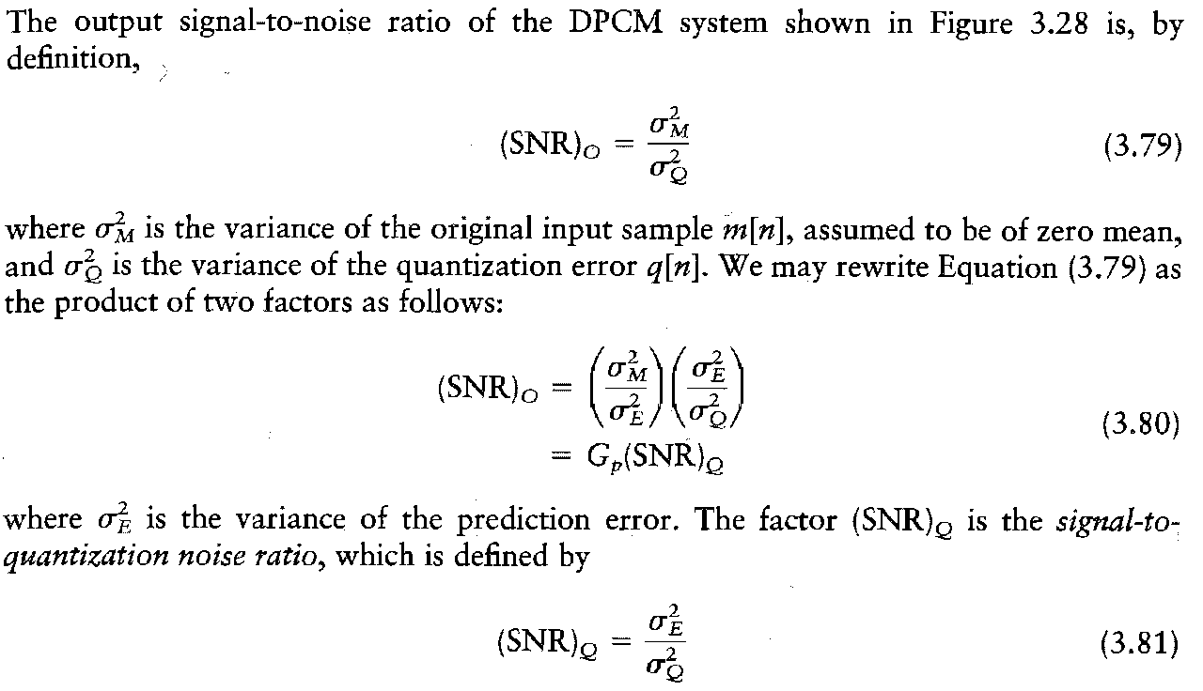
Process gain

Slide 11
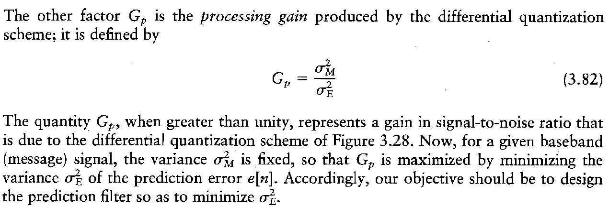
Process gain

