Slide 1
An-Najah National University
Faculty of Medicine
Department of Physiology
Anatomy and Physiology 1
7102101
Instructor: Heba Salah
Chapter 3:
The Skeletal System
Part 6: Appendicular Skeleton: Shoulder Girdle, and Upper Limb

Slide 2
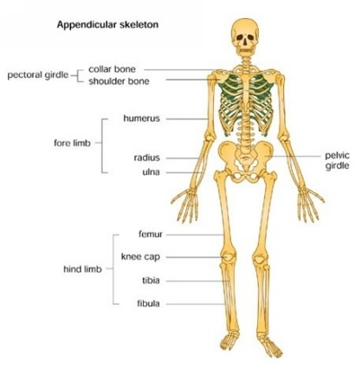
The Appendicular Skeleton
Limbs (appendages)
Pectoral girdle
Pelvic girdle

Slide 3
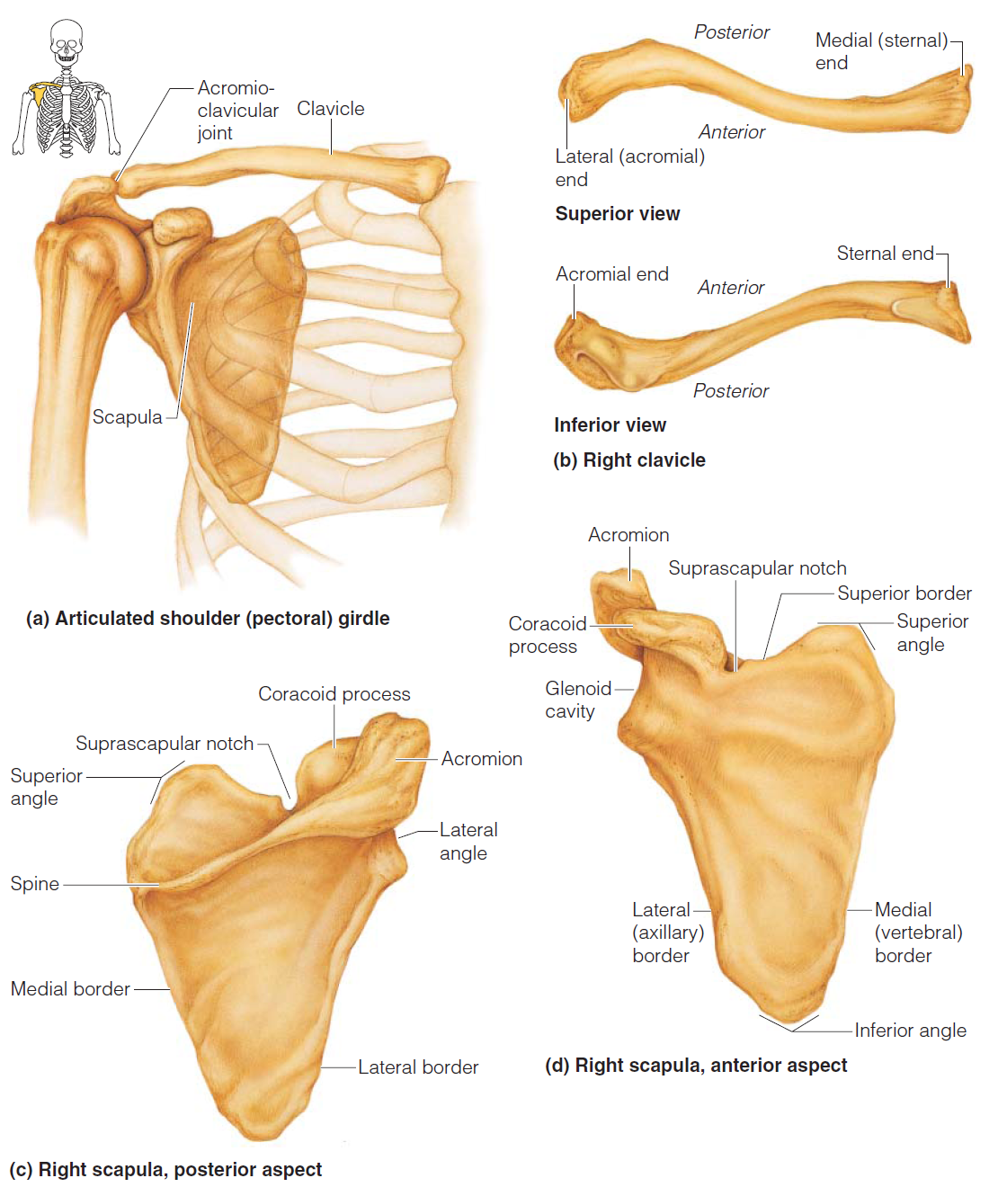
The Pectoral (Shoulder) Girdle

Slide 4
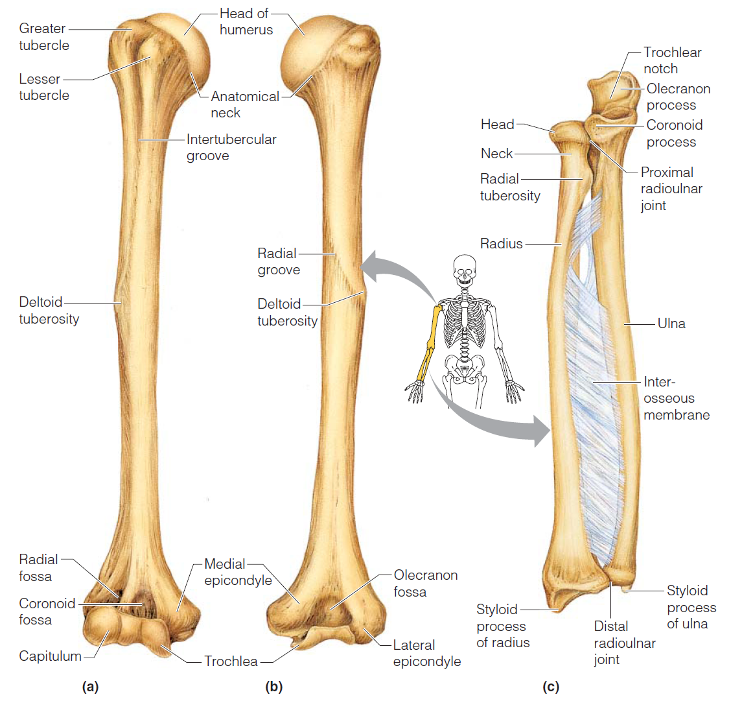
Bones of the Upper Limb
The arm is formed by a single bone: humerus

Slide 5
Bones of the Upper Limb
The forearm has two bones:
Ulna
Radius

Slide 6
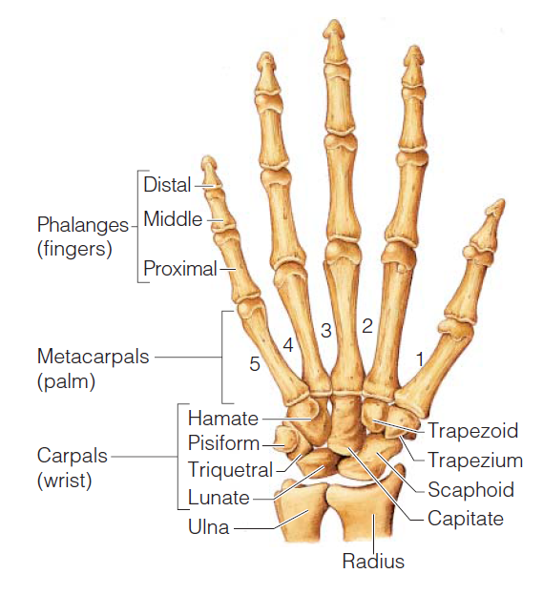
Bones of the Upper Limb
The hand
Carpals – wrist
Metacarpals – palm
Phalanges – fingers

