Slide 1
Chapter 3
The Macromolecules of the Cell

Slide 2
The Macromolecules of the Cell
Polymers are synthesized by condensation reactions in which activated monomers are linked together by the removal of water
Most biological macromolecules in cells are synthesized from about 30 common small molecules

Slide 3
3.1 Proteins
Proteins are extremely important macromolecules in all organisms, occurring nearly everywhere in the cell
Proteins fall into nine major classes

Slide 4
Classes of Proteins
Enzymes serve as catalysts, increasing the rates of chemical reactions
Structural proteins—physical support and shape
Motility proteins—contraction and movement
Regulatory proteins—control and coordinate cell function
Transport proteins—move substances into and out of cells

Slide 5
Classes of Proteins (continued)
Signaling proteins—communication between cells
Receptor proteins—enable cells to respond to chemical stimuli from the environment
Defensive proteins—protect against disease
Storage proteins—reservoirs of amino acids

Slide 6
The Monomers Are Amino Acids
Only 20 kinds of amino acids are used in protein synthesis
Some contain additional amino acids, usually the result of modification
No two different proteins have the same amino acid sequence

Slide 7
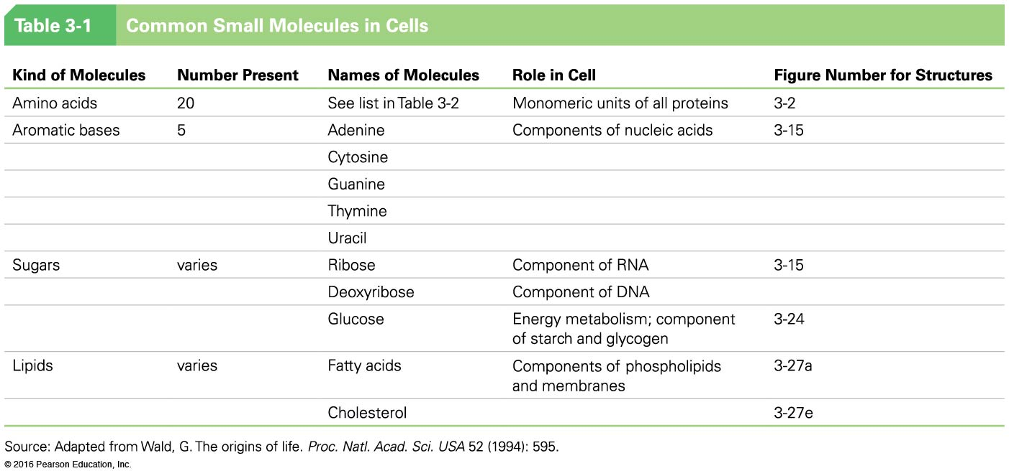

Slide 8
Amino Acids
Every amino acid has the same basic structure
Each has a unique side chain, called an R group
All amino acids except glycine have an asymmetric α carbon atom
The specific properties of amino acids depend on the nature of their R groups

Slide 9
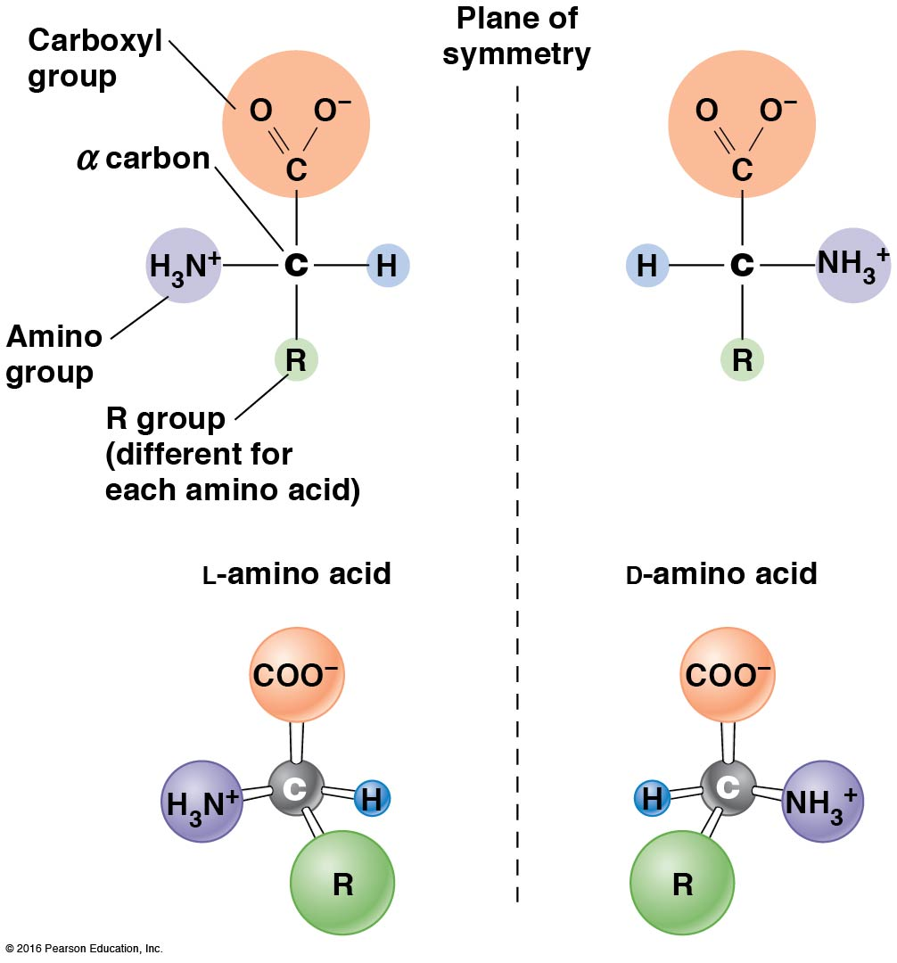

Slide 10
Classes of R Groups
Nine amino acids have nonpolar, hydrophobic R groups
The remaining eleven amino acids are hydrophilic, with R groups that are either polar or charged at cellular pH
Acidic amino acids are negatively charged, whereas basic amino acids are positively charged
Polar amino acids tend to be found on the surfaces of proteins

Slide 11
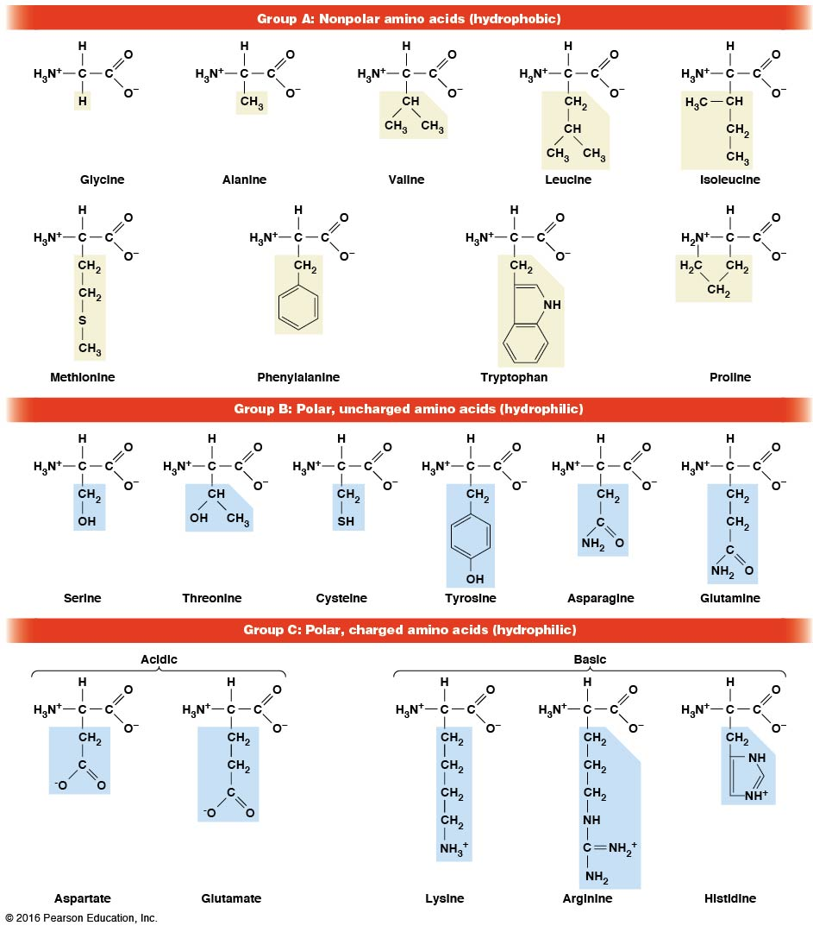

Slide 12
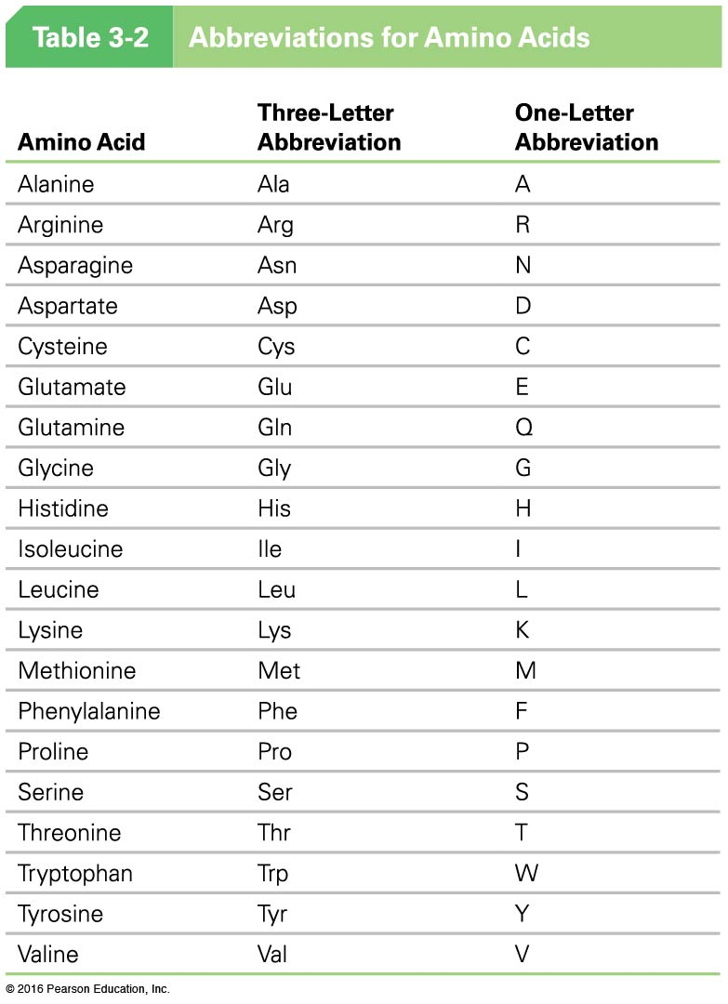

Slide 13
The Polymers Are Polypeptides and Proteins
Amino acids are linked together stepwise into a linear polymer by dehydration (or condensation) reactions
As the three atoms comprising the H₂O are removed, a covalent C—N bond (a peptide bond) is formed

Slide 14
Directionality of Polypeptides
Because of the way peptide bonds are formed, polypeptides have directionality
The end with the amino group is called the N- (or amino) terminus
The end with the carboxyl group is called the C- (or carboxyl) terminus

Slide 15
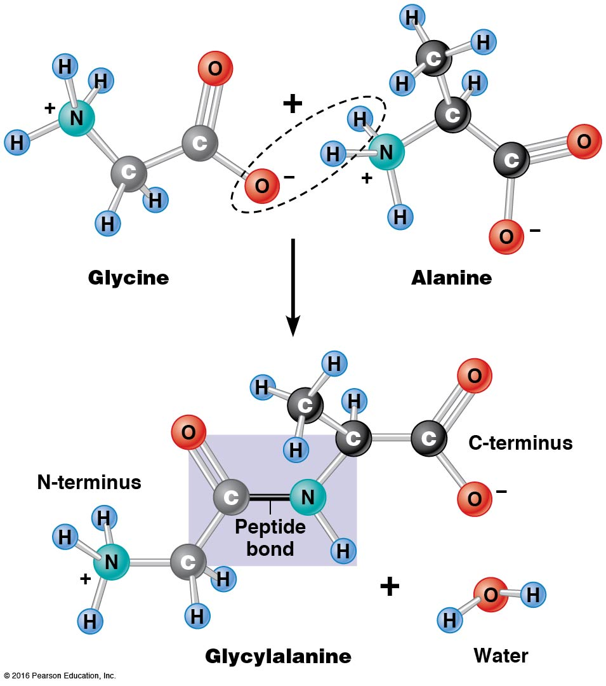

Slide 16
Proteins and Polypeptides
The process of elongating a chain of amino acids is called protein synthesis
However, the immediate product of amino acid polymerization is a polypeptide
A polypeptide does not become a protein until it has assumed a unique, stable, three-dimensional shape and is biologically active

Slide 17
Monomeric and Multimeric Proteins
Proteins that consist of a single polypeptide are monomeric proteins, whereas multimeric proteins consist of two or more polypeptides
Proteins consisting of two or three polypeptides are called dimers or trimers, respectively
Hemoglobin is a tetramer, consisting of two α subunits and two β subunits

Slide 18
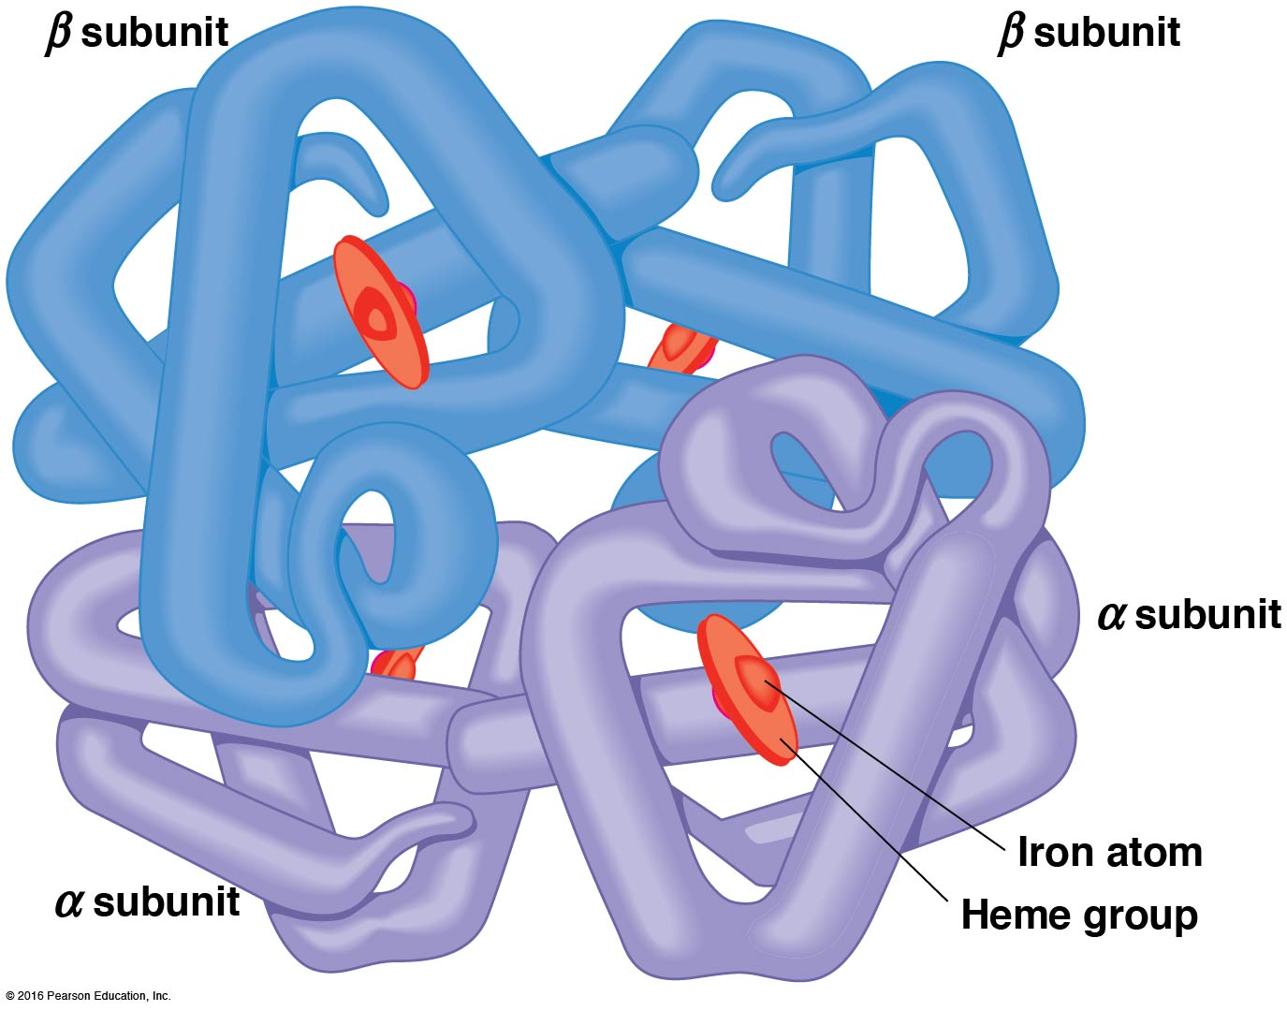

Slide 19
Several Kinds of Bonds and Interactions Are Important in Protein Folding and Stability
Both covalent bonds and noncovalent interactions are needed for a protein to adopt its proper shape, or conformation
These same bonds and interactions are required for polypeptides to form multimeric proteins
The interactions involve carboxyl, amino, and R groups of the amino acids, called amino acid residues once incorporated into a polypeptide

Slide 20
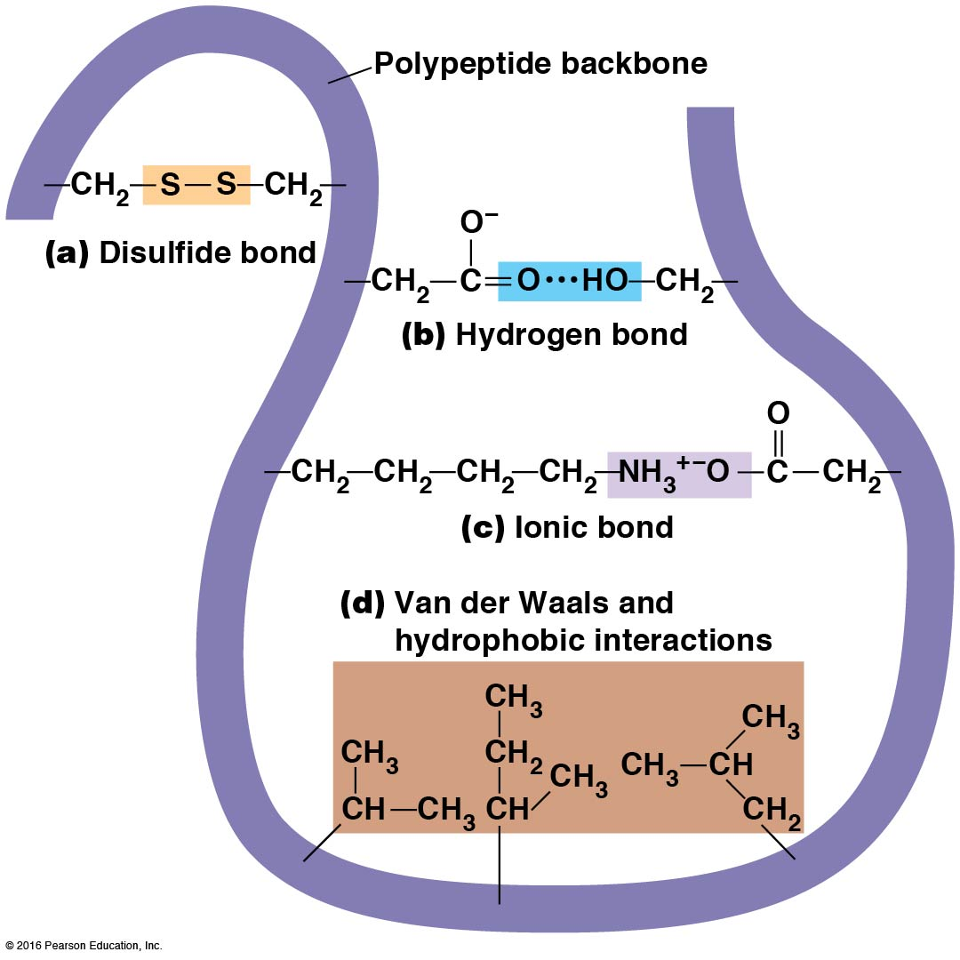

Slide 21
Disulfide Bonds
Covalent disulfide bonds form between the sulfur atoms of two cysteine residues
They form through the removal of two hydrogen ions (oxidation) and can be broken only by the addition of two hydrogens (reduction)
Once formed, disulfide bonds confer considerable stability to the protein conformation

Slide 22
Categories of Disulfide Bonds
Intramolecular disulfide bonds form between cysteines in the same polypeptide
Intermolecular disulfide bonds form between cysteines in two different polypeptides
They link the two polypeptides together

Slide 23
Noncovalent Bonds and Interactions
Noncovalent bonds and interactions include hydrogen bonds, ionic bonds, van der Waals interactions, and hydrophobic interactions
These are individually weaker than covalent bonds but collectively can strongly influence protein structure and stability

Slide 24
Hydrogen Bonds
Hydrogen bonds form in water and between amino acids in a polypeptide chain via their R groups
Hydrogen bond donors (e.g., hydroxyl or amino groups) have hydrogen atoms covalently linked to more electronegative atoms
Hydrogen bond acceptors (e.g., carbonyl or sulfhydryl groups) have an electronegative atom that attracts the donor hydrogen

Slide 25
Ionic Bonds
Ionic bonds, or electrostatic interactions, form between positively and negatively charged R groups
They exert attractive forces over longer distances than some of the other noncovalent interactions
Because they depend on the charge on the R groups, changes in pH can disrupt ionic bonds

Slide 26
Van Der Waals Interactions
Molecules with nonpolar covalent bonds may have transient positively and negatively charged regions
These are called dipoles, and two molecules with dipoles will be attracted to one another if they are close enough
This transient interaction is called a van der Waals interaction or van der Waals force

Slide 27
Hydrophobic Interactions
A hydrophobic interaction is the tendency of hydrophobic molecules or parts of molecules to be excluded from interactions with water
Amino acids with hydrophobic side chains tend to be found within proteins
Protein folding is a balance between the tendency of hydrophilic groups to interact with water and of hydrophobic groups to avoid interaction with water

Slide 28
Protein Structure Depends on Amino Acid Sequence and Interactions
The overall shape and structure of a protein are described in terms of four levels of organization
Primary structure—amino acid sequence
Secondary structure—local folding of polypeptide
Tertiary structure—three-dimensional conformation
Quaternary structure—interactions between monomeric proteins to form a multimeric unit

Slide 29
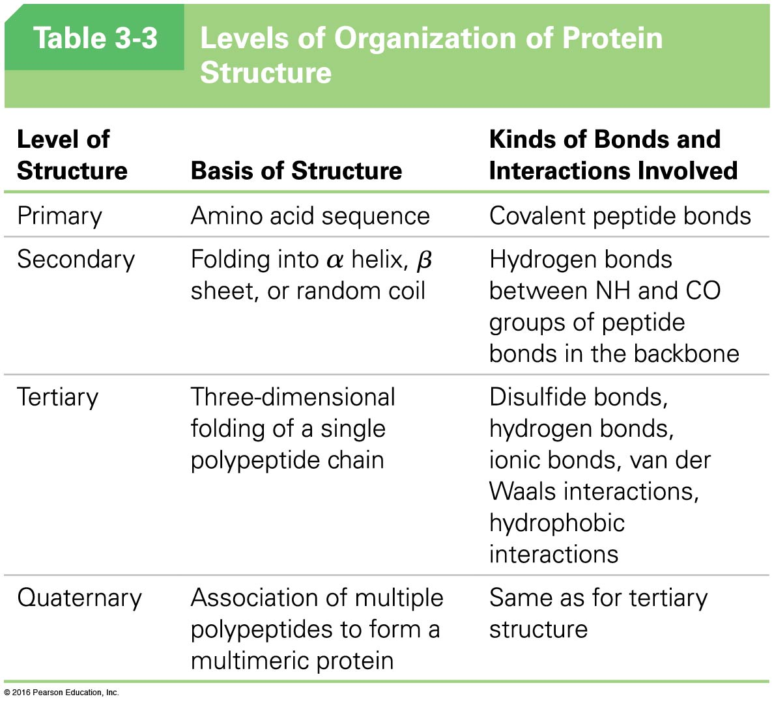

Slide 30
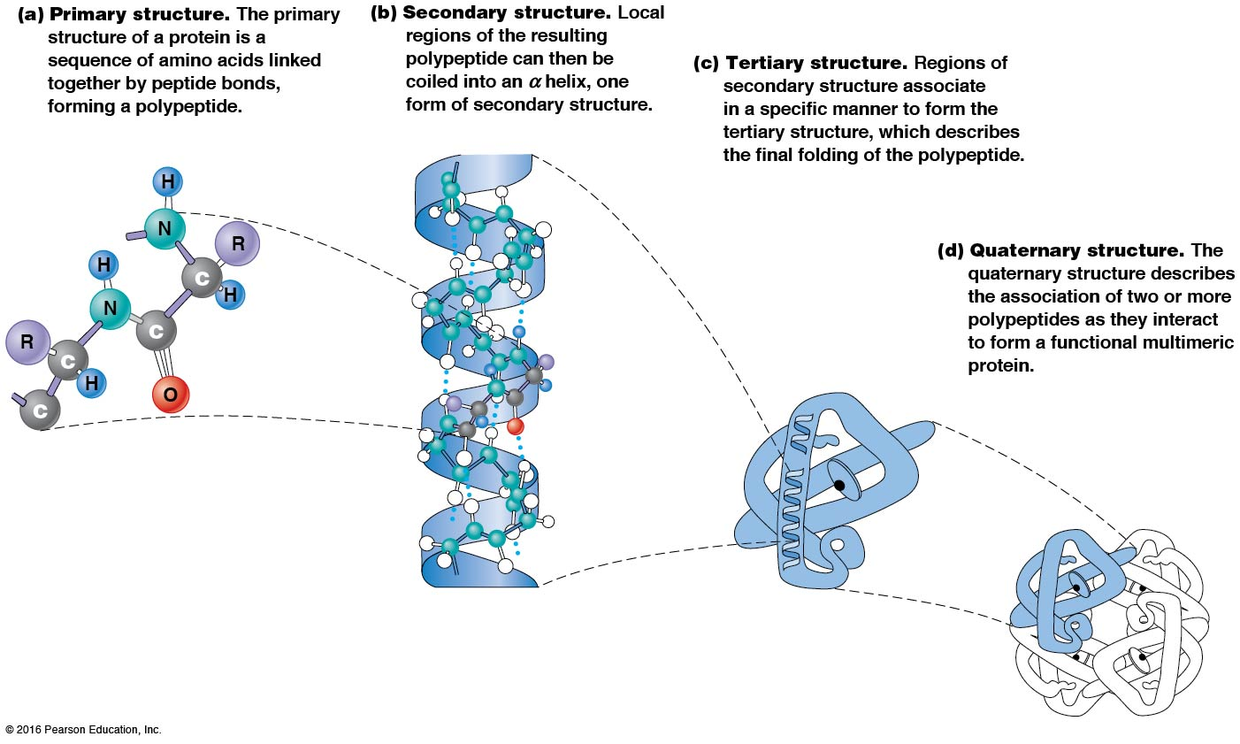

Slide 31
Activity: Primary Structure

Slide 32
Activity: Secondary Structure

Slide 33
Activity: Tertiary Structure

Slide 34
Activity: Quaternary Structure

Slide 35
Primary Structure
Primary structure refers to the amino acid sequence
By convention, amino acid sequences are written from the N-terminus to the C-terminus, the direction in which the polypeptide was synthesized
The first protein to have its amino acid sequence determined was the hormone insulin
Insulin consists of one A and one B subunit with 21 and 30 amino acids, respectively

Slide 37
Determining Amino Acid Sequence
Sanger obtained the Nobel Prize for his work on the insulin protein sequence
He cleaved the protein into smaller fragments and analyzed the amino acid order within individual overlapping fragments
Sanger’s work paved the way for the sequencing of hundreds of other proteins and for advancements in the methods used for sequencing proteins

Slide 38
The Importance of Primary Structure
Primary structure is important genetically because the sequence is specified by the order of nucleotides in the corresponding messenger RNA
It is important structurally because the order and identity of amino acids directs the formation of the higher-order (secondary and tertiary) structures

Slide 39
Secondary Structure
The secondary structure of a protein describes local regions of structure that result from hydrogen bonding between NH and CO groups along the polypeptide backbone
These result in two major patterns, the α helix and the β sheet

Slide 40
The α Helix
The α helix is spiral in shape, consisting of the peptide backbone, with R groups jutting out from the spiral
There are 3.6 amino acids per turn of the helix
A hydrogen bond forms between the NH group of one amino acid and the CO group of a second amino acid that is one turn away from the first

Slide 41
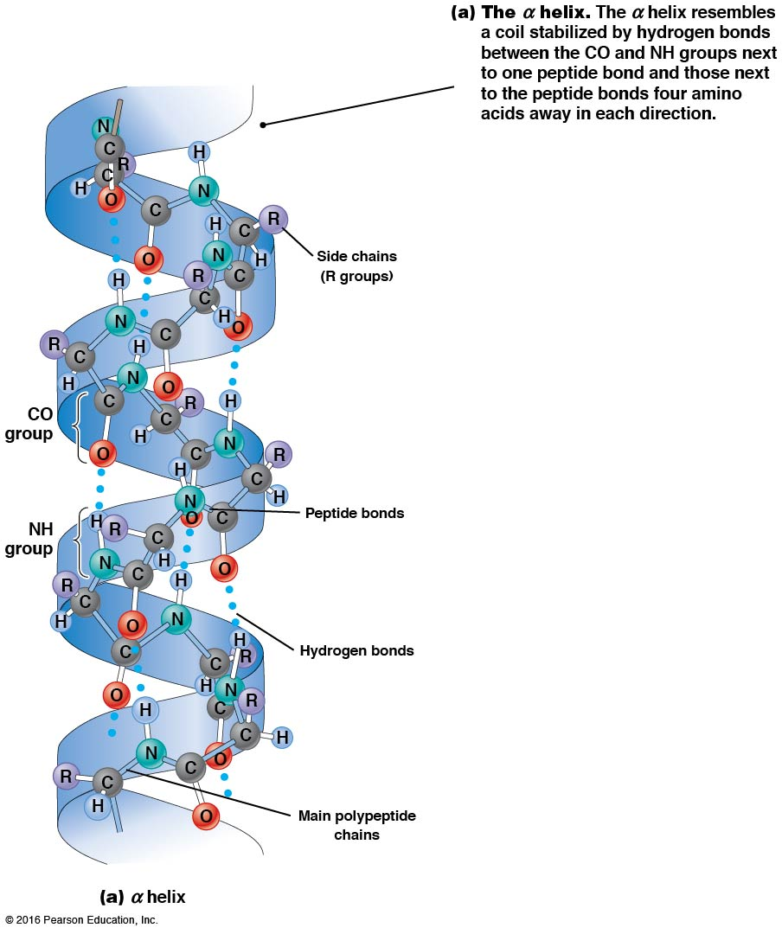

Slide 42
The β Sheet
The β sheet is an extended sheetlike conformation with successive atoms of the polypeptide chain located at “peaks” or “troughs”
The R groups jut out on alternating sides of the sheet
Because of the formation of peaks and troughs, it is sometimes referred to as a β-pleated sheet

Slide 43
The β Sheet (continued)
The β sheet is characterized by a maximum of hydrogen bonding, but β sheet formation may involve different polypeptides or different regions of a single polypeptide
If the parts of polypeptides forming the β sheet have the same polarity (relative to the N- and C- termini), they are called parallel
If the parts of polypeptides forming the β sheet have opposite polarity, they are called antiparallel

Slide 44
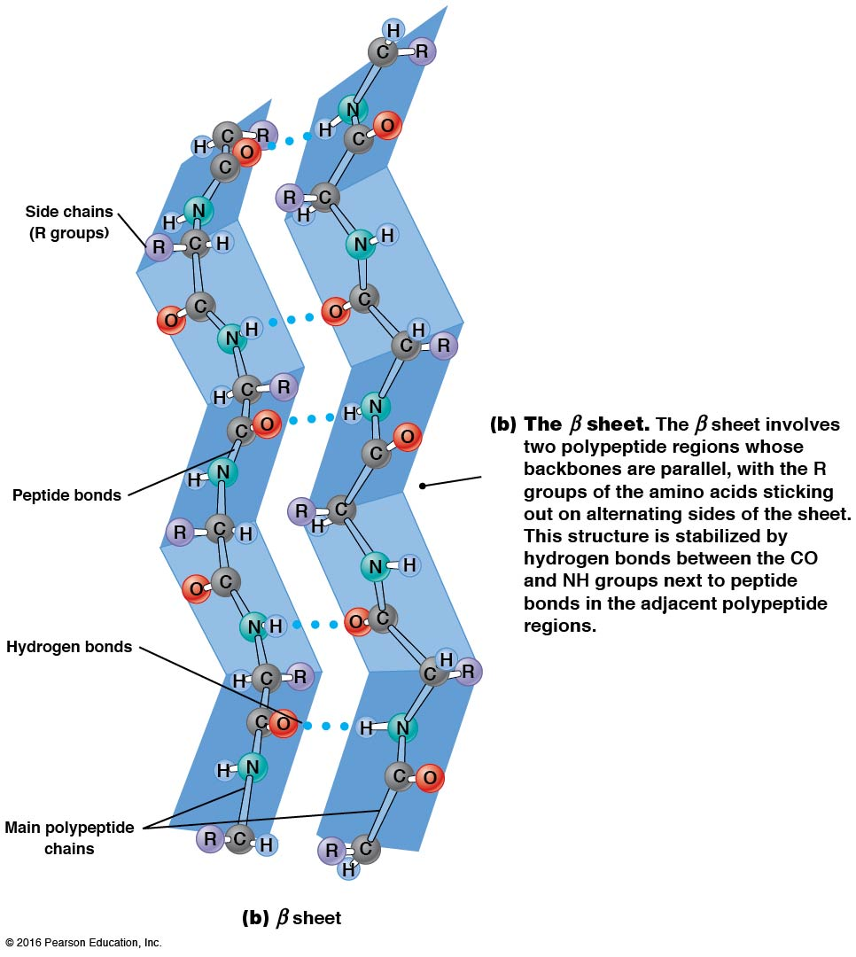

Slide 45
Video: An Idealized α Helix, An Idealized β Sheet

Slide 46
Amino Acid Sequence and Secondary Structure
Certain amino acids (e.g., leucine, methionine, glutamate) tend to form α helices, whereas others (e.g., isoleucine, valine, phenylalanine) tend to form β sheets
Proline cannot form hydrogen bonds and tends to disrupt α helix structures by introducing a bend in the helix

Slide 47
Motifs
Certain combinations of α helices and β sheets have been identified in many proteins
These units of secondary structure consist of short stretches of α helices and β sheets and are called motifs
Examples include the β–α–β, the hairpin loop, and the helix-turn-helix motifs

Slide 48
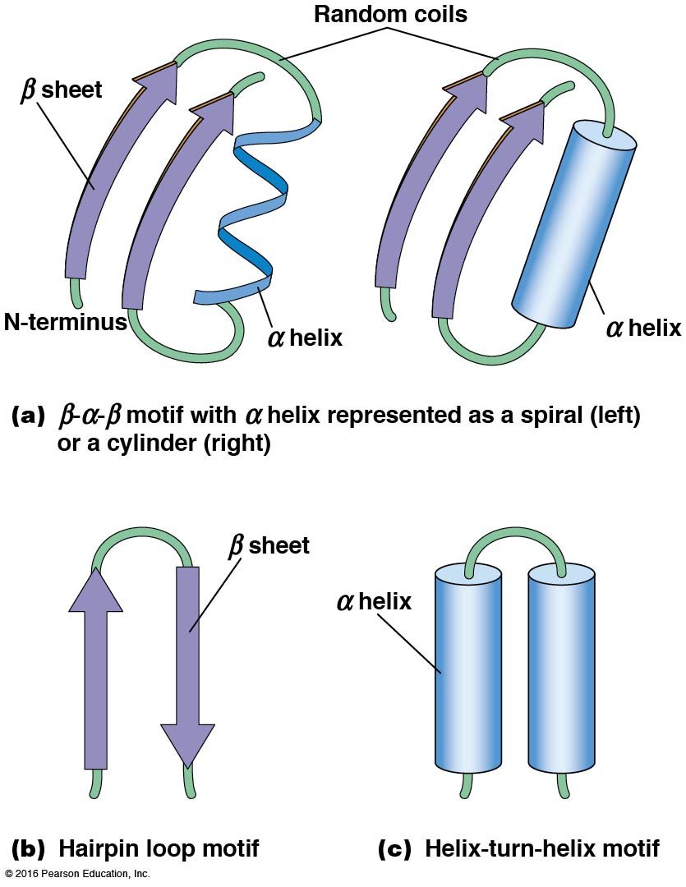

Slide 49
Tertiary Structure
The tertiary structure reflects the unique aspect of the amino acid sequence because it depends on interactions of the R groups
Tertiary structure is neither repetitive nor easy to predict
It results from the sum of hydrophobic residues avoiding water, hydrophilic residues interacting with water, the repulsion of similarly charged residues, and attraction between oppositely charged residues

Slide 50
Native Conformation
The most stable possible three-dimensional structure of a particular polypeptide is called the native conformation
Proteins can be divided into two broad categories
Fibrous proteins
Globular proteins

Slide 51
Fibrous Proteins
Fibrous proteins have extensive regions of secondary structure, giving them a highly ordered, repetitive structure
Some examples include
Fibroin proteins of silk
Keratin proteins of hair and wool
Collagen found in tendons and skin
Elastin found in ligaments and blood vessels

Slide 52
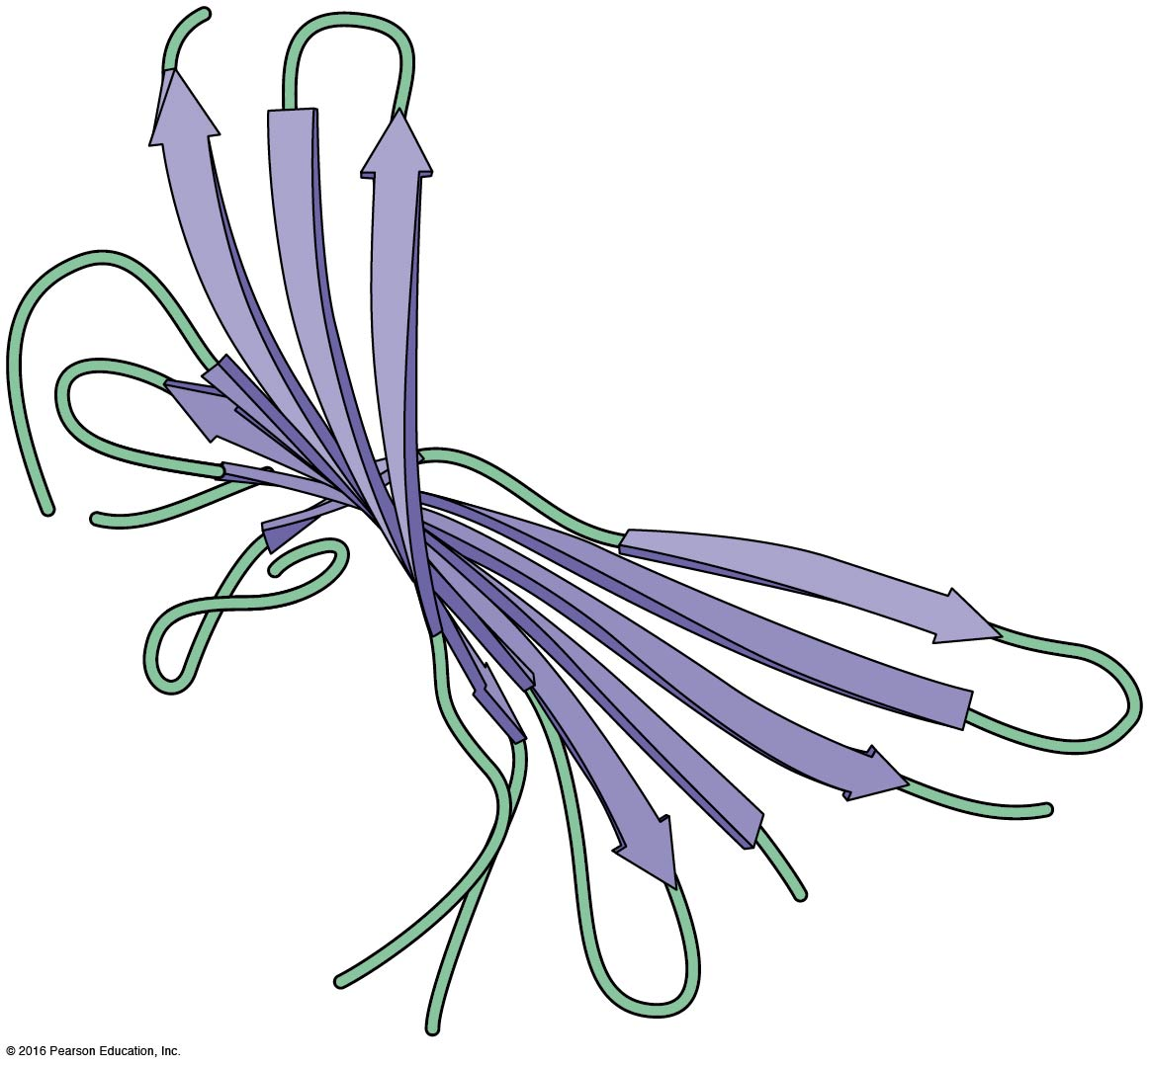

Slide 53
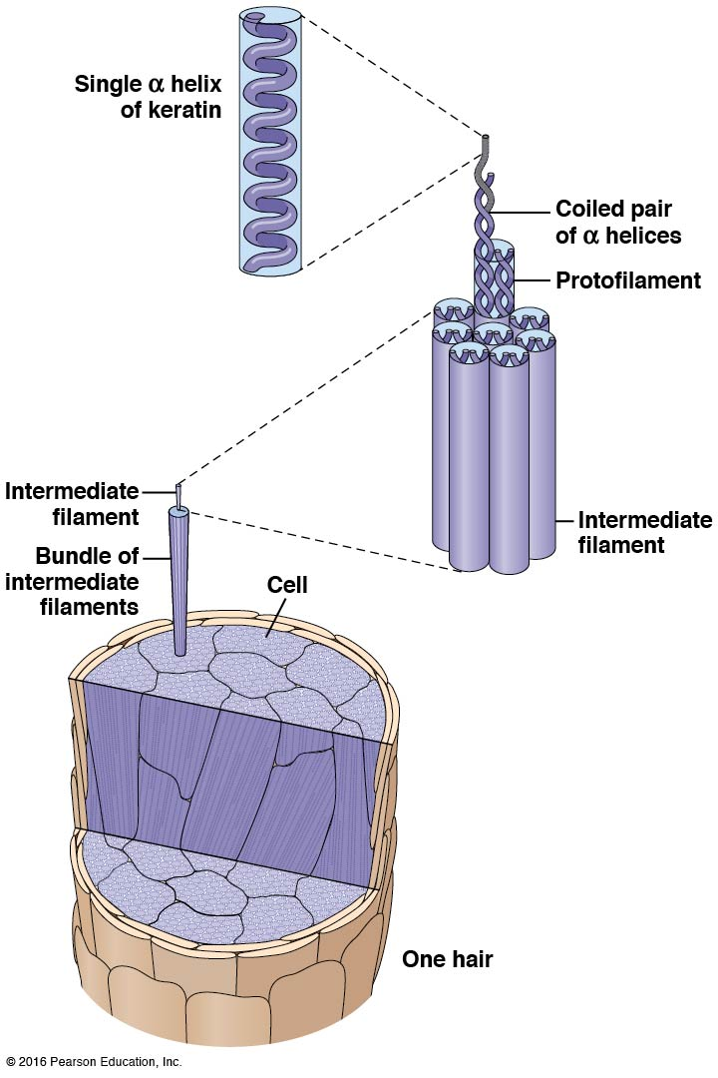

Slide 54
Globular Proteins
Most proteins are globular proteins that are folded into compact structures
Each type of globular protein has its own unique tertiary structure
Most enzymes are globular proteins

Slide 55
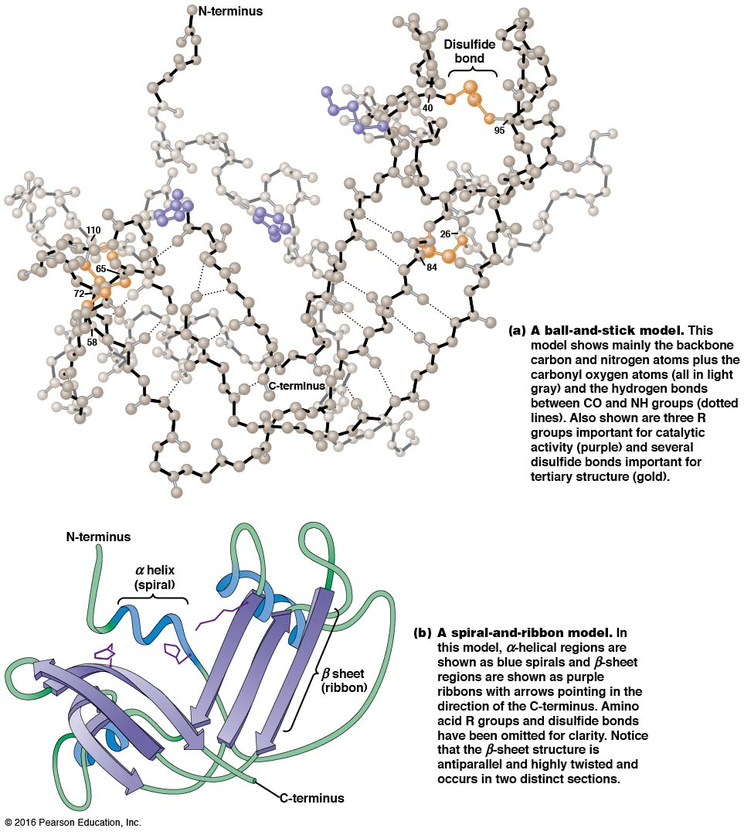

Slide 56
Structures of Globular Proteins
Globular proteins can be mainly α helical, mainly β sheet, or a mixture of both structures
Many globular proteins consist of a number of segments called domains

Slide 57
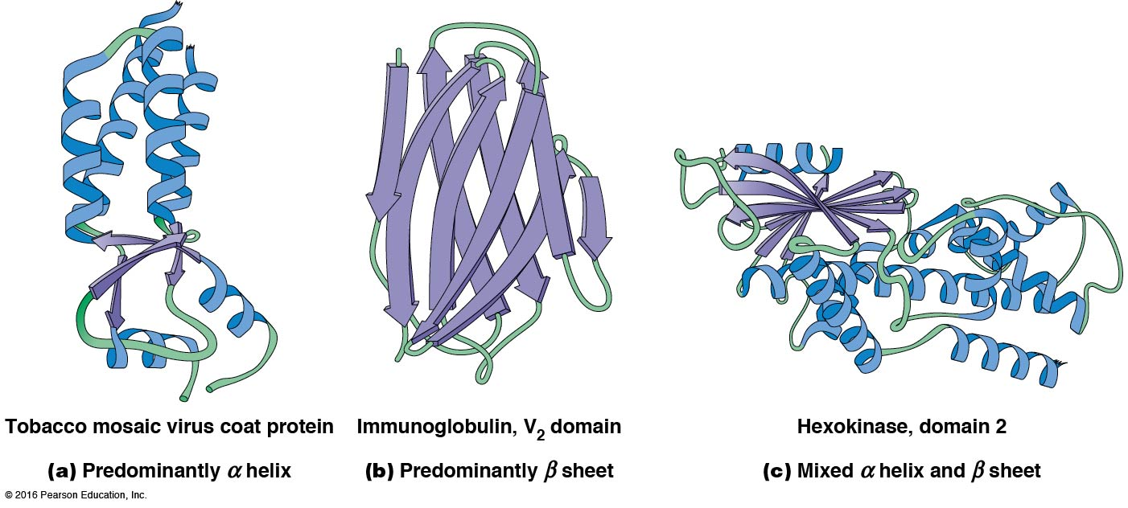

Slide 58
Protein Domains
A domain is a discrete, locally folded unit of tertiary structure, usually with a specific function
A domain is typically 50–350 amino acids long, with regions of α helices and β sheets packed together
Proteins with similar functions often share a common domain
Proteins with multiple functions usually have a separate domain for each function, like modular units from which globular proteins are constructed

Slide 59
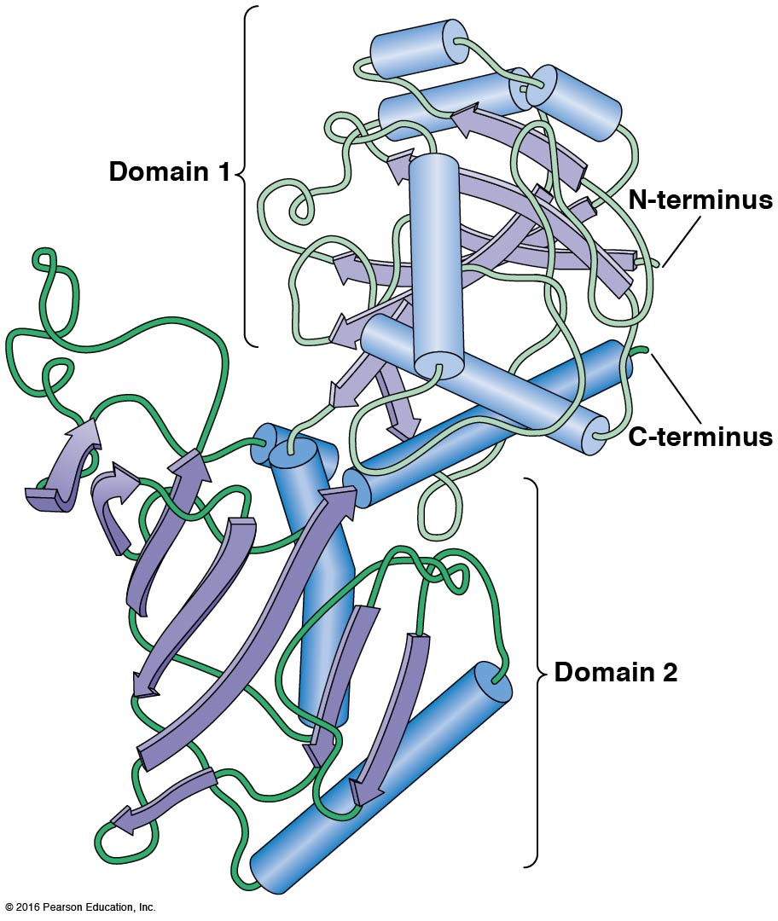

Slide 60
Prediction of Tertiary Structure
It is known that primary structure determines the final folded shape of a protein
However, we are still not able to predict exactly how a given protein will fold, especially for larger proteins

Slide 61
Quaternary Structure
The quaternary structure of a protein is the level of organization concerned with subunit interactions and assembly
The term applies specifically to multimeric proteins
Some proteins consist of multiple identical subunits; others, such as hemoglobin, contain two or more types of polypeptides

Slide 62
Maintenance of Quaternary Structure
The bonds and forces maintaining quaternary structure are the same as those responsible for tertiary structure
The process of subunit formation is usually spontaneous
Sometimes, molecular chaperones are required to assist the process

Slide 63
Higher Levels of Assembly
A higher level of assembly is possible in the case of proteins (often enzymes) that are organized into multiprotein complexes
Each protein in the complex may be involved sequentially in a common multistep process
An example is the pyruvate dehydrogenase complex, in which three enzymes and five other proteins form a multienzyme complex

Slide 64
3.2 Nucleic Acids
Nucleic acids are of paramount importance to the cells because they store, transmit, and express genetic information
They are linear polymers of nucleotides
DNA is deoxyribonucleic acid, and RNA is ribonucleic acid

Slide 65
DNA and RNA Differ
DNA and RNA differ chemically and in their role in the cell
RNA contains the five-carbon sugar ribose, and DNA contains the related sugar deoxyribose
DNA serves as the repository of genetic information, whereas RNA plays several roles in expressing that information

Slide 66
The Monomers Are Nucleotides
RNA and DNA each consist of only four different types of nucleotides, the monomeric units
Each nucleotide consists of a five-carbon sugar to which a phosphate group and N-containing aromatic base are attached
Each base is either a purine or a pyrimidine

Slide 67
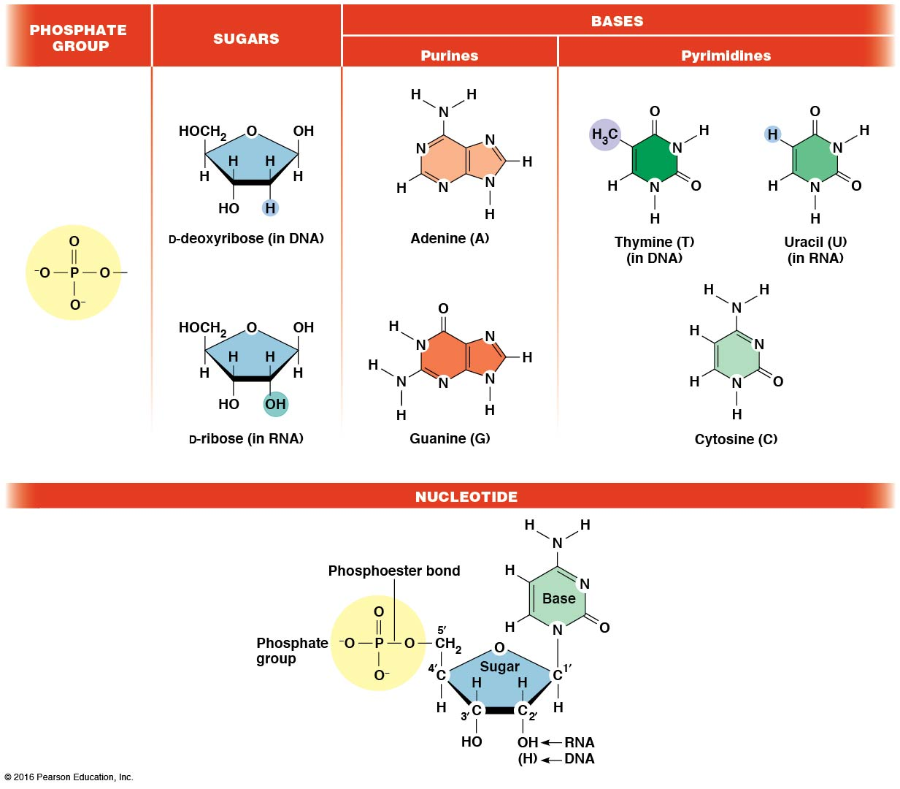

Slide 68
Types of Nucleotides
Purines are adenine (A) and guanine (G)
Pyrimidines are thymine (T) and cytosine (C), and in RNA, uracil (U)
The sugar-base portion without the phosphate group is called a nucleoside

Slide 69
Nomenclature
Nucleosides with one phosphate group can be thought of as nucleoside monophosphates (example: adenosine monophosphate, AMP)
Adenosine diphosphate (ADP) has two phosphate groups, and adenosine triphosphate (ATP) has three

Slide 70
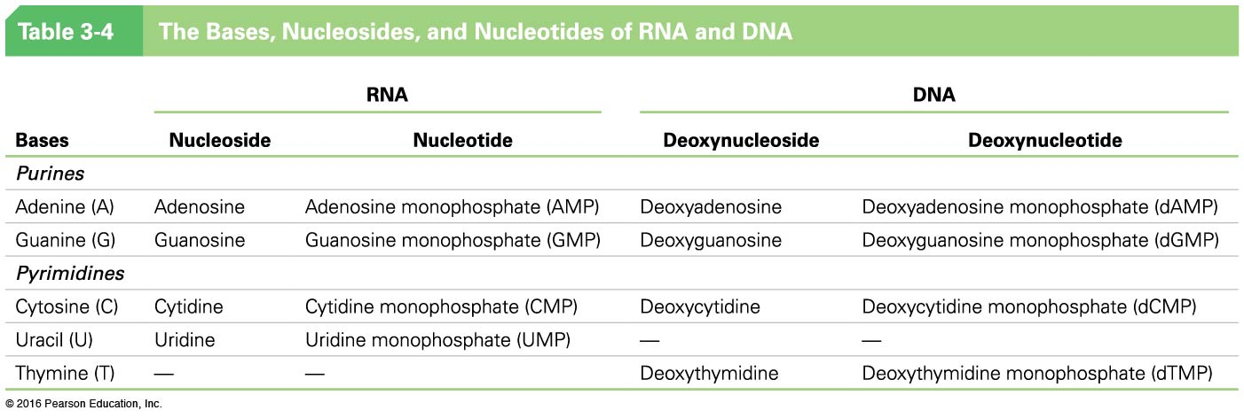

Slide 71
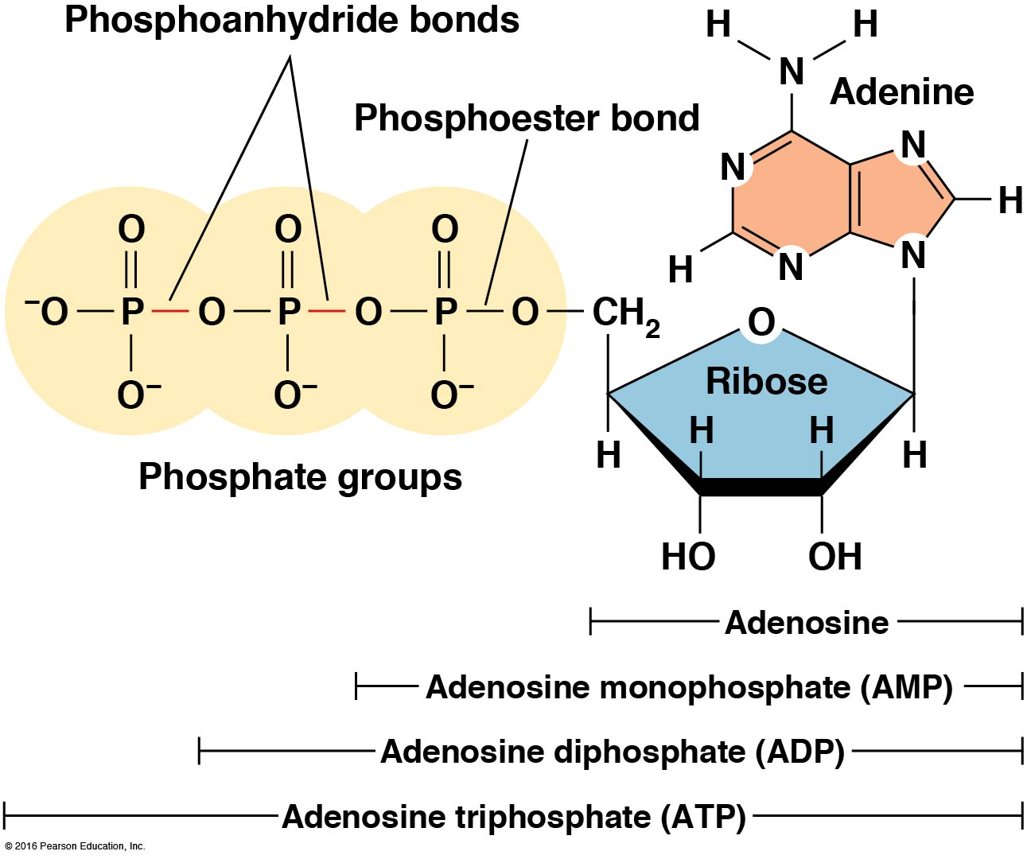

Slide 72
The Polymers Are DNA and RNA
Nucleic acids are linear polymers of nucleotides linked by a 3ʹ,5ʹ phosphodiester bridge, a phosphate group linked to two adjacent nucleotides via two phosphodiester bonds
The polynucleotide formed by this process has a directionality with a 5ʹ phosphate group at one end and a 3ʹ hydroxyl group at the other
Nucleotide sequences are conventionally written in the 5ʹ to 3ʹ direction

Slide 73
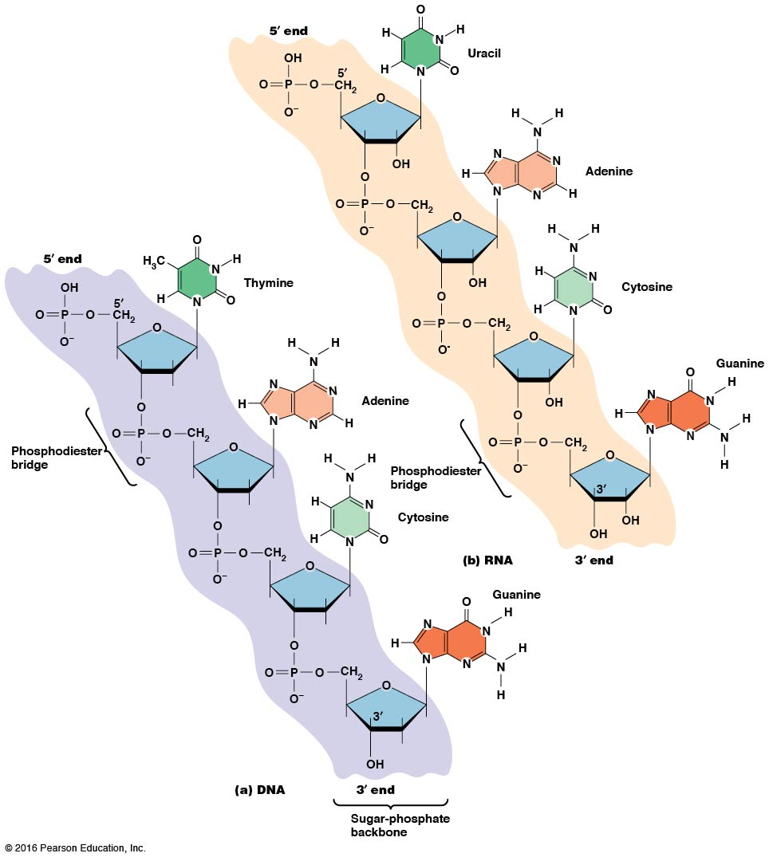

Slide 74
Nucleic Acid Synthesis
A preexisting molecule is used to ensure that new nucleotides (NTPs for RNA, dNTPs for DNA) are added in the correct order
This molecule is called a template, and correct base pairing between the template and the incoming nucleotide is required to specify correct order
A complementary relationship exists between certain purines and pyrimidines

Slide 75
Complementary Base Pairing
Complementary base pairing allows A to form two hydrogen bonds with T and G to form three hydrogen bonds with C
This base pairing is a fundamental property of nucleic acids

Slide 76
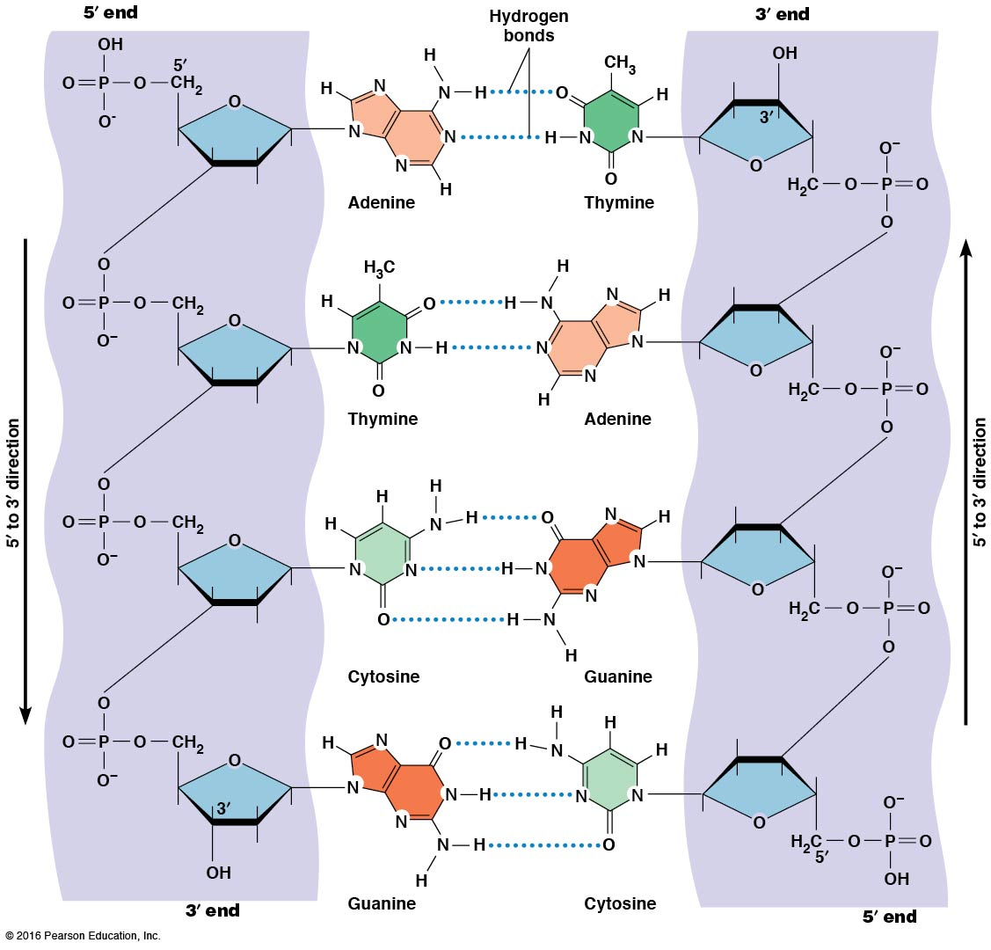

Slide 77
The DNA Molecule Is a Double-Stranded Helix
Francis Crick and James Watson postulated the double helix structure of DNA in 1953
The structure accounted for the known physical and chemical properties of DNA
It also suggested a mechanism for DNA replication
Two antiparallel and complementary strands of DNA twist around a common axis to form a right-handed spiral structure

Slide 78
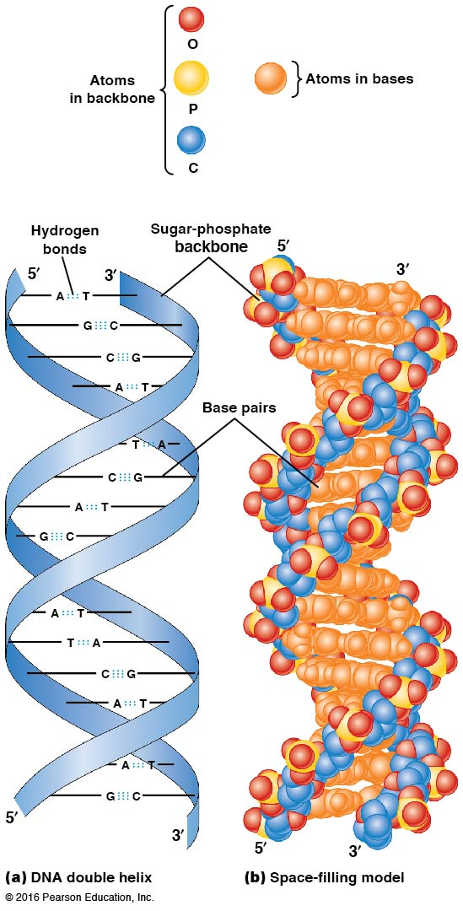

Slide 79
Base Pairing and RNA
RNA is normally single stranded
RNA structure also depends on base pairing
However, the pairing is usually between bases in different areas of the same molecule and is less extensive than that of DNA

Slide 80
3.3 Polysaccharides
Polysaccharides are long chain polymers of sugars and sugar derivatives
They serve primarily in structure and storage
They usually consist of a single kind of repeating unit or sometimes an alternating pattern of two kinds
Short polymers, oligosaccharides, are sometimes attached to cell surface proteins

Slide 81
The Monomers Are Monosaccharides
Repeating units of polysaccharides are monosaccharides
A sugar may be an aldehyde, aldosugars with a terminal carbonyl group; or ketone, ketosugars with an internal carbonyl group
Sugars within these groups are named generically based on how many carbon atoms they contain

Slide 82
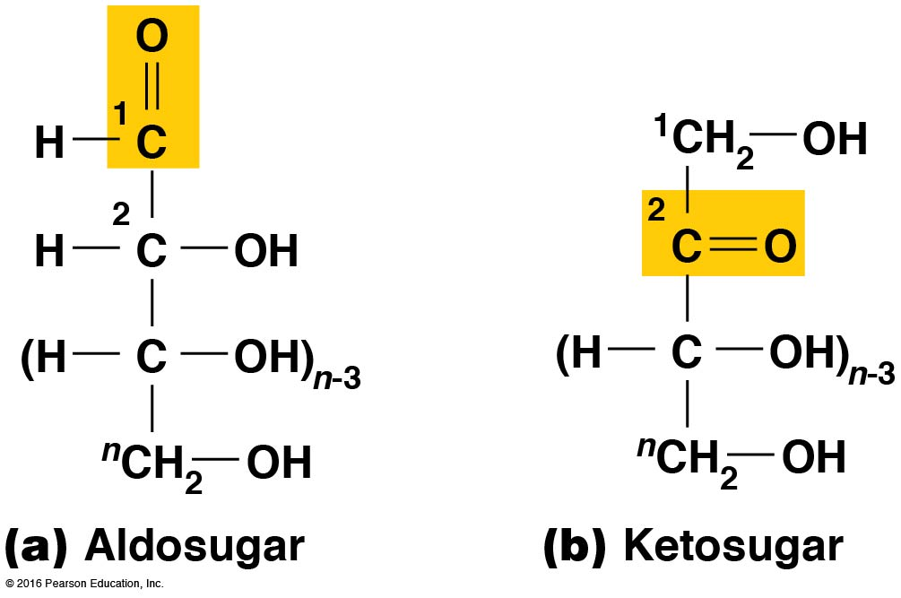

Slide 83
Classification of Sugars
Most sugars have between three and seven carbons and are classified as
Trioses (three carbons)
Tetroses (four carbons)
Pentoses (five carbons)
Hexoses (six carbons)
Heptoses (seven carbons)

Slide 84
Glucose
The single most common monosaccharide is the aldohexose d-glucose (C₆H₁₂O₆)
The formula C_{n}H_{2n}O_{n} is common for sugars and led to the general term carbohydrate
For every molecule of CO₂ incorporated into a sugar, one water molecule is consumed
The carbons of glucose (and other organic molecules) are numbered from the more oxidized, carbonyl end

Slide 85
The Structure of Glucose
d-glucose is the most stable form of glucose though many other stereoisomers are possible
d-glucose is often depicted as a linear molecule, as in the Fischer projection, in which the H and OH groups are intended to project out of the plane of the diagram
In the cell, d-glucose exists in a dynamic equilibrium between the linear and ring form
The Haworth projection shows the ring form of the molecule

Slide 86
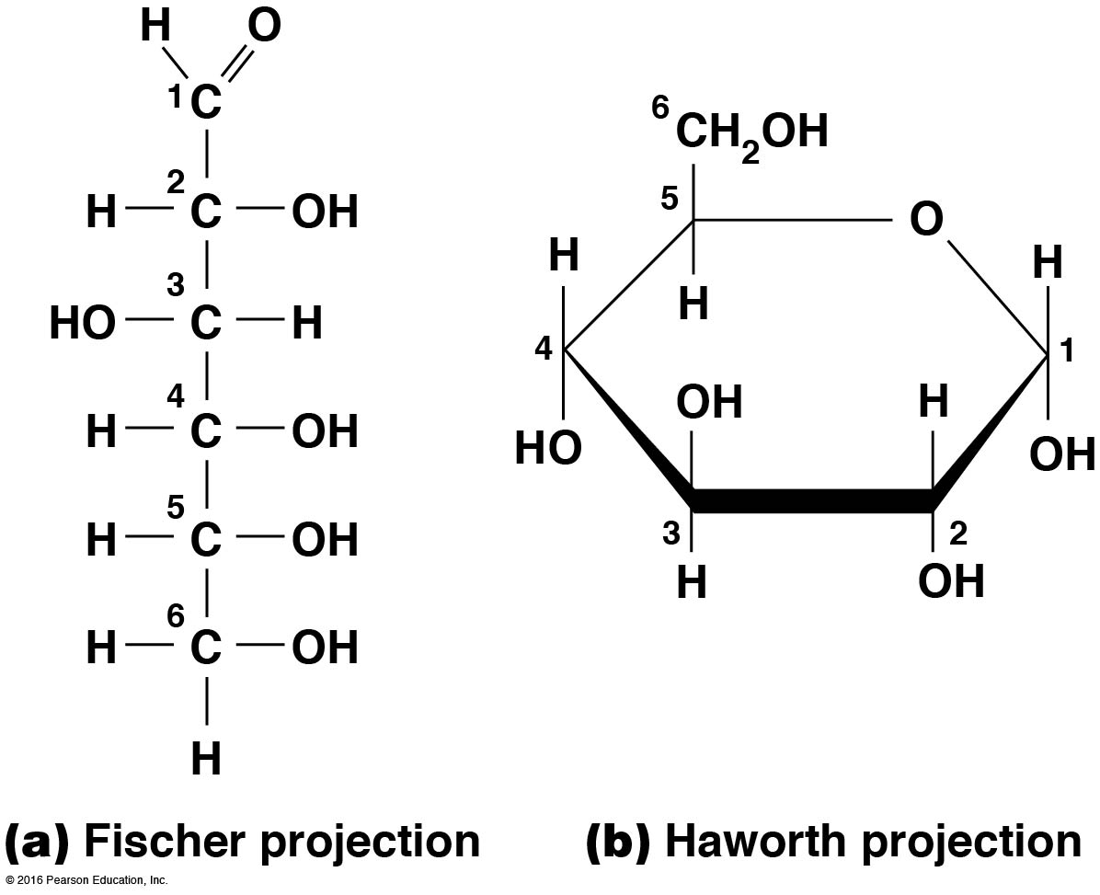

Slide 87
Two Ring Forms of d-glucose
The formation of a ring by d-glucose can result in two alternative forms
These depend on the spatial orientation of the hydroxyl group on carbon number 1
These forms are designated α (hydroxyl group downward) and β (hydroxyl group upward)

Slide 88
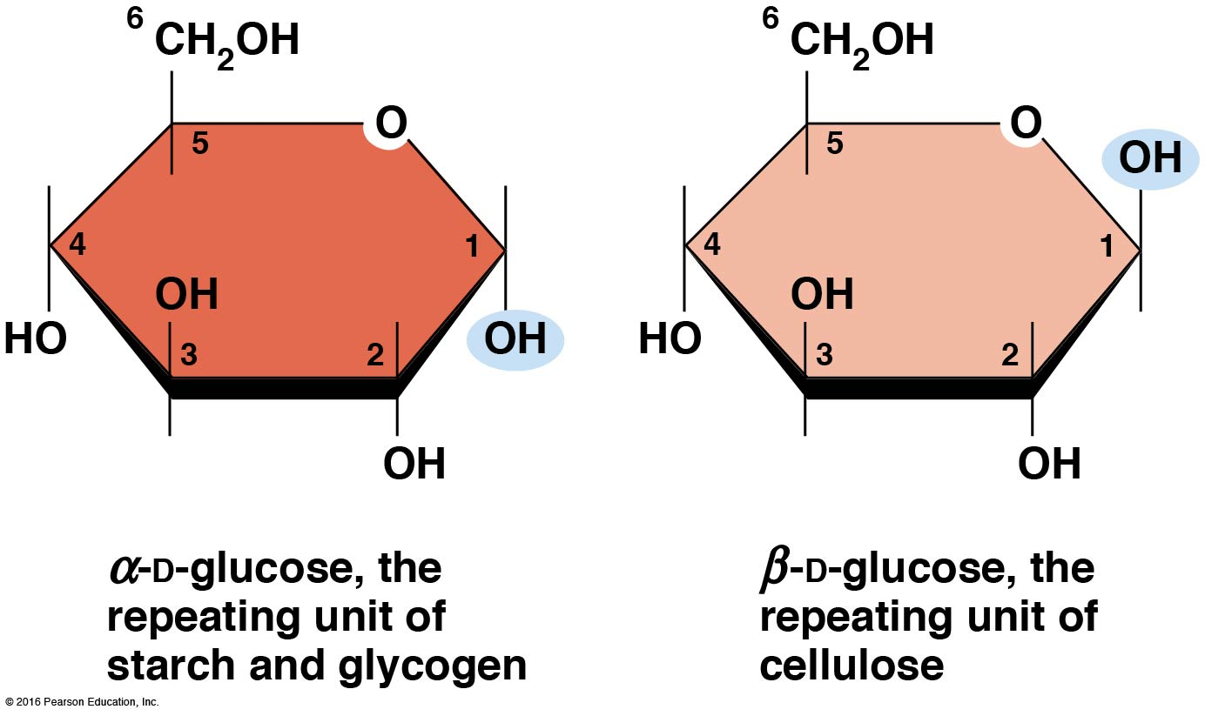

Slide 89
Glucose Also Exists in Disaccharides
Glucose exists in disaccharides, in which two monosaccharide units are covalently linked
Common disaccharides include
Maltose, two glucose units
Lactose, one glucose linked to one galactose
Sucrose, one glucose linked to one fructose

Slide 90
Disaccharides
The linkage of disaccharides is a glycosidic bond, formed between two monosaccharides by the elimination of water
Glycosidic bonds involving the α form of glucose are called α glycosidic bonds (e.g., maltose); those involving the β form are called β glycosidic bonds (e.g., lactose)

Slide 91
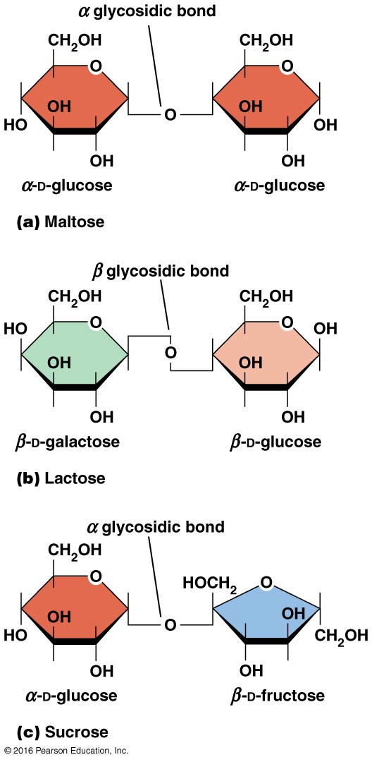

Slide 92
The Polymers Are Storage and Structural Polysaccharides
The most familiar storage polysaccharides are starch in plant cells and glycogen in animal cells and bacteria
Both consist of α-d-glucose units linked by α glycosidic bonds, involving carbons 1 and 4 (1→4)
Occasionally α(1→6) bonds may form, allowing for the formation of side chains (branching)

Slide 93
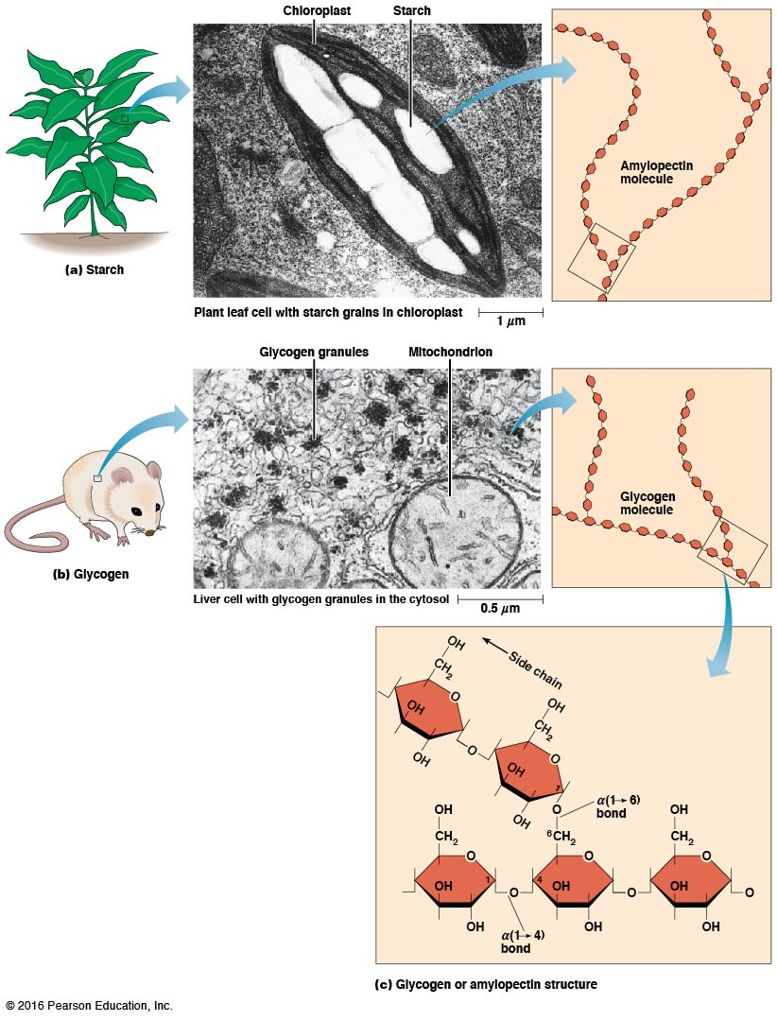

Slide 94
Glycogen
Glycogen is highly branched, the branches occurring every 8–10 glucose units along the backbone
Glycogen is stored mainly in the liver (as a source of glucose) and muscle tissues (as a fuel source for muscle contraction) of animals
Bacteria also store glycogen as a glucose reserve

Slide 95
Starch
Starch is the glucose reserve commonly found in plant tissue
It occurs both as unbranched amylose (10–30%) and branched amylopectin (70–90%)
Amylopectin has α(1→6) branches once every 12–25 glucose units and has longer side chains than glycogen

Slide 96
Starch (continued)
Starch is stored as starch grains within the plastids
Chloroplasts, the sites of carbon fixation and sugar synthesis in photosynthesis
Amyloplasts, which are specialized for starch storage

Slide 97
Structural Polysaccharides
The best-known structural polysaccharide is the cellulose found in plant cell walls
Cellulose, composed of repeating monomers of β-d-glucose, is very abundant in plants
Mammals cannot digest cellulose (though some have microorganisms in their digestive systems that can)

Slide 98
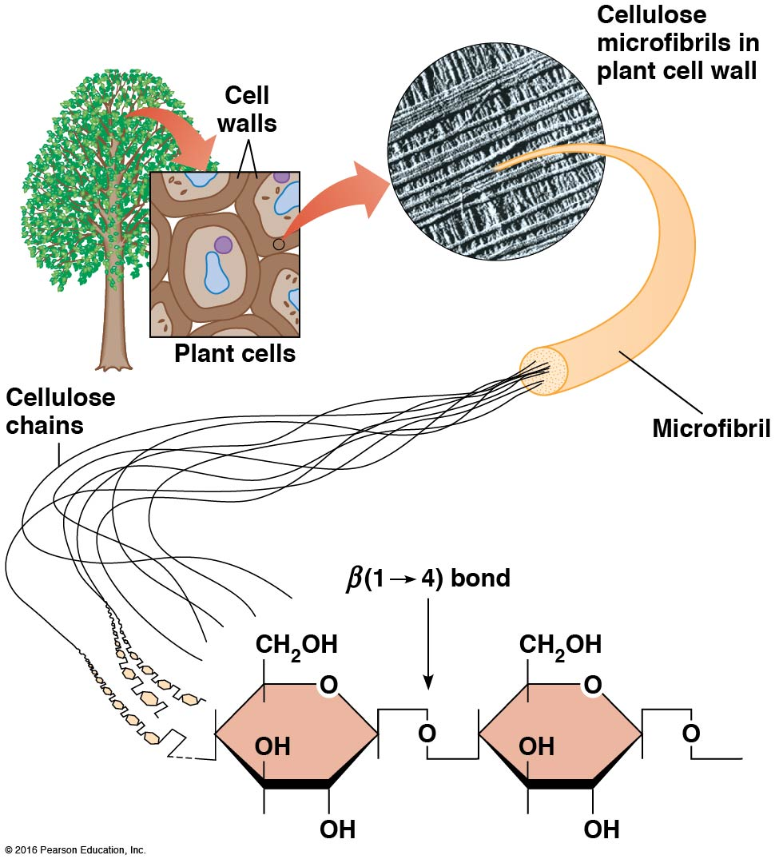

Slide 99
Activity: Carbohydrate Structure and Function—Part 1

Slide 100
Activity: Carbohydrate Structure and Function—Part 2

Slide 101
Activity: Carbohydrate Structure and Function—Part 3

Slide 102
Activity: Carbohydrate Structure and Function—Part 4

Slide 103
Activity: Carbohydrate Structure and Function—Part 5

Slide 104
Other Structural Polysaccharides
The cellulose of fungal cell walls differs from that of plants and may contain either β(1→4) or β(1→3) linkages
Bacterial cell walls contain two kinds of sugars: GlcNAc (N-acetylglucosamine) and MurNAc (N-acetylmuramic acid)
Both are derivatives of β-glucosamine and are linked alternately in cell walls

Slide 105
Chitin
The polysaccharide chitin consists of GlcNAc units only, joined by β(1→4) bonds
Chitin is found in insect exoskeletons, crustacean shells, and fungal cell walls

Slide 106
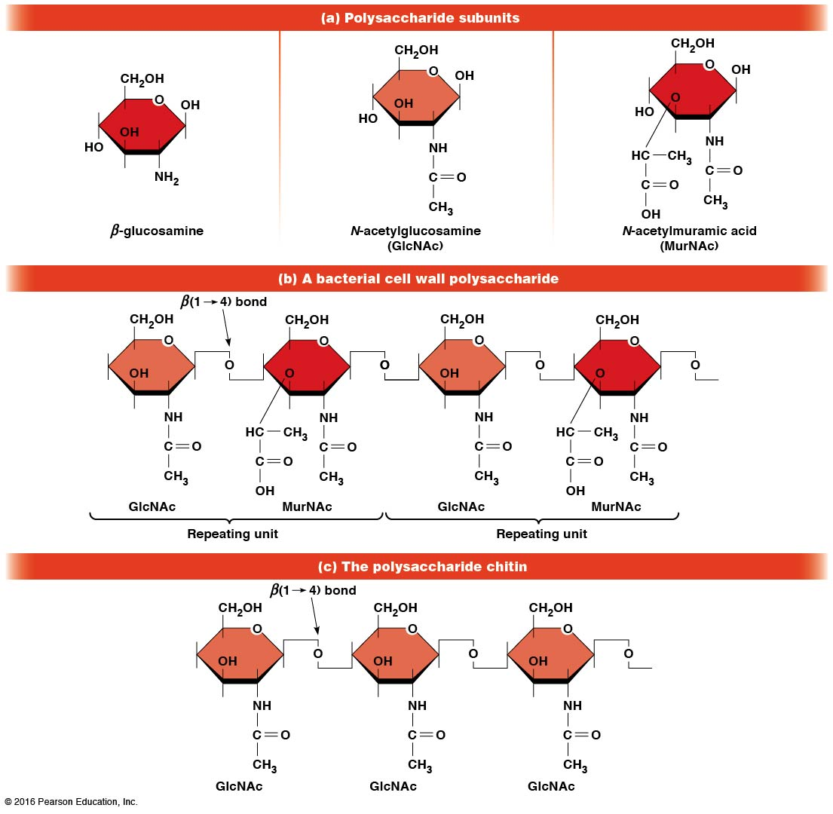

Slide 107
Polysaccharide Structure Depends on the Type of Glycosidic Bonds Involved
α and β glycosidic bonds are associated with marked structural differences
Starch and glycogen (α polysaccharides) form loose helices that are not highly ordered because of the side chains
Cellulose (that forms β linkages) exists as rigid linear rods that aggregate into microfibrils, about 5–20 nm in diameter
Plant and fungal cells walls contain these rigid microfibrils in a noncellulose matrix containing other polymers (hemicellulose, pectin) and a protein called extensin

Slide 108
3.4 Lipids
Lipids are not formed by the same type of linear polymerization that forms proteins, nucleic acids, and polysaccharides
However, they are regarded as macromolecules because of their high molecular weight and their importance in cellular structures, particularly membranes

Slide 109
Features of Lipids
Although heterogeneous, all have a hydrophobic nature and thus little affinity for water; they are readily soluble in nonpolar solvents such as chloroform or ether
They have relatively few polar groups, but some are amphipathic, having polar and nonpolar regions
Functions include energy storage, membrane structure, or specific biological functions such as signal transmission

Slide 110
The Main Classes of Lipids
The lipids can be divided into six classes based on their structure
Fatty acids
Triacylglycerols
Phospholipids
Glycolipids
Steroids
Terpines

Slide 111
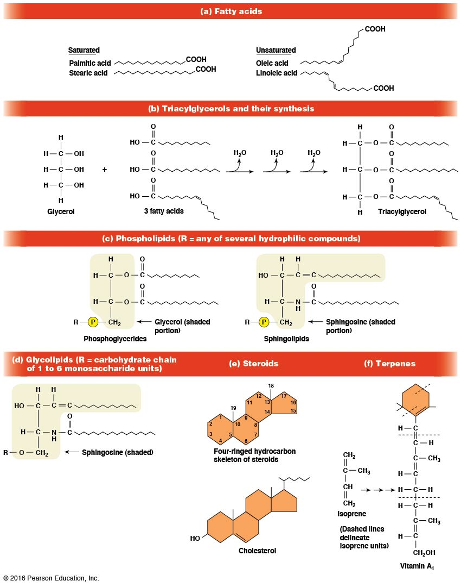

Slide 112
Fatty Acids Are the Building Blocks of Several Classes of Lipids
Fatty acids are components of several other kinds of lipids
A fatty acid is a long amphipathic, unbranched hydrocarbon chain with a carboxyl group at one end
The polar carboxyl group is the “head,” and the nonpolar hydrocarbon chain is the “tail”

Slide 113
Fatty Acid Structure
The hydrocarbon tails are variable in length but usually 12 to 20 carbons long
Even numbers of carbons are favored because fatty acid synthesis occurs via the stepwise addition of two-carbon units to the growing chain
Fatty acids are highly reduced and so yield a large amount of energy upon oxidation

Slide 114
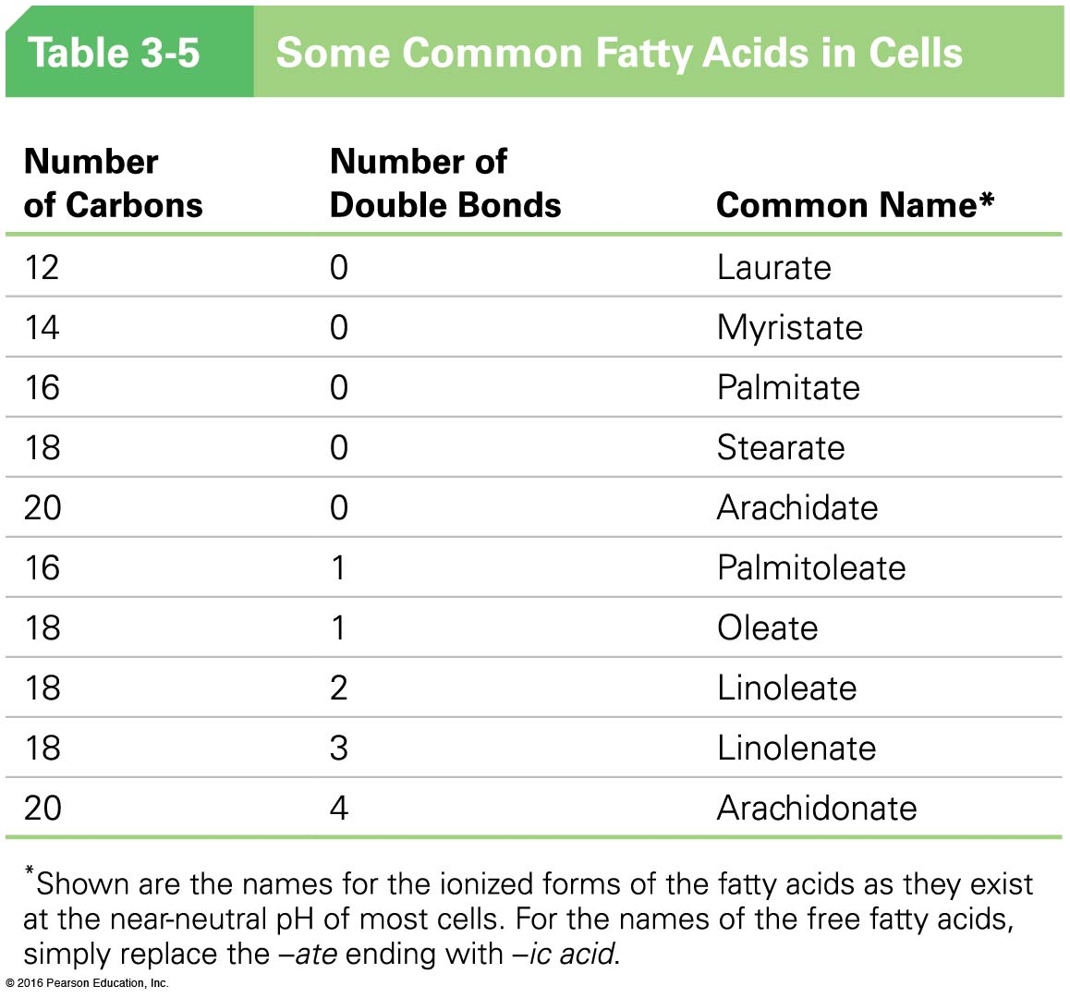

Slide 115
Fatty Acid Structure (continued)
In saturated fatty acids, each carbon atom in the chain is bonded to the maximum number of hydrogens
These have long straight chains that pack together well
Unsaturated fatty acids have one or more double bonds, so they have bends in the chains and are less tightly packed

Slide 116
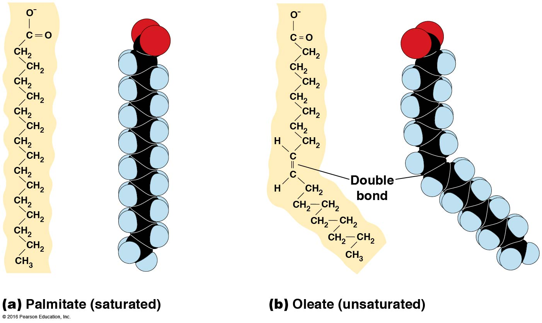

Slide 117
Trans Fats
Trans fats are a type of unsaturated fatty acid with a particular type of double bond that causes less of a bend in the chain
They are relatively rare in nature and are produced artificially in shortening and margarine
They have been linked to increased risk of heart disease and elevated cholesterol levels

Slide 119
Triacylglycerols Are Storage Lipids
Triacylglycerols, also known as triglycerides, consist of a glycerol molecule with three fatty acids attached to it
Glycerol is a three-carbon alcohol with a hydroxyl group on each carbon
Fatty acids are linked to glycerol, one at a time, by ester bonds formed by the removal of water

Slide 120
Triacylglycerol Structure
Monoacylglycerols contain a single fatty acid
Diacylglycerols have two fatty acids
The three fatty acids on a triacylglycerol may vary in length and degree of saturation

Slide 121
Triacylglycerol Function
The main function of triacylglycerols is energy storage
Triacylglycerols containing mostly saturated fats are usually solid or semisolid at room temperature and are called fats
Triacylglycerols in plants are liquid at room temperature (e.g., vegetable oil) and are predominantly unsaturated

Slide 123
Phospholipids Are Important in Membrane Structure
Phospholipids are important to membrane structure because of their amphipathic nature
Phospholipids can be divided into phosphoglycerides or sphingolipids, depending on their chemistry

Slide 124
Phosphoglycerides
Phosphoglycerides are the predominant phospholipids in most membranes
The basic components of phosphoglycerides is phosphatidic acid, which has two fatty acids and a phosphate group attached to a glycerol
Membrane phosphoglycerides invariably have a small hydrophilic alcohol linked to the phosphate by an ester bond

Slide 125
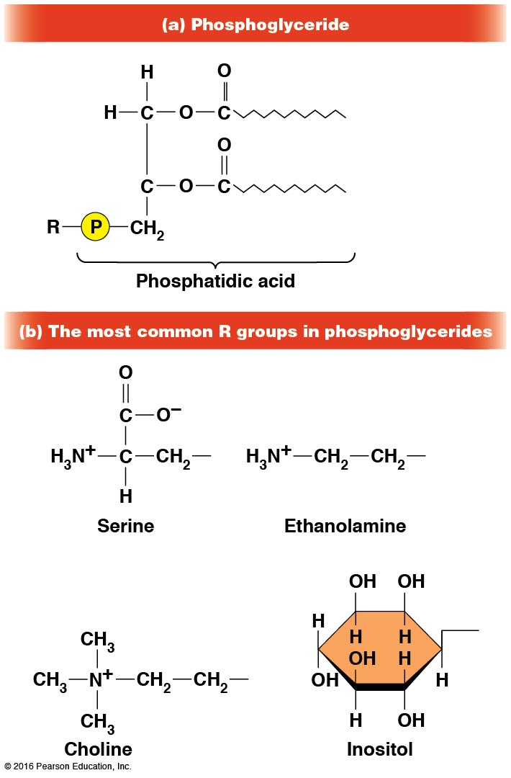

Slide 126
Phosphoglycerides (continued)
The alcohol is usually serine, ethanolamine, choline, or inositol, which contributes to the polar nature of the phospholipid head group
Typical phosphoglycerides often have one saturated and one unsaturated fatty acid
The length and degree of saturation of the fatty acids have profound effects on membrane fluidity

Slide 127
Sphingolipids
Sphingolipids are based on the amine sphingosine, which has a long hydrocarbon chain with a single site of unsaturation near the polar end
Sphingosine can form an amide bond to a long-chain fatty acid, resulting in a molecule called a ceramide

Slide 129
Sphingolipids (continued)
A whole family of sphingolipids exists, with different polar groups attached to the hydroxyl group of the ceramide
Sphingolipids are predominantly found in the outer leaflet of the plasma membrane bilayer, often in lipid rafts, localized domains within a membrane
Lipid rafts are important in communication between a cell and its external environment

Slide 130
Glycolipids Are Specialized Membrane Components
Glycolipids are lipids containing a carbohydrate instead of a phospholipid and are often derivatives of sphingosine and glycerol (glycosphingolipids)
Carbohydrate groups attached to a glycolipid may be one to six sugar units (d-glucose, d-galactose, or N-acetyl-d-galactosamine)
Glycolipids occur largely on the outer monolayer of the plasma membrane

Slide 131
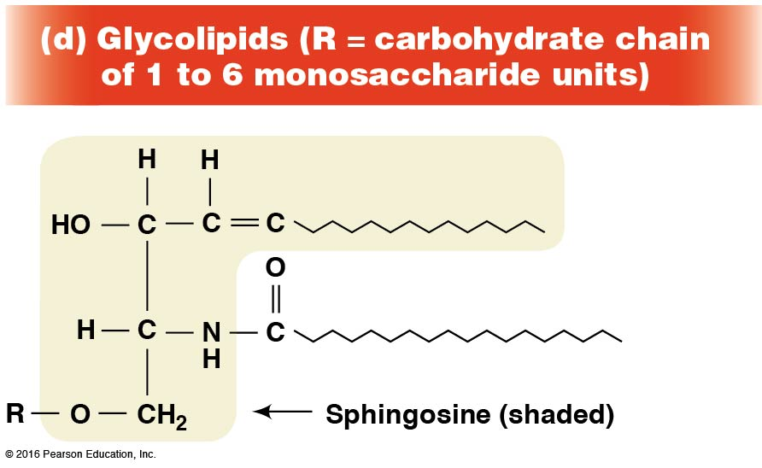

Slide 132
Steroids Are Lipids with a Variety of Functions
Steroids are derivatives of a four-ringed hydrocarbon skeleton, which distinguishes them from other lipids
They are relatively nonpolar and therefore hydrophobic
Steroids differ from one another in the positions of double bonds and functional groups
The most common steroid in animal cells is cholesterol

Slide 133
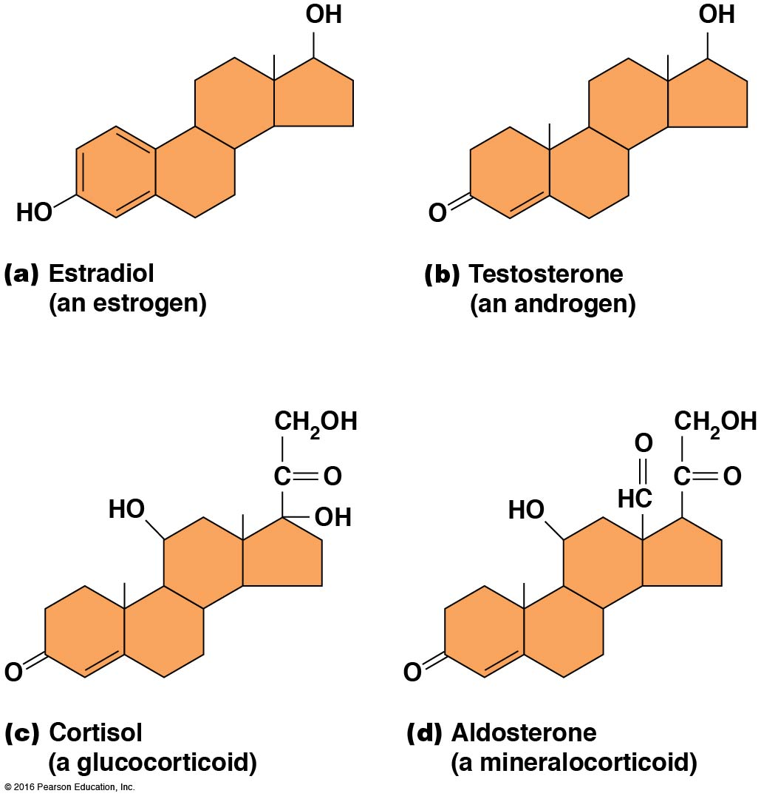

Slide 134
A Variety of Sterols
Cholesterol is insoluble and found primarily in plasma membranes of animal cells and most membranes of organelles
Similar molecules are found in plant cells (stigmasterol and sitosterol) and fungal cells (ergosterol)

Slide 135
Steroid Hormones
Cholesterol is the starting material for synthesis of steroid hormones, including male and female sex hormones, the glucocorticoids, and the mineralocorticoids
Sex hormones include estrogens produced by the ovaries of females (e.g., estradiol) and androgens produced by male testes (e.g., testosterone)

Slide 136
Steroid Hormones (continued)
The glucocorticoids (e.g., cortisol) are a family of hormones that promote synthesis of glucose and suppress inflammation
Mineralocorticoids (e.g., aldosterone) regulate ion balance by promoting reabsorption of sodium, chloride, and bicarbonate ions by the kidney

Slide 137
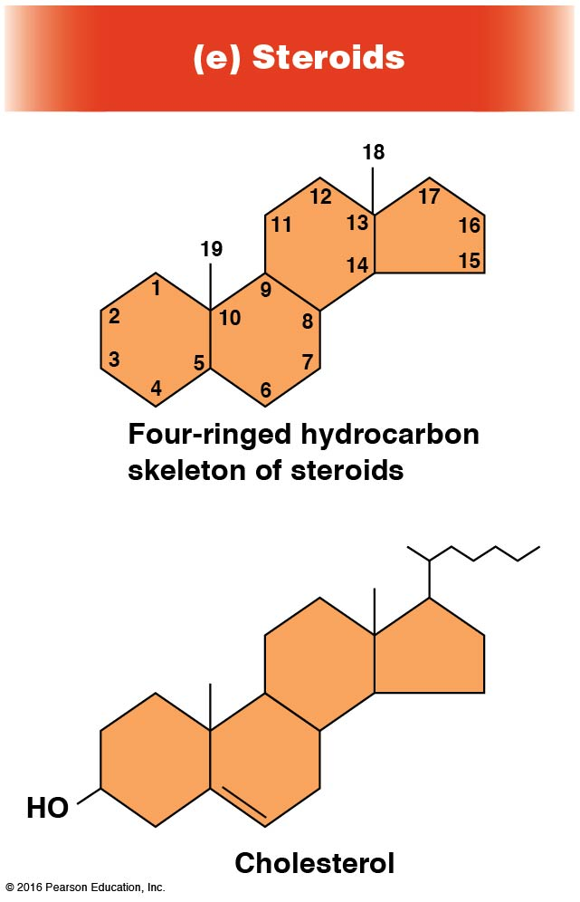

Slide 138
Terpenes Are Formed from Isoprene
Terpenes are synthesized from the five-carbon compound isoprene and are sometimes called isoprenoids
Isoprene and its derivatives are joined in various combinations to produce substances such as vitamin A and carotenoid pigments

Slide 139
Other Isoprene-Based Compounds
The isoprene-based compounds, dolichols, are involved in activating sugar compounds
Electron carriers such as coenzyme Q and plastoquinone are also isoprene derivatives
Polyisoprenoids, polymers of isoprene, are found in cell membranes of the Archaea
Notes:
139

Slide 140
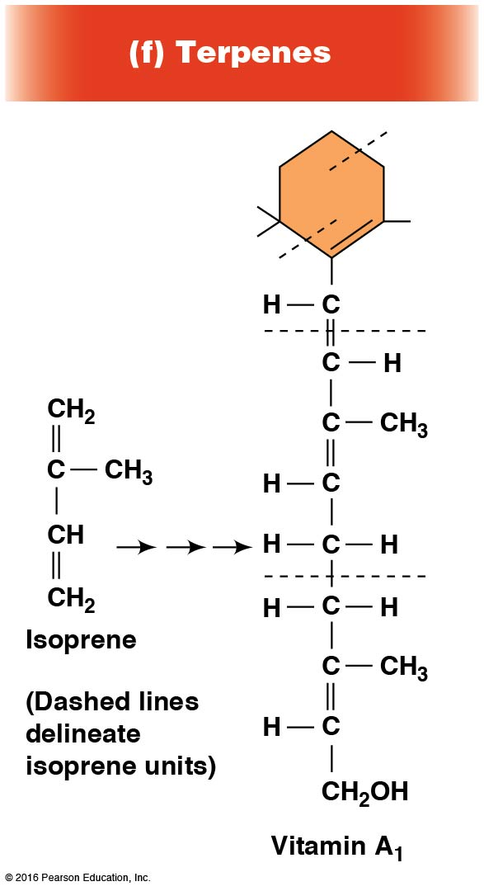

Slide 141
Activity: Lipid Structure and Function—Part 1

Slide 142
Activity: Lipid Structure and Function—Part 2

Slide 143
Activity: Lipid Structure and Function—Part 3

Slide 144
Activity: Lipid Structure and Function—Part 4

Slide 145
Activity: Lipid Structure and Function—Part 5

