Slide 1
An-Najah National University
Faculty of Medicine
Department of Physiology
Anatomy and Physiology 1
7102101
Instructor: Heba Salah
Chapter 4:
The Muscular System
Part 6: Gross anatomy of Trunk Muscles

Slide 2
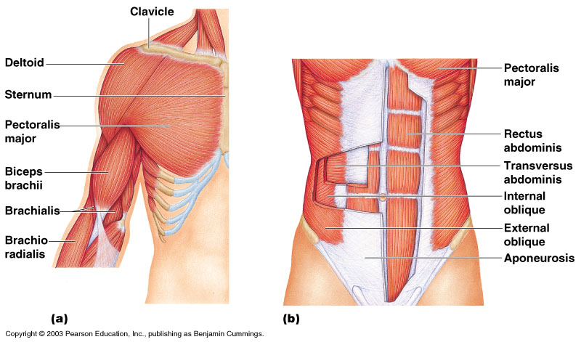
Trunk Muscles

Slide 3
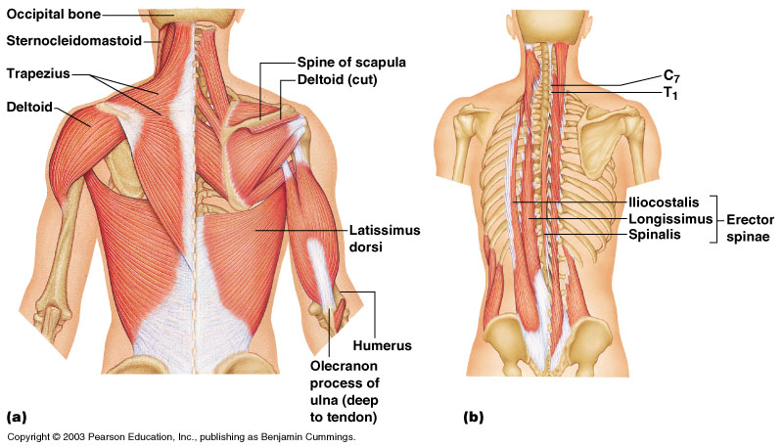
Deep Trunk and Arm Muscles

