Slide 1
An-Najah National University
Faculty of Medicine
Department of Physiology
Anatomy and Physiology 1
7102101
Instructor: Heba Salah
Chapter 4:
The Muscular System
Part 3: Contraction of Skeletal Muscles

Slide 2
Contraction of a Skeletal Muscle
Muscle fiber contraction is “all or none”
Graded responses – different degrees of skeletal muscle shortening, rapid stimulus = constant contraction or tetanus
Muscle force depends upon the number of fibers stimulated
Muscles can continue to contract unless they run out of energy
A whole muscle contraction in response to different rates of stimulation

Slide 3
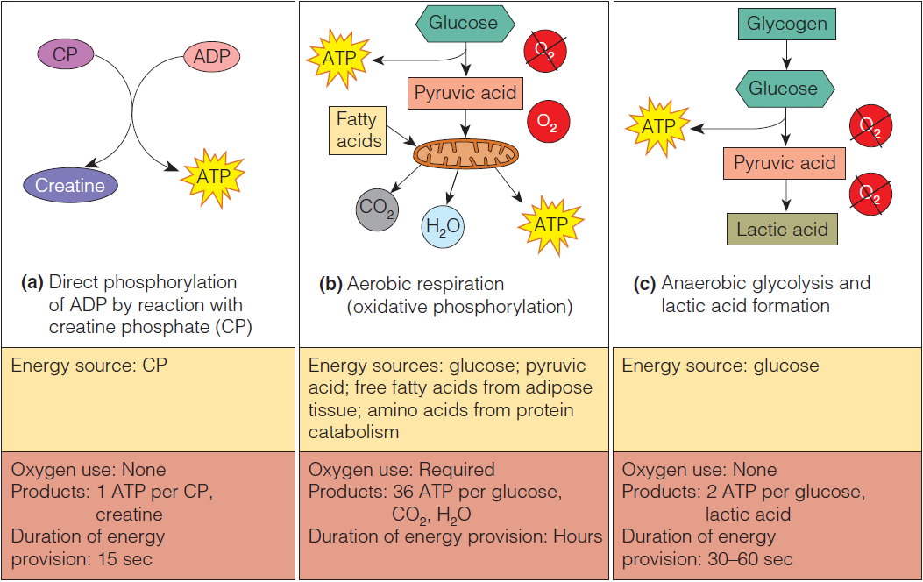
Energy for Muscle Contraction

Slide 4
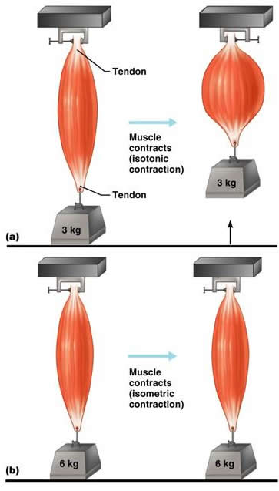
Types of Muscle Contractions
1. Isotonic contractions
Myofilaments are able to slide past each other during contractions
The muscle shortens
2. Isometric contractions
Tension in the muscles increases
The muscle is unable to shorten

