Slide 1
Chapter 15
Beyond the Cell: Cell Adhesions, Cell Junctions, and Extracellular Structures

Slide 2
Beyond the Cell: Cell Adhesions, Cell Junctions, and Extracellular Structures
Many cells spend all their lives in contact with neighboring cells
The organization of cells into tissues allows multicellular organisms to adopt complex structures

Slide 3
Types of Tissues in Animals
Epithelium: sheets of cells that are polarized, with discrete functional domains at opposite ends (apical and basal) of the cells
Connective tissue: more loosely organized, in which cells are attached to each other, a rigid scaffold, or both

Slide 4
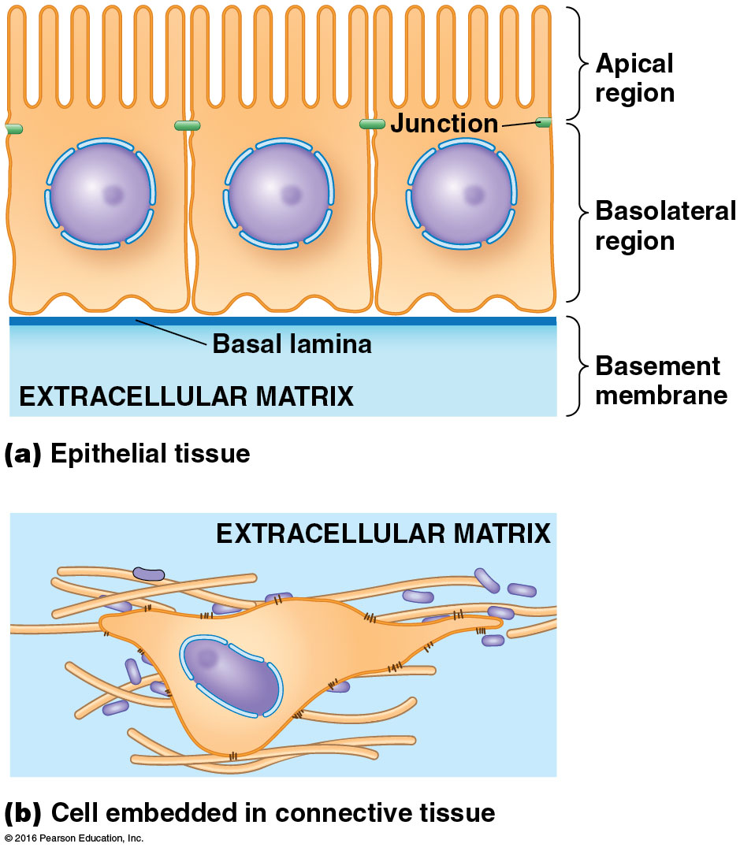

Slide 5
15.1 Cell-Cell Junctions
Multicellular organisms have means of joining cells in long-term associations to form tissues and organs
The specialized structures where two cells come together are called cell-cell junctions

Slide 6
Types of Junctions
Animal cells have three common types of junctions
Adhesive junctions
Tight junctions
Gap junctions
Plant cells have special structures called plasmodesmata

Slide 7
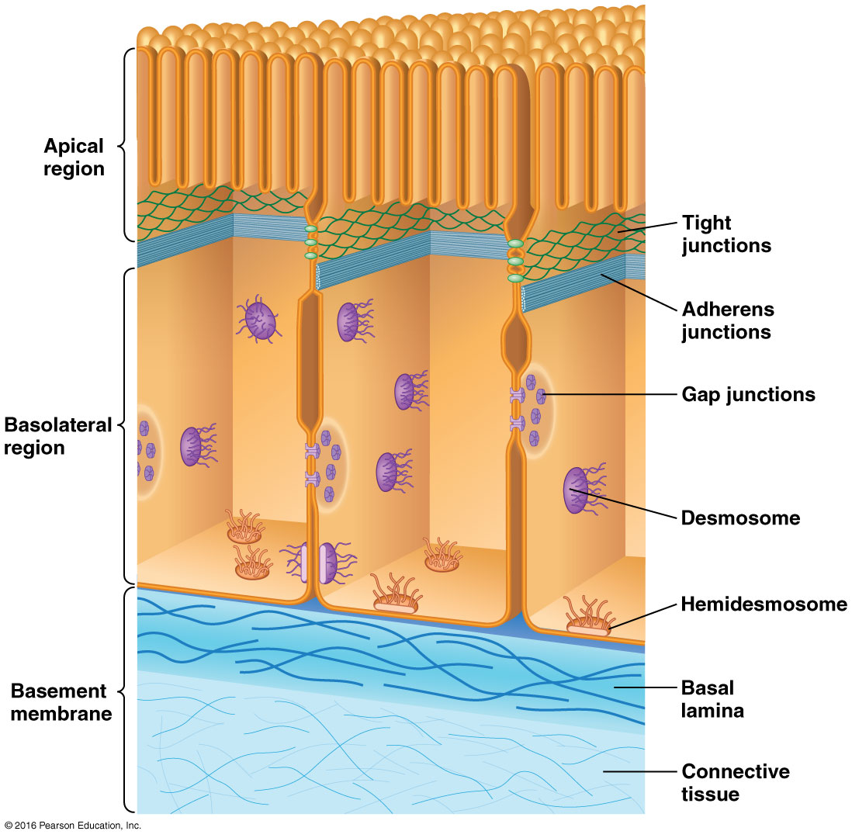

Slide 8
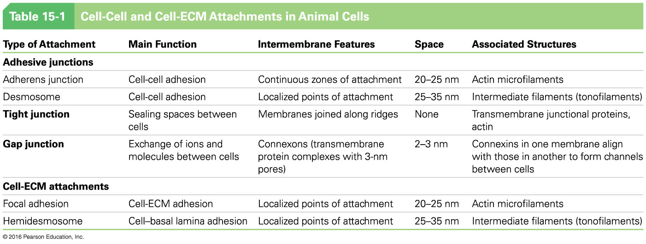

Slide 9
Adhesive Junctions Link Adjoining Cells
Adhesive junctions anchor the cytoskeleton to the cell surface
They rely on specialized adhesion proteins for this function
The extracellular portions of adhesion proteins on one cell can interact with the extracellular portions of similar proteins on neighboring cells

Slide 10
Interactions of Cell-Cell Adhesion Receptors
Homophilic interactions: cells with identical receptors on their surfaces interact with one another
Heterophilic interactions: cells with different receptors interact
Many adhesion receptors also interact with the cytoskeleton via linker proteins

Slide 11
Types of Cell-Cell Adhesive Junctions
Adherens junctions
Desmosomes
These rely on
Intracellular attachment proteins to link the junction to the cytoskeleton
Cadherins on the outer surface to bind cells to each other

Slide 12
Adherens Junctions
Adherens junctions are cadherin-mediated junctions that interact with actin; they are especially prominent in epithelial cells
Adherens junctions rely on cadherins and their associated proteins to confer adhesion between cells

Slide 13
Cadherins
Cadherins are characterized by
“Repeats” in their extracellular domain that vary from protein to protein
A transmembrane domain
Widely varying cytosolic ends

Slide 14
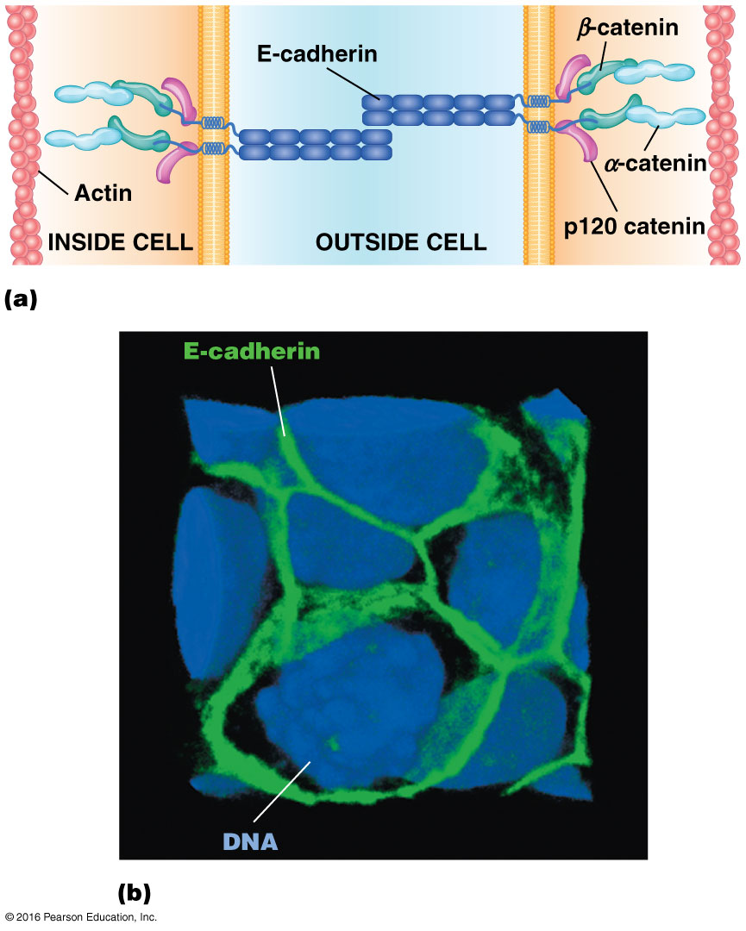

Slide 15
E-Cadherin
E-cadherin is the best characterized
It has five repeats on its extracellular domain through which two E-cadherin molecules can interact (by “zipping together”)
They associate in pairs in the plasma membrane, and their cytosolic portions interact with the cytoskeleton

Slide 16
β-Catenin
A protein called β-catenin binds to the cytosolic tail of the cadherin
β-catenin is bound by α-catenin, which recruits actin to the junction; sometimes plakoglobin is present alongside β-catenin

Slide 17
p120 Catenin
p120 catenin (p120ctn) binds the cytoplasmic tail of cadherins near the plasma membrane
It regulates stability of cadherin at the cell surface as well as the activity of Rho, an actin regulator
Many pathogens infect the body by using these same adhesion systems to gain entry into the cells

Slide 18
Tissue Specificity of Cadherins
Different types of cadherins are expressed in particular tissues
E-cadherins are found on epithelial cells, P-cadherins in placenta (and other tissues)
The amount and type of cadherins on cell surfaces help segregate cells into particular tissues

Slide 19
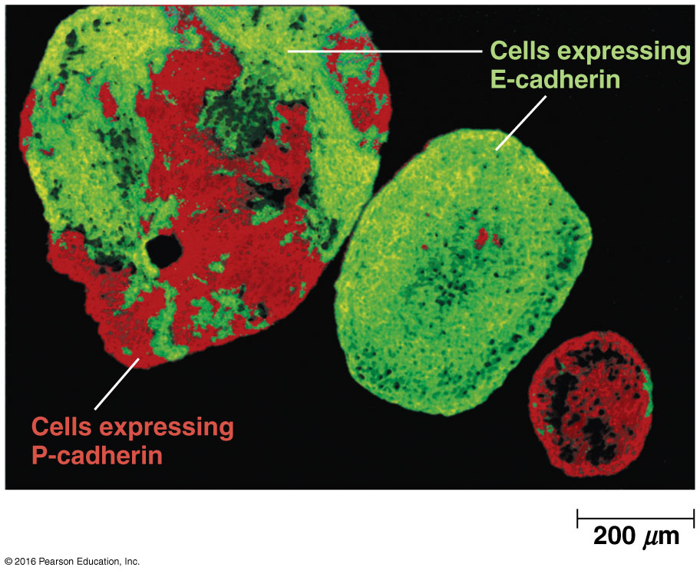

Slide 20
Video: Cadherins and Tissue Organization

Slide 21
The Epithelial-Mesenchymal Transition
The epithelial-mesenchymal transition (EMT), the breakdown of epithelium into loosely organized mesenchyme cells, is accompanied by changes in cadherin expression
This type of change occurs in cancer cells as they metastasize, acquire the ability to spread through the body
Notes:
21

Slide 22
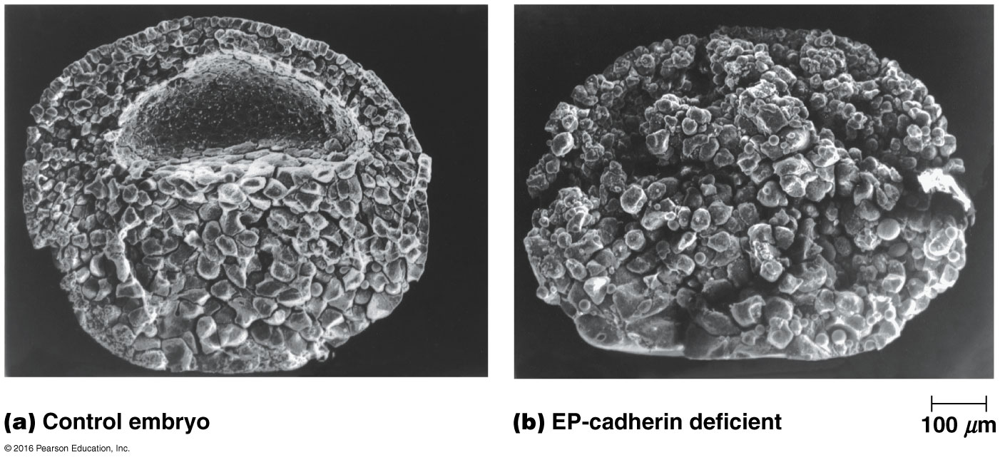

Slide 23
Desmosomes
Desmosomes are button-like points of strong adhesion between adjacent cells in a tissue
They provide a tissue with structural integrity
They are especially abundant in skin, heart muscle, and the neck of the uterus

Slide 24
Desmosome Structure
The extracellular space between the two connected cells is called the desmosome core
The desmosomal cadherins are called desmocollins and desmogleins
Linker proteins bind their cytosolic domains and link them to the cytoskeleton

Slide 25
Desmosome Structure (continued)
The β-catenin family protein plakoglobin binds desmocollin and a protein called desmoplakin
Desmoplakin attaches to tonofilaments, composed of intermediate filaments such as vimentin, desmin, and keratin
A thick plaque with these linker proteins and tonofilaments is located beneath the membrane of the two adjoining cells

Slide 26
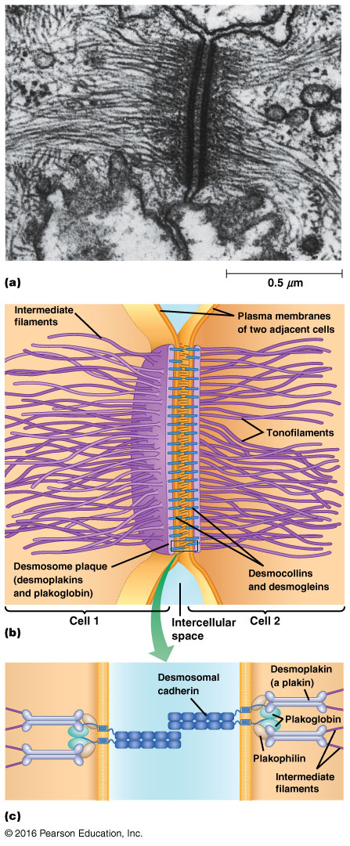

Slide 27
Transient Cell-Cell Adhesions Are Important for Many Cellular Events
Besides cadherins, other molecules are involved in cell-cell adhesion and cell recognition

Slide 28
Lectins
Many animal and plant cells secrete carbohydrate-binding proteins called lectins
Lectins promote cell-cell adhesion by binding to a specific sugar or sugars at the outer cell surface
They can bind to carbohydrate groups on two different cells, linking the cells together

Slide 29
Cell Adhesion Molecules (CAMs)
CAMs are members of the immunoglobulin super family (IgSF)
The first known member of the family is neural cell adhesion molecule, N-CAM
They have well-organized loops similar to those of immunoglobulins in their extracellular domains; homophilic interactions occur via these domains

Slide 30
Selectins and Leukocyte Adhesion
When leukocytes interact with platelets or the cells lining blood vessels during inflammation, the reactions are mediated by selectins
L-selectin is expressed on leukocytes, P-selectin on platelets, and E-selectin on the endothelial cells of blood vessels
Stable adhesions at the site of the inflammation are mediated by an integrin and ICAM
Notes:
30

Slide 31
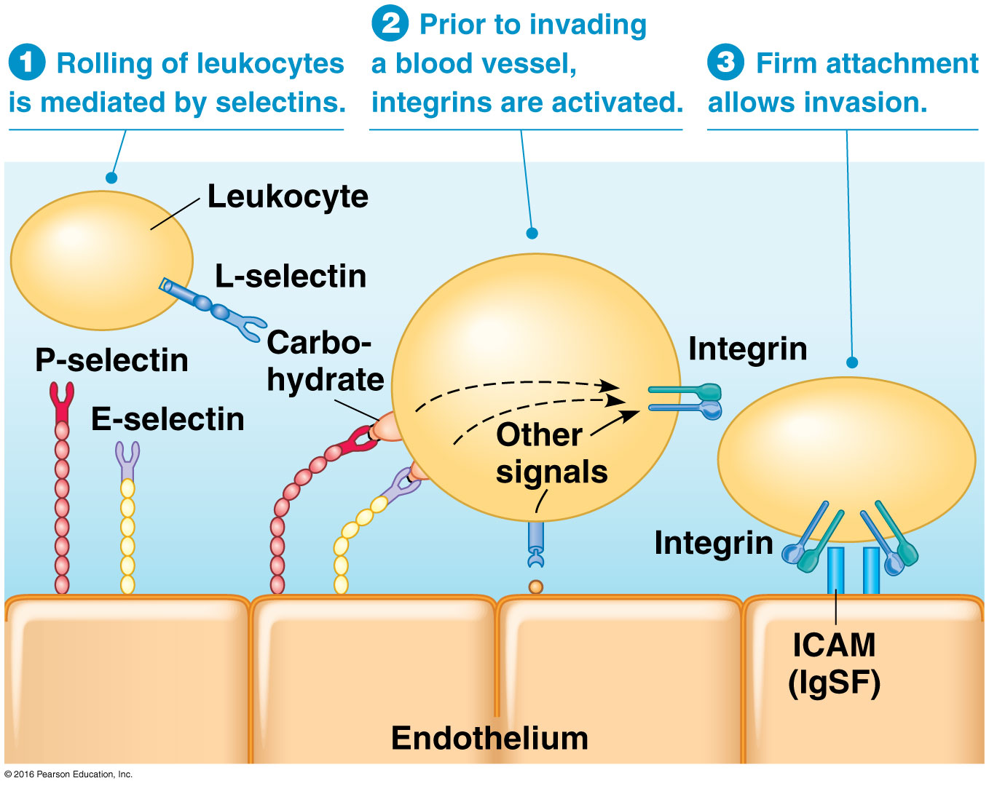

Slide 32
Video: Leukocyte Adhesion and Rolling

Slide 33
Tight Junctions Prevent the Movements of Molecules Across Cell Layers
Epithelial cells need specialized structures to seal them tightly together
Tight junctions serve this function, leaving no space between the plasma membranes of adjacent cells
They form a continuous belt around the apical ends of lateral surfaces of each cell; molecules cross the cell layer by passing through the cells

Slide 34
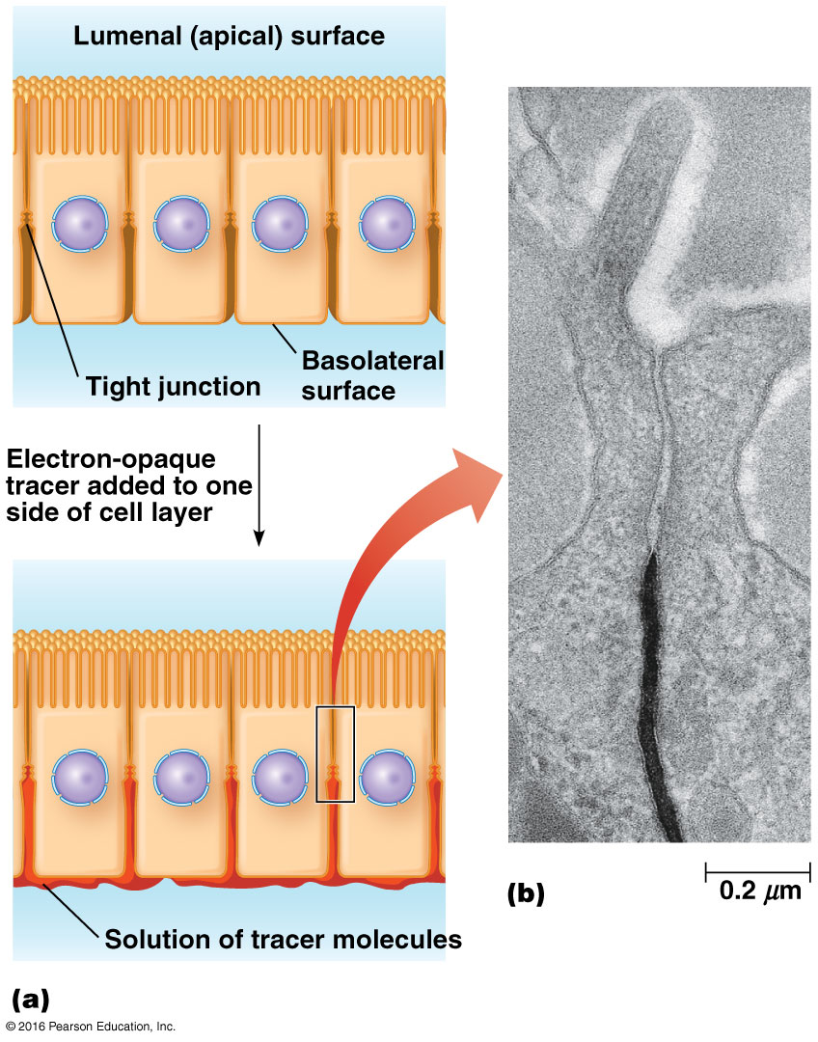

Slide 35
Role of Tight Junctions in Sealing Epithelia
Tight junctions contain several major transmembrane proteins such as occludin and immunoglobulin superfamily proteins called junctional adhesion molecules (JAMs)
They also contain claudins, proteins with four membrane-spanning domains

Slide 36
Function of Claudins
Claudins in adjacent cells are thought to interlock to form a tight seal; the large extracellular loop forms ion-selective pores to allow passage of specific ions
Because the ions move between cells, this transport is called paracellular transport, probably regulated by claudins
Different tissues express different claudins

Slide 37
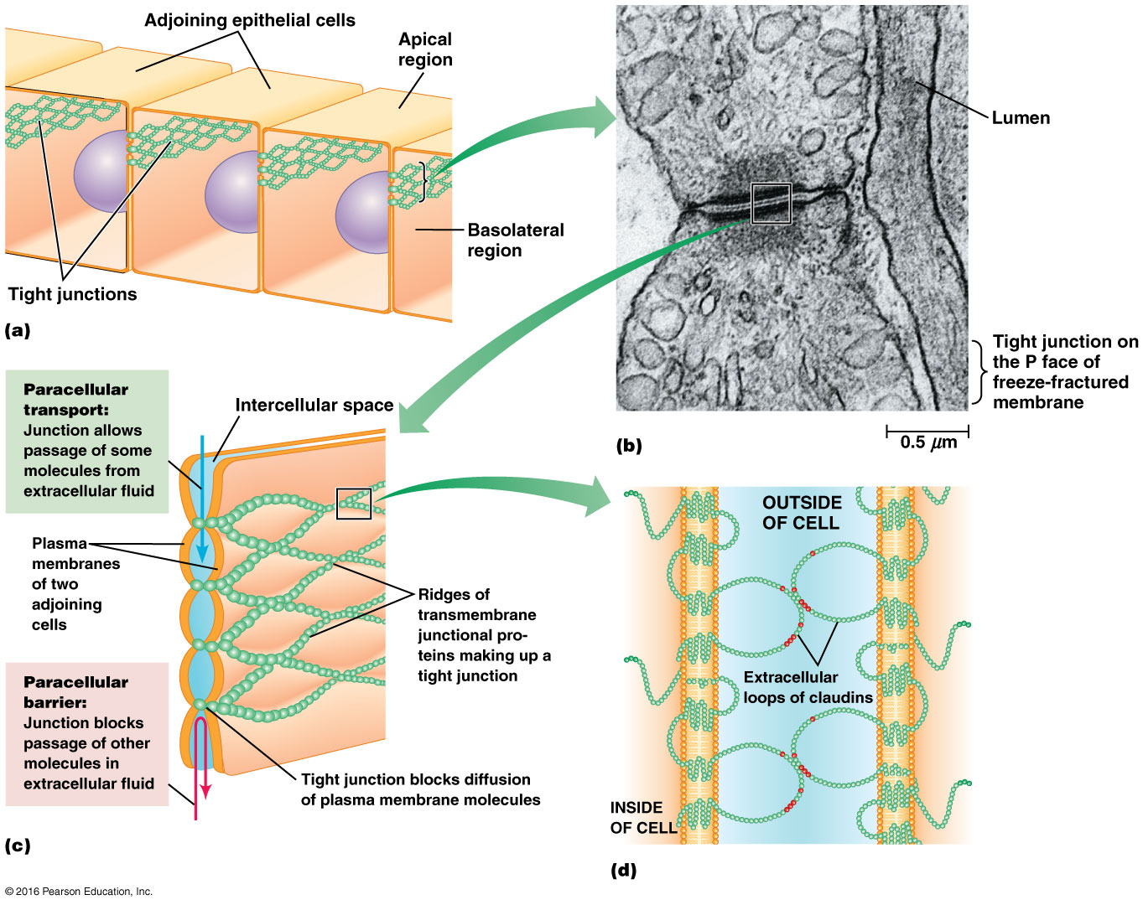

Slide 38
Role of Tight Junctions in Blocking Lateral Movement of Membrane Proteins
Tight junctions also block lateral movement of lipids and proteins in the plasma membrane
Movement of lipids is blocked only in the outer monolayer
Movement of integral membrane proteins is completely blocked

Slide 39
Gap Junctions Allow Direct Electrical and Chemical Communication Between Cells
A gap junction is a region where the plasma membranes of cells are aligned and brought into contact, with a very small gap between
The gap is spanned by small pipelines or passages between the cells
Small molecules and ions can pass directly from one cell to another

Slide 40
Gap Junction Structure
At the gap junction, the plasma membranes of adjacent cells are joined by hollow cylinders called connexons
Each connexon is an assembly of six subunits of connexin proteins, which form a circle
The invertebrate equivalent of connexin is innexin

Slide 41
Connexin
Different tissues have different types of connexins, but they all function the same way
Each connexon has a channel about 3 nm wide, too small to allow proteins, nucleic acids, or organelles to pass through

Slide 42
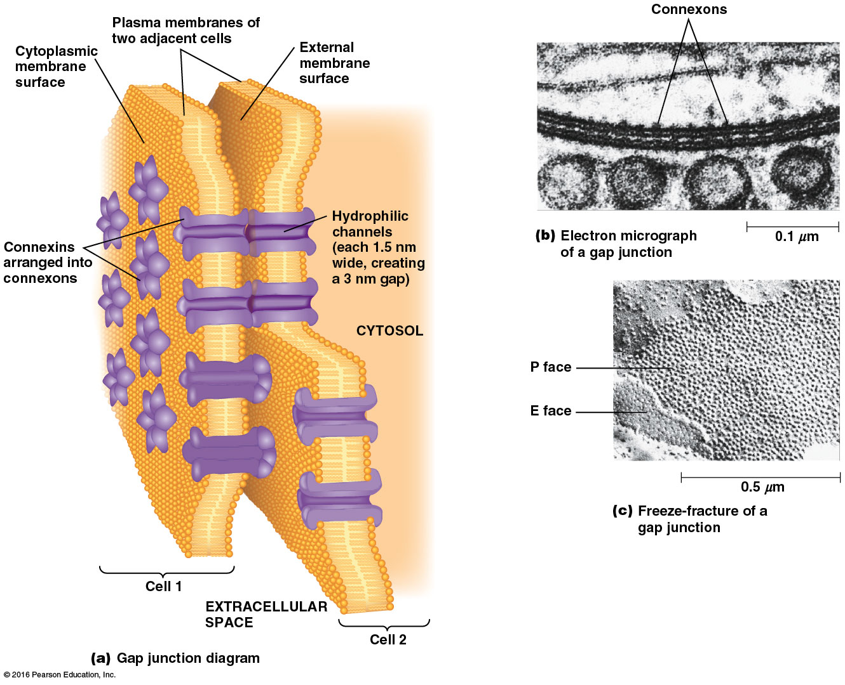

Slide 43
Video: Connexon Structure

Slide 44
15.2 The Extracellular Matrix of Animal Cells
In animal cells, the extracellular matrix (ECM) takes on a variety of forms in different tissues

Slide 45
Three Types of ECM
Bone consists mainly of a rigid extracellular matrix that contains a small number of interspersed cells
Cartilage is a tissue constructed mostly of matrix materials that is more flexible than bones
Connective tissue surrounding glands and blood vessels is relatively gelatinous and contains interspersed fibroblast cells

Slide 46
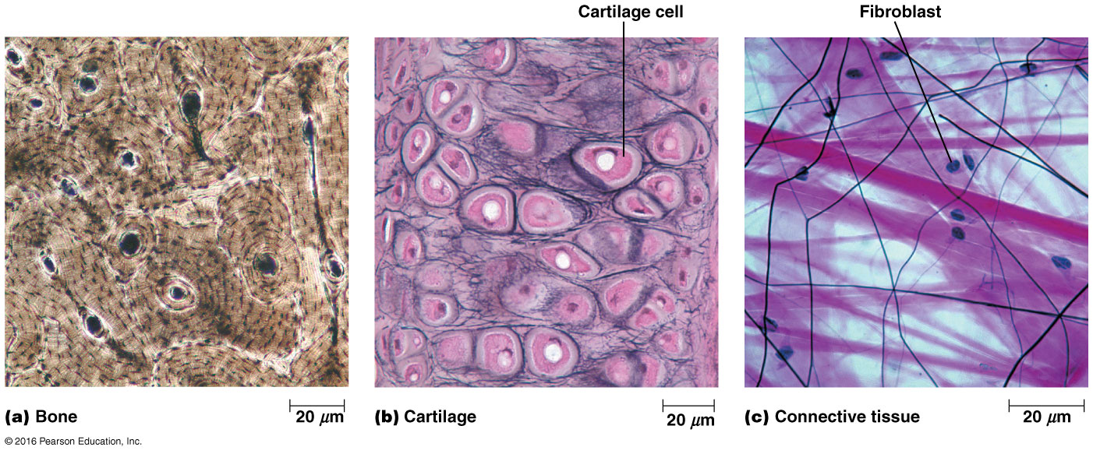

Slide 47
Three Classes of ECM Molecules
Despite the diversity of function, ECM consists of the same three classes of molecules
Structural proteins such as collagens and elastins, which provide strength and flexibility
Protein-polysaccharide complexes, proteoglycans, that provide the matrix
Adhesive glycoproteins, fibronectins and lamins, that allow cells to attach to the matrix

Slide 49
Collagens Are Responsible for the Strength of the Extracellular Matrix
The most abundant ECM component in animals is a family of closely related collagens, which form fibers with high tensile strength
Collagen is secreted by several types of cells in connective tissues, including fibroblasts

Slide 50
Features Shared by All Collagens
All collagens occur as a rigid triple helix of intertwined polypeptides
They have an unusual amino acid composition— very high in glycine and the rare amino acids hydroxylysine and hydroxyproline
The glycine spacing is important in forming a helix

Slide 51
Collagen Fibers
Collagen fibers are visible in the ECM under scanning electron microscopy (EM)
The fibers are enormously strong and are composed of numerous fibrils
Each fibril is made of many collagen molecules, each composed of three α chains twisted into a helix

Slide 52
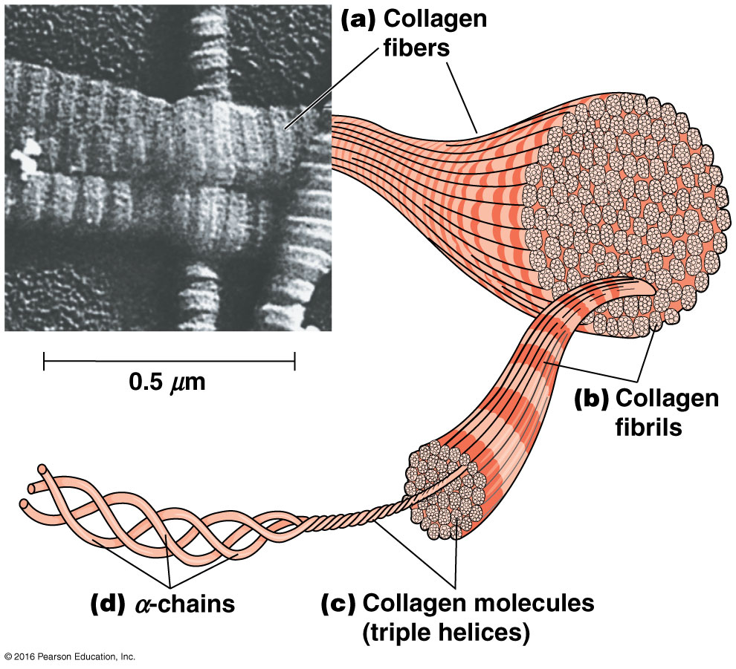

Slide 53
Procollagen
In the lumen of the ER, three chains assemble to form a triple helix called procollagen, with short nonhelical sequences at both ends
Once it is secreted out of the cell, it is cleaved by procollagen peptidase to remove both ends of the molecule
The resulting collagen molecules spontaneously associate into fibrils and then fibers

Slide 54
Collagen Stability
The stability of collagen fibrils is reinforced by hydrogen bonds involving hydroxylysine and hydroxyproline
The hydrogen bonds form crosslinks within and between collagen molecules
Vertebrates have about 25 kinds of α chains, which form at least 15 types of collagens that are tissue specific

Slide 55
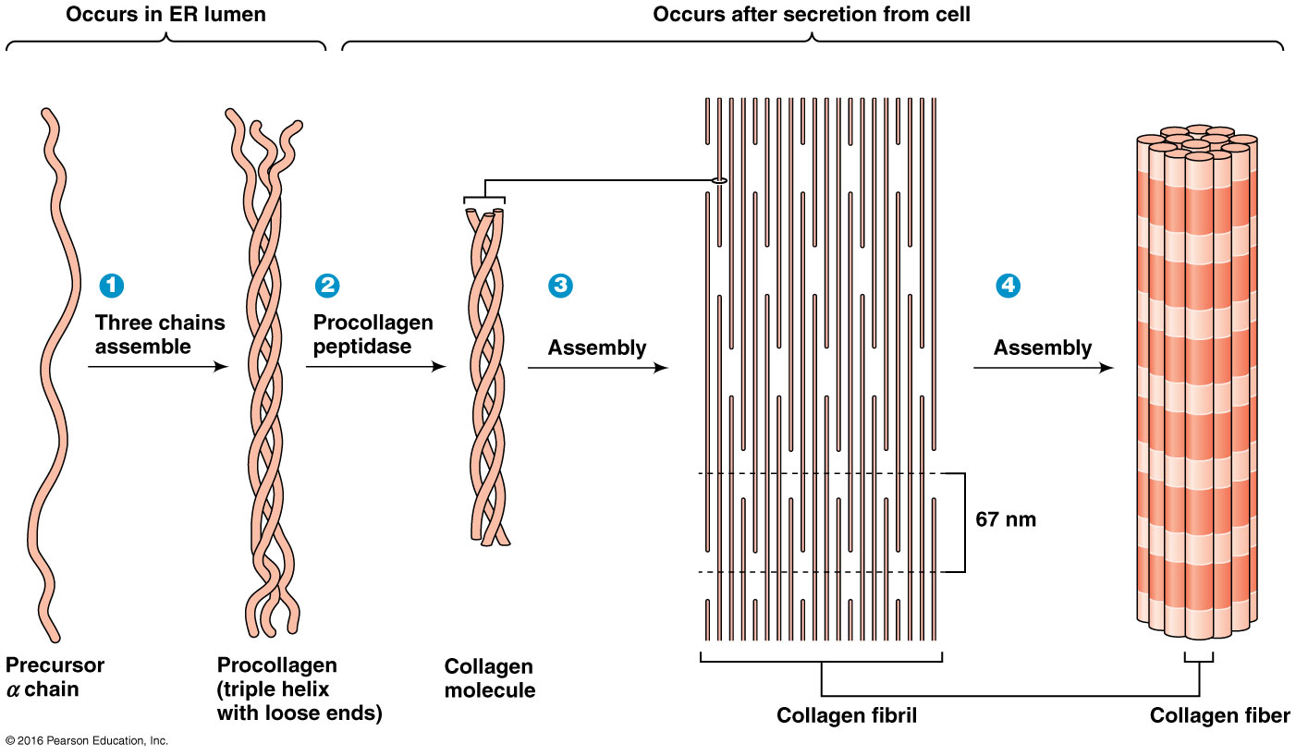

Slide 57
Elastins Impart Elasticity and Flexibility to the Extracellular Matrix
Elasticity is provided to the ECM by stretchable elastic fibers principally composed of elastins
These are rich in glycine and proline, and the molecules are crosslinked by bonds between lysine residues
Tension causes the overall network to stretch, and release of tension causes individual molecules to relax

Slide 58
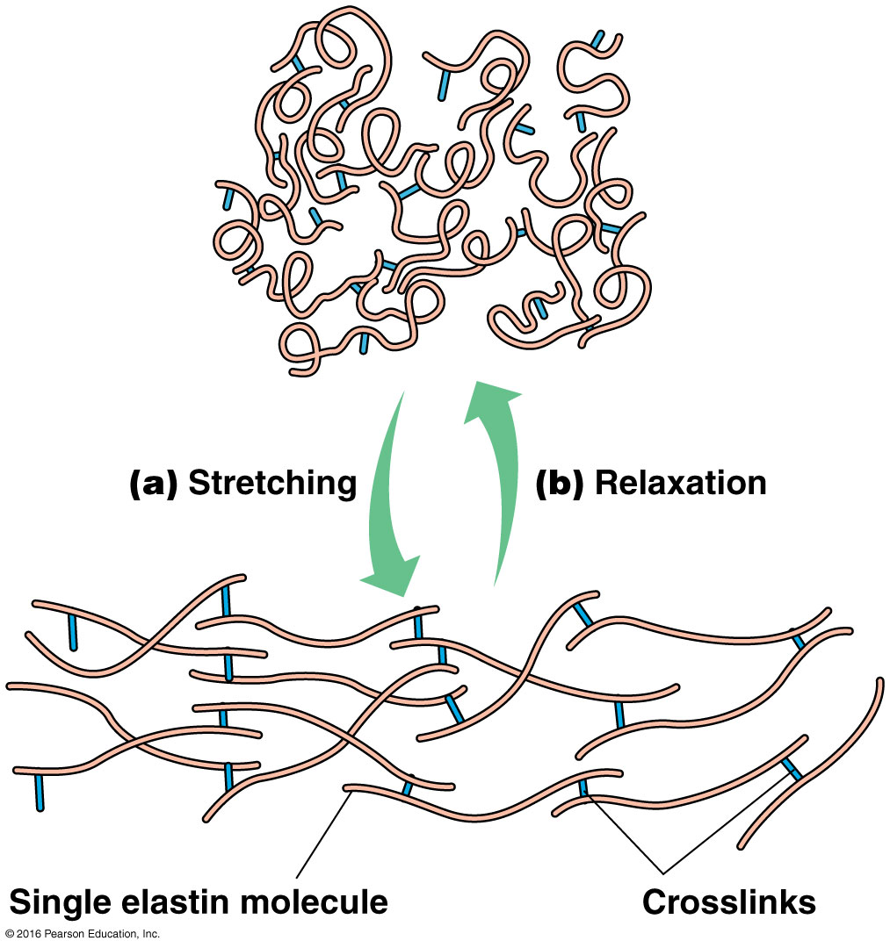

Slide 59
Collagen and Elastin Fibers Are Embedded in a Matrix of Proteoglycans
The collagen and elastin fibers are enmeshed in a gel-like network of proteoglycans, glycoproteins with a lot of glycosaminoglycans
Glycosaminoglycans (GAGs), are large carbohydrates with repeating disaccharide units
The most common types are chondroitin sulfate, keratan sulfate, and hyaluronate
Notes:
59

Slide 60
Glycosaminoglycans
The disaccharide repeating unit has one amino sugar, either N-acetylglucosamine (GlcNAc) or N-acetylgalactosamine (GalNAc)
The other sugar is usually a sugar or sugar acid, commonly galactose (Gal) or glucuronate (GlcUA)
In most cases, the amino sugar has one or more sulfate groups attached
Notes:
60

Slide 61
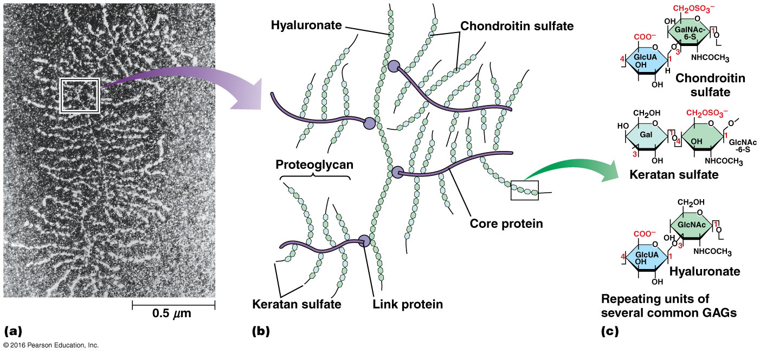

Slide 62
Proteoglycans
Most glycosaminoglycans in the ECM are covalently bound to proteins to form proteoglycans
Each proteoglycan has a number of GAG chains attached along the length of a core protein
Proteoglycans vary greatly in size depending on the size of the core protein and the length of the carbohydrate chains

Slide 63
Proteoglycans (continued)
Proteoglycans are usually integral components of the plasma membrane, with their core polypeptides embedded in the membrane
In many tissues, proteoglycans are present as individual molecules
In cartilage, numerous proteoglycans become attached to long molecules of hyaluronate

Slide 64
Free Hyaluronate Lubricates Joints and Facilitates Cell Migration
Most GAGs in the ECM exist only as components of proteoglycans
Hyaluronate is an exception that occurs both as a backbone of cartilage proteoglycans and as a free molecule
It has lubricating properties and is most abundant where friction needs to be reduced, such as in joints

Slide 65
Adhesive Glycoproteins Anchor Cells to the Extracellular Matrix
Direct links between the ECM and the plasma membrane are reinforced by a family of adhesive glycoproteins
They have multiple domains to bind molecules in the ECM and receptors on membranes
Laminins and fibronectins are the most common types

Slide 66
Fibronectins Bind Cells to the ECM and Guide Cellular Movement
Fibronectins are a family of closely related glycoproteins in the ECM
RNA transcribed from the fibronectin gene is processed to produce many different mRNAs and thus many different variants of the protein
A fibronectin molecule has two large subunits linked near the C-terminals by two disulfide bonds

Slide 67
Fibronectin Structure
Each fibronectin subunit is folded into a series of rodlike domains
Several domains bind one or more ECM macromolecules, including several types of collagen, heparin, and fibrin
Other domains recognize and bind cell surface receptors via the RGD (arg-gly-asp) sequence

Slide 68
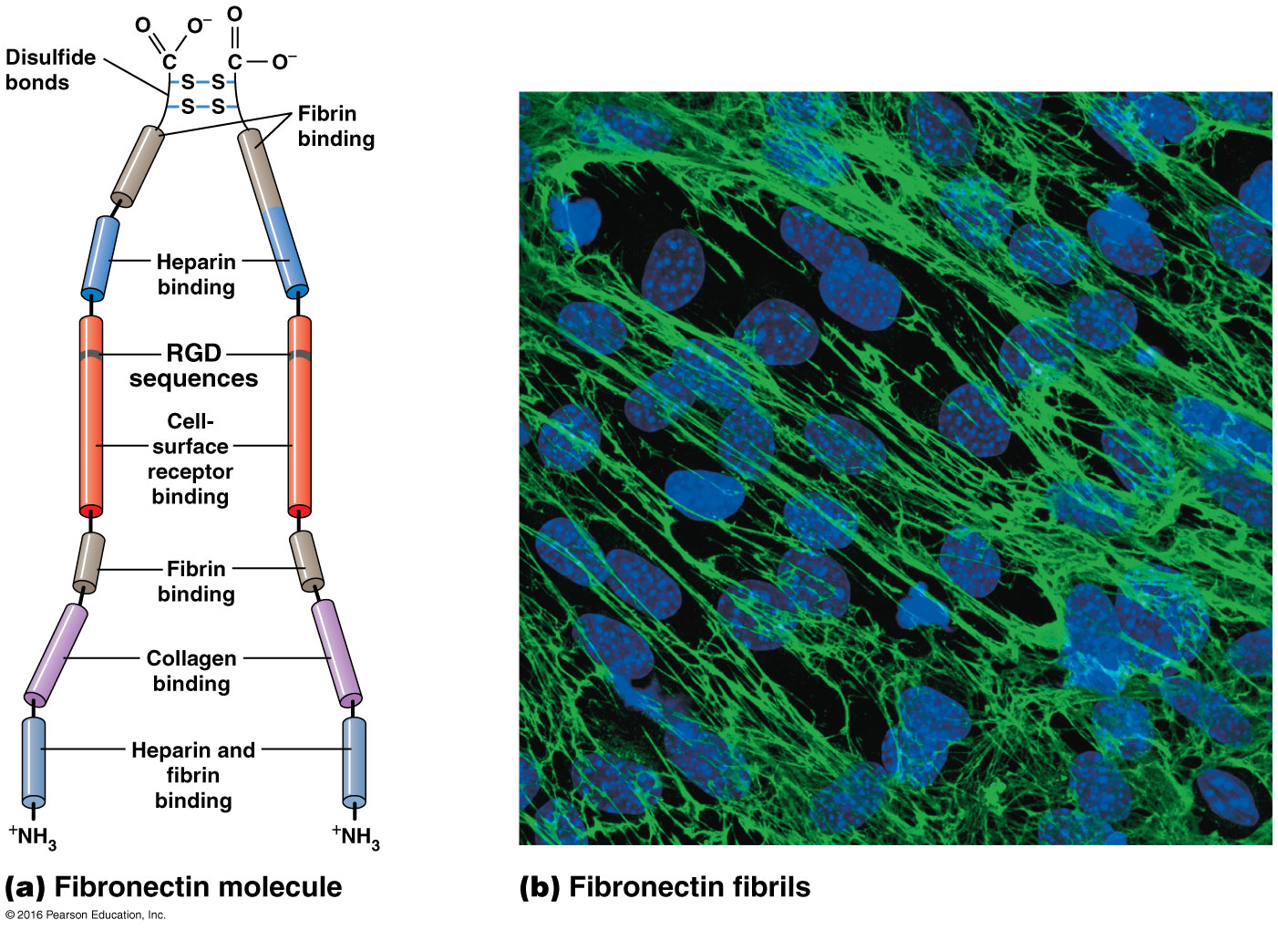

Slide 69
Effects of Fibronectin on Cell Movement
Fibronectin acts as a bridging molecule between cells and the ECM
Mice that cannot produce fibronectin have severe defects in musculature and vasculature
Many kinds of cancer cells do not produce fibronectin

Slide 70
Effects of Fibronectin on Blood Clotting
The soluble form of fibronectin in blood is called plasma fibronectin
It promotes blood clotting because it has domains for binding fibrin, the blood-clotting protein
It can attach blood platelets to fibrin as the clot forms

Slide 71
Laminins Bind Cells to the Basal Lamina
Laminins are found mainly in the basal lamina, a thin sheet of specialized extracellular material
It underlies epithelial cells, separating them from connective tissues

Slide 72
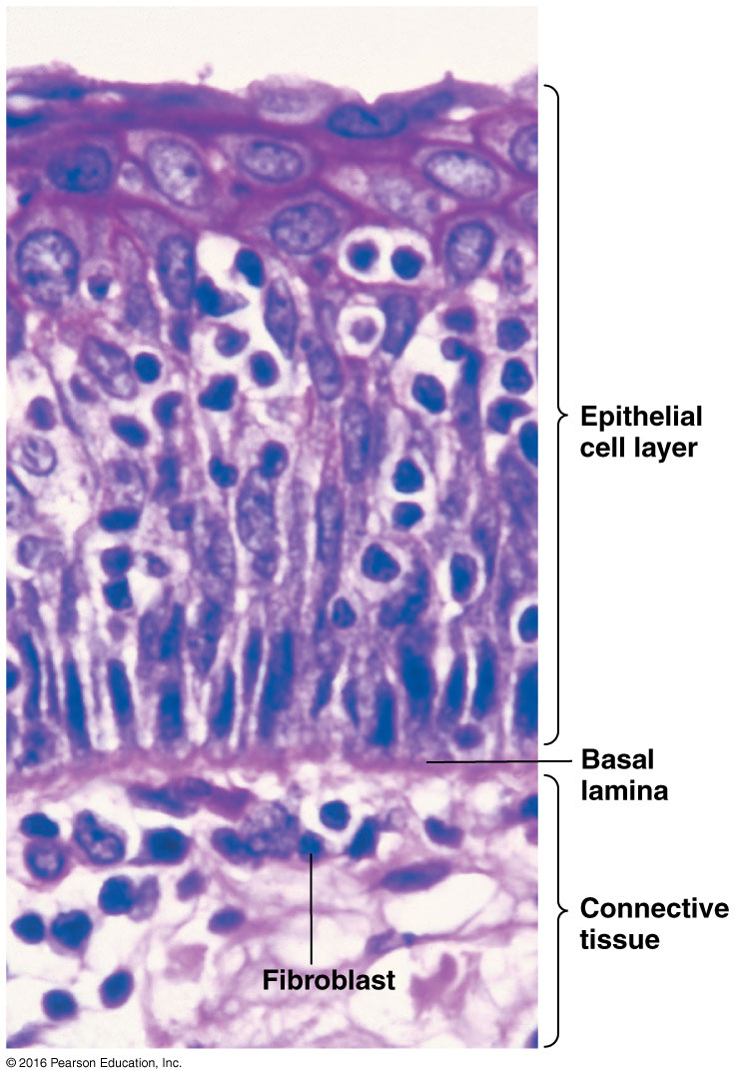

Slide 73
Properties of the Basal Lamina
The basal lamina is a structural support and a permeability barrier
All forms of basal lamina contain type IV collagen, proteoglycans, laminins, and another glycoprotein called entactin or nidogen
Cells can alter the properties of the basal lamina by secreting enzymes that catalyze changes in the lamina

Slide 74
Enzymes That Alter the Basal Lamina
One important class of such enzymes is matrix metalloproteinases (MMPs) that require metal ions as cofactors
They degrade the ECM locally, allowing cells to pass through
This is important for leukocytes to invade injured tissues and may be a factor in cancer cell invasiveness

Slide 75
Properties of Laminin
Laminin consists of three long polypeptides α, β, and γ; several types of each can combine to form many types of laminin
Disulfide bonds hold the polypeptides together in the shape of a cross
They have several domains, including binding sites for type IV collagen, heparin, heparin sulfate and entactin, and receptors on cell surfaces

Slide 76
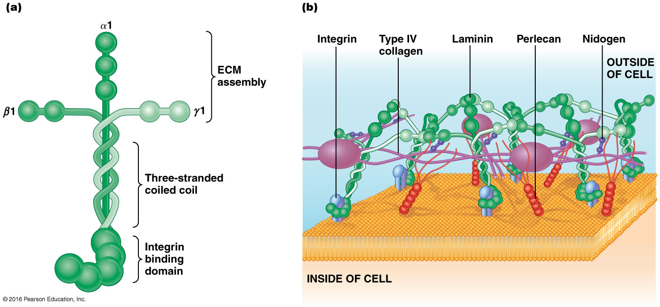

Slide 77
Integrins Are Cell Surface Receptors That Bind ECM Constituents
Integrins are a large family of cell surface receptors that bind to fibronectins or laminins
Integrins integrate the cytoskeleton with the ECM

Slide 78
Structure of Integrins
An integrin consists of two large transmembrane polypeptides, α and β
Integrins differ from one another in binding specificity and subunit sizes
The extracellular parts of the α and β subunits form the binding sites of the integrin; the specificity is mainly dependent on the α unit

Slide 79
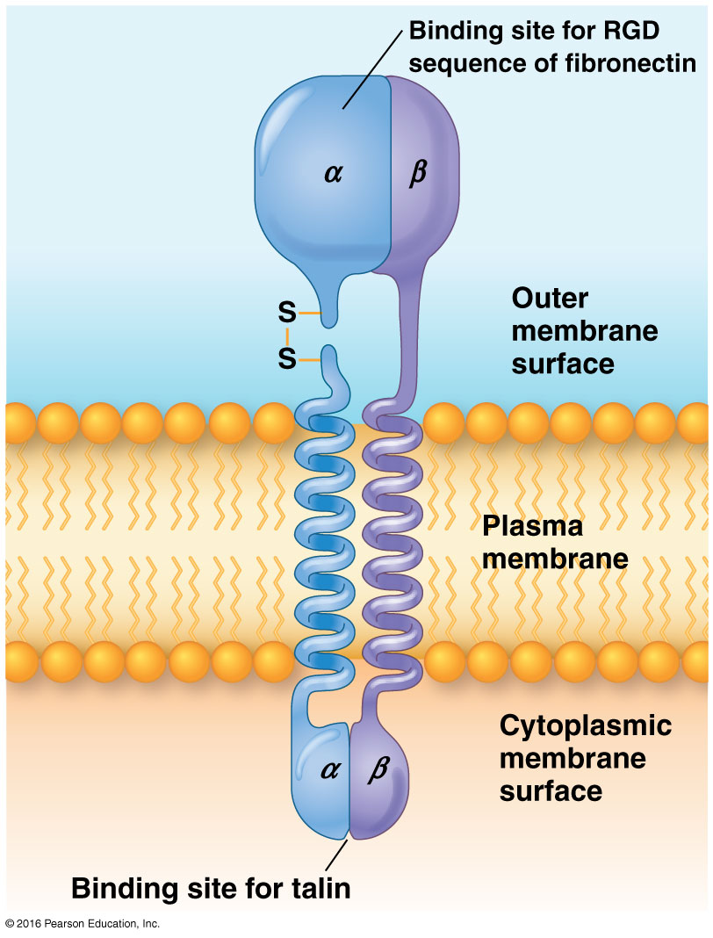

Slide 80
Integrin Variability
There are multiple types of α and β subunits, resulting in many types of integrin heterodimers
Many integrins recognize the RGD sequences in the ECM glycoproteins they bind

Slide 81
Integrins and the Cytoskeleton
Integrin tails interact with cytosolic proteins that link integrins to cytoskeleton
Migratory and non-epithelial cells such as fibroblasts attach to ECM molecules via focal adhesions
These contain clustered integrins that interact with bundles of actin filaments via talin, vinculin, and α-actinin

Slide 82
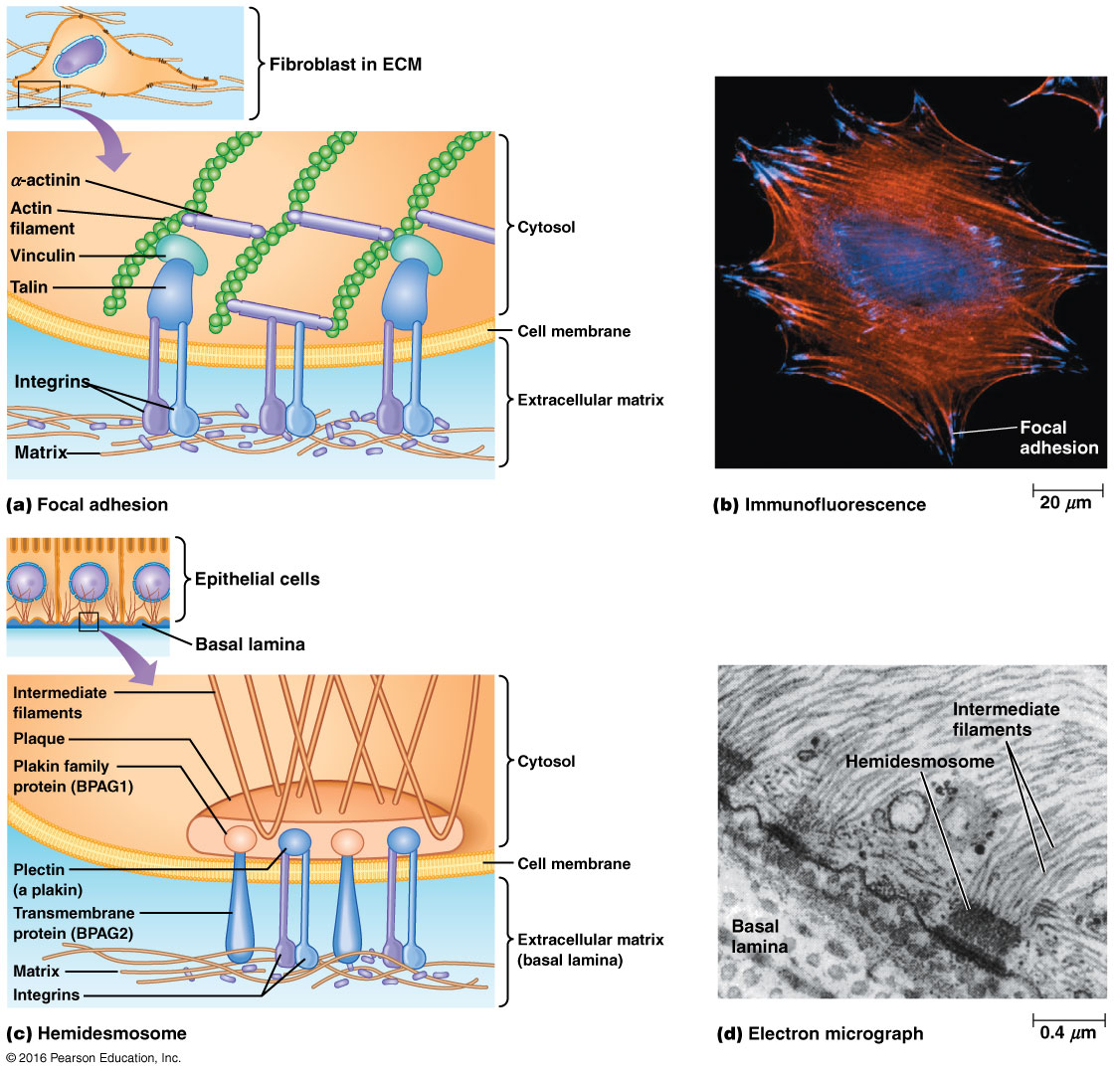

Slide 83
Hemidesmosomes
Hemidesmosomes are found in epithelial cells; they contain α6β4 integrin
The integrins are attached to keratin in this case
The linker proteins in hemidesmosomes form a dense plaque connecting the integrins to the cytoskeleton

Slide 84
Hemidesmosome Linker Proteins
Members of the plakin family are prominent linker proteins
A plakin called plectin attaches keratin filaments to integrins
Another transmembrane protein, BPAG2, and its associated plakin, BPAG1, serve as a bridge between keratin and laminin

Slide 85
Integrins and Signaling
Integrins also interact with intracellular signaling pathways
For example, signals such as growth factors that lead to MAP kinase activation can induce integrin clustering (“inside-out signaling”)
Integrins can also act as receptors that activate intracellular signaling (“outside-in signaling”)

Slide 86
Anchorage-Dependent Growth
For most cells to grow in culture, they must be attached to a substratum; if such cells cannot attach to an ECM layer, they stop dividing
This is anchorage-dependent growth, and it involves activation of intracellular pathways following integrin clustering
Kinases are recruited to focal adhesions by adaptor proteins such as paxillin

Slide 87
Kinases Recruited to Focal Adhesions
Focal adhesion kinase (FAK)
Kindlins
Integrin-linked kinase (ILK)
ILK probably functions as a scaffolding protein

Slide 88
The Dystrophin/Dystroglycan Complex Stabilizes Attachments of Muscle Cells to the ECM
A third type of ECM attachment is important in human disease
The costamere is an attachment structure at the surface of striated muscle
Costameres contain many of the same proteins found at focal contacts in addition to the protein dystrophin

Slide 89
Dystrophin
Mutations in the dystrophin genes cause the most common type of muscular dystrophies, Duchenne muscular dystrophy (DMD) and Becker muscular dystrophy (BMD)
Dystrophin interacts with a complex that includes integral membrane protein dystroglycan and the sarcoglycan-sarcospan complexes
It also interacts with cytosolic proteins such as dystrobrevins and syntrophins

Slide 90
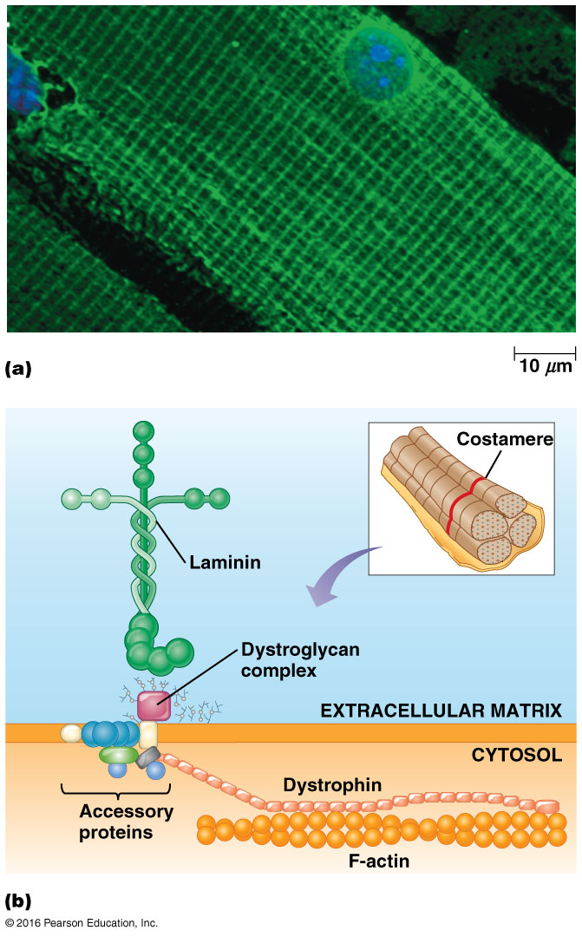

Slide 91
15.3 The Plant Cell Surface
The surfaces of plant, algal, fungal, and bacterial cells have some features distinct from those of animal cells

Slide 92
Cell Walls Provide a Structural Framework and Serve as a Permeability Barrier
The strength of plant cells is provided by rigid cell walls
Sturdy cell walls allow plants to withstand the high turgor pressure exerted by the uptake of water
The wall around the plant cell is also a permeability barrier for large molecules, though not gases, ions, or other small water-soluble molecules

Slide 93
The Plant Cell Wall Is a Network of Cellulose Microfibrils, Polysaccharides, and Glycoproteins
Plant cell walls consist of mainly long cellulose microfibrils enmeshed in a network of branched polysaccharides and glycoproteins called extensins
The two main polysaccharides are pectins and hemicelluloses

Slide 94
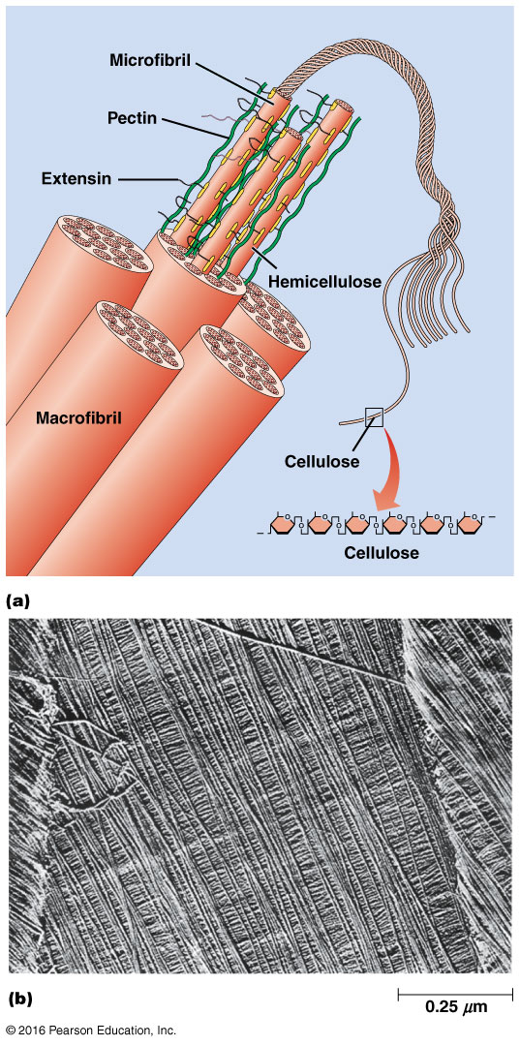

Slide 95
Cellulose and Hemicellulose
Cellulose is the predominant polysaccharide of the cell wall
Most abundant organic macromolecule on Earth
Long, ribbonlike structures that are stabilized by intramolecular hydrogen bonds
50–60 cellulose molecules associate laterally to form the microfibrils found in cell walls
Cellulose microfibrils twisted together in a ropelike fashion generate even larger structures called macrofibrils

Slide 96
Hemicellulose
Hemicelluloses are chemically and structurally different from cellulose
They are heterogeneous, each with a long linear chain of a single kind of sugar (glucose or xylose) with short side chains in a rigid network
The side chains contain several kinds of sugars
Notes:
96

Slide 97
Other Cell Wall Components
Pectins are branched polysaccharides with backbones called rhamnogalacturonans; the side chains have the same monosaccharides found in hemicelullose
Extensins are a group of related glycoproteins, which are deposited in soluble form
After deposition into the cell wall, extensins become covalently crosslinked to one another and cellulose
Notes:
97

Slide 98
Other Cell Wall Components (continued)
Lignins are very insoluble polymers of aromatic alcohols found mainly in woody tissues
They are localized between cellulose fibrils
Notes:
98

Slide 99
Cell Walls Are Synthesized in Several Discrete Stages
The cell wall is secreted in steps, creating a series of layers
The first structure laid down is called the middle lamella
The next is the primary cell wall, formed while cells are still growing, a loosely organized network of cellulose, hemicellulose, pectins, and glycoproteins
Notes:
99

Slide 100
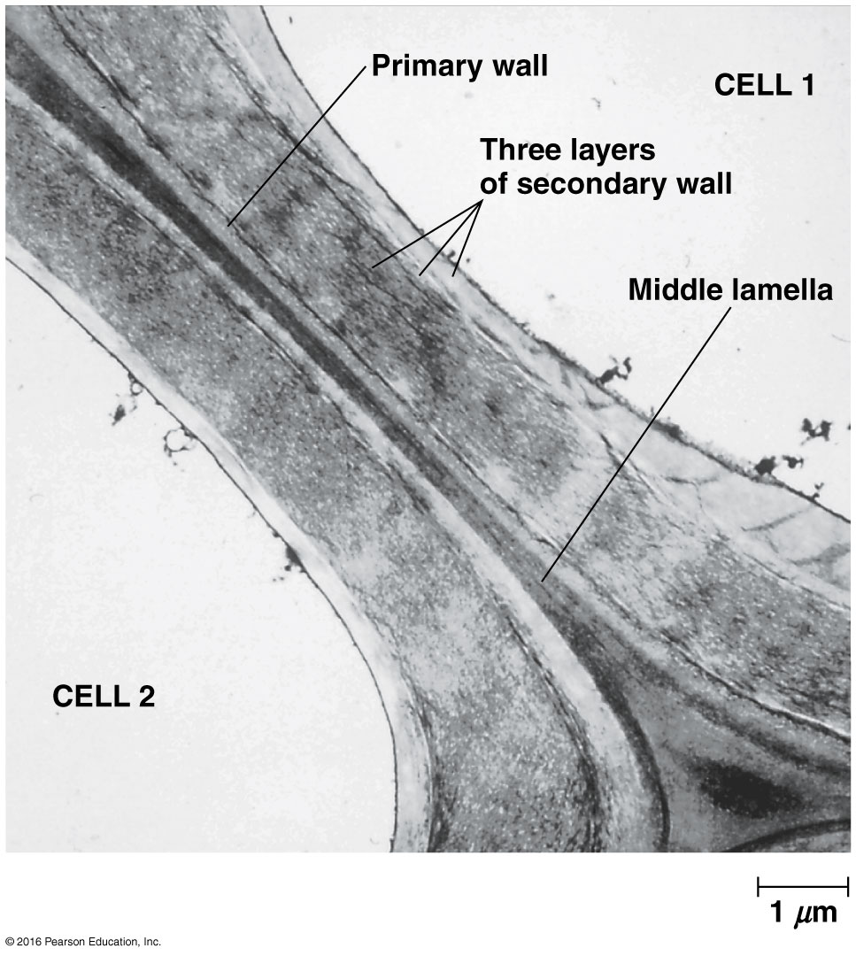

Slide 101
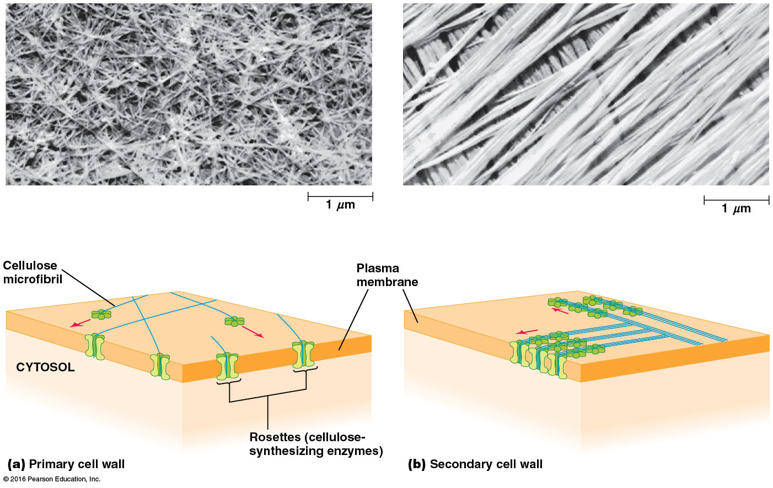

Slide 102
Stages of Cell Wall Formation
While shoots or roots are growing, expansins help cell walls retain pliability
The primary cell wall is a relatively thin, flexible structure
Cells that have stopped growing add a thicker, more rigid set of layers called the secondary cell wall
Notes:
102

Slide 103
Secondary Cell Wall
Cellulose and lignins are the primary constituents of the secondary cell wall
It consists of densely packed bundles of cellulose microfibrils in parallel and oriented to lie at an angle to adjacent layers
This organization gives great strength and rigidity to the wall
Notes:
103

Slide 104
Plasmodesmata Permit Direct Cell-Cell Communication Through the Cell Wall
Plasmodesmata are cytoplasmic channels through openings in the cell wall, allowing cytoplasmic continuity between two adjacent cells
Each plasmodesma is lined with plasma membrane common to the two cells, with the desmotubule in the central channel
The annulus lies between the desmotubule and membrane lining the plasmodesma
Notes:
104

Slide 105
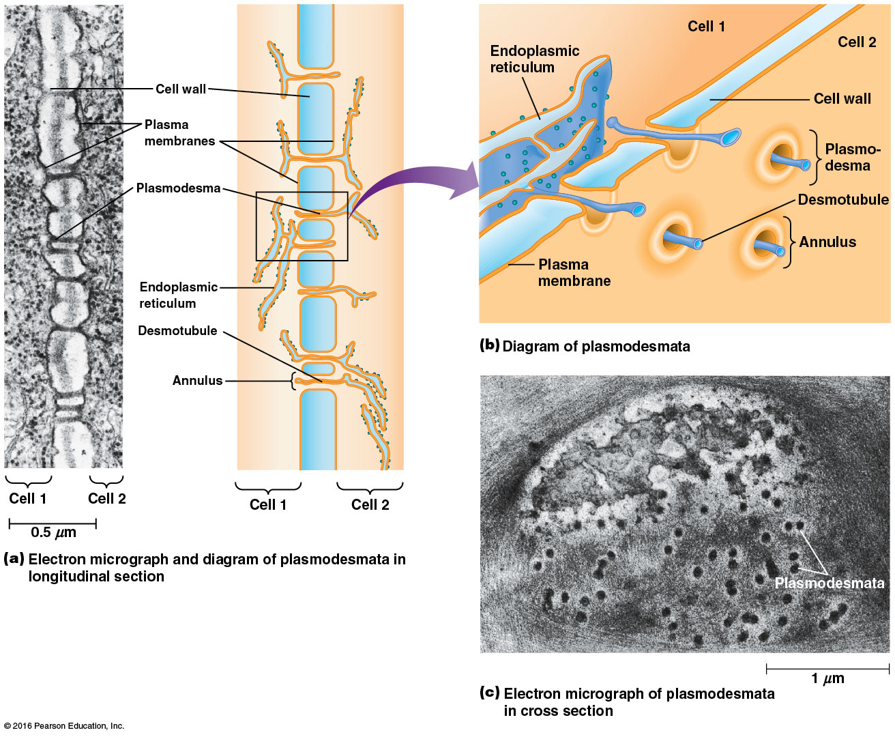

Slide 106
Cytoplasmic Continuity
The annulus is thought to provide the cytoplasmic continuity between adjacent cells, allowing molecules to pass freely from one cell to the next
Most plasmodesmata are formed at the time of cell division while the new wall is being formed
Plasmodesmata function like gap junctions

