Slide 1
Data dictionary
Chapter 8

Slide 2
data dictionary
A data dictionary is a collection of descriptions of the data objects (attributes)or items in a data model for the benefit of programmers and others who need to refer to them.
Is a reference work of data about data (metadata)
• It is where the systems analyst goes to define or look up information about entities, attributes and relationships on the ERD (Entity Relationship Design).

Slide 3
Importance of a Data Dictionary
• Avoid duplication
• Allows better communication between organizations who shares the same database.
• Makes maintenance straightforward
• Enables one description of a data item to be stored and accessed by all individuals so that definition for a data item is established and used.

Slide 4
Uses of Data Dictionary
1- Validates the date flow diagram for completeness and accuracy
2- Provides starting point for developing screen and reports.
3- Determine the contents of data files. (tables)

Slide 5
Defining Elements
Data elements (attributes) should be defined with descriptive information, length and type of data information, validation criteria, and default values.
Each element should be defined once in the data dictionary.

Slide 6
Defining Elements
Attributes of each element are
1-The name of the element, descriptive and unique. It should be what the element is commonly called in most programs or by the major user of the element.
2-The data type , either numeric, date, alphabetic or alphanumeric. Formats depend on how the data will be used, such as Currency, Number, or Scientific

Slide 7
Defining Elements
3- Caption: A short description of the element
Whether the element is base or derived
A base element is one that has been initially keyed into the system
A derived element is one that is created by a process, usually as the result of a calculation or some logic

Slide 8
Defining Elements
4-The length of an element (field size)
This should be the stored length of the item
The length used on a screen or printed lengths may differ.
What should the element length be?
Some elements have standard lengths, such as a id number or telephone number
For other elements, the length may vary and the analyst and user community must decide the final length.

Slide 9
Determining Element Length
Numeric amount lengths should be determined by figuring the largest number the amount will contain and then allowing room for expansion
Totals should be large enough to accommodate the numbers accumulated into them
It is often useful to sample historical data to determine a suitable length.
5- sample data: an actual value for the attribute.

Slide 10
6- Notes: if the attribute has default values (checkbox , radio or lists ).
* a special validation rules for the attribute, specified for programmers.

Slide 11
Example-1
Example DATA DICTIONARY
Table Name : Account
Column Name Column Type Column Size in Bytes Constraints
Account_Id numeric 6 Identify
Customer_code varchar 8 NULL
Address_Id numeric 6 NULL
Name varchar 50 NOT NULL
Logon_Name char 20 NOT NULL
Activation_Date smalldatetime 4 NOT NULL
Default_location int 4 NULL
Tax_code char 2 NOT NULL
Suspended bit 1 NOT NULL
Phone_Number varchar 30 NULL
Time_stamp timestamp 8 NOT NULL
Total Size of row in bytes 139

Slide 12
Example-2 Table-name : student_table
P/F | FIELD NAME | CAPTION | DATA TYPES | FIELD SIZE | SAMPLE DATA | NOTES
P | ST_NUM | STUDENT NUMBER | NUMERIC OR INTEGER | 8 | 25836977
 | GENDER | STUDENT GENDER | CHAR | 1 | F OR M | F- FEMALE M - MALE
 | ……

Slide 13
Example-3

Slide 14
Process Description Tools
A process description documents the details of a functional primitive, which represents a specific set of processing steps and business logic.
Methods:
A- structured English
B- decision tables
C- decision trees
Scenario

Slide 15
A- Structured English
is the use of the English language with the syntax of structured programming to communicate the design of a computer program to non-technical users by breaking it down into logical steps using straightforward English words.
Modified form of English used to specify the logic of information processes
Use a limited vocabulary, including standard terms used in the data dictionary and specific words that describe the processing rules

Slide 16
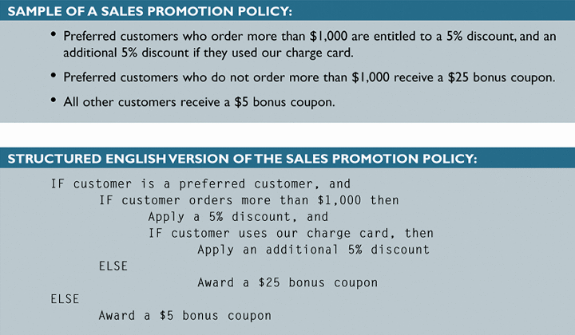
Structured English
Might look familiar to programming students because it resembles pseudocode

Slide 17
B- Decision Tables
Definition : A matrix representation of the logic of a decision (rows and columns), which specifies the possible conditions for the decision and the resulting actions. It consists of four parts:
1- conditions: the list of conditions relevant to the decision.
2-actions the list of the actions that result for a given set of conditions.
3-condition alternatives
4- action entries.

Slide 18
Use a Decision Table to:
• show sets of conditions and the actions resulting from them when the logic can be easily expressed in a table format, for example, calculating discount rates,
verify completeness and consistency of a process involving different actions under different conditions.
Decision Tables consists of 4 parts:
Condition statements Condition Entries
Action statements Action Entries

Slide 19
Example
Company X sells merchandise to wholesale and retail outlets. Wholesale customers receive a two percent discount on all orders. The company also encourages both wholesale and retail customers to pay cash on delivery by offering a two percent discount for this method of payment. Another two percent discount is given on orders of 50 or more units. Each column represents a certain type of order.

Slide 21
C- Decision trees
Definition: A graphical representation of a decision situation in which decision situation points are connected together by arcs and end with the ovals shape the action that is the result of all of the decisions made on the path leading to that oval.
It is useful to distinguish between conditions and actions when drawing decision trees.

Slide 22
Process Description Tools
Decision Tables

Slide 23
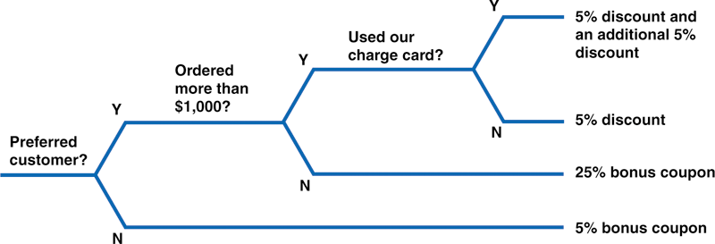
Process Description Tools
Decision Trees

Slide 24
scenario
scenario describes a real-world example of how one or more people or organizations interact with a system.
They describe the steps, events, and/or actions which occur during the interaction.
Scenarios may be related to ‘use cases’, which describe interactions at a technical level.
scenarios can be understood by people who do not have any technical background.

Slide 25
How do you write scenarios?
To write a scenario, you need a basic understanding of the tasks to be supported by the system.
You also need to have an understanding of the users and the context of use.
you can write scenarios based on prior knowledge or even ‘best guess’, provided the scenarios will be subject to review by users prior to being used as a basis for making design decisions.
To write a scenario, describe in simple language the interaction that needs to take place.
It is important to avoid references to technology, except where the technology represents a design constraint that must be acknowledged.

Slide 26
High-Level Example-1
Scenario: ATM banking for the week.
Sally Jones places her bank card into the ATM.
Sally successfully logs into the ATM using her personal identification number.
Sally deposits her weekly pay check of $350 into her savings account.
Sally pays her phone bill of $75, her electric bill of $145, her cable bill of $55, and her water bill of $85 from her savings account
Sally attempts to withdraw $100 from her savings account for the weekend but discovers that she has insufficient funds
Sally withdraws $40 and gets her card back

Slide 27
EXAMPLE-2
Scenario: PLACING PRODUCTS ORDER
USER LOGS into the system
User clicks on placing order choice [displayed on screen]
User clicks on the product name
The system displays quantity in store
User clicks in provider name [all providers for this product are displayed]
User selects one of the providers
User clicks in the quantity field
User enters the quantity
User clicks in submit
A new screen is shown, showing todays’ date, provider name , product name , quantity and a confirmation button and a cancel button
User reviews the information shown and either clicks cancel or confirm
If the user clicks confirm, he receives a message confirming that the order is sent

