Slide 1
Inter-symbol interference ISI
Up to this moment we have studied the effect of AWGN on baseband pulse transmission
The next source of bit error in baseband pulse transmission is the ISI which will be considered in details in this section

Slide 2
Inter-symbol Interference
For the input data stream:
The channel output is the superposition of each bit’s output:
1
0
1
1
0
1
Resultant Channel Output Waveform
1
0
1
1
0
1

Slide 3
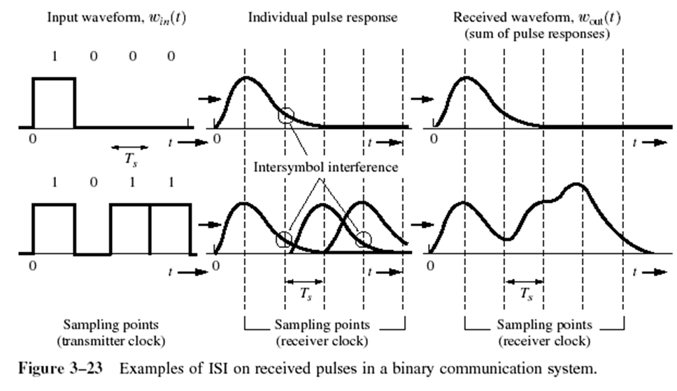
Inter-symbol interference ISI
If the rectangular multilevel pulses are filtered improperly as they pass through a communications system, they will spread in time, and the pulse for each symbol may be smeared into adjacent time slots and cause Intersymbol Interference.

Slide 4
General model of digital communication system
Consider the general model for the digital communications shown below
As the input binary data travels from the transmitter to the receiver it passes through three filters, transmit filter $g(t)$, channel $h(t)$ and the receive filter $c(t)$

Slide 5
Received signal formula
The receiver filter output $y(t)$ is given by $y\left(t\right)=μ\sum_{k}{a_{k}p(t−kT_{b})}+n(t)$
Where $μ$ is a scaling factor and $p(t)$ represent the overall system impulse response which is given by $μp\left(t\right)=g\left(t\right)∗h\left(t\right)∗c\left(t\right)$

Slide 6
Frequency response $P(f)$
We assume that the system impulse response is normalized by setting $P(0)=1$
The overall system impulse response in frequency domain can be found by taking the Fourier transform of $μp\left(t\right)$ which results in $μP\left(f\right)=G\left(f\right)H\left(f\right)C(f)$

Slide 7
Principle of operation of the receiver
The receiver filter output $y(t)$ is sampled at time $t_{i}=iT_{b}$, therefore
$$y\left(t_{i}\right)=μ\sum_{k=−∞}^{∞}{a_{k}p[\left(i−k\right)T_{b}]}+n(t_{i})$$
$$y\left(t_{i}\right)=μa_{i}+μ\sum_{\begin{matrix}k=−∞ \\ k≠i\end{matrix}}^{∞}{a_{k}p[\left(i−k\right)T_{b}]}+n(t_{i})$$

Slide 8
Principle of operation of the receiver
The term $μa_{i}$ represent the contribution of the $ith$transmitted bit (desired bit)
The term
$$μ\sum_{\begin{matrix}k=−∞ \\ k≠i\end{matrix}}^{∞}{a_{k}p[\left(i−k\right)T_{b}]}$$
represent the residual effect of all other transmitted bits (ISI) on the decoding of the $ith$ bit
In the absence of both ISI and noise, the sampled output will be only $y\left(t_{i}\right)=μa_{i}$

Slide 9
Situation where only the ISI will be considered and AWGN can be neglected
When the signal to noise ratio is high, as in the telephone system, the operation of the system is largely limited by ISI rather than AWGN noise

Slide 10
Nyquist’s criterion for distortion less base band binary transmission
In order to eliminate the ISI completely we need the residual effects from all symbols on the $ith$ symbol to be zero at the sampling instant
Also we need the output of the sampler to be $y\left(t_{i}\right)=μa_{i}$ at he sampling instant when $i=k$
This means that the term
$$p\left(iT_{b}−kT_{b}\right)=\left\{\begin{matrix}1, & i=k \\ 0, & i≠k\end{matrix}\right\}$$

Slide 11
Derivation of the system transfer function $P(f)$
If we take the Fourier transform of the previous equation, then we have $P_{δ}(f)=R_{b}\sum_{n=−∞}^{∞}{P(f−nR_{b})}$
The Fourier transform $P_{δ}\left(f\right)$of an infinite periodic sequence of delta functions of period $T_{b}$, whose individual areas are weighted by the respective sample values of $p(t)$ Is given by

Slide 12
Fourier transform of $P_{δ}(f)$
$$P_{δ}\left(f\right)=\int_{−∞}^{∞}{\sum_{m=−∞}^{∞}{\left[p(mT_{b})δ(t−mT_{b})\right]e^{−j2πft}}dt}$$
Where $m=i−k$
When $i=k\underset{→}{\text{yields}}m=0$, therefore
$$P_{δ}\left(f\right)=\int_{−∞}^{∞}{p(0)δ(t)e^{−j2πft}dt}=p(0)=1$$

Slide 13
Fourier transform of $P_{δ}(f)$
When $i≠k\underset{→}{\text{yields}}m≠0$, therefore $p(0)=0$ which means that
$$P_{δ}\left(f\right)=\int_{−∞}^{∞}{\sum_{m=−∞}^{∞}{\left[p(mT_{b})δ(t−mT_{b})\right]e^{−j2πft}}dt}=0$$

Slide 14
The final equation to obtain $P(f)$
Now the system transfer function $P(f)$ can be derived from the equation presented in slide 9
$$P_{δ\left(f\right)}=R_{b}\sum_{n=−∞}^{∞}{P(f−nR_{b})}=1$$
$$\sum_{n=−∞}^{∞}{P(f−nR_{b})}=T_{b}$$

Slide 15
Ideal Nyquist channel
The Nyquist criterion for distortion-less baseband transmission in the absence of AWGN noise states that the frequency function $P(f)$ of the channel eliminates inter-symbol interference for samples taken at intervals $T_{b}$ provided that it satisfies
$$\sum_{n=−∞}^{∞}{P(f−nR_{b})}=T_{b}$$

Slide 16
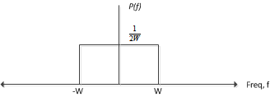
Ideal Nyquist channel
In order to satisfy the equation, $\sum_{n=−∞}^{∞}{P(f−nR_{b})}=T_{b}$, the frequency function $P(f)$ must be in the form of a rectangular function given by
$$P\left(f\right)=\left\{\begin{matrix}\frac{1}{2W}, & −W<f<W \\ 0, & \left|f\right|>W\end{matrix}\right\}$$
Or $P\left(f\right)=\frac{1}{2W}Rect\left(\frac{f}{2W}\right)$

Slide 17
Ideal Nyquist channel
The overall system bandwidth $W$ appears in $P(f)$ equation is defined as
$$W=\frac{R_{b}}{2}=\frac{1}{2T_{b}}$$
The special value of the bit rate $R_{b}=2W$ is called the Nyquist rate and $W$is called the Nyquist bandwidth

Slide 18
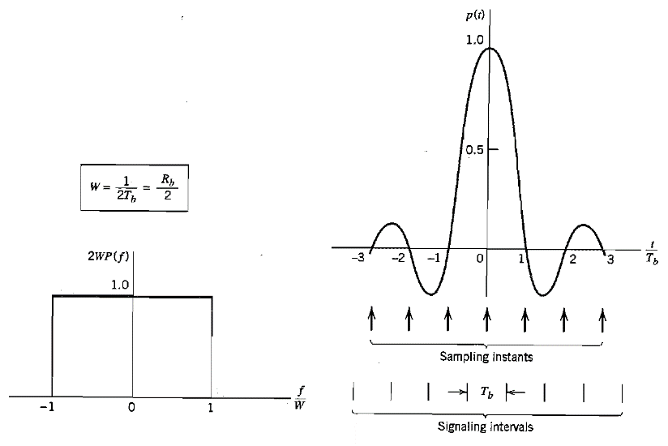
Ideal Nyquist channel
The system impulse response
$$p(t)=sinc(2Wt)$$
which can be obtained by taking the inverse Fourier transform of $P(f)$

Slide 19
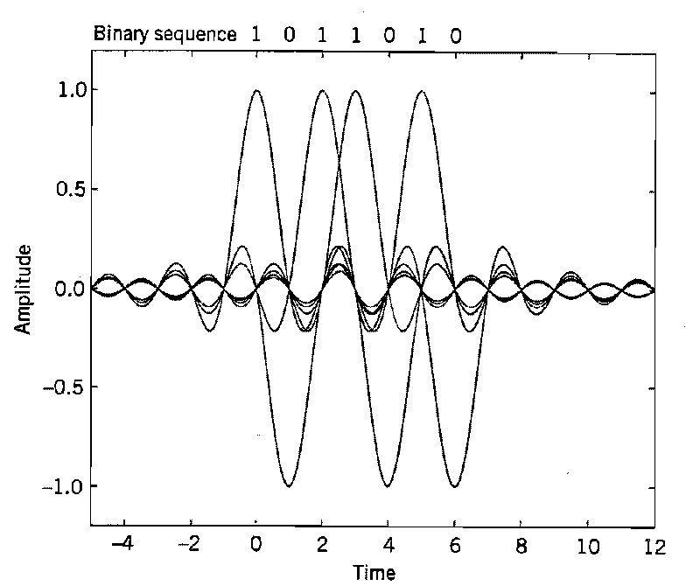
If digital binary bits are passed through a pulse shape filter, all the bits takes $μp\left(t−iT_{b}\right)=sinc2W$ then the received samples at $t=iT_{b}$ are ISI free as shown below

Slide 20
Practical difficulties in ideal Nyquist channel
There are two practical difficulties that make it undesirable objective for system design
It require an ideal low pass filter characteristics in frequency domain which is physically impossible
The function $p(t)$ decreases as $\frac{1}{\left|t\right|}$ for large $t$which results in slow decay rate of the side lobes (tails)

Slide 21
Practical difficulties in ideal Nyquist channel
If there is a small timing error (called jitter error) between the transmitter and the receiver, this will results in a significant ISI interference which may leads to errors in the decoded bits at the receiver
The more practical solution is to design the channel transfer function $P(f)$ based on the raised cosine spectrum which is discussed next

Slide 22
Raised cosine spectrum
In the raised cosine, the frequency response of the channel $P(f)$ is designed according to
$$P\left(f\right)=\left\{\begin{matrix}\frac{1}{2W} & 0≤\left|f\right|≤f_{1} \\ \frac{1}{4W}\left\{1−sin\left[\frac{π(\left|f\right|−W}{2W−2f_{1}}\right]\right\} & f_{1}≤\left|f\right|≤2w−f_{1} \\ 0 & \left|f\right|≥2W−f_{1}\end{matrix}\right\}$$

Slide 23
Raised cosine
The frequency parameter $f_{1}$ and the bandwidth $W$ are related by
$$α=1−\frac{f_{1}}{W}$$
The parameter $α$ is called the roll off factor
The roll factor indicates the excess bandwidth over the ideal Nyquist bandwidth $W$

Slide 24
Raised cosine
The transmission bandwidth, $B_{T}$, is defined by $B_{T}=2W−f_{1}=W(1+α)$
If $α=0$, then the transmission bandwidth is $B_{T}=W$ which is the Nyquist bandwidth
If $α=1$, then the transmission bandwidth is $B_{T}=2W$ which is equal twice the Nyquist bandwidth
If $α>0$, then transmission has to be at a lower bit rate to avoid ISI

Slide 25
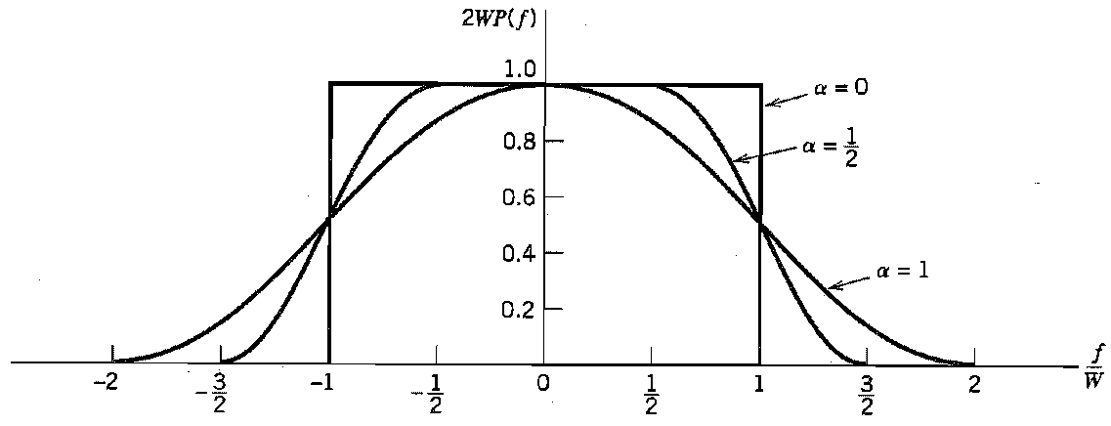
Graphical representation of the channel transfer function $P(f)$
The frequency response $P(f)$ normalized by multiplying it by $2W$is shown below for different values of the roll off factor $α$

Slide 26
The time domain( impulse response) $p(t)$ of the raised cosine function
The impulse (time) response $p(t)$ is obtained by taking the inverse Fourier transform of the frequency response $P(f)$
$$p(t)=sinc(2Wt)\left(\frac{cos⁡(2παWt)}{1−16α^{2}W^{2}t^{2}}\right)$$
The $p(t)$ function is plotted in graphically in the next slide

Slide 27
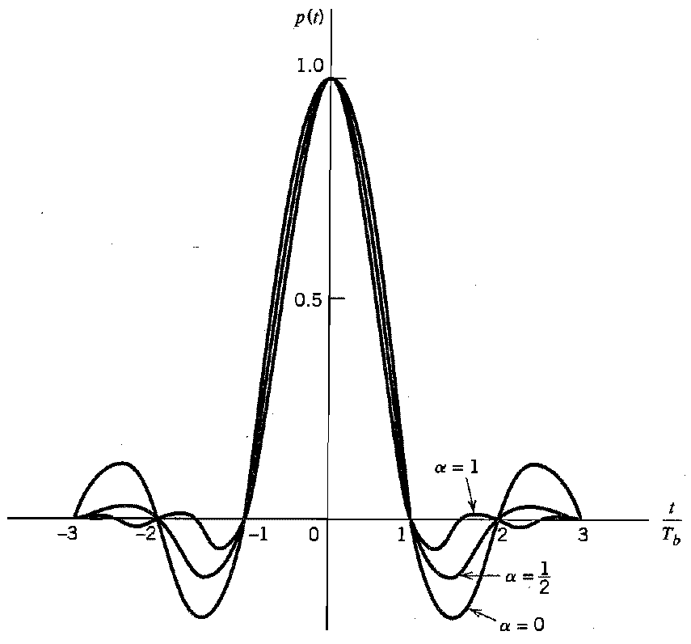
Graphical representation of the channel impulse response $p(t)$

Slide 28
Notes about $p(t)$
The time response $p(t)$ consists of the product of two factors
$Sinc(2Wt)$ which ensures the zero crossing of $p(t)$ at the desired sampling instant $t=iT_{b}$
$\left(\frac{cos⁡(2παWt)}{1−16α^{2}W^{2}t^{2}}\right)$ reduces the tails of the pulses considerably below that obtained from the ideal Nyquist channel ($decay rate=\frac{1}{{\left|t\right|}^{2}} compared to \frac{1 }{t}$for ideal Nyquist channel)

Slide 29
Notes about $p(t)$
The special case with $α=1$ is known as the full cosine rolloff characteristics
Under this condition the transmission bandwidth is given by $BW=\frac{R_{b}}{2}\left(1+1\right)=R_{b}$

Slide 30
Summery
ISI is a major source of bit error which degrades the communication system performance
ISI occurs due to the dispersive nature of the communication channel
ISI can be eliminated by transmitting the symbols (bits) at a rate equals the Nyquist rate $R_{b}=2W$ in an ideal Nyquist channel, where $W is the channel bandwdith$

Slide 31
Summery
A pulse shape filter can be used in the transmitter to reshape the pulses before the bits are transmitted
A commonly used filter is the raised cosine filter
The raised cosine filter overcome the practical difficulties associated with the ideal Nyquist channel on the expense of requiring extra bandwidth for transmission
The transmission bandwidth of the raised cosine equalized channel is
$$\begin{matrix}BW=\frac{R_{b}}{2}\left(1+α\right) & 0≤ α≤1\end{matrix}$$
The transmission bandwidth must be less than or equal to the channel bandwidth

Slide 32
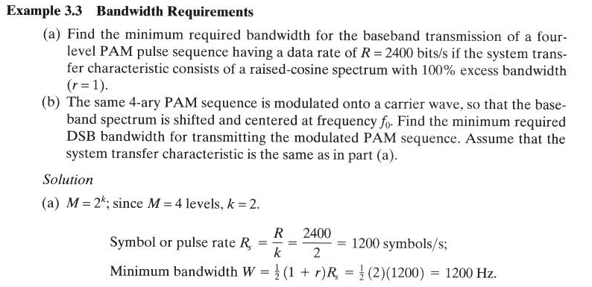
Example 1

Slide 33
Example 1
The bandwidth required for double side modulated carrier is given by
$BW=2f_{m}=2∗1200=2400 Hz$

Slide 34
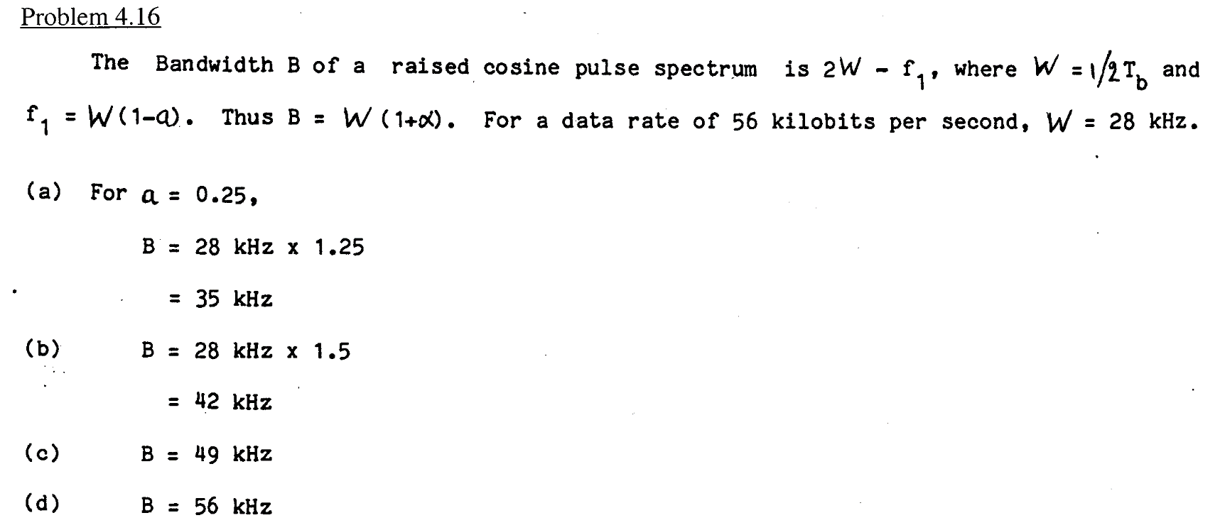
Example 2

Slide 35
Example 3

Slide 36
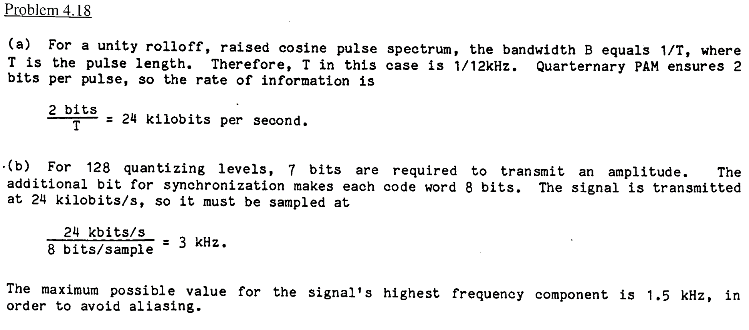
Example 3

