Slide 1
Chapter 7
Membranes: Their Structure, Function, and Chemistry

Slide 2
Membranes: Their Structure, Function, and Chemistry
Membranes define the boundaries of a cell and its internal compartments
Membranes play multiple roles in the life of a cell

Slide 3
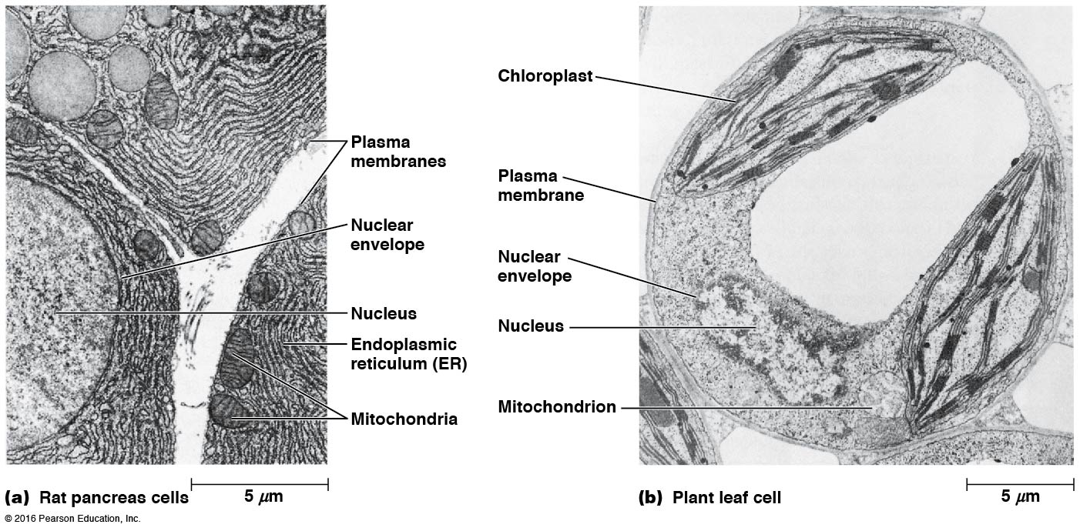

Slide 4
7.1 The Functions of Membranes
Define boundaries of a cell and organelles and act as permeability barriers
Serve as sites for biological functions, such as electron transport
Possess transport proteins that regulate the movement of substances into and out of cells and organelles

Slide 5
The Functions of Membranes (continued)
Contain protein molecules that act as receptors to detect external signals
Provide mechanisms for cell-to-cell contact, adhesion, and communication

Slide 6
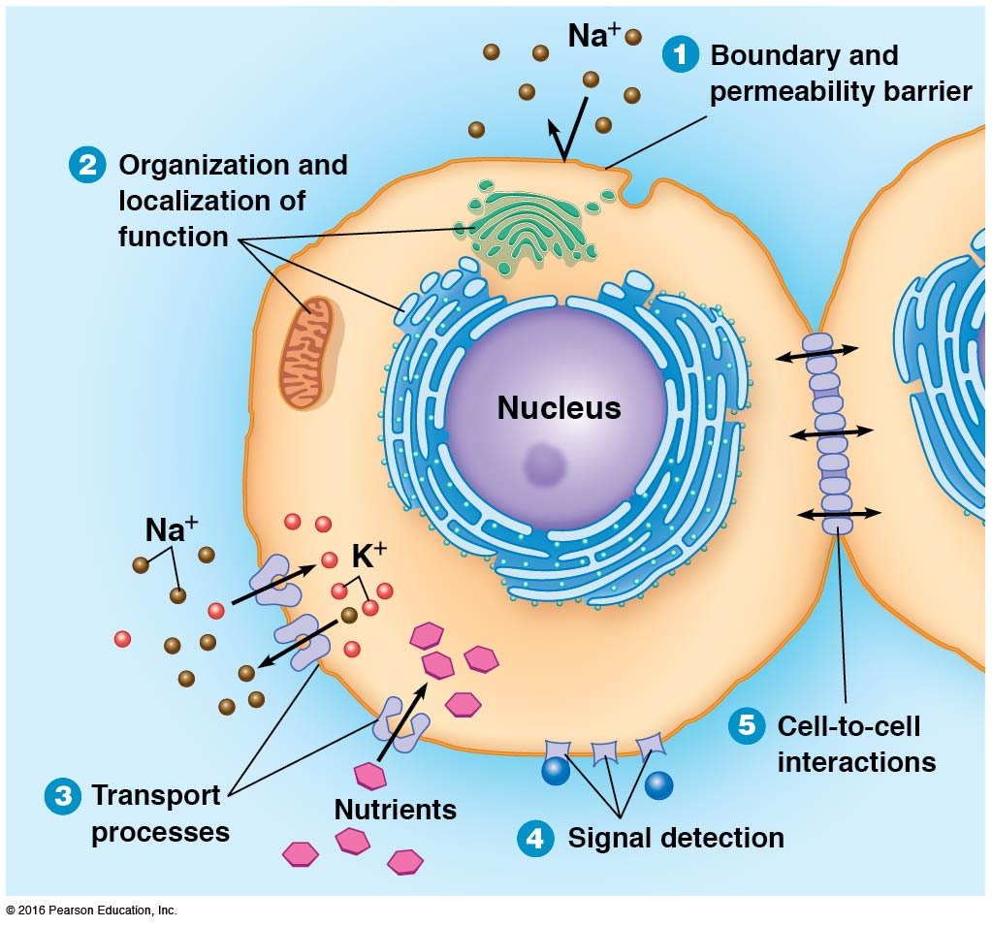

Slide 7
Membranes Define Boundaries and Serve as Permeability Barriers
Membranes define boundaries of the cell and its components
They are effective permeability barriers because their interior is hydrophobic
The plasma membrane surrounds the whole cell, whereas intracellular membranes compartmentalize functions within the cell

Slide 8
Membranes Are Sites of Specific Proteins and Therefore of Specific Functions
Membranes are associated with specific functions because the molecules responsible for the functions are embedded in or localized on membranes
The specific enzymes associated with particular membranes can be used to characterize a specific membrane

Slide 9
Membrane Proteins Regulate the Transport of Solutes
Membrane proteins carry out and regulate the transport of substances across the membrane
Cells and organelles take up nutrients, ions, gases, water, and other substances, and they expel products and wastes
Some substances diffuse directly across membranes, whereas others must be moved by specific transporters

Slide 10
Membrane Proteins Detect and Transmit Electrical and Chemical Signals
A cell receives information from its environment as electrical or chemical signals at its surface
Signal transduction describes the mechanisms by which signals are transmitted from the outer surface to the interior of a cell
Chemical signal molecules usually bind to membrane proteins, known as receptors, on the outer surface of the plasma membrane

Slide 11
Signal Transduction
Binding of signal molecules to their receptors triggers chemical events on the inner membrane surface that ultimately lead to changes in cell function
Membrane receptors allow cells to recognize, transmit, and respond to a variety of specific signals in nearly all types of cells

Slide 12
Membrane Proteins Mediate Cell Adhesion and Cell-to-Cell Communication
Most cells in multicellular organisms are in contact with other cells
Cell-to-cell contacts, critical in animal development, are often mediated by cadherins
Cadherins have extracellular sequences of amino acids that bind calcium and promote adhesion between similar types of cells in a tissue

Slide 13
Other Types of Junctions Between Cells in Animal Tissues
Adhesive junctions hold cells together
Tight junctions form seals that block the passage of fluids between cells
Gap junctions allow for communication between adjacent animal cells
In plants, plasmodesmata perform a similar function

Slide 14
7.2 Models of Membrane Structure: An Experimental Approach
The fluid mosaic model is thought to be descriptive of all biological membranes
The model envisions a membrane as two fluid layers of lipids with proteins within and on the layers
Many important experiments led to understanding of membrane structure and function

Slide 15
Overton and Langmuir: Lipids Are Important Components of Membranes
In the 1890s, Charles Overton observed the easy penetration of lipid-soluble substances into cells and concluded that the cell surface had some kind of lipid “coat” on it
Irving Langmuir studied phospholipids and found that they were amphipathic; he reasoned that they must orient on water, with the hydrophobic tails away from the water

Slide 16
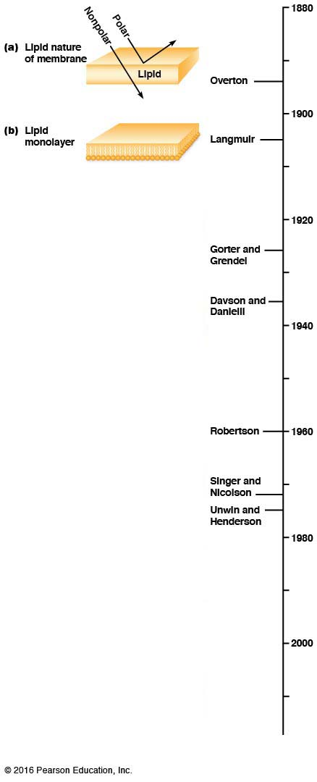

Slide 17
Gorter and Grendel: The Basis of Membrane Structure Is a Lipid Bilayer
In 1925, these two physiologists extracted lipids from red blood cells and spread the lipids in a monolayer on a water surface
The film on the water was twice the surface area of the blood cells, suggesting that lipids on the cell surface consisted of two layers
They suggested that the most favorable structure would be a lipid bilayer, with the nonpolar regions of the lipids facing inward

Slide 18
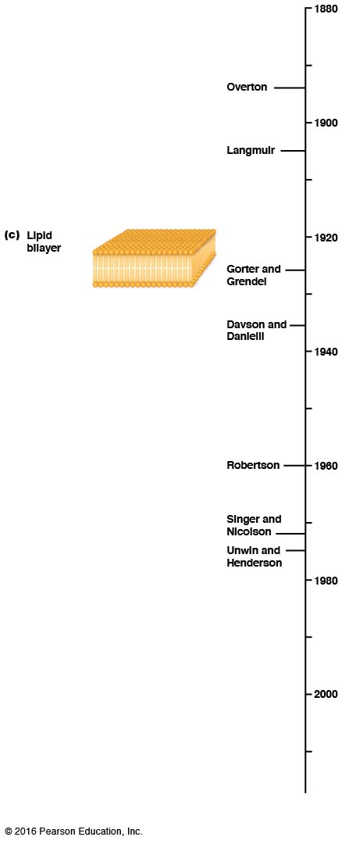

Slide 19
Davson and Danielli: Membranes Also Contain Proteins
Hugh Davson and James Danielli showed that the bilayer alone could not account for all properties of membranes, especially
Surface tension
Solute permeability
Electrical resistance
They suggested that proteins are present in membranes, as thin sheets, coating the lipids

Slide 20
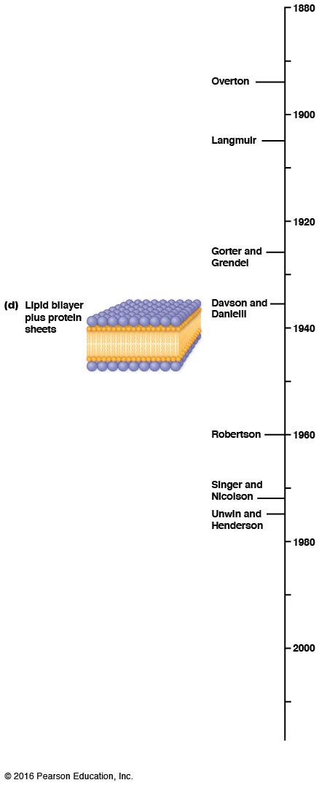

Slide 21
Robertson: All Membranes Share a Common Underlying Structure
Using electron microscopy, biologists could verify the presence of membranes around cells and organelles
A trilaminar structure, visible under the TEM, was observed for all membranes, leading to the suggestion of a common membrane structure, called the unit membrane

Slide 22
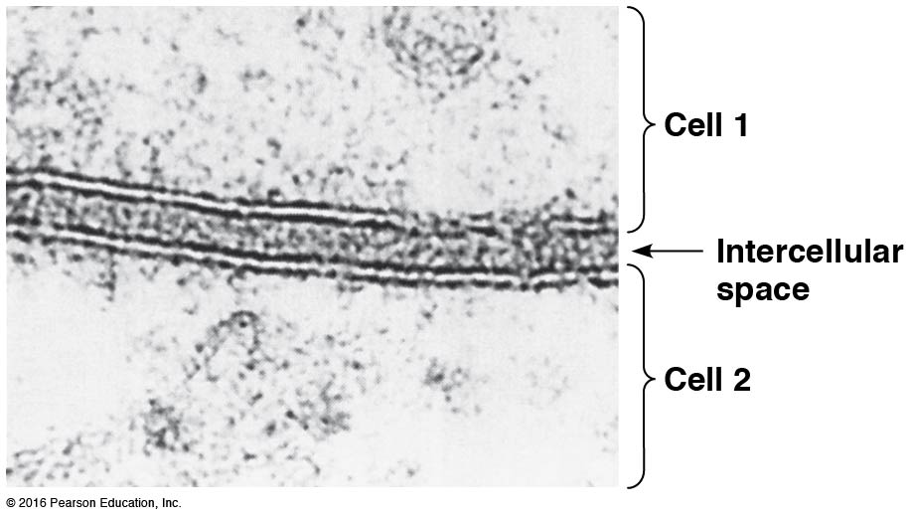

Slide 23
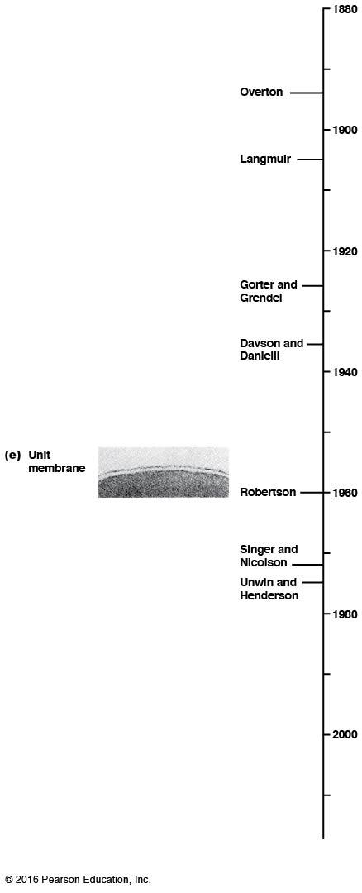

Slide 24
Further Research Revealed Major Shortcomings of the Davson–Danielli Model
Electron microscopy revealed that there was not enough space on either side of the bilayer for an additional layer of protein
The Davson–Danielli model also did not account for the chemical distinctiveness of particular types of membranes, especially the protein/lipid ratio

Slide 25
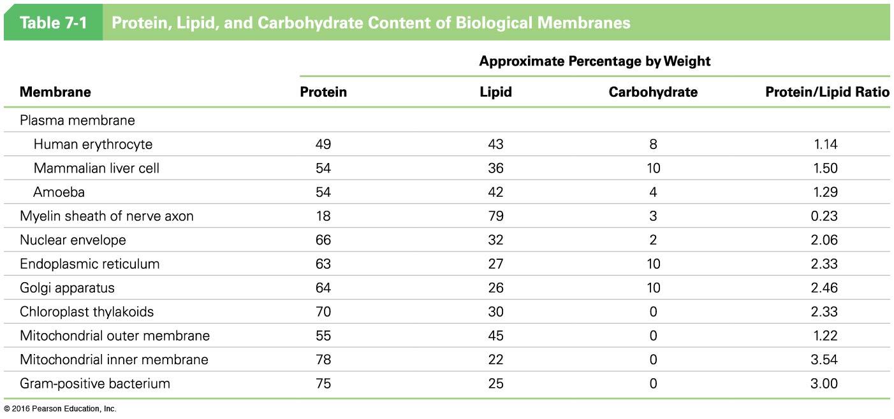

Slide 26
Additional Challenges to the Davson–Danielli Model
Membranes are susceptible to digestion by phospholipases, suggesting that membrane lipids are exposed
Scientists were unable to isolate “surface” proteins from membranes unless organic solvents or detergents were used

Slide 27
Singer and Nicholson: A Membrane Consists of a Mosaic of Proteins in a Fluid Lipid Bilayer
The fluid mosaic bilayer model accounts for all the inconsistencies with previous models
The model has two key features
A fluid lipid bilayer
A mosaic of proteins attached to or embedded in the bilayer

Slide 28
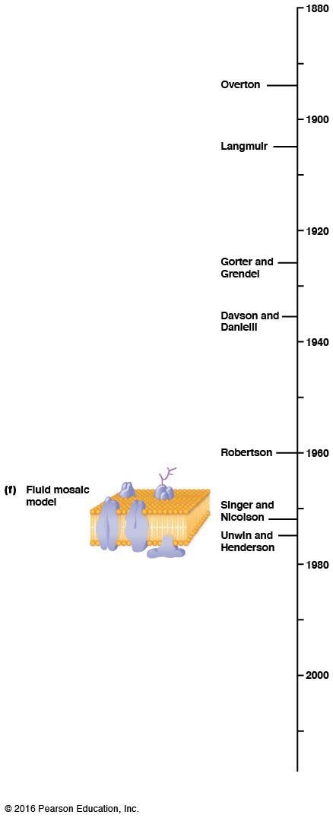

Slide 29
Unwin and Henderson: Most Membrane Proteins Contain Transmembrane Segments
Most integral membrane proteins have one or more hydrophobic segments that span the lipid bilayer
These transmembrane segments anchor the protein to the membrane
Bacteriorhodopsin was the first membrane protein shown to possess this structural feature

Slide 30
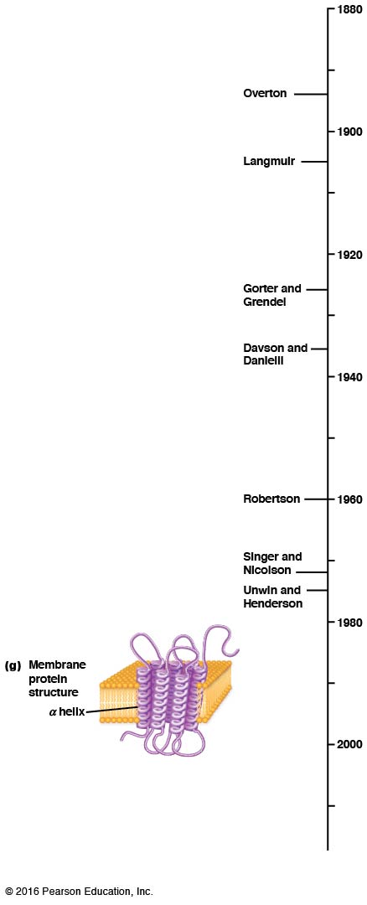

Slide 31
Recent Findings Suggest Membranes Are Organized into Microdomains
Membranes are
Not homogenous, freely mixing structures
Ordered through dynamic microdomains called lipid rafts
Most cellular processes that involve membranes depend on structural complexes of specific lipids and proteins

Slide 32
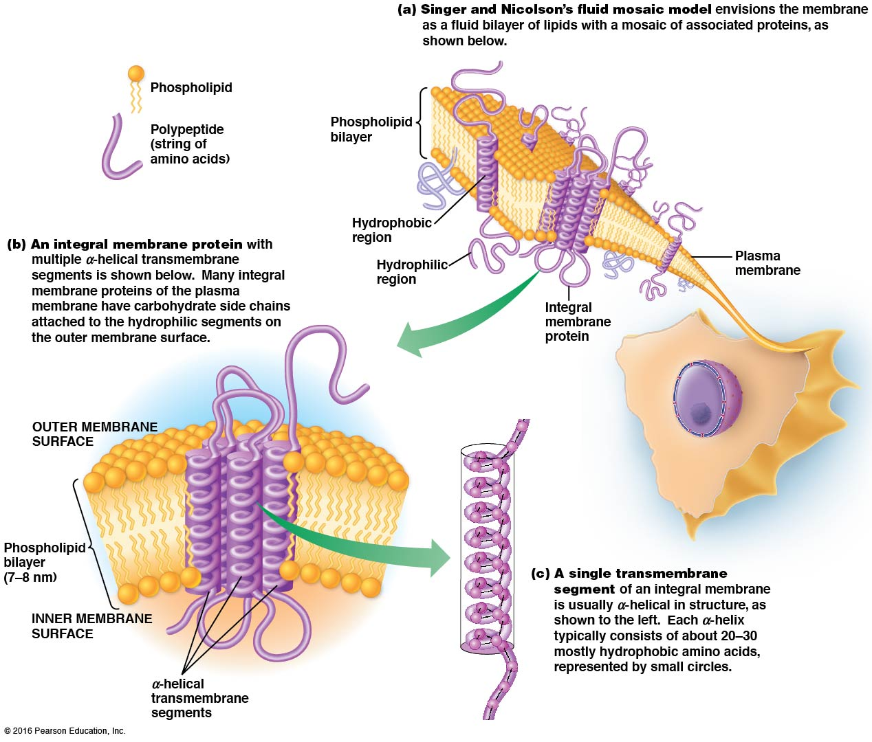

Slide 33
7.3 Membrane Lipids: The “Fluid” Part of the Model
Membrane lipids are important components of the “fluid” part of the fluid mosaic model
Membranes contain several types of lipids

Slide 34
Membranes Contain Several Major Classes of Lipids
The fluid mosaic model of membrane structure retains the lipid bilayer of earlier models
However, there is a greater diversity and fluidity of lipids than originally thought
The main classes of membrane lipids are phospholipids, glycolipids, and sterols

Slide 35
Phospholipids
Phospholipids are the most abundant lipids in membranes
They include the glycerol-based phosphoglycerides and the sphingosine-based sphingolipids
The kinds and relative proportions of phospholipids vary greatly among types of membranes

Slide 37
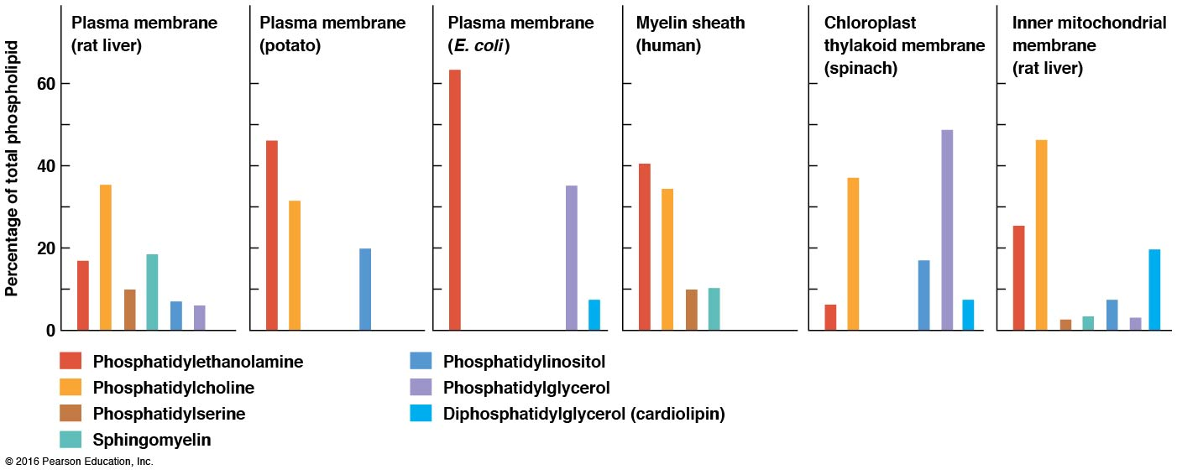

Slide 38
Video: Space-filling Model of Phosphatidylcholine

Slide 39
Glycolipids
Glycolipids are formed by the addition of carbohydrates to lipids
Some are glycerol based (the glycoglycerolipids), and some are sphingosine based (the glycosphingolipids)
The most common glycosphingolipids are cerebrosides and gangliosides

Slide 40
Cerebrosides and Gangliosides
Cerebrosides are neutral glycolipids; each molecule has an uncharged sugar as its head group
A ganglioside has an oligosaccharide head group with one or more negatively charged sialic acid residues
Cerebrosides and gangliosides are especially prominent in brain and nerve cells

Slide 42
Sterols
The membranes of most eukaryotes contain significant amounts of sterols
The main sterol in animal cell membranes is cholesterol, which is needed to stabilize and maintain membranes
Plant cell membranes contain small amounts of phytosterols, whereas fungal cell membranes contain ergosterol, similar to cholesterol

Slide 44
Activity: Membrane Structure—Part 1

Slide 45
Activity: Membrane Structure—Part 2

Slide 46
Fatty Acids Are Essential to Membrane Structure and Function
Fatty acids are components of all membrane lipids except the sterols
Their long hydrocarbon tails provide a barrier to diffusion of polar solutes
The sizes of membrane fatty acids range between 12 and 20 carbons long, which is optimal for bilayer formation and dictates the usual thickness of membranes (6–8 nm)

Slide 47
Fatty Acids Vary in Degree of Saturation
Fatty acids vary considerably in the presence and number of double bonds
Palmitate (16 carbons) and stearate (18 carbons) are common saturated fatty acids
Oleate (one double bond) and linoleate (two double bonds) are both 18-carbon unsaturated fatty acids

Slide 48
Polyunsaturated Fatty Acids
Polyunsaturated fatty acids have more than one double bond
Omega-3 fatty acids are polyunsaturated fatty acids that are essential for normal human development
They may also reduce the risk of heart disease

Slide 49
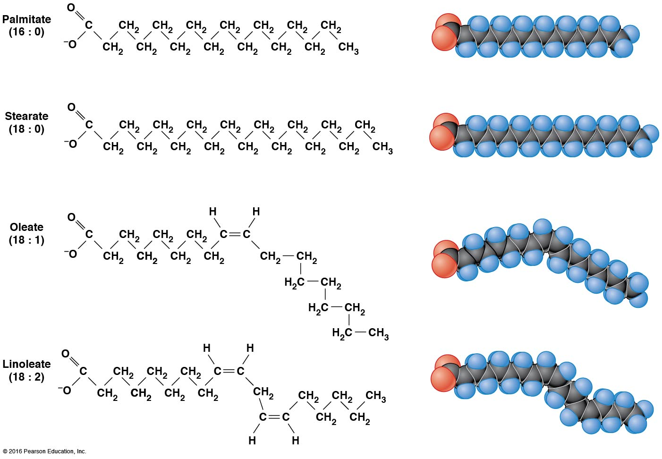

Slide 50
Thin-Layer Chromatography Is an Important Technique for Lipid Analysis
Lipids can be isolated, separated, and studied using nonpolar solvents such as acetone and chloroform
Thin-layer chromatography (TLC) is used to separate different kinds of lipids based on their relative polarities
A glass plate is coated with silicic acid, and lipids are spotted onto a position near the bottom of the plate called the origin

Slide 51
Principle of Separation of Lipids via TLC
A nonpolar organic solvent moves up the plate by capilary action, taking different lipids with it to varying degrees
Nonpolar lipids have little affinity for the silicic acid on the plate, so they move readily with the solvent, near the solvent front
Polar lipids will interact variably (depending on how polar they are) with the silicic acid, and their movement will be slowed proportionately

Slide 52
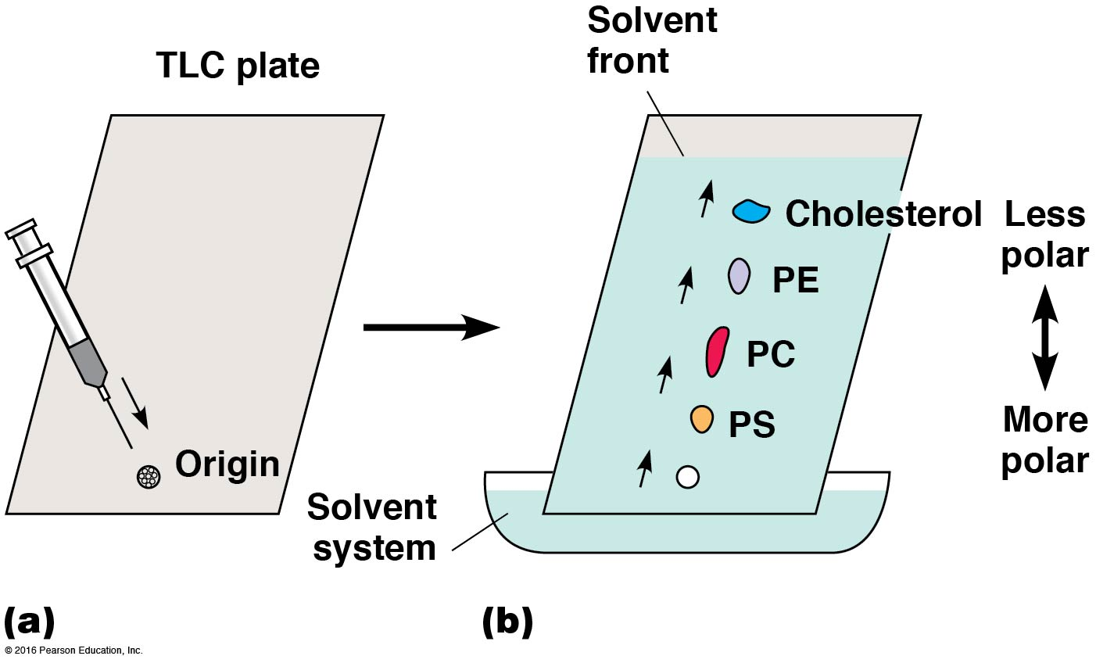

Slide 53
Membrane Asymmetry: Most Lipids Are Distributed Unequally Between the Two Monolayers
Membrane asymmetry is the difference between the monolayers regarding the kind of lipids present and the degree of saturation of fatty acids in the phospholipids
Most of the glycolipids in the plasma membrane of animal cells are in the outer layer
Membrane asymmetry is established during the synthesis of the membrane

Slide 54
Membrane Asymmetry Tends to Be Maintained
Once established, membrane asymmetry does not change much
The movement of lipids from one monolayer to another requires their hydrophilic heads to move all the way through the hydrophobic interior of the bilayer
This transverse diffusion (or “flip-flop”) is relatively rare

Slide 55
Lipids Move Freely Within Their Monolayer
Lipids are mobile within their monolayer
Rotation of phospholipids about their axes can occur
Phospholipids can also move within the monolayer, via lateral diffusion
Both types of movement are rapid and random

Slide 56
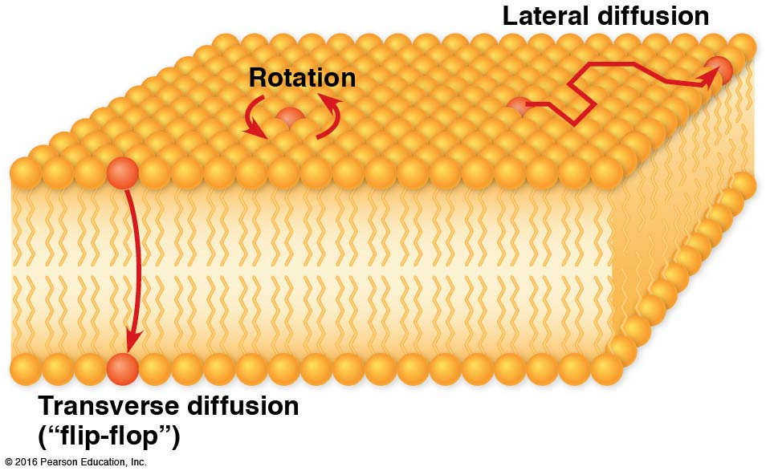

Slide 57
Transverse Diffusion Does Occur
Though rare, phospholipid flip-flop does occur in natural membranes
Some membranes, in particular the smooth ER membrane, have proteins that catalyze the flip-flop of membrane lipids
These proteins are called phospholipid translocators, or flippases

Slide 58
The Lipid Bilayer Is Fluid
The lipid bilayer behaves as a fluid that permits the movement of both lipids and proteins
Lipids can move as much as several μm per second within the monolayer
Lateral diffusion can be demonstrated using fluorescence recovery after photobleaching (FRAP)

Slide 59
Measuring Lipid Mobility with FRAP
Investigators label lipid molecules in a membrane with a fluorescent dye
A laser beam is used to bleach the dye in a small area, creating a dark spot on the membrane
The membrane is observed afterward to determine how long it takes for the dark spot to disappear, a measure of how quickly new fluorescent lipids move in

Slide 60
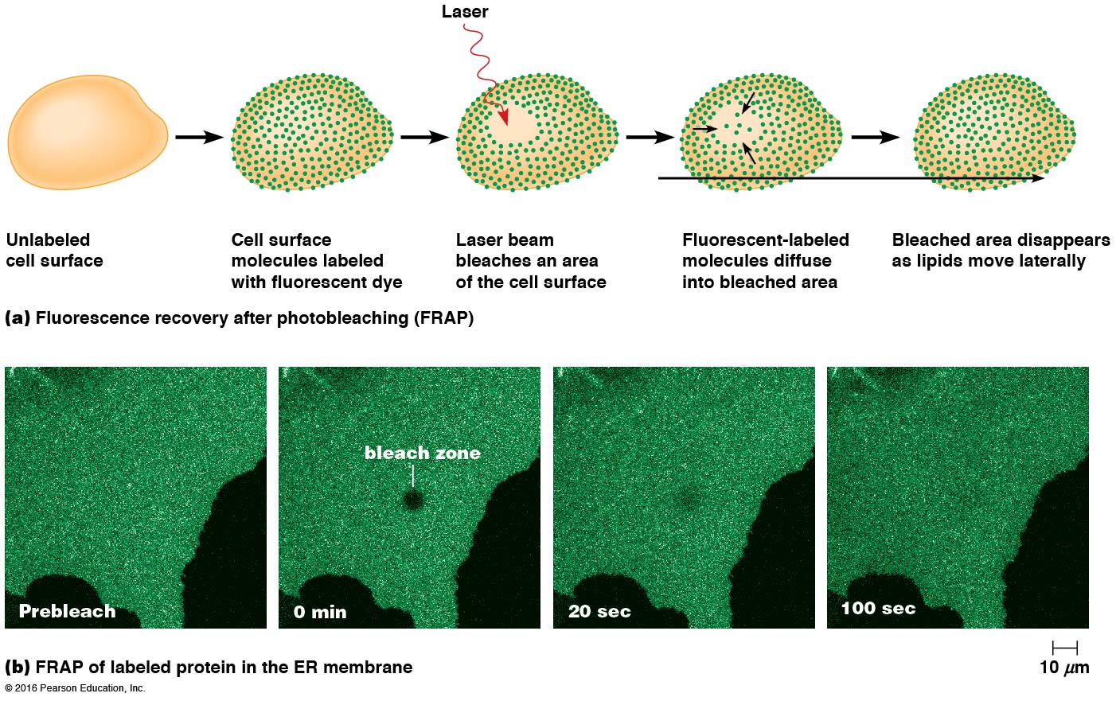

Slide 61
Membranes Function Properly Only in the Fluid State
Membrane fluidity changes with temperature, decreasing as temperature falls and vice versa
Every lipid bilayer has a characteristic transition temperature T_{m}, the temperature at which it becomes fluid
This change of state is called a phase transition, in this case from solid to liquid
Below the T_{m}, any functions that rely on membrane fluidity will be disrupted

Slide 62
Measuring the Transition Temperature of a Membrane
The transition temperature can be measured by differential scanning calorimetry
The membrane is placed inside a calorimeter, and the uptake of heat is measured as temperature is increased
The T_{m} is the point of maximum heat absorption as the membrane changes from the gel to the fluid state

Slide 63
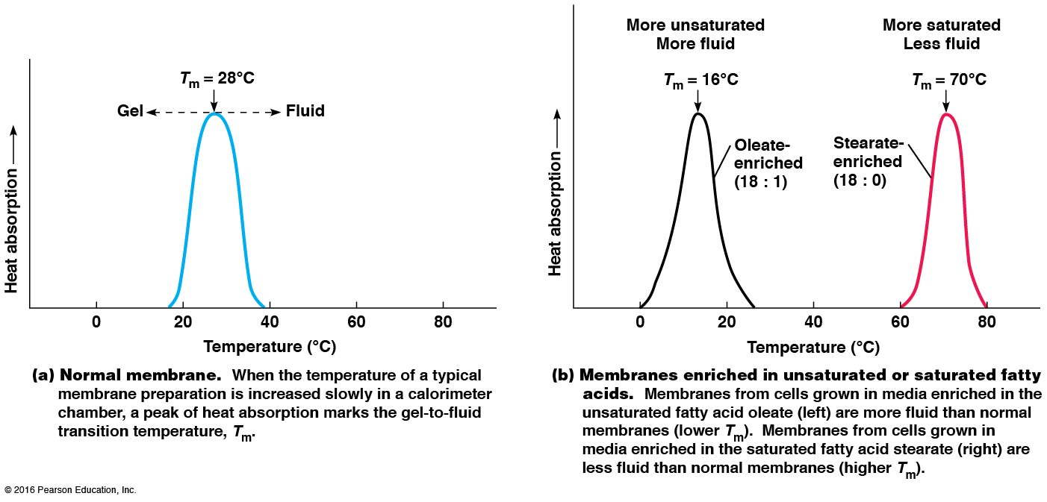

Slide 64
Effects of Fatty Acid Composition on Membrane Fluidity
Fluidity of a membrane depends mainly on the fatty acids that it contains
The length of fatty acid chains and the degree of saturation both affect the fluidity of the membrane
Long-chain and saturated fatty acids have higher T_{m} values, whereas short-chain and unsaturated fatty acids have lower T_{m} values

Slide 65
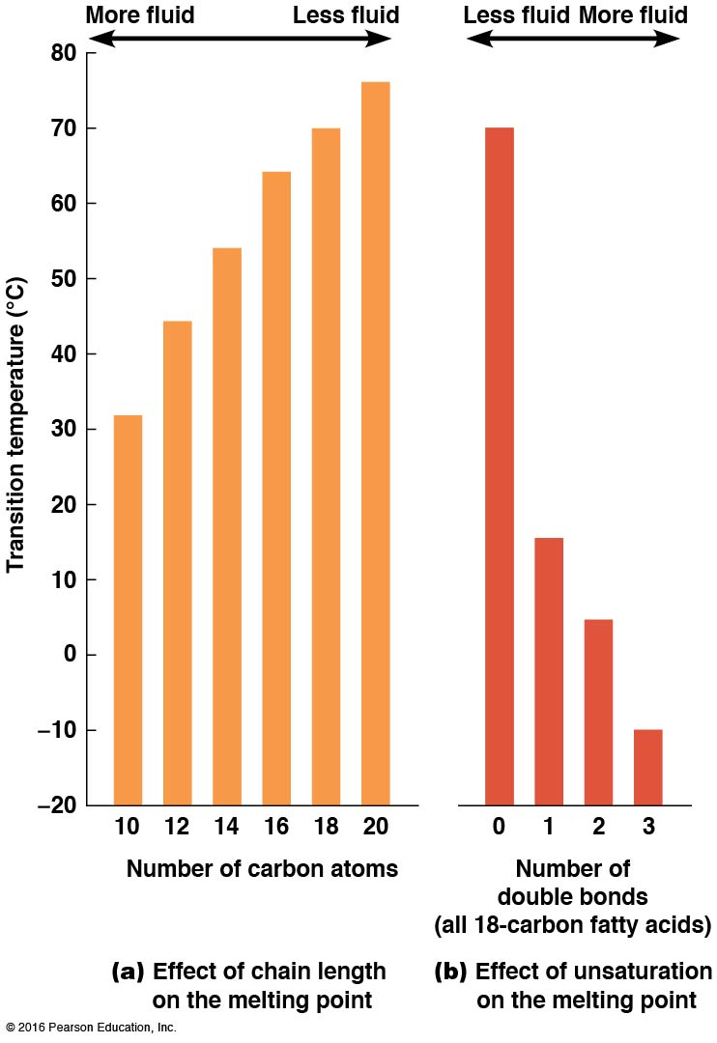

Slide 66
Fatty Acid Saturation and Membrane Fluidity
Saturated fatty acids pack together well in the membrane
Fatty acids with one or more double bonds have bends in the chains that prevent them from packing together neatly
Thus, unsaturated fatty acids are more fluid than saturated fatty acids and have lower T_{m} values

Slide 67
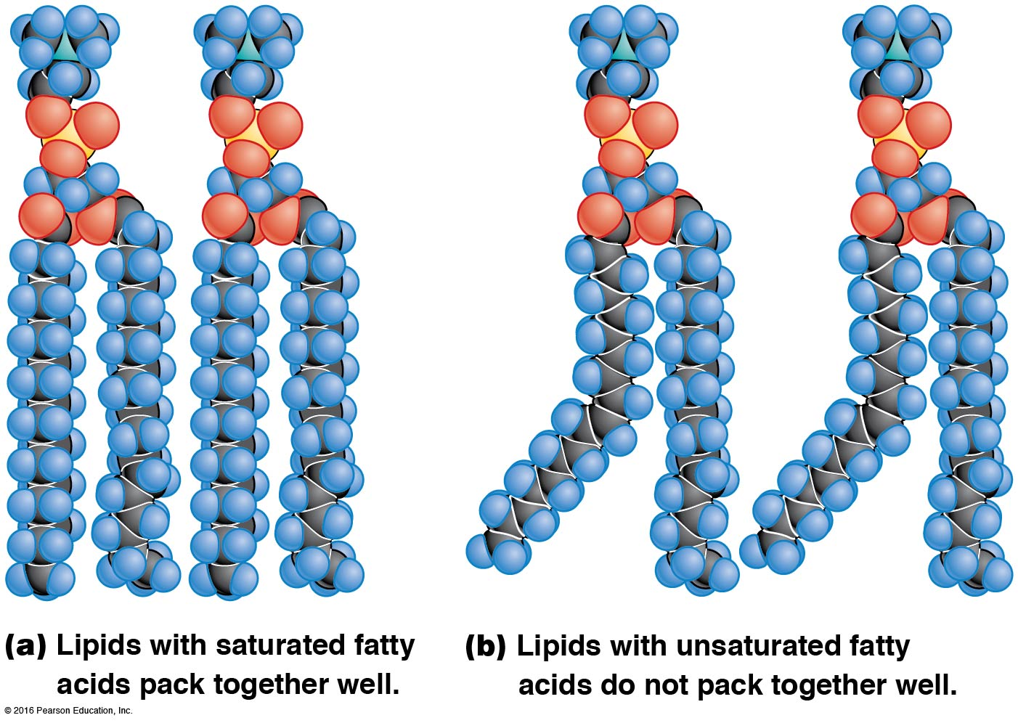

Slide 68
Membrane Composition
Most plasma membrane fatty acids vary in chain length and degree of saturation
This helps to ensure that membranes are fluid at physiological temperatures
Most unsaturated fatty acids have cis double bonds, unlike the commercially produced trans fats, which pack together like saturated fats do

Slide 70
Effects of Sterols on Membrane Fluidity
Membrane fluidity is influenced by sterols
The intercalation of rigid cholesterol molecules into a membrane decreases its fluidity and increases the T_{m}
However, cholesterol also prevents hydrocarbon chains of phospholipids from packing together tightly and so reduces the tendency of membranes to gel upon cooling
Therefore, cholesterol is a fluidity buffer; sterols in other organisms may function similarly

Slide 71
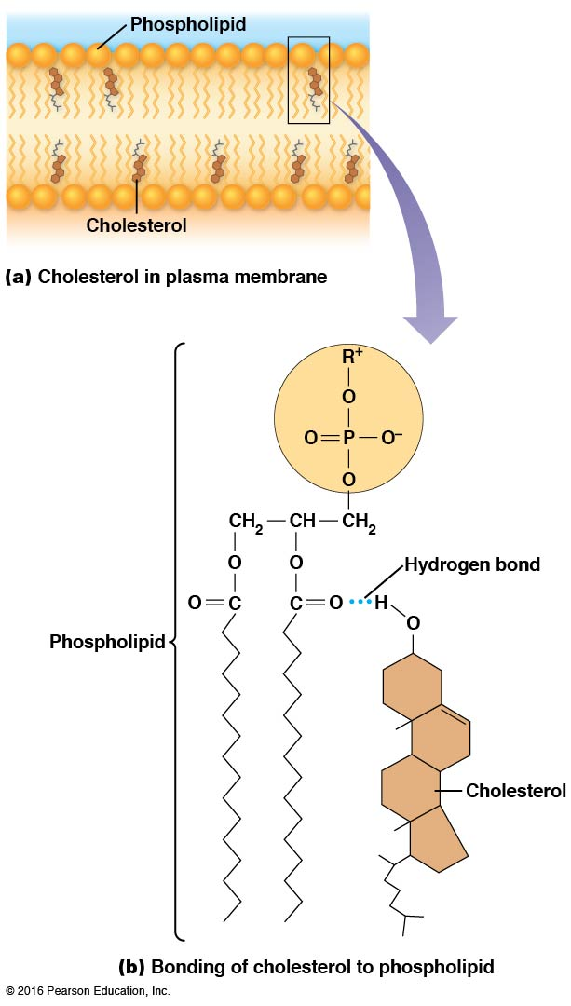

Slide 72
Video: Space-filling Model of Cholesterol

Slide 73
Other Effects of Sterols on Membranes
Sterols decrease the permeability of membranes to ions and small polar molecules
This is likely because they fill spaces between the hydrocarbon chains of phospholipids
This effectively blocks the routes that ions and small molecules would take through the membrane

Slide 74
Most Organisms Can Regulate Membrane Fluidity
Most organisms can regulate membrane fluidity by varying the lipid composition of the membranes
This is most important in poikilotherms, organisms that cannot regulate their body temperature
Poikilotherms use homeoviscous adaptation, compensating for changes in temperature by altering the length and degree of saturation of fatty acids in their membranes

Slide 75
Oxygen and Desaturase Enzyme
Some organisms have a desaturase enzyme, which introduces double bonds into fatty acids as needed
In plants and yeasts, temperature-related fluidity changes are tied to the increased solubility of oxygen at lower temperatures
More oxygen is available at low temperatures, and oxygen acts as a substrate for desaturase, allowing membrane fluidity to be maintained at lower temperatures

Slide 76
Lipid Rafts Are Localized Regions of Membrane Lipids That Are Involved in Cell Signaling
Localized regions of membrane lipids in association with specific proteins are called lipid microdomains, or lipid rafts
These are dynamic structures, changing composition as lipids and proteins move into and out of them
Lipid rafts in the outer monolayer of animal cells have elevated levels of cholesterol and glycosphingolipids and are less fluid than the rest of the membrane

Slide 77
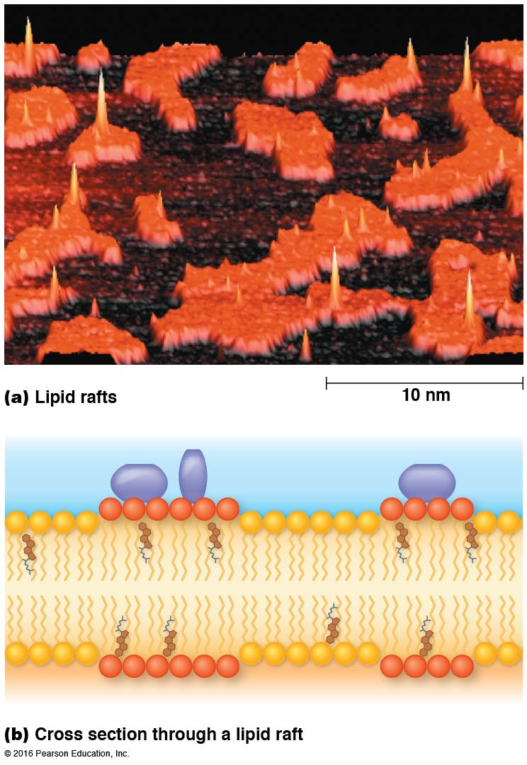

Slide 78
Lipid Raft Formation
Early models of raft formation proposed that localized regions of tightly associated cholesterol and glycosphingolipid molecules attracted particular proteins to them
Raft-associated proteins sometimes are lipoproteins, with fatty acids attached to them
Some of the more than 200 known raft-associated proteins capture and organize particular lipid rafts

Slide 79
Lipid Raft Formation (continued)
Lipid rafts contain actin-binding proteins, suggesting that the cytoskeleton may play a role in their formation and organization
Depleting cholesterol from a membrane or disrupting the actin cytoskeleton can both interfere with the targeting of proteins to rafts

Slide 80
Functions of Lipid Rafts
Lipid rafts are thought to have roles in detecting and responding to exracellular signals
For example, lipid rafts have roles in
Transporting nutrients and ions across membranes
Binding activated immune system cells to their microbial targets
Transporting cholera toxin into intestinal cells

Slide 81
Receptors in Lipid Rafts
When a receptor molecule on the outer surface of the plasma binds its ligand, it can move into lipid rafts also located in the outer monolayer
Lipid rafts containing receptors are coupled to lipid rafts on the inner monolayer
Some lipid rafts contain kinases, enzymes that generate second messengers in a cell via phosporylation of target molecules

Slide 82
7.4 Membrane Proteins: The “Mosaic” Part of the Model
The mosaic part of the fluid mosaic model includes lipid rafts and other lipid domains
However, membrane proteins are the main components

Slide 83
The Membrane Consists of a Mosaic of Proteins: Evidence from Freeze-Fracture Microscopy
Support for the fluid mosaic model came from studies involving freeze fracturing
A bilayer or membrane is frozen and then hit sharply with a diamond knife
The resulting fracture often follows the plane between the two layers of membrane lipid

Slide 84
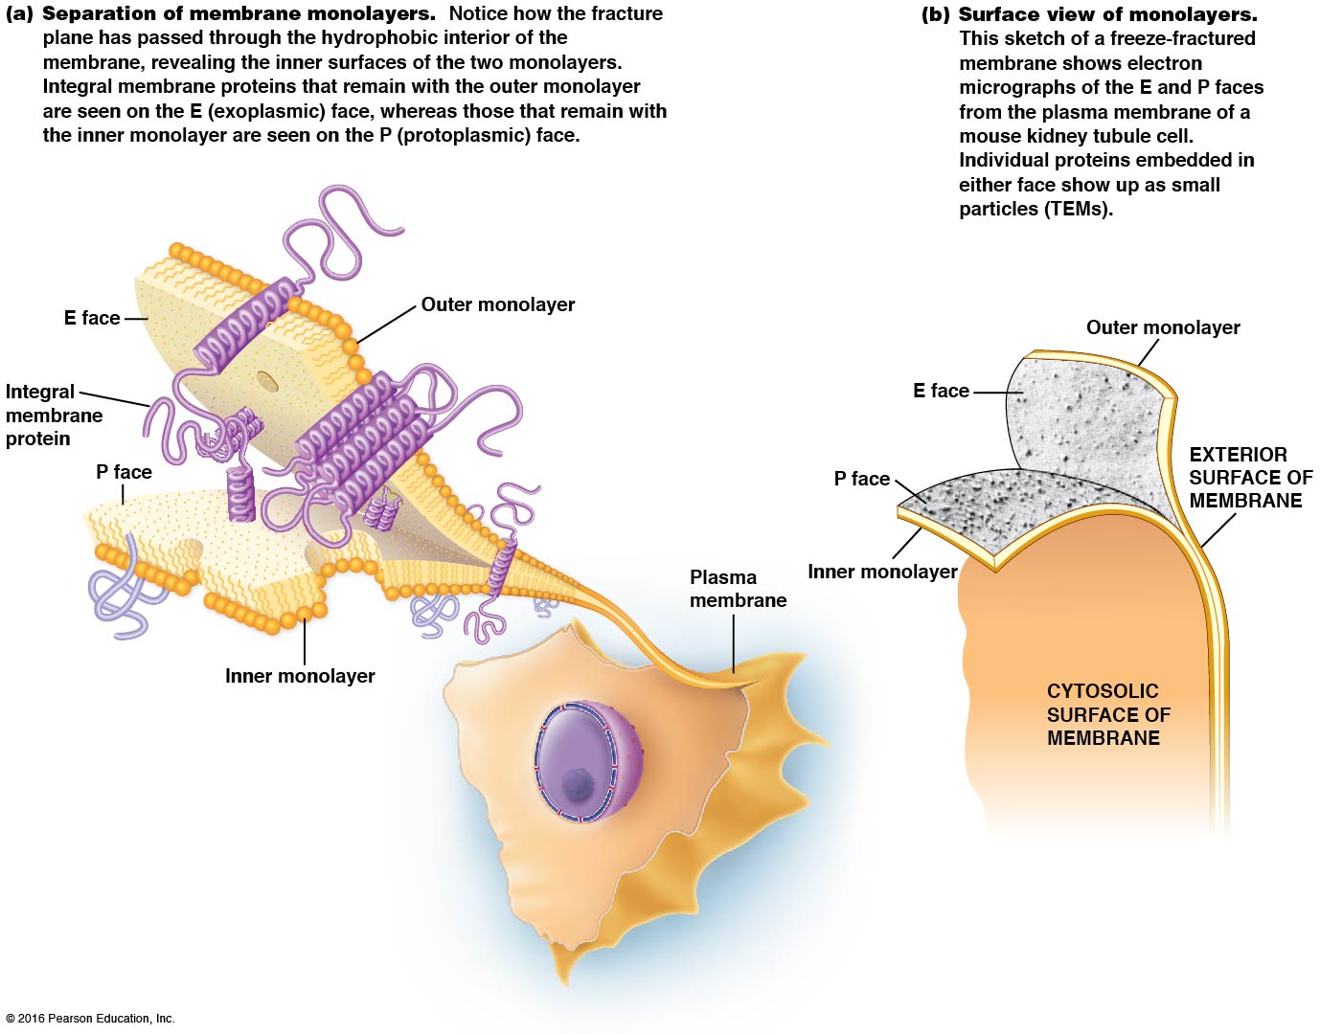

Slide 85
Freeze-Fracture Analysis of Membranes
When a fracture plane splits a membrane into its two layers, particles the size and shape of globular proteins can be seen
The E surface is the exoplasmic face, and the P surface is the protoplasmic face
The protein/lipid ratio varies among cell types

Slide 86
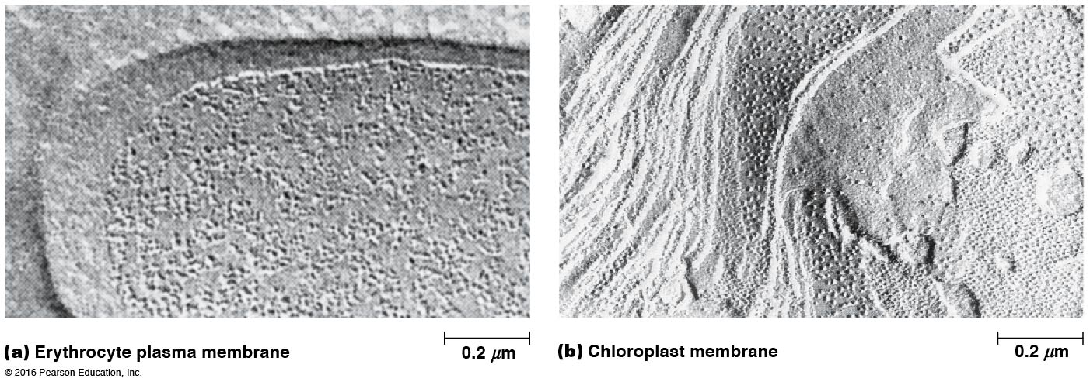

Slide 87
Membranes Contain Integral, Peripheral, and Lipid-Anchored Proteins
Membrane proteins have different hydrophobicites and so occupy different positions in or on membranes
This, in turn, determines how easily such proteins can be extracted from membranes
Membrane proteins fall into three categories: integral, peripheral, and lipid anchored

Slide 88
Classes of Membrane Proteins
Integral membrane proteins are embedded in the lipid bilayer because of their hydrophobic regions
Peripheral proteins are hydrophilic and located on the surface of the bilayer
Lipid-anchored proteins are hydrophilic and attached to the bilayer by covalent attachments to lipid molecules embedded in the bilayer

Slide 89
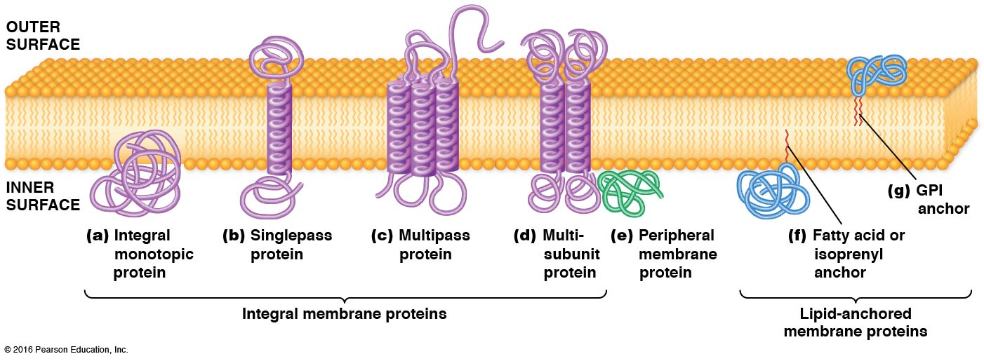

Slide 90
Integral Membrane Proteins
Most membrane proteins possess one or more hydrophobic regions with an affinity for the interior of the lipid bilayer
These are integral membrane proteins, with hydrophobic regions embedded in the interior membrane bilayer
They are difficult to remove from membranes by standard isolation procedures

Slide 91
Integral Membrane Proteins (continued)
Some integral membrane proteins, called integral monotropic proteins, are embedded in just one side of the bilayer
However, most are transmembrane proteins that span the membrane and protrude on both sides
Transmembrane proteins cross either once (singlepass proteins) or several times (multipass proteins)

Slide 92
Transmembrane Proteins
Most transmembrane proteins are anchored to the lipid bilayer by one or more hydrophobic transmembrane segments
In most cases, the polypeptide chain appears to span the membrane in an α-helical conformation about 20–30 amino acids long
Some are arranged as a closed β sheet called a β barrel

Slide 93
Singlepass Membrane Proteins
Singlepass membrane proteins have the C-terminus extending from one surface of the membrane and the N-terminus from the other
For example, glycophorin is a singlepass protein on the erythrocyte plasma membrane that is oriented so the C-terminus is on the inner surface and the N-terminus is on the outer

Slide 94
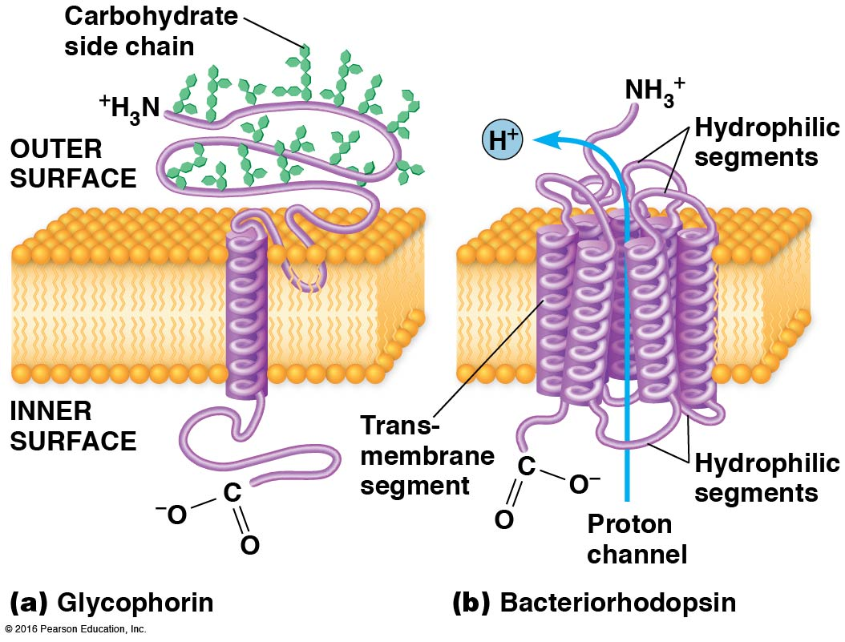

Slide 95
Multipass Membrane Proteins
Multipass membrane proteins have 2–20 (or more) transmembrane segments
For example, bacteriorhodopsin has seven transmembrane segments positioned to form a channel
Notes:
95

Slide 96
Peripheral Membrane Proteins
Membrane proteins that lack discrete hydrophobic regions do not penetrate the lipid bilayer
These peripheral membrane proteins are bound to membrane surfaces through weak electrostatic forces and hydrogen bonds
Some hydrophobic residues play a role in anchoring them to the membrane surface
Notes:
96

Slide 97
Lipid-Anchored Membrane Proteins
The polypeptide chains of lipid-anchored membrane proteins are located on the surfaces of membranes
They are covalently bound to lipid molecules embedded in the bilayer
Proteins bound to the inner surface of the plasma membrane are linked to fatty acids, or isoprenyl groups
Notes:
97

Slide 98
Types of Lipid-Anchored Membrane Proteins
Fatty acid-anchored membrane proteins are attached to a saturated fatty acid, usually myristic acid (14C) or palmitic acid (16C)
Isoprenylated membrane proteins are synthesized in the cytosol and then modified by addition of multiple isoprenyl groups (5C) usually farnesyl (15C) or geranylgeranyl (20C) groups
GPI-anchored membrane proteins are covalently linked to glycosylphosphatidylinositol
Notes:
98

Slide 99
Membrane Proteins Can Be Isolated and Analyzed
Membrane proteins can be solubilized and extracted from membranes so that they can be studied
Notes:
99

Slide 100
Isolation of Membrane Proteins
Peripheral membrane proteins are usually easy to isolate by altering pH or ionic strength
Chelating (cation-binding) agents are also used to solubilize peripheral membrane proteins
Lipid-anchored proteins are isolated by similar means
Notes:
100

Slide 101
Isolating Integral Membrane Proteins
Integral membrane proteins are difficult to isolate from membranes
Often detergents are used that disrupt hydrophobic interactions and dissolve the lipid bilayer
Notes:
101

Slide 102
Electrophoresis
Electrophoresis is a group of techniques that use an electric field to separate charged molecules
How quickly a molecule moves during electrophoresis depends on both charge and size
Electrophoresis uses various support media, most commonly polyacrylamide or agarose
Notes:
102

Slide 103
Electrophoresis of Membrane Proteins
Membrane fragments are solubilized in sodium dodecyl sulfate (SDS), which disrupts protein-protein and protein-lipid associations
The proteins are thus coated with negatively charged detergent molecules
The proteins are loaded onto a polyacrylamide gel and an electrical potential is applied
Notes:
103

Slide 104
Additional Techniques Using Electrophoresis
Two-dimensional SDS-polyacrylamide gel electrophoresis (SDS-PAGE) separates proteins in two dimensions, first by charge and then by size
Following electrophoresis, polypeptides can be identified by Western blotting
In this technique, proteins are transferred to a membrane and bound by specific antibodies
Notes:
104

Slide 105
Affinity Labeling
Affinity labeling utilizes radioactive molecules that bind to certain proteins based on function
For example, cytochalasin B is an inhibitor of glucose transport
Membranes exposed to radioactive cytochalasin B will likely have the radioactivity bound to proteins involved in glucose transport
Notes:
105

Slide 106
Membrane Reconstitution
In membrane reconstitution, proteins are extracted from membranes and separated individually
The purified proteins are mixed with phospholipids to form vesicles call liposomes
Liposomes can be loaded with particular molecules and tested for their ability to carry out certain functions
Notes:
106

Slide 107
Determining the Three-Dimensional Structure of Membrane Proteins Is Becoming Easier
X-ray crystallography can be used to determine the structure of proteins that can be isolated in crystalline form
Membrane proteins are hard to isolate and crystallize
An alternative approach called hydropathy analysis can be used
Notes:
107

Slide 108
X-Ray Crystallography
X-ray crystallography is widely used to determine the three-dimensional structure of proteins
Integral membrane proteins are difficult to isolate and crystallize, but recent techniques have improved
Now, over 500 proteins have been studied using this method
Notes:
108

Slide 109
Hydropathy Analysis
The number and location of transmembrane segments in a membrane protein can be inferred if the protein sequence is known
A hydropathy (or hydrophobicity) plot is used for this
A computer program identifies clusters of hydrophobic residues, calculating a hydropathy index for successive “windows” along the protein
Notes:
109

Slide 110
Molecular Biology Has Contributed Greatly to Our Understanding of Membrane Proteins
The study of membrane proteins has been revolutionized by DNA sequencing and recombinant DNA technology
Amino acid sequence can be deduced from DNA sequence
Site-specific mutagenesis allows determination of how certain amino acids affect protein function

Slide 111
Membrane Proteins Have a Variety of Functions
Some membrane proteins are enzymes, which accounts for the localization of particular functions to specific membranes
Electron transport proteins such as cytochromes and iron-sulfur proteins are closely related to enzymes in function

Slide 112
Solute Transport Across Membranes
Transport proteins facilitate the movement of nutrients across membranes
Channel proteins provide hydrophilic passageways through hydrophobic membranes
Transport ATPases use the energy of ATP to transport ions across membranes

Slide 113
Signaling Across Membranes
Receptors recognize and mediate the effects of specific chemical signals on the surface of the cell
Hormones, neurotransmitters, and growth-promoting substances are examples of chemical signals

Slide 114
Communication Between Cells
Membrane proteins involved with intercellular communication include
Proteins that form connexons at gap junctions in animal cells
Proteins that make up plasmodesmata in plant cells

Slide 115
Membrane Proteins Play Roles in Other Cell Functions
Membrane proteins play roles in uptake and secretion of substances by endocytosis and exocytosis
They take part in targeting, sorting, and modifying proteins in the endoplasmic reticulum and Golgi complex
They participate in autophagy, the digestion of a cell’s own organelles or structures

Slide 116
Stabilizing and Shaping the Cell Membrane
Membrane-associated proteins play structural roles in stabilizing and shaping the cell membrane
In animal cells, a cytoskeletal meshwork of peripheral membrane proteins underlies the plasma membrane of many kinds of cells

Slide 117
Membrane Proteins Are Oriented Asymmetrically Across the Lipid Bilayer
Membrane proteins exhibit asymmetric orientation with respect to the lipid bilayer
Once in place, in or on one of the monolayers, proteins cannot move across the membrane from one surface to the other
All the molecules of a particular protein are oriented the same way in the membrane

Slide 118
Detecting Proteins on Specific Membrane Proteins
Radioactive labeling procedures are used to distinguish between proteins on inner and outer surfaces of membrane vesicles
The enzyme lactoperoxidase (LP) can be used to attach ¹²⁵I to proteins
The enzyme galactose oxidase (GO) can be used to label carbohydrate side chains attached to membrane proteins and lipids

Slide 119
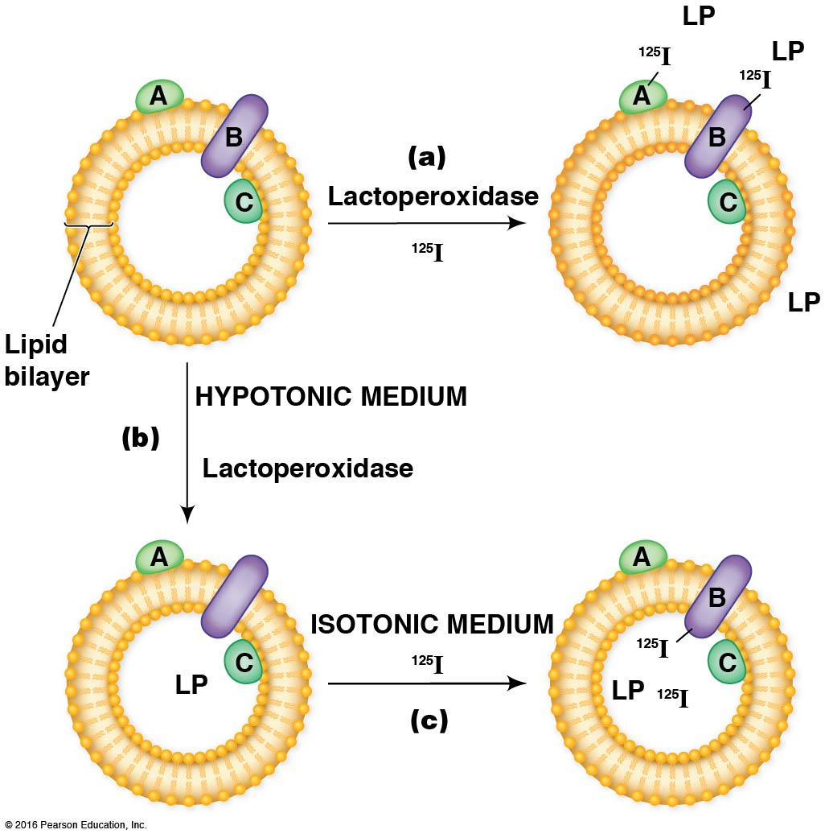

Slide 120
Many Membrane Proteins Are Glycosylated
Glycoproteins are membrane proteins with carbohydrate chains covalently linked to amino acid side chains
The addition of a carbohydrate side chain to a protein is called glycosylation
Glycosylation occurs in the ER and Golgi compartments
Notes:
120

Slide 121
Glycosylation
Glycosylation involves linkage of the carbohydrate to
The nitrogen atom of an amino group (N-linked glycosylation) of an asparagine residue, or
The oxygen atom of a hydroxl group (O-linked glycosylation) of a serine, threonine, or modified lysine or proline residue
Notes:
121

Slide 122
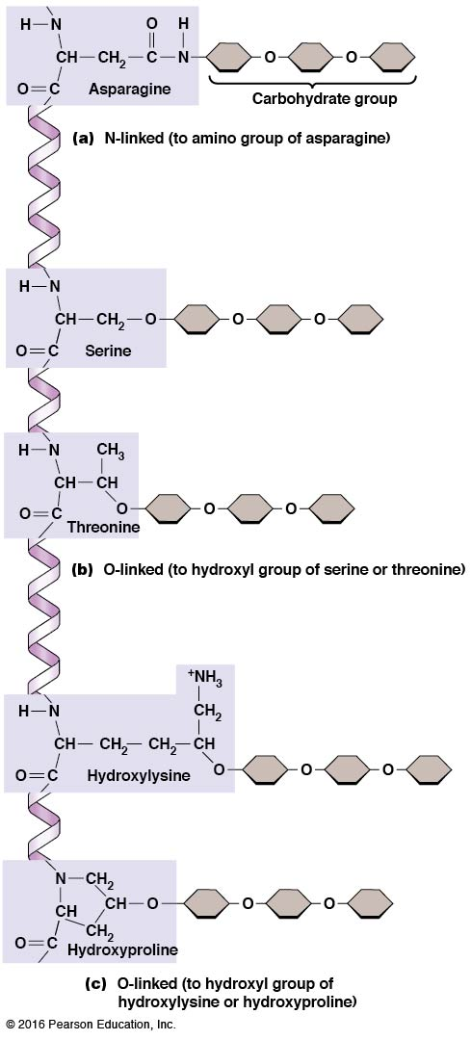

Slide 123
Carbohydrate Chains Attached to Proteins
Carbohydrate chains attached to peptides can be either straight or branched and range in length from 2 to about 60 sugar units
The most common sugars are galactose, mannose, N-acetylglucosamine, and sialic acid
Notes:
123

Slide 124
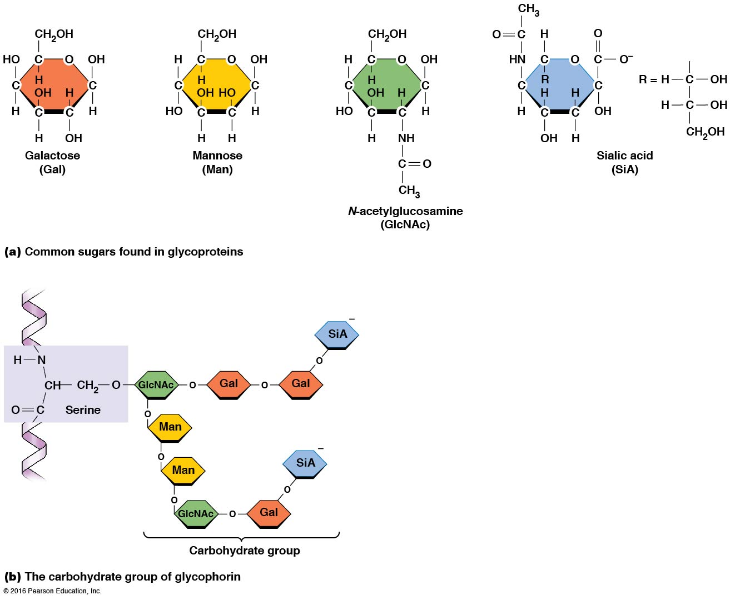

Slide 125
Roles of Glycoproteins
Glycoproteins are most prominent in plasma membranes, where they play a role in cell-cell recognition
The carbohydrate groups protrude on the outer surface of the cell membrane
Lectins are plant proteins that bind specific sugar groups very tightly and can be used to study membrane glycoproteins
Notes:
125

Slide 126
Glycocalyx
In animal cells, the carbohydrate groups of plasma membrane glycoproteins and glycolipids form a surface coat called a glycocalyx
The carbohydrate groups on the cell surface are components of the recognition sites of membrane receptors involved in antibody-antigen reactions
Notes:
126

Slide 127
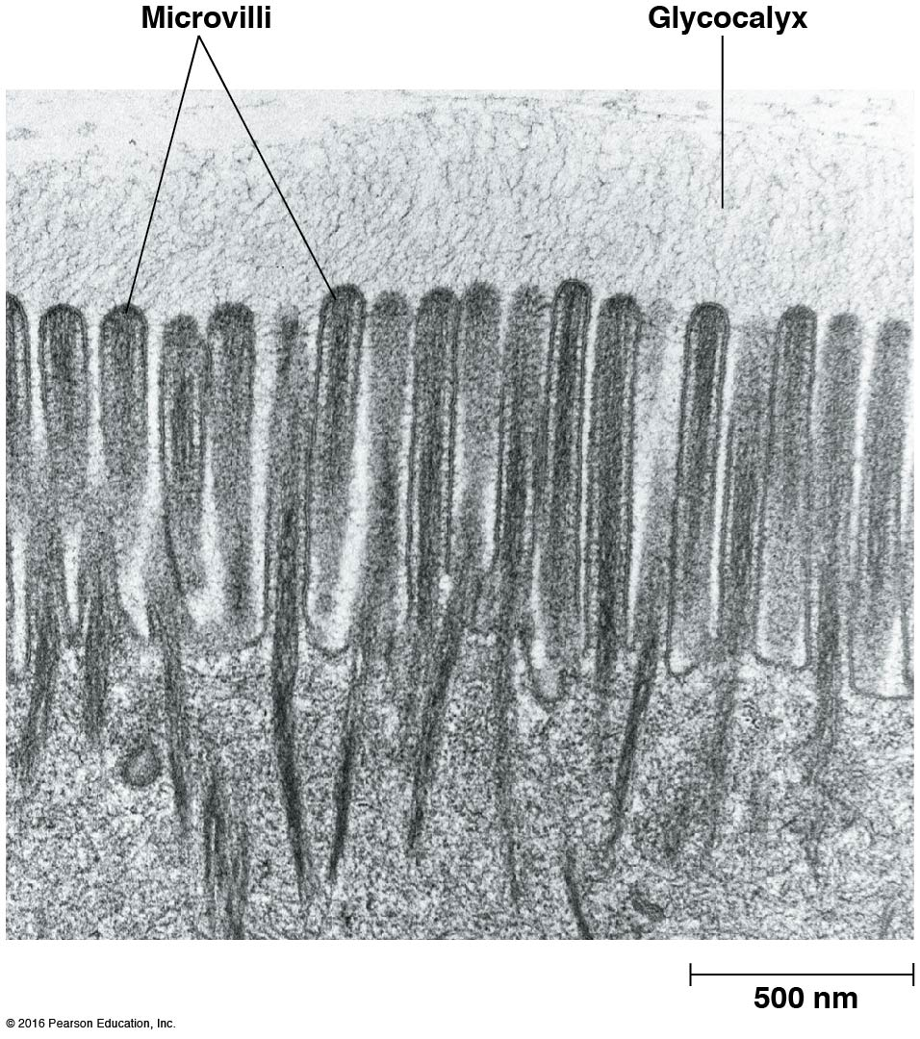

Slide 128
Membrane Proteins Vary in Their Mobility
Membrane proteins are more variable than lipids in their ability to move freely within the membrane
Some proteins can move freely, whereas others are constrained because they are anchored to protein complexes
Notes:
128

Slide 129
Experimental Evidence for Protein Mobility
Evidence for mobility of some membrane proteins comes from cell fusion experiments
These experiments were performed by David Frye and Michael Edidin
Notes:
129

Slide 130
The Frye and Edidin Experiments
Frye and Edidin fused human and mouse cells and used two fluorescent antibodies, each with a differently colored dye linked to it
The anti-mouse antibodies were linked to fluorescein, a green dye; and the anti-human antibodies were linked to rhodamine, a red dye
Within a few minutes of fusion, the red and green region proteins began to intermix
Notes:
130

Slide 131
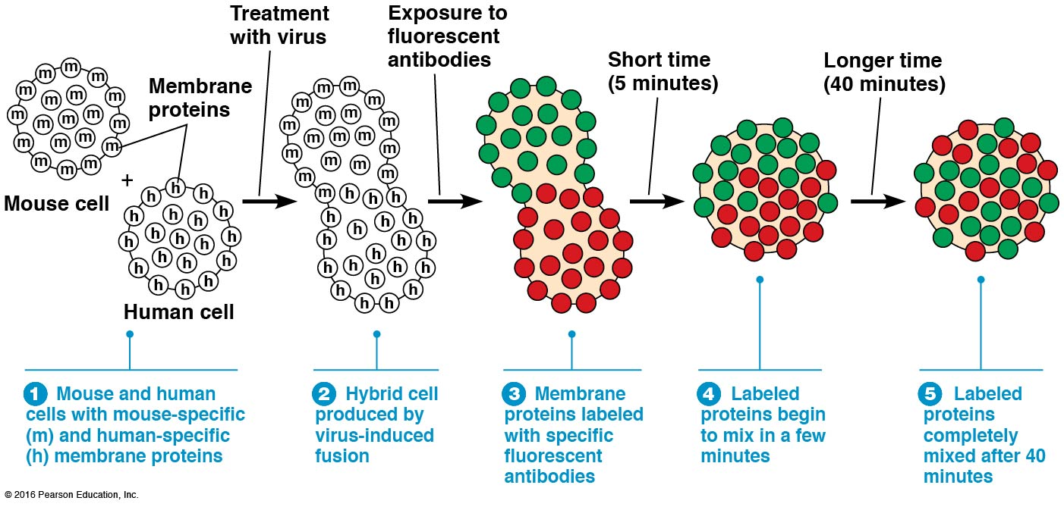

Slide 132
Random Distribution of Proteins
When plasma membranes are examined in freeze-fracture micrographs, the embedded proteins appear to be randomly distributed
The same is true for other types of membranes

Slide 133
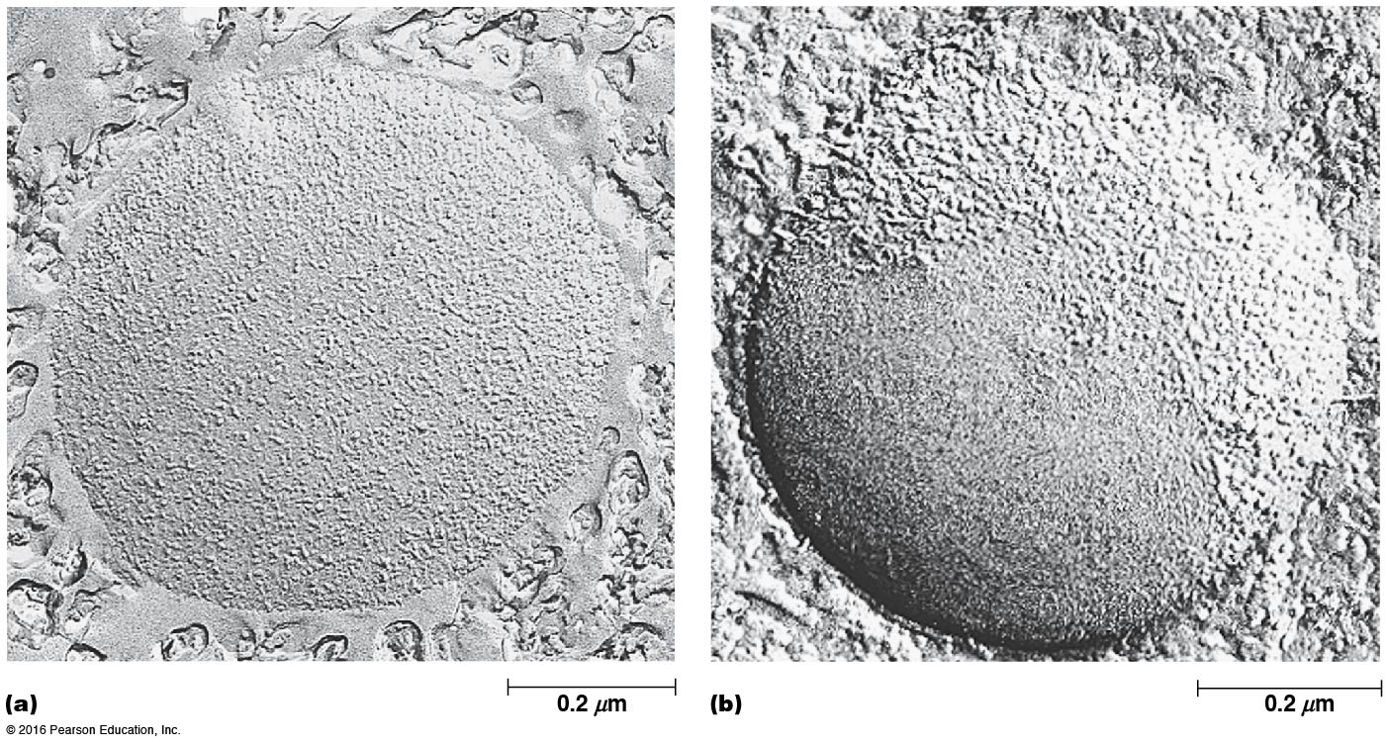

Slide 134
Experimental Evidence for Restricted Mobility
Although many types of membrane proteins do move freely through the bilayer, their rates of movement vary
Photobleaching recovery experiments can be used to determine diffusion rates
Membrane proteins are much more variable in diffusion rates than lipids are

Slide 135
Membrane Domains
Diffusion of many membrane proteins is restricted to a limited area of the membrane
So, some membranes consist of separate membrane domains that differ in protein composition and therefore in function

Slide 136
Mechanisms for Restricting Protein Mobility
Membrane proteins aggregate within the membrane, forming large, slow-moving complexes
Membrane proteins also form structures that become barriers to diffusion, creating membrane domains

Slide 137
Membrane Protein Anchoring
The most common restraint on mobility of membrane proteins is anchoring of such proteins to structures to one side of the membrane or the other
For example, many proteins of the plasma membrane are anchored either to cytoskeleton or to extracellular structures

Slide 138
The Erythrocyte Membrane Contains an Interconnected Network of Membrane-Associated Proteins
The plasma membrane is one of the most widely studied
An intricate meshwork of peripheral and integral membrane proteins is associated with the inner surface of the plasma membrane
This meshwork supports the membrane, helps maintain cell shape, and helps the cell withstand stress

Slide 139
Peripheral Proteins of the Erythrocyte Plasma Membrane
The main peripheral proteins of the erythrocyte plasma membrane are spectrin, ankyrin, and band 4.1 protein
Spectrin and its associated proteins provide mechanical support to the plasma membrane
Glyceraldehyde-3-phosphate dehydrogenase (GAPDH) is a peripheral membrane protein with a role in catabolism of blood glucose

