Slide 1
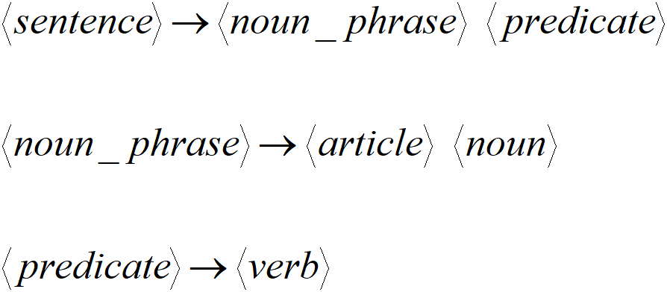
Grammars
Grammars express languages
Example: the English language

Slide 2
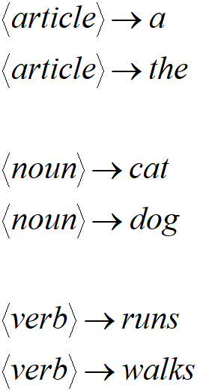
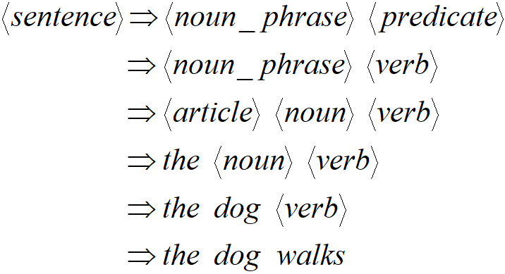
A derivation of “the dog walks”

Slide 3
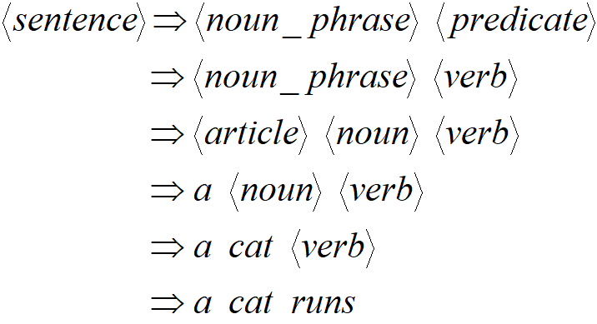
A derivation of “a cat runs”:

Slide 4
Language of the grammar:
L = { “a cat runs”, “a cat walks”, “the cat runs”, “the cat walks”, “a dog runs”,
“a dog walks”, “the dog runs”, “the dog walks” }

Slide 5
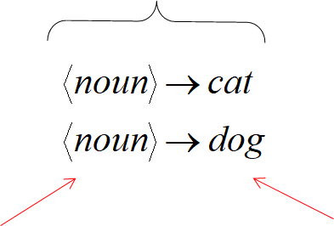
Notation
Production Rules
Variables Terminals

Slide 6
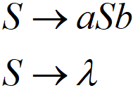
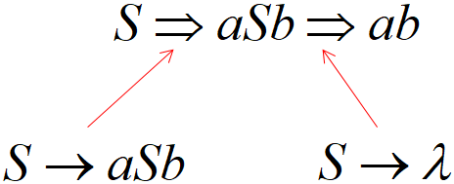
Another Example
Grammar:
Derivation of sentence :

Slide 7
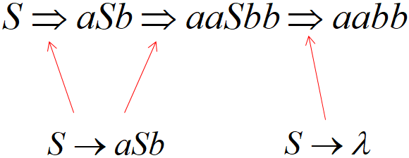
Another Example (cont)
Grammar:
Derivation of sentence :

Slide 8
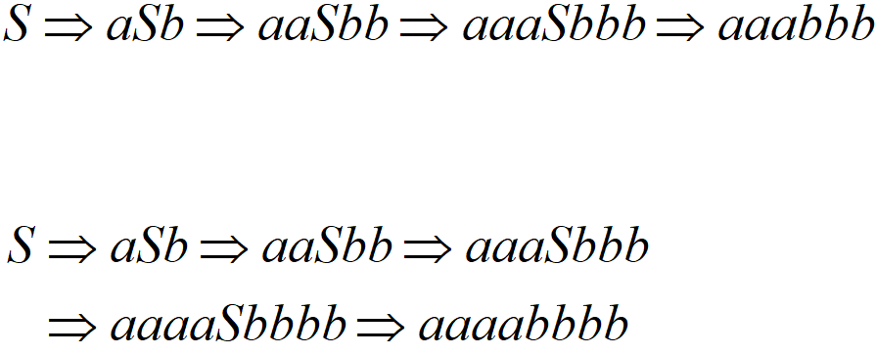
Other derivations:

Slide 9
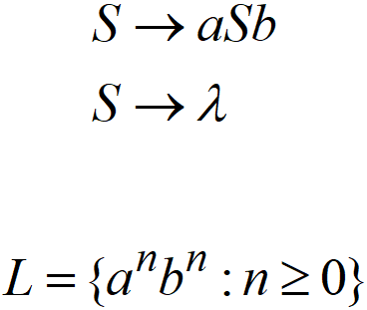
Language of the grammar

Slide 10
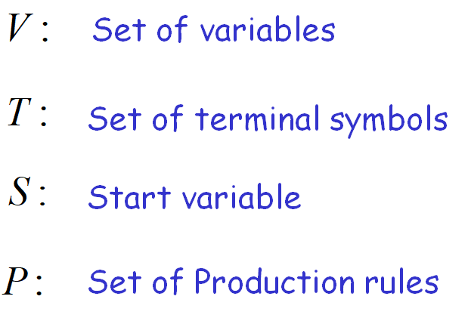
Notation
Grammar

Slide 11
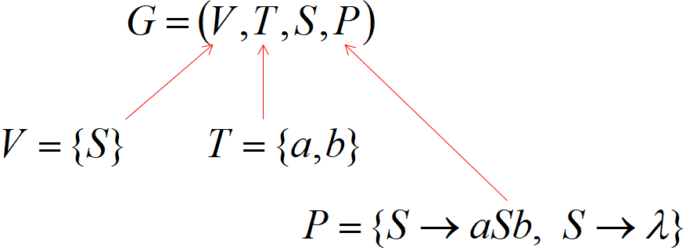
Example
Grammar

Slide 12
More Notation
Sentential Form: A sentence that contains variables and terminals.
Example:

Slide 13
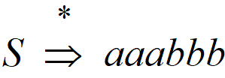
More Notation
We write:
Instead of:

Slide 14
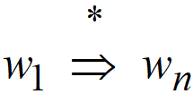
More Notation
In general we write:
If:

Slide 15
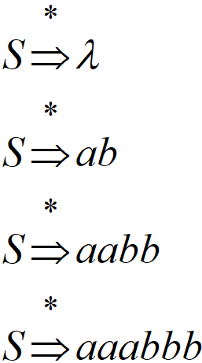
Example
Grammar Derivations

Slide 16
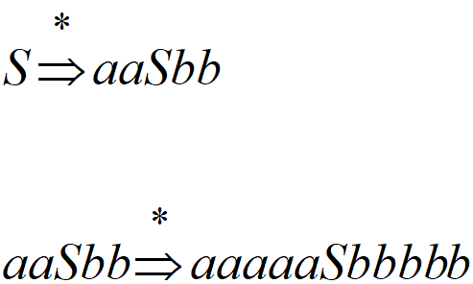
Example
Grammar Derivations

Slide 17
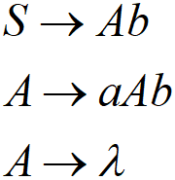
Another Grammar Example
Grammar
Derivations:

Slide 18
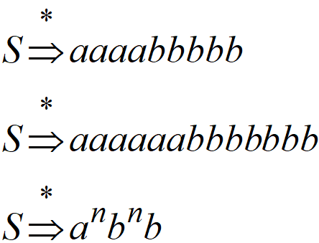
More Derivations

Slide 19
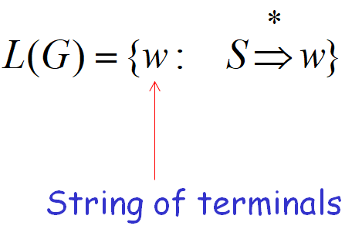
Language of a Grammar
For a grammar
with start variable :

Slide 20
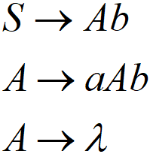
Example
For grammar
Since:

Slide 21
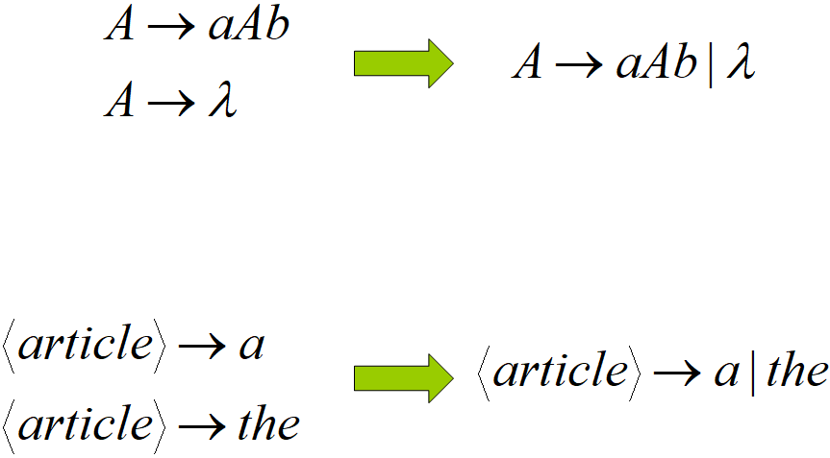
A Convenient Notation

Slide 22
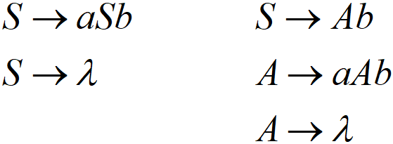
Linear Grammars
Grammars with at most one variable at the right side of a production
Examples:

Slide 23
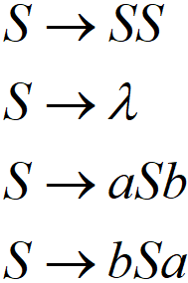
A Non-Linear Grammar
Grammar :
Number of in string

Slide 24
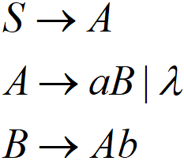
Another Linear Grammar
Grammar :

Slide 25
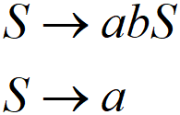
Right-Linear Grammars
All productions have form:
Or
Example:

Slide 26
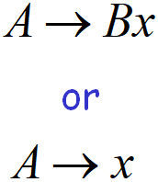
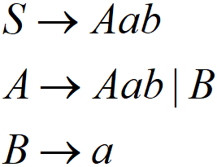
Left-Linear Grammars
All productions that have the form:
Example:

Slide 27
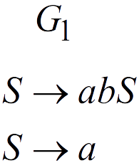
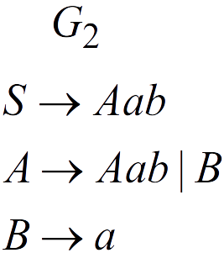
Regular Grammars
A regular grammar is any right-linear or left-linear grammar
Examples

Slide 28
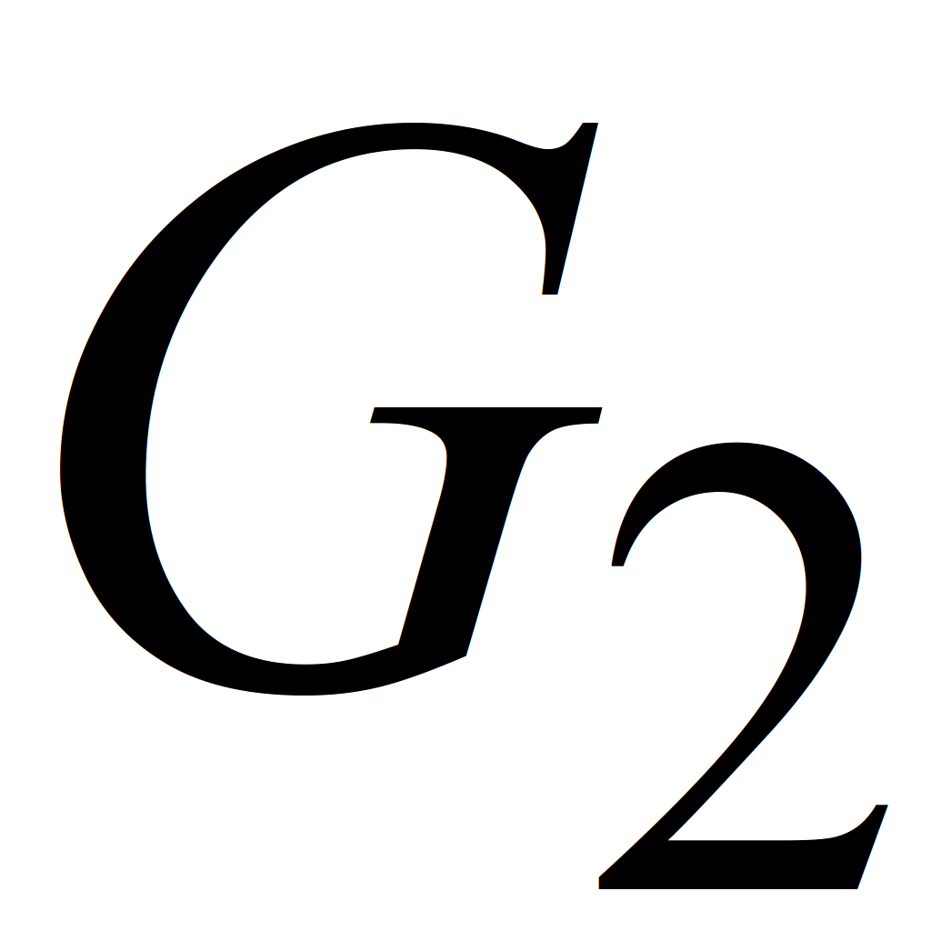
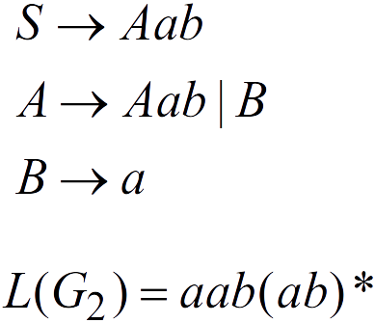
Observation
Regular grammars generate regular languages
Examples:

Slide 29
Regular grammars - NFA/DFA - Regular Language
Regular Expressions
DFA or NFA
Regular Grammars

Slide 30
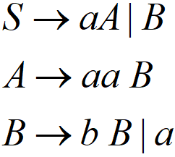
Example: from regular grammar to NFA

Slide 31
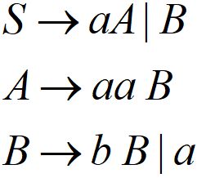

Slide 32
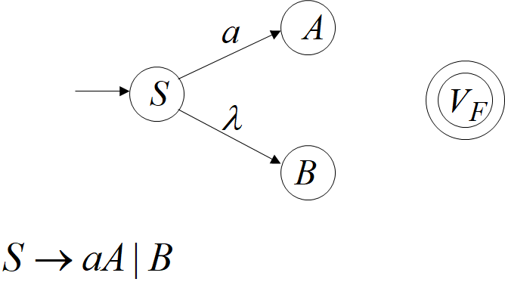

Slide 34
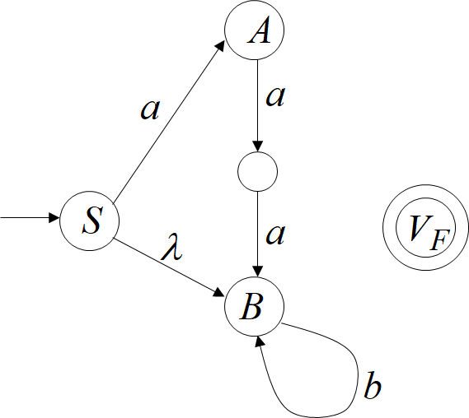
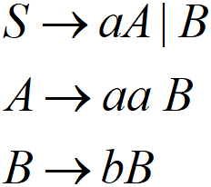

Slide 35
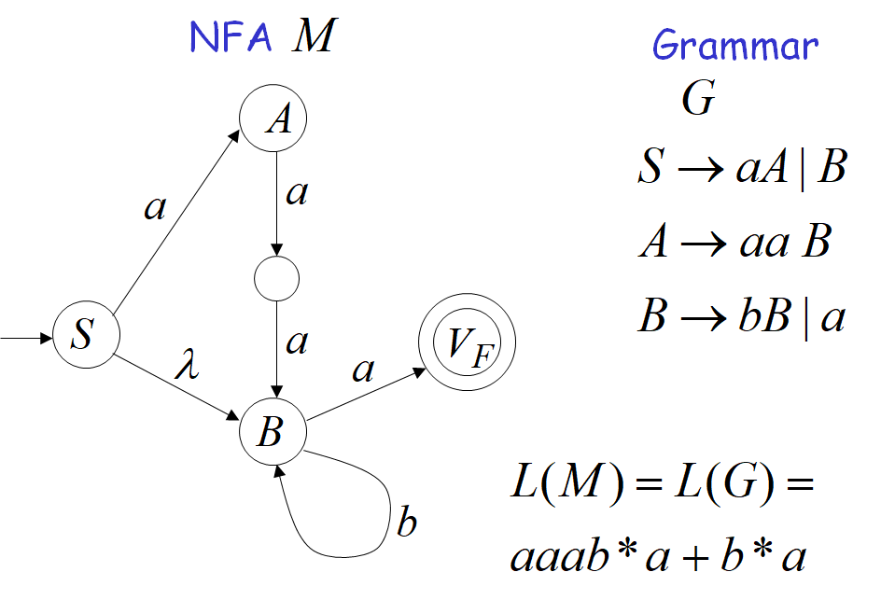

Slide 36
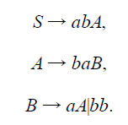
Exercise
Construct an NFA that accepts the language generated by the grammar:

Slide 37
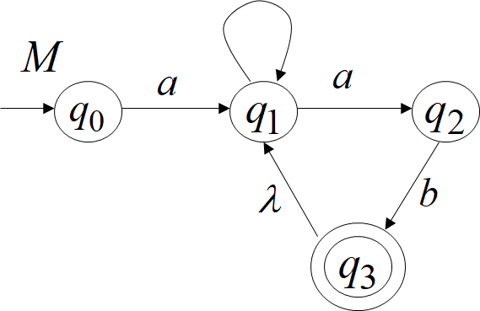
Example: from NFA to regular grammar
b

Slide 38
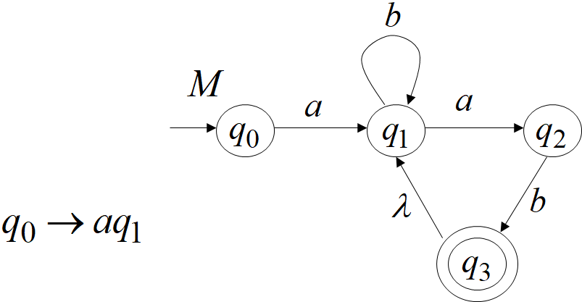

Slide 39
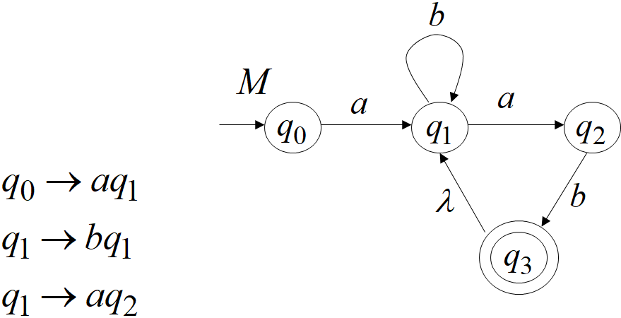

Slide 40
