Slide 1
Nephrotoxicity
Dr. Basma Damiri

Slide 2
Kidney function:
Filtration and excretion
Homeostasis of water-soluble molecules
Electrolyte homeostasis/acid-base balance
Metabolism/detoxification
Hormone production

Slide 3
Filtration and excretion
Rate of blood flow is higher than other very perfused tissue like heart, brain, and liver.
Kidneys receive about 25% of cardiac output 1.2-1.3L/min or 400 ml/100g tissue/ min.
The tubule resorbs greater than 99% of the glomerular filtrate
The proximal tubule has extensive resorption and selective secretion: Low MW protein resorption and primary site for cytochrome P450s.
Thin loop of Henle - resorption of fluids
Distal tubule - resorption of fluids and acid-base balance
Collecting duct - resorption of fluids, antidiuretic hormone and acid-base balance.

Slide 4
The kidney requires large amounts of metabolic energy to remove wastes from the blood by tubular secretion and to retain filtered nutrients to blood.
~10% of normal resting O2 consumption is required for maintaining proper kidney function.
Kidney is sensitive to agents such as barbiturates. Why?
Good question in the exam! You can find the answer - page 130 in the book.
Substances as great as 70,000 dalton can appear from glomelurar filtrate.

Slide 5
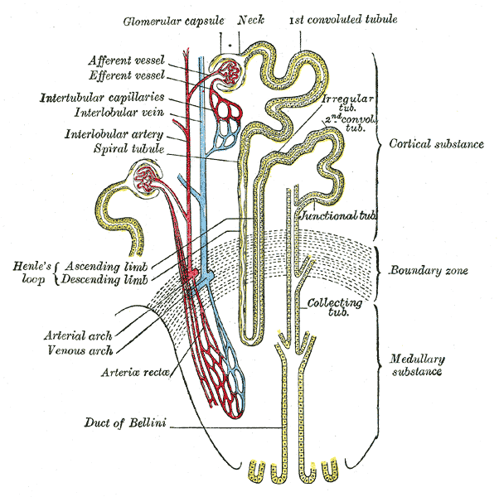

Slide 6
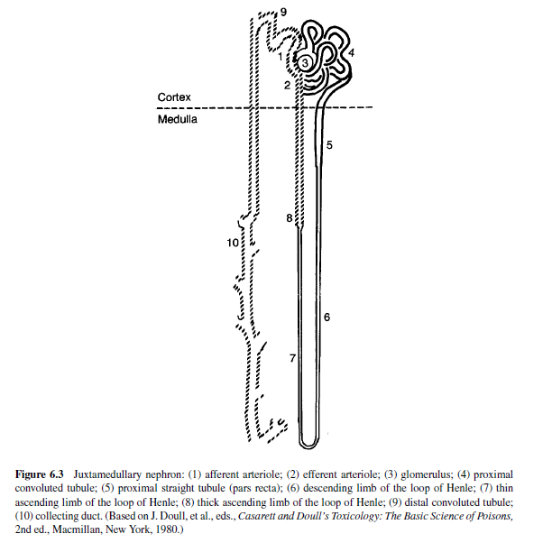
The functional unit of the kidney: The Nephron
Nephrosis or nephropathy:

Slide 7
Kidney as a Target Organ of Toxicity
Is a frequent site of toxic injury in rodent toxicity studies (second to the liver).
Role in filtration, metabolism, and excretion of xenobiotics and their metabolites.
Toxins can concentrate in the glomerular filtrate or within tubule cells.
Metabolic activation of xenobiotics

Slide 9
Renal Metabolism
Both Phase I and Phase II
Cytochrome P450's
Renal Cortex
Less total activity than liver
Regional differences in activity along nephron
Locally along nephron may be equal to liver
Sex-differences in some species
Cyclooxygenases
Renal Medulla

Slide 10
Proximal tubule (PT)
~75% of glumerular filtrate is reabsorped in PT.
Active reabsorption of glucose, sodium, potassium, phosphate, amino acids, sulfate, and uric acid.
Agents toxic to PT cause aminoacidouria and glycosuria.
Reabsorbtion, secretion, and transport of proteins, ions, and other organic molecules.
Differentiated into P1, P2 and P3 (S1, S2, S3) segments based upon histochemical and ultrastructural characteristics.
Sex differences exist, in some species, in the metabolic capabilities of proximal tubule cells.

Slide 12
Nephrotoxic agents
Two classes of environmentally or occupationally relevant chemicals that damage the kidney
Heavy metals
Halogenated hydrocarbons
2. Therapeutic agents

Slide 14
Acute single exposures
urine
blood
Metal levels
time
exposure

Slide 15
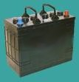
What is Cadmium?
A metal most often encountered in earth’s crust combined with chlorine (cadmium chloride), oxygen (cadmium oxide), or sulfur (cadmium sulfide)
Exists as small particles in air, result of smelting, soldering or other high temp. industrial processes
By-product of smelting of zinc, lead, copper ores
Used mainly in metal plating, producing
pigments, batteries, plastics and as a
neutron absorbent in nuclear reactors
Cadmium is used in batteries

Slide 16
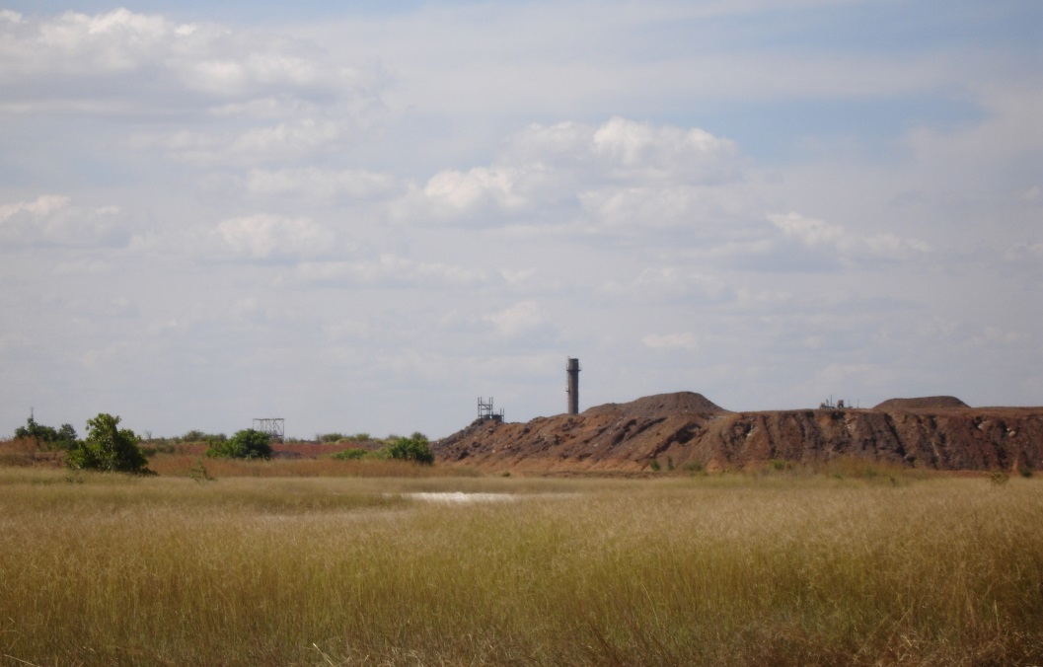
Cadmium and Smelters/Mine Sites
Cadmium is a by-product of smelter
Photo of Smelter

Slide 17
EXPOSURE SOURCES
Tobacco smoke (a one pack a day smoker absorbs roughly 5 to 10 times the amount absorbed from the average daily diet
Tobacco smoke is an important source of cadmium exposure Cadmium a component of chuifong tokwan , sold illegally as a miracle herb in china.
Low levels are found in grains, cereals, leafy vegetables, and other basic foodstuffs

Slide 18
Exposure Sources – By Mouth
Foods (only a small amount is absorbed)
Itai Itai disease (cadmium contamination + diet low in calcium & vitamin D)
Cadmium a component of chuifong tokwan, sold illegally as a miracle herb
Low levels are found in grains, cereals, leafy vegetables, and other basic foodstuffs

Slide 19
Why Is Cadmium a Health Hazard?
Affects lungs & kidneys
2º effects on skeletal system
Binds to sulfhydryl groups, displacing other metals from metalloenzymes, disrupting those enzymes
Competes with calcium for binding sites on regulatory proteins
Lipid peroxidation has been demonstrated

Slide 20
Renal Effects
May cause tubular and glomerular damage with resultant proteinuria
May follow chronic inhalation or ingestion
Latency period of ~10 yrs
Nephropathy is progressive & irreversible

Slide 21
Cd
The kidney is the organ most sensitive to the toxic effect of Cd.
Kidney accumulates Cd over life time of the individual until the age of 50. Biologic half-life may be up to 30 yrs
Liver also accumulates Cd but kidney 10 times more.
Indicators of kidney damage by Cd
2 microglobulin: usually reabsoroped by PT (target for damage).
Glycosuria, aminoacidourea, diminsih the ability of the kidney to secrete PAH (p-aminohipuric acid), do not be confused by PAHs polyaromatic hydrocarbons.
Increases in the secretion of low and high molecular weight proteins.

Slide 22
Kidney failure due to Cd
Metalothioneine (MT) with high binding affinity to Cd.
MT acts to protect certain organs such as testes.
MT is overcome by high [Cd] in the proximal tubule.
Free Cd exerts toxic effect to PT
Lysosomes will uptake Cd

Slide 23
Renal Effects
Chronic exposure – progressive renal tubular dysfunction
Toxic effects are dose related
Critical renal concentration
Decreased GFR
Chronic renal failure
Kidney stones more common

Slide 24
Skeletal Effects
Bone lesions occur late in severe chronic poisoning
Pseudofractures
Other effects of osteomalacia and osteoporosis
Appear to be secondary to increased urinary calcium and phosphorus losses
Outch-outch disease or itai-itai byo
Excessive loss of Cd and phosphorus in the urine combined with dietary Ca deficiency

Slide 25
Signs and Symptoms - Acute
Food poisoning (ingestion)
Bronchitis (inhalation)
Interstitial pneumonitis (inhalation)
Pulmonary edema (inhalation)
A condition that mimics metal fume fever
Children who eat dirt (pica behavior) are at risk

Slide 26
Signs & Symptoms - Chronic
Chronic exposure may result in renal dysfunction and bone disease
Mild anemia, anosmia & yellow discoloration of the teeth may occur
Chronic exposure may effect the sense of smell

Slide 27
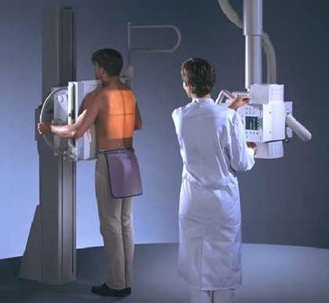
Evaluation
Inhalation
Chest radiograph
Chronic exposure
Renal tests
Serum electrolytes, BUN, serum and urinary creatinine, serum creatinine, cadmium in blood & urine, urinary protein
Other tests – CBC & LFTs

Slide 28
Direct Biologic Indicators
24 hour urine cadmium – reflects exposure over time an total body burden
Blood cadmium
Cadmium in hair – not reliable
No quantitative relationship between hair cadmium levels and body burden

Slide 29
Indirect Biologic Indicators
Urinary ß₂-microglobulin – evaluate urine levels > 300 μg/g creatinine
Urinary RBP - retinol-binding protein (RBP)
Urinary metallothionein (MT)

Slide 30
Treatment & Management
Acute Exposure
No proven treatment
Supportive treatment includes fluid replacement, oxygen, mechanical ventilation. With ingestion, gastric decontamination by emesis or gastric lavage soon after exposure. Activated charcoal not proven effective
Chronic – Prevent further exposure

Slide 31
Mercury
Occurs in three forms (elemental, inorganic salts, and organic compounds)
Contamination results from mining, smelting, and industrial discharges. Mercury in water can be converted by bacteria to organic mercury (more toxic) in fish.
Can also be found in thermometers, dental amalgams, fluorescent light bulbs, disc batteries, electrical switches, folk remedies, chemistry sets and vaccines.

Slide 32
Mercury - Exposure
Elemental
liquid at room temperature that volatizes readily
rapid distribution in body by vapor, poor in GI tract
Inorganic
poorly absorbed in GI tract, but can be caustic
dermal exposure has resulted in toxicity
Organic
lipid soluble and well absorbed via GI, lungs and skin
can cross placenta and into breast milk

Slide 33
Elemental Mercury
At high concentrations, vapor inhalation produces acute necrotizing bronchitis, pneumonitis, and death.
Long term exposure affects CNS.
Early: insomnia, forgetfulness, anorexia, mild tremor
Late: progressive tremor and erethism (red palms, emotional liability, and memory impairment)
Salivation, excessive sweating, renal toxicity (proteinuria, or nephritic syndrome)
Dental amalgams do not pose a health risk.

Slide 34
Inorganic Mercury (Hg⁺²)
Classical nephrotoxicants: model compound for producing nephrotoxicity in animals.
Massive dose can cause damage to the PT and leads to kidney failure
Breakdown of mucosal barriers leads to increased absorption and distribution to kidneys (proximal tubular necrosis and anuria).
Gastrointestinal ulceration or perforation and hemorrhage are rapidly produced, followed by circulatory collapse.

Slide 35
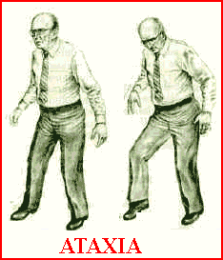
Organic Mercury
Toxicity occurs with long term exposure and effects the CNS.
Signs progress from paresthesias to ataxia, followed by generalized weakness, visual and hearing impairment, tremor and muscle spasticity, and then coma and death.
Teratogen with large chronic exposure
Asymptomatic mothers with severely affected infants
Infants appeared normal at birth, but psychomotor retardation, blindness, deafness, and seizures developed over time.

Slide 36
Diagnosis and Treatment
Dx made by history and physical and lab analysis. Inorganic mercury can be measured in 24 hour urine collection; organic mercury is measured in whole blood.
2 microglubulin in the blood not the urine
The most important and effective treatment is to identify the source and end the exposure
Chelating agents DimercaptoSuccinic Acid (DMSA) may enhance inorganic mercury elimination.
Dimercaprol may increase mercury concentration in the brain. Dimercaprol or British anti-Lewisite (abbreviated BAL)

Slide 37
Mercury - Prevention
Many mercury compounds are no longer sold in the United States.
Elemental mercury spills:
Roll onto a sheet of paper and place in airtight container
Use of a vacuum cleaner should be avoided because it causes mercury to vaporize (unless it is a Hg Vac)
Consultation with environmental cleaning company is advised with large spills.
State advisories on public limit or avoid consumption of certain fish from specific bodies of water.

Slide 38
Lead
Affect PT
Glucose, phosphate, and and amino acids reabsorption is depressed in PT→ glycosuria, aminociduria, hyperphosphauria, and phosphatemia.
Reversible by the treatment of the chelating agent (EDTA).

Slide 39
Sources of Exposure
The use of lead in residential paint was banned in 1977
Lead-containing pigments still are used for outdoor paint products because of their bright colors and weather resistant properties
Tetraethyl and tetramethyl lead are still used as additives in gasoline in several countries
Childhood lead poisoning is now defined as a blood lead level of 10 μg/dl

Slide 40
Toxicocokinetics and Toxicoynamics
Absorption:
Lungs: depends on size particle
GI:
Adults: 20-30%
Children: as much as 50% of dietary lead
Inadequate intake of iron, calcium, and total calories are associated with higher lead levels
Skin:
Inorganic lead is not absorbed
Organic lead is well absorbed
Lead is carried bound to the RBC

Slide 41
Pharmacokinetics and Pharmacoynamics
Distributed extensively throughout tissues: bone, teeth, liver, lung, kidney, brain, and spleen

Slide 42
Body lead storage: bones- can constitute a source of remobilization and continued toxicity after the exposure has ceased
Lead crosses the BBB and concentrates in the gray matter
Lead crosses the placenta
Excretion:
Kidneys. The excretion increases with increasing body stores (30μg-200 μg/day)
Feces

Slide 43
Clinical Manifestation
Acute toxicity
Acute encephalopathy, renal failure and severe GI symptoms

Slide 44
General Signs and Symptoms of Lead Toxicity
Fatigue
Irritability
Lethargy
Paresthesis
Myalgias
Abdominal pain
Tremor
Headache
Vomiting
Weight loss
Constipation
Loss of libido
Motor neuropathy
Encephalopathy
Cerebral edema
Seizures
Coma
Severe abdominal cramping
Epiphyseal lead lines in children (growth arrest)
Renal failure

Slide 45
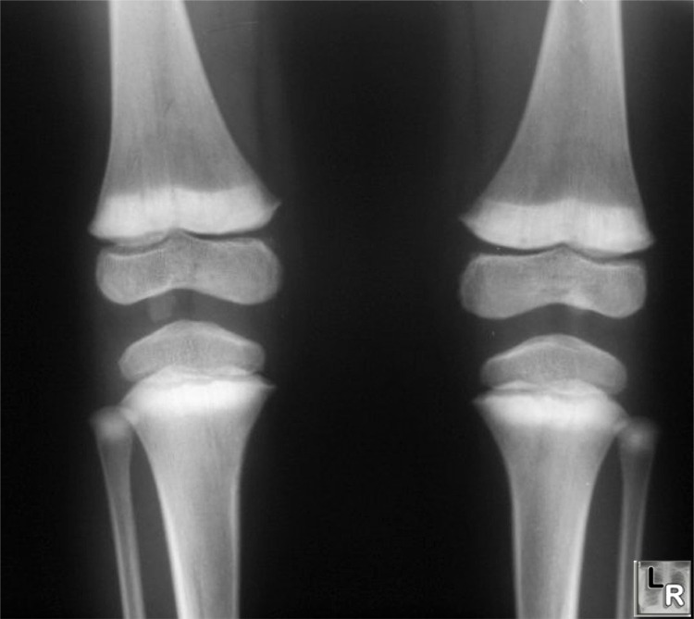

Slide 46
Range of Lead-induced Health Effects in Adults and Children
Blood lead levels | Adults | Children
10 μg/dL | Hypertension may occur | Crosses placenta Impairment IQ, growth Partial inhibition of heme synthesis
20 μg/dL | Inhibition of heme synthesis Increased erythrocyte protoporphyrin | Beginning impairment of nerve conduction velocity
30 μg/dL | Systolic hypertension Impaired hearing(↓) | Impaired vitamin D metabolism
40 μg/dL | Infertility in males Renal effects Neuropathy Fatigue, headache, and pain | Hemoglobin synthesis inhibition
50 μg/dL | Anemia, GI sx, headache, tremor | Colicky abd pain, neuropathy
100 μg/dL | Lethargy, seizures, encephalopathy | Encephalopathy, anemia, nephropathy, seizures

Slide 47
Halogenated carbons
CCl4→ sever hepatic necrosis but the ultimate death is due to kidney failur.
Chloroform (CHCl3).
Both are activated to toxic chemicals by mixed -function oxidize enzymes similar to that found in the liver.
Toxic metabolites → covalently bind macromolecule in the kidney→ nephrotoxicity.

Slide 48
Bromobenzene , tetrachloroethylene, and 1, 1, 2-trichlorethylene produce toxic effect to the kidney similar to CCl4 and CHCl3.
Methoxyflurane – a halogenated surgical anesthetic→ causes renal failur → polyuria, ↑ serum osmolality, ↑ serum sodium, and BUN.
It is metabolized to inorganic fluoride anion and oxalate.
Inorganic fluoride responsible on acting on the collecting tubules, which result on vasopressin resistance and causes polyuria

Slide 49
Other nephrotoxic compounds
Bromomethane
Hexachloroethane
Methyl isobutyl ketone
Dioxane
phenol

Slide 50
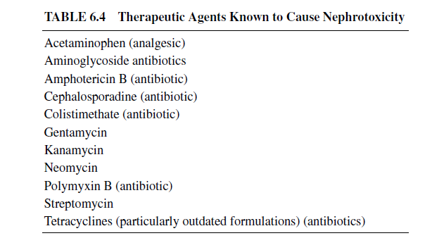

Slide 51
Renal erythropoietic factor
Hypoxia stimulates the kidney to secrete renal erethropoietic factor which acts on blood globulin (proerythropoietin) released from the liver to for erythropoietin → stimulates Hb synthesis, more RBC, and releases them into circulating blood.
In chronic renal failure -→ anemia is developed due to the damage to the tissue responsible for erethropoietic factor.
Hypoxia, androgens, and cobalt → increase production of erethropoietic factor

