Slide 1
An-Najah National University
Faculty of Medicine
Department of Physiology
Anatomy and Physiology 1
7102101
Instructor: Heba Salah
Chapter 5:
The Nervous System
Part 6: Protective Layers of the Brain, and the Spinal Cord

Slide 2
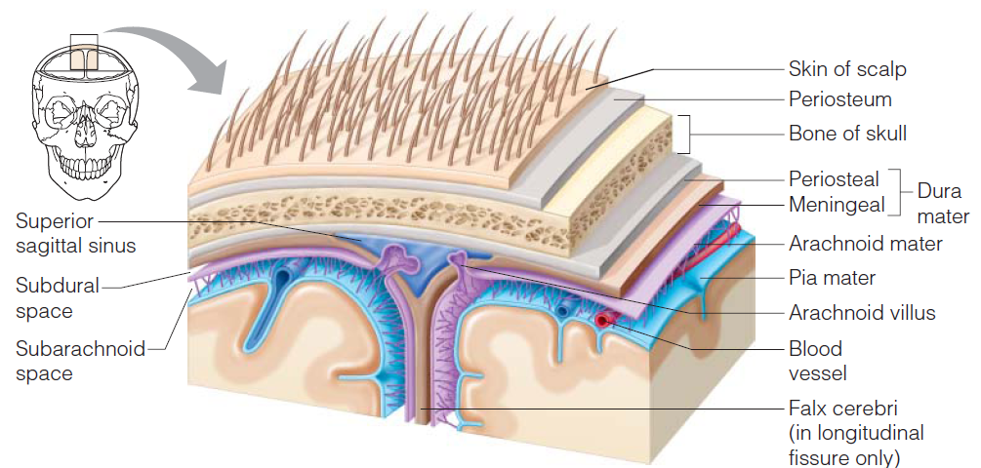
Protection of the Central Nervous System
Scalp and skin
Skull and vertebral column
Meninges
Cerebrospinal fluid
Blood brain barrier

Slide 3
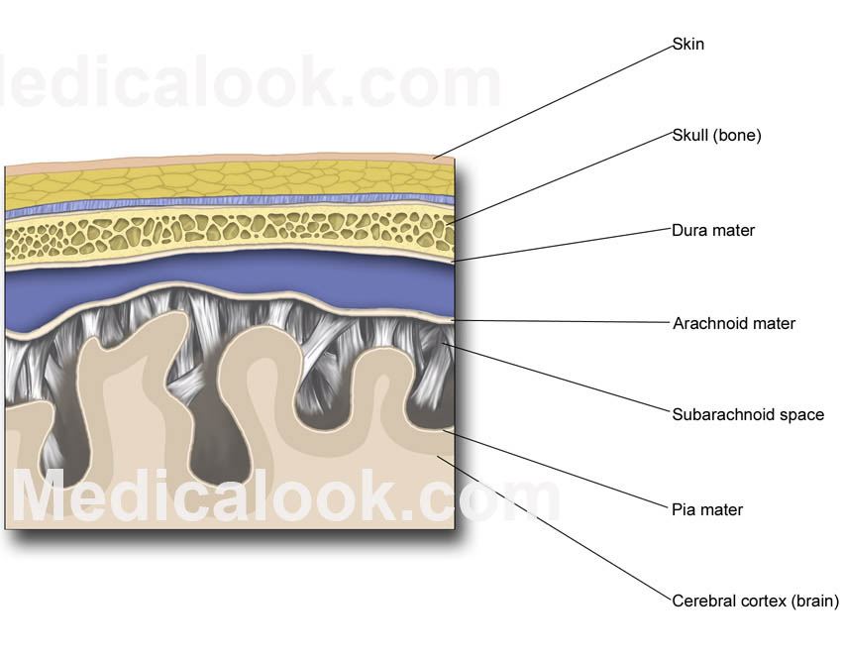
Meninges
1. Dura mater
Double-layered external covering
2. Arachnoid layer
Middle layer
Web-like
3. Pia mater
Internal layer
Clings to the surface of the brain

Slide 4
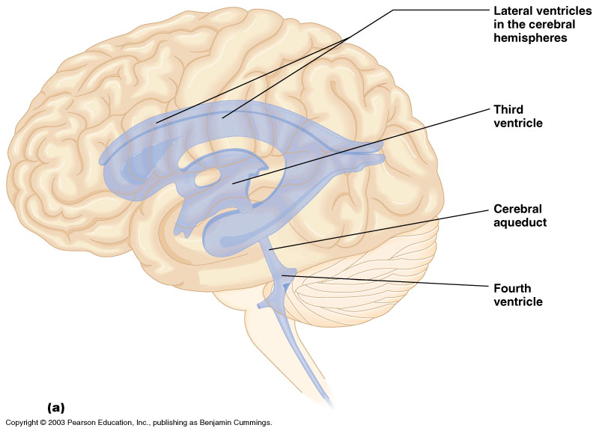
Ventricles and Location of the Cerebrospinal Fluid

Slide 5
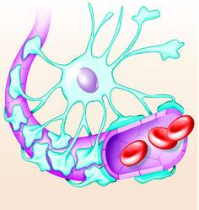
Blood Brain Barrier
Includes the least permeable capillaries of the body
Excludes many potentially harmful substances
Useless against some substances:
Fats and fat soluble molecules
Respiratory gases
Alcohol
Nicotine
Anesthesia

Slide 6
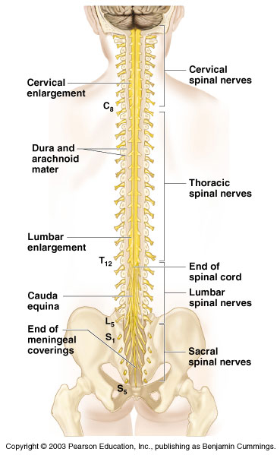
Spinal Cord
Extends from the medulla oblongata to the region of T12
Below T12 is the cauda equina (a collection of spinal nerves)
Enlargements occur in the cervical and lumbar regions

Slide 7
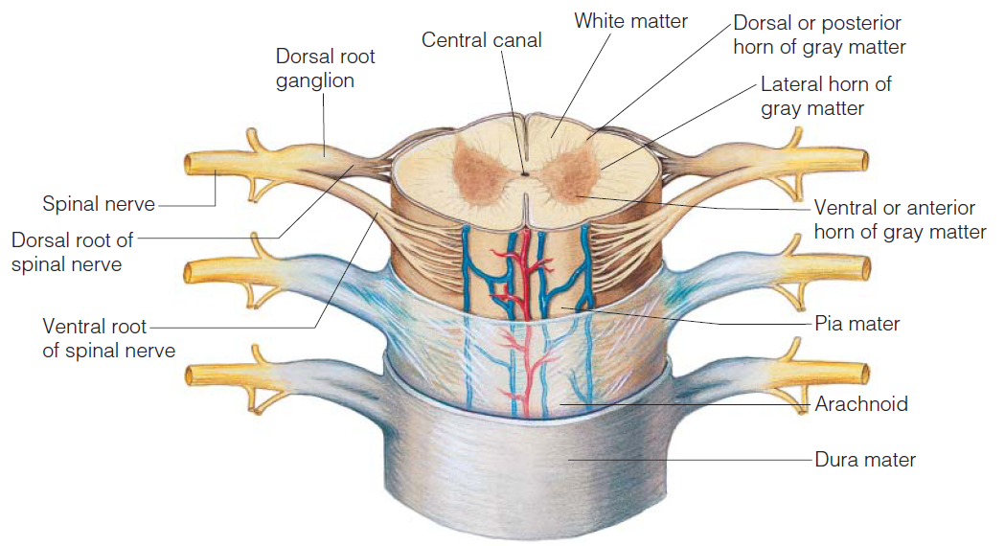
Spinal Cord Anatomy

