Slide 1
Oxidative stress and antioxidants

Slide 2
Definition (1)
Oxidative stress was defined as the lack of balance between the occurrence of reactive oxygen/nitrogen species (ROS/RNS) and the organism's capacity to counteract their action by the anti oxidative protection system (1)
Oxidative stress emerges from an enhanced ROS/RNS generation or from a decay of the antioxidant protective ability, being characterized by the reduced capacity of endogenous systems to fight against the oxidative attack directed towards target biomolecules. Its severeness is associated with several pathologies like cardiovascular, cancer and aging (1)
Various modifiable factors, such as diet, smoking, or medicines, are able to influence the OS process

Slide 3
Free radicals (2)
As a scientific term, free radicals are essentially unstable atoms" in medicine, they cause cells to break down over time and are linked to aging
Free radical-induced damage in oxidative stress has been confirmed as a contributor to the pathogenesis and pathophysiology of many chronic health problems such as neurodegenerative diseases (Parkinson, Alzhemier and others)
un-neutralized free radicals prompt a series of reactions that can damage DNA, proteins, and lipids, leading to cell injury and death .

Slide 4
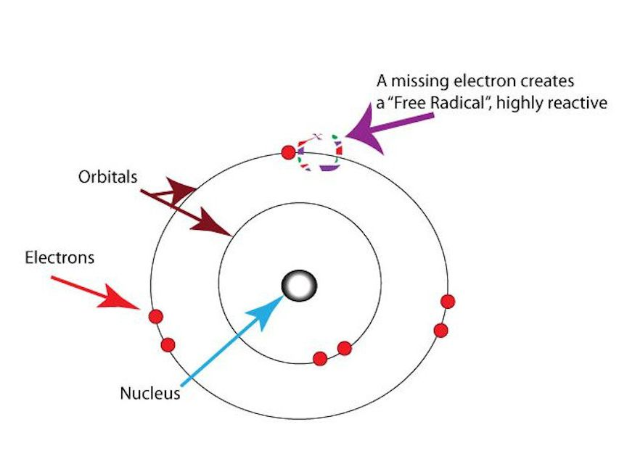
(2)

Slide 7
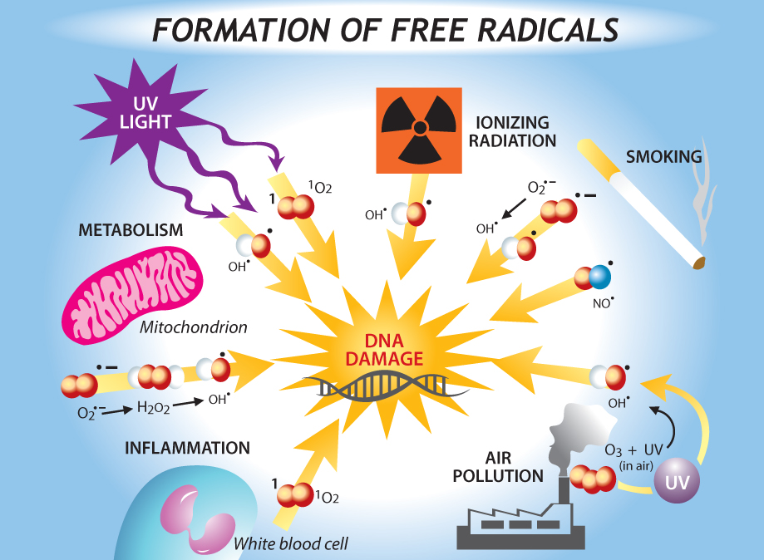

Slide 8
(2)

Slide 9
In normal respiration, it is estimated that 2% of the inhaled oxygen appears in the form of ROS, of which half is suggested to damage proteins and one-quarter to damage DNA

Slide 10
Characteristics of reactive species Oxygen
ORS has the extraordinary ability to oxygenate other molecules; it can
1- break chemical bonds
2- fragment molecules into smaller units.
New radical agents are generated by electron transfer that in turn can oxidize other molecules in a self-limiting chain reaction.
Molecular oxygen (O2 ) itself contains two unpaired electrons, making it a diradical.
However, it has only weak oxidative potential compared to some of its powerful cell-damaging metabolites

Slide 11
FR are inorganic or organic chemical compounds with one or more unpaired electron(s), symbolized by an additional point (• )
They tend to be highly reactive and short lived.
They are generated both exogenously by a great variety of reactions and endogenously. FR may be formed by chemical cleavage of covalent bonds, when one electron each of a common electron pair then remains with the split-off piece.
The hydroxyl radical (• OH) or hyperoxide/superoxide radical ( • O2 - ) ROS are of particular biological importance

Slide 12
Nitrogen dioxide (• NO2 ), a reactive FR, is a common indoor and outdoor gaseous pollutant (caused by combustion/traffic) that has been shown experimentally to cause epithelial damage and to induce inflammation in the airways. Chronic NO2 exposition may increase the incidence and severity of respiratory infections and worsen preexisting COPD.
Nitrogen monoxide (• NO) and nitrogen dioxide (• NO2 ) are also highly reactive FR and main constituents of urban areas

Slide 14
Hydroxyl radicals (• OH) are generated from hydrogen peroxide (H2 O2 )
peroxyl radicals in enzymatic pathways (oxidoreductases, xanthine oxidase, nicotinamide adenine dinucleotide phosphate [NADPH] oxidase), and electron transmission from flavins and quinolones.
Such reactions mainly occur in the context of inflammation processes and/ or phagocytosis by macrophages.
The • OH radical is one of the most reactive chemical agents. It may act as a physiological intracellular agent that, in excess, is considered to be a risk factor for several respiratory diseases
The • OH radical may go into a reaction chain with organic molecules, where each reaction generates both a reaction product and a new free radical

Slide 15
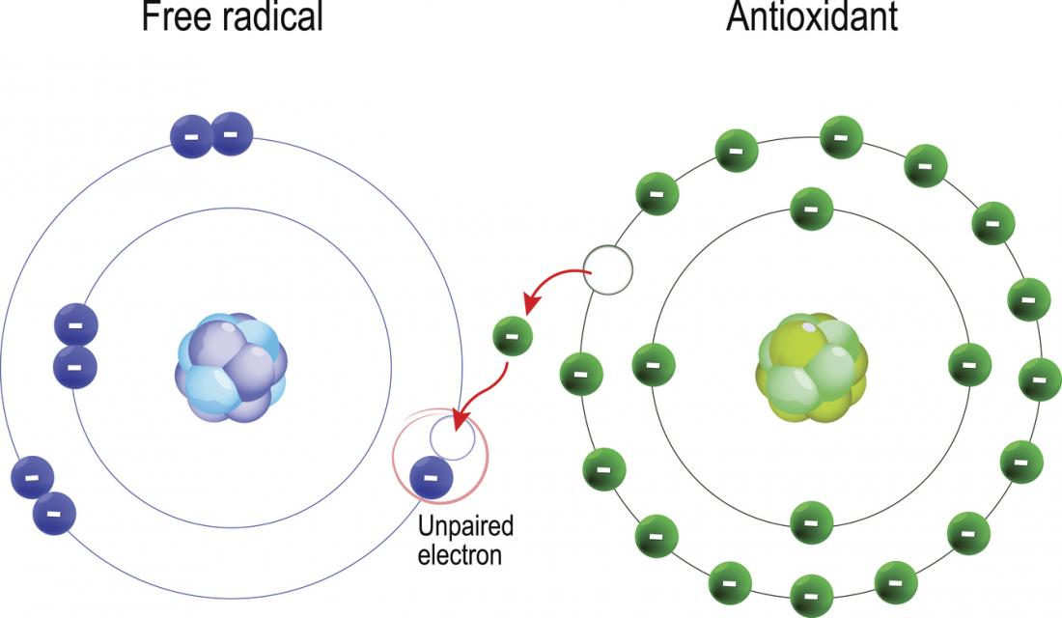
Oxidative balance

Slide 17
Oxidative stress biomarkers
RNS are highly reactive, quantifying them remains an unmet challeng
One of the most commonly determined biomarkers is plasmatic hydrogen peroxide
Oxidative Balance Scores (OBSs) are tools that have emerged to evaluate the global balance of individuals’ oxidation—reduction status

Slide 18
A combined measure of multiple pro- and antioxidant exposures could be a more accurate indicator of the OS stress burden of an individual.
Oxidative balance scores (OBSs), account for dietary and lifestyle anti- and pro-oxidant factors.
In these scores, antioxidant factors usually contribute positively whereas pro-oxidant factors contribute negatively, and therefore a higher OBS reflects a predominance of antioxidant relative to pro-oxidant exposures.
The first OBS was constructed as a combination of intake of two dietary antioxidants (vitamin C and ß-carotene) and a single dietary pro-oxidant (iron)

Slide 19
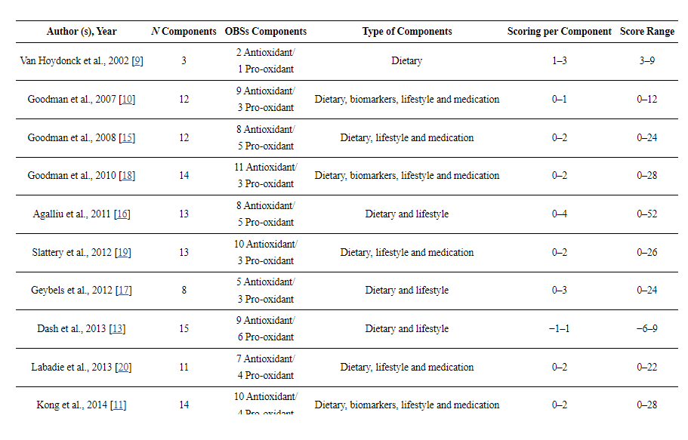
Hernández-Ruiz, Á., García-Villanova, B., Guerra-Hernández, E., Amiano, P., Ruiz-Canela, M., & Molina-Montes, E. (2019). A review of a priori defined oxidative balance scores relative to their components and impact on health outcomes. Nutrients, 11(4), 774.

Slide 20
Antioxidants\ Endogenous non-enzymatic antioxidants in the human body

Slide 21
major intrinsic non-enzymatic antioxidants, which include
1- metal-binding proteins (MBPs)
2- glutathione (GSH)
3- uric acid (UA)
3-melatonin (MEL)
4-bilirubin (BIL)
5- polyamines (PAs). Due to their location, these proteins and low molecular mass substances provide effective mechanisms of intracellular or extracellular defense against ROS and reactive nitrogen species (RNS)

Slide 22
MBPs are the main contributors to the plasma antioxidant capacity
Their antioxidant properties involve their ability to bind metal ions. These free-redox-active transition metal ions (Cu 2 + and Fe 2+) can be extremely pro-oxidant, which means that they can react with hydrogen peroxide and catalyze formation of reactive species (ROS)
Some of these proteins can additionally act as true scavengers of reactive species e.g. free sulfhydryl groups of cysteine in ALB and MTs are able to scavenge hydroxyl radicals. Such MBPs as transferrin (TF), ferritin (FER) and lactoferrin (LTF) are chelators of redox-active iron (Fe 2+), which can be effective free radical inhibitors
In contrast, ceruloplasmin acts as a reactive species inhibitor by binding free copper (Cu 2+) and iron ions (
In turn, albumin (ALB) is a multifunctional antioxidative protein, which binds redox metals (Fe II and Cu II) and can also act as a true scavenger reacting with hydroxyl radicals.
Myoglobin (MB) is another MBP, which is mainly an effective NO scavenger.
Metallothionein is capable of binding redox-active metal ions, e.g. Cu and redox-stable metal ions e.g. Zn and Cd, protecting cells against toxic metals. It also acts as a scavenger of reactive species

Slide 23
Antioxidants
The main mechanisms of antioxidants include free radical scavenging by single electrons or hydrogen atom transfer to reactive species; inhibition of expression, synthesis or activity of prooxidant enzymes involved in the formation of reactive species; the metal transition chelating effect of promoters of reactive species; and activation or induction of antioxidant enzymes
As for dietary antioxidants, the scores included Vitamin C, Vitamin E, carotenoids, flavonoids, and glucosinolates, among others. Vitamin C is a water-soluble antioxidant that scavenges oxygen-derived free radicals including those produced by lipid peroxidation
Vitamin C can also regenerate α-tocopherol, thereby contributing to its protection against lipid peroxidation. Carotenoids have potential antioxidant properties because of their chemical structure (isoprenoids in chains of polyenes) and interaction with biological membranes. These molecules act as scavengers of ROS protecting against OS and are able to reverse OS-induced inflammation processes

Slide 24
Among carotenoids, β and α-carotene, zeaxanthin β-cryptoxanthine and licopene are very efficient at neutralizing ROS by quenching singlet oxygen, neutralizing thyol radicals, and stabilizing peroxyl radicals.
Licopene is the carotenoid exerting the highest in vitro antioxidant activity. Its antioxidant potential consists in catching peroxide radicals and consequently inhibiting DNA damage and lipid peroxidation, including LDL lipoproteins
Vitamin E comprises four tocopherols (α, β, γ, and δ) and four tocotrienols, with α-tocopherol being the most biologically active form. It is a fat-soluble compound with many physiologic functions against diseases initiated or promoted by oxygen radicals, by conferring protection against lipid peroxidation and by conserving the membrane integrity. Both β-carotene and α-tocopherol can act synergically in cell membranes to reduce lipid peroxidation .
Also, together with ascorbic acid, these compounds work synergistically against ROS and RNS.

Slide 25
Flavonoids are compounds that belong to polyphenols, widely distributed in the plant kingdom. This group of compounds comprises several subclasses (e.g., flavones, flavonols, flavanones, flavanoles, anthocyanidins, and isoflavones).
Some of its antioxidant functions are based on the donation of hydrogen to free radicals, the prevention of metal-catalyzing free-radical formation, and the integration of cell membranes to protect against lipid peroxidation
Glucosinolates, secondary metabolites in Brassica vegetables, are sulfur compounds with antioxidant functions via their hydrolyzed forms (indoles and (iso)thiocyanates)

Slide 26
Regarding minerals, Se is a cofactor of glutathione peroxidase (GPx), which reduces H₂O₂ including hydroperoxides generated by oxidation of fatty acids, phospholipids, and cholesterol. Glutathione reductase is also Se-dependent and responsible for maintaining the ratio GSH/GSSG.
Se is also a cofactor of thioredoxin reductase enzymes, which protect against oxidative damage by regenerating oxidized vitamin C .
Zn is another antioxidant mineral considered in OBSs. It is a cofactor of more than 300 enzymes and of more than 2000 transcriptional factors, of which some are involved in the endogenous antioxidant system. Prominent among these enzymes are superoxide dismutase (SOD) and GPx.
This mineral also induces the synthesis of metallothioneins, through which the activity of ROS and NADPH-oxidase are blocked

Slide 27
Life style factors
With respect to lifestyle factors, there were also antioxidant and pro-oxidant factors considered. The only antioxidant factor was physical activity, for which several studies have shown that, regardless of the intensity and type of exercise, physical activity tends to increase antioxidant markers, while pro-oxidant markers are decreased .
The mechanisms by which response to OS is activated are initiation of cellular antioxidant signaling systems and enhancement of the expression of antioxidant enzymes .
Alcohol intake and smoking are two of the main factors acting as pro-oxidants. It is generally recognized that alcohol consumption can increase ROS and subsequently inflammation. Chronic alcohol intake induces OS through oxidation of ethanol to acetaldehyde, which can lead to RONS production, nucleic acid oxidation, and decreased activity of antioxidant enzymes .
Smoking and alcohol intake together might more prominently affect OS redox balance. In fact, smoking is a fundamental factor in the assessment of the individual´s pro-oxidant status. Cigarette smoking has been shown to influence the levels of some antioxidants in plasma . Tobacco is also related to inhalation of free radicals from smoke released during combustion , and smoking-induced free radicals have been detected in many tissues and organ systems

Slide 28
Another pro-oxidant factor included in most OBSs is obesity (body mass index, BMI, >30 kg/m²). OS induction in obesity has been related to metabolic switches and the involvement of redox-responsive signaling pathways in several clinical studies. These studies have elucidated not only a relationship between free radical biomarkers and BMI but also how several cell functions or tissues (including vascular endothelial cells, myocytes, or pancreatic-β-cells) are altered by OS-associated obesity, thereby leading to the development of metabolic diseases
https://www.ncbi.nlm.nih.gov/pmc/articles/PMC6520884/

