Slide 1
An-Najah National University
Faculty of Medicine
Department of Physiology
Anatomy and Physiology 1
7102101
Instructor: Heba Salah
Chapter 6:
The DigestiveSystem
Part 5: Digestive Activities in the Mouth, Pharynx, and Stomach

Slide 2
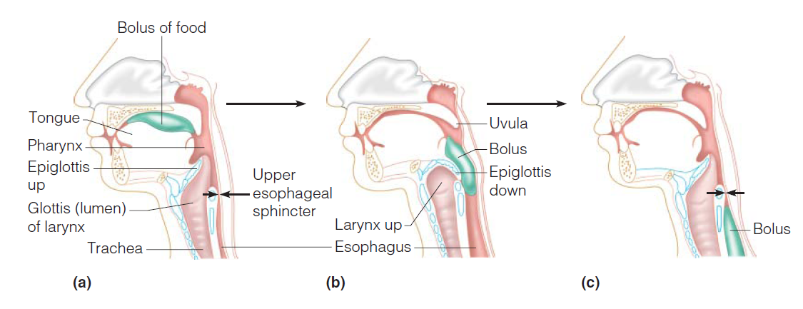
Activities of the Mouth Pharynx and Esophagus

Slide 3
Digestive Activities of the Mouth
Mechanical breakdown
Food is physically broken down by chewing
Chemical digestion
Food is mixed with saliva
Breaking of starch into maltose by salivary amylase

Slide 4
Activities of the Pharynx and Esophagus
These organs have no digestive function
Serve as passageways to the stomach

Slide 5
Deglutition (Swallowing)
Buccal phase:
Occurs in the mouth
Food is formed into a bolus
Pharyngeal-esophageal phase:
Involuntary transport of the bolus
All passageways except to the stomach are blocked

Slide 6
Deglutition (Swallowing)

Slide 7
Food Breakdown in the Stomach
Gastric juice is regulated by neural and hormonal factors
Presence of food or falling pH causes the release of gastrin
Gastrin causes stomach glands to produce protein-digesting enzymes
Hydrocholoric acid makes the stomach contents very acidic

Slide 8
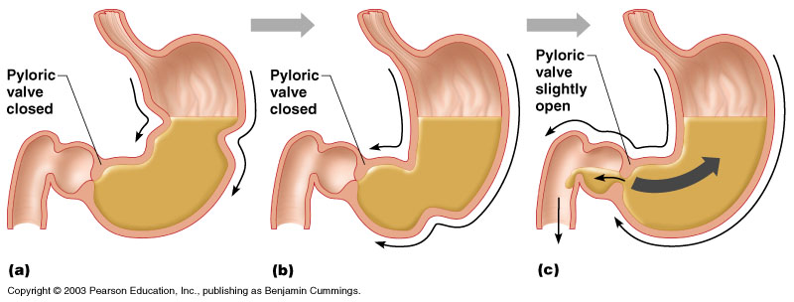
Propulsion in the Stomach
Food must first be well mixed
Rippling peristalsis occurs in the lower stomach

