Slide 1
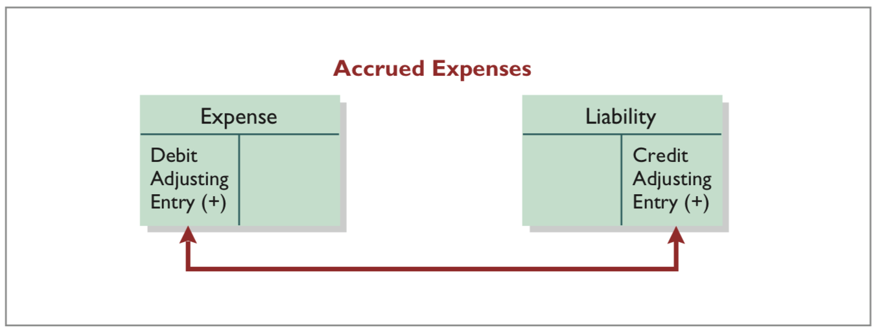
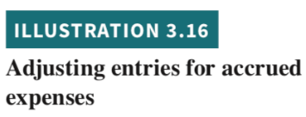
Accrued Expenses
Prior to adjustment, both liabilities and expenses are understated.
An adjusting entry for accrued expenses results in an increase (a debit) to an expense account and an increase (a credit) to a liability account.
LO 3

Slide 2
Accrued Interest
Assume: Yazici Advertising signed a three-month note payable in the amount of 5,000 on October 1. The note requires Yazici to pay interest at an annual rate of 12%.
Demonstrate:
How do you determine the interest to be recorded?
How do you create the adjustment for accrued interest, assume the company prepares monthly financial statements?
Continues on next slide
LO 3

Slide 3
Accrued Interest
Continues on next slide
LO 3

Slide 4
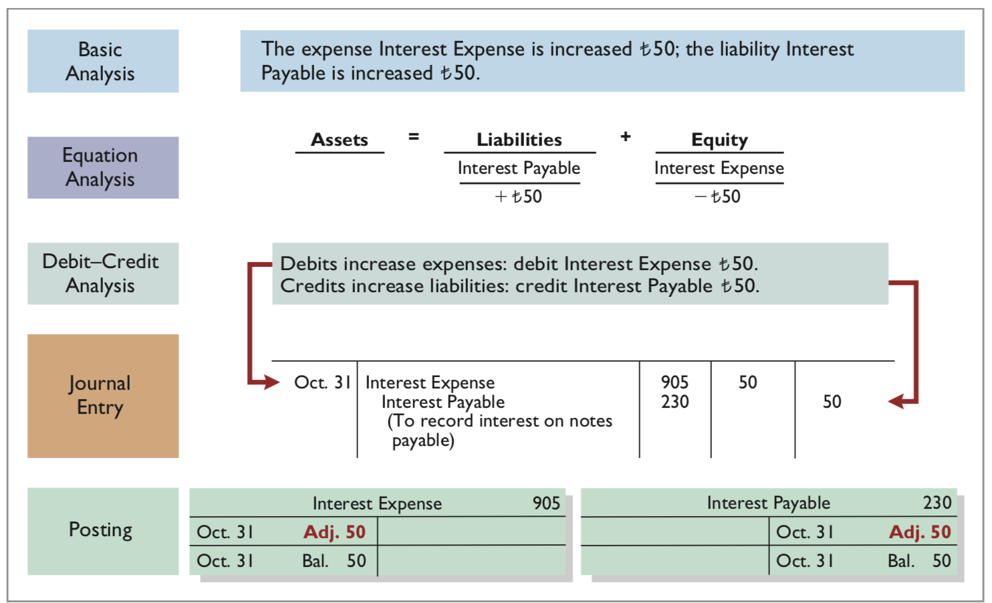
Accrued Interest
LO 3

