Slide 1
Financial Accounting
IFRS 4th Edition
Weygandt ● Kimmel ● Kieso
Chapter 6
Inventories

Slide 2
Chapter Outline:
Learning Objectives
LO 1 Discuss how to classify and determine inventory.
LO 2 Apply inventory cost flow methods and discuss their financial effects.
LO 3 Indicate the effects of inventory errors on the financial statements.
LO 4 Explain the statement presentation and analysis of inventory.

Slide 3
Learning Objective 1 Discuss How to Classify and Determine Inventory

Slide 4
Classifying and Determining Inventory
Merchandising Company
Manufacturing Company
One Classification:
Merchandise Inventory ( owned by the company and ready for sale)
Three Classifications:
Raw Materials
Work in Process
Finished Goods
Helpful Hint
Regardless of the classification, companies report all inventories under Current Assets on the statement of financial position.

Slide 5
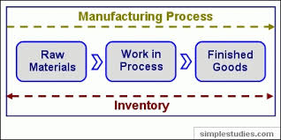
Classifying and Determining Inventory
Raw material : are the basic goods that will be used in the production but have not yet been placed into production. Work in process: is that portion of inventory that have been placed in the production process but not yet completed. Finished goods: is manufactured items that are completed and ready for sale.
Helpful Hint
Observing the level of these three inventory levels can give insight to the users about the production plan.
Sometimes companies use Just in time (JIT) inventory method.

Slide 6
Determining Inventory Quantities
Physical Inventory count taken for two reasons:
Perpetual System
Check accuracy of inventory records.
Determine amount of inventory lost due to wasted raw materials, shoplifting, or employee theft.
Periodic System
Determine the inventory on hand.
Determine the cost of goods sold for the period.
COGS = Beg inv + Purchases – end inv

Slide 7
Taking a Physical Inventory
Involves counting, weighing, or measuring each kind of inventory on hand.
Taken,
when the business is closed or business is slow
at the end of the accounting period.

Slide 8
Determining Ownership of Goods (1 of 5)
Goods In Transit بضاعة في الطريق
Purchased goods not yet received
Sold goods not yet delivered
Goods in transit should be included in the inventory of the company that has legal title to the goods.
Legal title is determined by the terms of sale.

Slide 9
Terms of sale (2 of 5)
Ownership of the goods passes to the buyer when the public carrier accepts the goods from the seller.
المشتري هو المالك للبضاعة خلال النقل
Ownership of the goods remains with the seller until the goods reach the buyer.
البائع هو المالك للبضاعة خلال النقل

Slide 10
Determining Ownership of Goods (3 of 5)
Review Question
Goods in transit should be included in the inventory of the buyer when the:
a. public carrier accepts the goods from the seller.
b. goods reach the buyer.
c. terms of sale are F O B destination.
d. terms of sale are F O B shipping point.

Slide 11
Determining Ownership of Goods (4 of 5)
Review Question
Goods in transit should be included in the inventory of the buyer when the:
a. public carrier accepts the goods from the seller.
b. goods reach the buyer.
c. terms of sale are F O B destination.
d. terms of sale are F O B shipping point.

Slide 12
Determining Ownership of Goods (5 of 5)
Consigned Goods بضائع معروضة برسم البيع
To hold the goods of other parties and try to sell the goods for them for a fee, but without taking ownership of the goods.
Many car, boat, and antique dealers sell goods on consignment. Why?
Keep inventory levels low
Reduce the risk of purchasing an item that may not be sold

Slide 13
Determining inventory quantities
Physical count
Goods in transit
Consigned goods
Involves counting, weighing, or measuring each kind of inventory on hand.
1,000,000
FOB distention
FOB shipping point
the company hold goods on consignment
The company sent goods to another party to be held on consignment
It should be added to the physical inventory by the seller
It should be added to the physical inventory by the Buyer
Shouldn’t be included in the inventory balance
(Subtracted from physical count )
Should be included in the inventory balance ( added to the physical count)

Slide 14
Do It! 1: Rules of Ownership (1 of 2)
Deng Imports completed its inventory count. It arrived at a total inventory value of ¥200,000. You have been given the information listed below. Discuss how this information affects the reported cost of inventory.
Deng included in the inventory goods held on consignment for Falls Co., costing ¥15,000.
The company did not include in the count purchased goods of ¥10,000, which were in transit (terms: F O B shipping poin)
The company did not include in the count inventory that had been sold with a cost of ¥12,000, which was in transit (terms: F O B shipping point).

Slide 15
Do It! 1: Rules of Ownership (2 of 2)
Solution
Goods of ¥15,000 held on consignment should be deducted from the inventory count.
The goods of ¥10,000 purchased F O B shipping point should be added to the inventory count.
Item 3 was treated correctly
Inventory should be ¥195,000 (¥200,000 − ¥15,000 + ¥10,000)

Slide 16
Learning Objective 2 Apply Inventory Cost Flow Methods and Discuss Their Financial Effects

Slide 17
Inventory Methods and Financial Effects
Inventory is accounted for at cost.
Cost includes all expenditures necessary to acquire goods and place them in a condition ready for sale
Unit costs are applied to quantities to determine the total cost of inventory and cost of goods sold using the following costing methods:
Specific identification
Cost flow assumptions (First-in first-out and Average-cost)

Slide 18
Specific Identification (1 of 3)
Illustration: Crivitz TV Company purchases three identical 50-inch TVs on different dates at costs of £720, £750, and £800. During the year Crivitz sold two sets at £1,200 each. These facts are summarized below. Required: calculate the cost of goods sold and end inv in each of the following cases
Purchases
February 3 | 1 TV at £720
March 5 | 1 TV at £750
May 22 | 1 TV at £800
Sales
June 1 | 2 TVs for £2,400 (£1,200 × 2)

Slide 19
Specific Identification (2 of 3)
If Crivitz sold the TVs it purchased on February 3 and May 22, COGS ( 720 + 800) 1520 . End, inv = 750
If Crivitz sold the TVs it purchased on February 3 and March 5, COGS ( 720 + 750) 1,470 , End inv = 800

Slide 20
Specific Identification (3 of 3)
Costing method in which items still in inventory are specifically costed to arrive at the total cost of the ending inventory.
Practice is relatively rare ( only when companies sell limited variety of high unit cost items that could be identified clearly)
Rather than keeping track of the cost of each particular item sold, most companies make assumptions (cost flow assumptions) about which units were sold
LO 2

Slide 21
Cost Flow Assumptions
There are two assumed cost flow methods:
First-in, first-out (FIFO).
Last in, First out ( LIFO) – not allowed under IFRS
Average-cost
Cost flow does not need be consistent with the physical movement of the goods.

Slide 22
Cost Flow Assumptions – periodic
Illustration: Data for Lin Electronics’ Astro condensers.
Date |  | Explanation |  | Units |  | Unit Cost |  | Total Cost
Jan. 1 |  | Beginning inventory |  | 10 |  | HK$100
Apr. 15 |  | Purchase |  | 20 |  | 110
Aug. 24 |  | Purchase |  | 30 |  | 120
Nov. 27 |  | Purchase |  | 40 |  | 130
Total units available for sale |  |  |  |  |  | COGAS
Units in ending inventory |  |  |  | (45)
Units sold

Slide 23
Cost Flow Assumptions
First-In, First-Out (FIFO)
Costs of earliest goods purchased are first to be recognized in determining cost of goods sold
Often parallels actual physical flow of merchandise
Companies determine cost of ending inventory by taking unit cost of most recent purchase and working backward until all units of inventory have been costed

Slide 24
First-In, First-Out (FIFO)- PERIODIC
COST OF GOODS AVAILABLE FOR SALE
Date |  | Explanation |  | Units |  | Unit Cost |  | Total Cost
Jan. 1 |  | Beginning inventory |  | 10 |  | HK$100 |  | HK$1,000
Apr. 15 |  | Purchase |  | 20 |  | 110 |  | 2,200
Aug. 24 |  | Purchase |  | 30 |  | 120 |  | 3,600
Nov. 27 |  | Purchase |  | 40 |  | 130 |  | 5,200
Total |  |  |  | 100 |  |  |  | HK$12,000
COGS
End. Inv.

Slide 25
Cost Flow Assumptions
Last-In, First-Out (LIFO)
Costs of latest goods purchased are first to be recognized in determining cost of goods sold
Companies determine cost of ending inventory by taking unit cost of the earliest goods purchased and working forwardward until all units of inventory have been costed
It is prohibited in IFRS because it leads to irrelevant inventory balance.

Slide 26
Last-In, First-Out (LIFO)
COST OF GOODS AVAILABLE FOR SALE
Date |  | Explanation |  | Units |  | Unit Cost |  | Total Cost
Jan. 1 |  | Beginning inventory |  | 10 |  | HK$100 |  | HK$1,000
Apr. 15 |  | Purchase |  | 20 |  | 110 |  | 2,200
Aug. 24 |  | Purchase |  | 30 |  | 120 |  | 3,600
Nov. 27 |  | Purchase |  | 40 |  | 130 |  | 5,200
Total |  |  |  | 100 |  |  |  | HK$12,000
End. Inv.
COGS

Slide 27
Cost Flow Assumptions
Average-Cost
Allocates cost of goods available for sale on basis of weighted-average unit cost incurred
Applies weighted-average unit cost to units on hand to determine cost of ending inventory

Slide 28
Average-Cost
COST OF GOODS AVAILABLE FOR SALE
Date |  | Explanation |  | Units |  | Unit Cost |  | Total Cost
Jan. 1 |  | Beginning inventory |  | 10 |  | HK$100 |  | HK$1,000
Apr. 15 |  | Purchase |  | 20 |  | 110 |  | 2,200
Aug. 24 |  | Purchase |  | 30 |  | 120 |  | 3,600
Nov. 27 |  | Purchase |  | 40 |  | 130 |  | 5,200
Total |  |  |  | 100 |  |  |  | HK$12,000
LO 2

Slide 29
Financial Statement and Tax Effects of Cost Flow Methods
The cost flow method doesn’t effect COGAS . However it affects ending inventory. Thus, it affects COGS .
Both Average cost method and FIFO are accepted under IFRS. However, companies would prefer one method over another because of their financial statement and income tax effects.

Slide 30
Income Statement Effects
 | FIFO | Average cost | LIFO
Sales revenue | 12,000 | 12,000 | 12,000
COGS
Beg | 1,000 | 1,000 | 1,000
Purchases | 11,000 | 11,000 | 11,000
Ending | (5,800) | (5,400) | (5,000)
COGS | (6,200) | (6,600) | (7,000)
Gross profit | 5,800 | 5,400 | 5,000
Operating exp | (2,000) | (2,000) | (2,000)
Net income from operation | 3,800 | 3,400 | 3,000
Other revenue and expense | (200) | (200) | (200)
EBIT( net income before interest and tax) | 3,600 | 3,200 | 2,800
Interest | (100) | (100) | (100)
EBT ( net income before tax) | 3,500 | 3,100 | 2,700
Tax ( 10%*EBT) | (350) | (310) | (270)
Net income | 3,250 | 2,790 | 2,430
In period of inflation : End inv/ Gross profit/ Net income from operation/ EBIT/ EBT/Tax/ Net income : FIFO>WAC>LIFO COGS : LIFO>WAC>FIFO
In period of inflation :
COGS : FIFO>WAC>LIFO.
End inv/ Gross profit/ Net income from operation/ EBIT/ EBT/Tax/ Net income : LIFO>WAC>FIFO

Slide 31
Tax Effects ( income statement effect)
Both inventory and net income are higher when companies use FIFO in a period of inflation
Average-cost results in lower income taxes (because of lower net income) during times of rising prices (inflation).

Slide 32
Statement of Financial Position Effects (1 of 2)
A major advantage of the FIFO method is that in a period of inflation, costs allocated to ending inventory will approximate their current cost
A shortcoming of the average-cost method is that in a period of inflation, costs allocated to ending inventory may be understated in terms of current cost

Slide 33
Using Inventory Cost Flow Methods Consistently
Method should be used consistently, enhances comparability
Although consistency is preferred, a company may change its inventory costing method
Should disclose the change and its effect on net income

Slide 34
Cost Flow Assumptions (5 of 6)
Review Question
The cost flow method that often parallels the actual physical flow of merchandise is the:
FIFO method
LIFO method
average cost method
gross profit method

Slide 35
Cost Flow Assumptions (6 of 6)
Review Question
The cost flow method that often parallels the actual physical flow of merchandise is the:
FIFO method
LIFO method
average cost method
gross profit method

Slide 36
Learning Objective 3 Indicate the Effects of Inventory Errors on the Financial Statements

Slide 37
Effects of Inventory Errors
Common Cause:
Failure to count or price inventory correctly
Not properly recognizing the transfer of legal title to goods in transit
Errors affect both the income statement and the statement of financial position

Slide 38
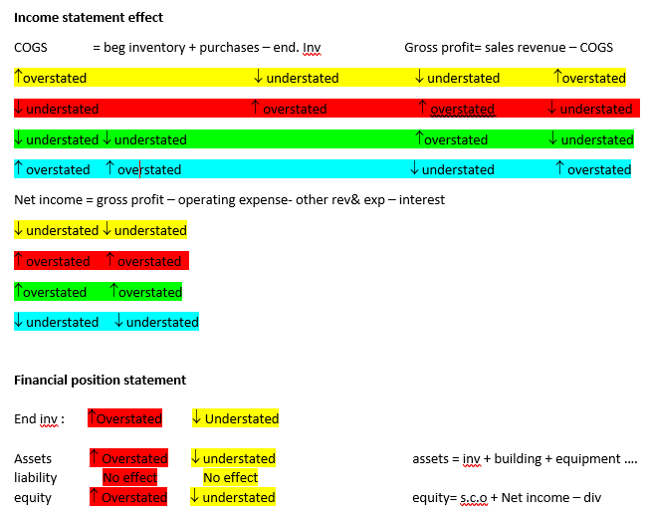
the Effects of Inventory Errors on the Financial Statements

Slide 39
Income Statement Effects (1 of 5)
Inventory errors affect the computation of cost of goods sold and net income in two periods.
Beginning Inventory | + | Cost of Goods Purchased | - | Ending Inventory | = | Cost of Goods Sold
When Inventory Error: |  | Cost of Goods Sold Is: |  | Net Income Is:
Understates beginning inventory |  | Understated |  | Overstated
Overstates beginning inventory |  | Overstated |  | Understated
Understates ending inventory |  | Overstated |  | Understated
Overstates ending inventory |  | Understated |  | Overstated

Slide 40
Income Statement Effects (2 of 5)
Ending Inventory errors affect the computation of cost of goods sold and net income in two periods.
An error in ending inventory of current period will have a reverse effect on net income of next accounting period
Over two years, total net income is correct because errors offset each other
Ending inventory depends entirely on accuracy of taking and costing inventory

Slide 41
Income Statement Effects (3 of 5)
 | 2019 |  |  |  | 2020
 | Incorrect |  | Correct |  | Incorrect |  | Correct
Sales | € 80,000 |  | € 80,000 |  | € 90,000 |  | € 90,000
Beginning inventory | 20,000 |  | 20,000 |  | 12,000 |  | 15,000
Cost of goods purchased | 40,000 |  | 40,000 |  | 68,000 |  | 68,000
Cost of goods available | 60,000 |  | 60,000 |  | 80,000 |  | 83,000
Ending inventory | 12,000 |  | 15,000 |  | 23,000 |  | 23,000
Cost of good sold | 48,000 |  | 45,000 |  | 57,000 |  | 60,000
Gross profit | 32,000 |  | 35,000 |  | 33,000 |  | 30,000
Operating expenses | 10,000 |  | 10,000 |  | 20,000 |  | 20,000
Net income | € 22,000 |  | € 25,000 |  | € 13,000 |  | € 10,000
Combined income for 2-year period is correct.
(€3,000)
Understated
€3,000
Overstated

Slide 42
Income Statement Effects (4 of 5)
Review Question
Understating ending inventory will overstate:
assets
cost of goods sold
net income
stockholders’ equity
LO 3

Slide 43
Income Statement Effects (5 of 5)
Review Question
Understating ending inventory will overstate:
assets
cost of goods sold
net income
stockholders’ equity
LO 3

Slide 44
Statement of Financial Position Effects (2 of 2)
Effect of inventory errors on the statement of financial position is determined by using the basic accounting equation: Assets = Liabilities + Equity.
Errors in the ending inventory have the following effects.
Ending Inventory Error |  | Assets |  | Liabilities |  | Equity
Overstated Understated |  | Overstated Understated |  | No effect No effect |  | Overstated Understated

Slide 45
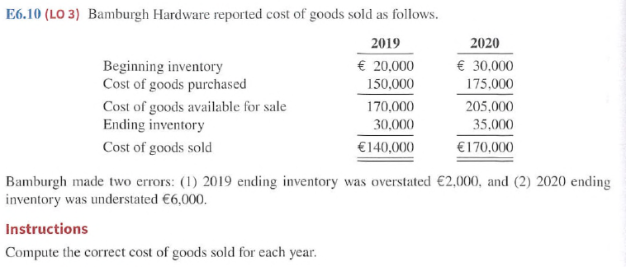
E6-10. Effect of inventory error

Slide 46
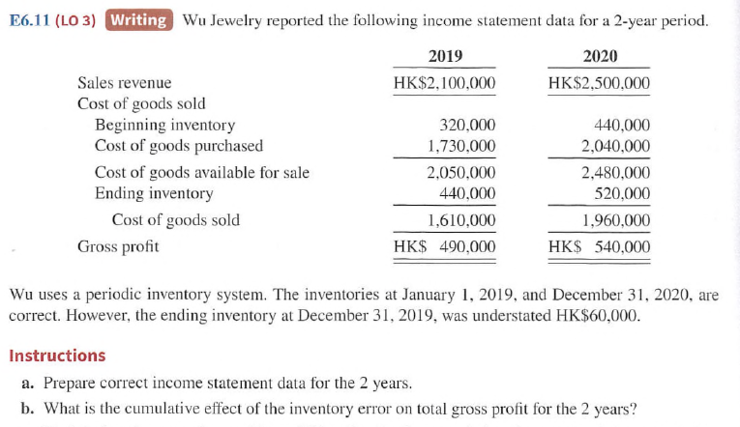
E6-11. Effect of inventory error

Slide 47
Learning Objective 4 Explain the Statement Presentation and Analysis of Inventory

Slide 48
Statement Presentation and Analysis (1 of 2)
Presentation
Statement of Financial Position - Inventory classified as current asset.
Income Statement - Cost of goods sold subtracted from sales.
There also should be disclosure of
major inventory classifications
basis of accounting (cost or LCNRV)
costing method (FIFO, or average-cost)

Slide 49
Lower-of-Cost-or-Net Realizable Value (1 of 2)
When the value of inventory is lower than its cost ( such as in companies selling high tech products)
Companies must “write down” inventory to its net realizable value
Net realizable value: Amount that company expects to realize (receive) from the sale of inventory = estimated selling price in the normal course of business, less estimated costs to complete and sell.
Example of prudence ( the best choice among accounting alternatives is the method that is least likely to overstate assets and income)
LO 4

Slide 50
Lower-of-Cost-or-Net Realizable Value (2 of 2)
Illustration: Assume that Gao TVs has the following lines of merchandise with costs and net realizable values as indicated.
 | Units |  | Cost per Unit |  | Net Realizable Value per Unit |  | Lower-of-Cost-or-Net Realizable Value
Flat-screen TVs | 100 |  | NT$600 |  | NT$550 |  | NT$ 55,000 |  | (NT$550 x 100)
Satellite radios | 500 |  | 90 |  | 104 |  | 45,000 |  | (NT$90 x 500)
DVD recorders | 850 |  | 50 |  | 48 |  | 40,800 |  | (NT$48 x 850)
DVDs | 3,000 |  | 5 |  | 6 |  | 15,000 |  | (NT$5 x 3,000)
Total inventory |  |  |  |  |  |  | NT$155,800

Slide 51
DO IT! 4: LCNRV and Inventory Turnover
Poon Heaters sells three different types of home heating stoves (gas, wood, and pellet). The cost and net realizable value of its inventory of stoves are as follows.
Cost Net Realizable Value
Gas NT$ 84,000 NT$ 79,000
Wood 250,000 280,000
Pellet 112,000 101,000
Determine the value of the company’s inventory under the lower-of-cost-or-net realizable value approach.
Solution: The lowest value for each inventory type is gas NT$79,000, wood NT$250,000, and pellet NT$101,000. The total inventory value is the sum of these amounts, NT$430,000.

Slide 52
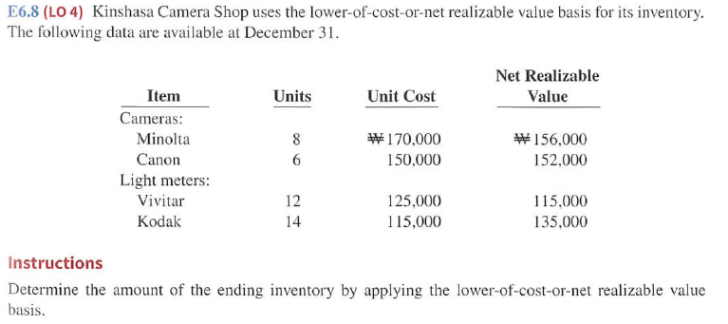
E6-8: LCONRV

Slide 53
Learning Objective 5 Apply the Inventory Cost Flow Methods to Perpetual Inventory Records

Slide 54
Appendix 6A Inventory Cost Flow Methods in Perpetual Inventory Systems
LIN ELECTRONICS
Date |  | Explanation |  | Units |  | Unit Cost |  | Total Cost |  | Balance in Units
1/1 |  | Beginning inventory |  | 10 |  | $100 |  | HK$ 1,000 |  | 10
4/15 |  | Purchase |  | 20 |  | 110 |  | 2,200 |  | 30
8/24 |  | Purchase |  | 30 |  | 120 |  | 3,600 |  | 60
9/10 |  | Sale |  | 55 |  |  |  |  |  | 5
11/27 |  | Purchase |  | 40 |  | 130 |  | 5,200 |  | 45
 |  |  |  |  |  |  |  | HK$12,000
Illustration: Compute Cost of Goods Sold and Ending Inventory under FIFO and average-cost.

Slide 55
First-In, First-Out (FIFO) (2 of 2)
Date |  | Purchases |  |  |  | Cost of Goods Sold |  | Inventory Balance
January 1 |  |  |  |  |  |  |  | (10 @ HK$100) |  | HK$1,000
April 15 |  | (20 @ $110) |  | HK$2,200 |  |  |  | (10 @ HK$100) |  | HK$3,200
 |  |  |  |  |  |  |  | (20 @ HK$110)
August 24 |  | (30 @ $120) |  | HK$3,600 |  |  |  | (10 @ HK$100)
 |  |  |  |  |  |  |  | (20 @ HK$110) |  | HK$6,800
 |  |  |  |  |  |  |  | (30 @ HK$120)
September 10 |  |  |  |  |  | (10 @ HK$100)
 |  |  |  |  |  | (20 @ HK$110)
 |  |  |  |  |  | (25 @ HK$120) |  | (5 @ HK$120) |  | HK$600
 |  |  |  |  |  | HK$6,200
November 27 |  | (40 @ $13) |  | HK$5,200 |  |  |  | (5 @ HK$120) |  | HK$5,800
 |  |  |  |  |  |  |  | (40 @ HK$130)

Slide 56
Average-Cost (2 of 2)
Date |  | Purchases |  |  |  | Cost of Goods Sold |  | Inventory Balance
January 1 |  |  |  |  |  |  |  | (10 @ HK$100) |  | HK$ 1,000
April 15 |  | (20 @ HK$110) |  | HK$2,200 |  |  |  | (30 @ HK$106.667) |  | HK$ 3,200
August 24 |  | (30 @ HK$120) |  | HK$3,600 |  |  |  | (60 @ HK$113.333) |  | HK$ 6,800
September 10 |  |  |  |  |  | (55 @ HK$113.333) |  | (5 @ HK$113.333) |  | HK$ 567
 |  |  |  |  |  | HK$6,233
November 27 |  | (40 @ HK$130) |  | HK$5,200 |  |  |  | (45 @ HK$128.156) |  | HK$5,767

Slide 57
