Slide 1
Nutrients
Ola anabtawi
Human nutrition
Notes:
.

Slide 2
Nutrients
A complete understanding of nutrition requires knowledge of nutrients
Chemical and physical structure
Food sources
Digestion, absorption, transport, cellular uptake
Metabolism, functions, storage, excretion
Physiological demands
Interactions with other nutrients/non-nutrients
Consequences of over/under consumption

Slide 3
Nutrients
Class | Subclass | Nutrient examples
Proteins | Plant sources Animal sources | Amino acids: e.g leucine, glycine, cysteine, tyrosine Essential / Non essential
Carbohydrates | Monosaccharides Disaccharides | Glucose, fructose, sucrose, maltose
Lipids | Saturated Monounsaturated Polyunsaturated | Palmitic & stearic acid Oleic & elaidic fatty acids Linoleic & arachidonic acids
Minerals | Minerals & electrolytes Trace elements | Calcium, iron, sodium, selenium, copper, chromium
Vitamins | Fat soluble Water soluble | Retinol (A), tocopherols (E) Thiamine (B₁), niacin (B₃)
Water | Water | Water
Introduction to Human Nutrition (Eds Gibney, Vorster & Kok) 2002, p5

Slide 4
CARBOHYDRATES

Slide 5
Outline of session
What is carbohydrate?
Digestion
Absorption
Fermentation
Dietary recommendations

Slide 6
Why do we need carbohydrates? Energy? Structure ?

Slide 7
CARBOHYDRATE CLASSIFICATION

Slide 8
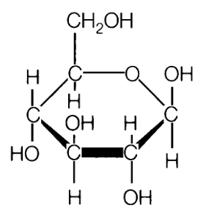
Carbohydrate
Main source of energy in the average human diet
Carbohydrate literally means ‘carbon with water’
Composed of carbon, hydrogen and oxygen
General formula (CH₂0)_{X}
Glucose = C₆H₁₂0₆

Slide 9
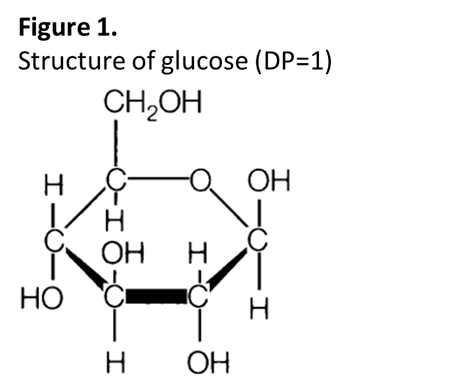
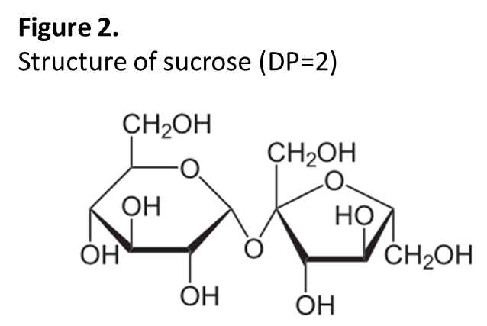
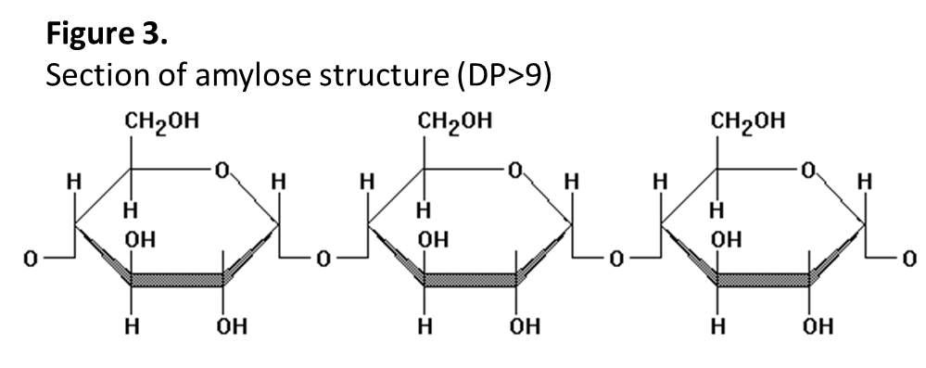
CLASSIFIED BY DEGREE OF POLYMERISATION
Sugars (mono- and disaccharides DP 1 – 2)
Oligosaccharides (DP 3 – 9)
Polysaccharides (DP>9)
MONOSACCHARIDE composition and TYPE of LINKAGE influence physiological/chemical properties

Slide 10
Monosaccharide
Disaccharide
Oligosaccharide
Polysaccharide
?

Slide 11
Classification of carbohydrates
CLASS (DP) | SUBGROUP | EXAMPLES
Sugars (1 – 2) | Monosaccharides Disaccharides Polyols (sugar alcohols) | Glucose, fructose, galactose Sucrose, lactose, maltose, Sorbitol, mannitol, lactitol, xylitol
Oligosaccharides (3 – 9) | a-glucans (malto-oligosaccharides) Non a-glucan oligosaccharides | Maltodextrins Raffinose, fructo- and galacto-oligosaccharides, polydextrose, inulin
Polysaccharides (>9) | Starch (a-glucans) Non-starch polysaccharides | Amylose, amylopectin, modified starches Cellulose, hemicellulose, pectin, arabinoxylans, plant gums.
amylose A digestible straight-chain type of starch composed of glucose units.
amylopectin A digestible branched-chain type of starch composed of glucose units.

Slide 12
Structural features
Source: advanced nutrition and human metabolism (P:64)

Slide 13
Source: Contemporary nutrition, functional approach

Slide 14
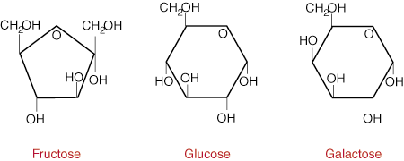
Monosaccharides
Glucose, fructose and galactose
Building blocks of naturally occuring di-, oligo-, and poly- saccharides
Same formula (C₆H₁₂0₆) but different structure
Dietary sources of glucose and fructose:
Honey
Cooked/dried fruit
Fruit, berries & vegetables
Corn syrup used by food industry
Galactose
Not normally found in its native form
Hydrolysed from its disaccharide lactose (Glucose + Galactose) in milk or dairy products

Slide 15
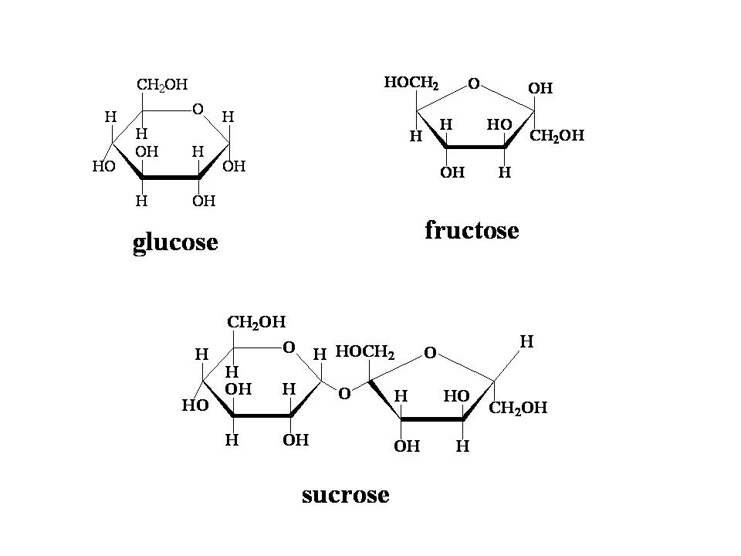
Linking monosaccharies
Monosaccharides can be linked together by a glycosidic bond
Numbers designate which carbon atoms form the bond
Alpha or beta bonds designate whether the bond faces up or down
E.g. Sucrose (α-1,2 linked glu-fru)
Alpha (a) glycosidic bond between carbon atom 1 of the glucose unit and carbon atom 2 of the fructose unit
Type of bond determines if a carbohydrate is digestible or non-digestible by mammalian enzymes
6
1
5
2
5
4
1
6
3
4
3
2
Formation of a glycosidic bond between glucose and fructose

Slide 16
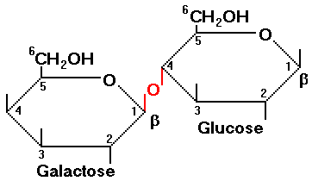
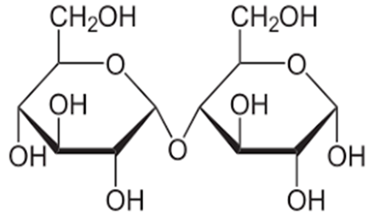

Slide 17
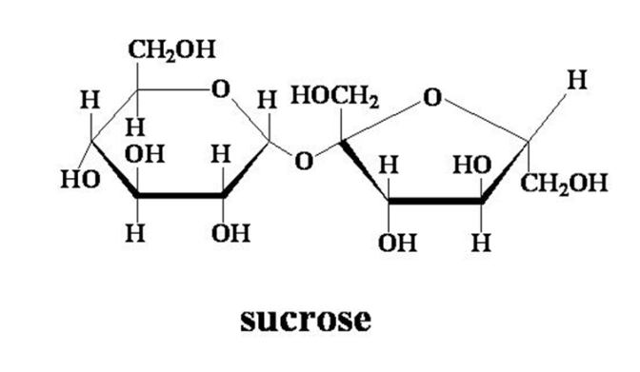
Disaccharides (DP2)
Sucrose (α-1,2 linked glu-fru)
Sugar cane, sugar beet, fruit
Now a major source of energy in the human diet
Most commonly used natural sweetener
Lactose (β-1,4 linked gal-glu)
Found naturally only in milk & dairy produce
Maltose (α-1,4 linked glu-glu)
Grain
Produced during the digestion of starch
Malt beverages e.g. Beers and malt liquors

Slide 18
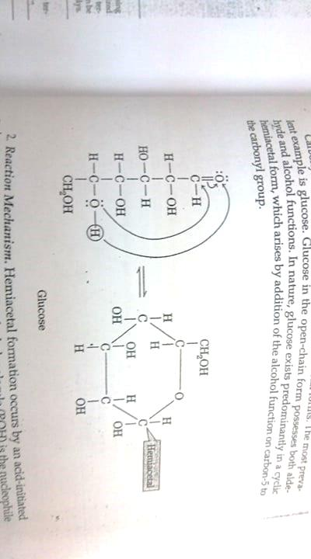

Slide 19
Oligosaccharides (DP3-9)
Two sub groups, depending on type of bond
Alpha glucans (α-1,4 or α -1,6 bonds)
Mostly derived from starch
Digested and absorbed like polysaccharide α -glucans
Non-alpha glucans
Peas, beans, lentils
Not susceptible to pancreatic or brush border enzyme breakdown
‘Non-digestible oligosaccharides’

Slide 20
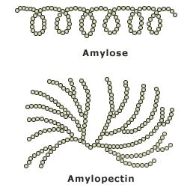
Polysaccharides (DP>9)
Two sub groups, depending on type of bond
Alpha glucans (starch)
Main storage polysaccharide of plants
Cereals, root vegetables, legumes
Starch consists of two polymers of glucose
Amylose (linear polymer a-1,4 bonds)
Amylopectin (branched polymer a-1,4 & a-1,6 bonds)
Modified starch
By chemical processing or plant breeding techniques
Glycogen (branched polymer a-1,4 & a-1,6 bonds)
Storage carbohydrate in animals (muscle, liver, skeletal muscle)

Slide 21
Polysaccharides (DP>9)
Two sub groups, depending on type of bond
Non-alpha-glucans (non-starch polysaccharides -NSP)
Polysaccharides of plant cell walls
Cellulose
Major component of plant cell walls
Linear polymer of glucose (b-1,4 linked)
10-30% of non-starch polysaccharides in food
Hemicelluloses
Polymer of various sugar monomers (b linked), branched
Pectins
Primarily β-1,4-D-galacturonic acid polymers
Plant gums
Common food additives (thickening and stabilizers)

Slide 22
Classification of carbohydrates
Classification according to chemical structure (Degree of Polyrization) does not necessarily predict physiological behaviour
Monosaccharide composition and type of linkage determine the nutritional properties
Glycaemic carbohydrates
Provides glucose for metabolism as a result of digestion and absorption in the small intestine
Non-glycaemic carbohydrates
Not digested in the small intestine
Fermented to short chain fatty acids, CO₂, H₂ and methane in the large intestine

Slide 24
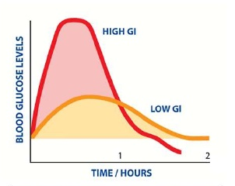
The Glycaemic Index (GI)
Index based on glycaemic response to carbohydrate containing foods compared with a reference food
Glucose GI = 100
Measure 2 hour blood glucose response curve following ingestion of 50 g carbohydrate (compared to 50 g glucose standard or white bread)
Must be in fasted state
Low GI: < 57
Medium GI: 58-69
High GI: > 70

Slide 25
Glycemic Index (GI)
GI of a food is defined by the area under the 2-hour blood glucose response curve (AUC) following the ingestion of a fixed portion of CHO (usually 50 g of test food).
The AUC of the test food is divided by the AUC of the standard (either glucose or white bread) and multiplied by 100.

Slide 26
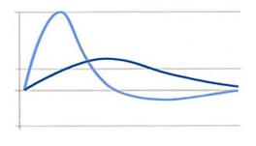
Glycemic Index (GI): Sample Graphs
Adapted from Good Carbs Bad Carbs Reprinted courtesy of Marlowe & Company.

Slide 27
Factors effecting GI
Whole-grain foods tend to have a lower GI than their refined products
Fibre content esp soluble fibre, slow down the digestion of starch-high fiber foods have lower GI. Eg. Apples with skin have lower GI than without skin
Fat & protein-slow down foods from leaving the stomach, therefore, foods containing fat and protein eg beans and milk have lower GI values
Acid content-lemon juice or vinegar can lower GI
Maturation-unripened fruit have lower GI and ripe fruits

Slide 28
Factors Influencing GI Ranking
Type of starch
Physical entrapment
Viscosity of fiber
Sugar content
Fat and protein content

Slide 31
Factors Influencing GI Ranking
Viscosity of Fiber
Viscous, soluble fibers transform intestinal contents into gel-like matter that slows down enzymatic activity on starch.
Lower GI
Apple (40)
Rolled oats (51)
Higher GI
Whole wheat bread (73)

Slide 32
Fat & Protein Content
Fat and protein slow down gastric emptying, and thus, slows down digestion of starch.
Lower GI
Peanut M&M’s (33)
Potato chips (54)
Special K (69)
Higher GI
Jelly beans (78)
Baked potato (85)
Corn Flakes (92)

Slide 33
Acid Content
Acid slows down gastric emptying, and thus, slows down the digestion of starch.
Lower GI
Sourdough wheat bread (54)
Higher GI
Wonder white bread (73)

Slide 34
Cooking degree and cooking method

Slide 35
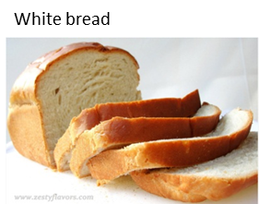
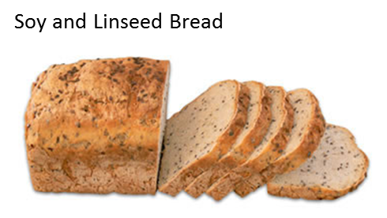
Higher or lower?
V’s

Slide 36
Glycemic Index (GI)
Foods that are digested and absorbed faster will have a higher glycemic index
Food high in sugar not necessarily high GI eg Sucrose –intermediate GI ~ bread, rice and potatoes

Slide 37
Glycemic Index (GI)
The use GI and glycemic load (GL) may provide a modest additional benefit over when total CHO is considered alone
Low GI foods that are rich in fiber and other important
nutrients should be encourage
The GI of a foods remains the same no matter how much is eaten. But eating a large amount of CHO-containing food will raise blood glucose level more than eating small amount of that food
Although various starches have different glycemic response, first priority should be given to the total amount of CHO consumed rather than the sources of CHO

Slide 38
Glycemic load (GL)
Is about portion size
GL of foods, meals, and diets are calculated by multiplying the GI of the constituent foods by the amounts of CHO in each serving of food and dividing the results by 100
GL= (GI x gram CHO)
100
Eg. 60g banana(1 exch CHO) therefore GL=(52x15)/100
=8

Slide 39
How to calculate GL
Dividing the glycemic index (GI) of a food by 100 and then multiplying by the grams of carbohydrate in one serving.
Example,
the GL of carrots that have a GI of 16 and contain approximately 8 g carbohydrates per serving is 1.3 (16 ÷ 100 × 8).
soft drink has a GI of 63 and 39 g carbohydrate is approximately 25 (63 ÷ 100 × 39).
Reference Food Glycemic Index (GI) Glycemic Load(GL)
High ≥70 ≥20
Medium 56–69 11–19
Low ≤55 ≤10

Slide 40
Application
Low GI:
weight management , DM control, endocrine problem, PCOS, Mood
lipogenicity

Slide 41
DIGESTION AND ABSORPTION

Slide 42
Digestion and absorption
Carbohydrate digestion aims to liberate monosaccharides from disaccharides and polysaccharides
Some carbohydrates hydrolysed to monosaccharides & absorbed in small intestine
Most sugars
α-glucan oligosaccharides
Starch (some starch is resistant)
Others resist digestion & pass into large intestine where they are fermented
Some sugars (e.g. lactose)
Non- α -glucan oligosaccharides
Non- α -glucan (non-starch) polysaccharides
Resistant starch

Slide 43
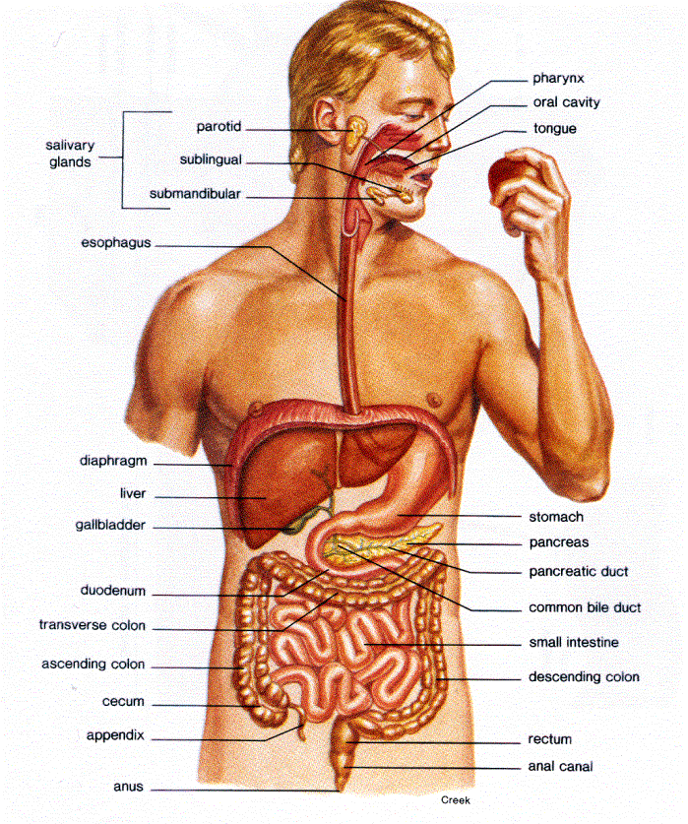
Digestion and absorption
Carbohydrate entering the mouth:
Mix of mono-, di-, oligo-, and polysaccharides
Differing susceptibility to digestion in small intestine
Carbohydrate entering the blood stream:
Mainly glucose
Small amounts of fructose and galactose
DIGESTION AND ABSORPTION

Slide 44
DIGESTION
Begins in the mouth
Chewing breaks up food structure and mixes with saliva (α -amylase)
Action of α-amylase
Produced by salivary gland and pancreas
Optimal pH range is 6.6-6.8
Activity inhibited by low pH in stomach (once swallowed)
Digests α -1,4 links in amylose and amylopectin
Does not hydrolyze bonds at the ends of molecules or those next to a-1,6 branch points
AMYLOSE
MALTOSE
AMYLOPECTIN
OLIGOSACCHARIDES
WITH 1 OR MORE
a1,6 LINKAGES

Slide 45
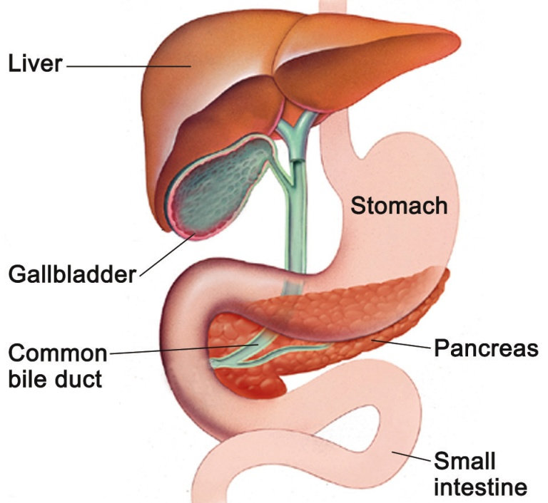
Digestion in small intestine
α -amylase produced by pancreas (acinar cells) & secreted into small intestine
Lumen of the SI
α-amylase hydrolyses α 1-4 glycosidic linkages
Starch → dextrins and maltose
Branched starch → mixture of dextrin (multiple glucose units/ molecule α1-6 bonds)
Remainder of digestion occurs at intestinal surface, close to transporter proteins. Ideal for absorption

Slide 46
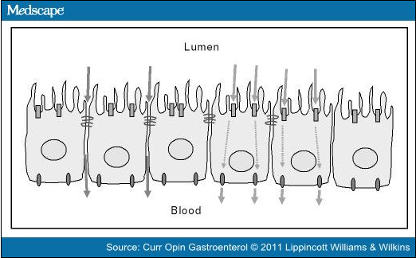
Digestion
Brush border of intestinal epithelium
Enterocytes lining villi of small intestine contain;
Glucosidases: Further reduce dextrin
Disaccharidases: Hydrolyse maltose, sucrose, lactose into constituent monosaccharides
Specific oligosaccharidases
e.g. sucrase-isomaltase – hydrolyses sucrose, maltose and isomaltose
Resulting monosaccharides (glucose, galactose, fructose) available for absorption
Transported across epithelial cells and into the portal vein
Most of the monosaccharides are absorbed in the small intestine.
Carbohydrate which has not been digested in this way passes into the large intestine e.g. NSP

Slide 47
Absorption in the small intestine
Sugar transporters on enterocytes
Apical membrane
Glucose and galactose
Sodium-glucose transport protein-1 (SGLT1)
Fructose
GLUT5 protein (passive transport)
Basolateral membrane
Glucose, galactose and fructose
GLUT2 protein
Monosaccharides are transported to blood vessels linking to portal vein to liver

Slide 48
Absorption in the small intestine
Glucose & galactose
Fructose
Na⁺
GUT LUMEN
KEY:
Apical membrane
GLUT5
SGLT1
Basolateral membrane
Fructose
Glucose & galactose
Na⁺
GLUT2
K⁺
Na⁺/K⁺-ATPase
BLOOD
Fructose
Glucose & galactose
K⁺
Na⁺

Slide 49
First exam
2 assign 5
Online 10 MCQ
Take home 10 (10 points short essay.
13-3 ( 5- 6:30) first 15 min online,,,, 5 min,,,,, 40 minutes.

Slide 50
Absorption in the small intestine
Active transport of glucose
Requires energy and a specific receptor/transporter
Active transport of sodium across apical membrane (Na⁺/K⁺-ATPase)
Decreased sodium inside the cell draws sodium across apical membrane with glucose (SGLT1)
Glucose passes across basolateral membrane into blood vessels by facilitated transport (GLUT2)
Facilitated diffusion of fructose
Across the apical membrane (GLUT5)
Across the basolateral membrane (GLUT2)

Slide 51
Carbohydrate Absorption
Rate of uptake of glucose from the intestine
is determined by the rate of hydrolysis of
oligosaccharides and polysaccharides
that are susceptible to brush border enzymes

Slide 52
Digestion and absorption
Some carbohydrates hydrolysed to monosaccharides & absorbed in small intestine
Most sugars
α -glucan oligosaccharides
Starch (some starch is resistant)
Others resist digestion & pass into large intestine where they are fermented
Some sugars (e.g. lactose)
Non- α -glucan oligosaccharides
Non- α -glucan (non-starch) polysaccharides
Resistant starch

Slide 53
AMDR calculation

Slide 54
AMDR calculation
Wt: 67 kg, ht: 166cm. BMI
AMDR.
Total calories req. = quick method 30* wt, 35*wt, 40*wt
Total Kcal: 35* 67= 2345 kcal.
Protein: 0.85 gm/kg or 1 gm/ kg = 67gm protein/ day.
Kcal. From protein= 67* 4 = 268 kcal from prn.
AMDR prn= 268/2345= 11%.
Non Protein KCal= 89% ( CHO or Fat) = 25- 30.
Fat: .30*2345= 704 kcal from fat= 78gm/day
Kcal from CHO= 1373 kcal/ day = 59%

Slide 55
2345 kcal
Protein= 0.2* 2345= 469 kcal= 117 = ( 7gm) 17 serving

Slide 56
Non-glycaemic carbohydrates
Carbohydrates enter colon because:
Enzymes needed to digest the carbohydrates
i) Are not present in the small intestine
ii) Cannot gain access to the carbohydrate
e.g. starch trapped inside plant cell walls
iii) Do not digest the carbohydrate rapidly enough
Affected by particle size and transit time
Monosaccharide transporters do not exist or function at a high enough rate
Notes:
56

Slide 57
Lack of enzyme
Bond type determines susceptibility to enzymatic breakdown in the small intestine
No enzyme produced by vertebrates which can hydrolyze the β−linkage
α -glucans
α - chemical bonds are susceptible to brush border or pancreatic enzymes
E.g. Amylose α -1,4 bonds
Non- α -glucans
β - chemical bonds not susceptible to brush border or pancreatic enzymes
E.g. Cellulose bonds are primarily β-1,4
Notes:
57

Slide 58
Fermentation in the large intestine
Carbohydrate is fermented by bacteria
Undigested starch
Dietary fibre (NSP)
Non-absorbable sugars
Sugar alcohols
Fermentation is anaerobic
Colon contains a complex ecosystem of over 400 known species of bacteria
Symbiotic relationship: pro , pre biotic
Obtain substrates for growth from the host
Return by-products of their metabolism to the host

Slide 59
Fermentation in the large intestine
Bacteria produce hydrolytic enzymes
di-, oligo- and polysaccharides broken down into monosaccharides
Monosaccharides are internalised by bacteria (energy for growth)
Converted to pyruvate via glycolytic pathway
Main products of fermentation are
Short chain fatty acids (SCFA)
Acetate,
Propionate
Butyrate.
Gases (C02, H20 and methane)

Slide 60
Fermentation in the large intestine
Produces short chain fatty acids (SCFA)
Butyrate
Major energy source for colonic epithelial cell
Propionate
Absorbed and transported to the liver
Acetate
Absorbed and enters peripheral circulation and metabolised by peripheral tissues
Metabolised by skeletal and cardiac muscle, and the brain
Total energy provided from fermentation in humans is only about 5-10% (healthy individuals following a western diet)

Slide 61
Fermentation
Some sugars (e.g. lactose)
Non-α-glucan oligosaccharides
Non-α-glucan (non-starch) polysaccharides
Resistant starch
Anaerobic microbial metabolism
Hydrogen
Carbon dioxide
Methane
Acetate
Propionate
Butyrate
Microbial biomass
Breath
Flatus
Blood
Faeces

Slide 62
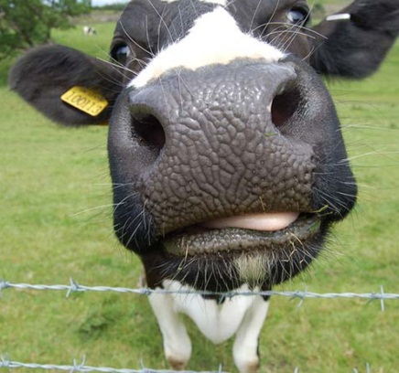
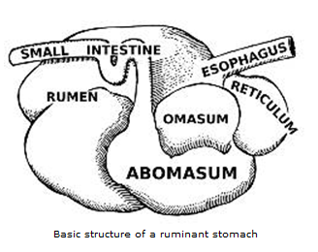
Ruminants
www.macroevolution.net
Cattle, sheep and goats
Unique digestive system
Diet rich in roughage and plant material
Use energy from plants
Diet consists mainly of b-linked polysaccharides (e.g. cellulose)
Not susceptible to mammalian digestive enzymes
Evolved a specialist digestive system
Foods exposed to microbial digestion in the rumen prior to exposure to host digestive enzymes
Partially digested to yield short chain fatty acids
Propionate, acetate, butyrate
Provide 70-80% of a ruminant’s energy requirements

Slide 63
GLUCOSE METABOLISM

Slide 64
Glucose metabolism
Monosaccharides absorbed from the gut are transported via the portal vein to the liver
Glucose, fructose, galactose
Concentrations of glucose in the portal vein can reach up to 10mM after a meal
Fructose and galactose are removed by the liver and metabolised
Blood concentrations rarely exceed 1mM
Only glucose appears in significant concentrations in the peripheral circulation
Uptake by all tissues for metabolism

Slide 65
In the liver…
FRUCTOSE → Fru-1-Phos → Glycolytic intermediates
LIVER
GALACTOSE → Gal-1-Phos → Glu-1-Phos
GLUCOSE
PORTAL VEIN
GLUCOSE
FRUCTOSE
TO PERIPHERAL CIRCULATION AND TISSUES FOR UTLISATION
GUT
GALACTOSE

Slide 66
Homeostatic control of glucose
Blood glucose is very tightly controlled within a range of
3.0 - 5.5 mmol/L
Why?
Glucose is the primary source of energy within the body
Brain and nervous system mainly dependent on glucose
Red blood cells are entirely dependent on glucose

Slide 67
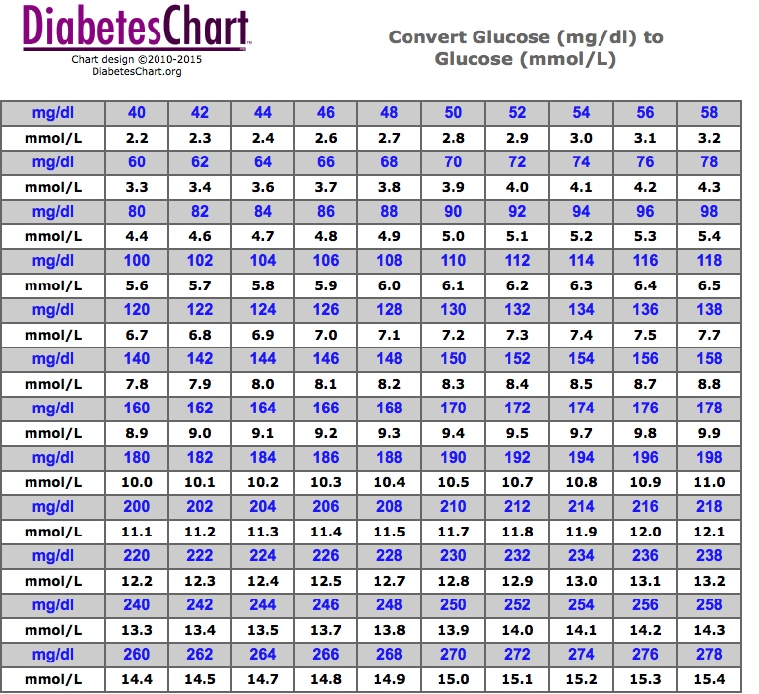

Slide 68
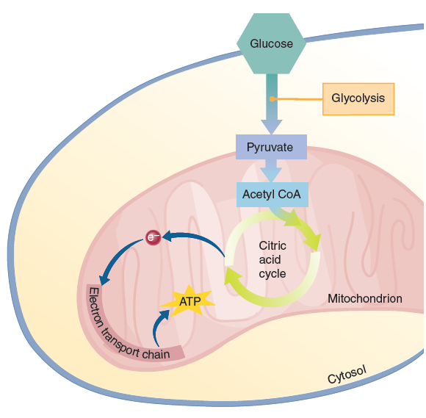
How is it used as an energy source?
Complete oxidation of glucose occurs under aerobic conditions (i.e. in the presence of oxygen)
C₆H₁₂0₆ + 6O₂ → 6CO₂ + 6H₂O + energy
By the processes of glycolysis, the citric acid cycle and oxidative phosphorylation
40% of the free energy is released as ATP (38 molecules per glucose molecule)
Remainder released as heat

Slide 69
How is it used as an energy source?
GLUCOSE
GLU-6-PHOS
Anaerobic glycolysis
Glycolysis
PYRUVATE
LACTATE
Citric acid cycle (Kreb’s cycle)
Oxidative phosphorylation

Slide 70
Consequences of low or high blood glucose
Excessively low or high concentrations
Loss of consciousness :
Hypoglycaemic coma (low blood glucose)
Hyperglycaemic coma (high blood glucose)
Moderate hyperglycaemia
Rate of glomerular filtration in kidney exceeds tubular reabsorption - glucose appears in the urine
Leads to osmotic diuresis resulting in excessive urination (polyuria) & excessive thirst (polydipsia)
Polyphagia
Weight loss.
Also causes microvascular damage, which can lead to blindness, limb amputation etc.

Slide 71
Homeostatic control of glucose
Blood glucose is very tightly controlled within a range of 3.0-5.5 mmol/L
Energy expenditure is relatively constant throughout the day
Food intake occurs in meals – switching between fed and fasted state
Metabolic regulation is essential to ensure:
A constant supply of fuel throughout the day
That glucose concentrations return to normal soon after a meal

Slide 72
Fate of glucose in the cell
As already shown, glucose is metabolised to provide energy
Primary source of energy in the cell
Central to all metabolic processes
Also converted into:
Glycogen (liver and muscle)
Fatty acids & then triacylglycerol (liver & adipose tissue
Ribose and deoxyribose (all tissues, high in liver & adipose tissue)
For synthesis of RNA, DNA, ATP, GTP, NAD, NADPH

Slide 73
DEFINITIONS
GLYCOGENESIS: Synthesis of Glycogen from glucose
GLYCOGENOLYSIS: Stored glycogen is converted to glucose
GLUCONEOGENESIS: Synthesis of glucose from non-carbohydrate sources

Slide 74
Gluconeogenesis
Synthesis of glucose from non carbohydrate substrates
Lactate- Cori cycle (lactate→ pyruvate +ATP→ glucose)
Alanine and Glutamine
Glycerol: Tg: Gl+ 3 FA
(also other amino acids but alanine is the main one)
Stimulated by glucagon, inhibited by insulin
Liver is the main site for gluconeogenesis
Gluconeogenesis and glycogenolysis tend to be active at the same time
Hyperglycemia in prolonged fasting in DM?

Slide 75
Fate of glucose in the cell
As already shown, glucose is metabolised to provide energy
Primary source of energy in the cell
Central to all metabolic processes
Also converted into:
Glycogen (liver and muscle)
Fatty acids & then triacylglycerol (liver & adipose tissue)
Non-essential amino acids (liver & kidney)
Ribose and deoxyribose (all tissues, high in liver & adipose tissue)
For synthesis of RNA, DNA, ATP, GTP, NAD, NADPH

Slide 76
REGULATION OF GLUCOSE METABOLISM

Slide 77
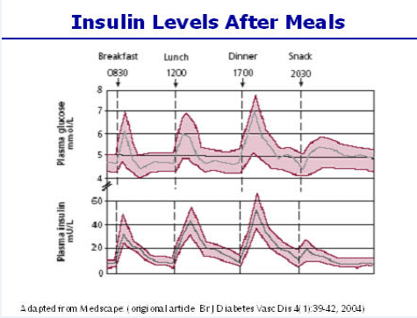
In the fed state
Immediately after a meal, there is a good supply of metabolic fuel
In the fed state, glucose is the primary source of fuel for most tissues
Increased concentrations of glucose in the portal blood leads to:
Stimulation of insulin production in β cells of pancreatic islets
Suppression of glucagon production in α cells of pancreatic islets

Slide 78
Insulin
Blood glucose
concentrations
3 – 5 mmol/l
FED
FASTED
Glucagon
Notes:
I

Slide 79
In the fed state
Insulin actions include:
↑ glucose uptake by muscle & adipose tissue
↑ glycogen synthesis in liver and muscle
↑ fatty acid synthesis in adipose tissue
↑ amino acid uptake, leading to ↑ rates of protein synthesis
Insulin acts to
Promote the use of glucose as fuel
Promote protein and fatty acid synthesis

Slide 80
In the fasting state
In the fasting state (or post-absorptive state – 4-5 hours after a meal):
Metabolic fuel enters the circulation from reserves of glycogen, triacylglycerol & protein
Glucose ‘spared’ for brain and red blood cells
Decreased concentrations of glucose in the portal blood leads to:
Suppression of insulin production β cells of pancreatic islets
Stimulation of glucagon production α cells of pancreatic islets
Insulin
FED
Blood glucose
concentrations
3 – 5 mmol/l
FASTED
Glucagon

Slide 81
In the fasting state
Glucagon actions include:
↑ glycogen breakdown to release glucose
↑ synthesis of glucose from amino acids and triglycerides in liver and kidney (gluconeogenesis)
The reduced secretion of insulin acts to:
↓ Rate of glucose uptake into muscle
↓ Rate of protein synthesis
↑ Release of fatty acids
Adrenaline, cortisol and growth hormone also contribute to these effects

Slide 82
DIETARY REQUIREMENTS

Slide 83
Dietary requirements
No absolute requirement to sustain life
Provided protein and fat intakes are adequate
However, low carbohydrate diets are associated with
High concentrations of ketone bodies
Absence of glycogen stores
Hypercholesterolaemia
Recommendations for dietary intake are those associated with optimal health

Slide 84
Basis of recommendations
Total carbohydrate ~ 50%
High levels may be associated with inadequate intakes of protein, fat and other essential nutrients
Low levels may be associated with excessive levels of saturated fat intakes
Non-starch polysaccharides
Main component of ‘dietary fibre’
Recommendation based on observed associations between NSP intake, bowel habit and bowel cancer risk ( less or more)
14gm/1000kcal/ day

Slide 85
Basis of recommendations
Total sugars split into:
Intrinsic - incorporated within plant cell walls
Extrinsic – added sugars
Extrinsic sugars fermented by bacteria in the mouth to yield acidic end products - dental caries
Should be limited to 10% of energy intake
Lactose is not incorporated within cell walls so could be considered extrinsic. However, it is in milk, which has important nutritional properties

Slide 86
Summary –
Blood glucose concentrations must be very tightly controlled
Glucose is the primary source of fuel in the body and is an absolute requirement for some tissues
Glucose can be stored as glycogen
Intermediates of carbohydrate metabolic pathways can be used for amino acid or protein synthesis
Insulin and glucagon play a key role in regulating glucose metabolism
Although not an ‘essential’ nutrient, dietary recommendations have been made to promote intakes consistent with optimal health

Slide 87
Health effect of sugars
Nutrient deficient
Dental caries
Obesity, does sugar cause obesity?
Heart diseases, Does sugar cause heart, disease?
Does sugar cause misbehavior in children ADHA and criminal in adults
Sugar cause addiction?

Slide 88
Sweet taste ,,,,, make us enjoying the food.
Sugar from fruits, vege, grains account for half of the sugar intake ( America), the rest from added sugars.
The added sugars : any sugars that can be added to the food.
Sugar is empty calories
Food with added sugars considered nutrients deficient food.

Slide 89
Why
Fruits is better than sweetened tea in same amount of sugars?

Slide 90
Dental caries
Bacteria in the mouth ferment the sugars and,
in the process, produce an acid that erodes tooth enamel
sugar in a juice consumed quickly, for example, is less likely to cause dental caries than sugar in a pastry.

Slide 91
How fast
How often

Slide 92
Sugar and obesity
I can of coca cola if replaced with water …. Decrease 1 kg /month.
Consider the energy balance

Slide 93
Sugar and heart diseases
A diet high in added sugars can alter blood lipids to favor heart disease.
This effect is most dramatic in people who respond to sucrose with abnormally high insulin secretions, which promote the making of excess fat
Eating trans fat has impact
Other factors can affect the heart: smoking, stress life

Slide 94
Sugar and ADHA children
Attention defect hyper active children
Or law breaking adults.
No scientific evidence supports a relationship between sugar and hyperactivity or other misbehaviors.

Slide 95
Sugar and craving
Carbohydrate cravings” “sugar addicts.”
Theory: CHO increase the level of serotonin.
Is it same in obese?

Slide 96
Recommended intake of sugars
Less is better
Less than 10% of the total energy intake
Less than 200 kcal/ day.

Slide 97
Health effect of starch and fibers
CHO (45 to 65 percent of energy intake) is acceptable
Heart disease: high fiber food protect from heart diseases. ( due to less animal fat) and lower cholesterol: ( fibers binds to bile and increase the secretion of the bile, and the bile made from cholesterol ( so the body use cheolesterol )

Slide 98
Fiber: fiber decrease the risk of DM, it delay the absorption from the GI.
GI health: fiber enhance the health of Intestine, how
More fiber, increase stool weight, easier passage of stool, less exposure to toxins

Slide 99
Cancer: increase fiber, protect against colon cancer.
People who ate the most dietary fiber (35 grams per day) reduced their risk of colon cancer by 40 percent compared with those who ate the least fiber (15 grams per day).
Fibers may help prevent colon cancer by diluting, binding, and rapidly removing potential cancer-causing agents from the colon.

Slide 100
Weight management:
High-fiber and whole-grain foods help a person to maintain a healthy body weight.
Foods rich in complex carbohydrates tend to be low in fat and added sugars and can therefore promote weight loss by delivering less energy

Slide 101
Harmful effect of fiber (123)
High fiber: cause abdominal discomfort, gas, diarrhea.
Can obstruct the GI
Make the food less in calories ( not good for malnurished)
Increase fiber gradually, drink plenty of water.
IBS: FODMAP

Slide 102
How to increase fiber intake
Eat whole meal grains
Eat vegetables daily
Eat fruits daily

Slide 103
Artificial sweetener (132)
FDA approved
Saccharin, aspartame, acesulfame potassium (acesulfame-K), sucralose, and neotame.
Stevia: herbal sweetener
Fructose : NAFL

