Slide 1
Static Variables
a static variable’s lifetime (or "extent") is the entire run of the program.

Slide 2
Automatic variable
Output: 111

Slide 3
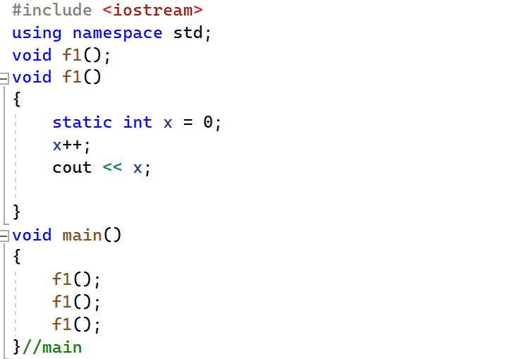
Static Variable
Output: 123

Slide 4
Function Overloading
Two or more functions can have the same name but differ in one or more of the following:
Type of parameters.
Number of parameters.
Order of parameters.
Note the type of returned data can not be used to differentiate between the overloaded functions.

Slide 5
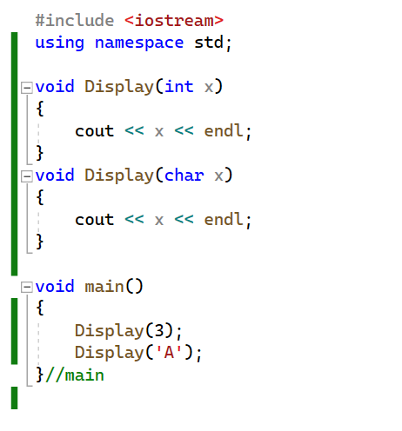
Function Overloading
Same function name
Same number of parameters
Different parameter datatypes

Slide 6
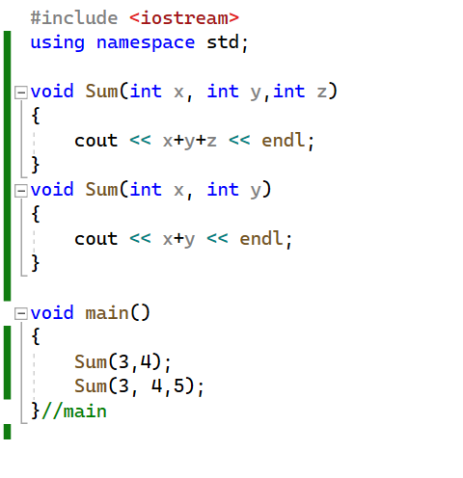
Function Overloading
Same function name
Same parameter datatypes
Different number of parameters

Slide 7
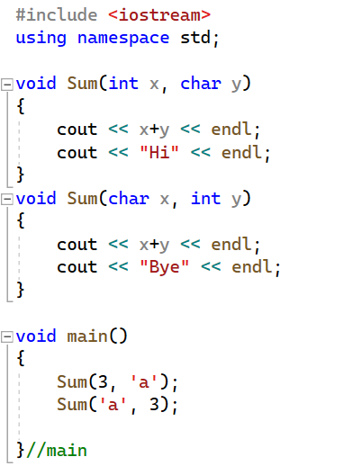
Function Overloading
Same function name
Same parameter datatypes
Same number of parameters
Different order of parameters

Slide 8
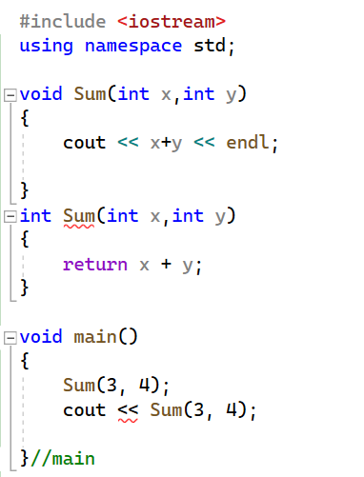
Function Overloading
Compiler Error:
Same function name
Same parameter datatypes
Same number of parameters
Different return datatype
the type of returned data can not be used to differentiate between the overloaded functions.

Slide 9
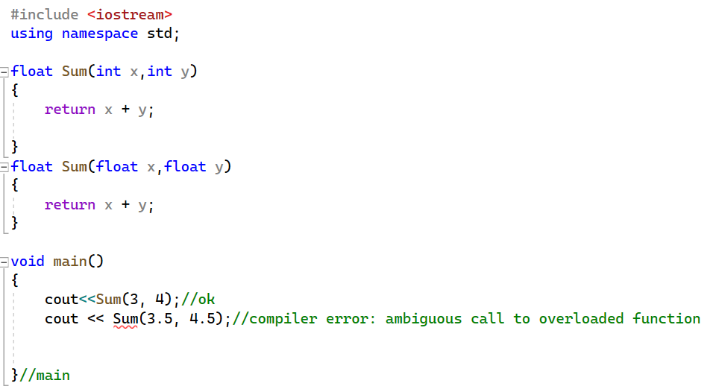
Function Overloading
Notice the error

Slide 10
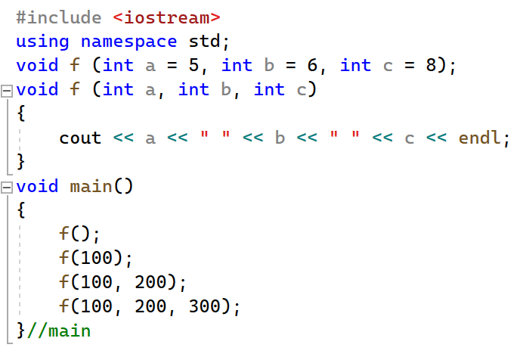
Default function arguments
Output

Slide 11
Default function arguments
If function overloading is done containing the default arguments, then we need to make sure it is not ambiguous to the compiler, otherwise it will throw an error.

Slide 12
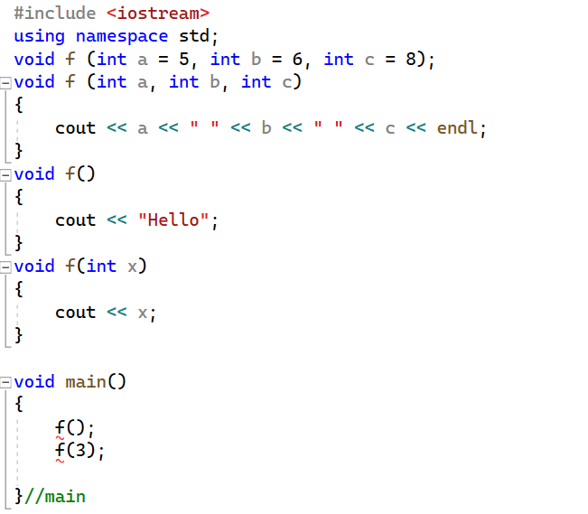
Default function arguments
Error: Ambiguous function calls to overloaded function

Slide 13
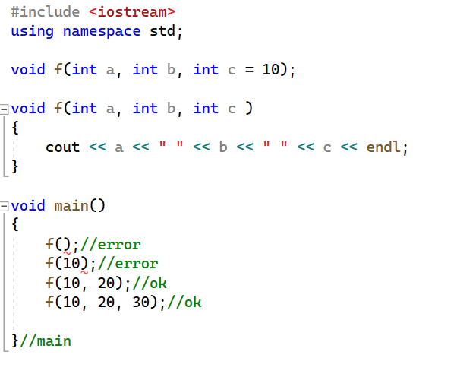
Default function arguments
Notice the errors

Slide 14
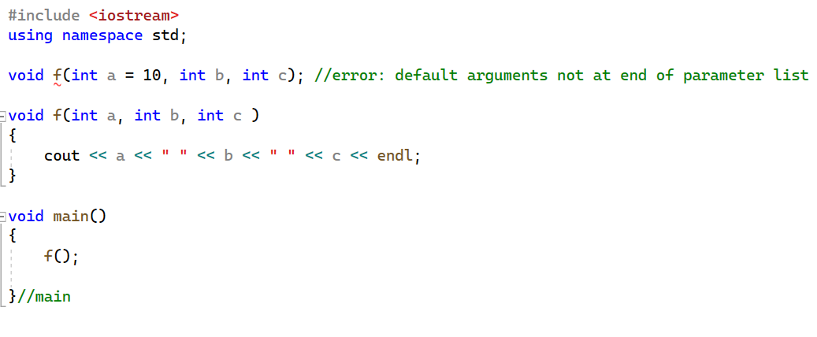
Default function arguments
Notice the error

